Slide 1


Ride the Knowledge Wave 1
Urgency, pace and temporality in implementation
Presentation 1: Michael Sykes
Presentation 2: Denise Thomson
Presentation 3: Natalie Taylor
Presentation 4: Skye McKay
Session host: Bruno Mazuquin

Slide 2

Urgency in implementation: How temporal structures influence health-system climate change and sustainability work
Denise Thomson, MA MBA PhD(c)
Kristie L. Ebi, Lisa Hartling, Stephanie Montesanti, Amanda S. Newton, Elden Wiebe, Ken J. Caine
European Implementation Event, June 2025

Slide 3
Time as context
Time and temporality constitute a contextual determinant for implementation.
Outer (outer) context
Climate change as a “slow disaster” – an assortment of long-term processes linked across time and history (Knowles 2020)
Outer context
Health systems increasingly being required to address the impacts of climate change and related extreme weather events
Inner context
Organizational timeframes drive action
Individual characteristics
Ability to navigate various temporal scales in their work
dthomson@ualberta.ca

Slide 4
Climate resilience and decarbonization
Climate change and human health
Health systems’ work
Adaptation and resilience
Mitigation (decarbonization)
Facility management, public health, clinical care, system management
dthomson@ualberta.ca

Slide 5
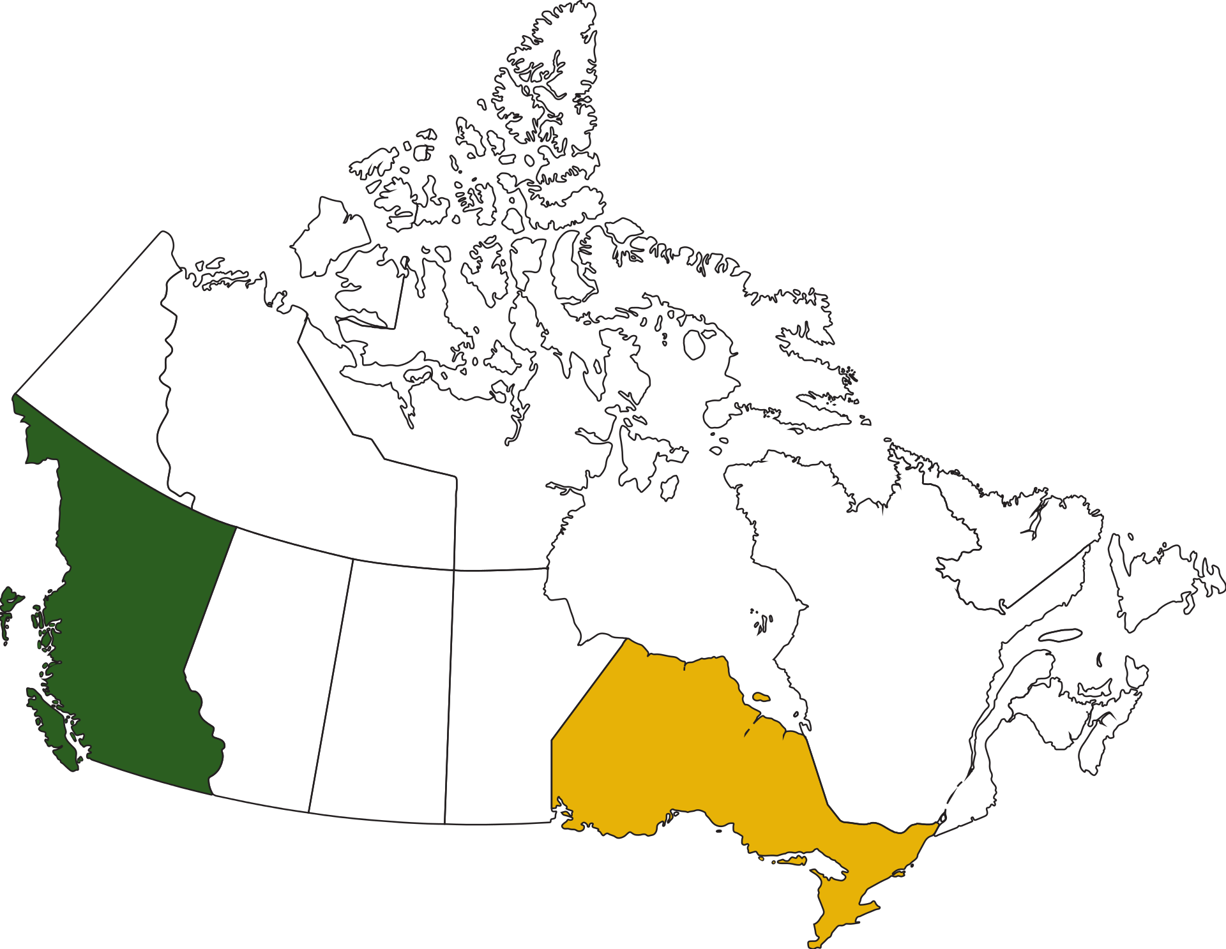
Methods
Data: 41 interviews, organizational documents
Thematic analysis – codebook based on CFIR and EPIS
dthomson@ualberta.ca

Slide 6
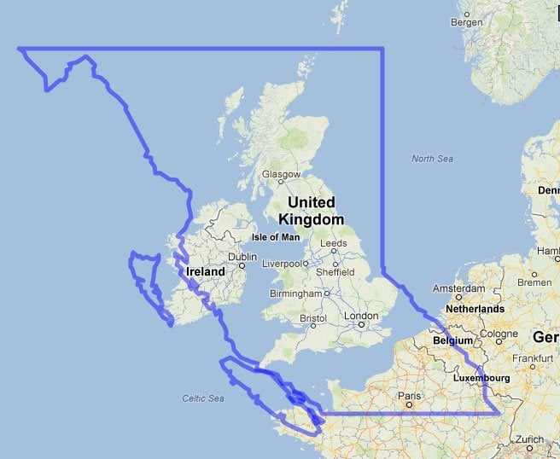
Methods
dthomson@ualberta.ca

Slide 7
Results
Specific events as a vision of the future
Navigating different time scales, including competing priorities
Long-term thinking versus short-term possibility
Personal motivation from seeing into the future
Sense of discrepancy between what’s needed and what’s happening
dthomson@ualberta.ca

Slide 8
Specific events as a vision of the future
That's one of the most frustrating things about climate and health, is, you know these things are coming. You know extreme heat's going to happen. You know it's going to be different than you've ever seen before. But until hundreds of people die or something catastrophic goes wrong, there is no motivation or impetus to actually address the risks that we know are coming at us. So you know, that event [the 2021 heat dome in which over 600 people died in BC] primed the pump for us to be able to do stuff, and we haven't had a lot of barriers to doing that stuff, because we can always look back now and say, We don't want that to happen again. We don't want that to happen again, but until it has happened, you don't have anything to point back to. (BC Health Authority 15)
dthomson@ualberta.ca

Slide 9
Navigating different time scales & competing priorities
This is important stuff, to try and think how we can, as healthcare workers, as healthcare providers, as advocates… to figure out the best way of bringing a system, slow moving, clunky system that is resistant to change to do the change that [it] needs to do. And this could be the biggest transition that we do in our healthcare system, for a generation. And so trying to do it, well, with the public on board.
(BC Health Facility 1)
It's so frustrating… I said, we cannot be opening a hospital in 2030 that runs on natural gas. Like that's absurd, right. But that's what they'll fund.
(Ontario Health Facility 8)
dthomson@ualberta.ca

Slide 10
Personal motivation – seeing into the future
And we are stealing from our children's future. And when it gets really bad, I want to be able to look my kids in the eye and say I did everything I could. I was one of the people who tried, because I love you.
(BC Health Facility 3)
dthomson@ualberta.ca

Slide 11
Discrepancy between what’s happening and what’s needed
Every time I'm asked to speak about climate change, [I] just say, fundamentally, until we make a major shift, the fact that we're using half the gloves we used to use is not going to resolve climate change.
(BC Health Authority 3)
dthomson@ualberta.ca

Slide 12
Long-term thinking vs short-term possibility
Climate change is an existential threat to our life on this planet. And it should be the top of mind in every single thing we do every single day. And I don't think it is yet. I think lots of other things take precedence in health care, because we're always putting out fires. (BC Health Authority 10)
Because it is such a long-term thing, but also … it is hard to sustain practices and sustain work, you know in order to make anything last, you need to actively fight against it degrading … in order to just maintain it. (Ontario Public Health Unit 3)
dthomson@ualberta.ca

Slide 13
Construction of urgency
Knowledgeable, committed policy actors navigating complex structures
High degree of personal commitment to addressing climate change
Mobilizing temporal practices to maintain organizational attention on climate change
Urgency reinforced by funding, benchmarking, windows of opportunity
Skade, L., E. Lehrer, Y. Hamdali and J. Koch (2024). "The Temporality of Crisis and the Crisis of Temporality: On the Construction and Modulation of Urgency During Prolonged Crises." Journal of Management Studies 62(3): 1087-1120.
dthomson@ualberta.ca

Slide 14
Conclusion
System staff
Navigating numerous timeframes in their implementation work
Emotionally taxing demands of continuously confronting an uncertain future
Implementation science scholars and practitioners
Implicit and explicit timescales in planning and analyzing implementation work
dthomson@ualberta.ca

Slide 15
Questions?
Contact:
dthomson@ualberta.ca
Graphic credit: Candace Ramjohn

Slide 16
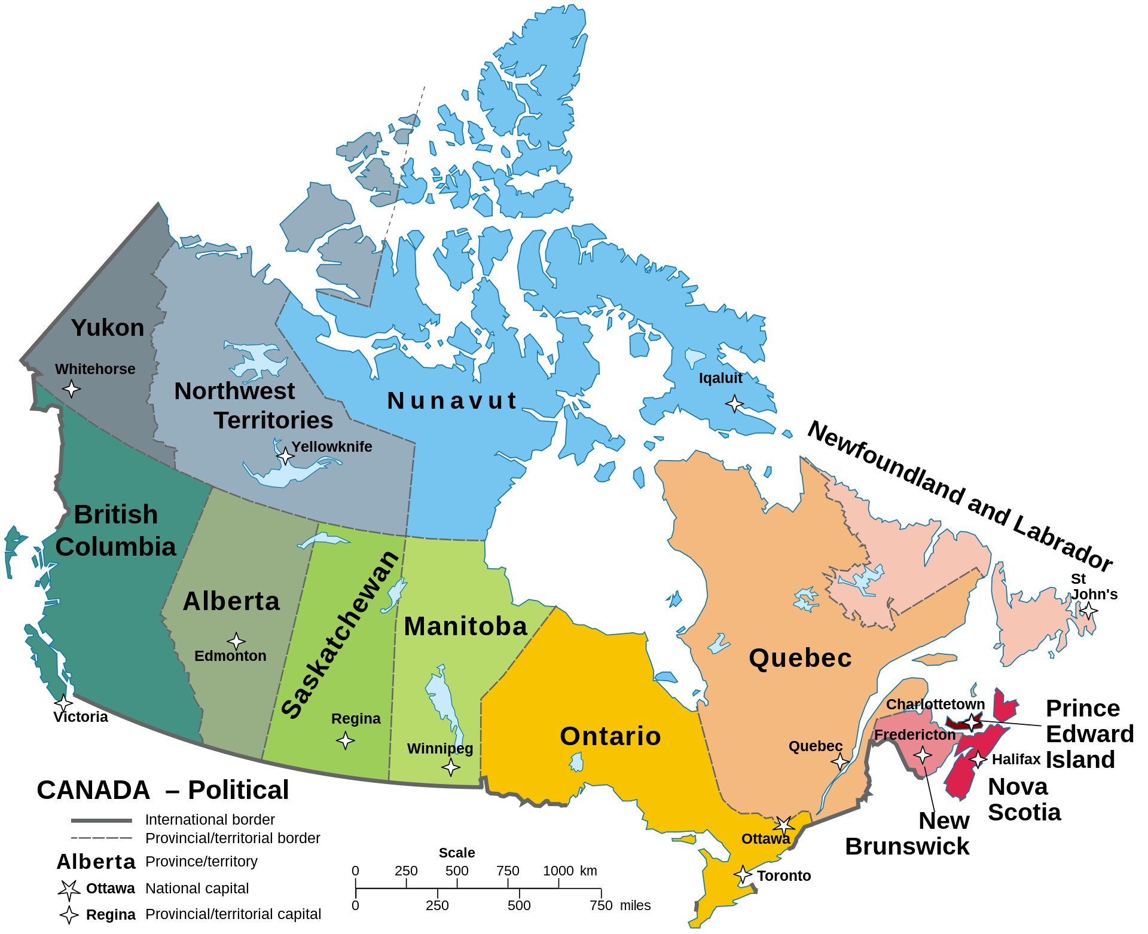
Canadian health systems
15 interlocking systems
Federal
Provincial/territorial (13)
Indigenous (First Nations, Metis, Inuit)
Most responsibilities devolved to provinces and territories
Decision-making at many levels & locations
dthomson@ualberta.ca

Slide 17



Developing an AI-enabled web platform to collect, analyse, synthesise, and accelerate implementation research and practice
ImpleMATE
A/Professor Natalie Taylor
Director | i2i | Implementation to Impact
Director of Research
School of Population Health
Faculty of Medicine and Health, UNSW
Director | Implementation Science Platform
Chair | Implementation Science Collaborative
Maridulu Budyari Gumal (SPHERE)
Team members:
Natalie Taylor, Shuang Liang, Skye McKay, Carolyn Mazariego, Elizabeth Kennedy, Helen Monaghan, Ely Tyedmers, Joey Elias, Frank Lin, Jeffery Chan

Slide 18











Our Team
Dr Shuang Liang
Ms Elizabeth Kennedy
Mr Joey Elias
Post Doctoral Fellow, UNSW Implementation to Impact
Research Officer, UNSW Implementation to Impact
PhD Candidate/Research Assistant, UNSW Implementation to Impact
Ms Skye McKay
Ms Helen Monaghan
Dr Frank Lin
Senior Research Officer, UNSW Implementation to Impact
Senior Project Officer, UNSW Implementation to Impact
Medical Oncologist & Senior Research Fellow, UNSW
Dr Carolyn Mazariego
Mr Elijah Tyedmers
Dr Jeffery Chan
Deputy Director and Senior Research Fellow, UNSW Implementation to Impact
PhD Candidate/Research Assistant, UNSW Implementation to Impact
Post Doctoral Fellow, UNSW Implementation to Impact

Slide 19



515,000 clinical trials registered globally ​
(as at Nov 2024; Statistica, 2025)
Research
Practice
Evidence
Patient care
Research to practice gap
Notes:
Scientific advances are outpacing health systems' ability to translate evidence into practice. With over 75 trials and 17 systematic reviews published globally daily, and currently 515,000 clinical trials currently registered globally, the challenges associated with successfully implementing the evidence into practice in cost-effective ways are both complex and relentless.
We know that evidence-driven implementation can drive effective system and practice change, improved outcomes, and reduce costs. However, the full potential of implementation science is hindered by knowledge underutilization caused by challenges in efficiently and effectively extracting and synthesising data that can tell us about patterns behind implementation success. This leads to constant reinvention of solutions.
Healthcare systems also lack dedicated infrastructure (e.g., implementation skills, resources, systems) to systematically translate evidence into practice. There is an urgent need for a more scientific, structured, and integrated approach to make health system implementation smarter.
If we do not act, we will persist in wasting time rehashing implementation approaches, leaving healthcare delivery further behind the science, such that it is impossible for the benefits of innovations to reach patients when they need it.

Slide 20
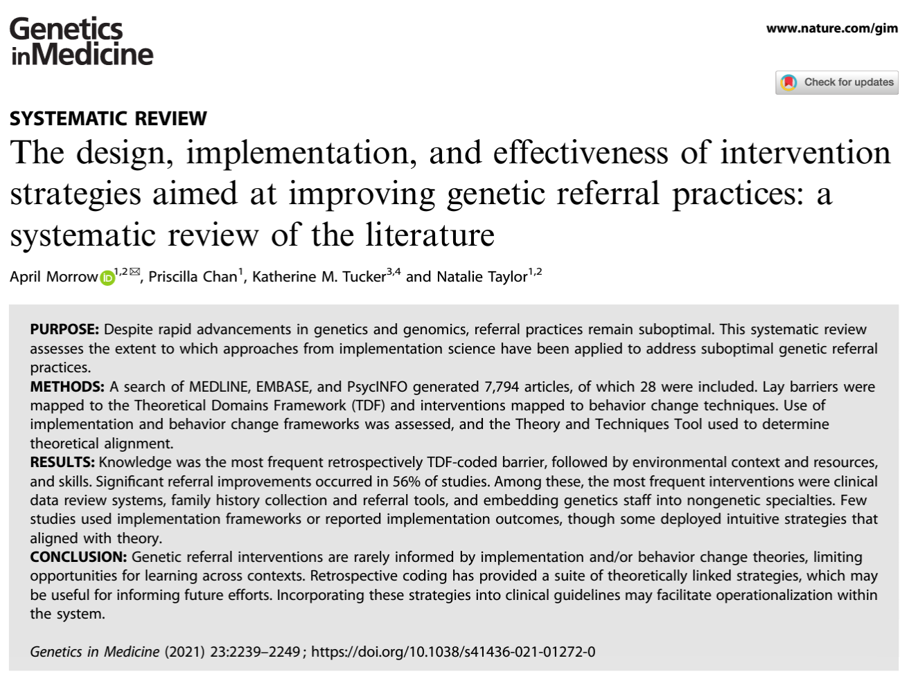
Implementation science inefficiencies
Retrospectively coded 28 studies
13% used implementation science or behavior change theory frameworks in the design and/or implementation of intervention strategies
Only one study fully applied BCTs; most required retrospective coding
Notes:
We know that evidence-driven implementation can drive effective system and practice change, improved outcomes, and reduce costs. However, the full potential of implementation science is hindered by knowledge underutilization caused by challenges in efficiently and effectively extracting and synthesising data that can tell us about patterns behind implementation success. This leads to constant reinvention of solutions.
Few studies (n = 4; 13%) explicitly made use of implementation science or behavior change theory frameworks in the design and/or implementation of intervention strategies
Applying the coding scheme developed by only one article applied behavior change theory to the full extent (e.g., describing how theoretical constructs were used to inform the design of each intervention strategy).
Only one study explicitly stated the BCTs used in intervention strategies with the majority of studies requiring retrospective coding of BCTs based on intervention descriptions.

Slide 21
Implementation science patterns
The BCT "social support—practical" was most common in successful studies (32 instances across 16 studies)
The BCT "information about health consequences" was most common in unsuccessful studies (14 instances across 5 studies)
41% of BCTs in successful studies showed mechanistic links (vs. 25% in unsuccessful studies)
Coding:
So. Much. Time!
Notes:
The BCT social support—practical was the most frequently observed BCT among studies that successfully led to improvements in referral (used on 32 occasions across 16 studies), while the BCT information about health consequences was the most frequently observed among studies that did not lead to improvements (used on 14 occasions across 5 studies).
Among successful studies, 41% (41/99) of the examinable BCTs had evidence of mechanistic links according to the Theory and Techniques Tool compared to 25% (11/44) in the non -successful studies.

Slide 22
Implementation data
Implementation Publications
Meeting Records
Comprehensive Understanding
Interviews
Live Projects
Surveys
Outcome Data
Notes:
So what are our all these sources of data?
Well we have implementation publications of varying quality. Some have used frameworks which help with standardising the information collected and speeding up the coding process. Many haven’t, which makes it a much bigger task to manually extract the information and code it to associated and associated framework. However the potential, if we were able to synthesise all the information in implementation publications would help us to generate a meta-evidence base of strategies associated with successful implementation for any given intervention in any given context.
In addition, we have our live project data, again of varying quality (e.g., unit led QI project versus carefully designed implementation trials and in depth process evaluations). These data often come from meeting records, interviews, surveys, and implementation, service, and sometimes patient level outcome data which we often attempt to link together to generate and test strategies, and establish the mechanistic links between them.
Most of the time we are manually coding all this information, attempting to keep up with the speed required on the ground to generate strategies in a timely way, but also undertake deep analysis of these data to advance the science of what we know works, for what kinds of interventions, for whom, in what settings, and at what cost.

Slide 23
Aim
Accelerate implementation research and practice by enabling rapid, automated evidence reviews, and real-time process evaluations to identify the most effective strategies for successful implementation across diverse settings (starting in cancer).
Practice
Patient care
Notes:
We propose ImpleMATE to accelerate cancer implementation research and practice by enabling rapid, automated evidence reviews, and real-time process evaluations to identify the most effective strategies for successful implementation across diverse settings.

Slide 24
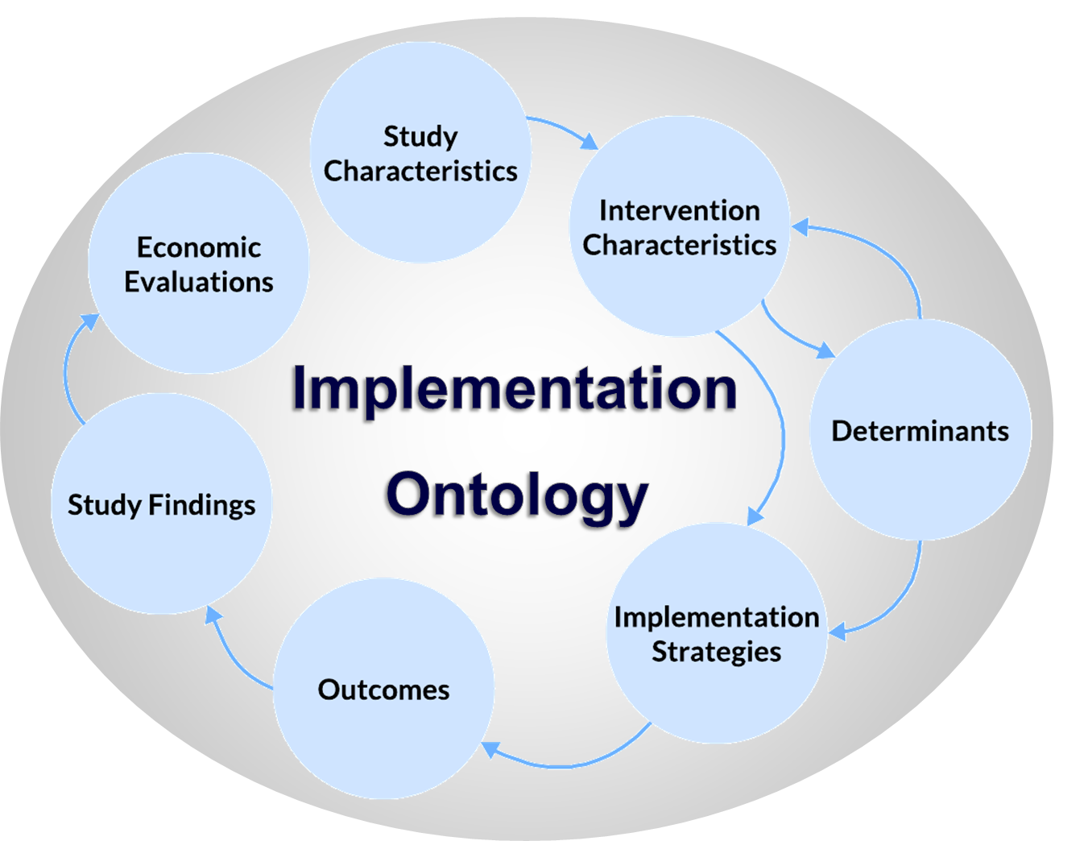
Solution - ImpleMATE
Data to Knowledge
Develop automated knowledge base
Practice to Data
Knowledge to Practice
Integrate expert review and feedback,
Improve AI accuracy
Provide timely guidance to professionals,
AI-assisted data analysis
Notes:
ImpleMATE will start with a Data to knowledge phase by curating data sources from published implementation studies and live project data; pre-process the data; feed data to LLM for evaluation and fine-tuning the model to identify and extract entities including the barriers, facilitators, strategies, outcomes, settings, and their relationships, to construct an implementation ontology (knowledge base).
Knowledge to practice – ImpleMATE will transfer knowledge through an interactive web application providing two different tools for different levels of supports. One of the tools is a question-answering interface to response to queries based on the knowledge base and LLM synthesis to answer questions about implementation challenges for different types of users. For example, hospital oncology department manager and change management team for their unique scenario for implementation challenges.
Another tool is Implementation coaching and data sharing platform to provide more supports and streamline implementation processes, including coaching and education support for their implementation steps, and AI real-time data analysis of data provided by the users.
Practice to data – Integrate expert review of the AI-generated knowledge base, and the AI analysis. Provide feedback to improve AI accuracy continuously. Ensure AI outputs will be guided by experts.
Finally, we plan to design evaluation framework and system integration

Slide 25
Implementation practice to data
Component 1 – Learning Implementation System
Component 2 – Interactive web application
Feedback mechanism for improvement
Implementation literatures/ studies
Implementation
Project data 1, 2, 3, …
Objective 1:
Co-design
a schema and data handling
AI real-time inferencing
Project Governance Structure
TOOL 1: AI-generated Decision Aid
Objective 3:
Develop an
interactive web application
Schema
Steering Committee
Principle Setting End User Committee
USERS
Primary: anyone responsible for or involved in an implementation endeavour
Other: Implementation researchers
TOOL 2: Implementation Coaching and Data Sharing Platform
Data handling and routing
Data to knowledge
Objective 2:
Build and validate
AI model
USERS
Primary: anyone responsible for an implementation endeavour wishing for additional support
Other: Implementation researchers; anyone wishing to upskill in implementation practice
Raw data
Large language models:
Training/ fine-tuning
Test and evaluation
Optimisation
System Integration Advisory Group
Tool 1 FUNCTIONS
Input:
Users enter their Implementation scenario
Output:
Users receive evidence-based implementation strategies
Annotation
(During initial AI training and evaluation phase)
Feedback mechanism for improvement
Ontology construction
Entities
Relation
Tool 2 FUNCTIONS
Log in
Receive communications
Coordinate with implementation team for training and coaching
Upload data for analysis
Network with peers (community of practice)
Access educational resources
Continuous learning and building ontology
Review
(quarterly)
Objective 4:
Co-design a national roadmap and evaluation for integration
Implementation scientists
Knowledge to implementation practice

Slide 26
Component 1, Objective 1
Component 1 – Learning Implementation System
Implementation literatures/ studies
Implementation
Project data 1, 2, 3, …
Objective 1:
Co-design
a schema and data handling
Schema
Data handling and routing
Raw data
Notes:
A data pipeline will curate implementation literature from MEDLINE, focusing on cancer care (screening, diagnostics, treatment, survivorship). This involves (1) keyword searches in titles and abstracts, and (2) topic semantic modelling with machine learning (ML) approach.
A robust preprocessing pipeline including file type classification, format conversion (e.g., parse PDF to plain text using PDFMiner Python library), will standardise data for AI models and ensure compatibility.
The initial focus will be on published cancer genetics/genomics studies that used two key frameworks (collectively cited >9000 times for use in implementation studies, and recently combined to first train the model: the Theoretical Domains Framework (TDF) for individual behaviour change, and the Consolidated Framework for Implementation Research (CFIR) for organizational and policy factors affecting implementation. Studies using alternative frameworks and/or with unstructured implementation data
(i.e., no framework used at all) will be next accessed for coding.
Second data input – existing and ongoing project data (e.g., interviews, surveys, meeting records, audit data):

Slide 27
Implementation practice to data
Component 1 – Learning Implementation System
Component 2 – Interactive web application
Feedback mechanism for improvement
Implementation literatures/ studies
Implementation
Project data 1, 2, 3, …
Objective 1:
Co-design
a schema and data handling
AI real-time inferencing
Project Governance Structure
TOOL 1: AI-generated Decision Aid
Objective 3:
Develop an
interactive web application
Schema
Steering Committee
Principle Setting End User Committee
USERS
Primary: anyone responsible for or involved in an implementation endeavour
Other: Implementation researchers
TOOL 2: Implementation Coaching and Data Sharing Platform
Data handling and routing
Data to knowledge
Objective 2:
Build and validate
AI model
USERS
Primary: anyone responsible for an implementation endeavour wishing for additional support
Other: Implementation researchers; anyone wishing to upskill in implementation practice
Raw data
Large language models:
Training/ fine-tuning
Test and evaluation
Optimisation
System Integration Advisory Group
Tool 1 FUNCTIONS
Input:
Users enter their Implementation scenario
Output:
Users receive evidence-based implementation strategies
Annotation
(During initial AI training and evaluation phase)
Feedback mechanism for improvement
Ontology construction
Entities
Relation
Tool 2 FUNCTIONS
Log in
Receive communications
Coordinate with implementation team for training and coaching
Upload data for analysis
Network with peers (community of practice)
Access educational resources
Continuous learning and building ontology
Review
(quarterly)
Objective 4:
Co-design a national roadmap and evaluation for integration
Implementation scientists
Knowledge to implementation practice

Slide 28
Component 1, Objective 2
Component 1 – Learning Implementation System
Large language models:
Training/ fine-tuning
Test and evaluation
Optimisation
Objective 2:
Build and validate
AI model
Ontology construction
Entities
Relation
Feedback mechanism for improvement
Annotation
(During initial AI training and evaluation phase)
Continuous learning and building ontology
Review
(quarterly)
Implementation scientists
Notes:
We are creating an ontology framework by: 1) gathering feedback, 2) updating entity definitions, 3) structuring the ontology, and 4) conducting stakeholder reviews and inter-rater reliability assessments.
The implementation schema will outline necessary entities and relationships, addressing questions about what works, why, in which settings, and at what cost. We are working with Janna Hastings to re-use, adapt and extend relevant parts of the Behaviour Change Intervention Ontology from the Health Behaviour Change Project for the implementation context to ensure interoperability.

Slide 29
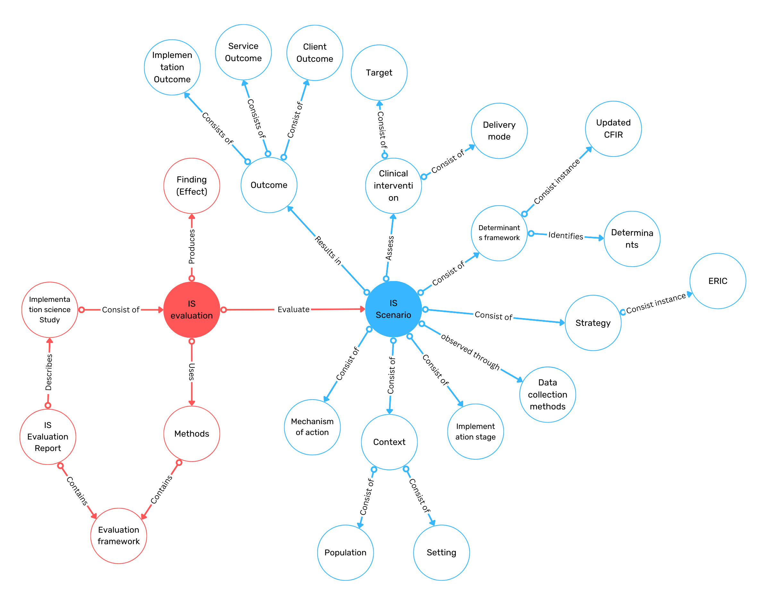
Implementation ontology
Label | Definition | Example
Strategy | Strategy content specific | Pathology report with results-based clinical guidance
Comparator | Comparator content specific | Standard pathology report
Population | Sample practice change role | Colorectal cancer surgeons; oncologists
Setting | Setting organisation | Tertiary hospitals
Mechanisms of action | Mechanism of action target | Enhanced memory attention and decision-making
Target behaviour | Target behaviour type | Appropriate referral of high risk patients into genetic service
Outcome | Target behaviour intervention % | 50%_increase_in_appropriate_referral
Study method | Study design | Implementation RCT
Effect | Effect size type | Odds ratio
Notes:
Specifically, development of HIPOs will involve extending existing taxonomies to describe implementation strategy content (e.g., Expert Recommendations for Implementing Change strategies)50 to BCT and mechanisms of action ontologies,27, 28 as well as new types of features to characterise the circumstances of the intervention and its implementation (e.g., mode of delivery,45 dose), population (e.g., roles targeted for change), setting (e.g., region, hospital size), source (EBI implementers), target behaviour (e.g., appropriate patient referral, results interpretation, communicating results to patients), exposure (e.g., strategy frequency), and outcomes (e.g., extent of change in intended direction.).
The table is an example of entities for evaluation of a standardised pathology report to support referral of patients at high risk of a hereditary cancer condition into to genetic services

Slide 30
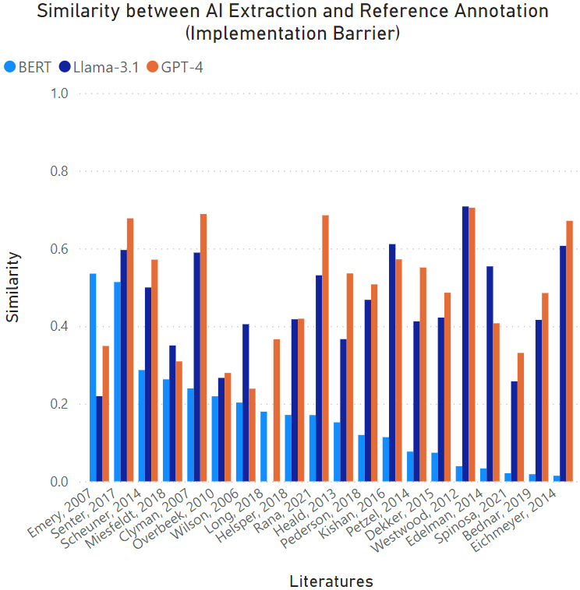
0.71
Similarity 0.71
Manual coding:
Difficulties applying referral guidelines/criteria to identify patients at increased genetic risk
TDF: Skills
AI extraction (Llama-3.1):
Lack of clear guidelines and protocols for the referral of patients with genetic conditions.

Slide 31
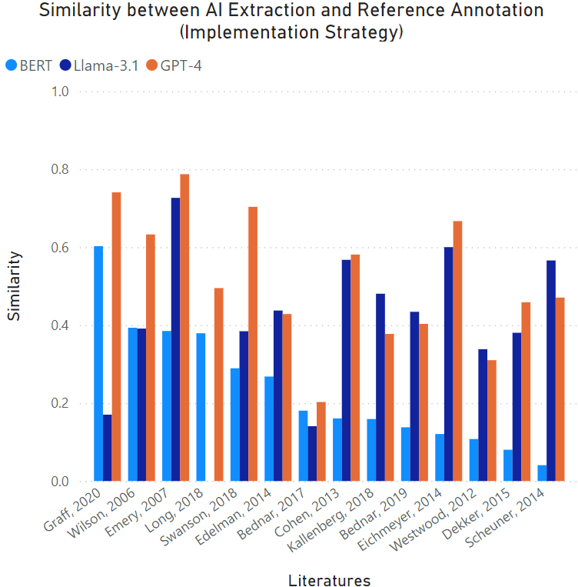
Similarity 0.79
Manual coding:
Lead clinicians attended a further 90-min interactive training session to learn to use the GRAIDS software.
BCTs
i: 7.1 Prompts/cues
ii: 11.3 Conserving mental resources
iii: 12.5 Adding objects to the environment
iv: ii: ? Instruction on how to perform the behaviour
AI extraction (GPT-4):
The GRAIDS software was used to assess family history and cancer risk, with lead clinicians receiving training and support.
0.79

Slide 32
Implementation practice to data
Component 1 – Learning Implementation System
Component 2 – Interactive web application
Feedback mechanism for improvement
Implementation literatures/ studies
Implementation
Project data 1, 2, 3, …
Objective 1:
Co-design
a schema and data handling
AI real-time inferencing
Project Governance Structure
TOOL 1: AI-generated Decision Aid
Objective 3:
Develop an
interactive web application
Schema
Steering Committee
Principle Setting End User Committee
USERS
Primary: anyone responsible for or involved in an implementation endeavour
Other: Implementation researchers
TOOL 2: Implementation Coaching and Data Sharing Platform
Data handling and routing
Data to knowledge
Objective 2:
Build and validate
AI model
USERS
Primary: anyone responsible for an implementation endeavour wishing for additional support
Other: Implementation researchers; anyone wishing to upskill in implementation practice
Raw data
Large language models:
Training/ fine-tuning
Test and evaluation
Optimisation
System Integration Advisory Group
Tool 1 FUNCTIONS
Input:
Users enter their Implementation scenario
Output:
Users receive evidence-based implementation strategies
Annotation
(During initial AI training and evaluation phase)
Feedback mechanism for improvement
Ontology construction
Entities
Relation
Tool 2 FUNCTIONS
Log in
Receive communications
Coordinate with implementation team for training and coaching
Upload data for analysis
Network with peers (community of practice)
Access educational resources
Continuous learning and building ontology
Review
(quarterly)
Objective 4:
Co-design a national roadmap and evaluation for integration
Implementation scientists
Knowledge to implementation practice

Slide 33
Component 2, Objective 3, Tool 1
Component 2 – Interactive web application
Feedback mechanism for improvement
AI real-time inferencing
TOOL 1: AI-generated Decision Aid
Objective 3:
Develop an
interactive web application
USERS
Primary: anyone responsible for or involved in an implementation endeavour
Other: Implementation researchers
Tool 1 FUNCTIONS
Input:
Users enter their Implementation scenario
Output:
Users receive evidence-based implementation strategies

Slide 34
Implementation practice to data
Component 1 – Learning Implementation System
Component 2 – Interactive web application
Feedback mechanism for improvement
Implementation literatures/ studies
Implementation
Project data 1, 2, 3, …
Objective 1:
Co-design
a schema and data handling
AI real-time inferencing
Project Governance Structure
TOOL 1: AI-generated Decision Aid
Objective 3:
Develop an
interactive web application
Schema
Steering Committee
Principle Setting End User Committee
USERS
Primary: anyone responsible for or involved in an implementation endeavour
Other: Implementation researchers
TOOL 2: Implementation Coaching and Data Sharing Platform
Data handling and routing
Data to knowledge
Objective 2:
Build and validate
AI model
USERS
Primary: anyone responsible for an implementation endeavour wishing for additional support
Other: Implementation researchers; anyone wishing to upskill in implementation practice
Raw data
Large language models:
Training/ fine-tuning
Test and evaluation
Optimisation
System Integration Advisory Group
Tool 1 FUNCTIONS
Input:
Users enter their Implementation scenario
Output:
Users receive evidence-based implementation strategies
Annotation
(During initial AI training and evaluation phase)
Feedback mechanism for improvement
Ontology construction
Entities
Relation
Tool 2 FUNCTIONS
Log in
Receive communications
Coordinate with implementation team for training and coaching
Upload data for analysis
Network with peers (community of practice)
Access educational resources
Continuous learning and building ontology
Review
(quarterly)
Objective 4:
Co-design a national roadmap and evaluation for integration
Implementation scientists
Knowledge to implementation practice

Slide 35
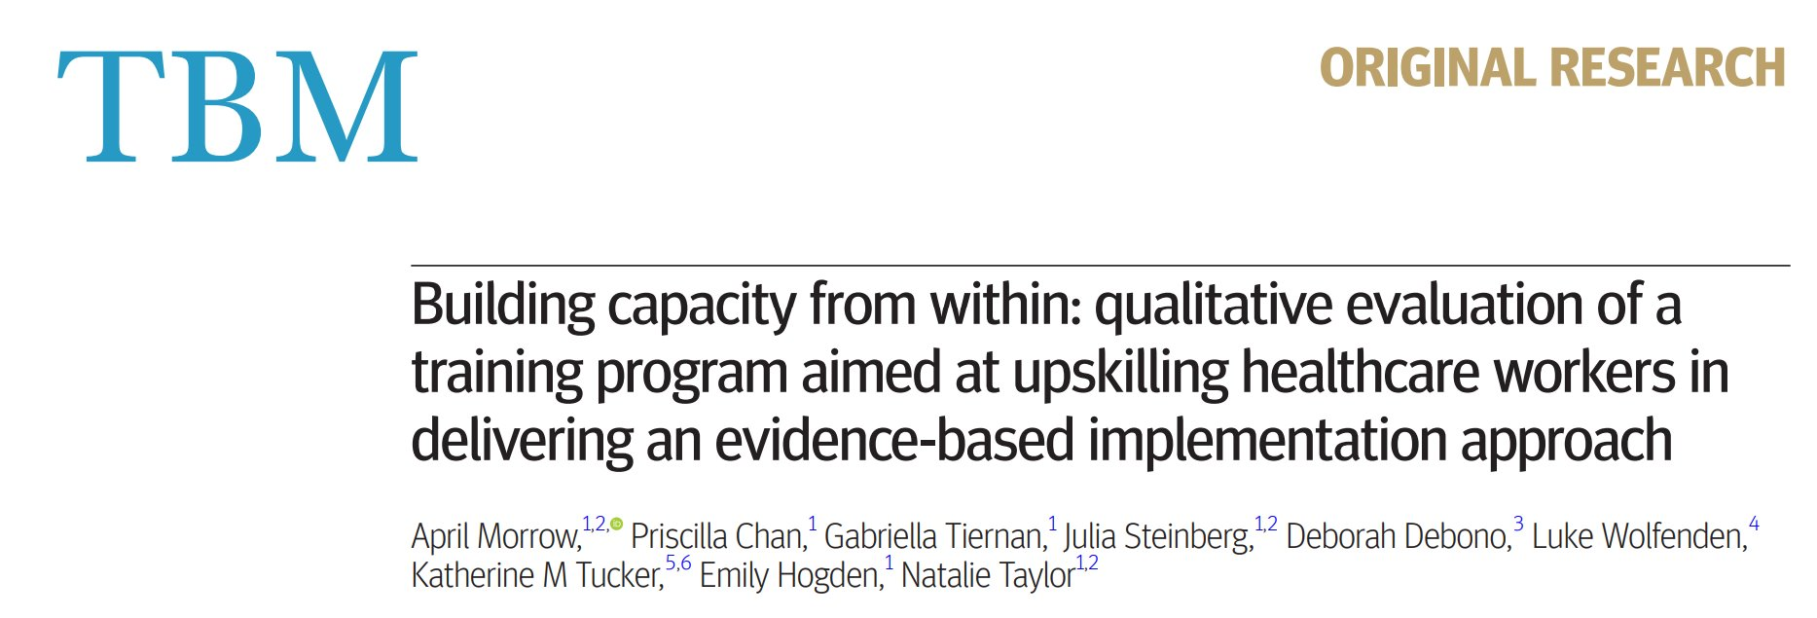
Component 2, Objective 3, Tool 2
Component 2 – Interactive web application
Feedback mechanism for improvement
AI real-time inferencing
TOOL 2: Implementation Coaching and Data Sharing Platform
Training, support
Data analysis
Objective 3:
Develop an
interactive web application
USERS
Primary: anyone responsible for an implementation endeavour wishing for additional support
Other: Implementation researchers; anyone wishing to upskill in implementation practice
Tool 2 FUNCTIONS
Log in
Receive communications
Coordinate with implementation team for training and coaching
Upload data for analysis
Network with peers (community of practice)
Access educational resources

Slide 36
User Scenario
Type of user | Requirement | Tool 1 – Query for implementation challenge | Tool 2 – Comprehensive implementation support all data collected fed into Learning Implementation System
Hospital cardiac department manager | To identify the most effective strategies for implementing remote pulse oximetry. | What are the optimal strategies to implement remote pulse oximetry, and what key barriers hinder patient adoption? | Interacts with ImpleMATE for guided implementation support as part of a continued professional development project.
NSW hospital CEOs and change management team | To scale and evaluate a precision oncology clinic in routine healthcare. | How can we effectively integrate a precision oncology clinic into existing workflows to improve patient outcomes in hospital settings? | Change mangers receive ImpleMATE support to collect context specific data. Provide analysis on operational changes, resource allocations, and policy amendments. Support to develop strategies.
Research team | Understand evidence to introduce whole-body MRI cancer screening in Li-Fraumeni Syndrome. | How effective is whole-body MRI screening, and what behavior changes are needed to support its implementation? | ImpleMATE-guided structured data collection to enable analysis and evaluation.
Department of Health and Aged Care | To run a national campaign to promote HPV self-collection in rural and remote settings. | What contextual and cultural factors influence the successful implementation of HPV self-collection in rural and remote settings? | Campaign staff to get ImpleMATE training to collect context specific data. Co-design strategies with ImpleMATE coaching team.

Slide 37
Implementation practice to data
Component 1 – Learning Implementation System
Component 2 – Interactive web application
Feedback mechanism for improvement
Implementation literatures/ studies
Implementation
Project data 1, 2, 3, …
Objective 1:
Co-design
a schema and data handling
AI real-time inferencing
Project Governance Structure
TOOL 1: AI-generated Decision Aid
Objective 3:
Develop an
interactive web application
Schema
Steering Committee
Principle Setting End User Committee
USERS
Primary: anyone responsible for or involved in an implementation endeavour
Other: Implementation researchers
TOOL 2: Implementation Coaching and Data Sharing Platform
Data handling and routing
Data to knowledge
Objective 2:
Build and validate
AI model
USERS
Primary: anyone responsible for an implementation endeavour wishing for additional support
Other: Implementation researchers; anyone wishing to upskill in implementation practice
Raw data
Large language models:
Training/ fine-tuning
Test and evaluation
Optimisation
System Integration Advisory Group
Tool 1 FUNCTIONS
Input:
Users enter their Implementation scenario
Output:
Users receive evidence-based implementation strategies
Annotation
(During initial AI training and evaluation phase)
Feedback mechanism for improvement
Ontology construction
Entities
Relation
Tool 2 FUNCTIONS
Log in
Receive communications
Coordinate with implementation team for training and coaching
Upload data for analysis
Network with peers (community of practice)
Access educational resources
Continuous learning and building ontology
Review
(quarterly)
Objective 4:
Co-design a national roadmap and evaluation for integration
Implementation scientists
Knowledge to implementation practice

Slide 38

Objective 4
Implementation Outcomes
Acceptability, Adoption, Appropriateness, Costs, Feasibility, Fidelity, Penetration, Sustainability
Objective 4:
Co-design a national roadmap and evaluation for integration
Service Outcomes
Efficiency, Safety, Effectiveness,
Equity, Patient-centeredness, Timeliness
Patient Outcomes
Satisfaction, Function, Symptomatology
Notes:
The successful implementation of ImpleMATE requires seamless integration into existing healthcare systems, ensuring the platform enhances workflows. This process involves collaboration with state-wide entities and organisations, aligning the platform with healthcare organisations' requirements.
To understand the effectiveness of integration of ImpleMATE, we aim to work closely with the Single Digital Patient Record Implementation Authority to reflect relevant patient outcomes, whose care has been influenced by implementation processes recommended via our tool/supported by our coaching module as part of ImpleMATE.

Slide 39
Implementation practice to data
Component 1 – Learning Implementation System
Component 2 – Interactive web application
Feedback mechanism for improvement
Implementation literatures/ studies
Implementation
Project data 1, 2, 3, …
Objective 1:
Co-design
a schema and data handling
AI real-time inferencing
Project Governance Structure
TOOL 1: AI-generated Decision Aid
Objective 3:
Develop an
interactive web application
Schema
Steering Committee
Principle Setting End User Committee
USERS
Primary: anyone responsible for or involved in an implementation endeavour
Other: Implementation researchers
TOOL 2: Implementation Coaching and Data Sharing Platform
Data handling and routing
Data to knowledge
Objective 2:
Build and validate
AI model
USERS
Primary: anyone responsible for an implementation endeavour wishing for additional support
Other: Implementation researchers; anyone wishing to upskill in implementation practice
Raw data
Large language models:
Training/ fine-tuning
Test and evaluation
Optimisation
System Integration Advisory Group
Tool 1 FUNCTIONS
Input:
Users enter their Implementation scenario
Output:
Users receive evidence-based implementation strategies
Annotation
(During initial AI training and evaluation phase)
Feedback mechanism for improvement
Ontology construction
Entities
Relation
Tool 2 FUNCTIONS
Log in
Receive communications
Coordinate with implementation team for training and coaching
Upload data for analysis
Network with peers (community of practice)
Access educational resources
Continuous learning and building ontology
Review
(quarterly)
Objective 4:
Co-design a national roadmap and evaluation for integration
Implementation scientists
Knowledge to implementation practice

Slide 40
Project Governance Structure
Steering Committee
Principle Setting End User Committee
System Integration Advisory Group
Crucial beginnings…
Notes:
To ensure the platform is grounded in real-world needs and ethical practice, we are establishing a Principle Setting End User Committee. This committee will include clinicians, consumers, government and commercial partners, educators, and legal experts. The committee will lead a series of workshops and focus groups to co-design data journeys, define privacy expectations, and test AI transparency and accountability principles. Insights from these sessions will inform the development of the ImpleMATE Ethics Principles and a robust data and AI governance framework.

Slide 41

Thank you
ImpleMATE
ADVANCED LEVEL
Data Science & AI
Implementation Science
BASIC LEVEL
AI engine
A/Professor Natalie Taylor
Director | i2i | Implementation to Impact
Director of Research
School of Population Health
Faculty of Medicine and Health, UNSW
Director | Implementation Science Platform
Chair | Implementation Science Collaborative
Maridulu Budyari Gumal (SPHERE)

Slide 42

Advancing the speed and science of implementation using mixed-methods process mapping – best practice recommendations
European Implementation Event 2025
Co-authors:
Natalie Taylor, Carolyn Mazariego, Rachel Baffsky, Shuang Liang, Luke Wolfenden, Justin Presseau, Guillaume Fontaine, Jane E. Carland, Christine T. Shiner, Sarah Wise, Deborah Debono, Stephanie Best, April Morrow
Skye McKay
Implementation to Impact | i2i
University of New South Wales
Sydney, Australia

Slide 43




Why Process Mapping?
Notes:
I don’t know about you, but I think process mapping might have a bit of a bad rap. Mention the phrase, and people brace themselves to be locked in a room with co-workers and a supervisor armed with a sharpie and post-its. But there is a reason that we all know process mapping – it’s a proven tool to help understand existing work processes, resource allocations and areas for improvement.

Slide 44
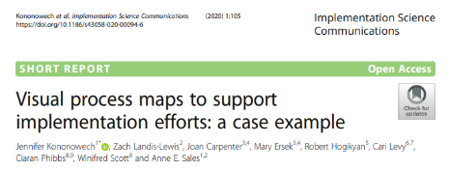
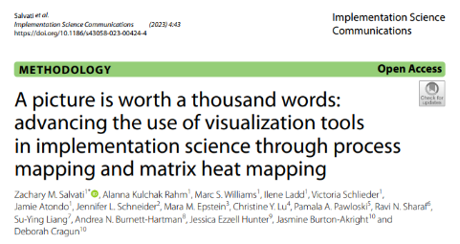
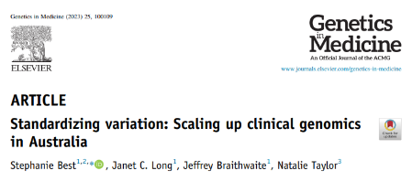
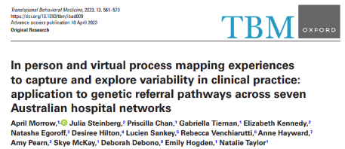
Why Process Mapping?
PLANNING
DOING
EVALUATING
ADAPTING
Notes:
When applied to different phases of implementation, there is clear evidence that process mapping can help us to understand complex systems, visualise integration of a new intervention, and identify target behaviours for change. And to achieve this, we often use mixed-methods….

Slide 45

Why ‘Mixed-Methods’ Process Mapping?
Inputs
Outputs
TARGET BEHAVIOURS
STAKEHOLDER ENGAGEMENT
INTERVIEWS
BARRIERS & FACILITATORS
FOCUS GROUPS
PROCESS MAPS
STRATEGIES
AUDIT DATA
IMPROVED PROCESSES
IMPROVED INTERVENTIONS
Notes:
I like to think of mixed-methods process mapping as the cooler cousin of traditional corporate mapping – less rigid, more insightful. It brings together the qualitative and quantitative data sources that are our bread and butter –interviews, focus groups, audit data - to produce targeted, useful implementation outputs. And this method is gaining traction….

Slide 46
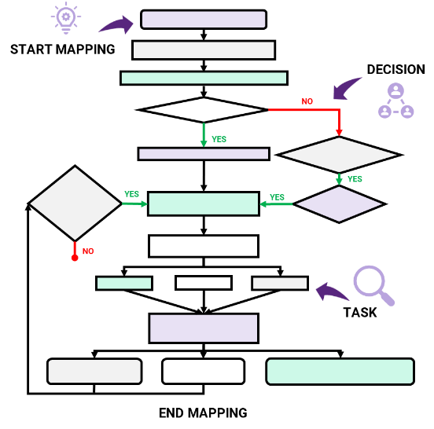
Aims
Inputs
Formalise the methodological steps to using mixed-methods process mapping
Provide guidance for best practice recommendations
Outputs
Improve consistency, quality, and utility in practice
Optimise implementation practice and research
Notes:
So, with some brilliant colleagues from Australia and Canada, we developed practical, consensus-based guidance on how to use mixed-methods process mapping across three core phases of implementation – with the overall goal to help improve consistency, quality, and utility in practice.

Slide 47
Methods
Across 3 core phases of implementation:
Stakeholder engagement
1
Engage stakeholders in the implementation process and maintain engagement
Provide rationale for using mixed-methods process mapping
Best practice guidance
Real-world case studies
Identify areas for change
2
Identify when, where, why, and to whom change is needed and the potential consequences
Identify determinants and strategies
3
Identify barriers and enablers and provide the opportunity to co-design implementation strategies
Notes:
Today I will walk you through these 3 core phases - Stakeholder engagement, Identifying what needs to change, Identifying barriers and enablers, and co-designing strategies – providing a rationale, best practice recommendations, and case studies for each.

Slide 48
Methods
i2i case studies
SETTING
AIM
INPUTS
OUTPUTS
Community sites ~
National Point of Care HCV
Improve existing clinical processes
Interviews
Focus groups
Audit data
Understand existing process
Identify barriers/facilitators
Co-design strategies
HCV Point-of-Care testing
Precision oncology
Co-design a new model of care
Interviews
Meetings
Audit data
Understand existing processes
Identify barriers/ facilitators
Intervention adaptation
The Precision Care Initiative
Childhood cancer survivorship
Integrate a new model of care
Interviews
Meetings
Understand existing processes
Identify practice variation
Identify barriers/ facilitators
Intervention adaptation
Engage
Hide and Seek Project
Clinical genetics ~ Lynch syndrome referral pathway
Improve existing clinical processes
Interviews
Focus groups
Audit data
Understand existing process
Identify practice variation
Identify target behaviours
Evaluate effectiveness
Notes:
Now the implementation to impact team at the University of New South Wales love our process mapping so I have selected a few i2i case studies to demonstrate application across the 3 phases
The HCV project aims to enhance the national uptake of Hepatitis C virus point-of-care testing through co-development of an implementation intervention
The Precision Care Initiative is co-designing a new precision medicine clinic to facilitate integration of research genomics into routine care.
The Engage study – which you can hear more about in Natalie Taylor’s presentation this afternoon –is a new model-of-care designed to overcome challenges faced in delivery of childhood cancer survivorship care.
Finally, the Hide and Seek project – a completed study which aimed to improve genetic referral pathway for Lynch syndrome, a hereditary cancer predisposition condition

Slide 49

Engaging Stakeholders
1
Engage stakeholders in the implementation process and maintain engagement
Stakeholder engagement
Rationale
Getting the right people in the room (and on the same page!)
Leverage partnerships to
recruit participants
4
Train implementation leads to disseminate research and facilitate activities
BEST PRACTICE RECOMMENDATIONS
2
3
What is qualitative input is feasible?
Apply determinants framework
What data is available to measure outcomes?
Design process mapping
activity based on insights
Identify determinants and strategies
2
Create and present an initial
process map (conversation starter)
Generate from knowledge, literature, guidelines
Core steps across settings /process phases
Co-refinement
3
Identify barriers and enablers and provide the opportunity to co-design implementation strategies
1
Content experts
Project planning meetings
Co-refinement
Establish partnerships between implementation researchers and stakeholders
Notes:
Let’s start with stakeholder engagement. We all know it’s not easy to pull busy clinicians away from their patients and a packed schedule to talk implementation. But early engagement is crucial — and this is where mixed-methods process mapping shines.
First, we recommend forging these partnerships – perhaps via a planning meeting. Show up with a rough sketch — a visual of how things currently work –generated by speaking with content experts or existing guidelines. This map is not meant to be perfect – but enough to spark conversations. Ask “Does this look right to you?” and suddenly you are learning about missing steps or workarounds, key players to speak to, or areas that just aren’t working as they should. These early conversations generate insights to help design the process mapping activities – are interviews or focus groups more feasible? What outcome data is available? Who else should be involved?
These early process maps are more than conversation props — they show people you’re listening and help build a network of collaborators who are more likely to stick around for the rest of the implementation journey.

Slide 50
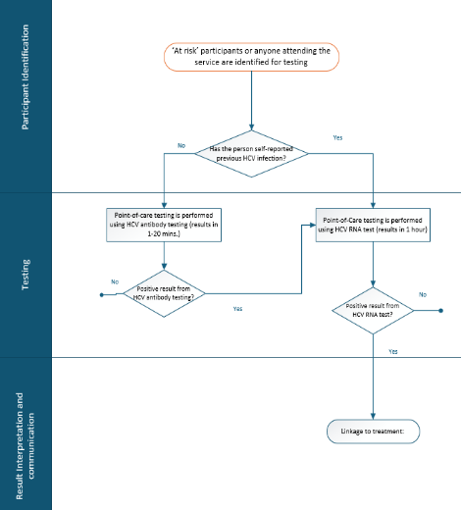
Case Study
1
1
HCV ~ Generate an initial process map to engage stakeholders
Engage stakeholders in the implementation process and maintain engagement
Stakeholder engagement
Initial process map:
Based on existing documented process
Final process map:
Based on experience, existing practice
Notes:
Take for example the HCV study – a simple process map was generated using documented processes, with the core steps aligned with 3 distinct phases of point of care testing. Following discussions with stakeholders, the initial map was contextualised and refined to represent real-world practice, and used in focus groups and interviews

Slide 51
Case Study
1
Precision Care Initiative ~ Process map iterations to reflect real-world complexity
Engage stakeholders in the implementation process and maintain engagement
Stakeholder engagement
New referral received by admin
Patient referral
Accepted
Referral triaged
Declined
Pt consent to research clinic (via intake call)
No
PROCESS MAP KEY
*Referring clinicians may be invited to join consult, where appropriate
= Patient not treated in clinic; receives standard of care from referring clinician / not participate in research; proceed with clinic pathways
Yes
½ day clinic
IN PERSON
½ day clinic
TELEHEALTH
Clinical assessment +/- testing
MDT (combined germline & treatment)
MDT (combined germline & treatment)
Genomics clinic in person consult*
Genomics clinic telehealth consult*
3
Clinical team meeting (review clinic)
Clinical team meeting (review clinic)
Patient discharge to usual care team
PCC summary letter mailed. Patient discharged from PCC
V1.0 Planning Phase
Notes:
With the Precision Care Initiative, a process map of the proposed clinic was developed with clinicians delivering the new intervention. Here you can see a simple clinical consultation model, across 3 phases of patient care

Slide 52
New referral received by admin
1
Case Study
Referral rejected
N
Referral acceptable ?
Engage stakeholders in the implementation process and maintain engagement
Letter to referring clinician
Y
Stakeholder engagement
Initial scheduling: MDT or Clinic?
Patient referral
Molecular MDT Stream
Clinic Stream
Is germline testing required?
PROCESS MAP KEY
Process step
Decision point
Termination point
PCC MDT Referral submitted
Admin circulates MDT list Friday prior
Clinical assessment +/- testing
Medical Oncology
Pre-clinic workup
Genetics
Pre-clinic workup
Pre-MDT workup
MDT meeting (TUES): Case presentation and recommendations documented
Admin books appointment (F2F or telehealth)
The way I provide routine care is not by sending a patient to a precision medicine clinic. It’s me, using the precision medicine clinic as my tool to then give my patient precision medicine.
[S14, medical oncologist]
MDT summary letter drafted by fellow into PCC Clinic Letter Template
Medical Oncology
appointment (WED)
Genetics
appointment (WED)
For MDT re-review?
Patient consents to germline testing?
N
For clinical consult?
Y
Y
Y
N
N
Y
Additional information obtained
Y
Additional info required?
GC arranges pathology
Clinic component of letter dictated
Germline testing completed?
GC follows up with patient or laboratory
Y
For MDT re-review?
N
N
Y
Y
For clinical consult?
N
MDT summary letter finalized & signed by MDT chair
Genetics results
appointment (WED)
Patient discharge to usual care team
For MDT review?
Y
V8.0 Mid-implementation
PCC summary letter mailed. Patient discharged from PCC
Genetics clinic letter dictated
N
Notes:
As the clinic was piloted, multiple iterations were required to reflect the evolving processes in response to real-world complexity. By speaking with referring clinician stakeholders throughout implementation, we begin to understand why one of the clinical consultation arms is less utilised, and why the multidisciplinary team meetings are perceived to be the central value-add service.

Slide 53
Identify Areas for Change
2
Identify when, where, why, and to whom change is needed and the potential consequences
Stakeholder engagement
Rationale
Seeing the gaps (not just the goals)
Incorporate meaningful audit
data that aligns with steps
7
Routinely collected clinical/ admin data
BEST PRACTICE RECOMMENDATIONS
2
6
Identify core components, gaps, variation, target behaviours
Ongoing refinement of process map
Conduct process
mapping activities
5
Adapt process mapping
methods to context
Actual vs anticipated practice
Frame questions
3
Notes:
Next we use process mapping to find the sweet spot for change. We carefully frame the prompts to specify who does What, When, Where and Why, and what are the potential consequences to change. Now clinical processes are translated into behaviours, and those causing barriers or bottlenecks start to emerge. For example, if someone says the “the referral process is clunky,” we can get specific to unpick the why… “So what you’re saying is - Dr. A sends Form B to Team C by 11am… except on Fridays when John from Team C has the morning off to look after his grandson, so those referrals sit there until Monday…..
Recommendation 7 is where assumptions can gently explode. By matching audit data to process steps, we demonstrate gaps and variations in practice, and work-as-imagined vs work-as-done starts to diverge. This step helps us zero in on the exact behaviours we need to either support, change, or retire and also how the desired practice change is going to be best measured

Slide 54
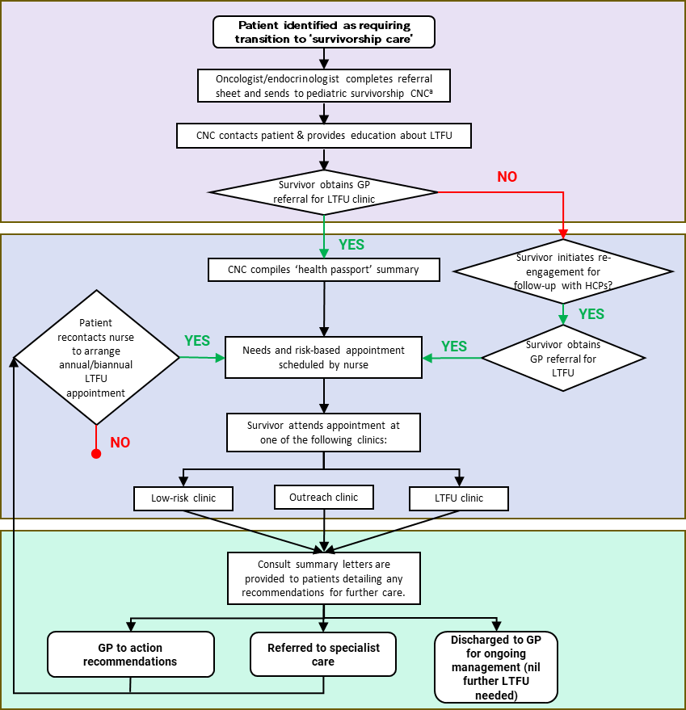
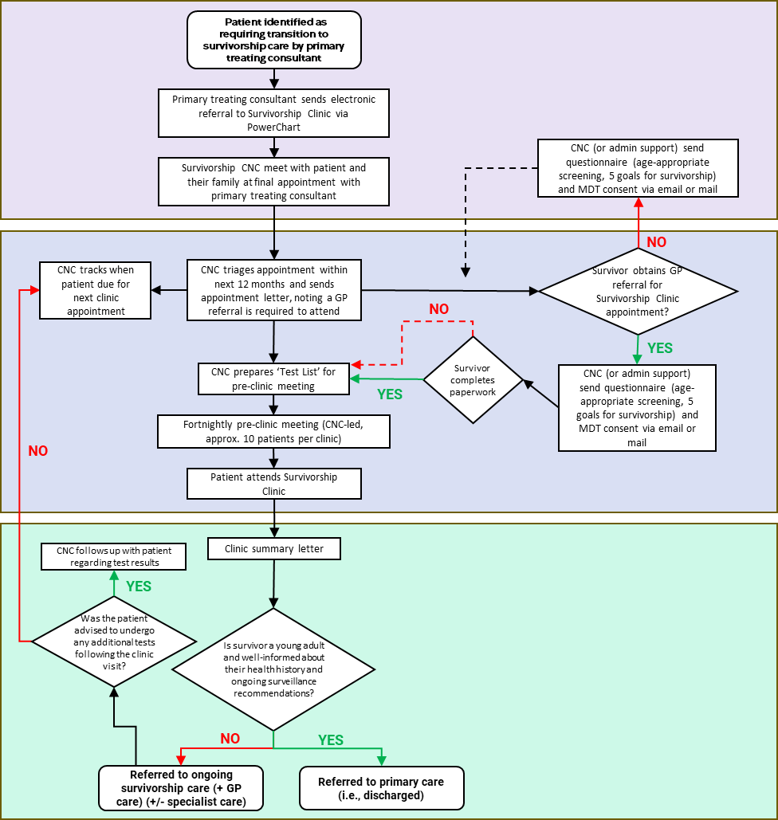
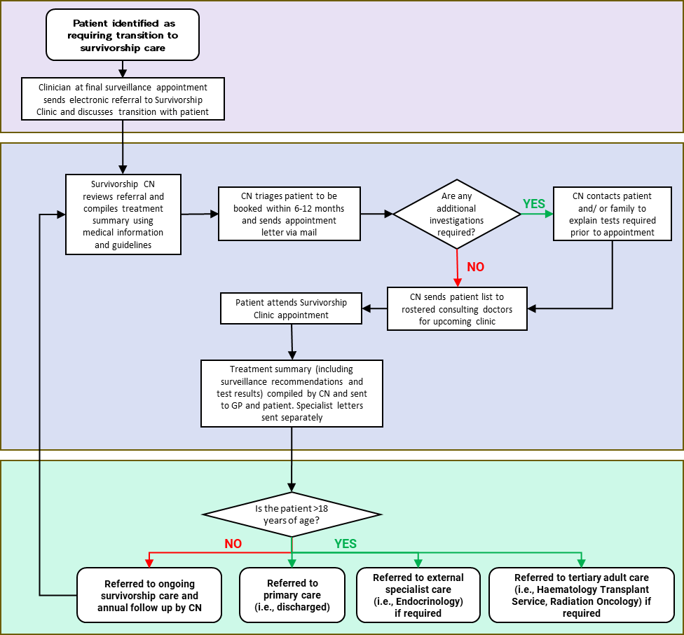
Case Study
2
Engage ~ Identify site variation across survivorship service pathways
Identify when, where, why, and to whom change is needed and the potential consequences
Stakeholder engagement
Site 1
Site 2
Site 3
IDENTIFICATION
ASSESSMENT
FOLLOW-UP
Notes:
With the Engage study, process mapping was applied to understand existing survivorship services across 3 hospitals prior to implementation, successfully highlighting important resource and practice variation between

Slide 55
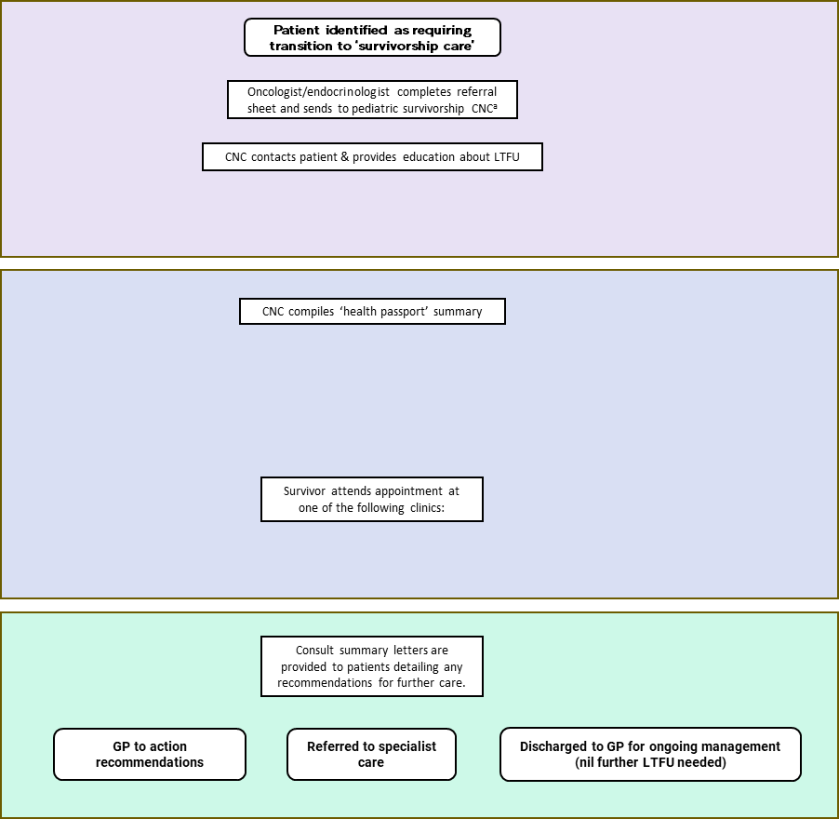
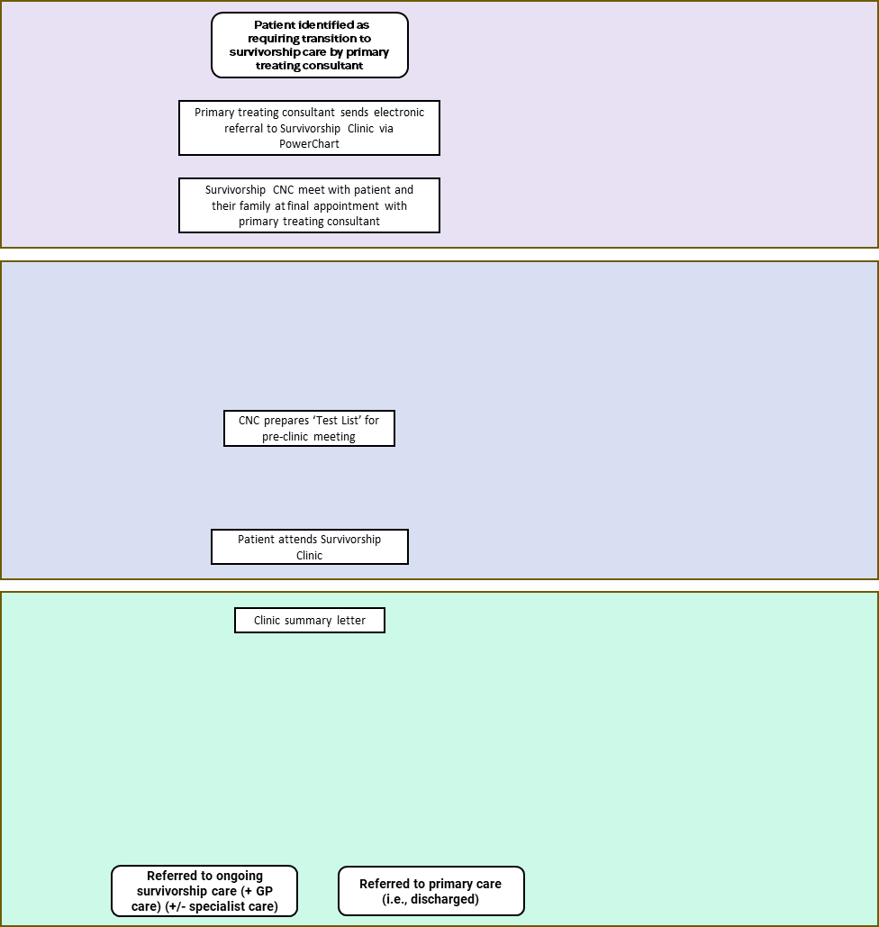
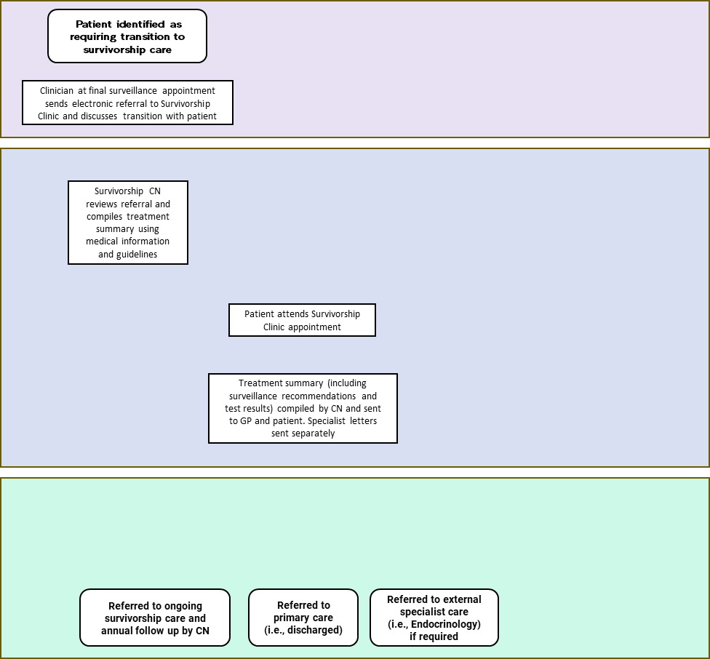
Engage stakeholders in the implementation process and maintain engagement
Case Study
2
Engage ~ Identify commonalities across survivorship service pathways
Identify when, where, why, and to whom change is needed and the potential consequences
Stakeholder engagement
Site 1
Site 2
Site 3
Clear processes around identifying patients ready to transition to survivorship care
Referral required to attend survivorship clinic
CNC compiles treatment summary and triages survivor to appropriate clinic
Referred to external specialist care
Referred to ongoing survivorship care
Referred to primary care
(i.e., discharged)
Notes:
This also allowed us to identify overlapping commonalties between each service…..

Slide 56
Engage stakeholders in the implementation process and maintain engagement
Case Study
2
Engage ~ Identify unique factors affecting implementation
Identify when, where, why, and to whom change is needed and the potential consequences
Stakeholder engagement
Clear processes around identifying patients ready to transition to survivorship care
IDENTIFICATION
Referral required to attend survivorship clinic
Experienced clinical nurse consultant to co-ordinate survivors and clinical team
CNC compiles treatment summary and triages survivor to appropriate clinic
Site 2
ASSESSMENT
Already has an established pre-clinic meeting
Clinic appointments with telehealth capability and established
multidisciplinary team
Site 3
Clinic summary letter, including MDT recommendations, sent to survivor and their GP
Site 1
No remit for survivorship care >17yrs, with no adult survivorship services to refer to
Provides survivorship care into adulthood
FOLLOW-UP
Referred to ongoing survivorship care
Referred to primary care
(i.e., discharged)
Referred to external specialist care
Notes:
and to delve a bit deeper and understanding underlying unique contextual factors across each site predicted to positively or negatively influence implementation of the Engage intervention, which need to be addressed in a site-specific manner

Slide 57
Engage stakeholders in the implementation process and maintain engagement
Case Study
2
HaSP ~ Outcomes map to identify practice gaps and target behaviours
Identify when, where, why, and to whom change is needed and the potential consequences
Stakeholder engagement
11
195
Other exclusion
5
No/very low tumour
CRC resection
Exclusions:
3 – tumour type
1 – no resection
1 – unclear resection procedure
179
LEGEND
Sample sent to pathology
N (N)
Number of patients correctly transitioned to step, parentheses: within 62 days of resection
179
N
Number of patients transitioned to step showing potential gap or bottleneck
MMR IHC test on tumour
of which 8 H7 code (0 referred)
N
Number of patients transitioned to step, with later steps determining whether correct or a possible gap
13
136 (134)
30
Patients whose referral to FCC agrees with tumour molecular information
MMR IHC test NOT completed
Staining preserved
Staining patchy or lost
N
133
1+2$
N
Patients whose non-referral to FCC agrees with tumour molecular information
MMR IHC test on biopsy
24
13
Loss of MSH2, MSH6, or PMS2
6
Loss of MLH1
N
Patients whose referral to FCC shows potential gap or bottleneck
TB1
TB2
Patients whose non-referral to FCC shows potential gap or bottleneck
4
1+1$
N
4
6
3
BRAF V600E test on tumour
parentheses: outcome within 62 days of resection
* referral by GP
$ self-referral or referral prior to resection
Staining patchy or lost
Staining preserved
MMR IHC test NOT completed
24
6
0
3
0
TB1
3
1
Loss of MLH1
Loss of MSH2, MSH6, or PMS2
2
15
8 (6)
BRAF V600E test NOT completed
BRAF V600E detected
BRAF V600E not detected
1
0
BRAF V600E test on tumour
2
0
13
2 (1)
5
2
TB1: Appropriate tumour testing of all CRC samples
5 patients (2.8%) did not receive appropriate tumour testing
3 – no IHC test
2 – no BRAF test despite MLH1 loss
3
TB2
TB2
1
BRAF V600E not detected
2
BRAF V600E detected
1
1
1 (0)
TB2: Use LS risk-assessment information to inform appropriate genetics referrals
11 patients (78%) – not referred despite abnormal tumour testing
5 – MSH2/MSH6/PMS2
6 – MLH1, BRAF V600E not detected
TB2
NO genetics referral
Genetics referral
Notes:
The hide and seek project gives a powerful example of how audit data can identify target behaviours for change. This is an outcomes map from one of the 7 hospital sites, showing how many patients underwent resection for colorectal cancer during a set time period, and according to established guidelines - how many samples were tested and interpreted appropriately, and how many high risk LS patients were referred to genetics services. This is where the process gaps emerge as red flags. First, we identify the missed tests, indicating the first TB for change. Then we start to see the high-risk patients who were not referred to genetics, indicating the second target behaviour for change.

Slide 58
Case Study
1
1
HaSP ~ Stakeholder feedback on process mapping outputs
Engage stakeholders in the implementation process and maintain engagement
Stakeholder engagement
Shared Understanding
Visualisation
Eye-opening
Consider work as actually done, rather than imagined
‘Gosh, and I thought we were quite good at it, but there are holes in the journey’ – Medical oncologist
‘The failure happens with us as clinicians. We refer patients who are not needing referral. We’re missing patients who need referral’ – Surgeon
Power of Evidence
Shared Understanding
Behaviours associated with gaps
Visualise downstream impacts of changing behaviours
Provide concrete evidence of gaps in practice
‘Along the way, there’s potential for misses. This is a process but the process can fail at any point’ – Geneticist
Notes:
Here we can see the impact these maps had on the study clinicians – linking us back to stakeholder engagement. These activities helped them to visualise the processes, develop a shared understanding of the gaps and behaviours, and most importantly, motivate real action for change.

Slide 59
Identify Determinants
& Strategies
3
Identify barriers and enablers and
co-design implementation strategies
Stakeholder engagement
Rationale
Fixing together – with real and usable solutions
Develop and evaluate
proposed intervention package
10
Map strategies to barriers, targeted behaviours, and potential impacts
BEST PRACTICE RECOMMENDATIONS
Theory-guided reporting to enhance standardisation
9
Deductively analyse to frameworks
Map barriers to potential evidence-based strategies
Identify determinants and strategies
8
Identify barriers and enablers and provide the opportunity to co-design implementation strategies
Identify barriers and enablers and intuitively generated solutions
Inductively vs deductively captured
3
Notes:
Finally, process mapping helps us to identify barriers and enablers to implementation, and co-design strategies. Traditionally, this is tackled over a number of linear steps. However, we find that in the previous phases, we organically uncover tacit knowledge which may otherwise go unsaid – such as the shared login that shouldn’t exist – and practical, intuitive solutions emerge — valid strategies that can be cross-checked against theory and considered as part of the intervention package. It’s fast, collaborative implementation design — without compromising the value of theory-driven strategies, because there’s room for both.
And step 10 recommends just that – map both sets of strategies to barriers, target behaviours and potential impacts in the proposed intervention package, and present to a new group of stakeholders to test the acceptability and feasibility, and guide further refinements.

Slide 60
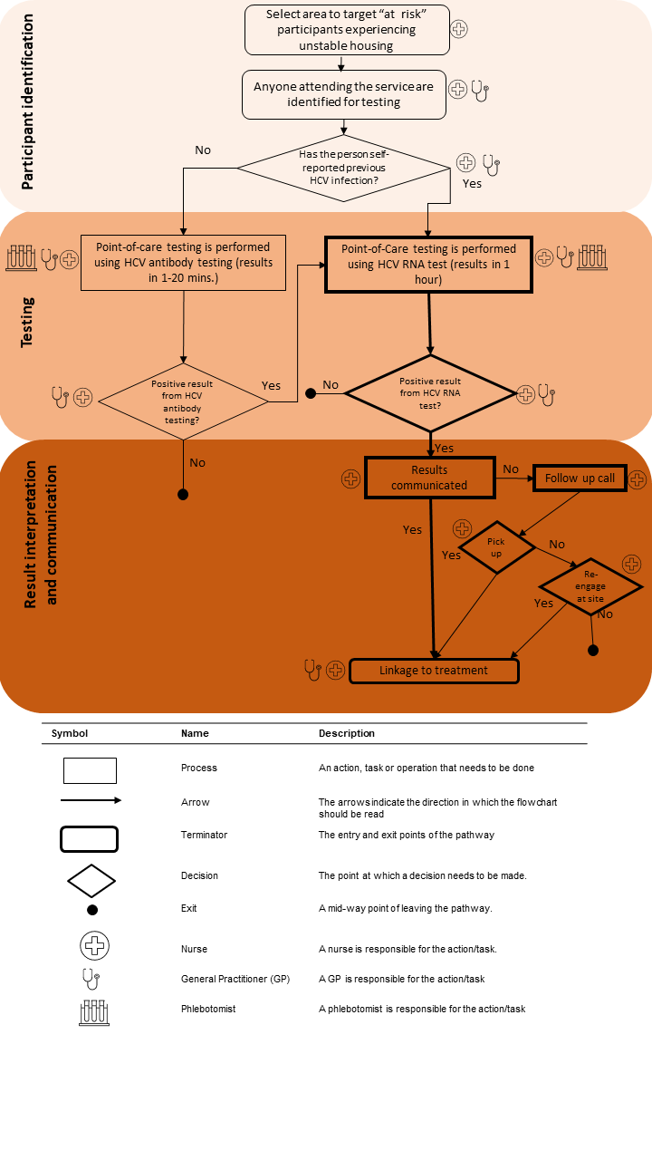
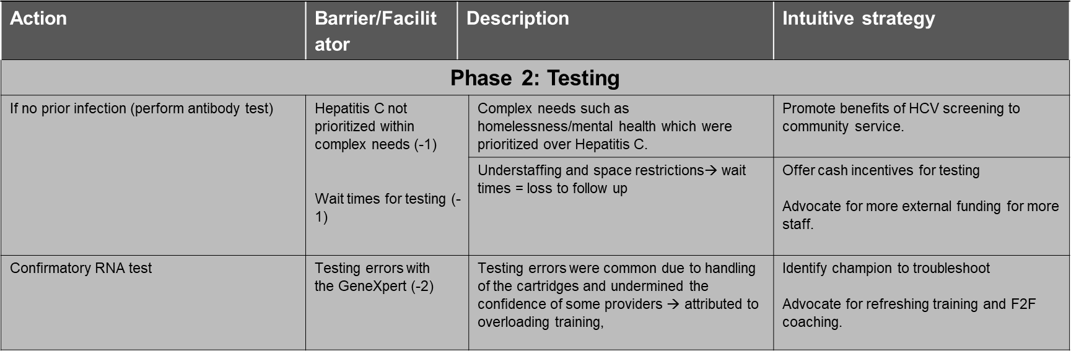
Case Study
3
HCV ~ Determine barriers and enablers influencing point-of care implementation
Identify barriers and enablers and
co-design implementation strategies
Stakeholder engagement
1638
372
883
781
Invalid
67
No Result
578
105
136
778
67
Notes:
In the HCV study, for example, a process map with overlayed audit data is used to systematically capture barriers and enablers across each phase, along with the intuitive strategies to overcome them, which can then be mapped back to ERIC taxonomy and considered part of the strategy package.

Slide 61


Case Study
3
HaSP ~ Intuitive approach to barrier identification and strategy design
Identify barriers and enablers and
co-design implementation strategies
Stakeholder engagement
Process mapping focus groups to identify target behaviours
Barriers inductively captured and coded to TDF domains
Focus-group barrier discussion prompted by intuitively-identified barriers
Theory and Techniques Tool to assess mechanistic alignment
Consensus ranking to determine top intuitively-identified barriers
Proposed strategies inductively captured and coded using Behaviour Change Techniques Taxonomy
Intuitive strategies mapped to intuitively-identified barriers,
theoretical links made explicit
Morrow, A., et al. (2024). "Bridging the Gap between Intuition and Theory: A Comparison of Different Approaches to Implementation Strategy Development for Improving Lynch Syndrome Detection." Public Health Genomics 27(1): 110-123.
Notes:
The Hide and Seek cluster randomised trial comparing intuitive and theory-informed implementation approaches. Theory won, perhaps not surprisingly, but intuitive strategies weren’t far off the mark. Forty-two percent aligned with behaviour change theory, suggesting mapping can generate real, actionable insights while still respecting scientific rigour. The study also provides guidance on how to theoretically align intuitively identified strategies using the theory and techniques tool, so perhaps implementation researchers are the real winners here.

Slide 62
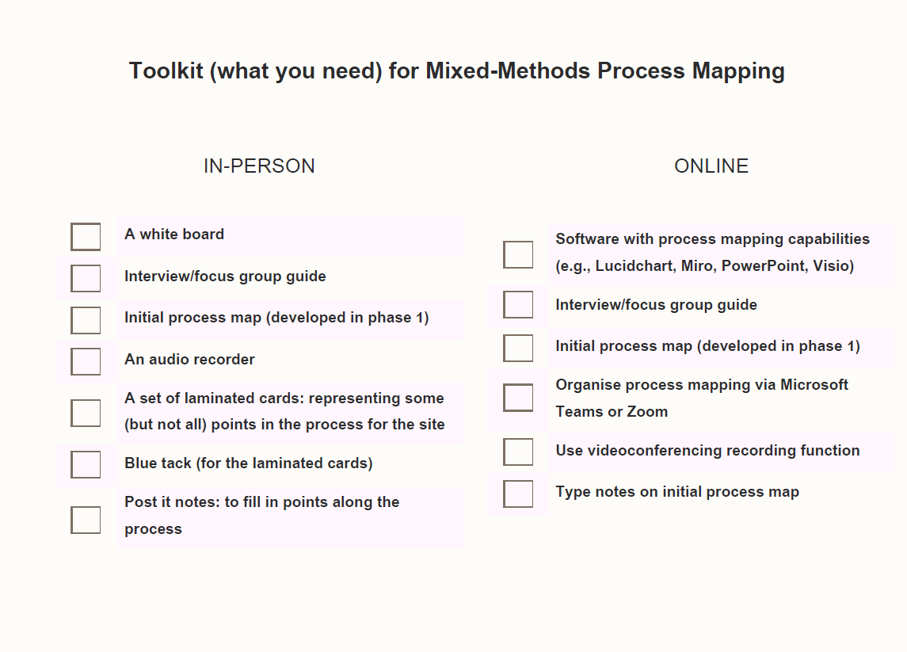
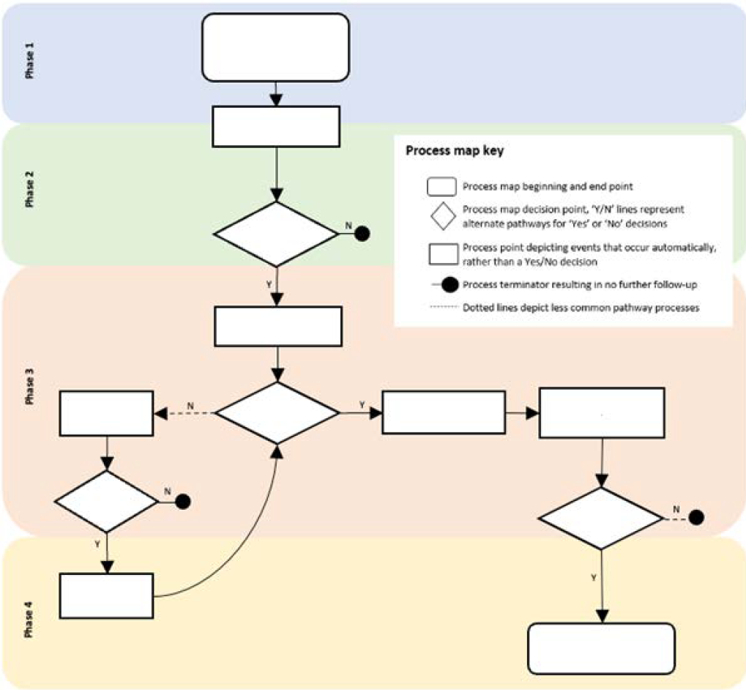
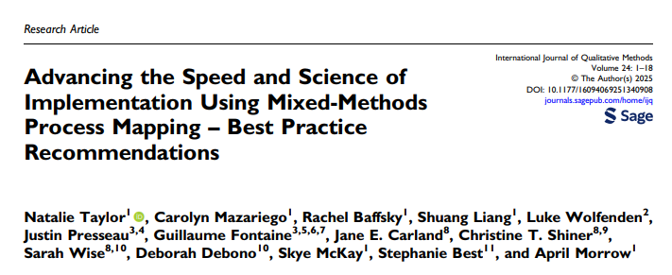
Summary
Presented a mixed-methods process mapping framework
- Guidance and practical tools
- Real-world application
Hot off the press
Taylor, N., Mazariego, C., Baffsky, R., Liang, S., Wolfenden, L., Presseau, J., Fontaine, G., Carland, J. E., Shiner, C. T., Wise, S., Debono, D., McKay, S., Best, S., & Morrow, A. (2025). Advancing the Speed and Science of Implementation Using Mixed-Methods Process Mapping – Best Practice Recommendations. International Journal of Qualitative Methods, 24. https://doi.org/10.1177/16094069251340908 (Original work published 2025)
Notes:
In summary, we’ve built a practical, consensus-based framework for using mixed-methods process mapping across three key phases - supported by practical tools and case studies. However, if you need further convincing or if you are just keen to start mapping, please have a read of the paper which has only just been published

Slide 63

Summary
Presented a mixed-methods process mapping framework
- Guidance and practical tools
- Real-world application
Advance speed and rigor of implementation practice and research
- Apply, test, report, refine!
Notes:
We believe mixed-methods process mapping is more than just a method — it can become the GPS of implementation. It helps us navigate complexity, stay on course between research and real-world change, and reroute when the system throws up unexpected roadblocks. To unlock its full potential, we invite you to apply these methods across diverse settings, share what works (and what doesn’t), and help us refine and strengthen the approach together.

Slide 64


Acknowledgements
Co-authors
A/Prof Natalie Taylor, University of New South Wales, AU
Dr Carolyn Mazariego, University of New South Wales, AU
Dr Rachel Baffsky, Black Dog Institute, AU
Dr Shuang Liang, University of New South Wales, AU
Prof Luke Wolfenden, University of Newcastle, AU
Dr Justin Presseau, Ottawa Hospital Research Institute, CA
A/Prof Guillaume Fontaine, McGill University, CA
A/Prof Jane E. Carland, St Vincent’s Hospital Sydney, AU
Dr Christine T. Shiner, St Vincent’s Hospital Sydney, AU
Dr Sarah Wise, University of Technology Sydney, AU
Dr Deborah Debono, University of Technology Sydney, AU
A/Prof Stephanie Best, University of Melbourne, AU
Dr April Morrow, University of New South Wales, AU
i2i Team
A/Prof Natalie Taylor
Dr Carolyn Mazariego
Dr April Morrow
Dr Andre Torres Robles
Dr Shuang Liang
Joseph Elias
Elijah Tyedmers
Deborah Johnston
Helen Monaghan
Dr Jeffery Chan
Dr Paul Watson
Dr Maria Gonzalez
Skye McKay
Zhicheng Li
Gabriella Tiernan
Mahitha Ramanathan
Lizzie Kennedy
Arya Shinde
Priscilla Chan
Thank you to the patients, clinicians and stakeholders for your engagement and collaboration in the presented case studies
Visit our website for more info on the i2i team and projects
Notes:
Thank you so much for your attention today, and to the co-authors, collaborators, and i2i team members

Slide 65
THANK YOU!
Questions & Discussion
Presentation 1: Michael Sykes
Presentation 2: Denise Thomson
Presentation 3: Natalie Taylor
Presentation 4: Skye McKay
Session host: Bruno Mazuquin
Thought-provoking presentations and interesting insights?
Spread the word and let us follow along by using #EIE2025!

