Slide 1


Ride the Knowledge Wave 10
IMPLEMENTATION MECHANISMS
Presentation 1: Alexandra Ziemann
Presentation 2: Sara Söling
Presentation 3: Dinka Caha
Presentation 4: Lydia Kwak
Session host: Thomas Engell

Slide 2
Ziemann

Slide 3

Research aims and reality: (Comprehensive) understanding or reduction of the complexity of social systems as a central research object in applied implementation research - to what extent must methods be adapted to gain socially meaningful and yet robust findings?
Sara Söling, Dip.Soc.Sci, M.Sc. (PH), PhD
Center for Health Economics and Health Services Research, University Wuppertal
June 6th, 2025

Slide 4
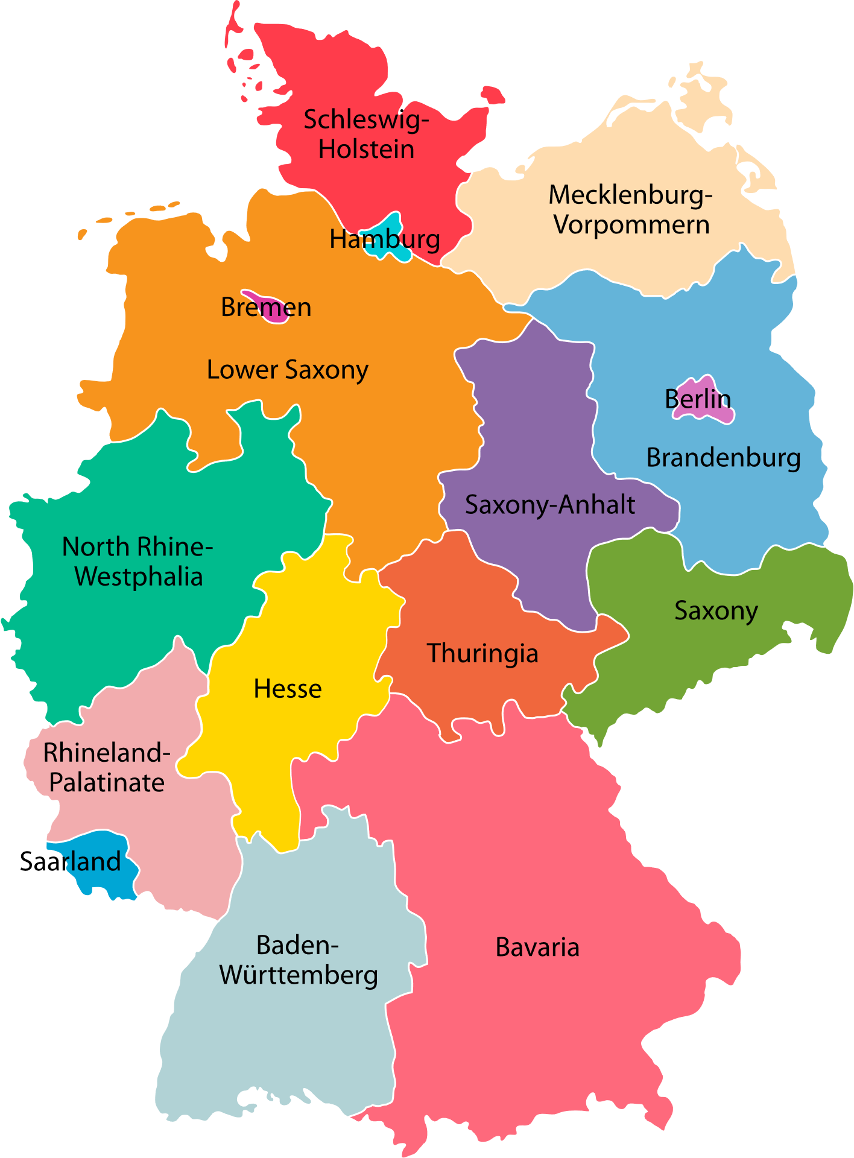


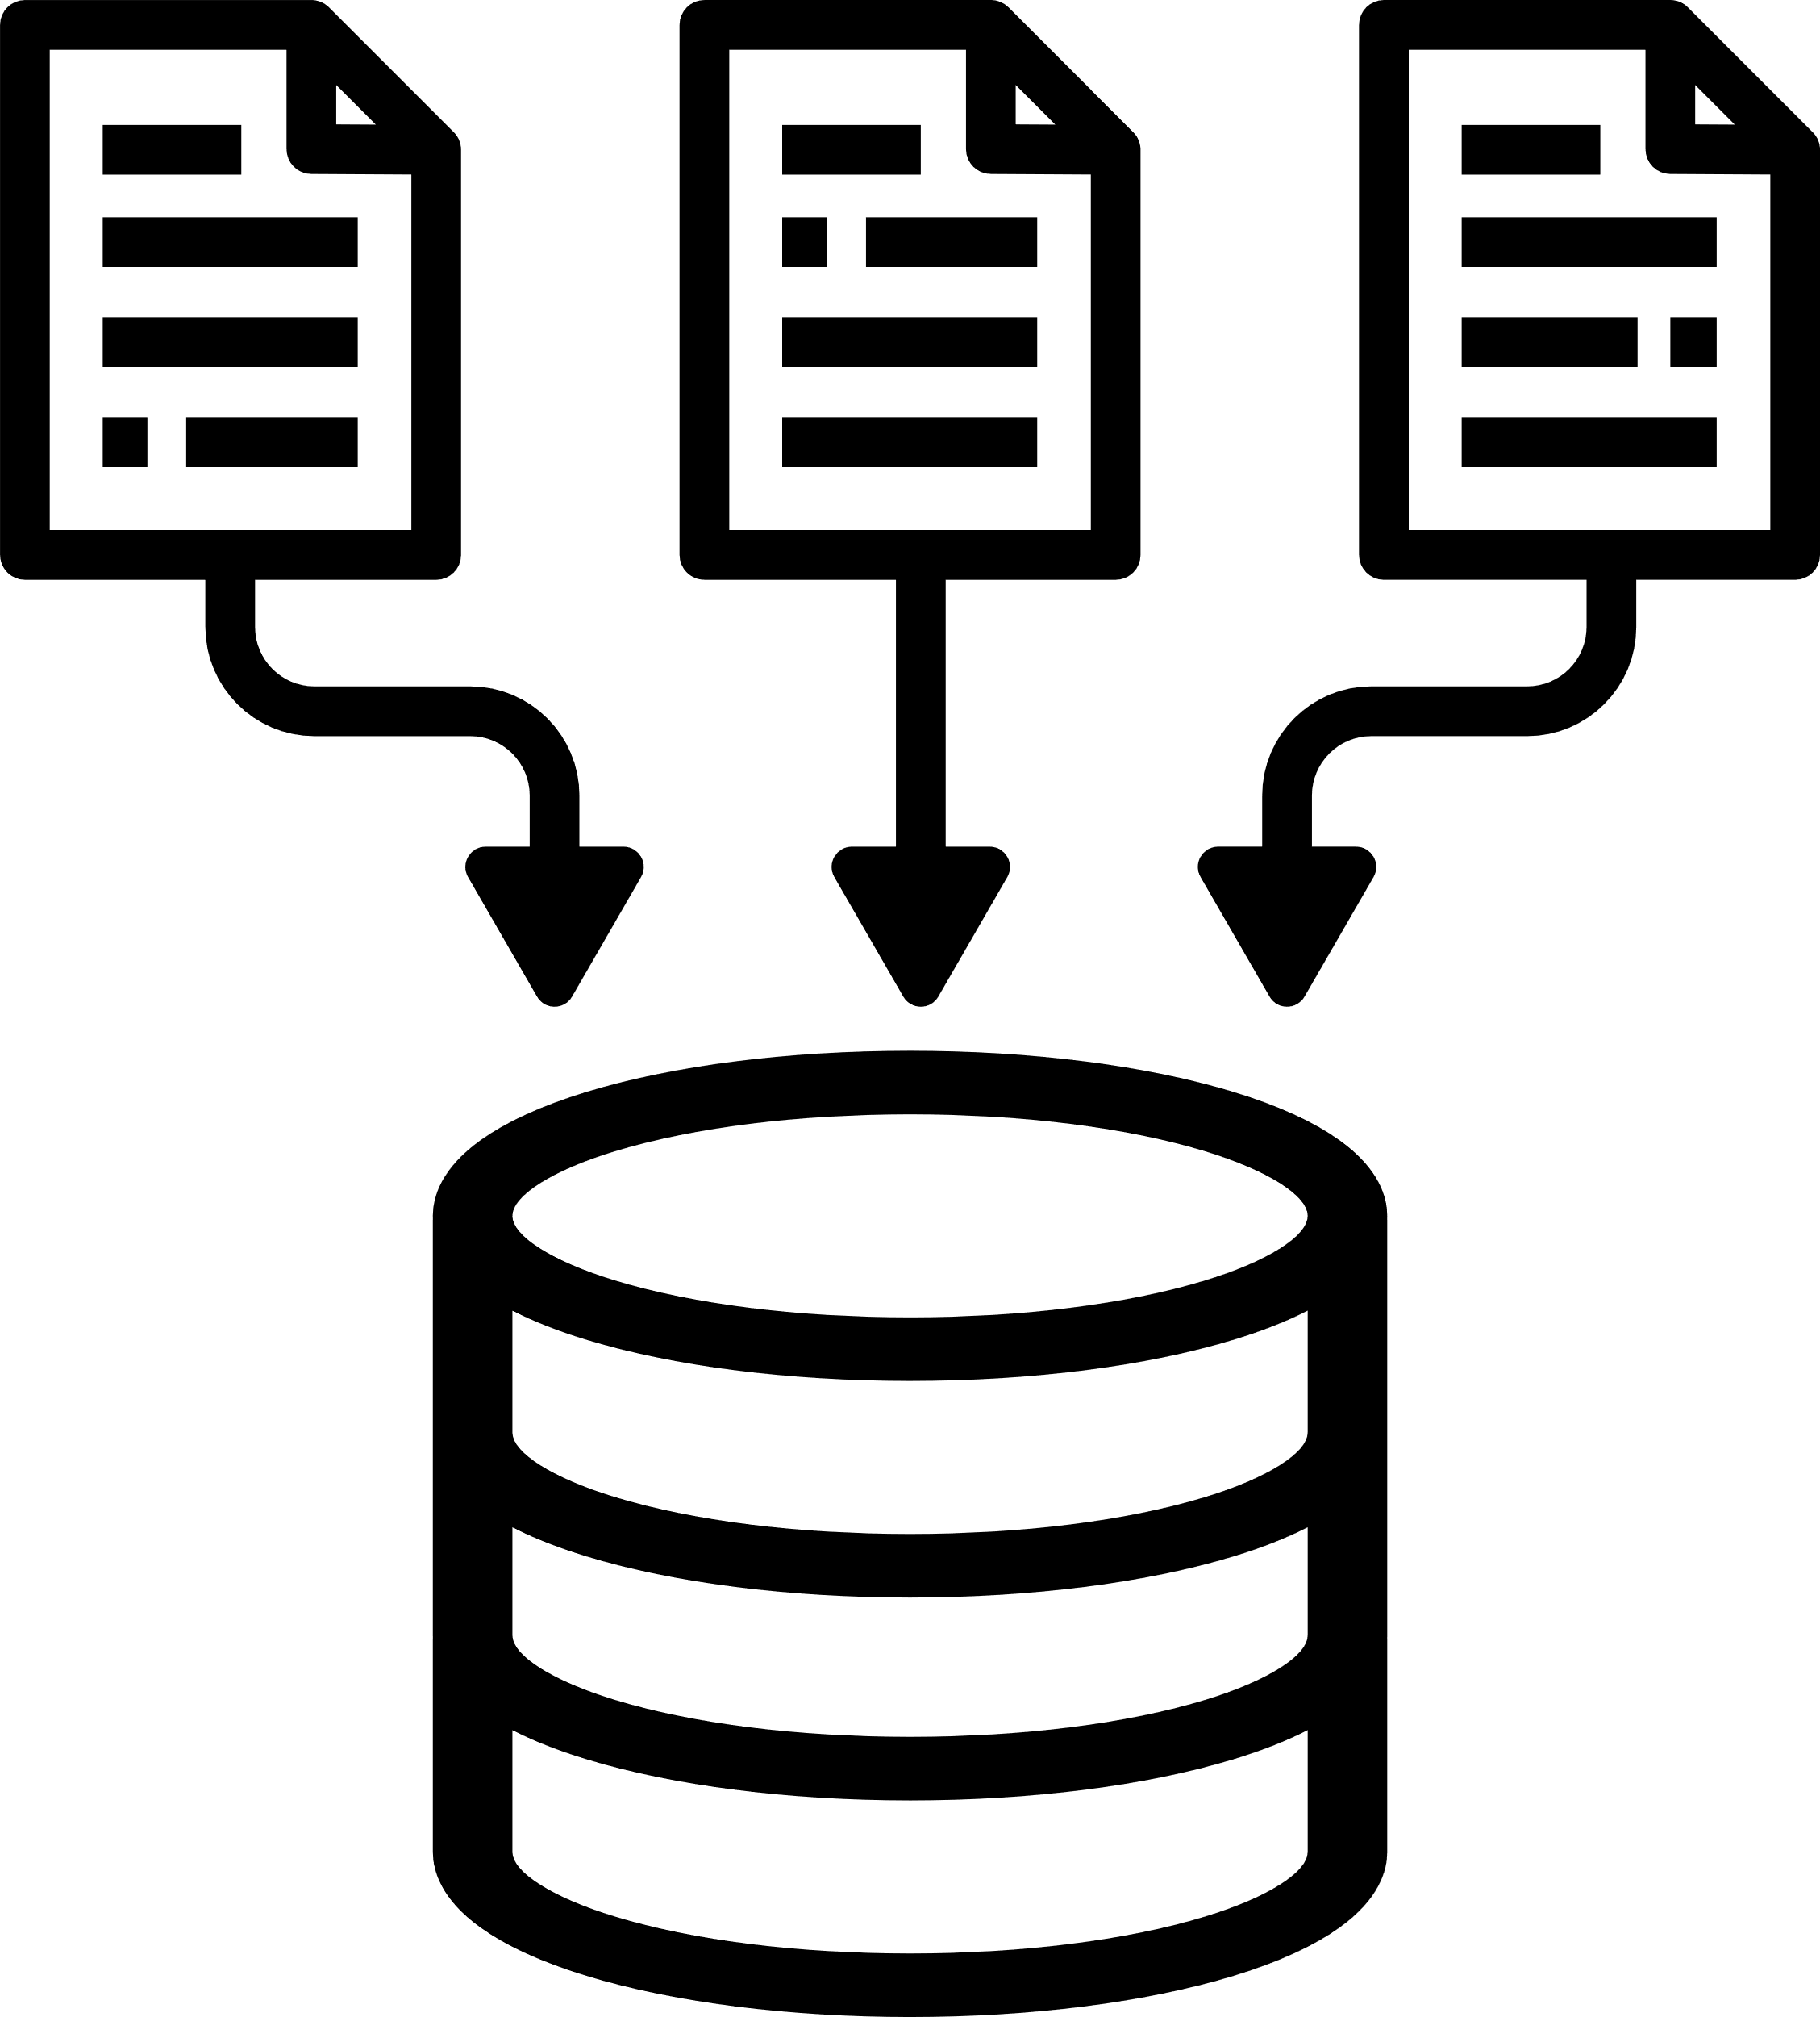
Cluster-Randomized Controlled Trial With a Stepped-Wedge Design in Primary Care Practices (AdAM -Project)
Structured medication history data &
risk analysis
Patient-relevant data, interactive risk assesment
planned via digital intervention
Provide clinical-decision making support for Multimedication Patients
n= 688 Primary Care Practices (= Cluster)
n= 42.700 Patients with Multimedication
Provide software implementation

Slide 5
Research priority setting in process evaluation
4 steps to generate contextual evidence in
hybrid type 1 study
-> Aims:
Tailoring implementation strategies
Testing mechanisms

Slide 6
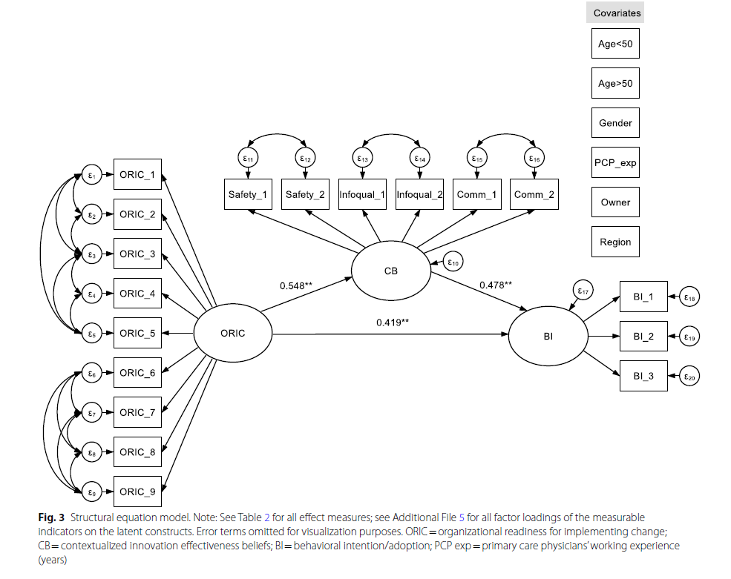
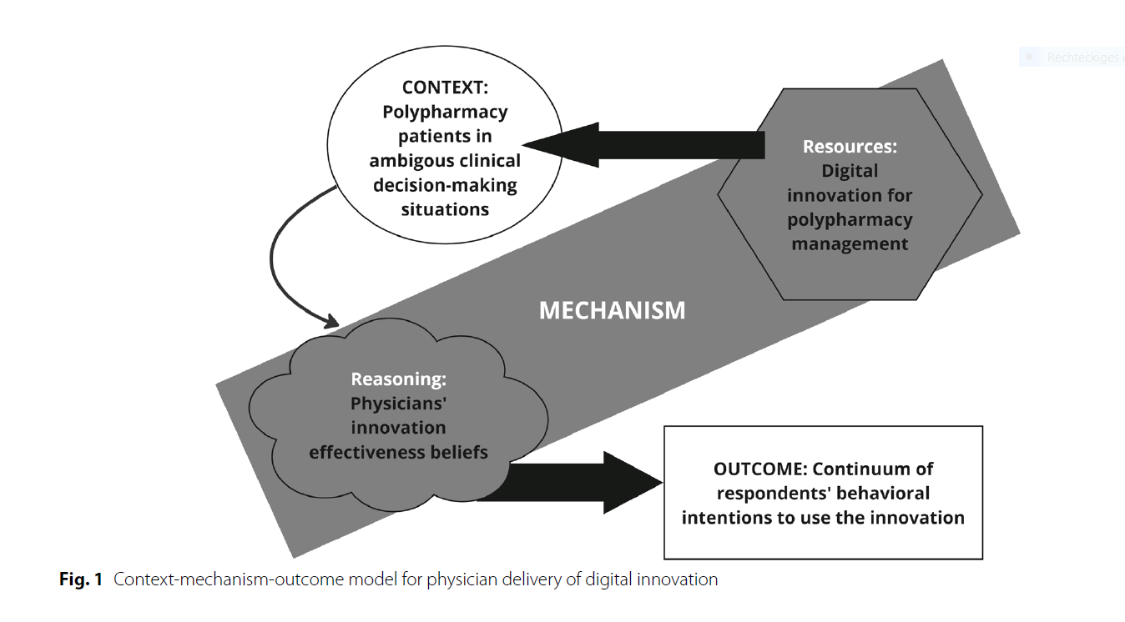
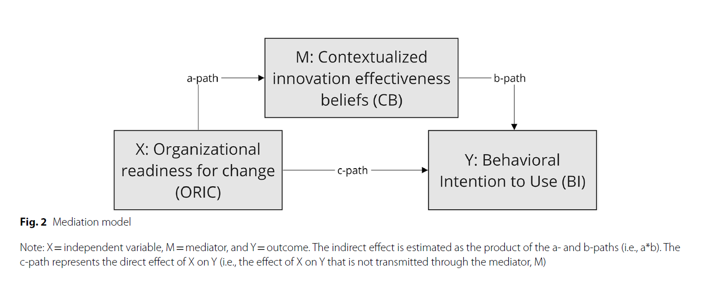
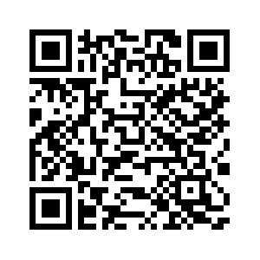
Understanding how context factors influence implementation mechanisms
1)
Context-Mechanism-Outcome-Configuration (Quali model)
3)
Structural equation model
2)
Mediation model
Söling, et al. (2023)

Slide 7
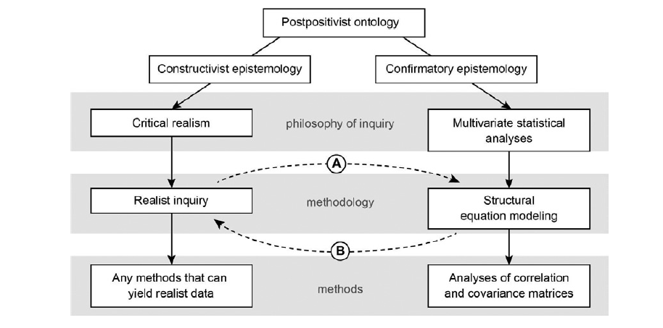
Exploring methodological intersections between realist inquiry and structural equation modeling
(Brown et al. 2021)

Slide 8
Work in progress: Conceptual model
References:
Thórarinsdóttir K, Kristjánsson K (2014) Patients' perspectives on person-centred participation in healthcare: a framework analysis. Nursing Ethics 21:129–147.
Harvey G, Kitson A (2016) PARIHS revisited: from heuristic to integrated framework for the successful implementation of knowledge into practice. Implementation Sci 11:33.
Zhao J, Jull J, Finderup J et al. (2022) Understanding how and under what circumstances decision coaching works for people making healthcare decisions: a realist review. BMC Med Inform Decis Mak 22:265
Note: own illustration
Notes:
- Konzeptuelles Modell beinhaltet Integration von Theorie : Realist Review zur Wirkung von Entscheidungscoachings, Phasenmodell der personenzentrierten Kommunikation, Implementation Frameworks (i-PARIHS), sowie Literatur zu Mechanismen in der Implementierung
Kontext: Patiententen mit komplexen Entscheidungsbedürfnissen brauchen Zeit um nach einem angepassten Entscheidungscoaching Informationen zu verarbeiten
Mechanismus: 2) Patienten wägen verschiedene Optionen ab : Arzt-Patientenbeziehung und Shared-decision making -> Outcome: Stufe der Entscheidungsfindung des Patienten
Kontext: Innere Kontextfaktoren auf der lokalen Ebene/Zentrum
Mechanismus: 1) Entscheidungscoach spielt eine Brückenfunktion zwischen dem Patienten und dem Arzt, indem er die persönlichen Umstände des Patienten mitteilt und sich für die Werte des Patienten für die bevorzugte Option einsetzt
Kontext: Bedingung, damit der Mechanismus aktiviert werden kann: Mechanismen welche Veränderungen ermöglichen,

Slide 9
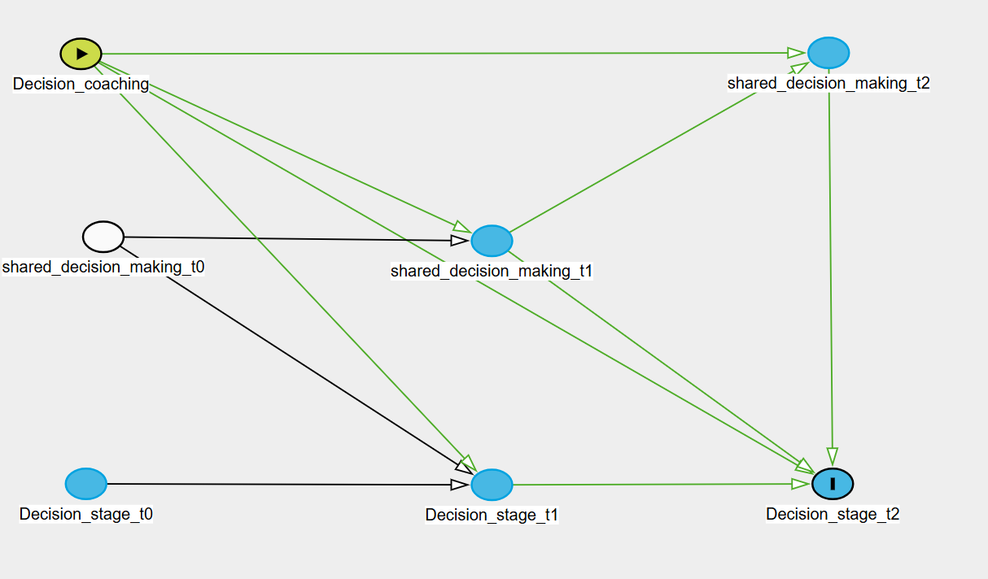
(Hybrid) Cross-lagged panel Model (CLMP) – Directed Acyclic Graph
Mediation effect of 25% via Shared-decision making on –decision stage t2
CLMP enables to estimate the interventional effects for t2 adjusted for reverse causality in t1 and t0
Model fit (CFI = 0.973; TLI = 0.927;)
Own illustration: DAG at the interventional level
n= 315
Notes:
Intervention t0 verläuft über den Mediator von t1 und t2 zu Outcome Entscheidungsfindung t2
Operationalisierung im hybriden Cross-lagged-panel Modell
Hybrid, weil Mediator-Outcome t0, und Mediator-Outcome t1 ko-variieren
Tests zu
Tests u. Sensitivitätsanalysen:
Tests zur Randomisierung
Indirekter Effekt (.08) signifikant (.006), Std. Err. (.029), Z-Wert (2.74) Konfidenzintervall (95%) zwischen .023 - .137
Keine x-m- Interaktion
Mögliche Confounder zwischen M-Y
Stichprobe von n= 315 limitiert noch differenziertere Modellierung
Erwartungen an die Wirkung des Mechanismus noch zu ungenau:
Ist es intendiert, dass der durchschnittliche Interventionseffekt zu 25% über die Arzt-Patienten-Beziehung verläuft? Höher oder niedriger?
Mittelwertvergleiche von Baselinekriterien der wesentlichen Variablen des CLMP, und Confounder: Zeitpunkt der Genbefundmitteilung; Offenheit für Behandlungsoptionen nach Genbefundmitteilung; Zeit zwischen Genbefundmitteilung und Intervention; Confounder X-Y: Alter: mit dem Alter steigt das Risiko für Brust- und Eierstockskrebs, damit der Entscheidungsdruck; stärkere Motivation zu partizipieren; Familienwunsch bei jüngeren Frauen.

Slide 10
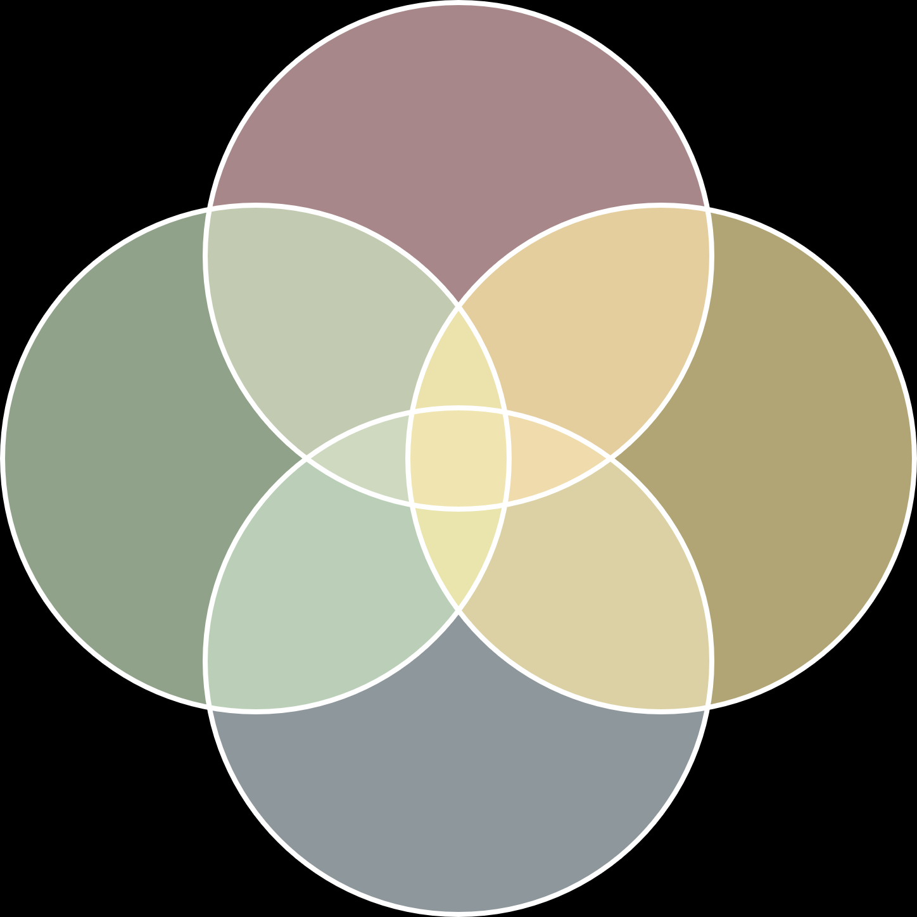
Does the importance of context in implementation imply that generalizing about the effects of
strategies is ultimately limited? (Geng et al. 2025) – Take home messages for mechanism research
Mechanism research requires in-depth qualitative context assessment via process evaluation
Aim: Generate socially meaningful findings and translate it for quantitative modeling
Test mechanisms via quantitative mediation analysis approaches
Use realist and SEM approaches
If proving the functionality of mechanisms becomes a central task in implementation research, generating robust evidence is possible
Stand-alone projects are not sufficient to gain robust insights into mechanisms
How do you use theories?
Generating theories
Testing theories
The methods
needed
MECHANISM
Implementation science scope
Realism
Positivism
What evidence level can you reach?

Slide 11


Thank you for your attention!
Sara Söling
Dip.Soc.Sci, M.Sc. (PH), PhD
Center for Health Economics and Health Services Research, University Wuppertal
soeling@wiwi.uni-wuppertal.de

Slide 12
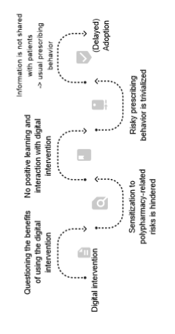
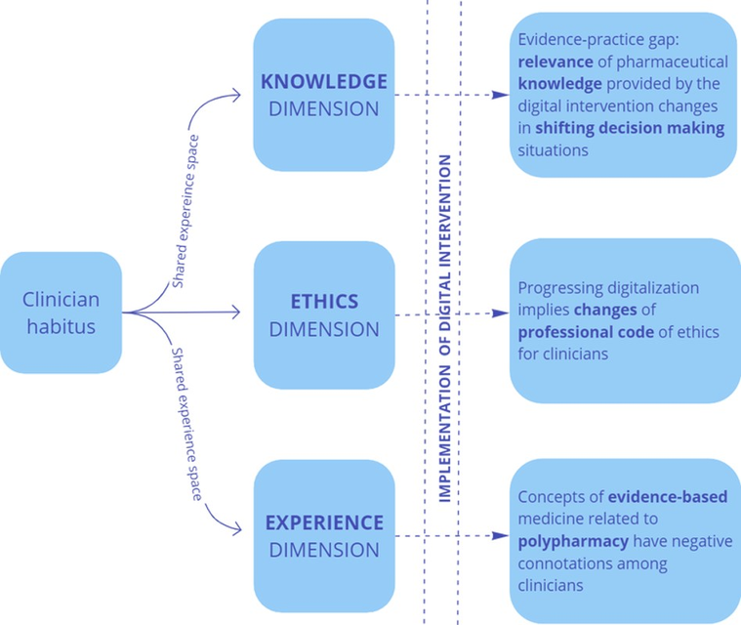
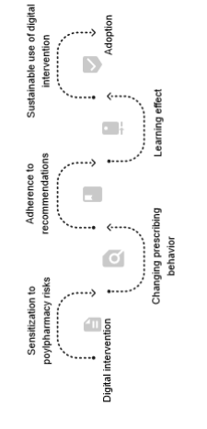
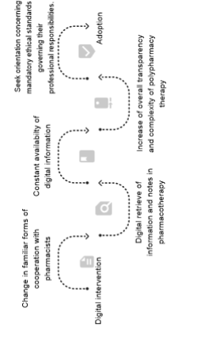







Qualitative process-oriented model of implementation pathways
Individual level
Health Care delivery
Social level
Moderating
context factors
Adoption
Seek orientation concerning
mandatory ethical standards governing their
professional responsibilities.
Adoption
(Delayed)
Adoption
Sustainable use of digital intervention
Information is not shared with patients
-> usual prescribing behavior
Increase of overall transparency and complexity of polypharmacy therapy
Learning effect
Risky prescribing behavior is trivialized
Pathways towards adoption
Constant availabilty of digital information
No positive learning and interaction with digital intervention
Adherence to recommendations
Digital retrieve of information and notes in pharmacotherapy
Sensitization to polypharmacy-related risks is hindered
Changing prescribing behavior
Change in familiar forms of cooperation with pharmacists
Questioning the benefits of using the digital intervention
Sensitization to poylpharmacy risks
Digital intervention
Digital intervention
Digital intervention
Complexity
Continuum of physicians behavioral intention = ADOPTION heterogeneity
CONTENT ANALYSIS
DOCUMENTARY METHOD
Söling, et al. (2020): "From sensitization to adoption? A qualitative study of the implementation of a digitally supported intervention for clinical decision making in polypharmacy." Implementation Science 15 (2020): 1-12.

Slide 13
Theoretical approaches used in implementation science
Describing and/or guiding the process of translating
research into practice
Understanding and/or explaining what influences
implementation outcomes
Evaluating implementation
Process models
Determinant
frameworks
Classic
theories
Implementation theories
Evaluation frameworks
Consolidated framework for implementation research (CFIR)
Technology acceptance model (TAM); Habitus theory; Evidence-based decision making model
Implementation leadership; Organizational readiness for implementing change
Medical research council (MRC) framework for process evaluation of complex interventions;
Realist evaluation frameworks
Applied theories, models and frameworks in thesis
Note: Own illustration based on Nilsen (2005; frame with dashed lines); applied theories in project in blue circled boxes

Slide 14
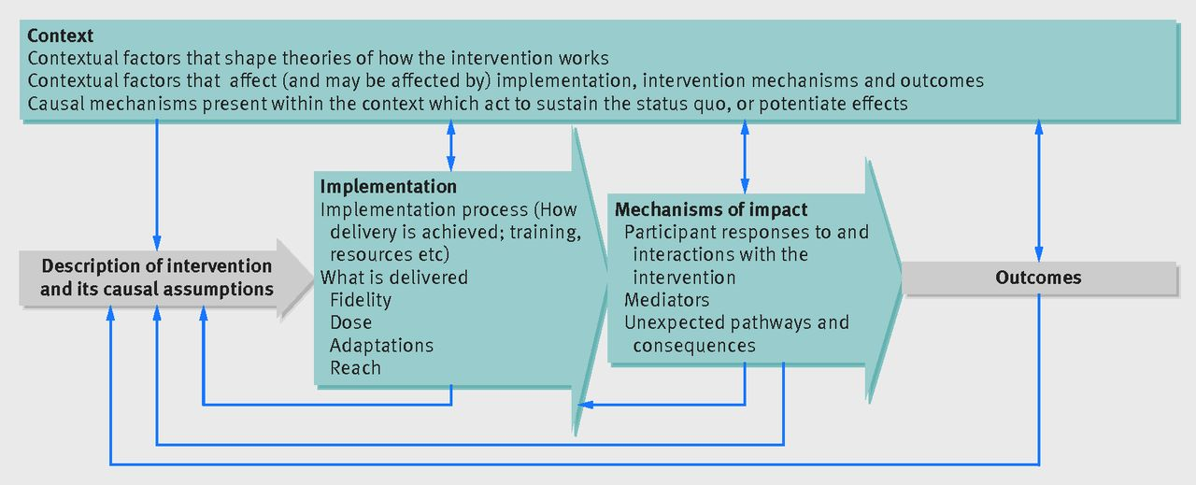

How did I get interested in research questions about (implementation) mechanisms in social systems?
Moore, Graham F., et al. "Process evaluation of complex interventions: Medical Research Council guidance." bmj 350 (2015; updated 2021)

Slide 15
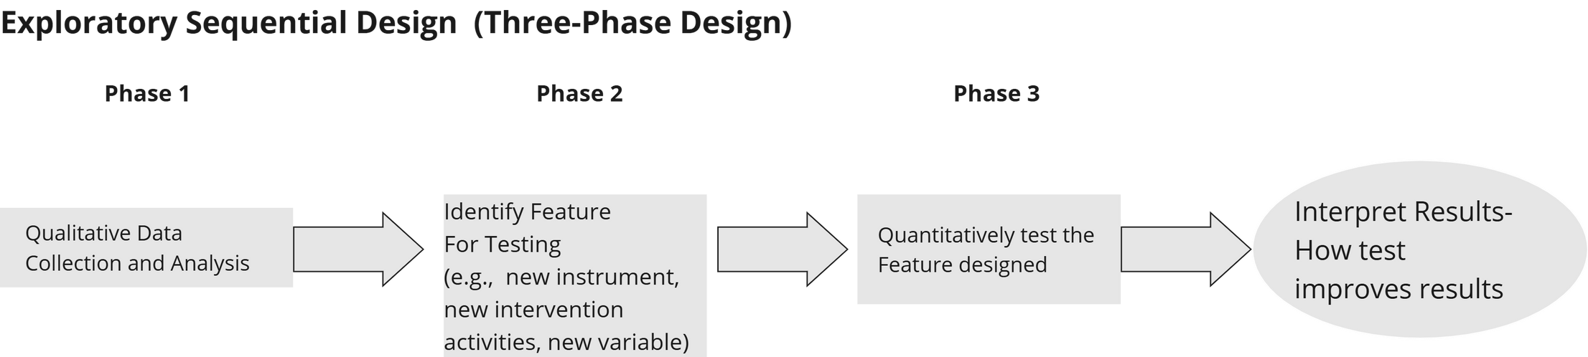

Study design for mechanisms research alongside clinical trial
&
Intersecting mixed methods within a theoretical framework
Implementation Science
Contextual
Evidence
Process Evaluation
8

Slide 16


Building support for schools that implement curriculum designed for students personal and social development
Dinka Caha & Mateja Marić
Josip Juraj Strossmayer University of Osijek, Faculty of Law Osijek, Croatia
dcaha@pravos.hr, mateja.maric@pravos.hr
Newcastle upon Tyne, 6 June 2025

Slide 17
Theoretical background
Integrated-promoting action on research implementation in health services framework
Proctor’s implementation outcome framework
Normalization process theory

Slide 18
Research objective
To examine the mechanisms that facilitate the implementation of the curriculum in Croatian high schools.
To analyze the mediating role of normalization in the relationship between organizational-level determinants and curriculum feasibility.
To investigate whether the relationship between organizational-level determinants and curriculum feasibility depends on the type of professionals delivering the curriculum.

Slide 19
Research objective
WP
Normalization
Organizational culture
Feasibility

Slide 20
Method
Mixed method implementation study
N = 338 Croatian high school teachers and support professionals
Online survey
ORCA culture dimension (Organizational Readiness to Change Assessment); subscales: leader culture, staff culture, leadership behavior, measurement, opinion leaders and resources.
NoMAD (Normalization Measure Development)
FIM (Feasibility of Intervention Measure)

Slide 21
Key findings
The normalization process fully mediated the relationship between four of the six organizational-level determinants (leadership culture, school staff culture, opinion leaders, and resources) and feasibility.
The normalization process positively relates to higher levels of feasibility.

Slide 22
H1: Mediation hypotesis
Normalization
Leadership culture .64***
Staff culture . 27***
Opnion leaders .12**
Resources .30***
.56***
Organizational culture
Feasibility
Leadership culture .19**
Staff culture . 15***
Opinion leaders .07*
Resources .17***

Slide 23
Key findings
The workplace fully moderated the mediation mechanism between school staff culture and the normalization process, as well as school staff culture and feasibility.
The mediated effect was significantly stronger for support professionals than for teachers.
The interaction between the workplace and the normalization process in predicting feasibility was not statistically significant.

Slide 24
H2: Mediated moderation model
Workplace
Normalization
-.20***
-.40
-.20**
Organizational culture (staff culture)
.33
Feasibility
.17***
School professionals β= .31*** vs. Teachers β=. 33

Slide 25
H2: Mediated moderation model
Workplace
Normalization
-.20***
-.40
-.20**
Organizational culture
(staff culture)
.33
Feasibility
.17***
Full model effects (SC:WP FIM) for school professionals explained 33,9% (p < .001) of the model variance. Total effects (direct effects) explained 24,2% variation.

Slide 26
Conclusions
Effective normalization and feasibility of the school curriculum requires embedding it in an internal culture that promotes shared responsibility, collaboration, and openness to change.
To uptake the intervention within everyday school practice it is important to strengthen leadership and staff commitment, especially among support professionals, while ensuring adequate resources.

Slide 27
Discussion
Why is it that leadership behavior and measurement did not exhibit a significant mediating effect on the feasibility through the normalization process?
What implementation strategies can help foster understanding and trust between professionals (to further the normalization and openness toward intervention delivery)?

Slide 28
References
Batterham, P., Allenhof, C., Cerga Pashoja, A., Etzelmueller, A., Fanaj, N., Finch, T., ... & Vis, C. (2024). Psychometric properties of two implementation measures: Normalization MeAsure Development questionnaire (NoMAD) and organizational readiness for implementing change (ORIC). Implementation research and practice, 5, 26334895241245448.
Duan, Y., Iaconi, A., Wang, J., Perez, J. S., Song, Y., Chamberlain, S. A., ... & Berta, W. (2022). Conceptual and relational advances of the PARIHS and i-PARIHS frameworks over the last decade: a critical interpretive synthesis. Implementation Science, 17(1), 78.
Finch, T.L., Girling, M., May, C.R., Mair, F.S., Murray, E., Treweek, S., Steen, I.N., McColl, E.M., Dickinson, C., Rapley, T. (2015). NoMAD: Implementation measure based on Normalization Process Theory. [Measurement instrument]. Retrieved from http://www.normalizationprocess.org.
Harvey, G., & Kitson, A. (2015). PARIHS revisited: from heuristic to integrated framework for the successful implementation of knowledge into practice. Implementation science, 11, 1-13.
Helfrich, C. D., Li, Y. F., Sharp, N. D., & Sales, A. E. (2009). Organizational readiness to change assessment (ORCA): Development of an instrument based on the Promoting Action on Research in Health Services (PARIHS) framework. Implementation science, 4, 1-13.
Murray, E., Treweek, S., Pope, C., MacFarlane, A., Ballini, L., Dowrick, C., ... & May, C. (2010). Normalisation process theory: a framework for developing, evaluating and implementing complex interventions. BMC medicine, 8, 1-11.
Schroeder, D., Luig, T., Finch, T. L., Beesoon, S., & Campbell-Scherer, D. L. (2022). Understanding implementation context and social processes through integrating Normalization Process Theory (NPT) and the Consolidated Framework for Implementation Research (CFIR). Implementation Science Communications, 3(1), 13.
Weiner, B. J., Lewis, C. C., Stanick, C., Powell, B. J., Dorsey, C. N., Clary, A. S., ... & Halko, H. (2017). Psychometric assessment of three newly developed implementation outcome measures. Implementation science, 12, 1-12.

Slide 29
Thank you for your attention.
dcaha@pravos.hr, mateja.maric@pravos.hr

Slide 30
Advancing our understanding of the complexity of implementation efforts Exploring implementation mechanisms of a multifaceted implementation strategy on fidelity to an evidence-based guideline for the prevention of mental ill health
Lydia Kwak, associate professor and senior lecturer
Intervention and Implementation Research for worker health, Institute of Environmental Medicine, Karolinska Institutet, Sweden

Slide 31



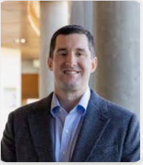





Lydia Kwak, KI
Anna Toropova, KI
Christina Björklund, KI
Project team
Byron Powell
Washington University
Andreas Rödlund, KI
Liselotte
Schäfer-
Elinder, KI
Rebecca Lengnick-Hall
Washington University
Irene Jensen, KI

Slide 32
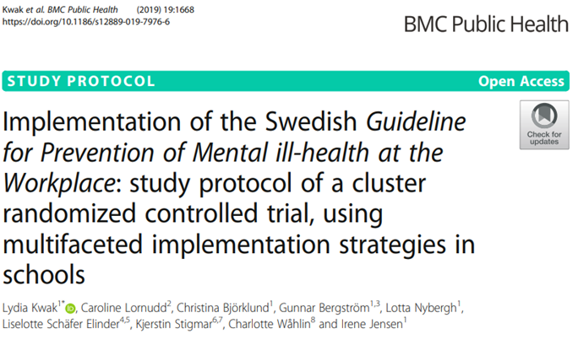
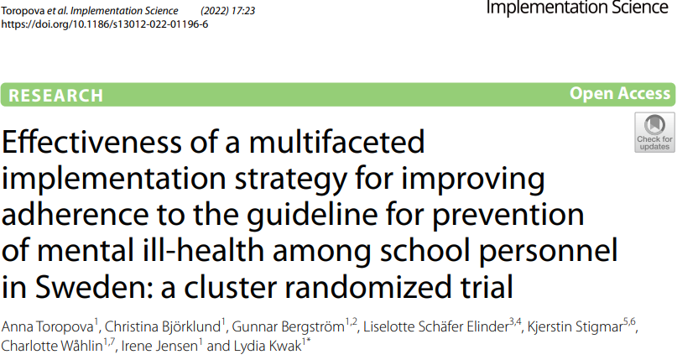
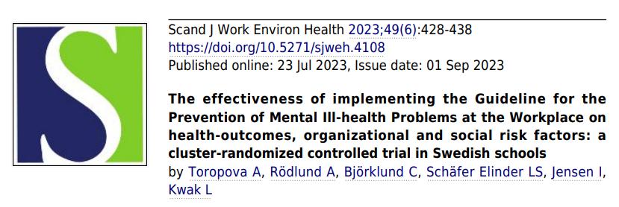
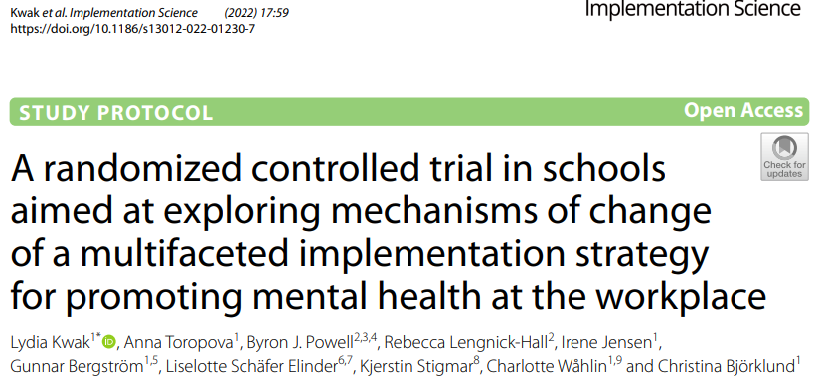
Background Trials’ problems and aims
Mental health problems are highly prevalent among teachers. Guidelines exist to support the prevention of mental health problems at the workplace. Schools seldomly work in accordance with these guidelines.
Trial 1: Test the effectiveness of a multifaceted strategy on fidelity to the guideline among 19 schools in Sweden
Positive trends in favour of multifaceted strategy
Guideline fidelity positively associated with improvements in health and work environment
Trial 2: Test the mechanisms of change of the multifaceted strategy among 58 schools in Sweden
To explore whether the effects of the implementation strategies on fidelity are mediated by capability, opportunity, and motivation.

Slide 33
Background Mechanisms of change
To better understand why and how strategies work, under what circumstances, and for whom, there is an interest in understanding the mechanisms of change of implementation strategies.
Systematic reviews show that evidence of strategies’ mechanisms is scarce.
Most studies are observational studies, and those studies with experimental designs are unable to confirm hypothesized mechanism.
Kim et al., 2024; Lewis et al. 2018, 2020; Williams, 2016

Slide 34
Methods Programme theory
Implementation Strategies
Health Outcome
Implementation Strategies
Hypothesized TDF mediators
Behavioural functions
Implementation Outcome
Train, Educate stakeholders - Conduct an educational meeting (15) - Conduct ongoing training in the form of workshops (19)
- Distribute educational materials (21)
Knowledge, Awareness
Guideline
fidelity
ERIC Cluster - Train, Educate stakeholders - Conduct an educational meeting (15) - Conduct ongoing training in the form of workshops (19)
- Distribute educational materials (21)
General Health, Stress
Skills
Capability
Behavioral regulation
Develop Stakeholder interrelationships - Organize implementation teams (48)
Social influences
Opportunity
ERIC Cluster - Develop Stakeholder interrelationships - Organize implementation teams (48)
Environmental context and resources
Social role and identify
Evaluate and iterative strategies - Conduct cyclical small tests of change (14)
Goals
ERIC Cluster - Evaluate and iterative strategies - Conduct cyclical small tests of change (14)
Beliefs about consequences
Motivation
Provide interactive assistance - Implementation facilitation (10)
Beliefs about capability
ERIC-Cluster - Provide interactive assistance - Implementation facilitation (10)
Intention
Kwak et al., 2022; Michie et al., 2011; Cane et al., 2012; Atkins et al., 2017
9 months
Notes:
We selected implementation strategies from existing compilations of implementation strategies, such as the Expert recommendations for implementing change taxonomy. We selected strategies from four different clusters of implementation strategies in their taxonomy, and operationalized them into concrete implementation strategies.

Slide 35
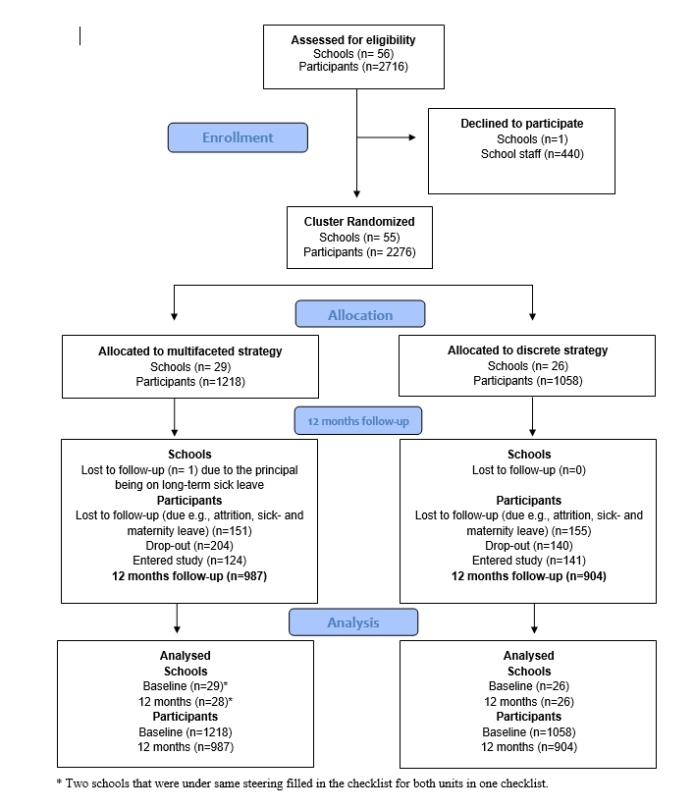
Methods Cluster-randomized controlled trial

Slide 36
Methods Implementation strategies
Implementation Strategies
ERIC Cluster - Train, Educate stakeholders - Conduct an educational meeting (15) - Conduct ongoing training in the form of workshops (19)
- Distribute educational materials (21)
Education Meeting
Workshop
1
Workshop 2
Workshop 3
Workshop 4
Workshop 5
ERIC Cluster - Develop Stakeholder interrelationships - Organize implementation teams (48)
Implementation Teams
ERIC Cluster - Evaluate and iterative strategies - Conduct cyclical small tests of change (14)
Cycles
Cycles
Cycles
Cycles
P
D
S
A
P
D
S
A
P
D
S
A
P
D
S
A
ERIC-Cluster - Provide interactive assistance - Implementation facilitation (10)
Internal Facilitator
Baseline
Kwak et al., Implementation Science 17; 59 (2022)
9 months
Notes:
As an additional strategy for the iskol plus trial, we employed a strategy of internal facilitator. This was based on findings from the process evaluation from the iskol study, where school that recieved the multifaceted strategy lacked support from the school district and the addition of this strategy would support and enable the implementation in the schools.
Just for clarification, this strategy were not included in the first trail.

Slide 37
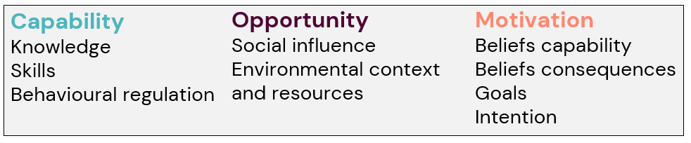
Methods Measurements
Mediators
n=220
Huijgh et al., 2014
Mediators
n=204
Mediators
n=180
Team level
12 months
Baseline
Staff level
Guideline fidelity
n=2776
Kwak et al. 2022
Guideline fidelity
n=1891
Kwak et al. 2022

Slide 38
Methods Statistical Analysis
Implementation Strategies
Implementation Outcome
ERIC Cluster - Train, Educate stakeholders - Conduct an educational meeting (15) - Conduct ongoing training in the form of workshops (19)
- Distribute educational materials (21)
Guideline fidelity
ERIC Cluster - Develop Stakeholder interrelationships - Organize implementation teams (48)
ERIC Cluster - Evaluate and iterative strategies - Conduct cyclical small tests of change (14)
Mediation analysis estimating the indirect effect of the strategy on fidelity through the hypothesized mediators was conducted using PROCESS Macro for SPSS.
The proportion-mediated statistics were calculated by dividing the indirect effect by the total effect.
ERIC-Cluster - Provide interactive assistance - Implementation facilitation (10)
Rödlund et al., Implementation Science – in publication
Notes:
In study 2, we assessed a pathway between implementation strategies and implementation outcome.

Slide 39
Results Absolute changes over time
MF group
DS group
Note * p<0.05, ** p<0.01

Slide 40
Results Guideline fidelity – aggregated at school level
 | T₀ (N= 2276) |  |  | T₄ (N= 1891)
 | Mean | SD |  | Mean | SD | B | 95% CI | p
Multifaceted group | 19.8 | 3.2 |  | 25.1 | 4.0 | 2.81 | 2.49 to 3.12 | <.001
Discrete group | 19.4 | 3.9 |  | 21.8 | 4.4
Rödlund et al., Implementation Science – in publication

Slide 41
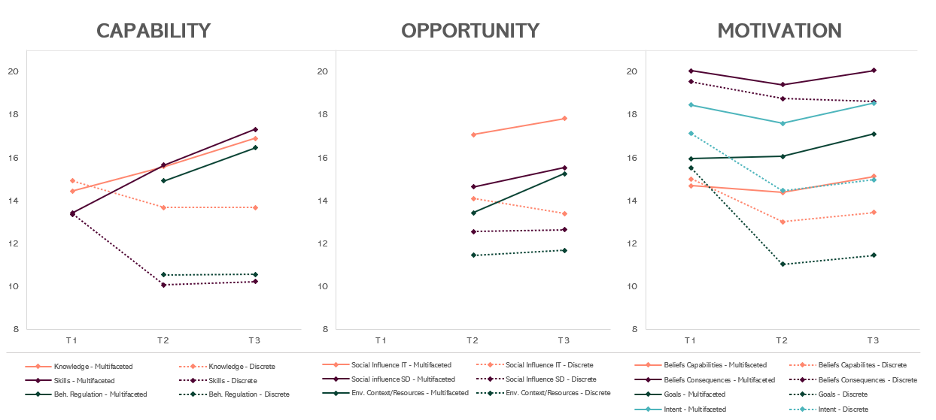
Results Changes over time
Rödlund et al., Implementation Science – in publication

Slide 42
Mediator | Average indirect effect (95 % CI) | Average direct effect (95 % CI) | Proportion mediated (%)
Capability
Knowledge | 0.81 (0.25 – 1.43) | 3.94 (2.52 – 5.36) | 17 %
Skills | 2.01 (0.73 – 3.37) | 2.78 (0.96 – 4.61) | 41 %
Beh. regulation | 1.69 (0.65 – 2.88) | 3.04 (1.43 – 4.64) | 35 %
Opportunity
Soc. Influence (IT) | 1.01 (0.20 – 1.86) | 3.71 (2.18 – 5.24) | 21 %
Soc. Influence (SD) | 0.74 (0.22 – 1.44) | 3.87 (2.49 – 5.26) | 16 %
Env. context/res | 0.97 (0.34 – 1.73) | 3.75 (2.33 – 5.17) | 20 %
Motivation
Beliefs Capabilities | 0.49 (0.12 – 1.05) | 4.26 (2.96 – 5.56) | 10 %
Beliefs Consequences | 0.35 (-0.06 – 0.77) | 4.31 (2.97 – 5.65) | 7 % *
Goals | 1.61 (0.62 – 2.68) | 3.07 (1.46 – 4.69) | 34 %
Intention | 0.94 (0.23 – 1.81) | 3.76 (2.30 – 5.23) | 19 %
Note: Coefficient = unstandardized Beta, * = not significant at p= 0.05, CI = 95 % Confidence Interval. Social influence was assessed from two perspectives; whether respondents perceived that they received support from the implementation team (IT) and whether they received support from the school district (SD).
Rödlund et al., Implementation Science – in publication

Slide 43

Conclusion
Multifaceted implementation strategy effective in improving fidelity to the guideline for the prevention of mental health problems in schools.
In line with the COM-B we can confirm that the strategy’s effectiveness is mediated through capability, opportunity and motivation and related TDF-mediators.
How can we optimize these strategies to be more tailored to school’s needs and to be more cost-effective?

Slide 44
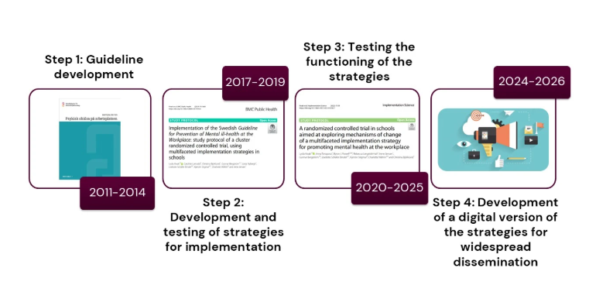
Scaling up for impact

Slide 45
Avslutningsbild med Karolinska Institutets logotyp

Slide 46
THANK YOU!
Questions & Discussion
Presentation 1: Alexandra Ziemann
Presentation 2: Sara Söling
Presentation 3: Dinka Caha
Presentation 4: Lydia Kwak
Session host: Thomas Engell
Thought-provoking presentations and interesting insights?
Spread the word and let us follow along by using #EIE2025!

