Slide 1


Ride the Knowledge Wave 11
NAVIGATING COMPLEXITY IN IMPLEMENTATION
Presentation 1: Peter van der Graaf
Presentation 2: Juul Tönis
Presentation 3: Leticia Bernués-Caudillo
Presentation 4: Anette Grønlie
Session host: Sven Geelen

Slide 2
Applying a complexity lens to policy implementation: how feedback loops help to understand systems change¹
Dr Peter van der Graaf, Associate Professor in Public Health, Northumbria University, UK, peter.graaf@northumbria.ac.uk; ‪@pvandergraaf.bsky.social‬
Dr. Andrew Passey, Embedded Senior Research Fellow, Leeds Beckett University, UK, A.C.Passey@leedsbeckett.ac.uk

Slide 3
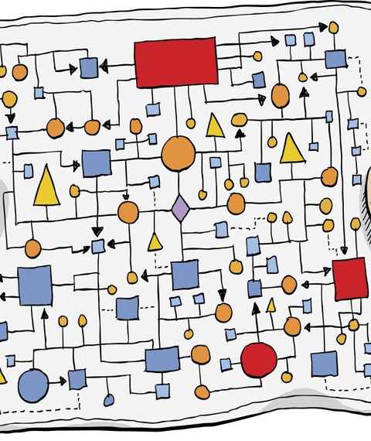
Why a complexity lens?
Implementation of health interventions is complex; ‘success’ requires loops of learning & adaptation to generate improved emergent outcomes [2]
Complexity lens: implementation as an ‘event in a system’ with dynamic interactions between policy interventions, stakeholders & systems [3]
However, application often remains metaphorical with lack of insight in practical application [4]
Notes:
Complex systems can self-adapt in non-linear, unpredictable ways. Small changes can have disproportionately large effects, while large changes can lead to minimal shifts

Slide 4
What is a complexity lens?
Concept | Sensitising definition
Adaptation | Response to the implementation by developing new processes and system patterns. E.g. setting up task groups, mapping existing services, designing new service pathways, and changing governance structures.
Feedback loops | Result of interactions between stakeholders, either negatively (diminishes/ balances out change taking place) or positively (reinforces/ promotes) other activities in system.
Emergence | System level changes from local-level interactions between stakeholders. E.g. school responses to mental health issues, and new ways of working in schools.
Co-evolution | New links between stakeholders, practices and values emerging across system boundaries as a result of cross-system interactions. E.g. school and CAMHS staff subscribed to joint values about mental health being everybody’s business, giving them a deeper mutual understanding.

Slide 5

What did we do?
Reanalyse interview data from UK case study: local implementation of national policy (Future in Mind; FiM)
Stratified purposive sample of staff from local government, National Health Service/ mental health, schools, and third sector (n=31)
Re-coded interview data in NVivo12 on cross-organisation working, workforce development, and sustainability, using complexity concepts as sensitising constructs

Slide 6

Case study: Future in Mind
Increased prevalence of mental health issues among children and young people, outstripping provision of fragmented services
2016: UK Government introduced national policy to improve school children’s access to mental health services [5]
National policy was loosely defined and non-prescriptive: space for adaptation based on local factors
Local authority in northern England (population between 250,000–500,000) in quartile of most deprived areas
Created a new multi-organisation partnership of local health commissioners, service providers, local government services, and third sector organisations
Notes:
Specific local factors in study Borough?

Slide 7
Findings
Notes:
five feedback loops: 1. flexing the training offer; 2. new skills, knowledge and behaviour by non-specialist staff; 3. short-termism, 4. free rider behaviour; 5. professional boundaries. These energised local adaptations of FiM by school and NHS staff, leading to system-level change (emergence), with the school system becoming more responsive to mental well-being needs of children and young people and shifts across systems (co-evolution) by developing joint values and language between schools and NHS.
Example 1 (positive feedback loop). F2 New skills, knowledge and behaviour by non-specialist staff
System became more responsive to the mental wellbeing needs of children and young people (emergent property E1). Teachers were less anxious labelling behaviour of children as a mental health issue, a change in their language that pointed to co-evolution between systems (C2). Co-evolution between the mental health and school-based education systems (C1) as school and CAMHS staff subscribed to joint values about mental health being everybody’s business, giving them a deeper mutual understanding.
Example 2 (negative feedback loop). F3 Short-termism
The potential for the system to become more responsive to the mental wellbeing needs of children and young people (emergent property E1) was constrained by the limited time that mental health and VCS practitioners were able to spend in schools and with individual or groups of children and young people. This negative feedback was underscored by structural conditions: the urgent need to respond to the ‘policy problem’, the fixed-term nature of FiM funding and shifting policy/funding attention.

Slide 8

Conclusions
Importance of positive and negative feedback loops for evidencing system-level change and shifts across systems
Complexity lens provides insights into unintended consequences of policy implementation
Identify and evaluate feedback loops while implementing health policy, adjusting in response to emerging properties and co-evolution processes at system level (Complexification)
Need for blurring of boundaries between implementation and evaluation in policy research to optimise the use of feedback
Notes:
opening-up the complex dynamics of policy implementation
bringing together an orientation towards complexity-informed research and a developmental evaluation approach

Slide 9

Discussion questions
How would you identify and evaluate feedback loops while implementing public policy?
How can we maximise positive feedback, while minimising negative feedback as the policy intervention plays out?
Notes:
(and adjust this policy in response to emerging properties and co-evolution processes at the system level?)

Slide 10
References
[1] Passey A, Van der Graaf P. (in print) Applying a complexity lens to policy implementation: how feedback loops help to understand systems change in integrated healthcare. BMJ Open Quality.
[2] Castelnovo W, Sorrentino M. Public Sector Reform Trajectories: A Complexity-embracing Perspective. Public Money & Management. 2024;44:2,165-173, doi:10.1080/09540962.2022.2117894.
[3] Skivington K, Matthews L, Simpson SA, Craig P, Baird J, Blazeby JM, Boyd KA. et al. Framework for the Development and Evaluation of Complex Interventions: Gap Analysis, Workshop and Consultation-informed Update. Health Technol Assess. 2021;25(57).
[4] Walton M, Gates EF, Vidueira P. Insights and future directions for systems and complexity-informed evaluation. In Systems and Complexity-Informed Evaluation: Insights from Practice. New Directions for Evaluation, edited by Gates EF, Walton M, Vidueira P. 2021;159–171. doi:10.1002/ev.20459.
[5] Department of Health. Future in Mind. 2015; https://assets.publishing.service.gov.uk/government/uploads/system/uploads/attachment_data/file/414024/Childrens_Mental_Health.pdf.

Slide 11
Thank you!
Any questions?

Slide 12

Implementation of Advance Care Planning across Multiple Health Care Organisations using Local Transdisciplinary Working Groups: Identifying Challenges
European Implementation event 2025
Authors: Juul Tönis, Annicka van der Plas, Marjon van Rijn, Eva Bolt, Bregje Onwuteaka-Philipsen

Slide 13
Implementation of collaboration working agreements on Advance Care Planning (ACP)
What?
‘Advance care planning enables individuals to define goals and preferences for future medical treatment and care, to discuss these goals and preferences with family and healthcare providers, and to record and review these preferences if appropriate.’ (Rietjens et al, 2018)
Why?
ACP leads to improved care
National guideline ACP
Importance of collaboration
Not implemented

Slide 14
Project design
Collaboration between healthcare organisations (primary, secondary)
and / or social services
Local working groups:
designing, implementing and sustaining working agreements
Supported by steering committee, advising expert group
& community of practice

Slide 15
Research
Research aim:
Identify barriers and facilitators for successfully designing working agreements
Research method:
Observations systematically recorded
25 meetings of working groups
26 preparatory meetings
Logbooks were coded using CFIR model
EIE 2025| 06-06-2025

Slide 16
Progress so far
Formation of working groups delayed
One working group recently withdrew
Working groups part of other projects
Slow progress in the establishment of working agreements
One working group started implementation
EIE 2025| 06-06-2025

Slide 17
CFIR model
Outer setting
Regional, other regions, national policy
Implementation
Process
Local working groups
Inner setting
Pilot area / organisations
Innovation
Working agreements ACP
Individuals
Working group members
EIE 2025| 06-06-2025

Slide 18
Preliminary results – Outer setting
+ Time and effort in collecting and assessing existing ACP materials and mapping current practices
+/- Connecting to other ACP projects/initiatives
- Fragmented healthcare landscape
Notes:
Voor in spreek tekst:
Kans op sustainment is groter, maar levert ook gedoe/vertraging bij ‘connecting to other ACP projects/initiatives

Slide 19
Preliminary results – Inner setting
Limited progress in implementation in inner setting so far
- Blind spot of working group to engage selected organisations and their stakeholders
Notes:
Overall niet te lang bij stil staan, kort benoemen dat we eigenlijk nog niet zover zijn.
Verschillende niveaus binnen organisaties

Slide 20
Preliminary results – Individuals
+ Consensus among professionals about importance ACP
- Limited knowledge of implementation among working group members
- Limited time in agenda of working group members
EIE 2025| 06-06-2025

Slide 21
Preliminary results – Implementation process
+ A lot of stakeholders are represented in the working groups
+ Attention to implementation in small steps, within local context and considering necessary preconditions
+/- Working in subgroups
+/- Involvement of patient representatives
+/- Role of (local) projectleader
EIE 2025| 06-06-2025

Slide 22
Preliminary results – Implementation process (2)
- Limited decision-making authority within the working groups
- Limited use of tools
- Some topics were not discussed in the working group
EIE 2025| 06-06-2025

Slide 23
Preliminary results – Innovation
+ Focus on using existing or used interventions and materials
+ Target group is determined
+ Implementation plans defined for ACP preconditions
e.g. public awareness and capacity building
- Complex intervention
- Differences between settings
- Electronic data transfer
EIE 2025| 06-06-2025
Notes:
Settings: between healthcare settings and between healthcare and welfare

Slide 24
Main insights regarding designing phase
Successes
Individuals involved
Innovation domain
Challenges
Outer setting
Implementation process
Innovation domain

Slide 25
Discussion questions
How can we effectively support working groups in designing an implementation plan, while ensuring that the responsibility for its content and execution remains within the working groups?
What is a good balance between being an observing and supporting researcher and participating or even leading in the making of the plans?
2. How can a feasible implementation plan for a collaborative working
method be developed in a fragmented and overburdened healthcare landscape?

Slide 26
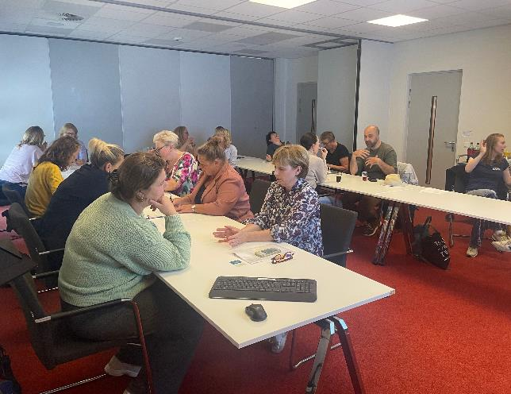
Thank you
Contact?
j.j.tonis@amsterdamumc.nl

Slide 27


Balancing Acts: navigating flexibility and complexity in implementing a parent training intervention across diverse local contexts
Anette Arnesen Grønlie¹, Agathe Backer-Grøndahl¹, Ragnhild Bang Nes², Truls Tømmerås¹
¹Norwegian Center for Child Behavioral Development, ²Promenta Research Center, Department of Psychology, University of Oslo, Norway

Slide 28
BACKGROUND: INTERVENTION
Around 7 % of children (4-14 years) have symptoms consistent with a mental disorder
Signs of internalizing and externalizing problems often appear early in life and are related to increased risk of negative consequences in adulthood
Complex problems and comorbidity is common, yet most EBIs do not target both internalizing and externalizing issues
(Bakken, 2022; Caspi et al., 2020; Kozák et al., 2023; Plana-Ripoll et al., 2019; Reneflot et al., 2018; Vergunst et al., 2023; Weisz et al., 2017)
Notes:
Mental distress among children and youth is common and increasing (2010-2022)
Prevalence data from Norwegian studies show that around 7% of children have symptoms that would classify as a mental disorder, at the time of examination. Comparable to other European countries (while some show higher).
Number of children and youth with sub-clinical symptoms are higher
--- Many children who display symptoms of one problem area (i.e., anxiety), also display symptoms in other problem areas (depression or behavioral problems); however, most EBIs are directed towards singular problem areas, thus they are only treated for part of their problems.

Slide 29
BACKGROUND: IMPLEMENTATION
Greater emphasis on prevention and early intervention, along with an increased responsibility placed on primary care services
Vulnerable target group: rejected by Child and Adolescent Mental Health Clinics → sent back to the municipality → treated for parts of their problems - or not at all
(Aase et al., 2020; Christiansen, 2015)
Notes:
Recent change in policy and legislation where municipalities are getting increased responsibility for child welfare services, in particular prevention and early intervention.
The children do not have «severe enough» problems to receive help in child and adolescent mental health clinics, so the municipalities are responsible for helping them.
Municipalities report not having EBIs for the target group.
There is an outspoken need for preventive interventions for the target group in primary services in Norway.

Slide 30


AIMS OF Supportive Parents - Coping Kids (SPARCK):
Effective and flexible parent training intervention aimed at children (4 - 12 years) showing early signs of internalizing and/or externalizing mental health problems
Acceptable, appropriate, and feasible intervention tailored to clients’ and stakeholders’ needs and contexts, to support implementation and sustainment in primary care services
(Curran et al., 2012; 2022; Lyon & Koerner, 2016)
Notes:
To try to answer some of these issues, the SPARCK intervention was born.
To achieve more rapid translation into practice field, there should be a focus on implementation from the earliest stages of intervention development
Dual focus of the project: 1) Develop a parent training program for parents of children with elevated, yet subclinical levels of internalizing symptoms (anxiety, depression and withdrawal) and/or externalizing symptoms (conduct problems, cooperation challenges).
2) The second aim: implementation, (focus in phd), how to make SPARCK acceptable, appropriate, feasible, and sustainable over time, to reach a large group of children, tailored to Norwegian primary care services.

Slide 31

Preparation
Optimization
Evaluation
RCT & implementation study (2023-2027)
Contextual analysis (2022)
SCED, cycle 2 (2021)
SCED, cycle 1 (2020)
29
14
Pilot (2019)
14
Design & development (2017-2019)
3
Analysis, co-creation & optimization
(Collins & Kugler, 2018; Lyon & Koerner, 2016; Mielke et al., 2019; Schindler et al., 2017; Stange & Glasgow, 2013)
Notes:
We designed a prototype of the intervention which was piloted with 3 families in 2019.
After refinement of the intervention, the 7 municipalties and 14 practitioners were recruited and trained. 14 families in each cycle.
Co-creation – testing – refinement – co-creation – testing – refinement - testing what is working and NOT working.
SCED design tested individual intervention effects: randomized multiple baseline. We got qualitative feedback from stakeholders to identify what content and implementation strategies that worked or not according to needs of users and constraints within the service system. (Clinicial supervision feedback, Co-creation seminars, NCCBD core-group meetings (researchers & clinicians))
--
The contextual analysis (implementation study) conducted during the first two design/redesign cycles of the intervention, were used to inform and adapt the SPARCK and imp strategies and was used as a seque to an ongoing RCT/implementation study.
Results were used both specifically to inform adaptation, and now we are analyzing the data doing a thematic analysis, where we are interested in more latent themes and mechanisms.

Slide 32
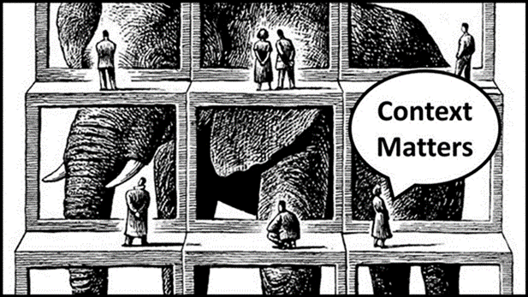
CONTEXTUAL Analysis
Inform development and adaptation of intervention
Inform choice and adaptation of implementation strategies
Understand and interpret clinical and implementation outcomes
→ Inform research design in subsequent hybrid effectiveness and implementation study
(Curran et al., 2012; 2022; Mielke et al., 2019; Stange & Glasgow, 2013)
Notes:
There’s an expressed need to move beyond identification of barriers and facilitators, and be part of something bigger (such as RCT) or identification of mechanisms.
I am going to talk about the contextual analysis we are doing now.
We used the analysis to
Inform choice, adaptation and deployment of implementation strategies in the ongoing RCT/imp study and
Will be used to contribute to understand and interpret outcomes in that study.

Slide 33
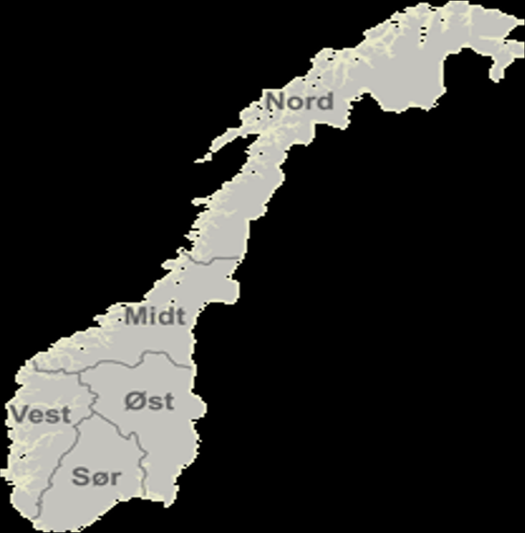







SPARCK Contextual analysis
RQ: What are the facilitators and barriers to successful implementation of SPARCK?
Design: qualitative; semi-structured interviews
Respondents: SPARCK practitioners (14) and leaders (15) in 7 municipalities
TMF: CFIR was used to develop interview guides, analysis and reporting
Methodology:
Reflexive Thematic Analysis
Inductive coding, followed by deductive mapping onto CFIR 2.0
Consensual Qualitative Research to describe themes’ representativeness across dataset
Interested in: a) practical and applied findings b) more latent and theoretical
(Braun & Clark, 2019; 2020; 2021; Damschroder et al., 2009; 2022; Fryer, 2022; Hill et al., 1997; 2005)​
Notes:
2) Which implementation strategies should be used to overcome the barriers and strengthen the facilitators, to promote long-term sustainability of SPARCK in the primary care services?
The goal is to understand the underlying themes of barriers and facilitators, to better be able to address and overcome them, and optimize the intervention and implementation strategies.
(Theme interview guides: organization, recruitment, target group, needs in municipality, views on SPARCK, training and supervision, feasibility, approprieness, acceptability, relevance. Open ended, with cues.)
To explore the multilevel nature of determinants of implementation and theorizing about underlying themes which may be transferable to similar contexts, Thematic Analysis is chosen. The RTA goes beyond the semantically obvious, into the mechanisms and latent themes and emphasizes the researcher’s active role in analyzing the data and theme production. Both are important and serve different purposes. A mix of inductive and deductive coding was used. Inductive was used in the initial steps of coding, as we wanted to be open to potential idiosyncratic barriers and facilitators that may help refine the intervention and implementation strategies, have direct relevance for our target group and setting and preparation for the consecutive effectiveness-implementation study. Hence, we were both interested in practical and applied findings, as well as more latent and theoretical.

Slide 34
DEMOGRAPHICS
 | n | % | M (SD) / range
Gender
Female | 24 | 82.8
Male | 5 | 17.2
Age (years) |  |  | 49.2 (8.2) / 32 - 65
Role
SPARCK practitioner | 14 | 48.3
Leader | 15 | 51.7
Service setting
Child Welfare | 9 | 31.0
Interdisciplinary | 8 | 27.6
Health | 4 | 13.8
Edu./Psych. Counseling | 4 | 13.8
Other (e.g. school, kindergarten, special edu.) | 4 | 13.8

Slide 35
I. INNOVATION DOMAIN – EXAMPLE CODING PROCESS
Determinant type
Facilitator
Barrier
Our codes
Flexibility (adaptation to families)
Complexity
Representativeness
Typical
Typical
Variant
Dose (# of sessions)
Dose (# of sessions)
CFIR construct
Innovation Adaptability
Innovation Complexity
Innovation Complexity
Innovation Complexity
Theme
Balancing flexibility with complexity
(Braun & Clark, 2019; 2020; 2021; Damschroder et al., 2009; 2022; Hill et al., 1997; 2005)​
Notes:
Example of how the data led to this theme: start left side (other domains, inner setting and individuals, show this as an example)
Facilitators / Flexibility: all practitioners, half the leaders Facilitators / Dose: most leaders, 1/3 practitioners Barriers / complexity: most practitioners, less than 1/3 leaders
A typical barrier, were that practitioners view the innovation as complex. It being flexible, means that it has many moving parts.
Leaders think that dose no of sessions (12) is feasible and a good thing, while variant practitioners think that it is too few.

Slide 36
THEMES
1. Meeting the need. There is a clear need for an intervention like SPARCK in Norwegian municipalities, voiced at multiple levels.
2. Confidence in SPARCK. Acceptance for and belief in the intervention, trust in theoretical underpinning and positive experiences and results.
3. Balancing flexibility with complexity. Adaptability to families and services are key strengths, however, fosters complexity. Increases need for structured support.
4. Navigating resource constraints. Prioritization and competition among projects in municipalities, combined with lack of resources. Promote SPARCK and results to get leader support and buy-in.
Notes:
Now, look into specific themes and more latent, underlying, themes.
Need for SPARCK – A shared need identified both at the municipal level and among families; this was the only point of full consensus.
Belief in the intervention – Stakeholders expressed confidence in the intervention’s relevance and potential.
Adaptability is valuable – Flexibility is viewed positively, but it also introduces complexity and increases the need for support.
Lack of resources and competing demands – Limited resources and competition between interventions, projects, and statutory obligations were noted as challenges. Differences between services (e.g., health vs. child welfare) were also highlighted.
Focus on theme 3
Flexibility: The intervention allows for adaptation to the presenting problem (rather than to the local context). This enables practitioners to focus on what matters most early on, which can foster motivation. The availability of “recommended pathways” and the option to include the child in the process are seen as positive features.
Complexity: The problems addressed are perceived as complex. When there are many options for adaptation, advisors may feel uncertain about how to proceed, and dilemmas can arise. This can place high demands on the advisors’ level of competence.

Slide 37
Mapped onto CFIR
II. Outer setting
III. Inner setting
IV. Individuals
V. Implementation
Process
I. Innovation
Theme 3: balancing flexibility with complexity
Theme 3: balancing flexibility with complexity
(Adapted from Damschroder et al., 2022)
Notes:
The theme covered mostly, Innovation and Individuals domain, and Inner Setting.
Show example of quote on Innovation and Individuals domain:

Slide 38
Theme 3: Balancing flexibility with complexity
«…what I appreciated was the flexibility it gave us […] we were offered a suggested package, but there was still room to make some decisions along the way about how to put things together. Of course, we’re in a luxury situation now, as we have psychological supervision for both debriefing and preparation for each session, every session. That’s not typically the case – usually, you have to make those decisions on your own.» (Practitioner 17)
Notes:
Most of the input regarding the flexibility of the intervention in relation to families came from the SPARCK practitioners.

Slide 39
BALANCING FLEXIBILITY WITH COMPLEXITY
The intervention’s adaptability was highlighted as a key strength, addressing the unique needs of families…
…but it introduced complexity, as it required high levels of therapeutic skills.
Fostered the need for ongoing supervision to maintain fidelity.
Notes:
Families express the need for a flexible intervention like SPARCK, through practitioners.
Typical barriers include the practitioners opportunity and capacity to have time to give 12 sessions to one family, as well as engage in clinical supervision. Easier for the practitioners in child welfare service, than mental health services (used to work group based and more universal)
Also, practitioners feel that the interverntion requires extensive competence, therapeutic prosess skills. Knowledge and skilled use of STM, and (general) intrapersonal / therapeutical competence is important.
This flexibility introduced complexity, as it required practitioners to tailor the intervention through nuanced adjustments, demanding advanced therapeutic skills and increased the need for supervision to maintain fidelity.

Slide 40
Mapped onto CFIR
II. Outer setting
III. Inner setting
IV. Individuals
Theme 3: balancing flexibility with complexity
V. Implementation
Process
I. Innovation
Theme 3: balancing flexibility with complexity
(Adapted from Damschroder et al., 2022)
Notes:
Show example of quote that covers the theme on the Inner Setting / Innovation domain:

Slide 41
Theme 3: Balancing flexibility with complexity
«In the health care sector, they will panic when they see the number of sessions [up to 12] – they will pull out. Because they approach it from a group-level perspective, right? They think in terms of groups, how many they can reach, and feel there’s too much focus on a single child.» (Leader 3)
Notes:
Leaders also emphasized the importance of flexibility, but highlighted complexity in a broader sense—particularly in relation to dose, referring to the number and frequency of sessions.
There are notable differences across services in how they are organized. In this study, we primarily included therapists employed in either the health or child welfare sectors. Perspectives vary regarding where the intervention fits best and who should be responsible for delivering it.
Within the health services, some argue for changes to the delivery format and dosage—for example, offering the intervention in a group format or reducing the number of sessions. In contrast, within child welfare services, there is often a preference to extend the intervention beyond the standard 12 sessions.

Slide 42
BALANCING FLEXIBILITY WITH COMPLEXITY
At service level, adaptability enabled alignment with the diversity of contexts and various target groups.
However, better fit with some services than others, where some services would benefit from more adaptability in format and dosage. Challenges sustainability.
Key finding: Be aware of this tension. Tailor implementation strategies accordingly.
Notes:
At the service level, flexible dosage, format, and delivery was critical but challenged sustainability.

Slide 43

IMPLEMENTATION STRATEGIES TO navigatE the complexity
Co-creation and user-centered design
Qual → Quan
Contextual analysis helped «tidy the mess»
Informed our understanding and helped us navigate the stakeholders’ context and what they view as complex (with intervention, their inner setting, and individuals’ opportunities, capacities and needs)
Adapt intervention and implementation strategies, used as a segue to a subsequent and ongoing hybrid RCT / implementation study
Notes:
First pragmatic (get the intervention done), then scientific rigor (articles)
Balancing scientific rigor and real-world pragmatism? Not one answer…For us, we took the time to co-create with stakeholders, analyzed context, adapted, refined and tried to make it pragmatic
These findings emphasize the need to balance adaptability with structure to ensure effective and sustainable implementation in diverse, dynamic settings.
Balancing the need for adaptability with maintaining intervention fidelity was challenging, especially when tailoring to diverse municipal demands. We addressed this by engaging stakeholders in co-creation, offering ongoing supervision to practitioners, and using iterative testing. However, this process required diverse skills, was time-consuming, and risked introducing delays.
The project demonstrates how user-centered co-creation balances scientific rigor with real-world pragmatism by making the intervention feasible, acceptable, and adaptable to diverse contexts.
Conducting a targeted contextual analysis refined intervention and implementation strategies, aligned with local needs, and strengthened validity, supporting a more ethical and resource-efficient scale-up.

Slide 44
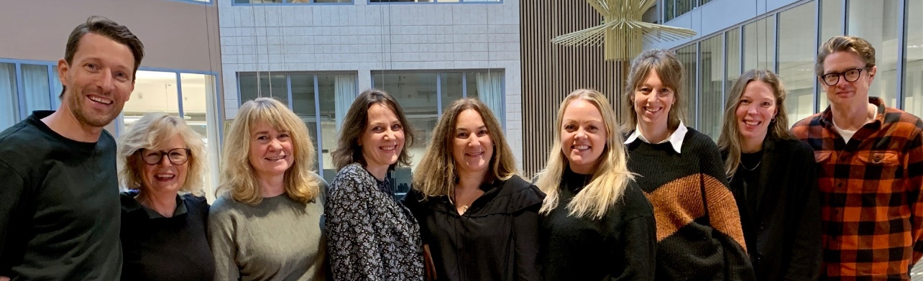
Thank you!
Anette A. Grønlie anette.gronlie@nubu.no

Slide 45
THANK YOU!
Questions & Discussion
Presentation 1: Peter van der Graaf
Presentation 2: Juul Tönis
Presentation 3: Leticia Bernués-Caudillo
Presentation 4: Anette Grønlie
Session host: Sven Geelen
Thought-provoking presentations and interesting insights?
Spread the word and let us follow along by using #EIE2025!

