Slide 1


Ride the Knowledge Wave 13
SCALING AND SUSTAINMENT - MAKING IMPLEMENTATION LAST
Presentation 1: Shalini Ahuja
Presentation 2: Martina Buljac-Samardzic
Presentation 3: Sarah Chew
Presentation 4: Natascha Stürmer
Session host: Heather Rogers

Slide 2
Sustainable team training in pediatric care
© 2025 Erasmus University Rotterdam, All rights reserved. No text and datamining
Martina Buljac-Samardžić
buljac@eshpm.eur.nl
On behalf of Ada van den Bos-Boon, Cynthia van der Starre, Robert-Jan Houmes, Guus van den Elzen, Saskia Gischler, Monique van Dijk

Slide 3
Why does the use of CRM fade over time?
Teams are critical in care delivery
Numerous team interventions exist
CRM among the most promising
CRM is widely adopted in hospitals
Gains in team functioning and patient safety are evident on the short-term
Understanding CRM sustainability is lacking
Understanding underlying mechanisms determining the sustainability of CRM use

Slide 4
Teams are key players in delivering care
Care delivery is team-based
Teams are key players for quality and safety
Room to improve team effectiveness

Slide 5
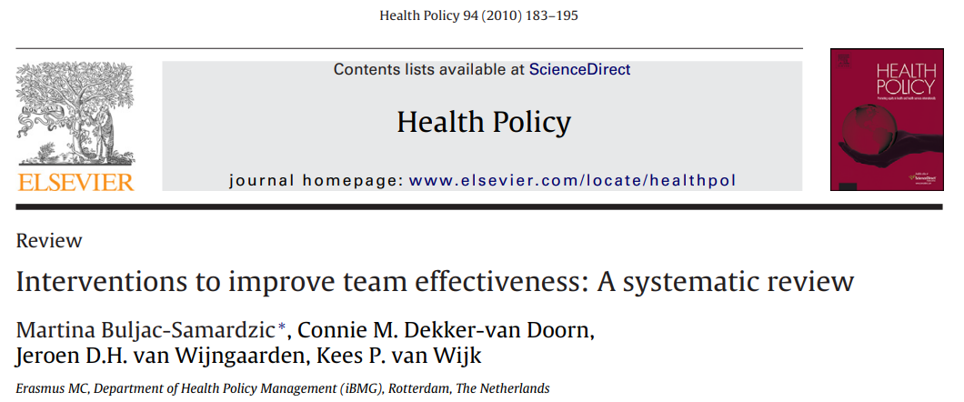
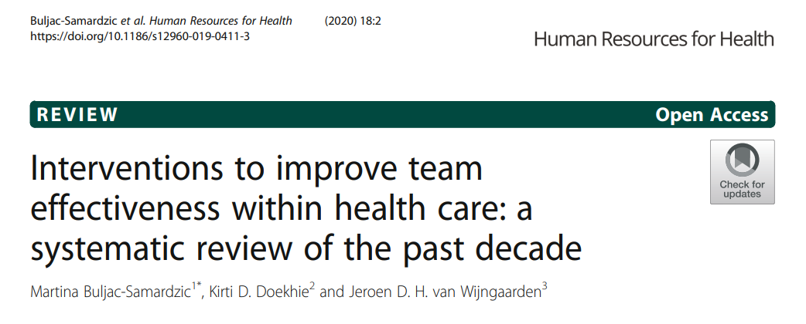
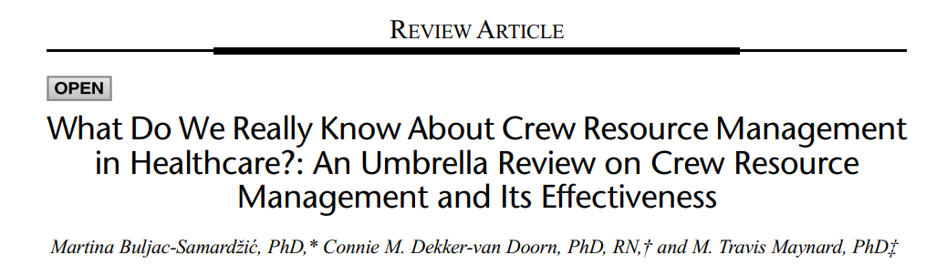
Overview of team intervention to improve team effectiveness

Slide 6
What is Crew Resource Management
CRM aims to optimize teamwork and patient safety via:
    Improving non-technical skills: team competencies
    Implementing tools: (de)briefings, huddles
CRM training combines:
    Theory-based methods: lectures
    Demonstration-based methods: videos
    Practice-based methods: simulation, role-playing
Provide team members with the knowledge, skills, and attitudes

Slide 7
Proven short-term Unclear long-term path
Evidence-based:
Strong evidence for improved short-term benefits on teamwork and patient safety
Gap:
Limited understanding on the mechanisms that support sustainability on the long-term

Slide 8
Understanding CRM sustainability
Sustainability of CRM in the pediatric hospital care
Insights into the underlying mechanisms that contribute to the long-term retention of CRM practices
"The first few weeks focus on CRM skills (…) more attention is needed for aftercare, because those skills tend to fade over time."

Slide 9

Research setting
Tertiary hospital
3 departments pediatric care
Varying CRM sustainability between 5 and 17 years

Slide 10


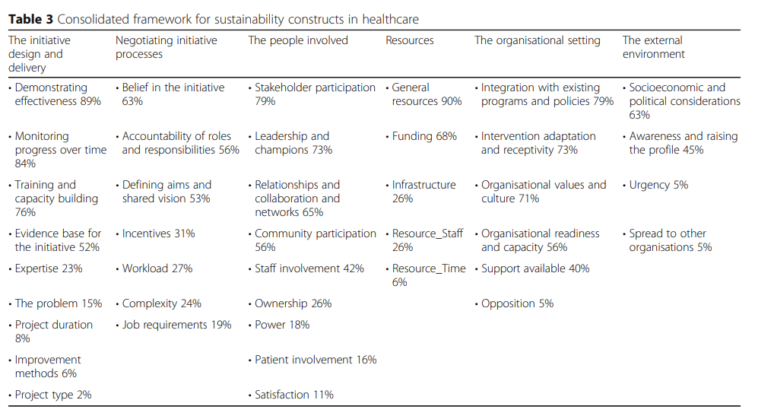

Methods
Multi-method qualitative study
Guided by the Consolidated Framework for Sustainability Constructs in Healthcare (Lennox et al. 2018)

Slide 11
Multi-level mechanisms
Organizational level:
      leadership support, alignment with institutional goals, readiness to create a supportive environment for teamwork
Team level:
      a shared mental model, effective communication, ownership of CRM tools play a crucial role
Individual level
      personal competencies like adaptability, resilience, the ability to integrate CRM practices into daily routines are key

Slide 12

Key condition for CRM sustainability: best practice vs best fit
Balance between adapting training and tools to its context and securing the evidence-based elements
An ongoing and iterative process
“Looking for what's going on in a department (…) so that you also have information from the patient's perspective so that connects to their work processes.”
“That it should become a training in which the team can see itself reflected.”

Slide 13
Key condition for CRM sustainability: supporting the use of CRM
Shared leadership in addition to support from formal leaders
“We can only do it together. Responsibilities lies with both sides. (…) Everybody needs to embody that.”
Ongoing availability of resources, time, and infrastructure
"There isn’t really a space where daily evaluations can take place. Now people just walk in while someone is crying.”

Slide 14

Time for your questions and remarks
Martina Buljac-Samardžić
buljac@eshpm.eur.nl

Slide 15
At Scale from the Ground Up: Challenges and Opportunities for Scaling Proven Interventions for MLTCs in Primary Care
Dr. Sarah Chew, Professor Natalie Armstrong and Professor Carolyn Tarrant from the Sapphire Research Group

Slide 16
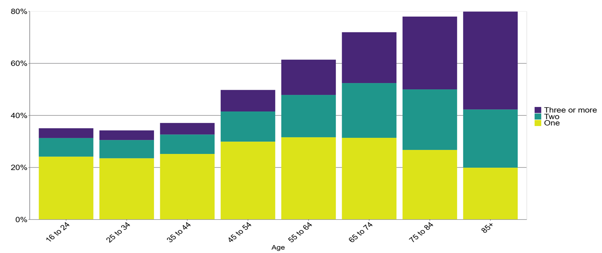
Why MLTCs Matter
“So we're talking about primary care, but also some of these people might be in care homes there's that complication of all the different settings. [There’s] just huge diversity in this group. So in your head, someone with multiple long term conditions is older. And I don't know, has hypertension and these kinds of classic things, but actually kind of defining who they are might be quite important. And there might be very different subgroups, people who are younger with all these multiple long-term conditions might be quite different.”
Caption and citation

Slide 17

Our Research
We followed four NIHR ARC projects trying to implement proven interventions for people with MLTCs at scale. These weren’t pilots. These were nationally endorsed, funded interventions.
A tailored intervention to improve CVD prevention in people with serious mental illness, delivered by primary care staff with peer support.
Understand and improve how structured medication reviews are conducted and experienced by patients and practitioners.
A digital feedback approach to help practices stop inappropriate prescribing in patients with cardiometabolic conditions.
A person-centred care planning tool for patients with multimorbidity, built into digital templates and supported by training
Each one had strong implementation science support

Slide 18

Key message 1: Scaling is Social
“Third time, three years down the line — then they said yes to health coaching”
“Actually, we just needed something a bit more tangible to really understand... the politics... the relationship building... it was incredibly complicated... iterative in every single site”
“I guess the additional challenges is that those champions need to be able to be knowledgeable about the local systems and to be able to draw people in not only from different disciplines from different parts of the system because of and primary care as well ”

Slide 19
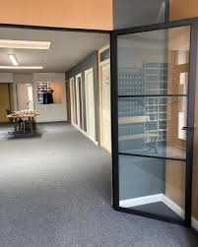


Key Message 2: Readiness and Capacity is uneven

Slide 20
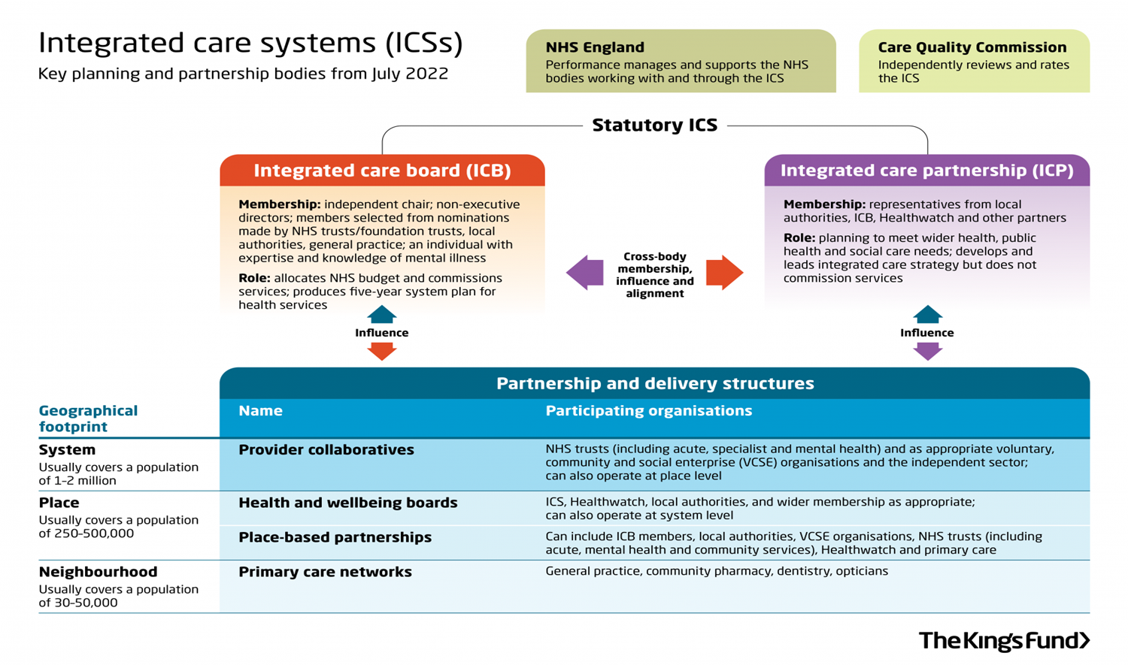

Key Message 3: Scale requires local knowledge
The 2022 Health and Care Act disrupted, and continues to disrupt commissioning structures.

Slide 21
2 questions for you
1] How can we ensure reach and improve engagement with MLTC providers?
2] How can we better support initiatives after the initial implementation phase; can we embed innovation support into ICB structures for long-term benefit?

Slide 22



Epidemiology, Biostatistics and Prevention Institute
TravelPrEPared
Implementing a New Service of Integrated Sexual Health Counselling for Travellers in Zurich
    N. Stuermer, M. Rasi, A. Anagnostopoulos, F. Sommer, R. Novillo, H. Komaromi, L. Künzi, J. Giovanoli Evack,
    K. Siebenhuener, N. Marques Guedelha, L. Sadiku, J. Fehr, B. Hampel, D. Nicca
    EIE2025 6 June
Notes:
Begrüssung, sagen wer wir sind? unrstricded funding Gilead
Story around taboo einführen wie?

Slide 23

Background and Aim
Rationale: In medical pre-travel services, sexual health counseling is insufficiently implemented¹
→ knowledge-practice gap
Aim: Systematic development and implementation of a scalable integrated sexual health intervention (TravelPrEPared) for medical pre-travel services
Setting: University of Zurich’s Center for Travel Medicine (CTM)
1 Santaolaya C, Malhotra J, Fowler JA, et al. Integrating sexual and reproductive health into pre-travel consultations. J Travel Med. 2024;31(4):taae024. doi:10.1093/jtm/taae024
Notes:
Kurz background ein satz zu bekannten barriers?
Aim
Setting

Slide 24
Methods
A participatory practice development approach was applied using combined intervention and implementation mapping method^{2;3}
Steps | Intervention | Implementation
1. Needs Assessment | Combined needs assessment (qualitative “nested in” study)
2. Logic Model of Change | Theory of Change Framework | Normalization Process Theory (NPT) Mechanisms
3. Program Design | Integrated patient pathway
4. Implementation Plan |  | Implementation strategy according to ERIC-Taxonomy⁴
5. Production | Combined Materials, i.e. communication training manual
6. Evaluation Plan | Quan (Questionnaire, performance tracking), qual (interviews) | Quan (NoMAD-questionnaire), qual (interviews)
2 Bartholomew Eldredge, 2013
3 Fernandez, 2019
4 Powell, 2015

Slide 25
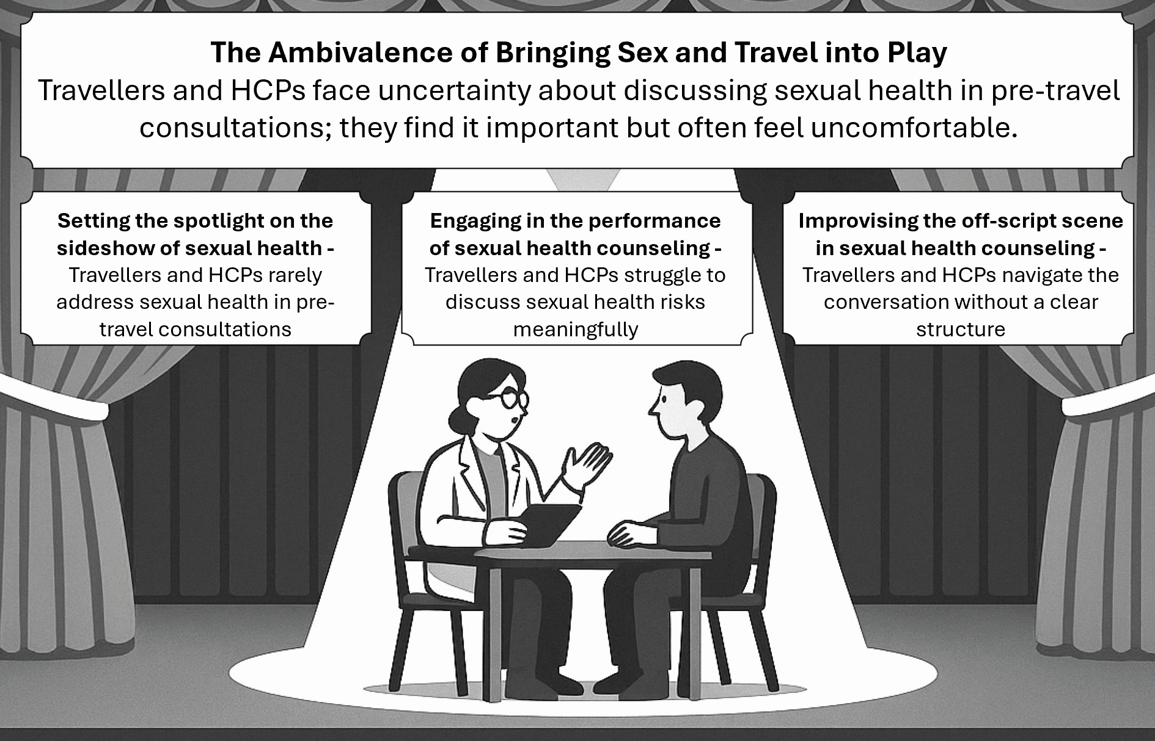
Results (1/3)
Needs Assessment
Logic Model of Change
Main outcomes on patient level are to increase basic knowledge, risk awareness and individual risk minimizing strategies
Improve sexual health
Basic knowledge about STI prevention
Individual risk awareness
Reflection on risks
Confidence to risk minimizing strategies
Readiness for risk minimizing strategies
Impact
Outcome
Output
Access to information
Activities
Provision of information
Risk assessment
Brief motivational intervention
Quote: “…I sometimes feel a bit guilty, like I’m implying they might have sex with other partners.” (HCP)
Quote: “…to say to have different sex partners is still somehow a taboo.” (traveller)
Graphics: Stuermer et al. 2025. under review

Slide 26
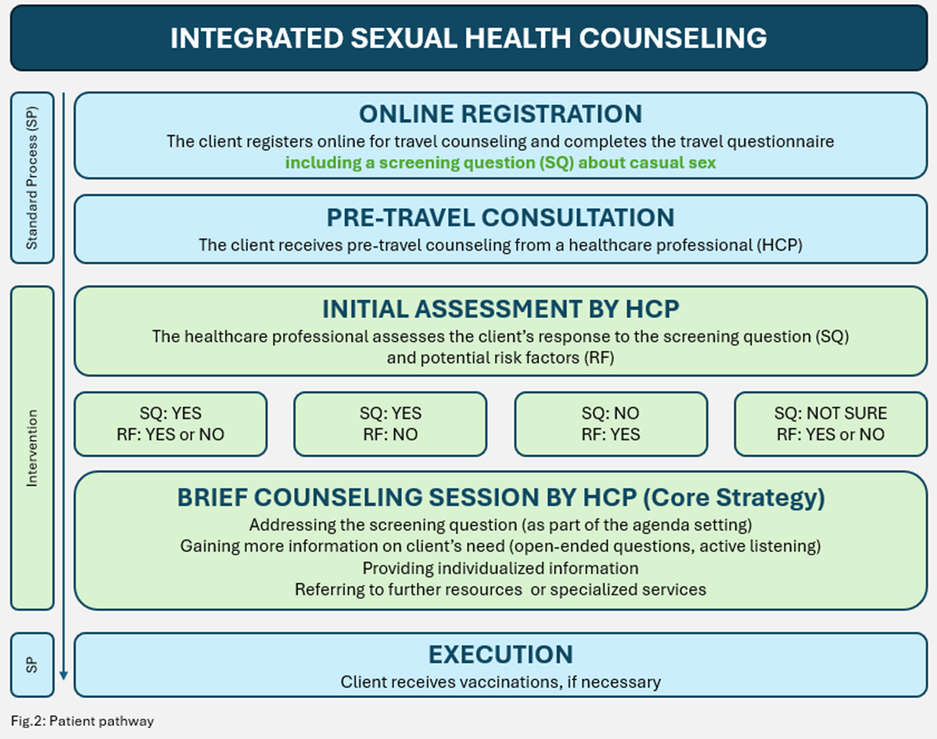
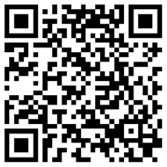
Results (2/3)
Program Design
Patient Pathway (see graphics):
Screening question
Risk assessment
Brief counselling according to risk
Implementation Plan
Selected main strategies:
Adapt and tailor to context
Train and educate stakeholders and champions
Support clinicians
Use evaluative and iterative strategies
Production
Materials:
Communication training manual
Information on website
Video (see QR code)

Slide 27
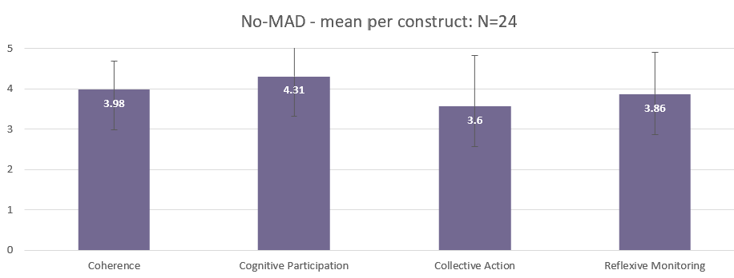
Results (3/3)
Evaluation Implementation (after 3 months)
Quote: “I recognize the value of sexual health counseling but often find it misplaced in pre-travel consultations.”
Quote: “Support from leaders and knowledge holders is available; you can always ask them questions.”
Quote: “Sometimes it feels strange to switch to a more patient-centred counseling styles, and I'm not always confident I can answer all questions”
Quote: “For me, it’s an additional skill; after the training I feel comfortable raising the topic, and I consider it a success when it leads to a dialogue with clients”

Slide 28

Discussion
Implementation of a service on a stigmatised issue such as sexual health is challenging.
What are the key learnings in such situations?
A Theory of Change-based multilevel implementation approach enables testing and adaptation of interventions to meet the specific needs of travellers and health providers. Scaling these interventions is critical for broader impact.
What are the key points for scaling?

Slide 29


Declaration of interest: unrestricted funding by Gilead Switzerland
Contact
Natascha Stürmer
MScN/Scientific staff
natascha.stuermer@uzh.ch

Slide 30
THANK YOU!
Questions & Discussion
Presentation 1: Shalini Ahuja
Presentation 2: Martina Buljac-Samardzic
Presentation 3: Sarah Chew
Presentation 4: Natascha Stürmer
Session host: Heather Rogers
Thought-provoking presentations and interesting insights?
Spread the word and let us follow along by using #EIE2025!

