Slide 1


Ride the Knowledge Wave 2
CO-CREATING IMPLEMENTATION
Presentation 1: Sarah Serhal
Presentation 2: Rakhi Vashishtha
Presentation 3: Gabrielle Zimmermann
Presentation 4: Harvy Joy Liwanag
Session host: Leonike Boendermaker

Slide 2




June 5th, 2025
University of Geneva
DR. SARAH SERHAL
EIE 2025
Co-creation approach to adapting and implementing an interprofessional service targeting initiation adherence in Switzerland: myCare Start – Implementation Science project
Sarah Serhal, Karima Shamuratova, Chiara Jeiziner, Juliane Mielke, Samuel Allemann, Selina Barbati, Linnéa S. Wälti, Cedric Lanier, Dagmar M. Haller, Eva Pfarrwaller, Fanny Mulder, Karen Maes, Marc Dupuis, Stephen P. Jenkinson, Alice Panchaud, Stéphane Guerrier, Joachim Marti, Giulio Cisco, Clemence Perraudin, Alexandra L. Dima, Sabina De Geest, Marie P. Schneider.
Notes:
Introduction
Thank you, I appreciate the opportunity today to share a part of the ongoing research taking place at the University of Geneva.

Slide 3


I
Research Background and Objective
What we know…
What we don’t know…
48% of persons within Switzerland have at least one chronic illness.⁽¹⁾
Adherence (initiation and implementation) to long term medications is suboptimal.^{(2, 3)}
Evidence based interventions to improve adherence exist – New Medicines Service (UK).⁽⁴⁾
How to effectively implement known interventions into new healthcare contexts.^{(5, 6)}
Amador-Fernández N, et al (2023) Explor Res Clin Soc Pharm
Vrijens B, De Geest S et al (2012). Br J Clin Pharmacol
Sabaté E (2003) Adherence to long-term therapies: evidence for action. Geneva: World Health Organization; 2003.
Elliott RA, Boyd MJ, Salema N, et al. (2016) BMJ Quality & Safety.
Fraeyman, J. et al. (2017). Research and Social Administrative Pharmacy, 13(1), 98-108.
Matthe, E. F. et al. (2015). [Masters Thesis]. Journal de Pharmacie de Belgique, 4.
What we did…
NMS → myCare Start
The myCare Start implementation project seeks to adapt the NMS for Switzerland (myCare Start) to enhance medication adherence of patients commencing new long-term treatments.
.
myCare Start-I
Notes:
What we know:
To set the scene I want to share with we know and that is:
1. That in Switzerland, almost half of the population (48%) have at least one long-term illness, a prevalence that is expected to rise as the population ages.
2. Globally, patient initiation and implementation adherence is suboptimal. This perpetuates more burden on the patient and health system and compromises patient safety and health outcomes.
It is estimated that 1 in 4 patients that are prescribed a new medication do not have the medication dispensed.
And amongst those that start taking a new medication 30-50 % are non-adherent.
3. Evidence based intervention to address initiation patient adherence exist - One of the best evaluated examples, to reinforce early adherence after medication initiation, is the UK developed New Medicines Service (NMS). The service targets adult patients with a first prescription for a new long-term medication and engages them in 2 10-minute pharmacist/patient consultations in the first 6 weeks of treatment. The service showed promise at improving improve patient adherence and delivering cost savings to the health system.
However, there are things we don’t know…
…and that is how to best implement the service in new healthcare contexts. Following on from success in the UK 11 countries decided to implement in their settings. However, roadblocks were experienced within these settings which have compromised real world impact and in some cases the ability of the service to be successfully integrated into routine care with only a few able to sustain the service in practice.
There exists a gap between knowing what to do and knowing how to do it in a given context.
Which brings us to our study.
Objective of myCare Start-I
We understood that a copy paste process may not be the best approach and thus we set out to adapt the New Medicines Service for Switzerland to create an optimized myCare Start Model using a co-creation approach with stakeholders.

Slide 4
II
Methodology
UNDERSTAND CONTEXT
Context Analysis
Mixed methods (semi-structured interviews and online surveys)
Guiding and analytical framework: Context and Implementation of Complex Interventions (CICI) framework.
Participants: Pharmacists, pharmacy assistants, patients, physicians.
Identified 63 contextual factors impacting intervention design or implementation of myCare Start in Switzerland.
PRIORITISE CONTEXTUAL FACTORS
Investigator Consensus Workshop
Panel of interprofessional investigators including primary care physicians and end-user representatives (n=15)
Factors prioritised in terms of the IMPORTANCE of addressing each factor and the CONFIDENCE that it could be addressed in the Swiss context.
CO-CREATE SOLUTIONS WITH STAKEHOLDERS
Iterative Focus Groups
Priority areas formed the focus of repeated semi-structured stakeholder focus groups (n=12 focus groups involving 50 stakeholders).
Solutions and possible service adaptations discussed.
Culminated in 12 proposed adaptations to the original NMS intervention.
SELECT ADAPTATIONS
Investigator Consensus Workshop
Panel of interprofessional investigators including primary care physicians and end-user representatives (n=17)
Adaptations were assessed based on ACCEPTABILITY to Swiss context.
Final list of seven selected intervention adaptations.
Adaptions reported using Framework for Reporting Adaptations and Modifications Expanded (FRAME)
Adapted myCare Start model.
TIME (May 2023 to January 2024)
TIME (September 2023 to October 2024)
Figure 1. Methodology for stakeholder driven intervention adaptation
myCare Start-I
Notes:
Methodology
The co-creation process involved an exploratory qualitative approach.
First, we wanted to better understand the context. An initial context analysis identified 63 contextual factors impacting intervention design or implementation of myCare Start in Switzerland.
A panel of interprofessional investigators including primary care physicians and end-user representative (n=15) prioritised these factors, assessing both the importance of addressing each factor and the confidence that it could be addressed in the Swiss context.
Priority areas formed the focus of repeated semi-structured stakeholder focus groups (n=12 focus groups involving 50 stakeholders).
Solutions and possible service adaptations discussed.
Culminated in 12 proposed adaptations to the original NMS intervention.
Adaptations were assessed based on ACCEPTABILITY to Swiss context.
Final list of seven selected intervention adaptations.

Slide 5

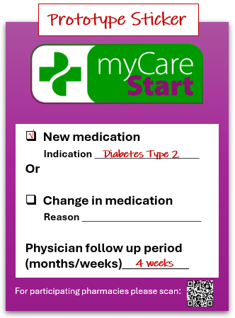

II
Adaptation 4: Elaborating the consultation guide to include evidence-based intervention options available to pharmacists to address issues presented by patients.
Adaptation 5: Re-demonstration of any new device is required at MCS Consultation One. This is an adjunct to demonstration that is carried out upon initial dispensation. This can be conducted in-person or via video conference.
Adaptation 6: More flexibility for Consultation Two. This may occur 2-4 weeks after Consultation One, in accordance with physician follow up.
Results
Adaptation 7: Short and concise feedback form to be sent from the pharmacist to the patient's physician via email after the completion of both myCare Start consultations unless issues are disclosed at first consultation. This is compulsory for all patients.
Patient self refers or is identified by community pharmacist for MCS.
Compulsory: Pharmacist to send feedback to physician upon completion of MCS Follow-up for all patients.*
Refer patient back to physician if needed.
Optional: Pharmacist to send feedback to physician if unresolved medication issues exist.
Refer patient back to physician if needed.
MCS Consultation One
(via phone, video-conference or in-person)
Pharmacist + Patient + Support Person (Optional)
Resolution of any medication related issues and patient adheres to new medication.
Patient prescribed new long-term medicine
Initial Medication
Dispensation
MCS Consultation Two
(via phone, video-conference or in-person)
Pharmacist + Patient + Support Person (Optional)
7-14 days
14-28 days
Physician referral to community pharmacy for MCS and endorsement of service.
Partnering with patients in building appropriate self-management habits
Adaptation 2: Flexible intervention mode of delivery based on both patient and pharmacy preferences and needs. Options include over the phone, in-person or via video conference.
Adaptation 3: A support person may accompany a patient during myCare Care Start consultations. This could be a family member, friend or official care person. The person may accompany the patient but cannot attend in place of the patient.
Adaptation 1: Facilitated physician referrals to the myCare Start service will form a secondary route of recruitment into the service.
Figure 5. Adapted New Medicine Service for Switzerland (myCare Start) – Service framework. Adapted from Elliott RA, Boyd MJ, Salema N, et al. (2016) BMJ Quality & Safety. (MCS- myCare Start) *If a patient does not attend MCS Consultation Two, then a feedback form based on the MCS Consultation One should be sent to the patient’s physician.
myCare Start-I
Notes:
Results
Adaptations occurred at both individual and organizational levels.
Adaptation 1: Facilitated physician referrals to the myCare Start service will form a secondary route of recruitment into the service. (greater emphasis on interprofessional collaboration, still being developed)
Adaptation 2: Flexible intervention mode of delivery based on both patient and pharmacy preferences and needs. Options include over the phone, in-person or via video conference.
Adaptation 3: A support person may accompany a patient during myCare Care Start consultations. This could be a family member, friend or official care person. The person may accompany the patient but cannot attend in place of the patient.
Adaptation 4: Elaborating the consultation guide to include evidence-based intervention options available to pharmacists to address issues presented by patients.
Adaptation 5: Re-demonstration of any new device is required at MCS Consultation One. This is an adjunct to demonstration that is carried out upon initial dispensation. This can be conducted in-person or via video conference.
Adaptation 6: More flexibility for Consultation Two. This may occur 2-4 weeks after Consultation One, in accordance with physician follow up.
Adaptation 7: Short and concise feedback form to be sent from the pharmacist to the patient's physician via email after the completion of both myCare Start consultations unless issues are disclosed at first consultation. This is compulsory for all patients.

Slide 6
IV
Conclusion
What we don’t know…
Impact and summary
Implications for myCare Start in Switzerland
Adaptations are anticipated to enhance fit for the context, recipient and provider alignment, service feasibility, engagement and cultural relevance.
Enhanced fit for context may translate to improved intervention and implementation outcomes, when evaluated in 2025 Hybrid Type 2 effectiveness-implementation trial.
Implications for pharmacy practice and interprofessional practice research
Promotes and provides guidance for the use of theory driven community-based participatory research and stakeholder driven intervention design.
.
myCare Start-I

Slide 7

June 5th, 2025
University of Geneva
DR. SARAH SERHAL
EIE 2025
Have a comment? Want to know more? or want to keep up to date with publications?
Please scan the QR code and register your interest or email mycarestart@unige.ch
Thank you

Slide 8
V
Supplementary slides

Slide 9
V
Supplementary slides
Patient self refers or is identified by community pharmacist for MCS.
Refer patient back to physician if needed.
Refer patient back to physician if needed.
Patient Consultation
Patient and pharmacist resolve and medicines related issues .
Patient prescribed new long-term medicine
Initial Medication
Dispensation
Patient Follow-up
7-14 days
14-21 days
Physician referral to community pharmacy for MCS and endorsement of service.
Patient and pharmacist resolve and medicines related issues .
Figure 2. UK New Medicine Service framework. Adapted from Elliott RA, Boyd MJ, Salema N, et al. (2016) BMJ Quality & Safety. (MCS- myCare Start)
myCare Start-I
Notes:
Results
Adaptation 1: Facilitated physician referrals to the myCare Start service will form a secondary route of recruitment into the service.
Adaptation 2: Flexible intervention mode of delivery based on both patient and pharmacy preferences and needs. Options include over the phone, in-person or via video conference.
Adaptation 3: Re-demonstration of any new device is required at MCS Consultation One. This is an adjunct to demonstration that is carried out upon initial dispensation. This can be conducted in-person or via video conference.
Adaptation 4: Elaborating the consultation guide to include evidence-based intervention options available to pharmacists to address issues presented by patients.
Adaptation 5: A support person may accompany a patient during myCare Care Start consultations. This could be a family member, friend or official care person. The person may accompany the patient but cannot attend in place of the patient.
Adaptation 6: More flexibility for Consultation Two. This may occur 2-4 weeks after Consultation One, in accordance with physician follow up.
Adaptation 7: Short and concise feedback form to be sent from the pharmacist to the patient's physician via email after the completion of both myCare Start consultations unless issues are disclosed at first consultation. This is compulsory for all patients.

Slide 10
V
Supplementary slides
Patient self refers or is identified by community pharmacist for MCS.
Compulsory: Pharmacist to send feedback to physician upon completion of MCS Follow-up for all patients.*
Refer patient back to physician if needed.
Optional: Pharmacist to send feedback to physician if unresolved medication issues exist.
Refer patient back to physician if needed.
MCS Consultation One
(via phone, video-conference or in-person)
Pharmacist + Patient + Support Person (Optional)
Resolution of any medication related issues and patient adheres to new medication.
Patient prescribed new long-term medicine
Initial Medication
Dispensation
MCS Consultation Two
(via phone, video-conference or in-person)
Pharmacist + Patient + Support Person (Optional)
7-14 days
14-28 days
Physician referral to community pharmacy for MCS and endorsement of service.
Partnering with patients in building appropriate self-management habits
Figure 5. Adapted New Medicine Service for Switzerland (myCare Start) – Service framework. Adapted from Elliott RA, Boyd MJ, Salema N, et al. (2016) BMJ Quality & Safety. (MCS- myCare Start) *If a patient does not attend MCS Consultation Two, then a feedback form based on the MCS Consultation One should be sent to the patient’s physician.
myCare Start-I
Notes:
Results
Adaptations occurred at both individual (e.g., flexible delivery modes, extended follow-up timeline, pharmaceutical device demonstration options, inclusion of support persons) and organizational levels (e.g., physician referrals to myCare Start, standardized pharmacist feedback to physicians and greater guidance for interventions to assist patients).
Adaptation 1: Facilitated physician referrals to the myCare Start service will form a secondary route of recruitment into the service. (greater emphasis on interprofessional collaboration, still being developed)
Adaptation 2: Flexible intervention mode of delivery based on both patient and pharmacy preferences and needs. Options include over the phone, in-person or via video conference.
Adaptation 3: A support person may accompany a patient during myCare Care Start consultations. This could be a family member, friend or official care person. The person may accompany the patient but cannot attend in place of the patient.
Adaptation 4: Elaborating the consultation guide to include evidence-based intervention options available to pharmacists to address issues presented by patients.
Adaptation 5: Re-demonstration of any new device is required at MCS Consultation One. This is an adjunct to demonstration that is carried out upon initial dispensation. This can be conducted in-person or via video conference.
Adaptation 6: More flexibility for Consultation Two. This may occur 2-4 weeks after Consultation One, in accordance with physician follow up.
Adaptation 7: Short and concise feedback form to be sent from the pharmacist to the patient's physician via email after the completion of both myCare Start consultations unless issues are disclosed at first consultation. This is compulsory for all patients.

Slide 11
V
Supplementary slides
Table 1. Details of Focus Groups conducted (n=8)
Date | Profession of Interest | Number of attendees | Attendee Organisations | Time of FG (min) | Mode of delivery | Region represented | Language FG was conducted
25.06.2024 | Physicians | 2 | Maison de Santé Meinier | 90 | Videoconference | Suisse Romandie | English
01.07.2024 | Patients | 3 | EUPATI-Switzerland, Patient Safety Foundation, Patient representative | 90 | Videoconference (written feedback provided by two patients) | Suisse Romandie, Suisse Allemande | English
03.07.2024 | Physicians | 9 | Medical Center of Lancy | 60 | In-person | Suisse Romandie | French
04.07.2024 | Patients | 2 | Patient representatives | 90 | In-person | Suisse Romandie | French
10.07.2024 | Pharmacists | 4 | Galenica, CHUV/GSASA, Government (Vaud) | 90 | Videoconference | Suisse Romandie | French
12.07.2024 | Pharmacists | 3 | Community pharmacy, ETH Zurich, UNIBE, pharmaSuisse | 90 | Videoconference | Suisse Romandie, Suisse Allemande | English/French
19.09.2024 | Patients | 2 | Community recruited Patients | 90 | In-person | Suisse Allemande | German
25.09.2024 | Physicians | 4 | Family physicians | 60 | Videoconference | Suisse Allemande | German
myCare Start-I

Slide 12
V
Supplementary slides
Table 2. Topics covered in iterative focus groups
 | Topics Covered
Patients | Increasing patient uptake of the myCare Start service Patient perceived value of interprofessional collaboration Patient preferences for content, flexibility and number of consultations
Pharmacists/Pharmacy Assistants | Role of pharmacists in improving recruitment, reach, and patient uptake Facilitating interprofessional collaboration and communication between pharmacist and physician Patient follow-up and the myCare Start timeline (Overlapping physician and myCare Start consultations)
Physicians | Physician role in the myCare Start service (recruitment, collaboration and/or consultations) Physicians support of the service Facilitating interprofessional collaboration and communication between physician and pharmacist Patient follow-up and the myCare Start timeline (Overlapping physician and myCare Start consultations)
myCare Start-I

Slide 13
V
Supplementary slides
Adaptation 1: Facilitated physician referrals to the myCare Start service will form a secondary route of recruitment into the service.
Adaptation 2: Flexible intervention mode of delivery based on both patient and pharmacy preferences and needs. Options include over the phone, in-person or via video conference.
Adaptation 3: Re-demonstration of any new device is required at MCS Consultation One. This is an adjunct to demonstration that is carried out upon initial dispensation. This can be conducted in-person or via video conference.
Adaptation 4: Elaborating the consultation guide to include evidence-based intervention options available to pharmacists to address issues presented by patients.
Adaptation 5: A support person may accompany a patient during myCare Care Start consultations. This could be a family member, friend or official care person. The person may accompany the patient but cannot attend in place of the patient.
Adaptation 6: More flexibility for Consultation Two. This may occur 2-4 weeks after Consultation One, in accordance with physician follow up.
Adaptation 7: Short and concise feedback form to be sent from the pharmacist to the patient's physician via email after the completion of both myCare Start consultations unless issues are disclosed at first consultation. This is compulsory for all patients.
myCare Start-I

Slide 14
V
Supplementary slides
Framework for Reporting Adaptations and Modifications Expanded (FRAME)
Adaptation 1: Facilitated physician referrals to the myCare Start service will form a secondary route of recruitment into the service.
Adaptation 2: Flexible intervention mode of delivery based on both patient and pharmacy preferences and needs. Options include over the phone, in-person or via video conference.
Adaptation 3: Re-demonstration of any new device is required at MCS Consultation One. This is an adjunct to demonstration that is carried out upon initial dispensation. This can be conducted in-person or via video conference.
Adaptation 4: Elaborating the consultation guide to include evidence-based intervention options available to pharmacists to address issues presented by patients.
Adaptation 5: A support person may accompany a patient during myCare Care Start consultations. This could be a family member, friend or official care person. The person may accompany the patient but cannot attend in place of the patient.
Adaptation 6: More flexibility for Consultation Two. This may occur 2-4 weeks after Consultation One, in accordance with physician follow up.
Adaptation 7: Short and concise feedback form to be sent from the pharmacist to the patient's physician via email after the completion of both myCare Start consultations unless issues are disclosed at first consultation. This is compulsory for all patients.
WHEN did the modification occur?
Pre-implementation/planning/pilot (1,2,3,4,5,6,7)
WHAT was modified
Implementation and scale-up activities (1,2,5,6,7)
Context (1)
Content (3,4)
Contextual Changes are made to:
Personnel (1)
Setting (1)
Were adaptations PLANNED?
Planned/Proactive adaption (1,2,3,4,5,6,7)
Nature on content modification:
Integrating another treatment into EBP (3)
Integrating parts of the intervention into another framework (4)
WHO participated in the decision to modify?
Community members (1,2,3,4,5,6,7)
Coalition of Stakeholders (1,2,3,4,5,6,7)
Treatment/Intervention team (1,2,3,4,5,6,7)
Investigative Team (1,2,3,4,5,6,7)
Ultimate decision made via consensus discussion amongst investigator team.
At what LEVEL OF DELIVERY?
Organisation (1)
Individual (2,3,4,5,6)
Individual practitioner (7)
Process
Relationship to fidelity core elements
Fidelity Consistent/Core elements or functions preserved (1,2,3,4,5,6,7)
WHAT was the GOAL?
Increase reach or engagement (1)
To address cultural factors (1,5)
Improve feasibility (2,6)
Increase satisfaction (2)
Improve fit with recipients (2,5,6)
Improve effectiveness/outcomes (3,4,7)
Socio Cultural | Socio-Cultural | Socio-Economic | Political | Epidemiological
Patient acknowledgment of the pharmacist's role and openness to pharmacy health services (1) Patient relationships with health professionals (physicians, pharmacists) (1) Patient perception that the physician is the primary/sole source of care (1) Lack of physician referrals for service (1) Physician awareness and active involvement in the myCare Start service (1) Patient time constraints (2,6) | Misconceptions of the role of the pharmacists and physicians amongst health care professionals (4) Undefined roles within the health workforce (4) Patient reliance on familial or external care (5) Communication between pharmacists and physicians during and after the myCare Start service (7) Lack of communication between physicians and pharmacists (7) Perceived benefits from the perspective of pharmacists and physicians to deliver the service (7) | Time constraints within pharmacy practice (2,6) | Misconceptions of the role of the pharmacists and physicians amongst health care professionals (4,7) | Lack of understanding of the medication (3) Difficulty taking or using the medication due to drug formulation and administration (3)
Reasons
Figure 7. Adaptations made to the myCare Start service using FRAME. Wiltsey Stirman, S., et al (2019) Implementation Science. https://doi.org/10.1186/s13012-019-0898-y
myCare Start-I

Slide 15
Integrating Economic Evaluation into Implementation Research and Practice
Presenter – Dr Rakhi Vashishtha
Rakhi.vashishtha@nus.edu.sg

Slide 16
Acknowledgements
Care Policy and Evaluation Centre, London School of Economics and Political Sciences
Dr Ties Hoomans
Centre for Behavioural and Implementation Science, National University of Singapore
Prof Nick Sevdalis
Ms. Amrita Dutta
Dr Woan Shin
Dr Jumana Hashim
Mr Shao Chuen

Slide 17
Context
Healthcare resources are limited and often overstretched
Implementation science helps optimize their use through promoting evidence-based care
Yet, strategies effective in research don’t always translate into practice—creating a “voltage drop”
One key reason: economic factors are often overlooked in decision-making
Economic evaluation offers a way to bridge the gap between research and practice
It provides insights into resource use, costs, and trade-offs, enabling stakeholders to make better-informed implementation decisions

Slide 18
Practical uses of economic evaluation
Evidence generation
Generate evidence to support implementation decisions
Communication
Effective communication about costs and benefit
Alignment
Alignment of resource allocation decision-making across stakeholders
Economic evaluation process becomes an implementation strategy itself

Slide 19
Our Project
Development of economic evaluation framework for implementation research and practice

Slide 20
Specific aims and components of the project
Specific project aims | Main components
To investigate methodological developments, the approaches which have been applied and identify the key challenges in relation to different methodologies | Literature Review
To apply and compare economic evidence generated using different economic evaluation approaches | CVD Case Study
To assess the application of economic evaluation process to inform real-world implementation decision | Expert Panel Discussions

Slide 21

01
Literature Review

Slide 22
Review Results
A mix of methodologies including expert recommendations, snowballing and forward citation mining were conducted to identify relevant literature
There are 74 studies included in this review
The studies are categorised as:
Conceptual and methodological studies (N=13)
Evidence review studies (N= 21)
Original economic evaluation studies (N= 31)
Opinion and discussion pieces (N= 7)
Other studies (N=2)

Slide 23
Insights based on methodological approaches
Begin economic evaluations ex ante- at the design phase and throughout the implementation process
Consider perspectives from all stakeholders - including staff, patients and policymakers
Differentiate implementation research and development costs from sustainment costs
Include both intervention delivery costs and all long-term downstream costs
Account for timing differences between intervention effects and implementation strategy impact

Slide 24
Insights based on practical application of economic evaluation methods
Most commonly applied methods- costing approach
Most commonly evaluated implementation costs- labour cost
Limited scope – mostly healthcare or provider perspective included, short time horizons (<1 year),
Limited availability of high-quality data—on implementation costs, process outcomes, and contextual modifiers
Limited or no reporting of stakeholder involvement in process or impact on implementation research and practice

Slide 25

02
Case study: Economic evaluation of active Implementation strategies to increase CVD screening uptake in Singapore

Slide 26
Case study: Different evaluation approaches lead to economic evidence
Aim is to increase uptake of CVD screening in Singapore
Target population 2.2M (40 years and above) in Singapore in 2022 (Singstats)
62.6% received the intervention without any implementation strategy in 2023 (NHS report 2023)
36% expected increase in screening uptake using “task-shifting” strategy (Beratarrechea et. al 2019)
Perspective | Costs | Benefits | Implementation Decision
Patient | Direct travel time and work loss | Better health outcomes in later life | Trade-off
Government | Investment in organizational change | — | No immediate benefits
Society | Patient costs; government costs | Population health gain Productivity | Social development

Slide 27

03
Expert panel workshops

Slide 28
Methodology for engaging stakeholders
Panel members will initially assess 2–3 implementation scenarios and provide baseline judgments from individual perspective
Sequential presentation of economic evaluation results from individual stakeholder perspectives will follow
Stakeholders will be prompted to make decisions at each stage
A comprehensive evaluation integrating all perspectives will then be presented for a final decision-making exercise
Concludes with a discussion on how economic evidence shaped decisions and its relevance for future implementation planning

Slide 29
Next Steps
Complete the economic analysis for CVD case study
Conduct expert panel workshops
Examine actual stakeholder choice behaviour (based on generated evidence and taking part in the evaluation process)
Refine and propose the systematic methodological approach for integrating economic evaluation in implementation science

Slide 30





2026 AUGUST INTAKE
Master of Science in Behavioural and Implementation Sciences in Health (MScBIS)
APPLICATIONS OPEN IN OCT 2025
Scan the QR code to learn more about our MScBIS programme!
bisilearning@nus.edu.sg
Centre for Behavioural and Implementation Science Interventions (BISI)
@BISI_NUS

Slide 31
Thank you!
Email contacts
Dr Ties Hoomans (T.Hoomans@lse.ac.uk)
Dr Rakhi Vashishtha (rakhi.vashishtha@nus.edu.sg)
Prof Nick Sevdalis (nick_sev@nus.edu.sg)
BISI MSc Program (bisilearning@nus.edu.sg)

Slide 32
Co-Designing Practical Guidance to Bridge Implementation Science and Frontline Practice in Acute Care
RTKW2, EIE2025
Presented by: Gabrielle Zimmermann, Ph.D.
June 5, 2025
Notes:
Hello my name is Gabrielle Zimmermann and I am presenting today on behalf of my co-authors on Co-designing practical implementation

Slide 33

Where:
Notes:
This work explored the co-design of an implementation guide for a provincially-scaled acute care improvement initiative in the province of Alberta in Canada
During program development and implementation, Alberta Health Services (or AHS for short) was the province-wide single health authority for the province and the largest provincial health authority in Canada, serving over 4.3 million people.
AHS includes more than 113,00 employees providing programs and services at more than 900 facilities throughout the province organized into five geographic zones represented by the different colors on this map.
The program I will be talking about today was provincially coordinated and implemented across the province’s 14 high-volume acute care hospitals in the five regional zones beginning in March 2022.

Slide 34
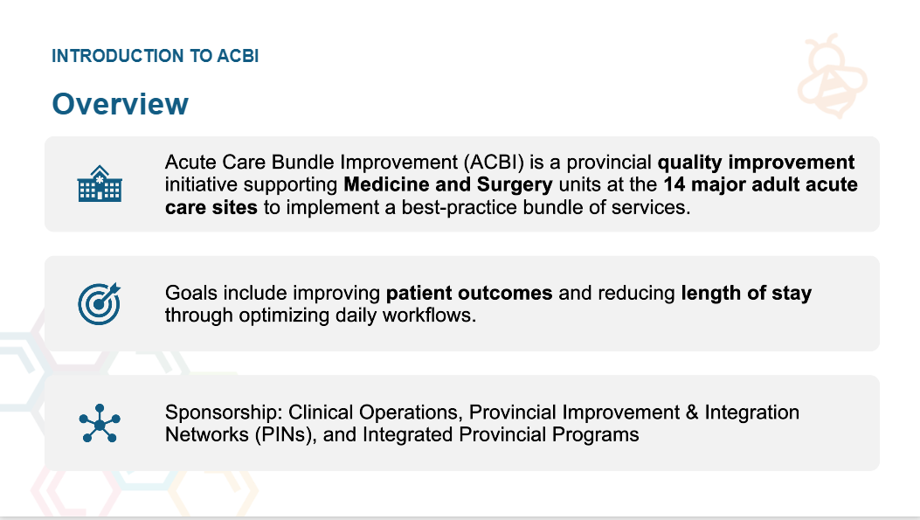
What: Acute Care Bundle Improvement (ACBI)
Notes:
The program is called Acute Care Bundle Improvement or ACBI for short. AHS developed ACBI to improve quality outcomes for patients and providers and address a provincial government mandate to reduce patient length of stay.
ACBI is a provincial quality improvement initiative supporting Medicine and Surgery units at the 14 major adult acute care sites to implement a best-practice bundle of services, which I’ll talk more about in a minute, but really focused on optimizing daily workflows.
The program had provincial and clinical operational support throughout

Slide 35
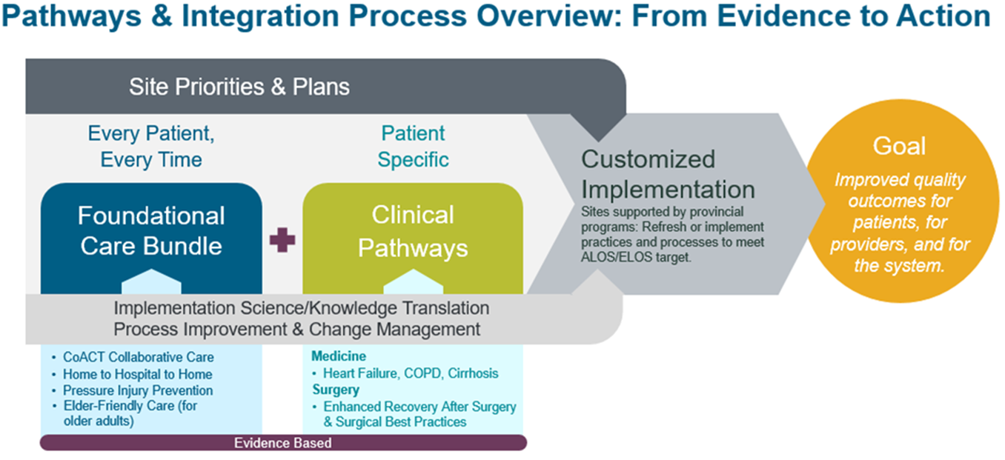
Why Acute Care Bundle Improvement (ACBI)?
Excellent care for “every patient, every time” to improve quality outcomes for patients, for providers, and for the system
Reduce complexity of overlapping initiatives​
Optimize Connect Care use​
Tailored implementation approach​
Build improvement capacity​
Notes:
So why ACBI?
A provincial audit identified and recommended the consistent and concurrent implementation of eight existing evidence-based initiatives, but they were either not implemented provincially or were not sustained. This recommendation also conflicted with the historical concerns of frontline staff and operational leadership about implementing numerous programs simultaneously as the cognitive load on staff could be significant.
There was a need to reduce the complexity of these often overlapping initiatives – seen here as a number of foundational care bundles that are intended to be applied to every patient, every time, such as pressure injury prevention; as well as patient specific clinical pathways in Medicine and Surgery
There was also an opportunity to optimize all of these within Connect Care, which was being rolled out at the same time. Connect Care is the provincial integrated electronic medical record system able to prompt embedded best practices, facilitate care team communication, and use data to drive improvement efforts.
This all required a tailored implementation approach! But what was being implemented also needed to be tailored…

Slide 36
Transitions in Care (Discharge) Activities
Admission
Daily Care
Discharge
CoACT
H2H2H
Elder Friendly Care
Pressure Injury Prevention
COPD
Heart Failure
ERAS
Cirrhosis
Expected Discharge Date
Follow up Appointments
Screening Tools
Discharge Teaching
Expected Discharge Date
Expected Discharge Date
Follow up Appointments
Discharge Teaching
Attachment Confirmation
Discharge Checklist
Rapid Rounds
Supported Decision Maker
Referral and Access to Community Supports
Discharge Checklist
Discharge Teaching
Discharge Notification
Admission Notification
Safe Discharge Checklist
Written Communication to receiving care team
Discharge Teaching
Discharge Teaching
Discharge Criteria
Follow up Appointments
My Discharge Checklist
Screening Tools
Screening Tools
Patient Experience Survey
Referral/ Access to Community Supports
Screening Tools
Screening Tools
Referral and Access to Community Supports
Risk Assessment Screening Tool
Discharge Notification
Discharge Notification
Written Communication to receiving care team
Discharge Checklist
Discharge Notification
Discharge Management Plan
Discharge Management Plan
Patient Orientation
Transition Care Plan
Follow Up Appointments
Follow Up Appointments
Safe Discharge Checklist
Written Communication to receiving care team
Written Communication to receiving care team
Identify Circle of Care
Notes:
As mentioned, there was a need to reduce the complexity of what was being implemented. This figure shows the eight different initiatives in columns with specific activities related to admission (in dark green), daily care (in orange) or discharge (in light green), but only shows activities for transitions in care, as one example

Slide 37
Transitions in Care (Discharge) Activities
Admission
Daily Care
Discharge
CoACT
H2H2H
Elder Friendly Care
Pressure Injury Prevention
COPD
Heart Failure
ERAS
Cirrhosis
Expected Discharge Date
Attachment Confirmation
Screening Tools
Screening Tools
Expected Discharge Date
Expected Discharge Date
Screening Tools
Admission Notification
Patient Orientation
Supported Decision Maker
Screening Tools
Screening Tools
My Discharge Checklist
Rapid Rounds
Discharge Teaching
Discharge Teaching
Discharge Teaching
Discharge Teaching
Discharge Teaching
Identify Circle of Care
Referral/ Access to Community Supports
Referral and Access to Community Supports
Discharge Checklist
Discharge Checklist
Safe Discharge Checklist
Referral and Access to Community Supports
Safe Discharge Checklist
Discharge Notification
Discharge Notification
Discharge Checklist
Follow up Appointments
Discharge Management Plan
Discharge Management Plan
Patient Experience Survey
Risk Assessment Screening Tool
Discharge Criteria
Discharge Notification
Follow Up Appointments
Follow Up Appointments
Discharge Notification
Written Communication to receiving care team
Written Communication to receiving care team
Written Communication to receiving care team
Written Communication to receiving care team
Follow up Appointments
Follow up Appointments
Transition Care Plan
Notes:
As shown by the highlighted example, when they are lined up you can start to see the duplication

Slide 38
Transitions in Care (Discharge) Activities
Admission
Patient Orientation
Attachment Confirmation/ Notification
Supported Decision Maker
Expected Discharge Date
My Next Steps
Screening Tools
Daily Care
Identify Circle of Care
Patient Education/ DischargeTeaching
Rapid Rounds
Referral and Access to Community Supports
Safe Discharge Checklist
Condition Specific Discharge Checklist
Discharge
Risk Assessment Screening Tool
Transition Care Plan (Discharge Summary)
Follow up Appointments
Discharge Management Plan
Patient Experience Survey
Discharge Notification
Notes:
Which can be simplified to certain key activities across admission, daily care and discharge.
The focus then is on the patient and workflow and not individual initiatives, which gives the frontline staff less to worry about on any given day.

Slide 39

What: Acute Care Bundle Improvement (ACBI)
ACBI offers a coordinated improvement approach to
7 Areas of Focus
Notes:
As a result of identifying these overlapping and foundational practices, it was possible to integrate them into evidence-based “bundles” or areas of focus that aligned with daily workflows.
Given the variability across the 14 acute care sites in terms of what had already been accomplished or implemented, a tailored yet systematic implementation approach was needed.

Slide 40



Who: Strategic Implementation Group
Quality Improvement (QI)
Change Management
Planning
Implementation Science (IS)
Knowledge Translation (KT)
Notes:
An ad hoc task group called the Strategic Implementation Group was formed in response to the ACBI organizational sponsors’ decision to develop an adaptable provincial implementation that was more responsive to operational pressures.
The members were from Alberta Health Services, the Alberta Strategy for Patient-Oriented Research (SPOR) Support Unit (AbSPORU), and the University of Alberta. The team had expertise in quality improvement, change management, planning, implementation science, and knowledge translation.

Slide 41
How: Co-designing a Playbook for Implementation
Development Phase | Activities
Phase 1: Framework | Identify an implementation framework Thought mapping
Phase 2: Playbook | Validation and refinement Activity mapping Tool prioritization and development
Phase 3: Reflection & Refinement | Finalization of the Playbook through iterative feedback
Notes:
Iterative co-design involved multidisciplinary collaboration across system levels with healthcare providers, operational leaders, and researchers.
Co-design activities were planned pragmatically. Examples include activity mapping, walkthroughs, and prototyping tools. Feedback cycles prioritized practicality and contextual sensitivity while integrating evidence-based practices into a cohesive guide.

Slide 42

Phase 1: Identify an Implementation Framework
Priorities for selecting a framework:
informs the implementation process
facilitates adaptation
supports the selection of practical implementation tools and resources.
This Photo by Unknown Author is licensed under CC BY-NC
Notes:
The first phase involved identifying an implementation framework.
The Strategic Implementation Group defined three key priorities to guide the selection of an implementation framework for ACBI based on operational feedback and early learnings from the first four sites that piloted implementation. The priorities included that the framework: (1) informs the implementation process; (2) facilitates adaptation; and (3) supports the selection of practical implementation tools and resources.

Slide 43
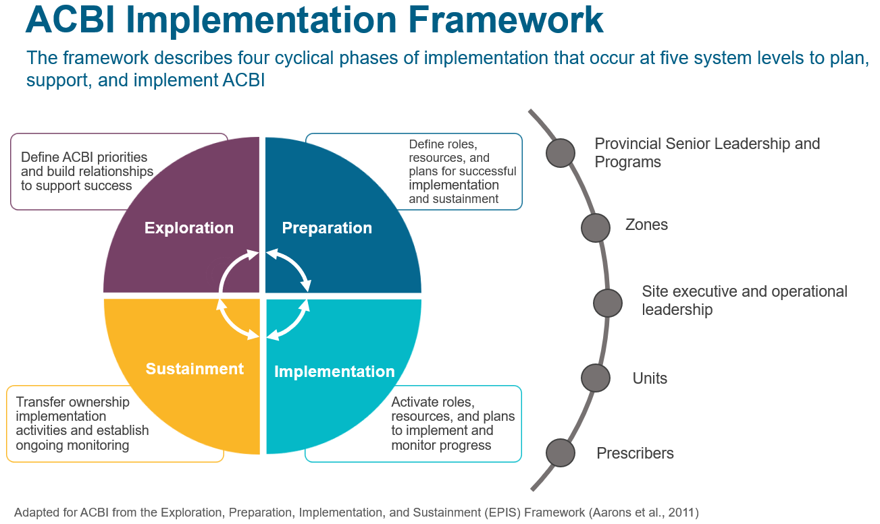
ACBI Implementation Framework
Notes:
The Exploration, Preparation, Implementation, and Sustainment framework, otherwise known as EPIS, was selected.
The Strategic Implementation Group engaged in a thought mapping exercise and consensus discussions to tailor the EPIS Framework concepts and processes and determine how the framework would be used to inform the implementation of ACBI.
This ensured that all system levels would be able to understand, apply, and operationalize the framework.
This formed the basis of the Playbook.

Slide 44
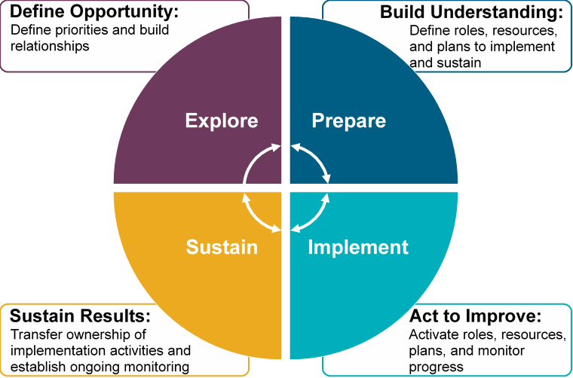
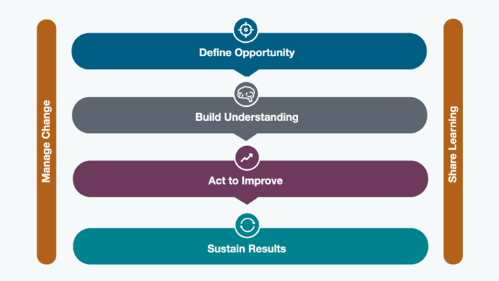
Integration of QI and IS
AHS Improvement Way (AIW)
ACBI Implementation Framework
Notes:
Co-designing the “Playbook” not only facilitated integration across different system levels, but also improvement approaches, like quality improvement and implementation science, which are often siloed.
This enabled alignment of diverse priorities and practices.
For example, the EPIS phases were aligned with the AHS Improvement Way phases – define opportunity, build understanding, act to improve and sustain results
Aligning implementation science methods with quality improvement and change management allowed for the inclusion of language and processes familiar to frontline staff, enhancing the usability and practical application of the “Playbook”.

Slide 45
ACBI Implementation Playbook
Site Level
Explore: Define opportunity | Prepare: Build understanding | Implement: Act to improve | Sustain Results
Introductory Meeting
Assess Site Readiness & Current Performance
Select Areas of Focus
Introduce Areas of Focus
Assess Barriers & Develop Action Plan
Implement Action Plan
Report & Review Progress
Sustain & Monitor
Develop Site Engagement Plan
Notes:
The final version of the Playbook specifies objectives, steps, tasks, and tools across each phase of the EPIS framework. The primary intended users include site staff responsible for ACBI implementation such as unit managers and the intended purpose is to provide flexible and evidence-informed guidance on the ACBI implementation process.
All of our work is grounded in evidence. We’ve applied implementation science, quality improvement, and change management principles to develop these 4 phases of work.
A co-design approach allows sites to own and drive the work that is responsive to their context
However, sites do not operate in isolation – ACBI aims to coordinate across levels to make sure the work is tailored to local needs

Slide 46
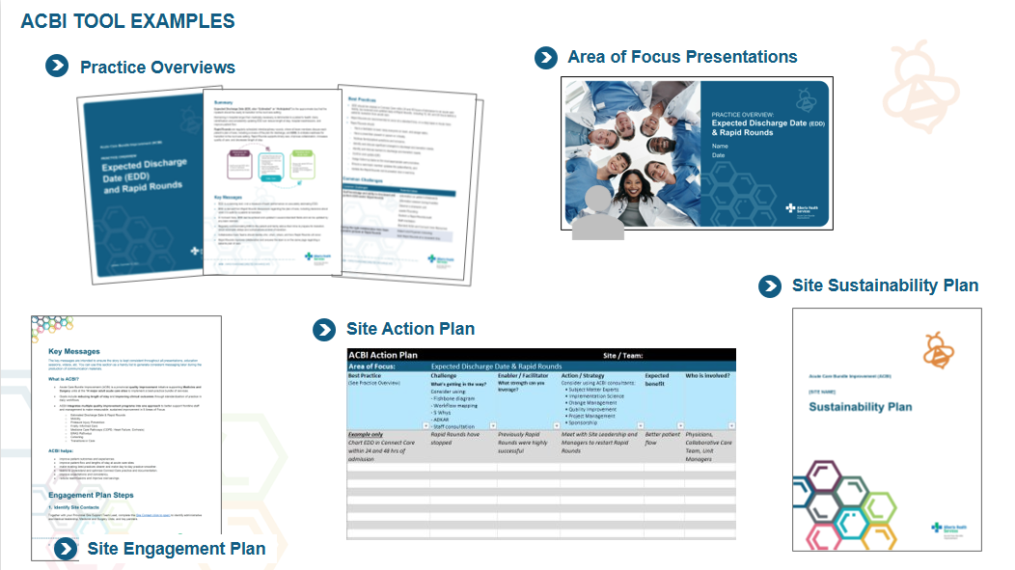
ACBI Tool Examples
Notes:
The co-design approach enhanced relevance and adaptability, resulting in a flexible implementation guide with tools tailored to the language and processes of frontline users.

Slide 47


Findings
Integrating implementation science knowledge with real world practice required extensive collaborative and iterative work.
Notes:
Extensive collaborative and iterative work was required to integrate implementation science knowledge with real world practice across multiple sites within a single health authority

Slide 48

Findings
The co-design process enabled co-creation of knowledge that more closely resembles the complexity of local contexts.
Notes:
The process of co-design highlights the recognition of and negotiation between differing forms of knowledge within the healthcare system to co-create knowledge that more closely resembles the complexity of local contexts.

Slide 49


Conclusion
Co-design mediated tensions between theoretical implementation frameworks and practical constraints.
Notes:
[This multi-year implementation process required ongoing collaboration and negotiation across system levels to maintain alignment with the initiative’s core objectives while supporting tailoring to reflect the local context, needs, and priorities at each site.]
The co-design process reconciled tensions between implementation science frameworks and the dynamic realities of healthcare delivery, fostering alignment between theoretical rigour and practical utility

Slide 50

Thank you! Comments? Questions?
Gabrielle Zimmermann, PhD Program Coordinator, Knowledge Translation & Implementation Science,
LHS Team, AbSPORU gzimmerm@ualberta.ca

Slide 51


Are Rigour and Pragmatism Mutually Exclusive? Reflections from Implementing Health Policies in the Global South
European Implementation Event 2025
Newcastle, UK
Dr Harvy Joy Liwanag
Saw Swee Hock School of Public Health
National University of Singapore

Slide 52
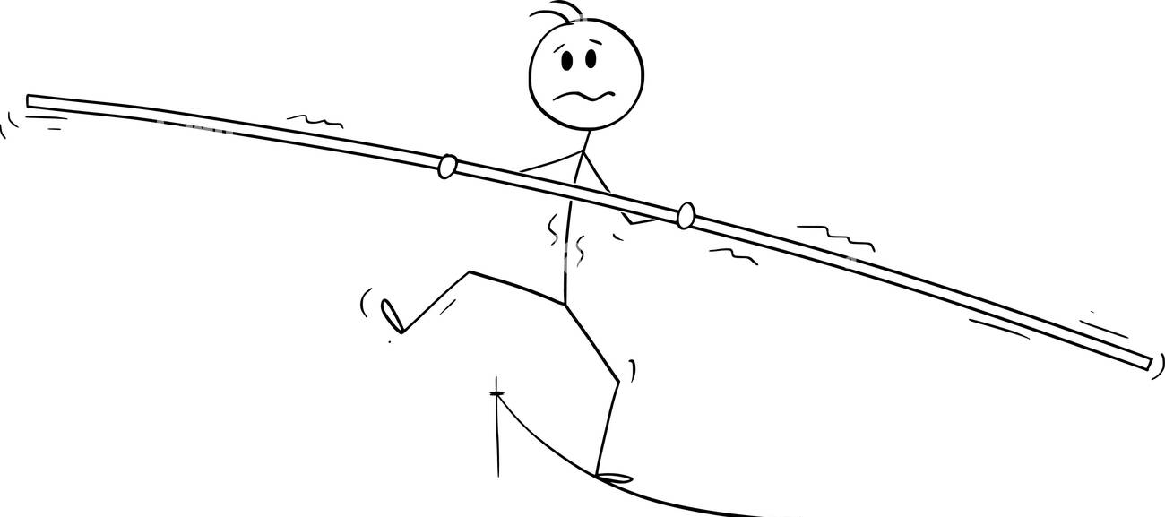
Knowledge for Implementing Health Policies
Rigorous
“Only randomized trials and experimental study designs provide the best evidence for implementation.”
We need strong evidence!
Pragmatic
“Everything is contextual. What works in one setting may not work in another setting.”
Let’s be practical!

Slide 53
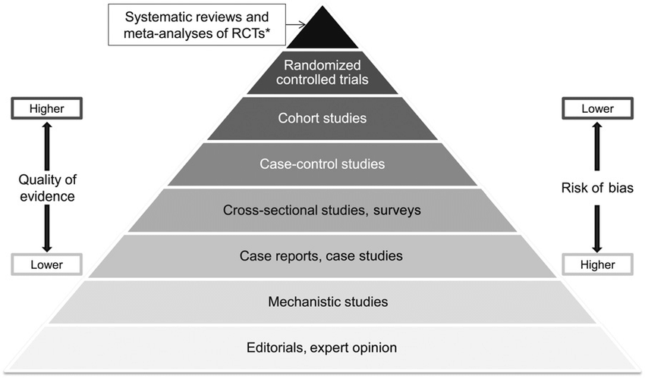
Hierarchy (?) of Evidence
More Useful for Implementation?
Well, it depends what problem we are trying to solve!
Less Useful for Implementation?
Yetley et al. Am J Clin Nutr 2017

Slide 54
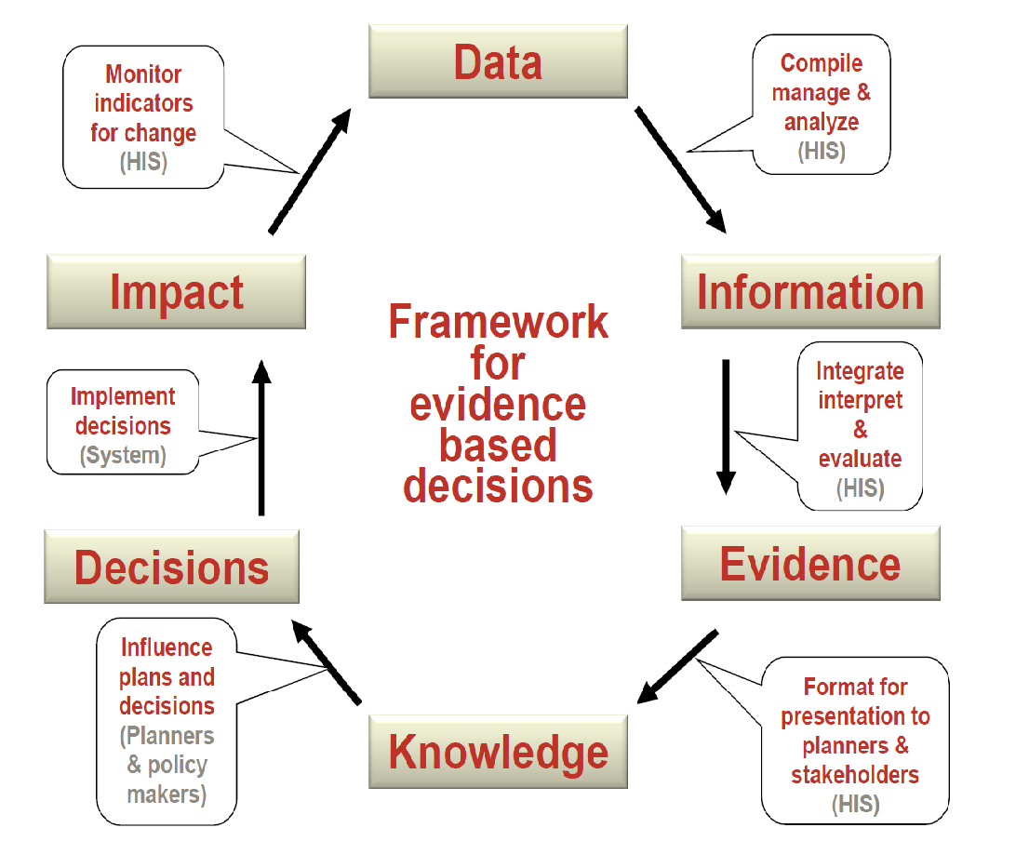

*Data are not numbers only!
- Quanti or quali
De Savigny D and Binka F (2004)

Slide 55


Questions for the Policy-Oriented Research
Quantity: How do we assess the adequacy of the health workforce and meet current and future population demand for health services, particularly primary care?
Skill mix: How do we achieve an appropriate mix of cadres of the health workforce?
Distribution: How can the distribution of the health workforce be more equitable to reach the most underserved areas?

Slide 56
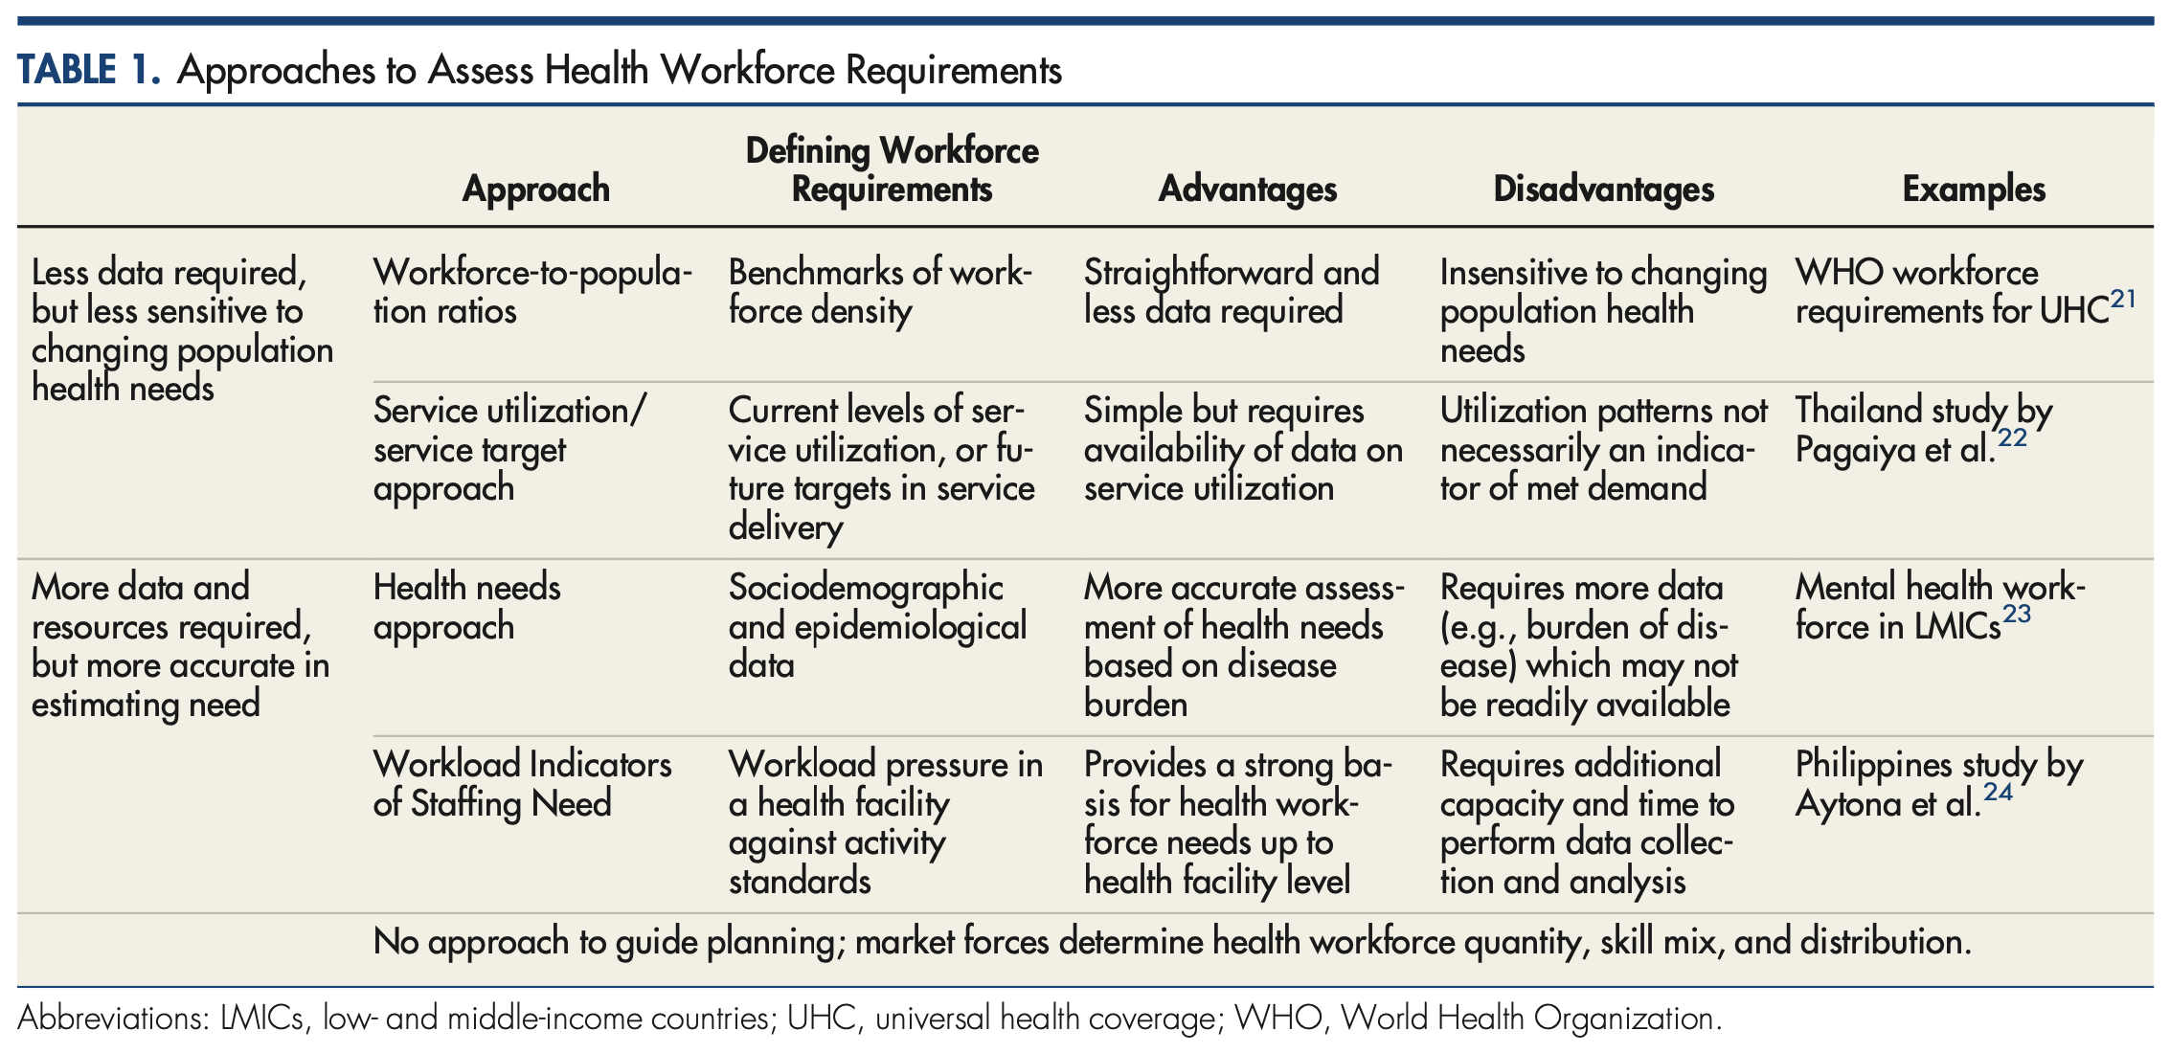
Estimating health workforce requirements
Pragmatic
Simple,
Crude Data
Complex,
Time-Consuming
Rigorous

Slide 57
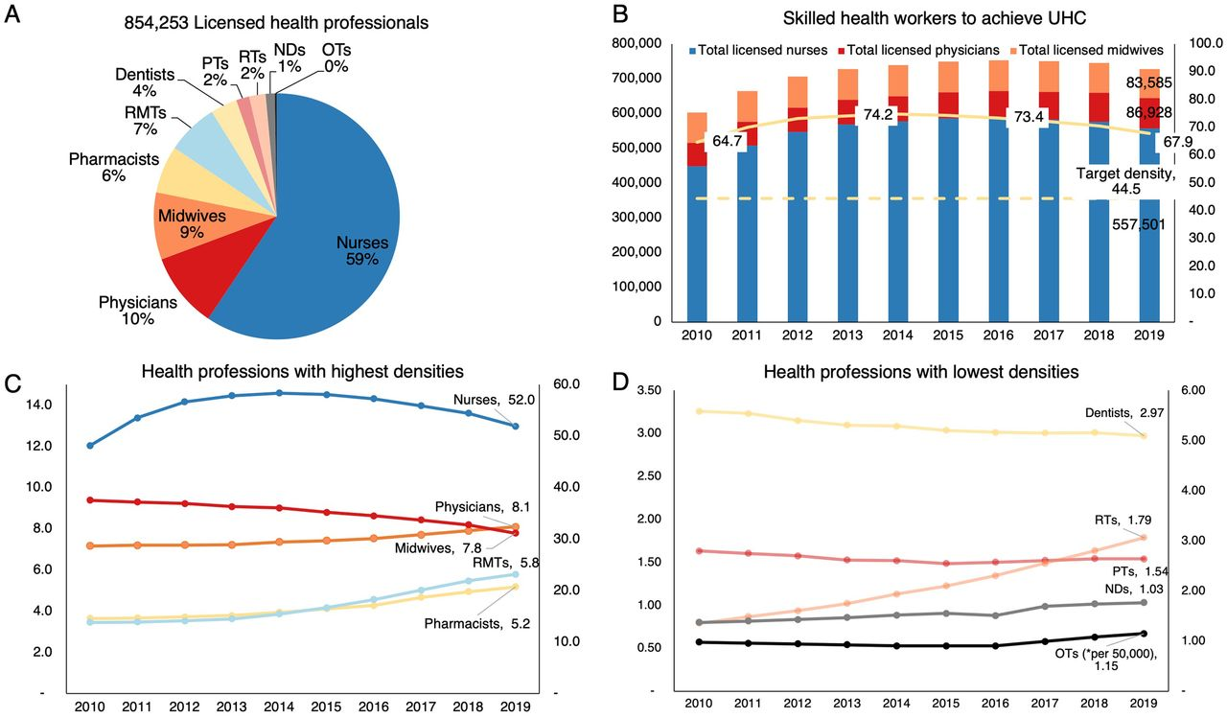

Slide 58
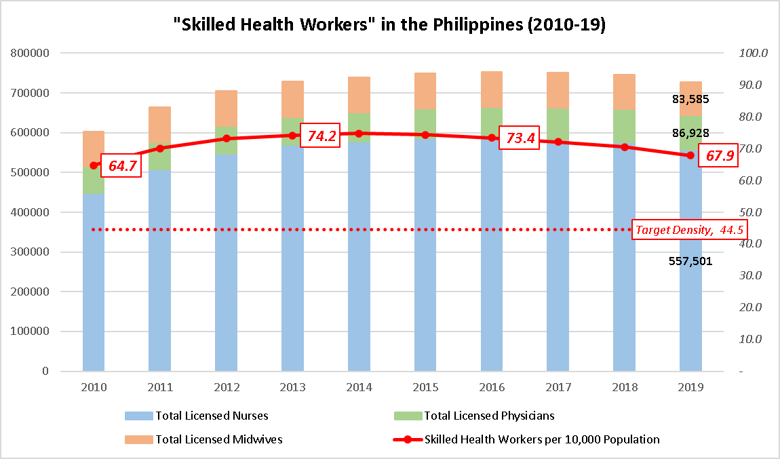
Skilled Health Workers in the Philippines (2010-19) to Achieve UHC
Midwives
Physicians
Nurses

Slide 59
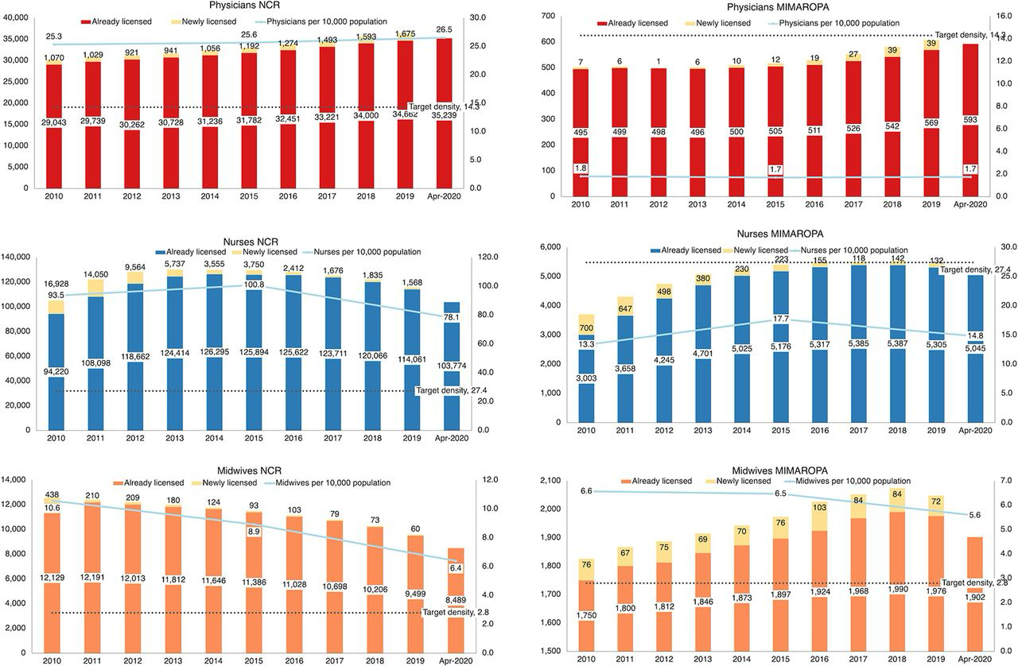
Above theshold
Below theshold
Above theshold
Below theshold
Above theshold
Above theshold

Slide 60
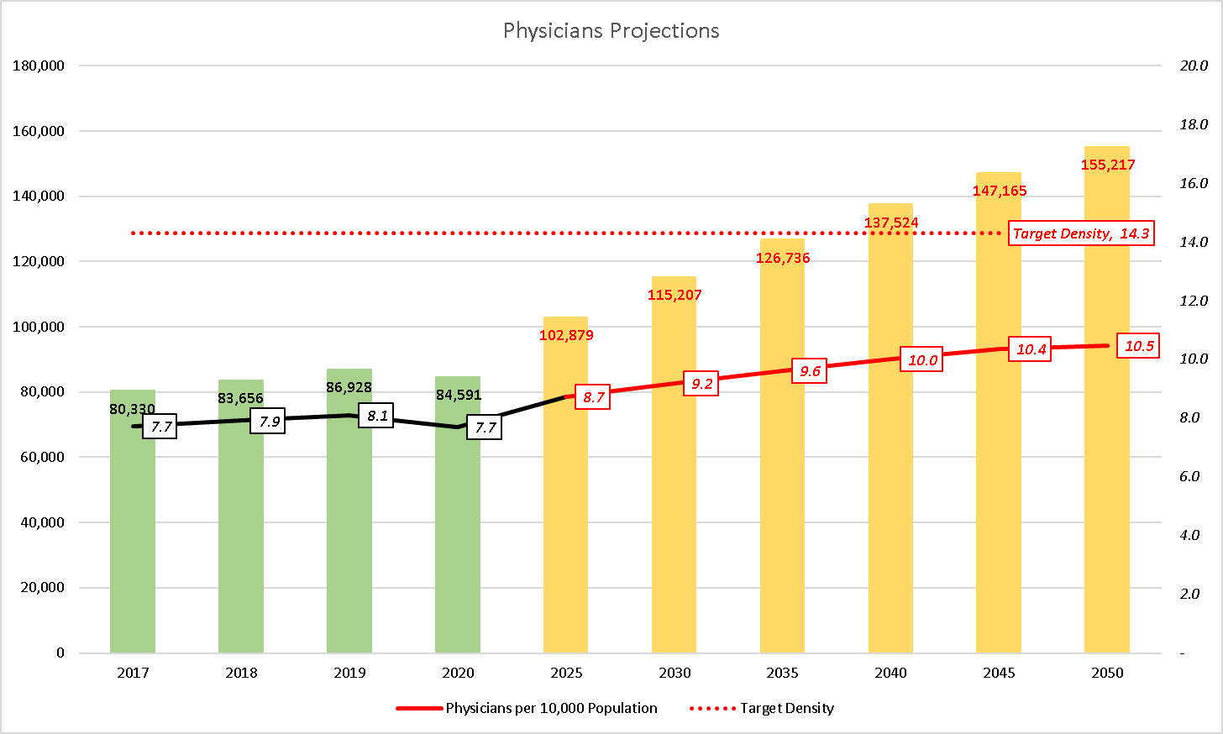
Total Licensed Physicians (2017-20) and Projected every 5 Years (2025-50)
What is a realistic solution?
+ 65,803 additional physicians to meet 14.3 per 10,000 !!!

Slide 61

Some Policy Recommendations
Training
Expand scholarships to support physicians, midwives, dentists, and occupational therapists
Support stepladder programs for nurses and midwives to transition to become physicians
Central support
Deployment of the health workforce to support provinces based on needs (low densities)
Task shifting
Identify physician functions that may be delegated to nurses or midwives
Create the enabling regulatory framework and credentialing mechanisms to enable task shifting

Slide 62
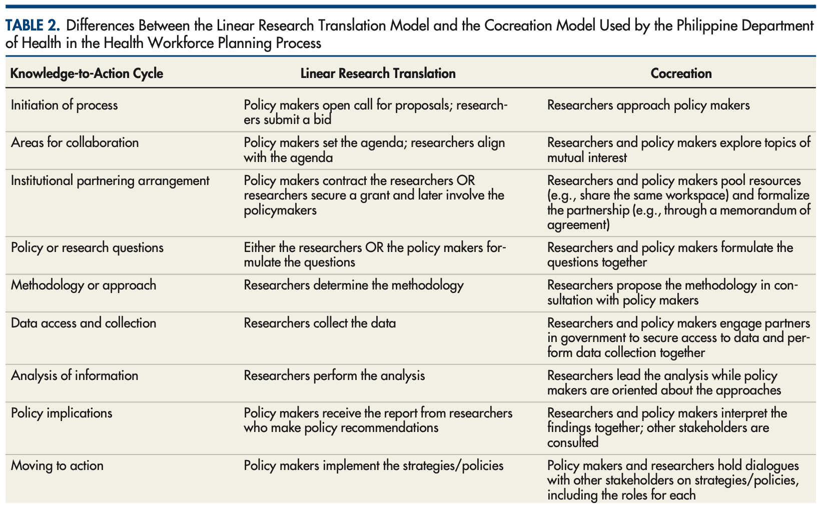
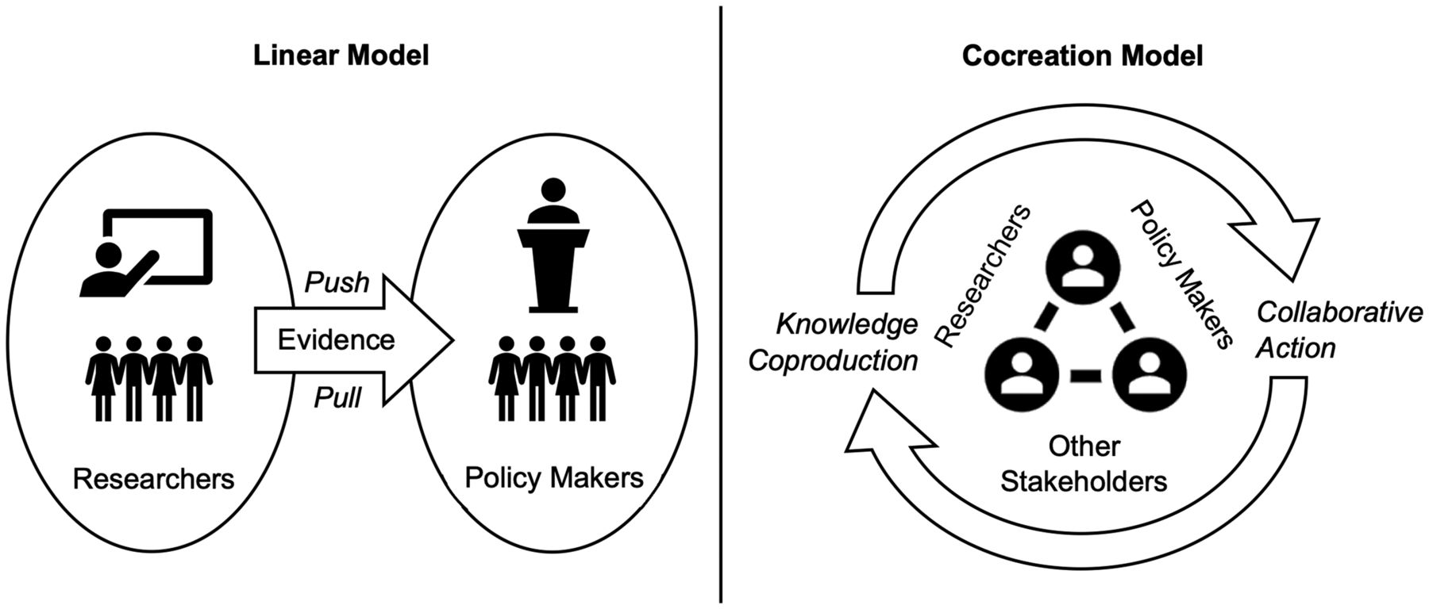

Slide 63
In Summary
Rigour and Pragmatism are less about “either or” but more about “balancing.”
From the perspective of rigour
Begin with how the study answers a policy or implementation question rather than an “a priori” hierarchy of methods
Promote the importance of multiple methods taken together, rather than relying on a singular approach
From the perspective of pragmatism
Do not use ‘complexity’ as an excuse for lack of rigour and understanding
Everything is contextual, yes, but it is also possible to think of dimensions/factors broad enough to be universal to guide implementation across contexts.

Slide 64

Thank you!
Email: liwanaghj@nus.edu.sg

Slide 65
THANK YOU!
Questions & Discussion
Presentation 1: Sarah Serhal
Presentation 2: Rakhi Vashishtha
Presentation 3: Gabrielle Zimmermann
Presentation 4: Harvy Joy Liwanag
Session host: Leonike Boendermaker
Thought-provoking presentations and interesting insights?
Spread the word and let us follow along by using #EIE2025!

