Slide 1


Ride the Knowledge Wave 3
IMPLEMENTATION TOOLS AND GUIDANCE
Presentation 1: Cathy Duggan
Presentation 2: Nina Zipfel
Presentation 3: Megan Wainwright
Presentation 4: Louise Hull
Session host: Monika Sztankay

Slide 2
Bridging the gap
A practical guide to facilitate implementation of national standards in health, mental health and social care services
June 2025
Cathy Duggan
Project lead – Health and Social Care Standards
Health Information and Quality Authority (HIQA), Ireland
cduggan@hiqa.ie | standards@hiqa.ie | www.hiqa.ie
Notes:
My role is about developing national standards for health and social care and supporting implementation of those standards into practice
This session focuses on one of our implementation support tools, which is a guide on how to put nationals standards into practice

Slide 3
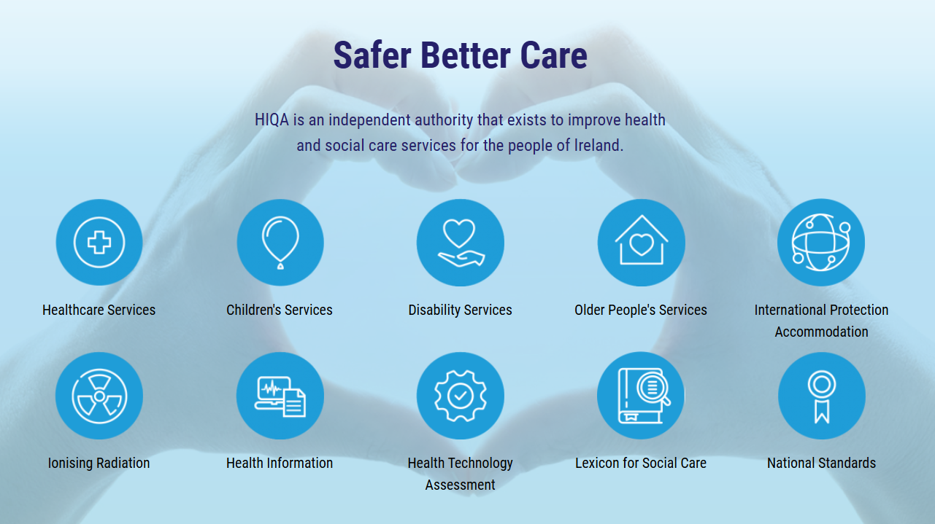
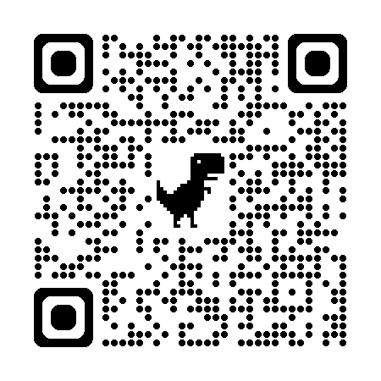
www.hiqa.ie
Notes:
HIQA is an independent statutory authority, established in 2007, to improve the safety and quality of health and social care services for the public in Ireland. (Health Act 2007)
There are a number of different areas under HIQA’s remit
Setting standards for health and social care services
Regulating social care services
Regulating & monitoring health services
Health Technology Assessment
Health Information
National Care Experience Programme

Slide 4
What are national standards?
National standards
Provide a common language to describe what high-quality, safe, person-centred care looks like.
Create a basis for services to improve the quality and safety of the care they deliver, by identifying strengths and highlighting areas for improvement.
Assist people using services to understand what they should expect from a service.
Promote practice that is up to date, effective and consistent.
Notes:
National standards are a set of high-level outcomes that describe how health and social care services in Ireland can achieve safe, quality, person-centred care and support.
The standards HIQA develops are quality improvement standards, to be used as targets for the provision of quality and safe care.
Provide a common language
They are also a resource for people using services to understand what safe, high-quality care looks like and what to expect from a service.

Slide 5







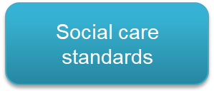







National standards for health & social care
Overarching standards
All standards available on www.hiqa.ie
Notes:
There is currently a total of 12 national standards developed by HIQA for health and social care services
There are standards for a range of health and social care services, including older persons, disability services, acute healthcare settings and residential settings
Supporting Implementation: HIQA also develops tools and resources to support services to put national standards into practice and to comply with them

Slide 6

Enablers and barriers to implementing standards
Enablers
Support tools prompt compliance, improve performance and assure effective implementation of standards.
Staff who act as champions and role models are key elements to implementation of standards.
Training courses to increase awareness and knowledge of the standards help implement the standards.
Barriers
A lack of knowledge, awareness and understanding of what standards are.
Staff have insufficient time
Kelly Y, O’Rourke N, Flynn R, O'Connor L, Hegarty J. Factors that influence the implementation of (inter)nationally endorsed health and social care standards: a systematic review and meta-summary. BMJ Quality & Safety. https://doi.org/10.1136/bmjqs-2022-015287
Notes:
Understanding the mechanisms of change and what is needed to support the successful application of standards into practice helps us in developing targeted implementation support tools, ensure we’re prioritising areas of need, reaching our target audiences and having an impact on the quality and safety of health and social care services in Ireland. The ultimate aim is improving the experience of people using health and social care services.
Enablers and barriers show what works well and what gets in the way of implementing initiatives. Colleagues on the standards team published the findings of this systematic review last year on the factors that influence the implementation of (inter)nationally endorsed health and social care standards
This slide outlines the most frequently reported enablers and barriers in which the study authors had high confidence.
“The availability of support tools, training courses and accessible educational materials helped to implement standards. Studies referred to support tools as standardised assessment tools, checklists, policies and guidelines.”
Some examples of the enablers and barriers that were reported in the literature are detailed below.
31 studies reported enablers to implementing health and social care standards. Of these 31 studies, 17 reported that using support tools at local level prompted compliance and improved performances. 16 studies reported that recruitment and availability of staff were key to implementing standards. Key staff members described in studies included champions, designated personnel, specialist nurses and physicians. 16 studies reported that training courses (education) increased awareness and knowledge of the standards. Training courses included targeted training, national training, in-service training, workshops and role play sessions.
35 studies reported barriers to implementing health and social care standards. Of these 35 studies, 22 reported a lack of knowledge, awareness and understanding of what the standards are. This gap in knowledge, awareness and understanding of standards related to the rationale for standards; content of standards; expectations of service delivery; available support tools. 15 studies reported that services were experiencing increased capacity and work overload that resulted in a lack of time to implement the standards.
An understanding of these enablers and barriers will assist in decision-making when selecting appropriate implementation support actions and support tools. These support actions and support tools aim to help health and social care services with the implementation of standards, ultimately for the benefit of service users. For example, selecting and then developing an e-learning module can help overcome barriers such as a lack of knowledge of what the standards are.

Slide 7

Implementation support tools
HIQA develops implementation support tools to assist services and staff to implement the national standards in their setting.
Throughout the standards development process, HIQA works to identify potential enablers and barriers to the implementation of the standards and addresses these within the standards or through the development of additional support tools.
Materials to support the implementation of national standards are available on HIQA’s Learning Hub www.hiqa.ie/learning-hub
Notes:
At all stages in the development of National Standards, HIQA seeks to identify and understand potential barriers and facilitators to the implementation of National Standards in health and social care services.
To do this, HIQA engages with people with experience of using services, staff, service providers, policymakers, advocates and subject matter experts to ask them what they see as the barriers, for example knowledge gaps, and facilitators to the implementation of the standards, such as national policy or protocols, or centrally provided training for staff.
This is done by asking specific questions during the two public consultations that take place during standards development, at Advisory Group meetings, during focus groups, and as part of the public consultation on draft standards.
Feedback on the barriers to implement standards and proposed strategies are reviewed, strategies identified and developed in collaboration with stakeholders – so the approach is really based on identified support needs within the system
The team develops a broad spectrum of tools and resources including guides, leaflets or online learning courses. To give a sense of uptake, there’s been over 350,000 completions of our online learning courses so far

Slide 8




Available on www.hiqa.ie
Notes:
I’ll be sharing some more detail about the guide and how it was developed now
The guide acts as a resource for service providers, helping them to understand what national standards are, what they mean for their service and how to put national standards into practice in their own service setting
Published October 2024

Slide 9


Why develop this guide?
Requests from staff in services for a self-assessment, self-audit or quality improvement tool, and
analysis of staff-reported knowledge gaps and barriers to implementing national standards
CFIR x ERIC Matching Tool strategy identification
(Consolidated Framework for Implementation Research x Expert Recommendations for Implementing Change)
Opportunity to develop a perpetual resource that is relevant across all national standards, all service types, whether regulated or unregulated, and all service-user cohorts.
Notes:
The guide was developed in response to feedback received from stakeholders during several standards development processes. During public consultation on draft standards, stakeholders indicated that while service providers welcomed the standards and agreed with the content, some felt unprepared to implement them and wanted to prepare in advance before their commencement and others felt that resources to help with self-assessing their service would be helpful.
As part of the consultation process with stakeholders during standards development, stakeholders specifically suggested that guidance on self-assessment against the standards would be highly beneficial in preparing them to implement new standards.
Given that all national standards have core components essential for achieving high-quality, safe, person-centered care and support—components set out under the four principles of a rights-based approach, safety and wellbeing, responsiveness, and accountability—it was seen as a valuable opportunity to develop a resource relevant across all National Standards, service types, and service-user cohorts.
HIQA’s remit was also important to consider at this point, whereby it’s important for us to identify solutions that will work at scale across the health and social care sector as a whole – and in this case the mental health sector too.
Thinking back to the systematic review findings, we know that support tools and educational materials help to implement standards, and that a lack of knowledge, awareness and understanding of what standards are barriers to put them into practice. So, while national standards set clear expectations that are welcomed by service providers, translation into practice can be challenging.
The Consolidated Framework for Implementation Research (CFIR) X Expert Recommendations for Implementing Change tool was also used to prioritise development of this guide. CFIR is a implementation framework that brings together key constructs from implementation theories. The matching tool was developed to help with identifying strategies to address identified barriers to implementation. It’s a downloadable excel document and while it’s not a magic bullet, it provides a good starting point. At the output from this matching tool also pointed us towards developing this guide.
The key barriers to implementing the standards using the CIFR framework are the adaptability and complexity of the standards. Appropriate strategies identified through the matching tool for addressing these barriers include:
Assess the organisation’s readiness to implement the standards and identify barriers and facilitators
Develop a formal implementation plan
Tailor the implementation strategies to address the barriers, and leverage facilitators
Promote adaptability of the standards by identifying how the standards can be tailored to local needs.
So in developing this resource we aimed to offer a comprehensive guide addressing these topics.

Slide 10




Implementation guide contributors
Notes:
This guide was a joint project by HIQA & MHC (agency responsible for setting standards for mental health services in Ireland)
this guide was developed in response to stakeholder recommendations to develop a self-appraisal tool to facilitate the implementation and embedding of national standards. A working group was established with representation across health, mental health and social care sectors. A literature review was conducted on comparable implementation tools. Semi-structured focus groups and interviews (n=70) were conducted with standards-setting and regulatory staff, managers and frontline staff in services, and people with experience of using services, which were recorded and selectively transcribed. The review and stakeholder feedback informed the design and content of the guide.
Working group with representatives from difference sectors and people with experience of using services
Service providers including managers and frontline staff
This collaboration enabled us to create something useful, realistic, and grounded in service realities.

Slide 11
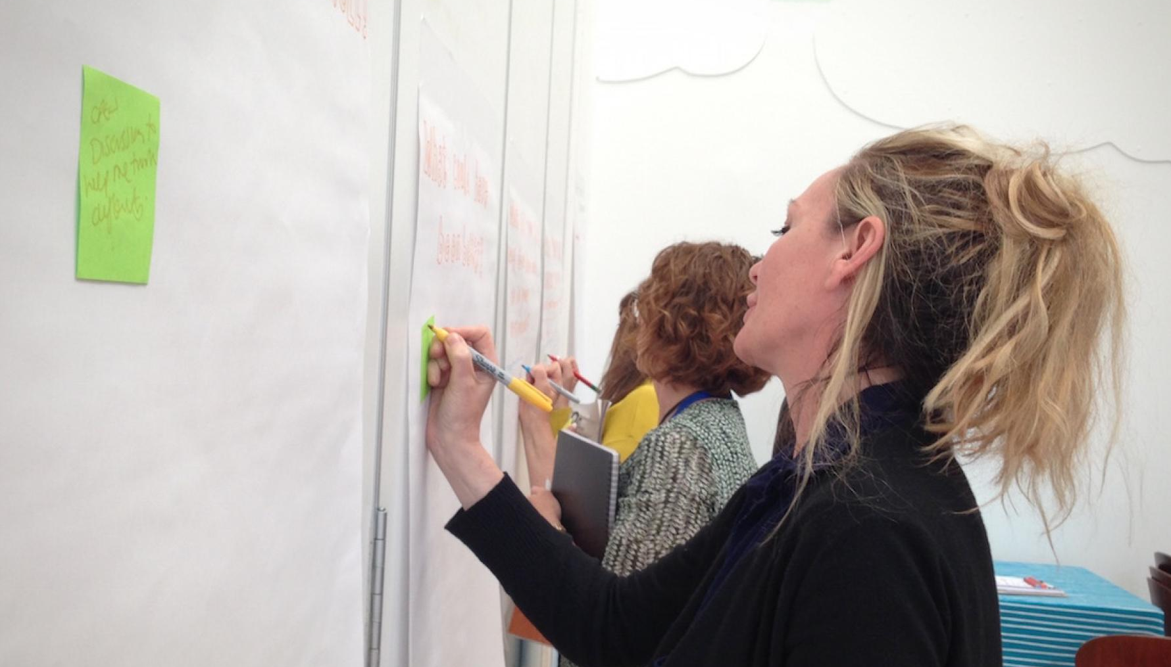
What we did to develop the guide:
Working group
Literature review
Focus groups and interviews (n=70)
Member checking of the draft guide.
Notes:
As the guide was to apply to staff across the health, mental health and social care sectors, stakeholder mapping and engagement was important, so the perspectives of staff and service users from different sectors was sought in different ways at different stages of the process –
A diverse working group made up of about 10 people provided advice and recommendations throughout the process: representatives of regulators, providers and people using services
A literature review was conducted on comparable implementation tools.
Semi-structured focus groups and interviews were conducted with standards-setting and regulatory staff, managers and frontline staff in services, and people with experience of using services, which were recorded and selectively transcribed . The review and stakeholder feedback informed the design and content of the guide.
The draft guide was also reviewed by staff and services users who had contributed to its development prior to finalisation
Development started in April 2023 and it was published in October 2024

Slide 12

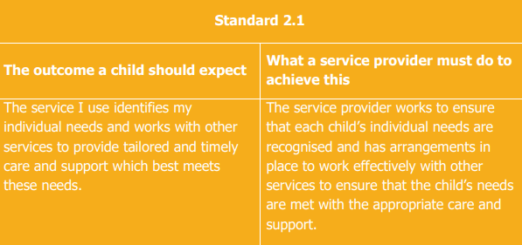
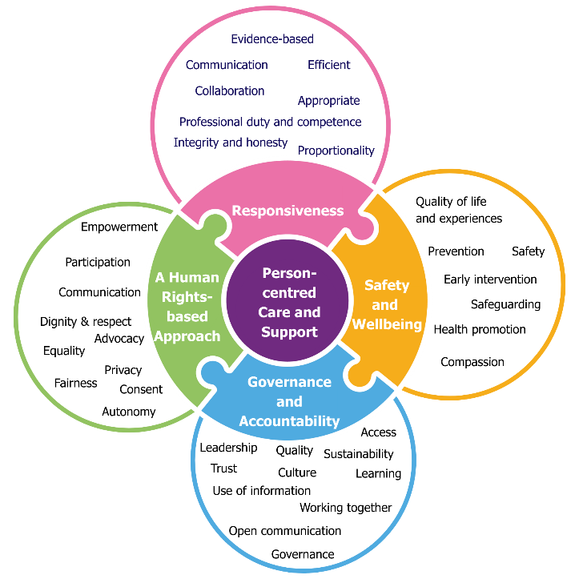
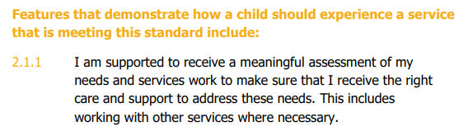
How staff in services interpret national standards
Safety and Wellbeing
Draft Overarching National Standards for the Care and Support of Children using Health and Social Care Services
Notes:
It’s useful to give a little more information about how standards are structured to set the scene about why and how this implementation guide was developed, as the focus of the guide is on helping service providers to understand what national standards are, what they mean for their service and how to put national standards into practice
All national standards are underpinned by a set of principles: a rights-based approach, safety and wellbeing, responsiveness, and accountability, all working together to achieve person-centred care.
Under each principle, staff will find a list of standard statements. These standard statements explain the principle or theme in more detail by setting out what an individual accessing the service should expect and why the organisation should do to achieve it.
After each standard statement, there are a number of features that illustrate what a service that reaches the standard might look like.
You can see this example illustrates a standards statement and features illustrating the principle of Safety and Wellbeing. The example is taken from the Draft Overarching National Standards for the Care and Support of Children using Health and Social Care Services, which is in development .

Slide 13

Objectives of the guide
The guide aims to enhance:
Knowledge and awareness of national standards among staff
Staff confidence in applying standards to practice
Readiness to implement change within services
Capacity to leverage enablers and address barriers to meeting standards
Collaboration between staff and with people using services
Understanding of how current practice compares with national standards, and
Alignment with national standards.
Notes:
It provides a structured process for implementing national standards, including self-appraising services and developing an action plan, and providing helpful tools, templates and resources throughout.

Slide 14

Challenges
Developing one guide for different sectors and settings
Ensuring the guide is helpful and not overly prescriptive
Balancing consistency with flexibility
Notes:
Services differ in size, structure, and regulatory and other legislating requirements. Because HIQA and the MHC are regulatory bodies, some were concerned that the guide might become another mandatory compliance tool, so we were very clear throughout the development process and in the guide that it is not.
The structure of the standards themselves enables consistency and clarity of language and approach, so the guide emphasises those core components of safe, high quality and person centred care and reassures providers that if their service is focused on and working to achieve these core components, then they are on the way to meeting national standards. The guide is also designed so it can be used from any starting point, not just when new standards are being introduced.

Slide 15
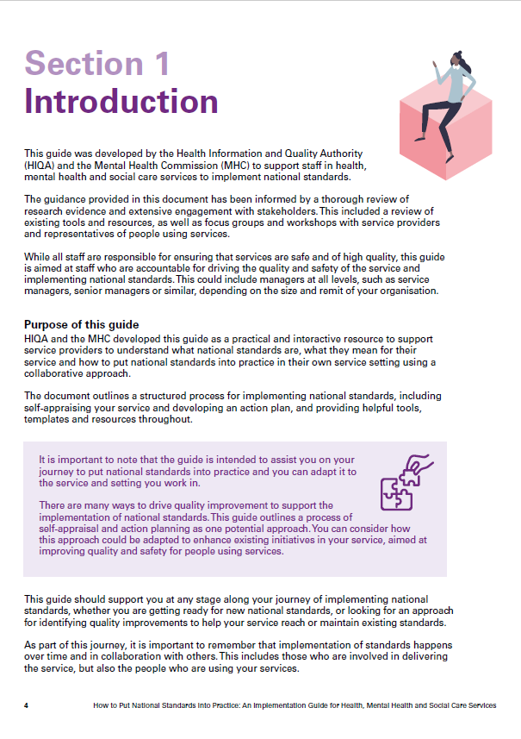
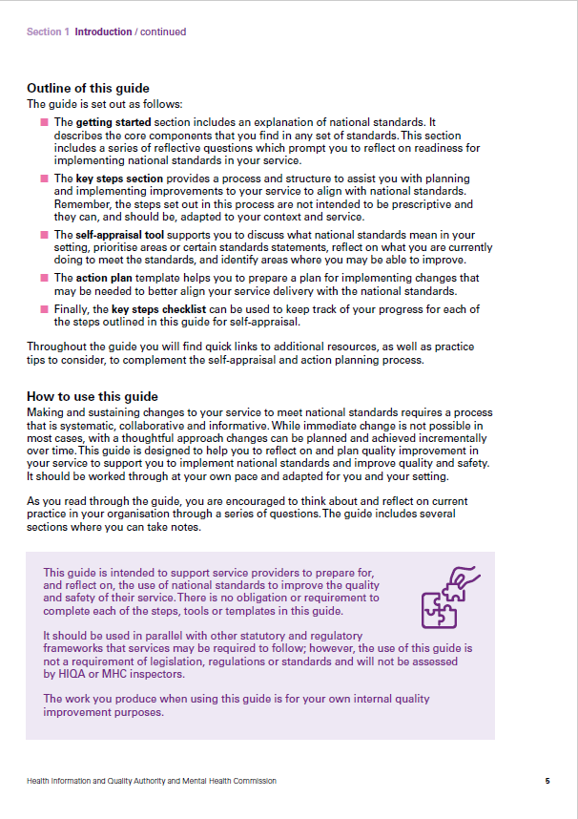
Notes:
Draw attention to:
Key sections are hyperlinked for ease of use
Wanted to emphasise supportive and assistive nature of the guide at the outset –

Slide 16
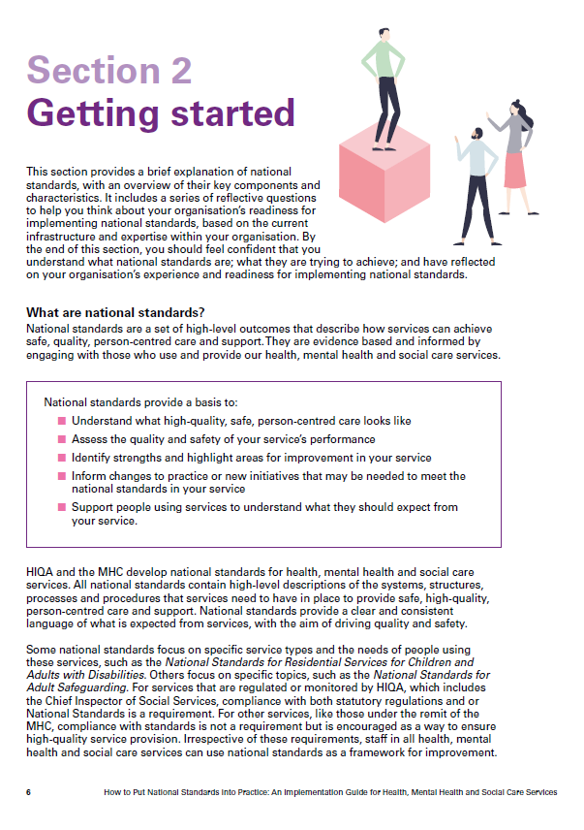
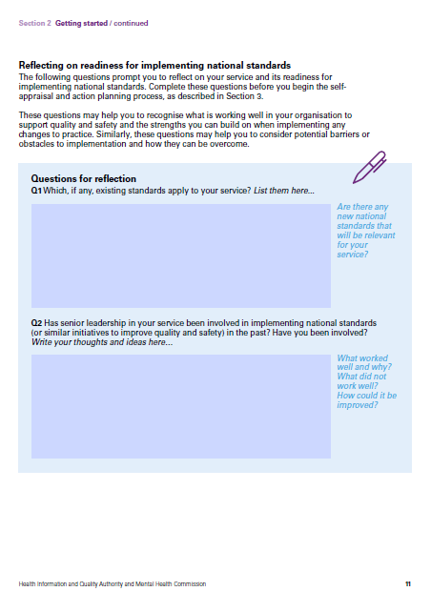
Notes:
Section 2 is called getting started, because it’s all about building readiness within services for standards – given that the guide is intended to support services at any stage along the journey of implementing national standards – including those services who don’t have a set of standards published for their area but maybe know that draft standards are in the works.
So this section provides education on what standards are, how they’re structured, how to interpret them as a way to demystify them and build confidence.
On the right you can see this interactive section where we’ve drawn from the literature on organisational readiness for change to develop these prompts, to get staff thinking about what is working well to support quality and safety, and what strengths can be built upon when implementing changes. We know from the literature that an understanding of how ready an organisation is can be helpful as they prepare to implement new interventions and throughout the process of implementation. So you can see, for example q2 is prompting reflection on the leadership and skills available to bring about change.

Slide 17
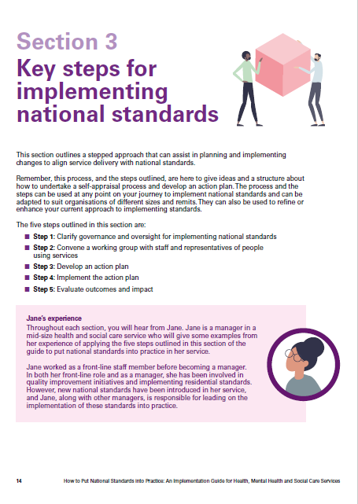
Notes:
The guide includes a case study featuring Jane, a manager in a mid-size health and social care service, provides practical examples of the information contained in the guide. The case study was developed with two members of the working group who manage services, who described how the processes outlined in the guide work in practice. So it builds transferability and offers practical insights
The five steps are central to the guide, they offer an approach that helps providers to get started with national standards, by moving through a process of understanding the standards, to assessing readiness for them, identifying priorities for change, making and implementing a plan and evaluating progress.
You can see there are 5 steps:
Working with senior leadership in your organisation to clarify governance and oversight arrangements for the process, including the role of a working group that will be tasked with leading a self-appraisal process and developing an action plan
bringing together a working group to assess how national standards apply to the service - collaboration with staff and service users
Based on this assessment, develop an action plan
Put the changes into practice – this section emphasises the importance of monitoring any change and making adjustments as necessary
Assess whether the changes made to practice have resulted in improvements, and identify learnings from the process
Throughout the guide it’s emphasised that any piece of guidance should be adapted to suit different contexts, and that’s the same with this process. So for example while we set out each step, and actions to achieve each step, we also set out high level objectives for each of the 5 steps, so the users of this guide can see what the ultimate aim of each step is and maybe identify an existing process or structure they have to achieve that.

Slide 18
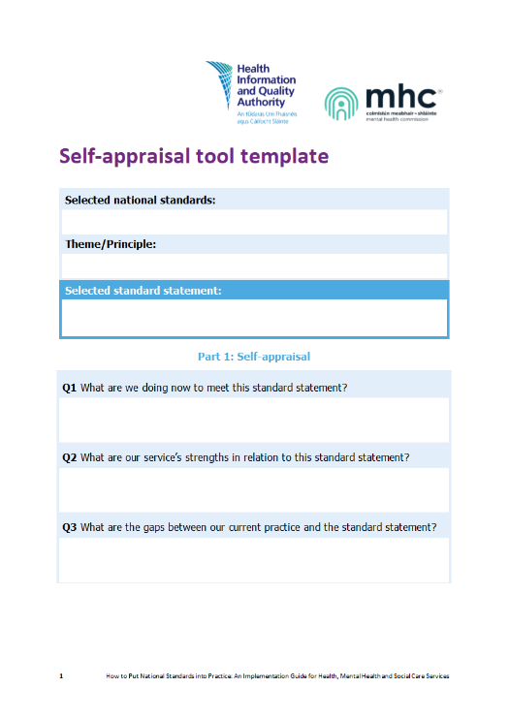
Notes:
Available to download from the website as a word document, also available within the guide itself
Prompts staff to hone in on a particular national standard, a principle or theme that’s relevant to them, and then one particular standard statement. It encourages involving staff at different levels and positions, and people using services which is key to meaningful change.
Completed example available too
Encourages structured, team-based reflection.
Focus on what's working well and where improvements are needed.
Includes prompts for evidence gathering and stakeholder input.

Slide 19
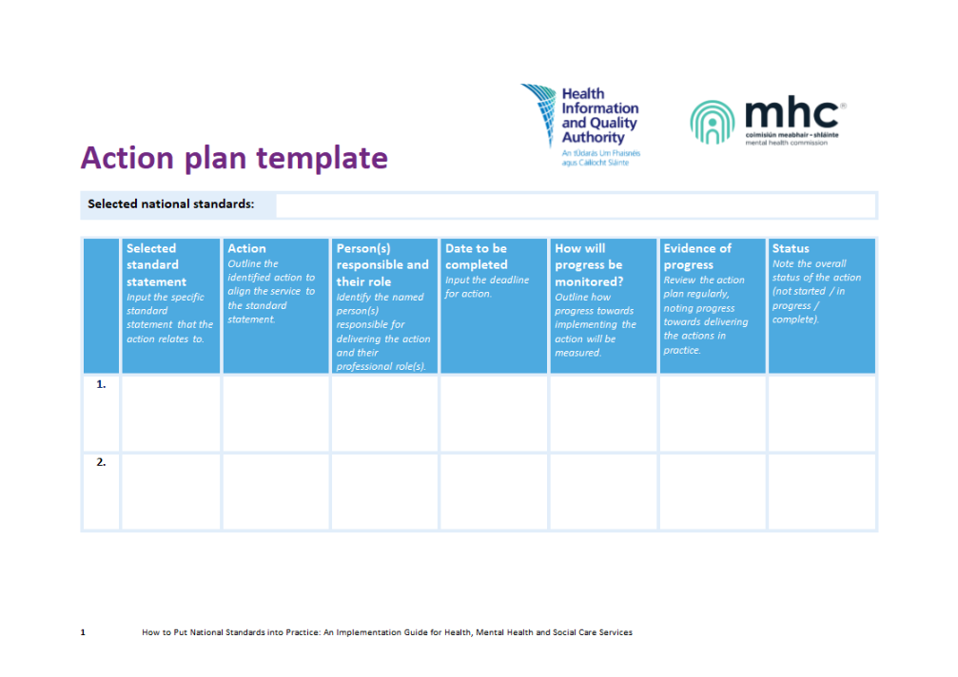
Notes:
The action plan links standards to actions, responsibilities and timelines.
Promotes clear accountability and progress tracking.
Adaptable for any size or type of service. Structured but flexible enough to suit different settings and can easily by amended as needed.
Templates like this were important to include in the guide given feedback from staff showing that they welcome the efficiency of templates

Slide 20

Discussion and next steps
How should we evaluate the guide’s impact?
Could alternative formats support wider use?
Notes:
In order to reach intended audience we plan to promote the guide alongside new national standards as they are published
We’re currently planning our approach to gathering feedback on the guide, to identify opportunities to improve it and explore how it’s being used
We’d love to hear your thoughts! How should we evaluate the guide’s impact? Could sector-specific versions support wider use? Or different formats? And how to keep it alive and relevant over time?

Slide 21

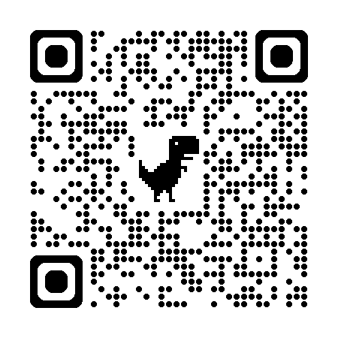
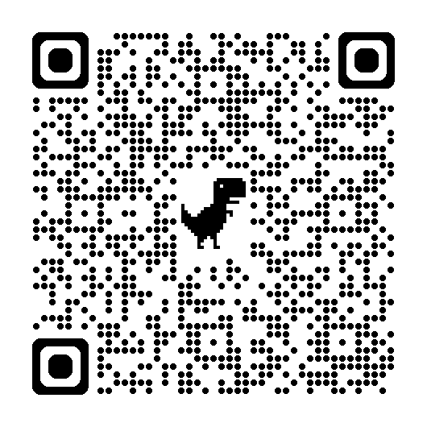



Thank you
Learning Hub
Implementation guide
Health Information and Quality Authority (HIQA), Ireland
cduggan@hiqa.ie | standards@hiqa.ie | www.hiqa.ie

Slide 22





ENHANCING PERIOPERATIVE LUNG CANCER CARE
Barriers and facilitators for the implementation of an audit and feedback dashboard
in the Netherlands
Nina Zipfel
June 5 2025

Slide 23
 | No, Nothing to disclose
 | Yes, please specify
Company / Name | Honoraria / Expense | Consulting / Advisory Board | Funded Research | Royalties / Patent | Stock Options | Ownership / Equity Position | Employee | Other (Please specify)
Example: company xyz
EIE 2025, June 5 2025

Slide 24












Enhanced Recovery After Thoracic Surgery
Preadmission
Preoperative
Perioperative
Postoperative
Discharge

Slide 25
Enhanced Recovery After Thoracic Surgery
Preadmission
Preoperative
Perioperative
Postoperative
Discharge
Standardized anesthesia protocol
Information and counseling
Smoking cessation
Post-op pain management
Fasting policy
Early mobilisation
Nutritional screening

Slide 26





Background
ERATS guideline publication
Practice variation among hospitals
Multidisciplinary approach
Standardize perioperative care
Improve patient outcomes
Effective implementation in daily practive
Audit and feedback dashboard
Notes:
Current situation in the Netherland: guideline publication
But the goal of erats is: standardize perioperative care
Erats also: multidisicplinaru approach
Effective: bridiging the gap is=

Slide 27



Background
Real-time feedback on delivered care – guideline adherence
ERATS elements linked to patient outcomes
NL benchmark
Discuss results with multidisciplinary team
Monitor quality improvement!
Notes:
The Dutch-Lung-Cancer-Audit-surgery-database was expanded to support the development of a dashboard, serving as an A&F tool for healthcare care professionals (HCPs) in hospitals. The dashboard added-value lies in monitoring adherence and linking it to patient outcomes by providing efficient feedback. Providing HCPs with feedback on their delivered care, is a powerful method for encouraging continuous improvements in the quality. Effective implementation of the dashboard is essential to ensure its use in daily practice. This research focuses on identifying facilitators and barriers for the implementation of the A&F dashboard into daily practice.
To support healthcare professionals in following this protocol, we developed a dashboard.
The Dutch-Lung-Cancer-Audit-surgery mandatory database was expanded to support the development of a dashboard, serving as an audit and feedback tool for perioperative care teams in hospitals. The dashboard added-value lies in monitoring adherence and linking it to outcomes by providing timely and efficient feedback. Effective implementation of the ERATS dashboard is crucial to ensure its use in daily practice.

Slide 28
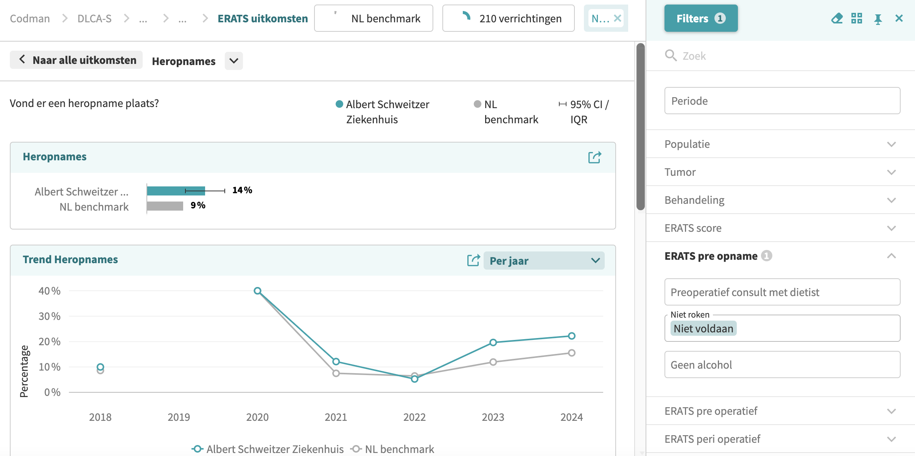
ERATS Dashboard
Hospital A
Readmission
Hospital A
Trend readmission
Per year
Percentage
Smoking cessation
Not fulfilled
Hospital A

Slide 29
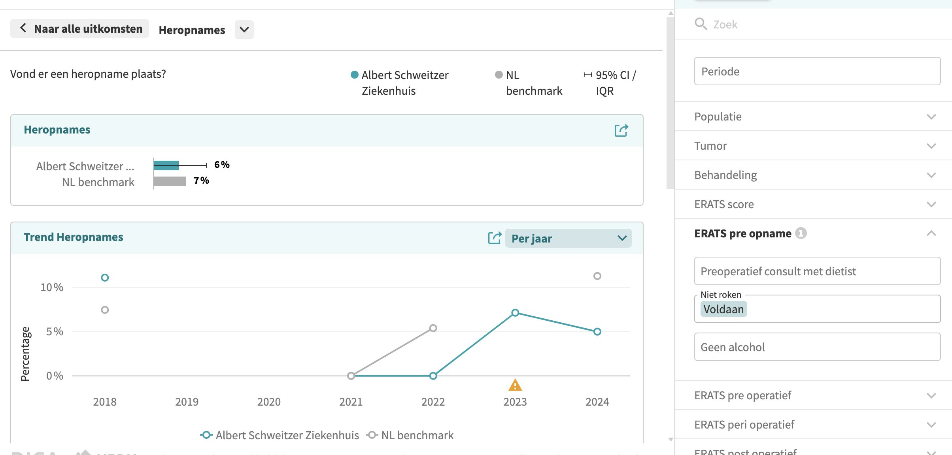
ERATS Dashboard
Hospital A
Readmission
Hospital A
Trend readmission
Per year
Smoking cessation
Fulfilled
Percentage
Hospital A

Slide 30

O
OBJECTIVE
To identify facilitators and barriers for the implementation of an audit and feedback dashboard

Slide 31




Methods
Measurement Instrument for
Determinants of Innovations (Fleuren, 2004)
Development interview guide
Semi- structured interviews
n=11
Multidisciplinary perioperative care team
Hospital management
Datamanagers
Dashboard developers
Patient reprentatives
The Consolidated Framework for Implementation Research (CFIR)
(Damschröder, 2022)
Thematic analysis
Focus group discussion
n=1
European Society of Thoracic Surgeons, 26 May 2025
Notes:
In the first phase, we conducted interviews and a focus group with 20 stakeholders from different disciplines. We used the Consolidated Framework for Implementation Research to guide our analysis.
Data managers, hospital management, business intelligence specialists, industry (dashboard developers) and patient representatives Thoracic surgeons, pulmonary physician, anesthesiologists, nurses, physical therapist and dietitian
A qualitative study was conducted, using n=11 semi-structured interviews and n=2 focus group discussions to gather insights from diverse stakeholders (perioperative care teams, hospital management, patient representatives) to identify facilitators and barriers for implementation and explore current practices. A thematic data analysis was performed using The Consolidated Framework for Implementation Research (2022).

Slide 32
Results
CFIR Domain | Theme | F/B
Innovation | Registration burden for data entry | Barrier
 | Concise definitions in dashboard | Facilitator
 | Sensitivity to errors in data entry | Barrier
 | Monitor real-time outcomes | Facilitator
 | Feedback mechanism | Facilitator
 | Limited integration with EPRs | Barrier
Inner Setting | Lack of budget | Barrier
 | Share best practices between hospitals | Facilitator
 | Diversity in treatment and staff among hospitals | Barrier
 | Lack of consistent audit and feedback cycles | Barrier
Characteristics of individuals | Background of data managers | Barrier
Process implementation | Need for practical training | Facilitator
 | ERATS champion appointment | Facilitator
 | Need for clear task division within teams | Facilitator
European Society of Thoracic Surgeons, 26 May 2025

Slide 33
Results
“If you want to learn and improve in short cycles, you need to increase the frequency and discuss the results every quarter.” — Thoracic surgeon
“In the beginning, you are just searching around in the dashboard and do not know where to find something. But yes, the more often you use it, the faster you become.” — Data manager
European Society of Thoracic Surgeons, 26 May 2025

Slide 34



Conclusion
Implementation plan
ERATS Champion
Help texts for definitions in EPR
Dashboard training
Feedback session every 3 months
Cross-hospital learning adds value
Evaluation implementation plan
Pilot study n=2
Implementation trial n=10
Implementation success depends on both technical and team processes
Clear role distribution is essential for sustained use
Continually enhancing perioperative care for lung cancer patients!
European Society of Thoracic Surgeons, 26 May 2025
Notes:
Implementation success depends on both technical design and team processes → A clear dashboard alone is not enough — embedding it into structured team routines and assigning roles is essential.
Clear role distribution is essential for sustained use
Defining responsibilities for data entry, analysis, and feedback within the team helps ensure consistent use and ownership of the dashboard.
Effective dashboard use requires more than design
Clear layout and visual feedback helped teams reflect, but only when embedded in structured team routines.
Feedback alone is not enough
Real-time data only leads to improvement when staff have time, skills, and clear responsibilities to act on it.
Implementation is a team effort
Defining ERATS roles (e.g. data entry, interpretation, leadership) appears more realistic than relying on one central coordinator.
Digital integration is essential for sustainability
Without linkages to existing systems (e.g. EMRs), the dashboard remains a separate tool rather than part of daily practice.
Cross-hospital learning adds value
Mirror sessions encouraged reflection and ownership, showing that cultural and social dimensions matter in quality improvement.

Slide 35
Thank you
Nina Zipfel
Pauline Mens
Erik von Meyenfeldt
Geertruid Marres
Han Anema
p.c.mens@amsterdamumc.nl
n.zipfel@amsterdamumc.nl

Slide 36

Canadian Institutes of Health Research Grant # IT8 188176
Megan Wainwright PhD, Presenting author
Myra Piat PhD, Principal Investigator
June 5th 2025, Newcastle UK

Slide 37

Equity-deserving groups' suggested adaptations to an implementation toolkit in mental health recovery - a qualitative analysis using the FRAME-IS
Article in progress:
Myra Piat, Megan Wainwright, Eleni Sofouli, Sevil Amina, Shannon Wiltsey-Stirman, Marie-Pier Rivest, Hélène Albert, Lucy Melville-Richards, Charles-Albert Morin, Anita Makokis, Karen Minde, Ian D. Graham
No conflicts of interest to declare
Equity-deserving groups' suggested adaptations to an implementation toolkit in mental health recovery - a qualitative analysis using the FRAME-IS (Piat et al.)

Slide 38
Land acknowledgement
"McGill University is on land which has long served as a site of meeting and exchange amongst Indigenous peoples, including the Haudenosaunee and Anishinabeg nations. We acknowledge and thank the diverse Indigenous peoples whose presence marks this territory on which peoples of the world now gather."
Equity-deserving groups' suggested adaptations to an implementation toolkit in mental health recovery - a qualitative analysis using the FRAME-IS (Piat et al.)

Slide 39
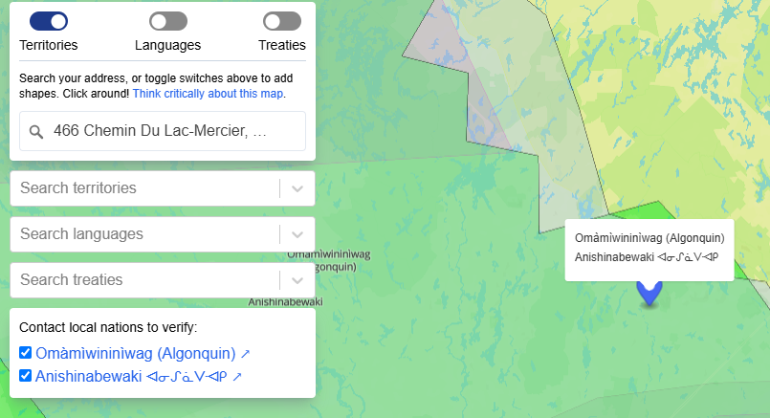

Personal land acknowledgement
Equity-deserving groups' suggested adaptations to an implementation toolkit in mental health recovery - a qualitative analysis using the FRAME-IS (Piat et al.)
Notes:
I grew up on the lands waters around Lac-Mercier—part of Omàmìwininìwag (Algonquin) and Anishinabewaki ᐊᓂᔑᓈᐯᐗᑭ territories— this land is very special. It profoundly shaped me and I carry this place with me wherever I go. In remembering I honour its traditional stewards, the injustices that displaced them, and their resilience.

Slide 40
EQUITY
DIVERSITY AND INCLUSION
How to adapt Walk the Talk to be inclusive and benefit everyone?
Tailoring/Adapting implementation strategies can help reduce barriers to implementing best practices like mental health recovery
Equity-deserving groups' suggested adaptations to an implementation toolkit in mental health recovery - a qualitative analysis using the FRAME-IS (Piat et al.)

Slide 41

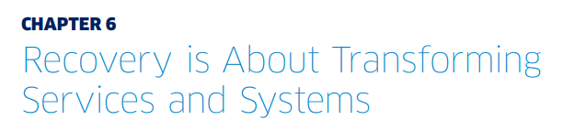
Mental Health Commission of Canada - 2015
Equity-deserving groups' suggested adaptations to an implementation toolkit in mental health recovery - a qualitative analysis using the FRAME-IS (Piat et al.)

Slide 42
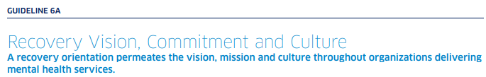
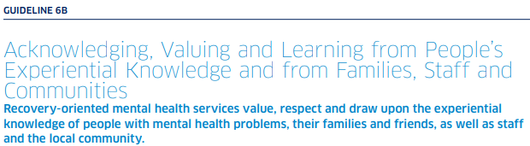
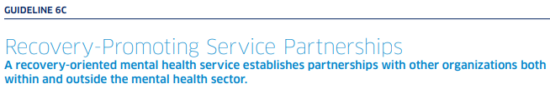
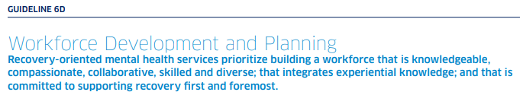
Chapter 6 Guidelines
Equity-deserving groups' suggested adaptations to an implementation toolkit in mental health recovery - a qualitative analysis using the FRAME-IS (Piat et al.)

Slide 43
Walk the Talk toolkit
Implementation strategy
facilitation implementation teams planning
Guidelines 1 recovery-oriented innovation (of their choice)
Service users, providers, families, managers, knowledge users
Equity-deserving groups' suggested adaptations to an implementation toolkit in mental health recovery - a qualitative analysis using the FRAME-IS (Piat et al.)

Slide 44
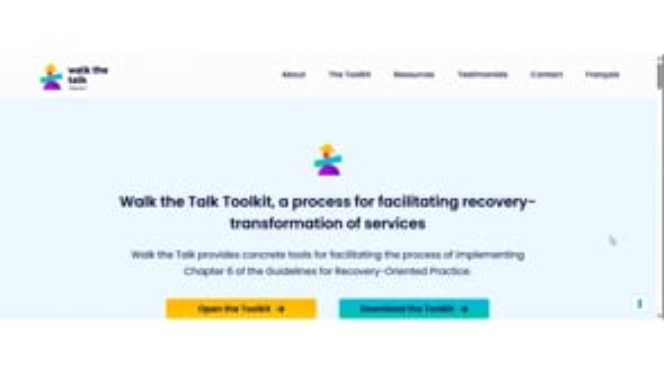
Developed -2017-2021
Launched - 2022
Equity-deserving groups' suggested adaptations to an implementation toolkit in mental health recovery - a qualitative analysis using the FRAME-IS (Piat et al.)

Slide 45

THINC project Adapting the toolkit for equity-deserving groups (2023-2027)
FRAME-IS
analysis
10 workshops
1. Adaptation Teams
2. Adaptation Guide
3. Organizations use toolkit + Adaptation Guide
4. v.2 of Walk the Talk toolkit and Adaptation Guide
Suggested adaptations
Collaborative analysis
Equity-deserving groups' suggested adaptations to an implementation toolkit in mental health recovery - a qualitative analysis using the FRAME-IS (Piat et al.)
Notes:
Diverse teams - Adaptations
Statement on equity – how important it is to do this kind of work.

Slide 46
Participating organisations
ALBERTA​ | ONTARIO​ | QUÉBEC​ | NEW BRUNSWICK​
An indigenous-run organisation providing health and wellness programs to a First Nations community.​ ​ | A City of Toronto agency committed to the health, happiness and full participation of 2SLGBTQ+ communities (including BIPOC and newcomers) | A public local community health and social service centre in a socio-economically diverse suburb of Montréal that provides mental health services. ​ | ​Community-based organisation providing housing, counselling, outreach, and workshops to victims and survivors of domestic violence in a rural county
​ | A multi-service agency for at-risk, socially isolated women and trans people in Toronto who are homeless or precariously housed. | A community-based organisation for women who experience violence or homelessness in Montréal.​ ​ | ​
Equity-deserving groups' suggested adaptations to an implementation toolkit in mental health recovery - a qualitative analysis using the FRAME-IS (Piat et al.)

Slide 47
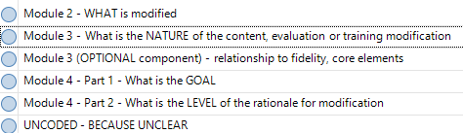
Methodology
DATA COLLECTION AND PREPARATION
DATA ANALYSIS
Adaptation Teams – diverse!
10 workshops
46 elements from the toolkit
Written feedback and recorded plenaries
Extracted every suggested adaptation into bullet point format
What is the nature and goal of the suggested adaptations?
Coding to FRAME-IS (Miller et. 2021*)
*Miller, C., Barnett, M.L., Baumann, A.A. et al. The FRAME-IS: a framework for documenting modifications to implementation strategies in healthcare. Implementation Sci 16, 36 (2021). https://doi.org/10.1186/s13012-021-01105-3
Equity-deserving groups' suggested adaptations to an implementation toolkit in mental health recovery - a qualitative analysis using the FRAME-IS (Piat et al.)

Slide 48
Nature of the suggested adaptations - emerging findings
Equity-deserving groups' suggested adaptations to an implementation toolkit in mental health recovery - a qualitative analysis using the FRAME-IS (Piat et al.)

Slide 49
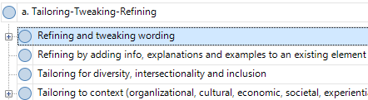
Tailoring – Tweaking – Refining (most common)
Equity-deserving groups' suggested adaptations to an implementation toolkit in mental health recovery - a qualitative analysis using the FRAME-IS (Piat et al.)

Slide 50
“Mental health” – tone it down!
Remove “diagnosis” – stigma and equity (access to a diagnosis)
Clarify the link between homelesss, violence, discrimination, colonialism and mental health
Acknowledge how mental health has been weaponized
Focus on wellness, healing, mental health – not mental health problems.
Equity-deserving groups' suggested adaptations to an implementation toolkit in mental health recovery - a qualitative analysis using the FRAME-IS (Piat et al.)

Slide 51
Tailoring to non-mental health organisations
Why should non –mental health organizations implement recovery guidelines?
The work of “recovery” is done by individuals and communities outside mental health services
All services have potential to help or hinder mental health recovery
Equity-deserving groups' suggested adaptations to an implementation toolkit in mental health recovery - a qualitative analysis using the FRAME-IS (Piat et al.)

Slide 52

Balancing scientific rigour and real-world pragmatism?
Partnership
Co-production
Applied Research
Equity-deserving groups' suggested adaptations to an implementation toolkit in mental health recovery - a qualitative analysis using the FRAME-IS (Piat et al.)

Slide 53
Thank you for listening!
Myra Piat PhD
myra.piat@douglas.mcgill.ca
Equity-deserving groups' suggested adaptations to an implementation toolkit in mental health recovery - a qualitative analysis using the FRAME-IS (Piat et al.)

Slide 54
Development of the Implementation Research Proposal Appraisal Criteria (ImpResPAC) tool: An International Expert Modified e-Delphi Study Louise Hull, PhD Associate Professor in Implementation Science, University of Leicester, UK. ImpResPAC development team: Louise Hull, Chloe Sweetnam, Rachel E Davis, Zarnie Khadjesari, Andy Healey, Annette Boaz, Ioannis Bakolis, Nick Sevdalis, Lucy Goulding. Funding acknowledgement: NIHR Applied Research Collaboration South London

Slide 55
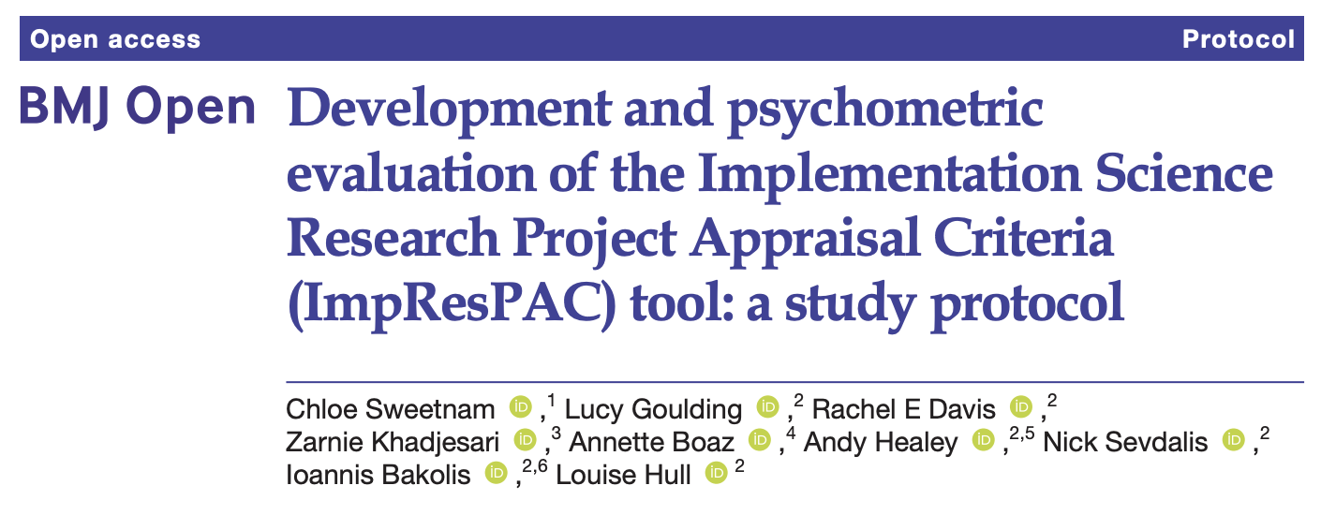
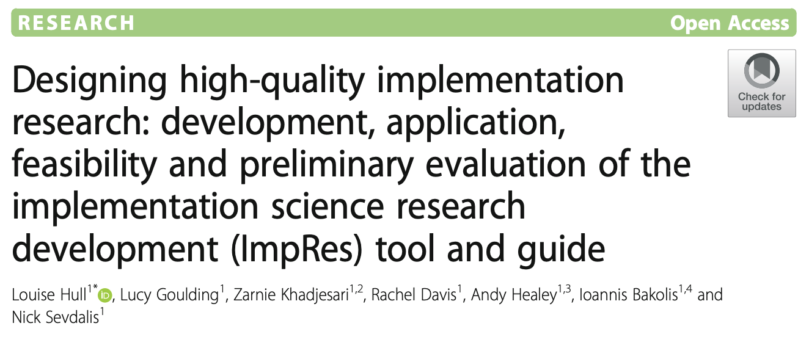
What is ImpResPAC?
A tool designed to appraise the conceptual and methodological quality of implementation research proposals. Based on ImpRes tool and guide.
ImpResPAC represents the first in-depth quantitative appraisal tool for evaluating implementation research proposals, incorporating state-of-the-science guidelines and recommendations, based on extensive input from a large international expert advisory panel.
Notes:
Not intended to replace the broad and varied criteria of funding bodies and programmes rather it is intended to complement and strengthen the review process

Slide 56
Methods
Two-stage sequential mixed-methods design, including a two-round modified e-Delphi
Stage 1: Content development of ImpResPAC
Stage 2: Expert content validation and refinement
ImpResPAC Expert Advisory Group
Delphi Round 1 (Survey 1)
Delphi Round 2 (Survey 2)
ImpResPAC Content development
ImpResPAC refinement & final ImpResPAC tool
ImpResPAC refinement
Stage 1
Stage 2

Slide 57

Stage 1: ImpResPAC content development
The ImpResPAC development team used the ImpRes tool and supplementary guide as a starting point to develop ImpResPAC
This resulted in the initial development of 55 domain items (indicators of high-quality implementation research) organised across ten domains
ImpResPAC overview and user instructions, including scoring instructions developed.
ImpResPAC domain | Example domain items
Implementation research characteristics | Implementation aims and objectives are explicitly and clearly articulated and align with the proposed project design, methods, and measures.
Implementation outcomes | The proposed project includes the evaluation of implementation outcome(s).

Slide 58
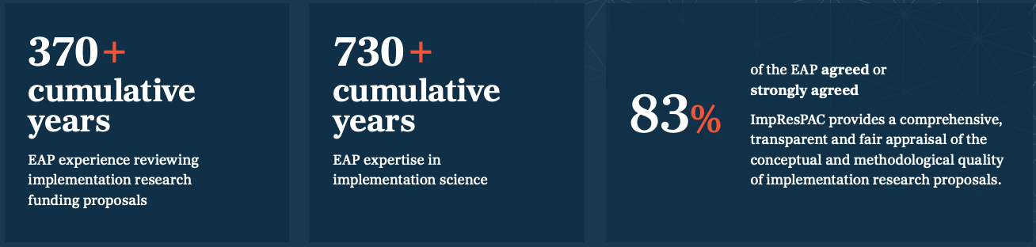
Stage 2: ImpResPAC EAP formation
Purposive and snowball sampling was used to form an Expert Advisory Panel (EAP), consisting of 68 academics across the world who have made a significant contribution to the conceptual and methodological advancement of implementation science.

Slide 59
Stage 2: Expert content validation and refinement
Delphi Round 1 | Delphi Round 2
Refinements - Modification of domain item (n=41) Addition of domain items (n=20) Removal of domain items (n=5) Merger and modification of two domain items into one domain item (n=6) Split of one domain item into two domain items (n=1) | Refinements - Modification of domain item (n=17) Addition of domain items (n=4) Removal of domain items (n=0) Merger and modification of two domain items into one domain item (n=0) Split of one domain2item into two domain items (n=2)
Domain items: 55 > 67 | Domain item 67 > 71

Slide 60
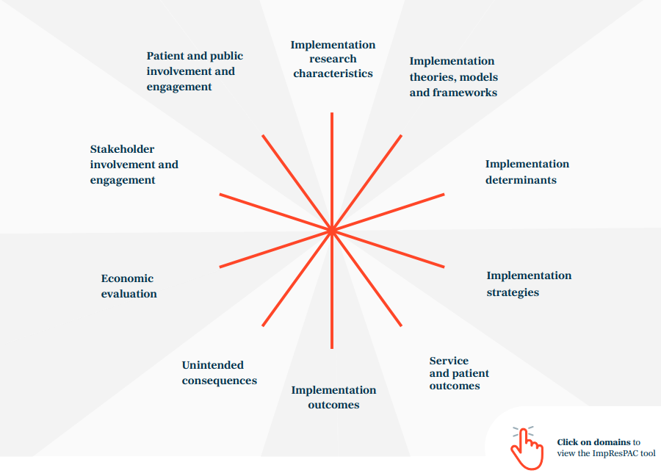
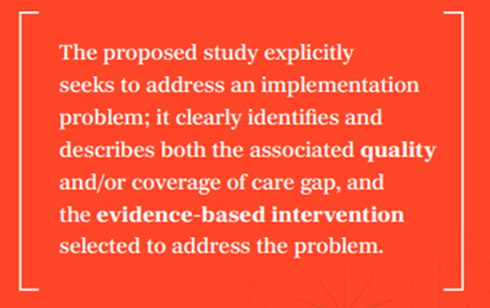
ImpResPAC domains and domain items
10 distinct, but interrelated, domain
Each domain represents a core
element of IR
Domain items are indicative of high-quality IR
ImpResPAC contains 71 domain items

Slide 61
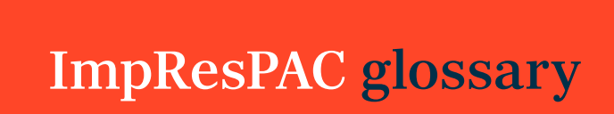
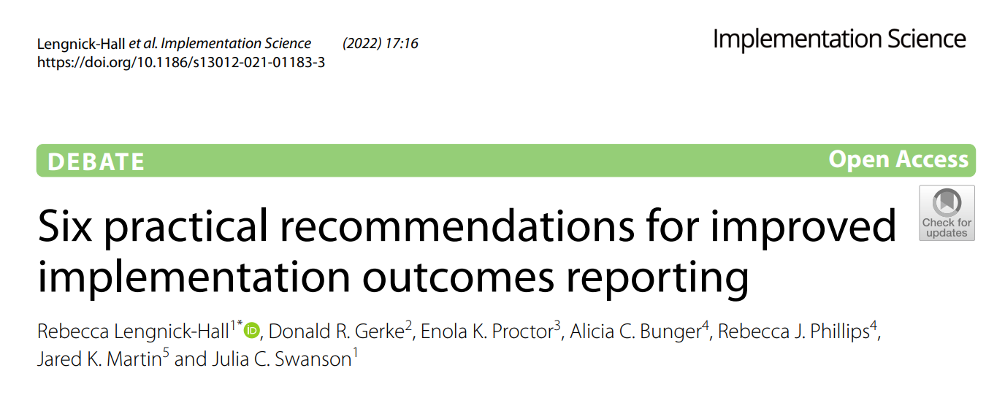
Implementation outcome domain

Slide 62

Scoring scale and anchors
Each domain is scored 1-5
Global ImpResPAC score = Median of applicable domain scores

Slide 63



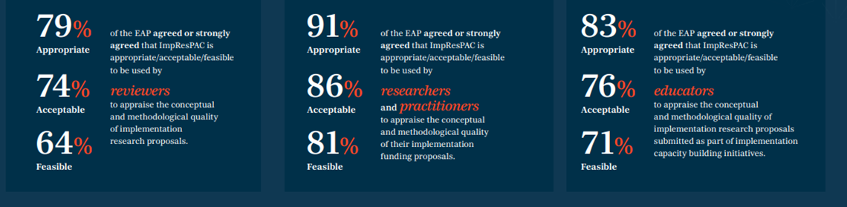
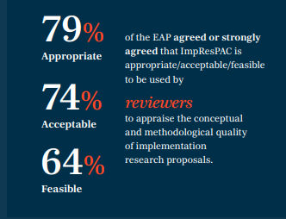
ImpResPAC Evaluation
83% of the EAP agreed or strongly agreed that ImpResPAC provides a comprehensive, transparent and fair appraisal of the conceptual and methodological quality of implementation research proposals.

Slide 64



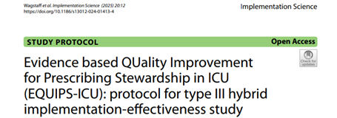
Immediate benefits
Support research teams to identify strengths and weaknesses prior to funding submission
Aid grant reviewers in identifying the most promising implementation research proposals for funding
Serve as a valuable resource for educators in assessing proposals submitted within implementation science training and teaching programs
Future research
Evaluate the usability and psychometric properties (reliability and validity) of ImpResPAC
Notes:
Evaluation to date suggests that ImpResPAC has three immediate and significant benefits

Slide 65
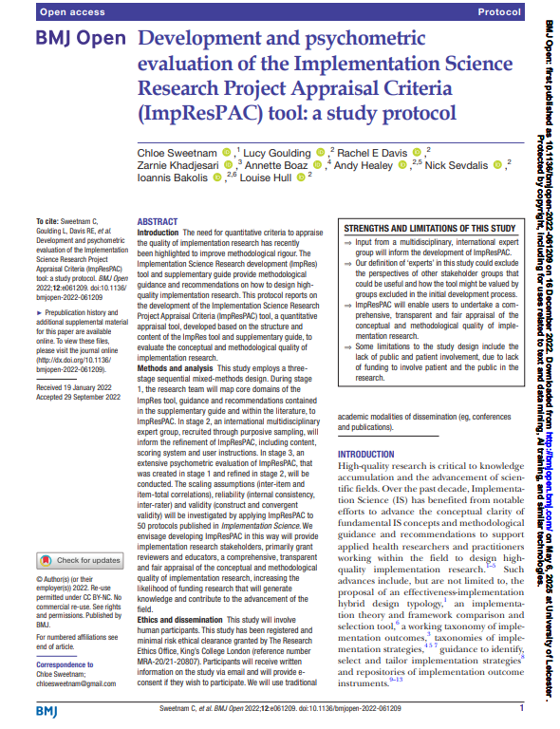

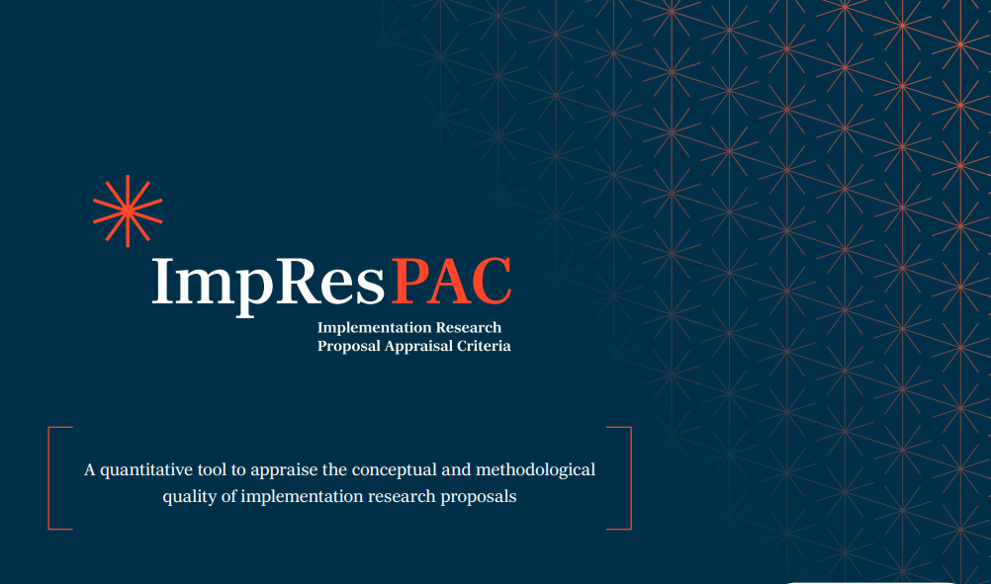
Where to find out more…
https://arc-sl.nihr.ac.uk/news-insights/latest-news/new-resource-appraise-quality-implementation-research-proposals

Slide 66
THANK YOU!
Questions & Discussion
Presentation 1: Cathy Duggan
Presentation 2: Nina Zipfel
Presentation 3: Megan Wainwright
Presentation 4: Louise Hull
Session host: Monika Sztankay
Thought-provoking presentations and interesting insights?
Spread the word and let us follow along by using #EIE2025!

