Slide 1


Ride the Knowledge Wave 4
THE FIDELITY-ADAPTATION DILEMMA
Presentation 1: Sharon Blok
Presentation 2: Robyn Cody
Presentation 3: Mirthe Oude Lansink
Presentation 4: Fiona Leggat
Session host: Tracy Finch

Slide 2








The Fidelity-Adaptation Dilemma in Practice:
Experiences from implementing a complex intervention in routine clinical care in three specialised Dutch Burn Centres
Co-authors
Dr. Marianne Nieuwenhuis, Dr. Sonja Scholten MD, Dr. Cornelis van der Vlies MD, Annabel Snoeks MD, Dr. Eelke Bosma MD, Prof. Dr. Corry van der Sluis MD, Dr. Sven Geelen, PT
European Implementation Event
05-06-2025
Sharon Blok MSc, PhD candidate
Alliance of Dutch Burn Care

Slide 3

Disclosure
Nothing to disclose.

Slide 4
The main question of today
How can you navigate adaptations that are requested by key stakeholders, but are not aligned with an intervention’s core functions?

Slide 5
The ‘THING’
Discharge from burn centre
Core functions
Holistic approach
Solution-based
Goal-setting/action planning
Burn survivor empowerment
Case-management
(aftercare nurses)
Main goal
Improving the self-management skills of burn survivors during the aftercare phase
Phase 1: Assessment
(self-management web)
Phase 2: Solidify
Phase 3: Monitor
Phase 4: Continuation

Slide 6

Location
The 3 specialized Dutch Burn Centres:
Groningen
Beverwijk
Rotterdam

Slide 7
Methods
Identifying barriers & facilitators
CFIR-informed interviews
Implementation strategies
CFIR-ERIC matching tool
2. Promote adaptability
1. Tailor strategies
Adaptations
MADI
CFIR: Consolidated Framework for Implementation Research Damschroder et al. (2022)
ERIC: Expert Recommendations for Implementing Change
Powell et al. (2015)
MADI: Model for Adaptation Design and Impact
Kirk et al. (2020)

Slide 8
Adaptation 1 – Centre 2
Adaptation characteristics
Potential mediator
What
Postponing the startdate of BreeZe within a burn survivors’ trajectory with 4 weeks
Nature
Modifying
Decision-making by whom
Aftercare nurses, intervention development team
For whom
Aftercare nurses
When
Pre-implementation
Alignment with core functions?
→ Yes
Implementation outcomes
Acceptability
Feasibility
Sustainability
Intervention outcomes
Patient outcomes ?
Potential moderators
Reason
Logistically not possible to start earlier due to different locations for wound care and aftercare
Systematic
Adaptation made with due consideration on outcomes
Proactive
Adaptation was made proactive
Model for Adaptation Design and Impact
(Kirk et al., 2020)

Slide 9
Adaptation 2 – Centre 3
Adaptation characteristics
Potential mediator
What
Casemanagement
Nature
Substituting
Decision-making by whom
Aftercare nurses, intervention development team
For whom
Aftercare nurses
When
Pre-implementation
Alignment with core functions?
→ No
Implementation outcomes
Acceptability
Feasibility
Fidelity
Intervention outcomes
Patient outcomes ?
Potential moderators
Reason
Logistically not possible due to changing work schedules of aftercare nurses
Systematic
Adaptation made with due consideration on outcomes
Proactive
Adaptation was made proactive
Model for Adaptation Design and Impact
(Kirk et al., 2020)

Slide 10
Impact of an adaptation that is not aligned with the core functions
Contextual considerations
Team of 3 aftercare nurses
Detailed nursing handover
2 of the 3 aftercare nurses also work as nurses on the ward, in addition to their aftercare duties
Negative
Continuity in BreeZe process is more difficult → effect on fidelity?
No designated casemanager: potentially negative effects on building trust between burn survivor – aftercare nurse
Positive
Intervention better aligned with local routine clinical care
Small team of aftercare nurses
Burn survivors meet the aftercare nurses already during their admission

Slide 11

Back to the main question of today
How can you navigate adaptations that are requested by key stakeholders, but are not aligned with an intervention’s core functions?
Bonus question:
How can a sound judgment of an intervention’s effectiveness be ensured when such adaptations must be adopted?
Feel free to connect!
Contact me at sharon.blok@mzh.nl or scan the QR code

Slide 12

Thank you for your attention!
A special thanks to:
All co-authors
All healthcare professionals who contributed to the development of BreeZe
All TZO consortium members
Irma Visser and Rolf Bron (patient experts)
Financed by:
With the support of:
Feel free to connect!
Contact me at sharon.blok@mzh.nl or scan the QR code

Slide 13

A framework tailored to assess the implementability of medication adherence interventions: CFIR-adherence
Mirthe Oude Lansink^{1,2}, Bart van den Bemt^{1,2} Caroline van de Steeg-van Gompel³, Marcia Vervloet⁴,
Liset van Dijk^{4,5}, Charlotte Bekker²
1 Sint Maartenskliniek, the Netherlands
2 Radboudumc, the Netherlands
3 SIR Institute for Pharmacy Practice and Policy, the Netherlands
4 Nivel Netherlands institute for health services research, the Netherlands
5 University of Groningen, the Netherlands
Notes:
I’m Mirthe Oude Lansink, PhD student and I will present our research called …….. to you

Slide 14
Conflict of interest
I have no conflicts of interest to declare

Slide 15
Medication adherence
44-77% chronic medication users are non-adherent¹
Nonadherence leads to
Worsened health conditions ²
Hospital admissions ³
Increased healthcare spending ³
1. Chowdhury R, Khan H, Heydon E, et al. Adherence to cardiovascular therapy: a meta-analysis of prevalence and clinical consequences. European Heart Journal. 2013 Oct 7;34(38):2940–8.
2. Walsh CA, Cahir C, Tecklenborg S, et al. The association between medication non‐adherence and adverse health outcomes in ageing populations: A systematic review and meta‐analysis. British Journal of Clinical Pharmacology. 2019 Nov 6;85(11):2464–78.
3. Qiao Y, Steve Tsang CC, Hohmeier KC, Dougherty S, Hines L, Chiyaka ET, et al. Association Between Medication Adherence and Healthcare Costs Among Patients Receiving the Low-Income Subsidy. Value in Health. 2020 Sep;23(9):1210–7.
Notes:
First, let me tell you why improving medication adherence is important. Medication adherence is the extent to which patients take their medication as agreed to with their healthcare provider. This is important, as nonadherence can lead to worsened health conditions, hospital admissions and an increase in healthcare spending. It is therefore important that effective adherence improving interventions are implemented into daily practice.

Slide 16
Aim
→ Tailoring the Consolidated Framework for Implementation Research (CFIR) to assess the implementability of medication adherence interventions
Notes:
The Medication Adherence Knowledge and Expertise and Implementation Taskforce, also known as Make-It, aims to enhance the implementation of medication adherence interventions into daily practice. As part of this taskforce, this study aims to tailor the consolidated framework for implementation research, in order to assess the implementability of medication adherence interventions into specific settings in advance
MAKEIT NIET TOELCIHTE

Slide 17
2 stages
Stage 1
Delphi survey
Important determinants according to experts
Stage 2
Prospective evaluation
Determinants influencing implementation in
real-world settings
Notes:
Our research consists of 2 stages.
In the first stage we aimed to assess which determinants experts find important for the implementation of adherence interventions, we assessed this by the means of a Delphi survey
In the second stage, we assessed which determinants actually influenced implementation in real-world settings, for which we performed a prospective evaluation

Slide 18
Stage 1: Delphi
Three-round Delphi survey
Design
Dutch experts in adherence support or implementation
Population
Rating CFIR determinants on importance
Method
CFIR determinants considered important by experts
Outcome
Notes:
In the first stage, we performed a three-round Delphi study for which we included Dutch experts in adherence support or implementation
We asked the experts to rate determinants of the CFIR framework on their importance for implementing adherence interventions, on a 5-point Likert scale. We defined consensus as 70% agreement on importance.
- Ultimately, the outcome of this first stage are CFIR determinants experts consider important for implementing adherence interventions
Wel wat over delphi vertellen zodat ze betr idee hebben van hoe ze gescoord hebben
Dus kort 1e ronde in het algemeen, 2e ronde proeftuinen voorgelegd om in een praktijksituatie te scoren, 3e ronde voor definitieve akk ja/nee

Slide 19
Stage 2: living labs
Prospective evaluation
Design
4 living labs
Population
Implementation of evidence-based adherence interventions
Intervention
Deductive analysis using CFIR
Analysis
Implementation determinants observed in 75% of the living labs
Outcome
Notes:
In the second stage of our study, we performed a prospective evaluation in four different living labs implementing different medication adherence interventions
The living labs are local settings comprised of 2-15 community pharmacies and related general practices, where in all living labs pharmacy team members were the implementers of the intervention (interventionists)
The living labs were followed up on during a period of 1 to 2 years
The outcome of this second stage are determinants observed to influence implementation in the majority of the living labs. These determinants were identified after analysis of meeting documents, progress reports, field notes and transcrips of interviews with project leaders, which we deductively analysed using the CFIR

Slide 20
Stage 1 – Delphi results
Background | N=18
Researcher | 4
(Specialized) nurse | 4
Community pharmacist | 3
Outpatient pharmacist | 2
General practioner | 2
Medical specialist | 2
Hospital pharmacist | 1
28 of 40 determinants were considered important
Notes:
In total, 18 experts agreed to participate in the Delphi rounds, with different backgrounds as shown in the table. In total, experts considered 28 of the 40 CFIR determinants important for implementing adherenced interventions

Slide 21
Stage 2 – living lab observations
Outer setting
Implementation process
Inner setting: living lab
Intervention
Individuals
16 of 40 determinants were observed to be important
Notes:
Then the observations in the living labs. We found that 16 of 40 determinants influenced implementation in the majority of the living labs, divided over all CFIR domains exept for the outer setting. These 16 determinants were therefore included into the tailored CFIR to medication adherence interventions. I will highlight some of these determinants, ellaborate on how they influenced implementation
DUDIELIJK UITLEGGEN DAT JE VOORBEELDEN GAAT BENOEMEN, EN DEZE VOORBEELDEN GOED TOELICHTEN

Slide 22
Stage 2 – living lab observations
Outer setting
Implementation process
Inner setting: living lab
Available Resources
Intervention
Compatibility
Individuals
Communication
Notes:
For the inner setting, available resources was important, mainly observed as a lack of time during certain periods and staff shortages. Also, compatibility, meaning the extent to which the intervention was compatible with daily routine or whether many additional actions were needed in order to perform the intervention, was important. The communicational structure within the community pharmacies but also the communication between communicty pharmacies and general practices was an important facilitator and barrier.

Slide 23
Stage 2 – living lab observations
Outer setting
Implementation process
Inner setting: living lab
Available Resources
Intervention
Compatibility
Individuals
Communication
Motivation
Capability
Notes:
As for individual characteristics, we identified that motivated and capable individuals were key faciliators for the implementation. Training in the intervention and communicational skills helped feel pharmacy technicians secure about delivering the intervention. We also found that HCPs with genuine intrinsic motivation to provide optimal patient care continued ot deliver the intervention despite lack of time or work pressure. In contrast, other less motivated HCPs tended to forget about the intervention and discontinue to deliver the intervention, as it was not yet perceived as standard routine. This highlights motivation is a critical factor.

Slide 24
Stage 2 – living lab observations
Engaging
Outer setting
Reflecting & Evaluating
Implementation process
Reflecting & Evaluating
Inner setting: living lab
Available Resources
Intervention
Compatibility
Individuals
Communication
Motivation
Capability
Notes:
For the implementation process, we observed that activities aimed at engaging individuals to join the intervention and reflecting and evaluating activities facilitated the implementation. These activities contributed in keeping the pharmacy technicians and other project members motivated.

Slide 25
Results – real-world practice vs expert opinions
45%
Notes:
We also compared these observations to the expert opinions obtained in the first stage. We found that 45% of the expert opinions matched the living lab observations, so 45% of their opinion regarding the unimportance or importance of CFIR determinants matched the observations. This indicates that it was difficult for experts to predict the importance of CFIR determinants for implementing medication adherence interventions.

Slide 26
Conclusion
CFIR-adherence could guide the assessment of the implementability of medication adherence interventions in specific settings in advance
Contact: Mirthe Oude Lansink m.oudelansink@maartenskliniek.nl
Notes:
Then we arrive to our conclusion, which is that
Furthermore, it would be interesting to assess the applicability of this tailored framework in other settings as well, was it is now based on first-line care settings in the netherlands

Slide 27
Living labs
 | Living lab
 | A | B | C | D
Intervention | Animated patient information followed by telephone counselling intervention | Annual consultation for patients who use chronic medication including preparation of this consultation by patients | Telephone counselling of patients who may be non-adherent according to dispensing records | Teach-back method and comprehensible drug label instructions
Setting and involved healthcare providers | Outpatient pharmacy, 14 community pharmacies and collaborating general practitioners | Three community pharmacies and collaborating general practitioners | Five community pharmacies and cooperating general practitioners, a hospital and a home care organization | Two community pharmacies and cooperating general practitioners
Patient population | Patients with cardiovascular disease initiating treatment, after hospital discharge | Patients who use the automated refill service | Patients taking cardiovascular medication | All patients starting medication, of which 2/3 are estimated to have limited health literacy

Slide 28
Tailored framework
Innovation
Innovation adaptability
Inner setting
Structural Characteristics
Communications
Culture
Compatibility
Relative Priority
Available Resources
Individuals – Roles
High-level leaders
Implementation Facilitators
Implementation Leads (formally appointed)
Individuals – Characteristics
Capability (competence)
Motivation (general)
Motivation (for change)
Implementation Process
Planning
Engaging
Reflecting & Evaluating

Slide 29
Three-round Delphi survey
1
1 Rating determinants for implementing adherence interventions in general
Exclude: ≥70% agreement on unimportance (1-2)
2
1 Reading project proposals
2 Rating determinants for implementing a specific intervention in a specific setting
≥70% agreement on importance (4-5) → classified as ‘important’ in round 3
3
1 Final vote: experts agree/disagree with (un)importance
Include: ≥70% agreement on importance OR ≥70% disagreement on unimportance
Determinants experts consider important
Notes:
This flow chart shows how we performed the Delphi
In the first round, experts were asked to rate the determinants on their importance for implementing adherence interventions in general. Determinants were excluded if there was 70% or more agreement on the unimportance of determinants
In the second rounds, experts were provided with project proposals of in total 4 living labs who were going to implement a certain adherence intervention. The project proposal described the type of adherence intervention and characteristics of the setting. Experts were then asked to rate the CFIR determinants for their importance for implementing a specific adherence intervention in a specific setting, based on the project proposal. If there was more than 70% agreement on the importance of a determinant, it was classified in round 3 as important, if not, it was classified in round 3 as unimportant
Then in the third round, experts gave their final vote, so they agreed or disagreed with the importance or unimportance of a determinant. Finally, when there was 70% or more agreement on importance or 70% or more disgareement on unimportance, determinants were included into the tailored framework for implementing adherence interventions

Slide 30


The Long CovId personalised Self-managemenT support co-design and EvaluatioN (LISTEN) project.
Dr Fiona (Fi) Leggat
Research Associate
City St George’s, University of London
Co-Chief Investigators
Prof Fiona Jones – City St George’s, University of London
Prof Monica Busse – Cardiff University

Slide 31








Overview of the LISTEN project
Work Package 2:
Effectiveness & Cost-Effectiveness Evaluation
Work Package 1: Intervention Co-design
To understand the effectiveness and cost effectiveness of the intervention in comparison to a control group receiving ‘usual care’ (UC).
To work with people with Long Covid, and healthcare professionals (HCPs) to co-design the LISTEN intervention.
Work Package 3:
Mixed Methods Process Evaluation
To explore context, implementation, mechanisms of impact and outcomes.

Slide 32
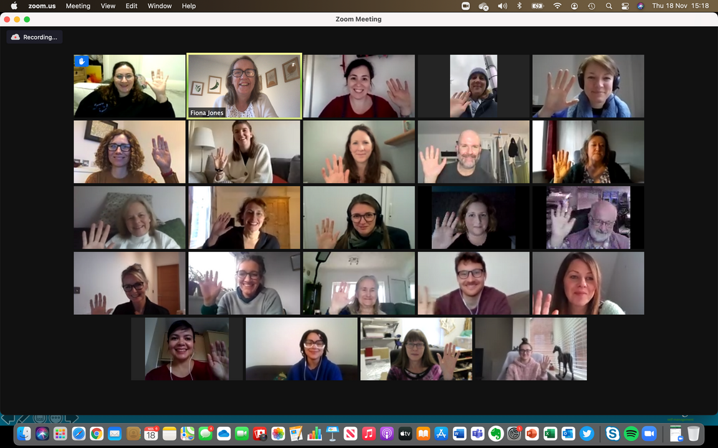
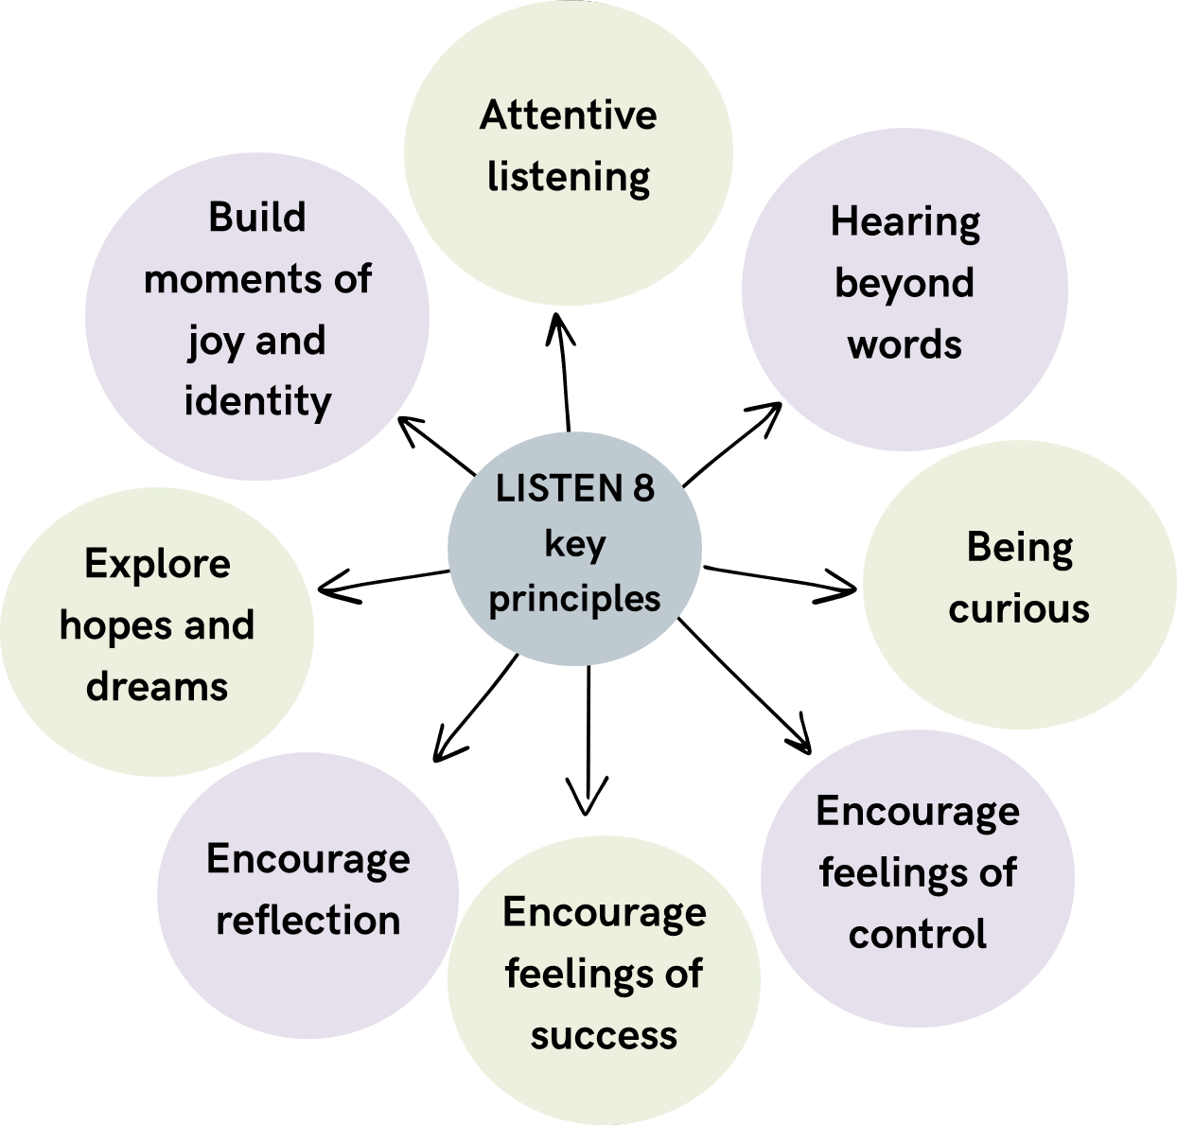
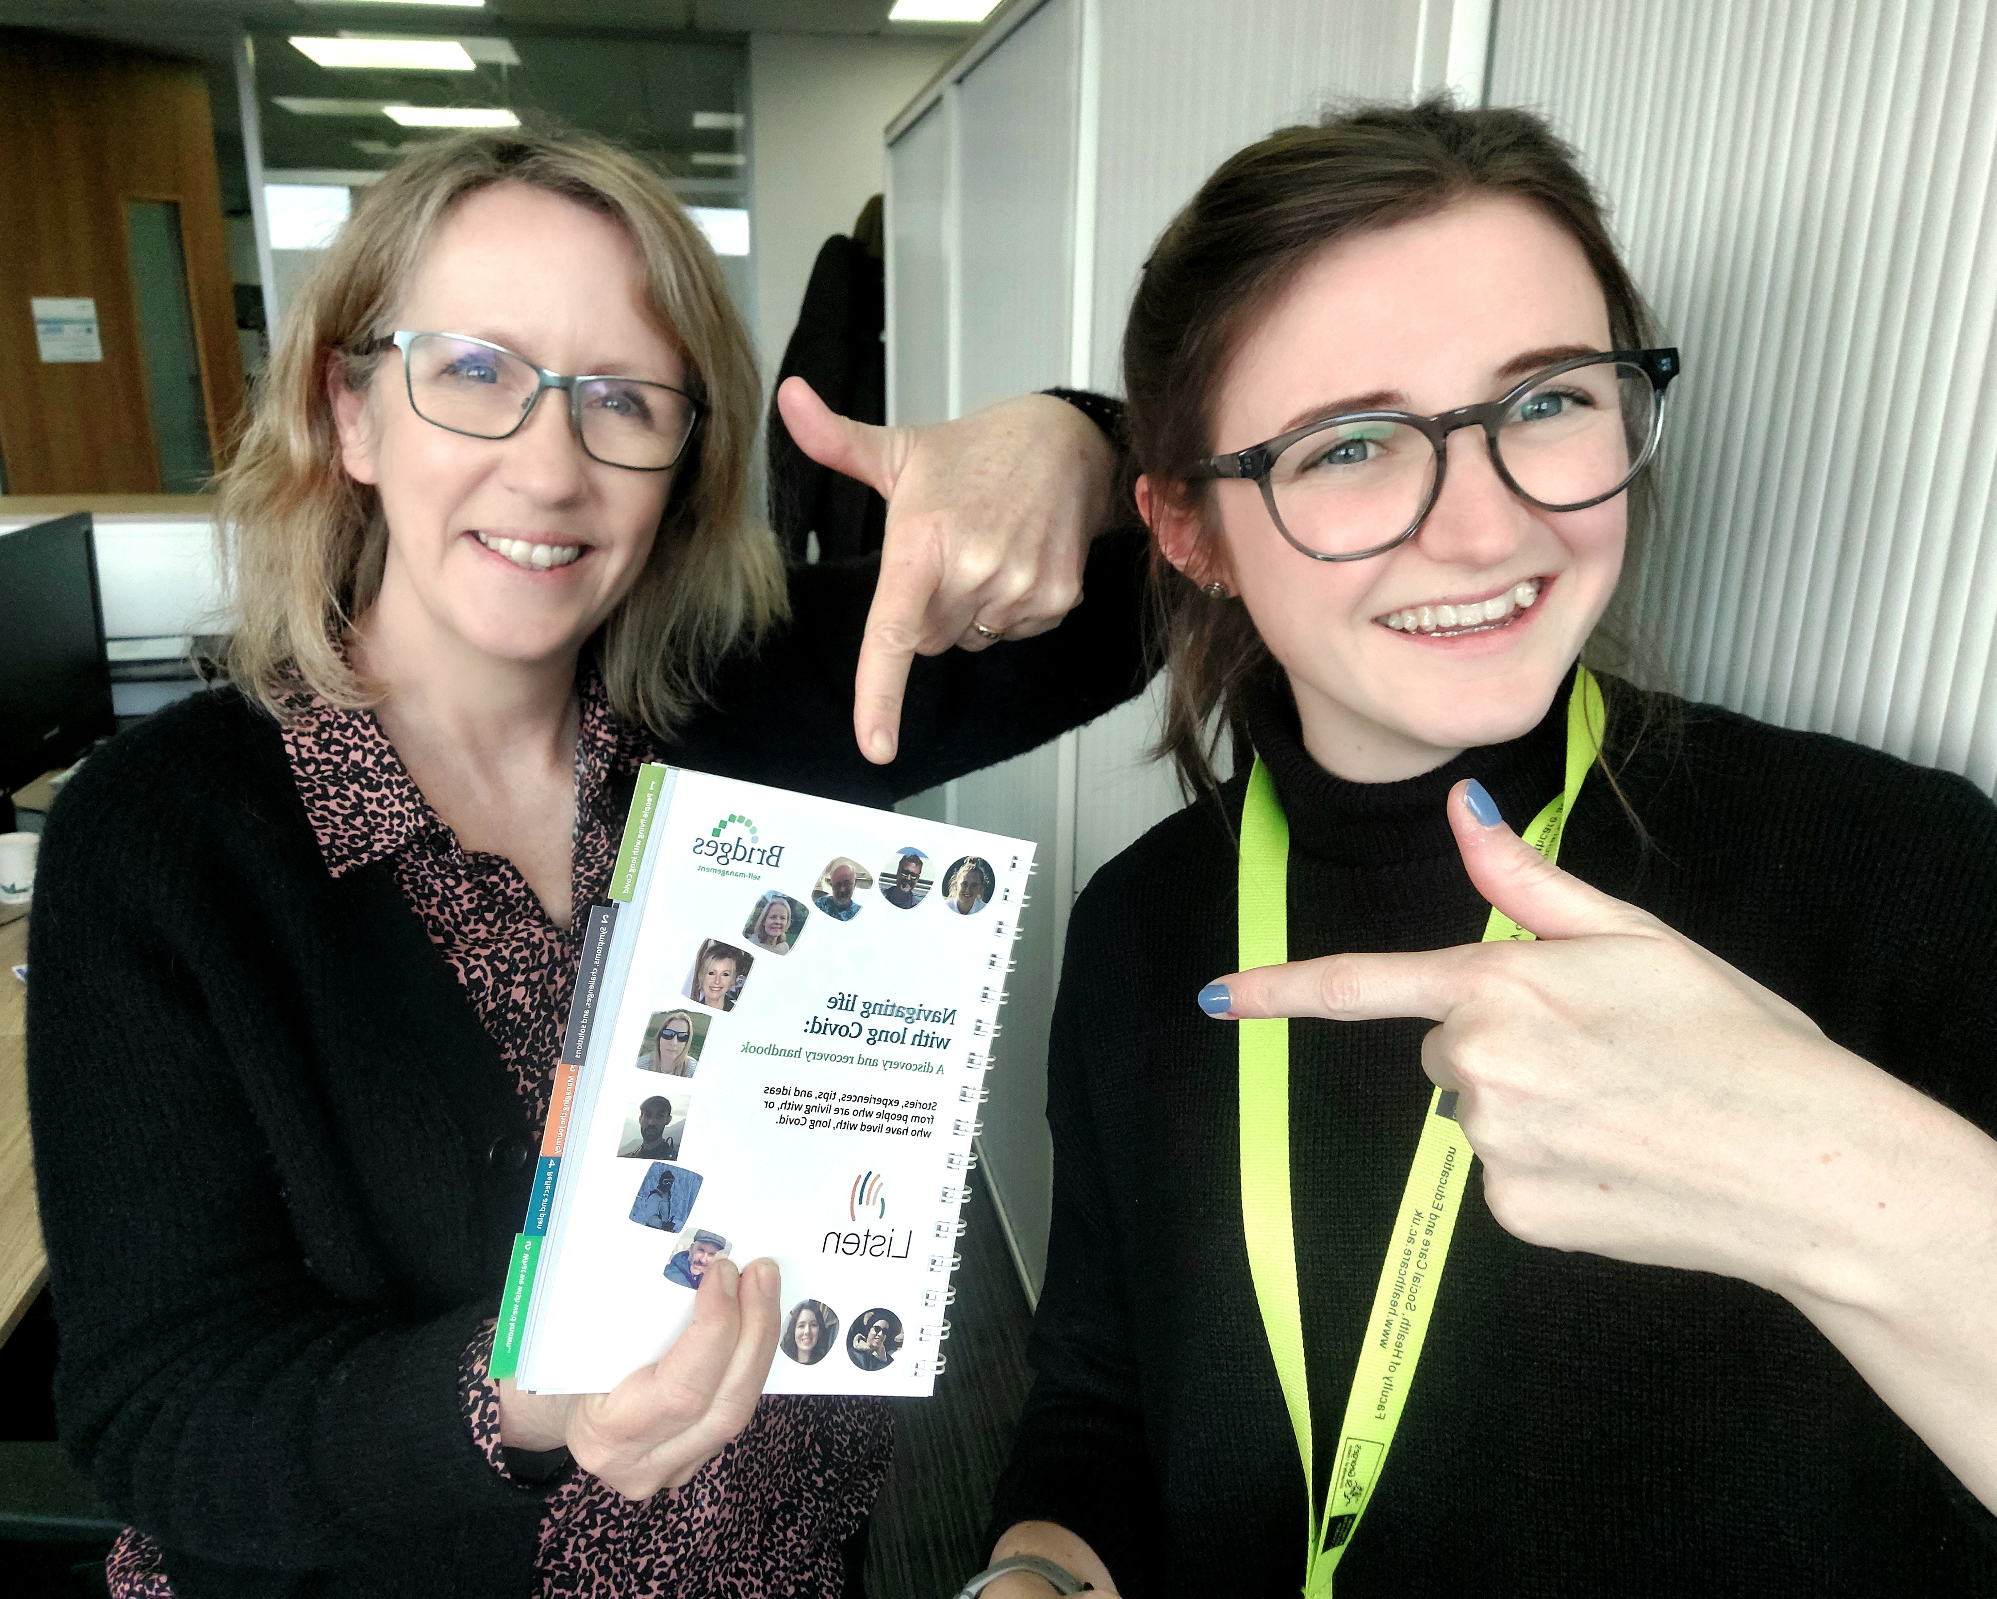
WP 1: Intervention co-design
Two parts:
Up to 6, 1-hour, virtual 1-1 sessions with a HCP trained in 8 key principles.
LISTEN book (paper & online)
Small co-design meetings
Large co-design meeting
Mixed co-design meetings
Interviews
Editing
Notes:
Co-designed a personalised self-management support intervention adapted from Bridges principles
- Recruited 28 people living with Long Covid, and healthcare professionals to work with us through a 5-stage process using AEBCD.
All co-design activities were hosted remotely.
From the co-design, we developed the LISTEN intervention.
- formed of two components, but under pinned by 8 key principles.
- The principles which were co-designed by our group and informed a handbook and a healthcare practitioner training package.
- Those randomised to receive the intervention, were subsequently able to access the handbook, in paper or virtual formats, and up to 6, one hour, 1-1 sessions with a practitioner who had undergone a specialised training package.
- The intervention training for practitioners and intervention sessions for participants were delivered remotely.

Slide 33

Clinical trial findings
Randomised (n = 554)
*n=10 participants withdrew after random allocation
Allocation
Allocated to Usual NHS Care
(n=277)
Allocated to LISTEN Intervention
(n=277)
Received intervention as intended (n=237)
Completed 12-week follow up (n=200)
Lost to follow up (n=74)
Completed 12-week follow up (n=210)
Lost to follow up (n=60)
Analysis
LISTEN outcomes in comparison to usual care:
Activities of Daily Living
Self-Efficacy
Scan here for the published paper:
Emotional Wellbeing

Slide 34
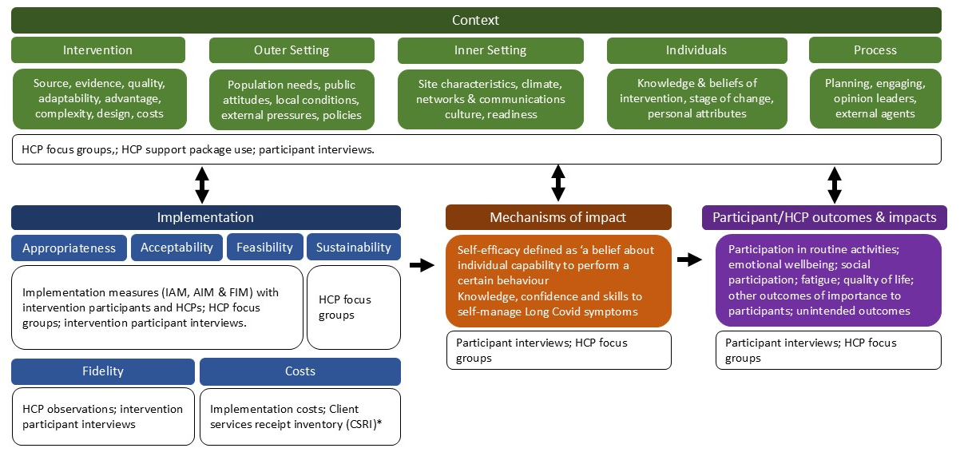
Process evaluation
Informed by: Consolidated Framework for Implementation Research (CFIR) & MRC Process Evaluation Guidance

Slide 35





Process evaluation:
How did we evaluate the delivery & people’s experiences of the intervention and usual care?
1. Observations of HCPs delivering intervention sessions
25 HCPs
2. Wrap-around support access from HCPs
All HCPs
Data analysis:
Independent analysis of each data source.
Hybrid inductive and deductive thematic analysis to combine data sources.
3. Implementation science scales (AIM, FIM, IAM) with intervention participants & HCPs
38 HCPs – 3 months
26 HCPs – 6 months
4. Focus groups with HCPs delivering the intervention
27 HCPs
5. 1:1 interviews with trial participants in both arms (intervention & UC)
49 participants
(25 intervention)

Slide 36
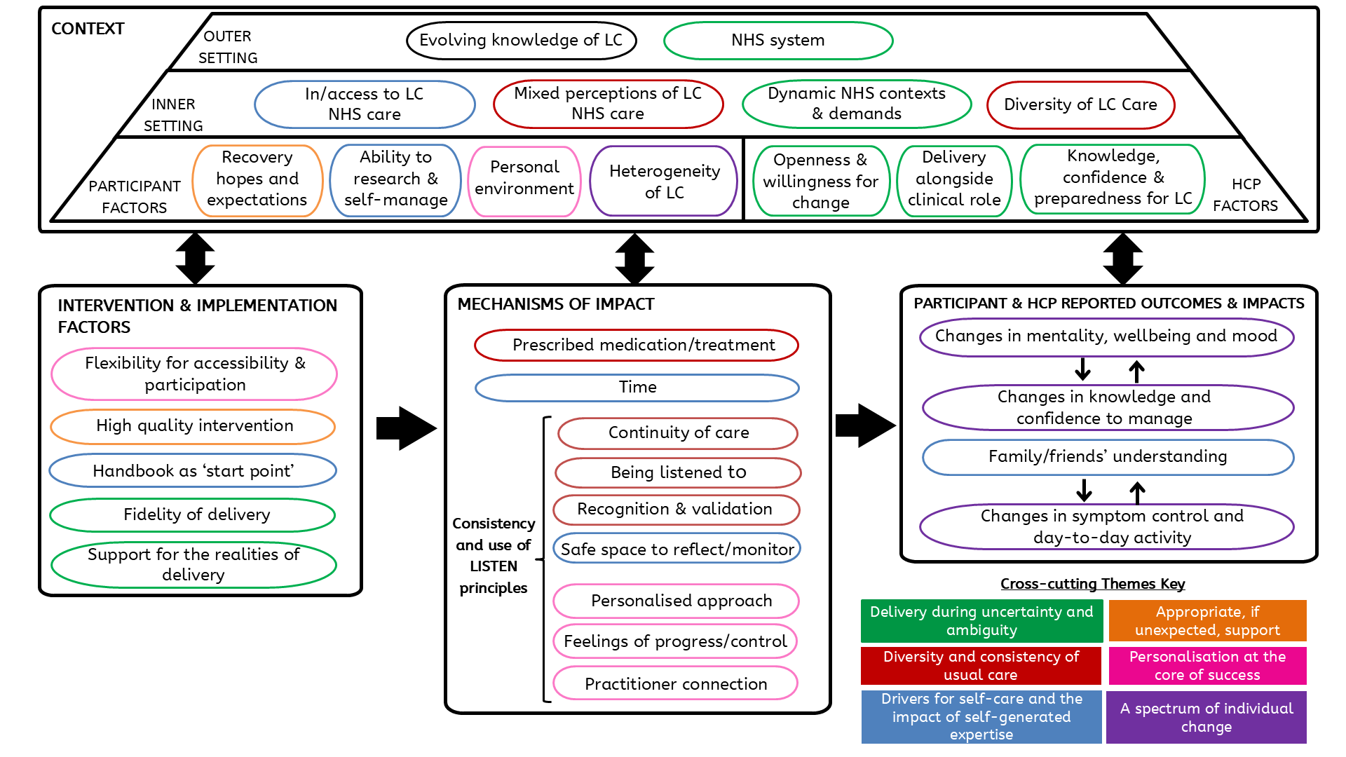
Findings

Slide 37
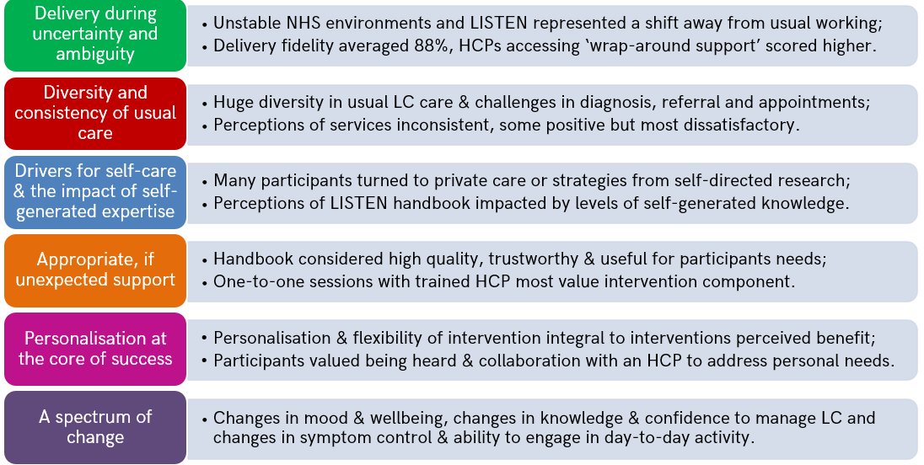
Six Themes:

Slide 38
Conclusions
LISTEN intervention was found to be an appropriate, feasible and acceptable intervention for participants & HCPs delivering.
Co-design can support the development and implementation of a pragmatic intervention.
Intervention delivery fidelity scores were positively associated with greater wrap-around support access by HCPs.
HCPs emphasized it can be necessary to provide more than one-off training and to adapt to meet the needs of those delivering interventions.
How can we undertake pragmatic fidelity assessments of complex personalized interventions?

Slide 39





Thank you for LISTENing!
Since LISTEN we have….
Piloted a new training programme for healthcare professionals based upon the co-designed LISTEN training.
We continue to aim to…
Integrate LISTEN into primary and secondary care across England and Wales.
Leggat et al. (2025)
Personalisation at the Core of Success: Process Evaluation of the LISTEN Randomised Controlled Trial Evaluating a Personalised Self-Management Support Intervention for People Living With Long Covid
Health Expectations.
Process Evaluation
Potter et al. (2023)
Effectiveness and cost-effectiveness of a personalised self-management intervention for living with long COVID: protocol for the LISTEN randomised controlled trial.
Trials.
Busse et al. (2025)
Effectiveness of a personalised self-management intervention for people living with long covid (Listen trial): pragmatic, multicentre, parallel group, randomised controlled trial.
BMJ Medicine.
Heaton-Shrestha et al. (2022)
Co-designing personalised self-management support for people living with long Covid: The LISTEN protocol
PLOS ONE.
Jones et al. (2024)
Using co‐design methods to develop new personalised
support for people living with Long Covid: The ‘LISTEN’ intervention.
Health Expectations.
Leggat et al. (2024)
An exploration of the experiences and self-generated strategies used when navigating everyday life with Long Covid.
BMC Public Health.
Co-design Protocol
Co-design Process
Co-design Interviews
Trial Protocol
Trial Findings

Slide 40
THANK YOU!
Questions & Discussion
Presentation 1: Sharon Blok
Presentation 2: Robyn Cody
Presentation 3: Mirthe Oude Lansink
Presentation 4: Fiona Leggat
Session host: Tracy Finch
Thought-provoking presentations and interesting insights?
Spread the word and let us follow along by using #EIE2025!

