Slide 1


Ride the Knowledge Wave 6
IMPLEMENTATION SUPPORT
Presentation 1: Allison Metz
Presentation 2: Erwin Ista
Presentation 3: Heather Morris
Presentation 4: Ashley Boers
Session host: Michael Sykes

Slide 2
Development and Psychometric Evaluation of the Implementation Support Competencies Assessment
Allison Metz and Todd Jensen, UNC Chapel Hill
Bianca Albers, University of Zurich

Slide 3
Who are Implementation Support Practitioners?
Implementation support practitioners are professionals who support organizations, leaders and staff in their implementation of evidence-informed practices and policies. They identify, contextualize and improve the use of evidenced implementation strategies in a range of settings. They also build implementation capacity among teams, organizations and systems.
Implementation Support

Slide 4
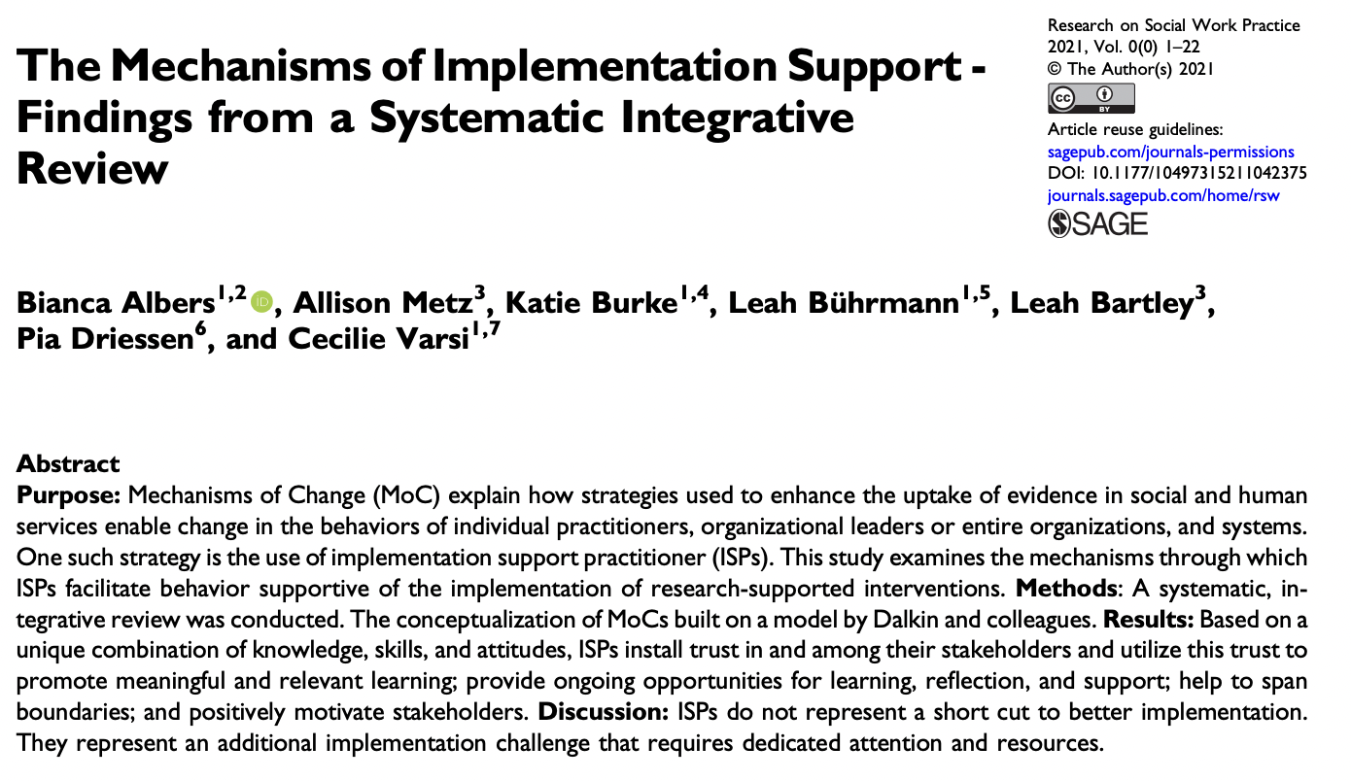
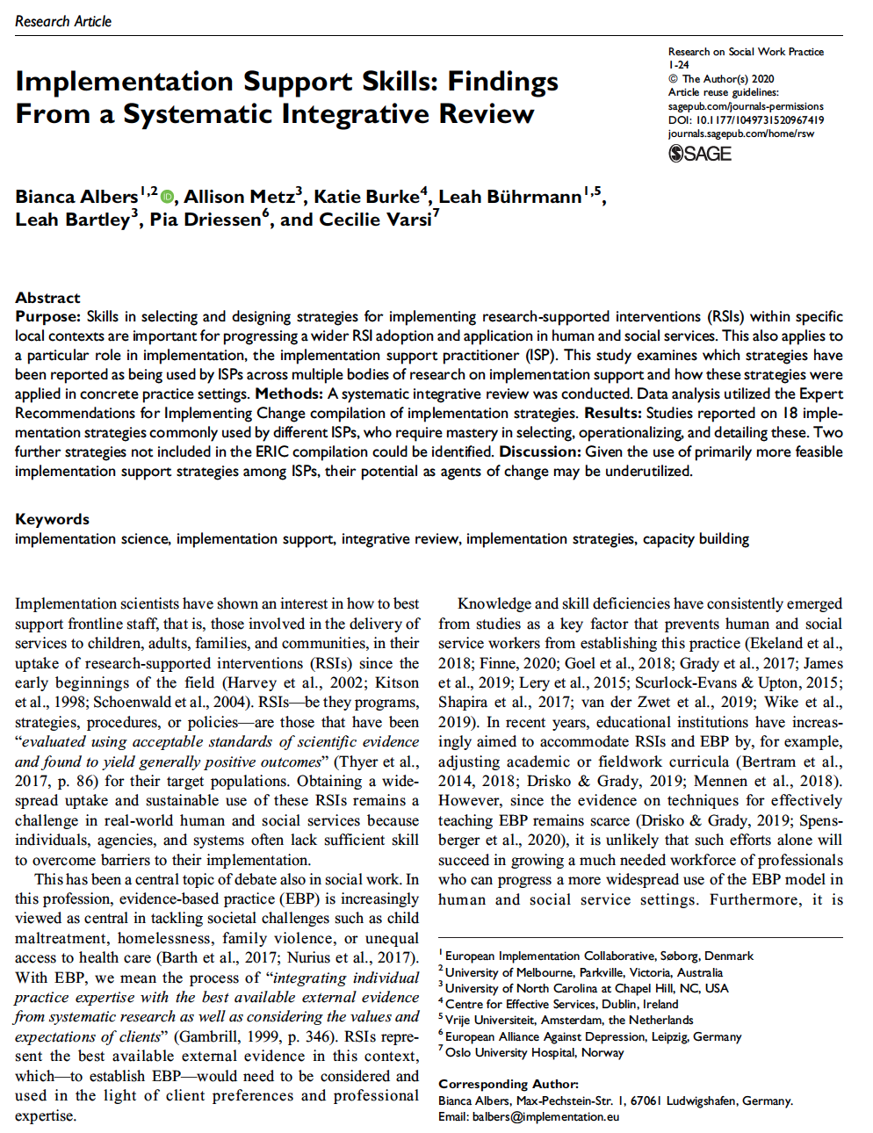
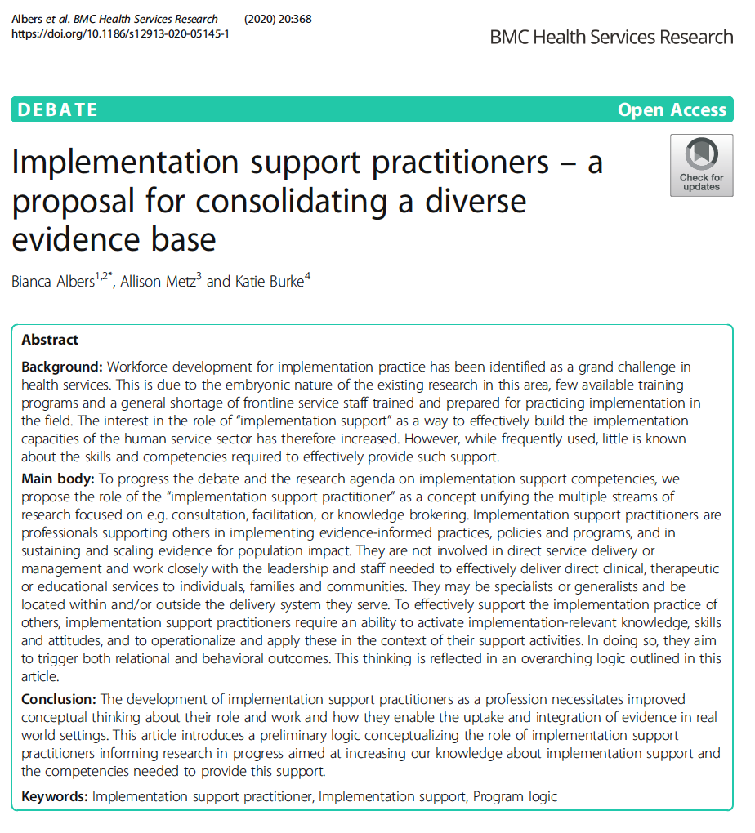
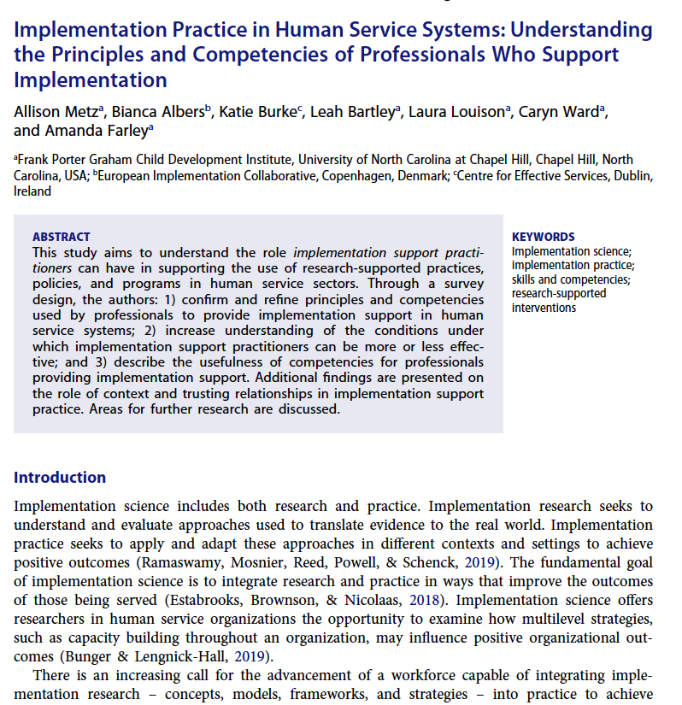
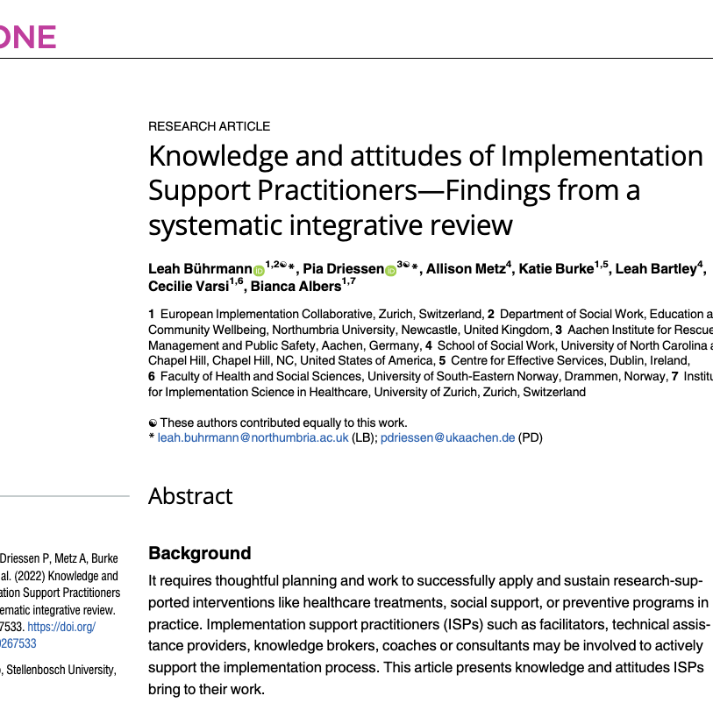
Research on Implementation Support
ISP Competencies

Slide 5
Implementation Support Practitioner Competencies
Co-learning
Brokering
Address power differentials
Co-design
Tailor support
CO-CREATION AND ENGAGEMENT
Implementation practice
Assess needs and assets
Understand context
Apply and integrate implementation frameworks, strategies, and approaches
Facilitation
Communication
Conduct improvement cycles
Be empathetic
Be curious
Be committed
Embrace cross-disciplinary approaches
Advance equity
Use critical thinking
ONGOING IMPROVEMENT
Grow and sustain relationships
Develop teams
Build capacity
Cultivate leaders and champions
SUSTAINING CHANGE
Metz, A., Albers, B., Burke, K., Bartley, L., Louison, L., Ward, C., & Farley, A. (2021). Implementation practice in human service systems: Understanding the principles and competencies of professionals who support implementation. Human Service Organizations: Management, Leadership & Governance, 45(3), 238-259.
Notes:
Interest in building competent workforce to support evidence use and implementation
Recent publications in describing the competencies needed to be effective in an implementation support role
Growing calls to address the emerging gap between implementation research and implementation practice
Emerging evidence that the use of multi-faceted implementation strategies to support innovations in health and social care has limited effects on population outcomes

Slide 6
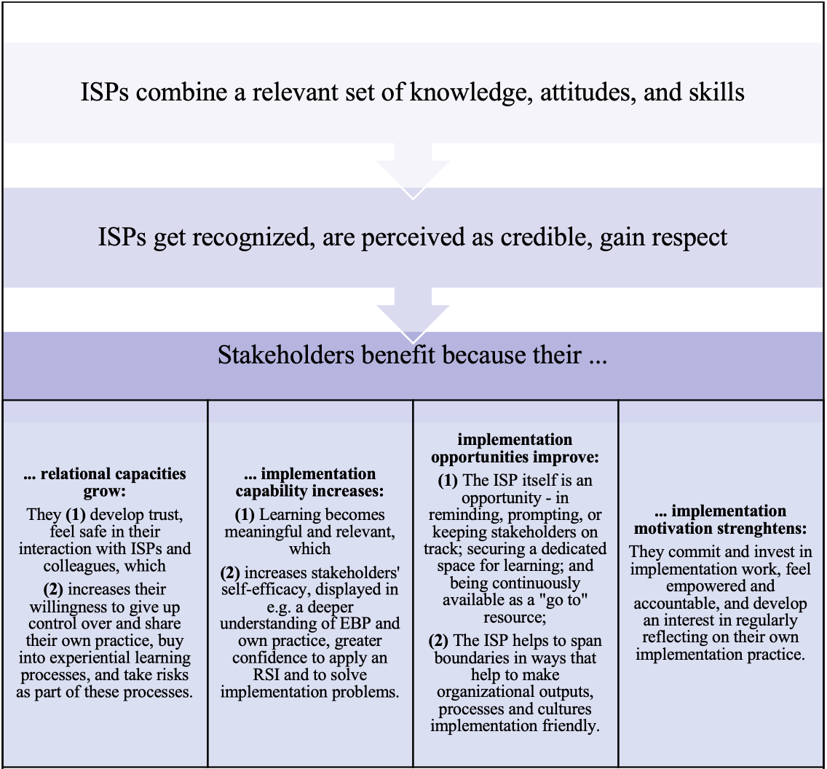
ISP Mechanisms of Change
Albers, Metz, et al., 2022
Notes:
Albers, B., Metz, A., Burke, K., Bührmann, L., Bartley, L., Driessen, P., & Varsi, C. (2022). The mechanisms of implementation support-findings from a systematic integrative review. Research on Social Work Practice, 32(3), 259-280.

Slide 7
Measuring and Improving Competencies
Measuring the use of competencies by ISPs provides a unique opportunity to assess an understudied facet of implementation science—how knowledge, attitudes, and skills used by ISPs affects sustainable change in complicated and complex service systems.
Implementation practice
Jensen, T. M., Metz, A. J., & Albers, B. (2024). Development and psychometric evaluation of the Implementation Support Competencies Assessment. Implementation Science, 19(1), 58.
Metz, A., Albers, B., & Jensen, T. (2024). Implementation Support Competencies Assessment (ISCA). https://doi.org/10.17605/OSF.IO/ZH82F
Notes:
In terms of professional service types, participants worked in public health (32%), health (31%), mental and behavioral health (26%), child welfare (22%), and K-12 education (18%), among others.
In terms of work settings, many participants worked in non-profit organizations (36%), higher education (27%), state government (20%), and hospitals (14%), among others.
Our analyses produced evidence that the ISCA possesses:
Internal consistency reliability
There is consistency in how individuals respond to each item belonging to the same competency
Factorial validity
Items represent well their underlying competencies, and competencies represent well their over-arching domains
Construct validity
The competencies are significantly associated with other variables that they should be if the ISCA is measuring what it purports to measure

Slide 8
Internal Consistency Reliability
Cronbach’s alpha
McDonald’s omega
Competency | Number of Items | α | Ω
Co-learning | 6 | 0.82 | 0.83
Brokering | 6 | 0.86 | 0.86
Address power differentials | 7 | 0.91 | 0.91
Co-design | 6 | 0.91 | 0.91
Tailoring support | 7 | 0.91 | 0.91
Assess needs and assets | 6 | 0.88 | 0.88
Understand context | 6 | 0.92 | 0.92
Apply and integrate implementation frameworks, strategies, and approaches | 5 | 0.92 | 0.91
Facilitation | 9 | 0.94 | 0.94
Communication | 6 | 0.95 | 0.96
Conduct Improvement Cycles | 6 | 0.94 | 0.94
Grow and sustain relationships | 11 | 0.95 | 0.95
Develop teams | 15 | 0.96 | 0.96
Build Capacity | 8 | 0.94 | 0.94
Cultivate Leaders and Champions | 9 | 0.96 | 0.96
ISCA Validation
Notes:
Assessments of internal consistency reliability for each competency-specific item set yielded evidence of strong reliability.
Cronbach’s alpha and McDonald’s omega ranged from 0.82 to 0.96 across competencies (values above 0.70 generally are acceptable).

Slide 9
Factorial Validation
Co-Creation and Engagement
Visual example of the hypothesized factor structure of the Co-Creation and Engagement domain and its competencies
ISCA Validation
Co-Learning
Brokering
Address Power Differentials
Co-Design
Tailoring Support
Items C1.1—C1.6
Items C2.1—C2.6
Items C3.1—C3.7
Items C4.1—C4.6
Items C5.1—C5.7
Notes:
Standardized factor loading values closer to 1 indicate a strong relationship between an item and its underlying factor; typically, we like to see factor loadings of 0.60 or higher in the context of CFA. We have definitely cleared that bar.
Results from Confirmatory Factor Analysis (CFA) supported the hypothesized factor-structure of the ISCA:
Competency-specific items sets were strongly linked to their underlying competencies (i.e., first-order latent factors); standardized factor loadings were valued between 0.66 and 0.87 across items for all 15 competencies
Competencies were strongly linked to their over-arching domains (i.e., second-order latent factors); standardized factor loadings were valued between 0.89 and 0.93 across competencies for all three domains

Slide 10
Construct Validation
Domain: Co-Creation and Engagement
Co-Learning
Brokering
Address Power Differentials
Co-Design
Tailoring Support
ISP Gains
ISPs receive recognition, credibility, and respect from those who receive their implementation support
ISCA Validation
Domain: Ongoing Improvement
Assess Needs and Assets
Understand Context
Apply and Integrate Implementation Frameworks, Strategies, and Approaches
Facilitation
Communication
Conduct Improvement Cycles
Recipient Benefits
Extent to which ISPS perceive the recipients of their support experience increases in (a) relational capacities with the ISP, (b) implementation capability, (c) implementation opportunities, and (d) implementation motivation
Domain: Sustaining Change
Grow and Sustain Relationship
Develop Teams
Build Capacity
Cultivate Leaders and Champions
Notes:
Higher levels of overall competence in each domain was significantly associated with higher levels of ISP gains and recipient benefits.

Slide 11


Open Source
The assessment is open source and can be found at https://doi.org/10.17605/OSF.IO/ZH82F
The validation study is published in Implementation Science and can be found at https://doi.org/10.1186/s13012-024-01390-8
Section Title

Slide 12
Learning Together
Please let us know if you use the ISCA
In what capacity did you use the ISCA?
How were findings from the ISCA used to understand and/or strengthen implementation support competencies needed in different service contexts?
What are some next steps for implementation research and practice to build a workforce of implementation support practitioners?
Certificate program evaluation

Slide 13

Implementation Science Practitioner Fellowship
A training and coaching program for healthcare professionals
Notes:
I thank the organising committee for the opportunity to share our experience of the training and coaching program ‘implementation science pratitioners fellowship. This was
I declare, I have no conflicts of interest.

Slide 14




Notes:
The demand for care is increasing, new innovations are being developed rapidly, and the quality of care is under pressure. Finally, the implementation of existing and new evidence and innovations does not happen automatically.
Currently, there is a strong international and national demand for experts who can apply implementation science knowledge (concepts, models, and frameworks) to improve patient and client care. We need bridge-builders who can close the gap between evidence and practice.

Slide 15


    Develop and evaluate the impact of a new national Implementation Science Support Practitioner (ISP) education, training and coaching program for healthcare professionals
Notes:
To equip future bridge builders and avoid leaving them in the fog, we develop and evaluate the impact of a new (Dutch) national Implementation Science Support Practitioner (ISP) education, training and coaching program for healthcare professionals with the support of ZonMw. As a consortium of three Dutch healthcare and educational organizations were responsible for development of this ISP-program
ZonMw is the Dutch funding agency for healthcare research and development.

Slide 16


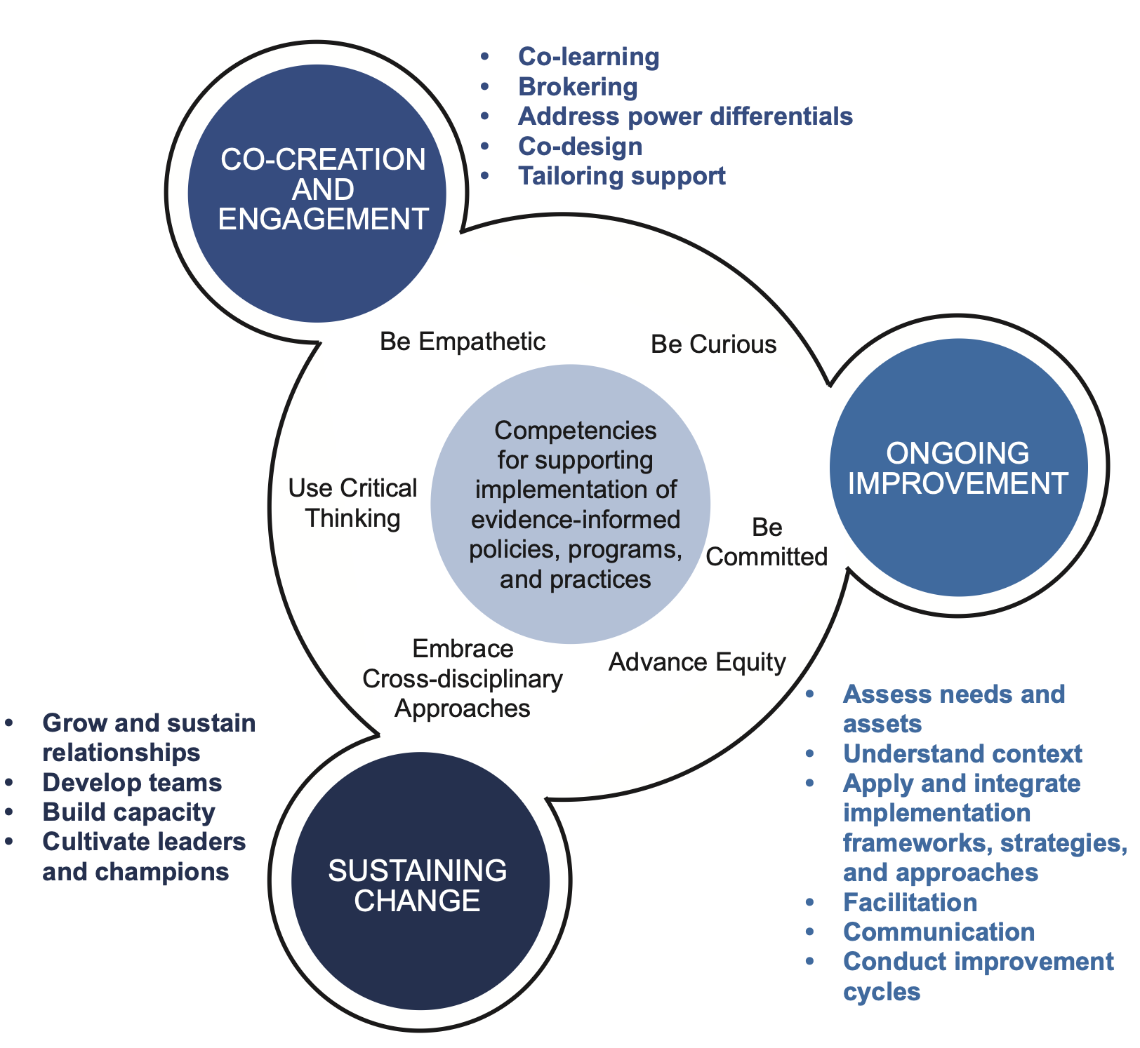
ISP-PROgram (18 months)
“Learning by doing”
Implementation Support Practitioner Profile
Implementation case
Personal learning objectives & goals
Metz, A., Louison, L., Burke, K., Albers, B., & Ward, C. (2020). Implementation support practitioner profile: Guiding principles and core competencies for implementation practice. National Implementation Research Network
Notes:
The development of the ISP-program was based on two core principles. First, learn by doing. Participants have to implement or de-implement an intervention during the 18-month program. Second, the educational program is based on the international profile, comprised of fifteen core competencies grouped into three domains: Co-Creation and Engagement, Ongoing Improvement, and Sustaining Change.
The ISP competence profile was already explained by the previous speaker, Alisson Metz.
Based on outcomes of the ISP competence profile, fellows defined their own learning/developing objectives

Slide 17
ISP-PROgram (18 months)
Implementation case
Personal development ISP-practitioner
‘Implementation science’
Context of healthcare
Portfolio
Metz, A., Louison, L., Burke, K., Albers, B., & Ward, C. (2020). Implementation support practitioner profile: Guiding principles and core competencies for implementation practice. National Implementation Research Network
Notes:
The program has three tracks.
1 Role Development and Knowledge Gained from Executing the Implementation Plan
2 The “Implementation Science” track addresses the theoretical and practical aspects of implementation and provides insights on models, frameworks, strategies, etc.
3 The program focuses on context, stakeholder engagement, sustainable implementation and anchoring, national developments, and healthcare transformation.
Finally, all fellows have their own portfolio in which they describe their progress on the implementation case and the lessons they have learned. They also reflect on the learning objectives, role development, and their position in their organization.

Slide 18
Characteristics
Program & participants
Program
  18 months
  Meetings:
  11 full-day face-to-face
  10 half-day (online)
  Type:
  Lectures, group work, inspiration sessions, peer-review sessions
Participants (n=37)
Education level | N (%)
Bachelor | 3 (8)
Master | 13 (36)
Doctoral | 21 (56)
Setting | N (%)
Hospital | 22 (59)
Elderly / long-term care | 4 (11)
Professional/knowledge organization | 6 (16)
Other | 5 (14)
Work experience in current position (yrs) | N (%)
1-5 | 11 (30)
6-10 | 10 (26)
11-15 | 8 (22)
> 15 | 8 (22)
Notes:
Over the course of 18 months, the fellows attended 11 full-day and 10 half-day meetings. We used a variety of session types and work formats.
A committee selected 39 participants, 37 of whom completed the program.
Most of the fellows had a doctoral degree and worked in a hospital.

Slide 19
Findings & experiences
Expectations of ISP program & role
An ambassador for the implementation profession
Knowledge of implementation models and frameworks
‘A coach for project leaders; bridge builder’
Theoretical foundation for implementation
Learning to work with a number of widely accepted tools for the different phases of implementation
I can facilitate teams to carry out implementation projects.
‘I can also advise colleagues inside and outside the hospital on implementation issues’
Building a network
Developing my soft and social skills and leadership
I see my ISP role as connecting practice and research
Learning how to enable others to flourish in their role
Notes:
I would like to share some insights about the program and the experiences that the fellows had. At the beginning and end of the program, they completed a survey about the expectations on the program and their role development as an implementation practitioner and bridge builder.
On this slide you see some quates about their expectations of the program.
[click] Regarding their role, the expected that…..

Slide 20
Findings & experiences
Development on competences
Start program
Midway program
End program
Notes:
The follows completed the ISP competence profile three times: at the start, midway through, and at the end of the program. They received a personalized summary of the fifteen competencies based on their scores. They used this feedback to evaluate their learning objectives and role development.
This slide shows a summary of the participants' scores on the competencies. Overall, the fellows believe that they have increased their competence in all three domains. The fellows demonstrated the greatest growth in their competence to "Apply and integrate implementation frameworks, strategies, and approaches."

Slide 21
Findings & experiences
Experiences with ISP program
Having an implementation case was a crucial part of the ISP programme, which adopted a learning-by-doing approach.
Learning about theories and models in implementation science taught me how to guide an implementation in a structured way.
It also strengthened my analytical skills.
An important insight I gained was realising how essential ownership is in the implementation process.
The diversity among ISP fellows was also very valuable.
Notes:
At the end of the program the fellows completed the survey again. Also we have to focus group interviews about the program.
The most important findings are….

Slide 22




Conclusion & Discussion
implementation knowledge & skills
‘science’ & ‘practice’
Challenges next edition:
  Different timing: project vs. Program
  Mentoring fellows

Slide 23
Keeping families together: How implementation science underpinned the reform of Victoria's child welfare sector
Dr Heather Morris and Professor Helen Skouteris

Slide 25





Family Preservation and Reunification Response (FPRR)
Families engaged with Child Protection (Child welfare)
61% of parents experienced 4 or more Adverse Childhood Experiences (M=5)
Several presenting concerns
Intensive home visiting program funded for 240-hours
Brokerage funds ($4,000)
Key worker
Evidence based program or evidence informed practices
Child protection navigator
Data collection in embedded

Slide 26

IMPLEMENTATION SUPPORTS
Program logic and training about implementation science
Online and in person training about the practice elements for providers
(Some) community consultation
Implementation support- Hub and spoke model
Implementation science leads within government
Implementation teams (local and central)
Dedicated funding of implementation staff
Data driven decision making
Regular coaching

Slide 27
The FPRR worked…
Families moved from domain challenges to domain strengths over time
Statistically significant changes
And…
An 18% reduction in children entering care (across Victoria)¹
¹ https://www.ceiglobal.org/work-and-insights/evidence-backed-intervention-sees-fewer-children-entering-care

Slide 28
AND the outcomes stuck…
Follow up (6 months post) from 127 participants found:
63% of families did not have child protection re-engage
91% of children were still in the parent’s care
92% of children were in school or childcare
70% of families had improved a little or a lot over overall (22% remained the same)

Slide 29





Family Preservation and Reunification Response
TIMELINE- Simple complexity
PRIOR TO 2020
2020
2022
2024-Current
Exploration and Preparation
Testing Common Elements Develop ways of working Embedding implementation science Funding commitments New roles created Policy directions Royal Commissions Political Will
Preparation and Early Implementation FPRR BEGAN (and COVID) PHASE 1 (Awarded Tenders only)
Delivered across Victoria MacKillop Family Services provider in 9 of 17 Victorian regions Evidence based and evidence informed program
Implementation (MacKillop) PHASE 2 (Remodel of service sector programs)
Continued growth and embedded ways of working System changes impeding implementation Rapid adaption
Sustainment (MacKillop)
Program delivered as intended Sustainable change is being achieved Internal coaching program

Slide 30

PRAGMATIC IMPLEMENTATION … of the FPRR
Notes:
Phase 1 (hands up) and Phase 2- hands up vs heads down – distracted etc. dispersed vs being thrown
Lead balloons- hopes and outcomes
Researcher in residence
Throwing stuff and hoping it will stick(communication)
Changes in scope
Change in role, effectively blinding to what is going on around you

Slide 31


Enhancing small-scale implementation projects in Belgium:
The Implementation Support Program (ISP)
Ashley Boers
Nathalie Pauwen
An Lehouck
Marleen Corremans
Notes:
Nathalie

Slide 32

Declaration of Conflict of interest
To the best of my knowledge, I declare that I, and/or any of my co-authors/co-presenters, and any of my/our close family members, have not had employment, received research support or other funding from, or had any other professional relationship with, an entity directly involved in the production, manufacture, distribution or sale of tobacco, tobacco products, weapons or arms, or have represented the interests of any such entities in any way.
I have no actual or potential conflict of interest in relation to this presentation.

Slide 33


Who are we?
Ebpracticenet was founded in 2011 with the mission to enhance
the quality of primary health care in Belgium by:
Dissemination
spreading evidence-based information, promoting its access to primary health care providers
Implementation
translating evidence into practice, presenting the evidence in a way that facilitates its use at the point of care
Notes:
Government funded and part of the Evikey Netwerk. Where we supports Belgian healthcare professionals in applying evidence-based practices through validated guidelines and expert collaboration.

Slide 34


“Through our Implementation Support Program we offers support to healthcare providers who want to implement evidence-based practices in primary care"
Notes:
We are doing this in collaboration with JBI (Joanna Briggs Institute) Belgium.
JBI is dedicated to promoting evidence-based healthcare practices in Belgium. It supports the synthesis, dissemination, and implementation of high-quality evidence to enhance clinical decision-making and patient outcomes.

Slide 35
Provide support to small-scale implementation projects in primary care, addressing challenges related to evidence-practice gaps and needs for implementation.
OBJECTIVES
ISP
Improving implementation knowledge and skills
Promoting shared learning and good-practice sharing
Establishing an implementation network of local implementation champions
Development and operationalization of the implementation plan
Sustainable improvements in evidence-based practices within primary care
Notes:
The aim of the Implementation Support Program (ISP) by ebpracticenet is to supports small-scale implementation projects in primary care, addressing challenges related to a perceived lack of evidence and the need for implementation.
4 objectives
Improving implementation knowledge and skills: this we will do by Tailored training focused on improving implementation knowledge and skills for developing a comprehensive implementation plan, that includes stakeholders, addresses local determinants, incorporate interventions, and meaningful evaluation
Promoting shared learning and good-practice sharing: by bringing together divere multidiplinary projects. And sharing experiences about implementation and giving feedback in group
Establishing an implementation network of local implementation champions: work in practices
Development and Operationalization of the implementation Plan:
Individual support and coaching during the actual implementation of the plan.
With the ISP we want to support the sustainability of implementation projects, by improving the quality of their development

Slide 36

Implementation support program
1ste edition
2nd edition
IMPLEMENTATION SUPPORT PROGRAM
2024
IMPLEMENTATION SUPPORT PROGRAM
2025
BASIC PROGRAM
ebpracticenet
ebpracticenet approach in Evidence Implementation
Training: ebpracticenet
Intervisions: ebpracticenet
Worksheet: ebpracticenet
INTENSIVE PROGRAM
JBI
JBI approach in Evidence Implementation
Training: JBI
Intervisions: ebpracticenet
Online program (PACES): JBI
Ebpracticenet + JBI
JBI Approach in Evidence Implementation
Training: JBI
Intervisions: ebpracticenet
Worksheet: ebpracticenet

Slide 37

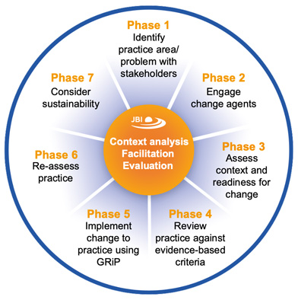

Structure of the program (18 months)
Phase 1: Developing the Implementation Plan
Phase 2: Carrying out the implementation plan
Implementation Training
JBI Evidence Implementation Training
JBI Clinical Leadership Workshop
Exercises linked to each project
Intervision Sessions
Peer exchange & inspiration
Practical frameworks, tips & tricks, feedback, and good practice sharing
Guidance for next steps
Individual Coaching
Tailored support for each project
Follow-up, reflection and addressing specific questions or challenges
Individual Coaching contacts
Structured Worksheets: based on internal worksheets ebpracticenet and JBI Manual for Evidence Implementation
Each project receives financial funding of €30,000
(Munn et al., 2023)

Slide 38



Example:
Timeline
ISP 2025
31 JAN
31/01 KICKOFF MEETING
3 FEB
3/02 JBI Training 1
11 FEB
11/02 JBI Training 2
19 FEB
JBI Training Days
Theory and training are offered, linked to the individual projects through exercises.
19/02 JBI Training 3
27 FEB
STAKEHOLDERMEETING 1
(FEBUARY – APRIL)
22 APR
27/02 INTERVISIon 1
22/04 INTERVISIon 2
Intervision
Exchange sessions focus on good practice sharing, providing practical theory, updates & feedback, and inspiring next steps.
MEI
STAKEHOLDERMEETING 2
(APRIL – JUNE)
2/06 INTERVISIon 3 + focusgroep
2 JUN
JUN
Individual contact moments
WEEK 1 SEP
1/10 START IMPLEMENTATIon
1 OKT
3/10 NETWoRK EVENT (ISP ‘24+‘25)
3 OKT
Notes:
Ashley
Focus Group: A group session in which the program is collectively evaluated. Questions focus on satisfaction with the ISP. The input is used for a qualitative evaluation and to identify areas for improvement.

Slide 39
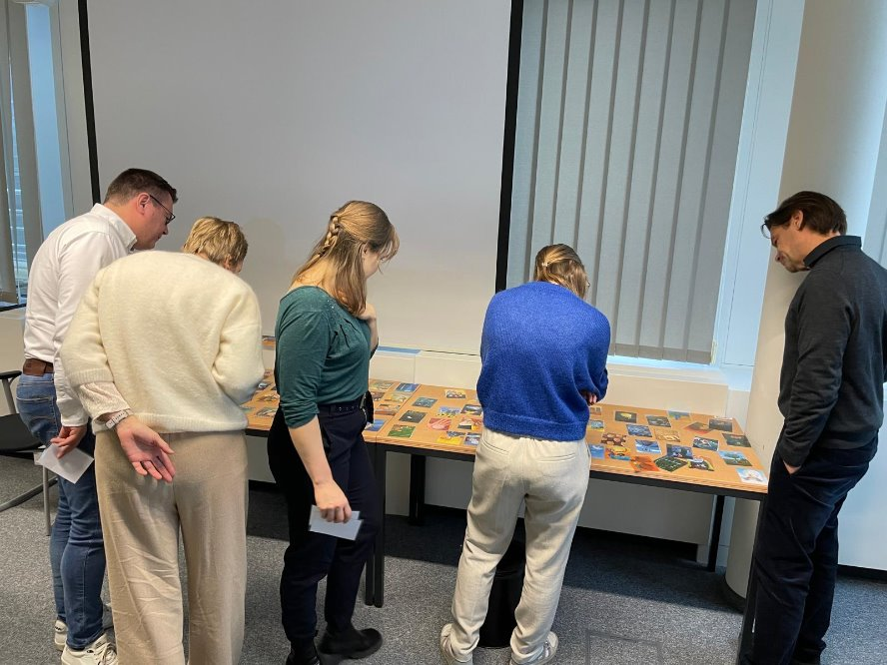
Evaluation
+
Qualitative evaluation
Satisfaction and relevance
Quantitative evaluation
Structure and outcome
Surveys
Focus groups
Internal teammeetings
Quantitative assessment tool for implementation plans (IP) quality
Comprehensiveness
Alignements
Feasability
GLOBAL ASSESSMENT of the IP
Notes:
Based on several items from different models:
Knowledge Translation Plan Appraisal Tool (Barwick et al., 2018)
RE-AIM framework (Glasgow et al., 2019)
CFIR outcome addendum (Damschroder et al., 2022)
Implementation Outcome Framework (Proctor et al., 2011)
T-cast Tool (Birken et al., 2018)

Slide 40





Thank you!
Ashley Boers
ashley.boers@ebpracticenet.be
Nathalie Pauwen
nathalie.pauwen@ebpracticenet.be
An Lehouck
an.lehouck@ebpracticenet.be
Any questions?
Marleen Corremans
Marleen.corremans@ebpracticenet.be

Slide 41
THANK YOU!
Questions & Discussion
Presentation 1: Allison Metz
Presentation 2: Erwin Ista
Presentation 3: Heather Morris
Presentation 4: Ashley Boers
Session host: Michael Sykes
Thought-provoking presentations and interesting insights?
Spread the word and let us follow along by using #EIE2025!

