Slide 1


Ride the Knowledge Wave 7
LEARNING FROM IMPLEMENTATION TRIALS
Presentation 1: Rosa Lorente Català
Presentation 2: Jay Ford
Presentation 3: Natalie Taylor
Presentation 4: Anne Etzelmüller
Session host: Brian Mittman

Slide 2
Presentation 1: Rosa Lorente Català (switch to separate presentation)

Slide 3

Stagewise Implementation to Target: Clinic participation, fidelity, and costs within two resource implementation strategies in an adaptive implementation trial to improve access to MOUD
Jay Ford, PhD, FACHE, LFHIMSS
University of Wisconsin-Madison, School of Pharmacy
Associate Professor, Social & Administrative Sciences Division
Co-Director of the Wisconsin Opioid Overdose Response Center
Director of Graduate Studies – Health Services Research in Pharmacy
Presentation at European Implementation Event, June 4-6, 2025, New Castle upon Tyne, UK

Slide 4





Disclosures
Funded by National Institute on Drug Abuse under Award Numbers
1R01DA052975-01A1 (Stagewise Implementation-To-Target- Medications for Addiction Treatment [SITT-MAT]; MPI: McGovern and Ford),
1R01DA9944745 (Facilitating Sustainment Through Implementation Feedback: The SIC Coaching Model; PI: Saldana), and
P50 DA054072-01A1 (Center for Dissemination
and Implementation at Stanford; CDIAS; PI: McGovern)
Co-Authors
Mark Campbell, MS – Chestnut Health Systems
Lisa Saldana, PhD – Chestnut Health Systems
Michele Gassman, MA – University of Wisconsin – Madison
No conflicts of interest

Slide 5
Stagewise-Implementation-To-Target: Medications for Addiction Treatment (SITT-MAT)
An adaptive trial to implement medications for opioid use disorder within addiction specialty and primary care clinics in Washington State.
Targets:
REACH: Percent of opioid use disorder patients prescribed an MOUD
Goal: 75% of patients prescribed an MOUD
ADOPTION: Number of active MOUD prescribers
Goal: At least one active prescriber
IMPLEMENTATION: MOUD quality measured with the Integrating Medications for Addiction Treatment (IMAT)
Goal: Total IMAT Score >= 4
Builds on prior work,¹ to adapt the Stages of Implementation Completion® (SIC) and Cost of Implementing New Strategies (COINS)^{2,3} assess competency and implementation costs continuously across all implementation strategies.
Ford, J. H., Zehner, M. E., Schaper, H., & Saldana, L. (2023). Adapting the stages of implementation completion to an evidence-based implementation strategy: The development of the NIATx stages of implementation completion. Implementation Research and Practice, 4
Saldana L. The stages of implementation completion for evidence-based practice: Protocol for a mixed methods study. Implement Sci. 2014;9(1):43
Saldana L, Chamberlain P, Bradford WD, Campbell M, Landsverk J. The cost of implementing new strategies (COINS): A method for mapping implementation resources using the stages of implementation completion. Child Youth Serv Rev. 2014;39:177-182

Slide 6
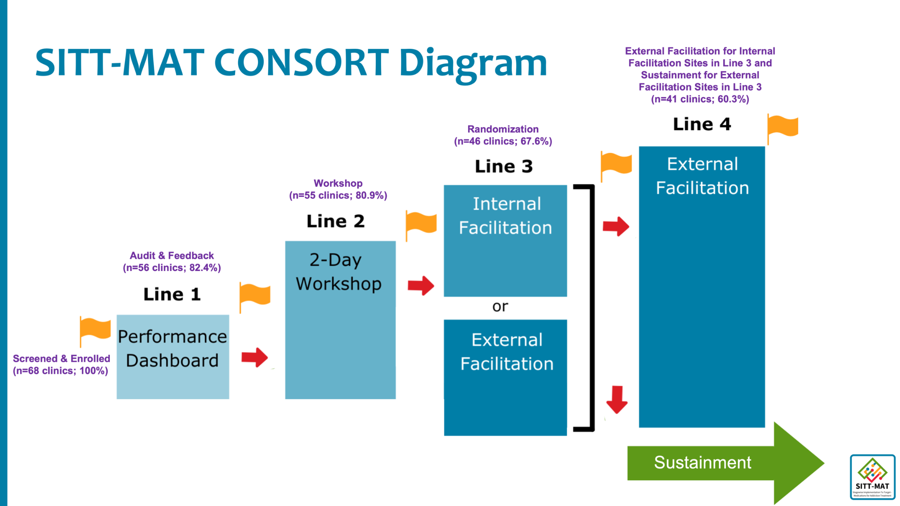





Current Activities
Line 4: External Facilitation for those assigned in Line 3 to Internal Facilitation
Continue data collection and sharing of Performance Dashboard
Finalize data share agreement with HCA to obtain aggregated, clinic-level MOUD service data from ProviderOne to supplement the SITT-MAT primary outcomes analysis
Conduct quantitative, qualitative, and economic analyses to examine outcomes of interest
Disseminate study products and results to communities of interest

Slide 7

Process to Develop the SITT-MAT SIC
Identify Universal Components yet Adaptable for each implementation strategy
SINGLE SITT-MAT SIC

Slide 8
Defining Variables and Identifying Data Sources
SIC Variable | Strategy | SIC Variable Description | Variable Definition | Assigned (Source)
4.a | Internal Facilitation | Date of implementation strategy introductory training | Date attended internal implementation strategy introduction (NIATx) | Not Applicable
5.b |  | Date Change Project form is introduced | Date Change Project form is introduced and reviewed. This might be “Expansion/Existing” if it was introduced in the Virtual Academy arm. | IPC online course - date completed Module 9 (if did not attend Academy). If attended Academy Day 2 then Expansion/Existing
6.g |  | Date site completed Quiet Coaching Module 1 homework | Date site completed homework for Quiet Coaching Module 1 | Date submitted homework in IPC online course. Otherwise Not Completed
4.a | External Facilitation | Date of implementation strategy introductory training | Date of the introductory meeting (e.g., virtual site visit) | Coach Qualtrics survey - Date of Virtual Site Visit or On-Site Visit otherwise Not Completed
5.b |  | Date Change Project form is introduced | Date Change Project form is introduced and reviewed. This would be “Expansion/Existing” if it was introduced in the Virtual Academy arm. | If attended Academy then Expansion/ Existing, otherwise need to know if coach talked to site about the change team (date) otherwise Not Completed
6.g |  | Date site completed Quiet Coaching Module 1 homework | If completed in Internal Facilitation, this would be “Expansion/Existing”, otherwise, “Not completed” | Not Completed
4.a | Two-day academy | Date of implementation strategy introductory training | Date of the pre-academy NIATx introductory call (Engagement, participation, expectation). Add date if they attended the Pre-Academy otherwise Not Completed. | Kim (source: attendance tracker)
5.b |  | Date Change Project form is introduced | Date Change Project form is introduced and reviewed; Date of Academy Day 2 | Kim (Source: Attendance Tracker)
6.g |  | Date site completed Quiet Coaching Module 1 homework | Not Completed | Not Completed
SITT-MAT SIC has 150 implementation activities, 84 activities tracked for resource use with COINS tool.

Slide 9
SIC/COINS Overview, Data Collection & Analysis Process
Stages of Implementation Completion (SIC):
Tracks implementation progress across three phases: Pre-implementation, Implementation & Sustainment with multiple stages in each phase across 8 defined stages, from Engagement (Stage 1) to Competency (Stage 8).
Pre-Implementation & Implementation phase proportion of activities completed, and duration (time) scores were calculated for the EMF and Academy implementation strategy overall and by clinic type (Primary versus Specialty care).
Clinic level competency defined as No, Partial or Full based on achieving target for Reach (75% of patients receiving MOUD), Adoption (at least one active prescriber), and implementation (Total IMAT Score >= 4) within each implementation strategy.
Cost of Implementing New Strategies (COINS):
Tracks the resources and reports cost to complete activities (staff time, hourly wages).
Provides a validated and standardized approach for economic evaluation of implementation efforts.
Role data matched to Bureau of Labor Statistics¹ for hourly wage estimates and costs were calculated by multiplying role-specific wages by hours per activity
The total implementation cost was compared in a two-sample mean t-test, where the samples were the different strategies (Academy vs. A&F) and clinic type (Specialty vs. Primary Care).
¹Wage Data May 2023 (https://www.bls.gov/oes/tables.htm)
Notes:
COINS: 43 distinct roles identified (e.g., pharmacist); roles consolidated to 24 categories based on functional similarity

Slide 10
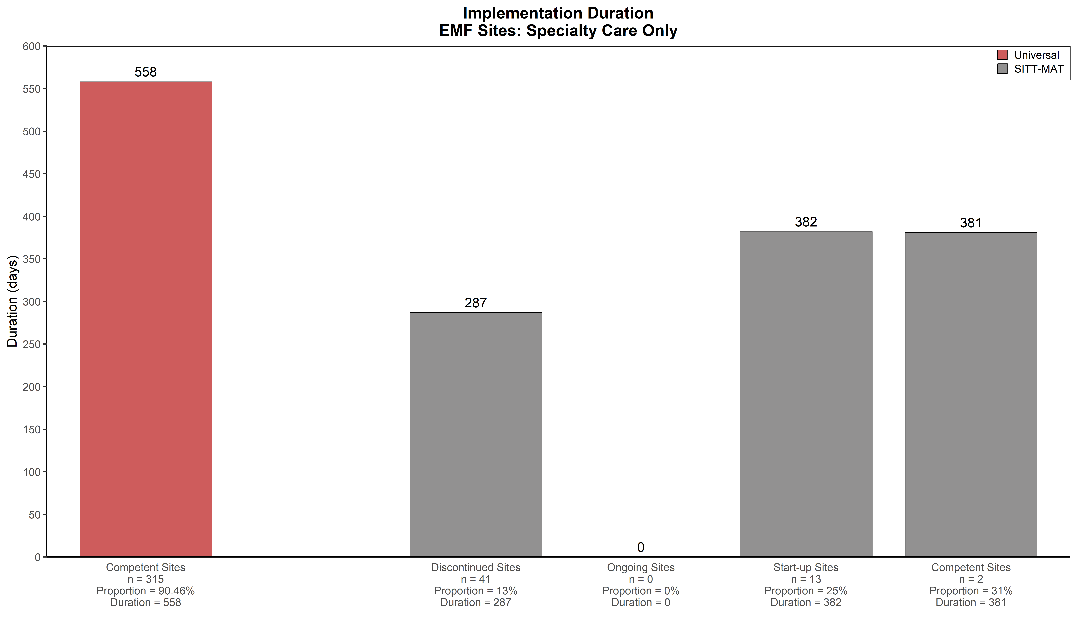
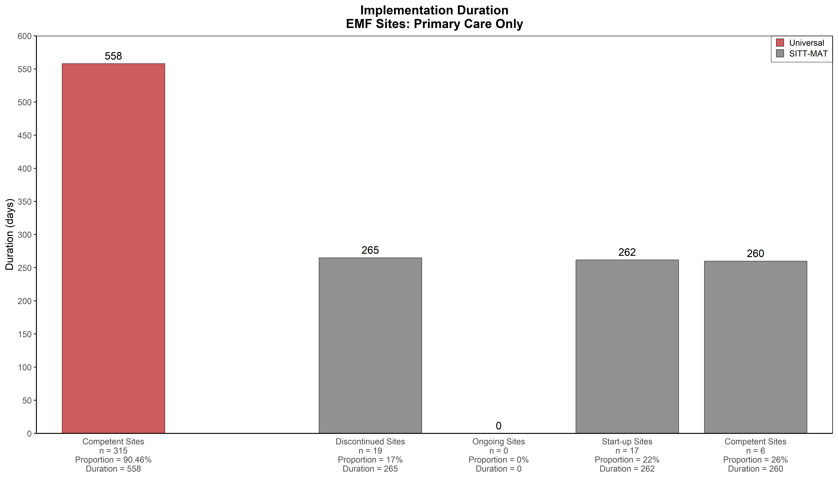
SITT-MAT SIC Results – EMF Implementation Duration
Notes:
Data was entered for Audit & Feedback (A&F) (n = 69) and Academy (n = 57) clinics.

Slide 11
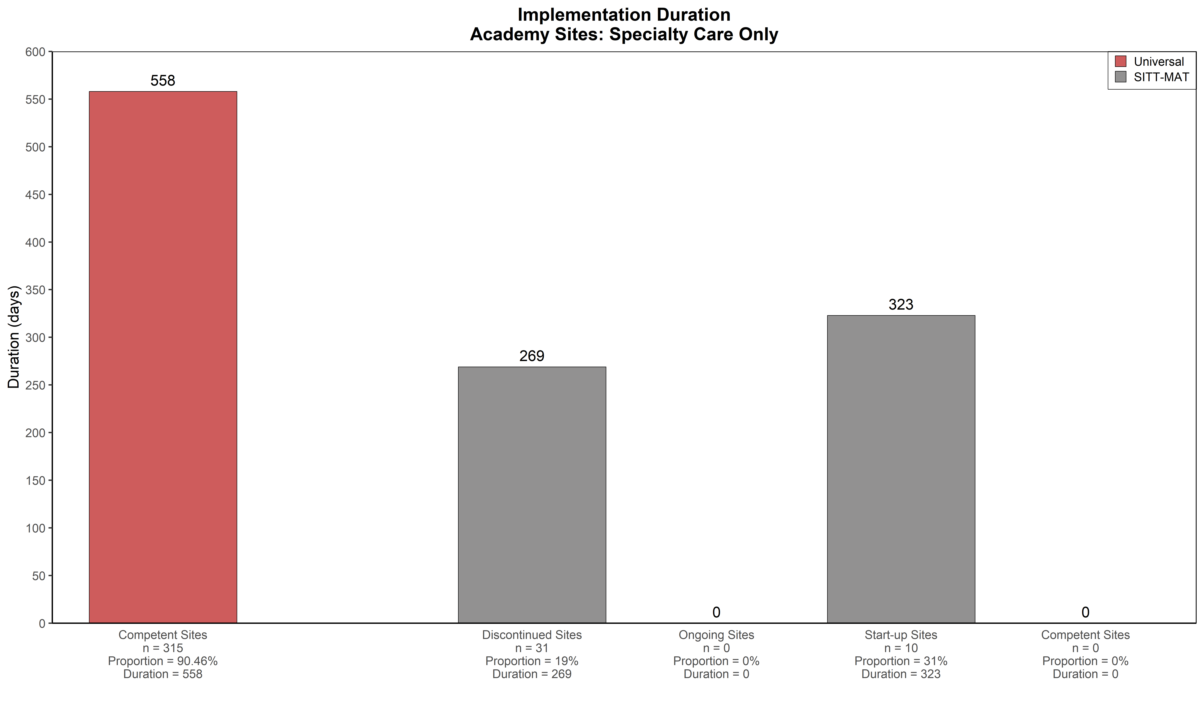
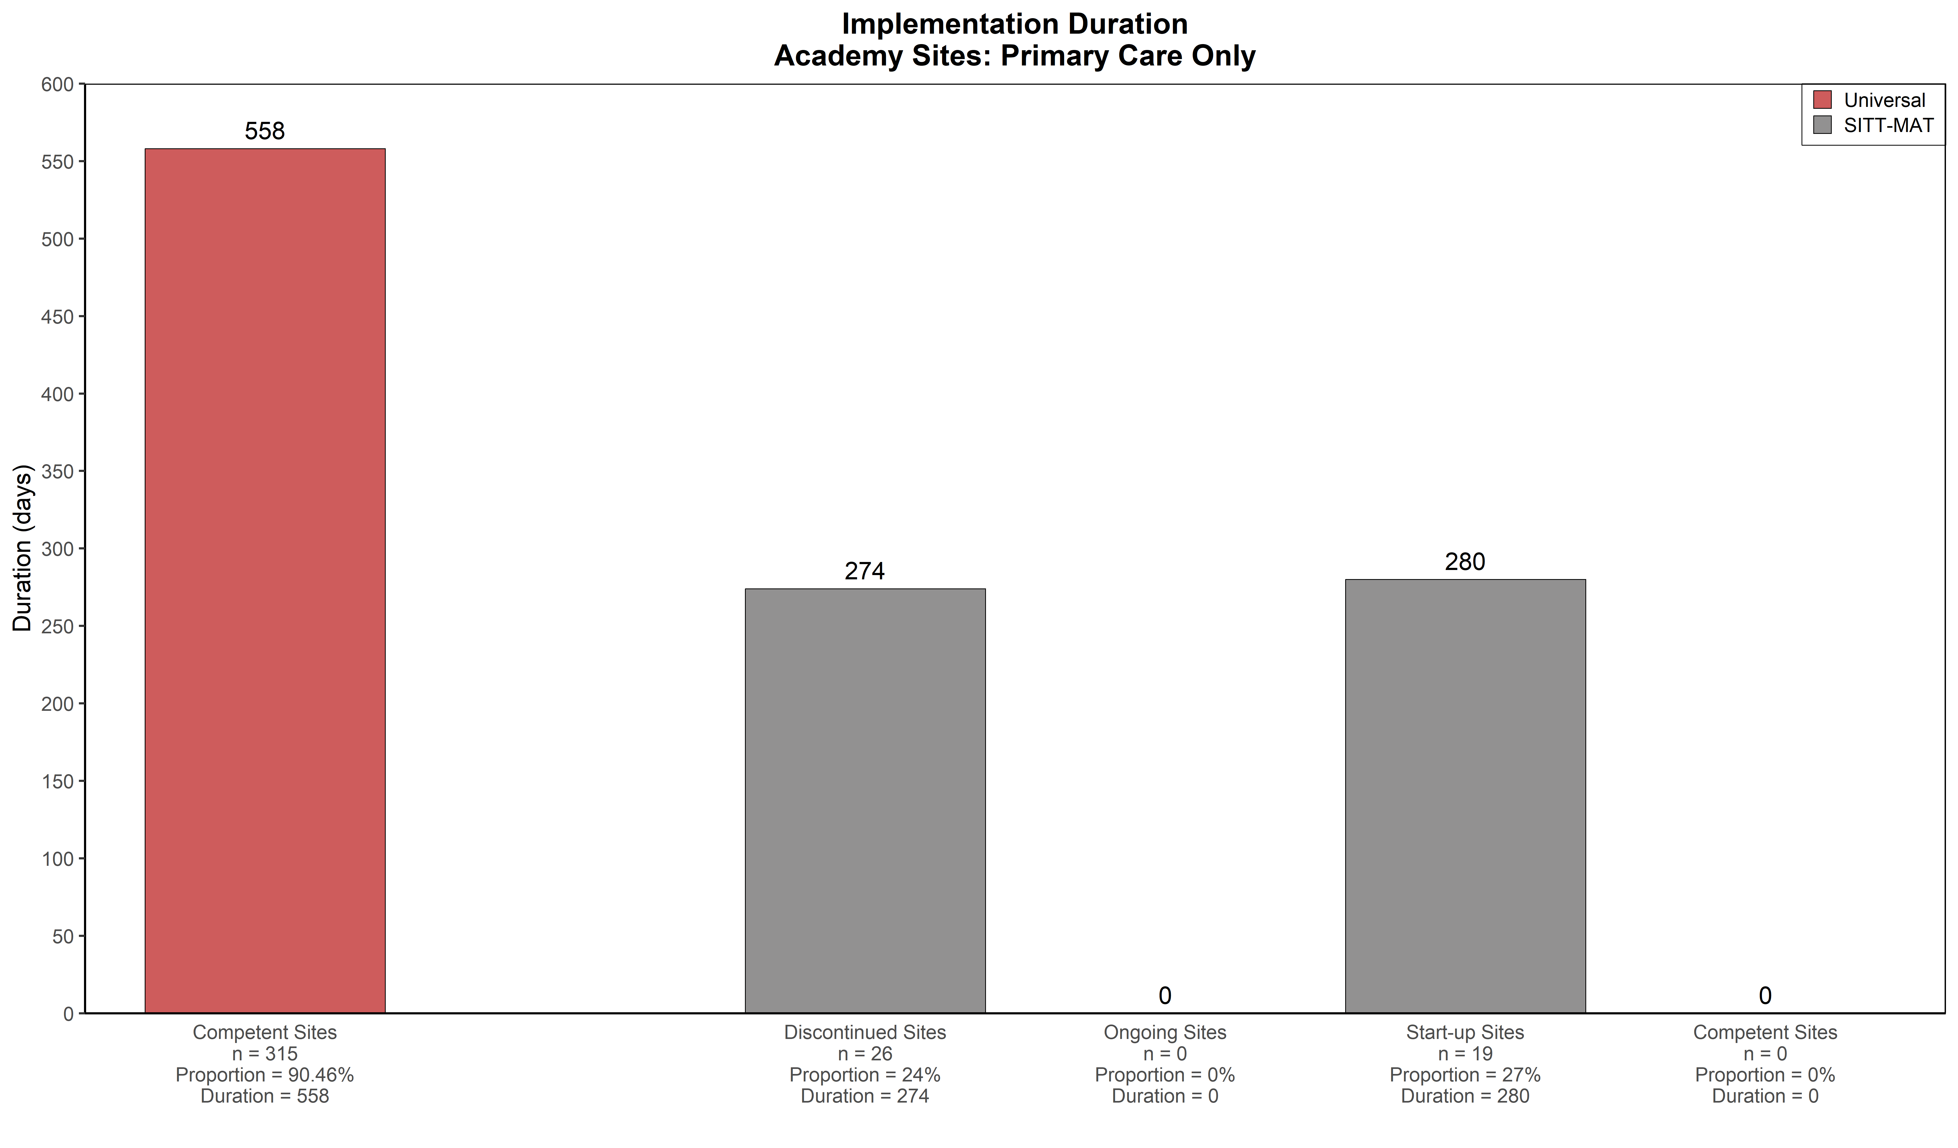
SITT-MAT SIC Results – Academy Implementation Duration

Slide 12
Implementation Cost Findings
Significant difference overall (p=0.015) and for primary care clinics (p = 0.004)
Specialty care clinics: No significant cost difference between strategies.

Slide 13
What does the SIC and COINS data tell us?
Pre-Implementation and Implementation phase proportion and duration scores for all clinics were much lower than competent sites from other EBPs that use the SIC.
Academy did not yield competency whereas A&F did.
Primary care is both faster and more often able to achieve competency than specialty care.
Overall, the duration is much shorter than typical universal SIC for both conditions and across both settings.
Implementation costs were significantly higher for the Audit and Feedback strategies both overall and for primary care clinics.

Slide 14
Lessons Learned
Adaption of the SIC for this adaptive trial required multiple meetings to:
Define and identify key activities across implementation strategies to create a common SIC framework,
Determine how to assess each activity, including which activities have a cost component, and
Track activity completion or non-completion.
Implementation of the SIC
SITT-MAT strategies evolved over time differing from initial SIC definition.
Establish data entry systems and definitions for the SIC to prevent recall challenges and enable assignment of staff to COINS activities.
Defining competency is difficult for time bound implementation strategies.

Slide 15
Implications for Policy & Practice
Highlights the feasibility to adapt the SIC & COINS in an adaptive trial to compare implementation strategy participation & fidelity within and across implementation strategies.
Informs efforts to tailor implementation strategies to specific organizational context and explore implementation strategy intervention effectiveness.
Suggests that costs are initially higher but may decrease as clinics move through the stepped sequence of implementation strategies in an adaptive trial design.

Slide 16
Questions
Contact Information
Jay Ford jhfordii@wisc.edu

Slide 17


An implementation science informed process evaluation for a multi-disciplinary intervention for childhood brain cancer survivors
A/Professor Natalie Taylor
Director | i2i | Implementation to Impact
Director of Research
School of Population Health
Faculty of Medicine and Health, UNSW
Director | Implementation Science Platform
Chair | Implementation Science Collaborative
Maridulu Budyari Gumal (SPHERE)
Team members:
Joseph Elias, Skye McKay, Carolyn Mazariego, Jordana McLoone, Christina Signorelli, Claire E. Wakefield, Richard J. Cohn, Nada Vidić, Shuang Liang, Elijah Tyedmers, and Natalie Taylor

Slide 18


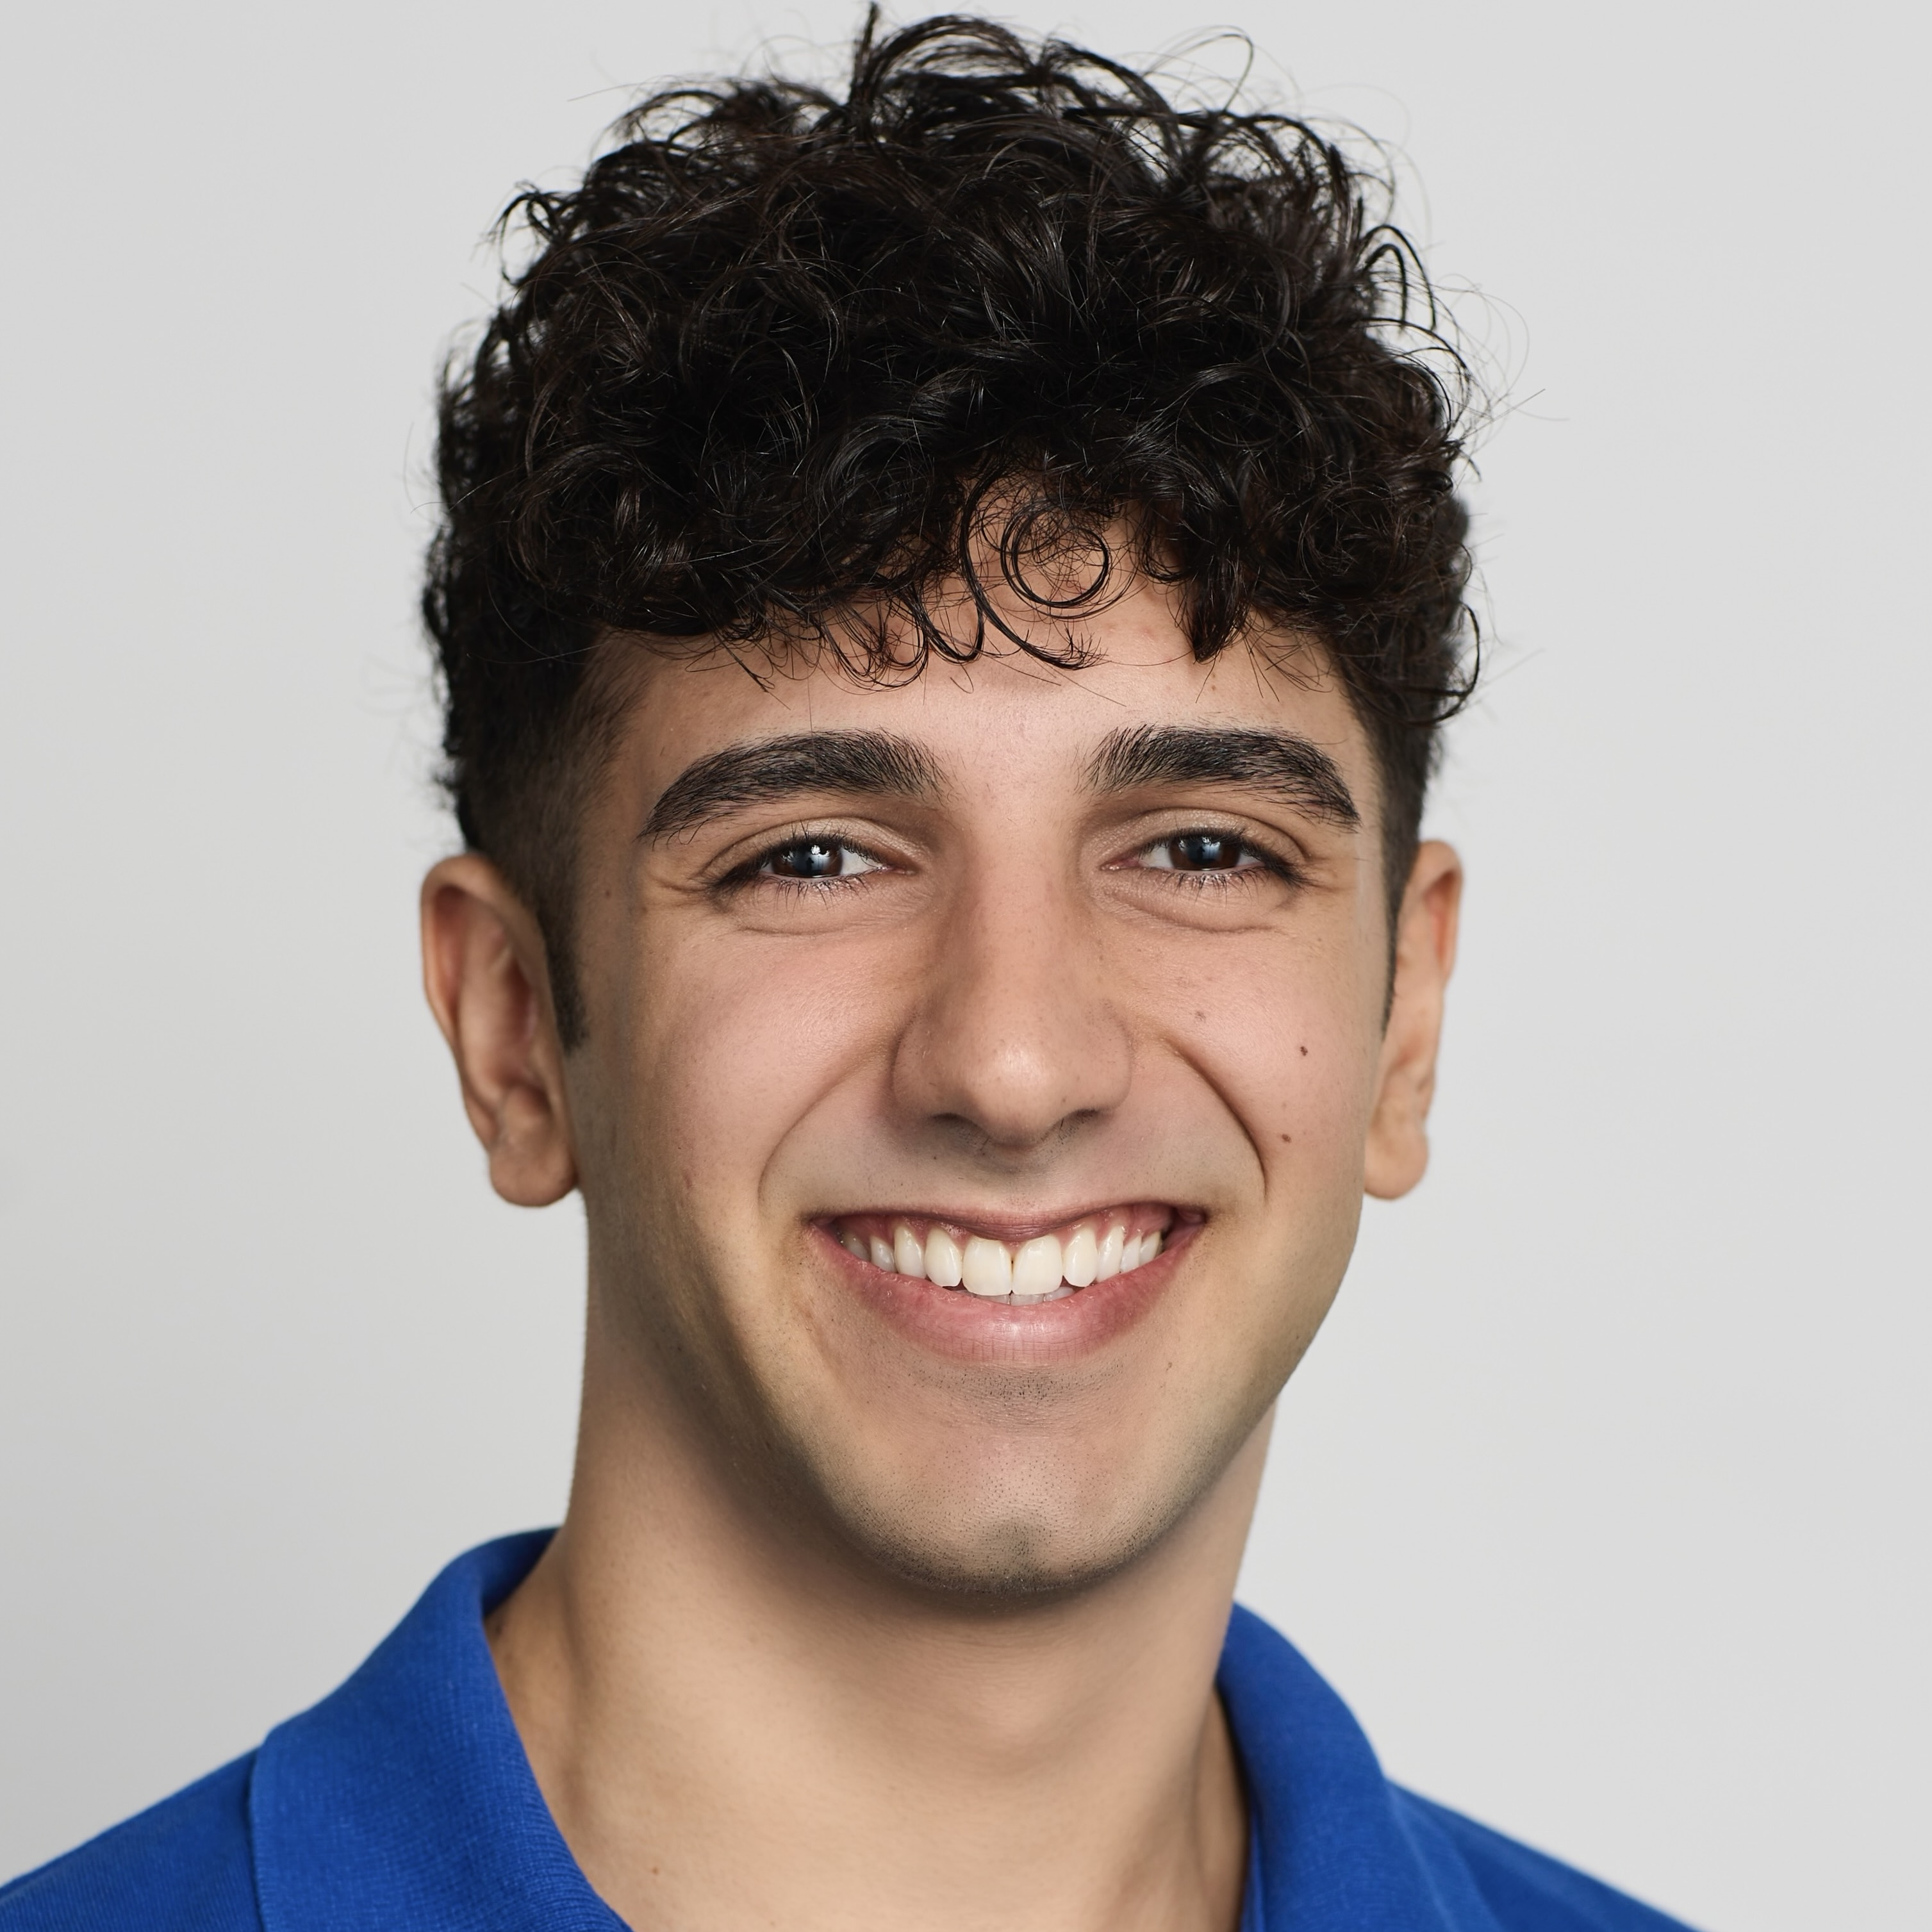

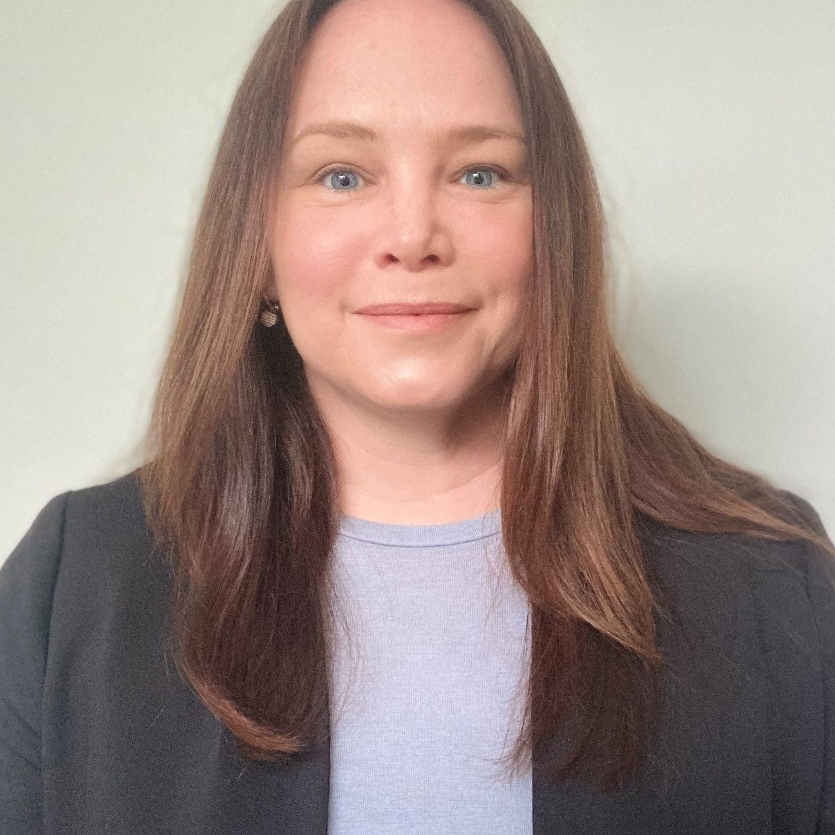




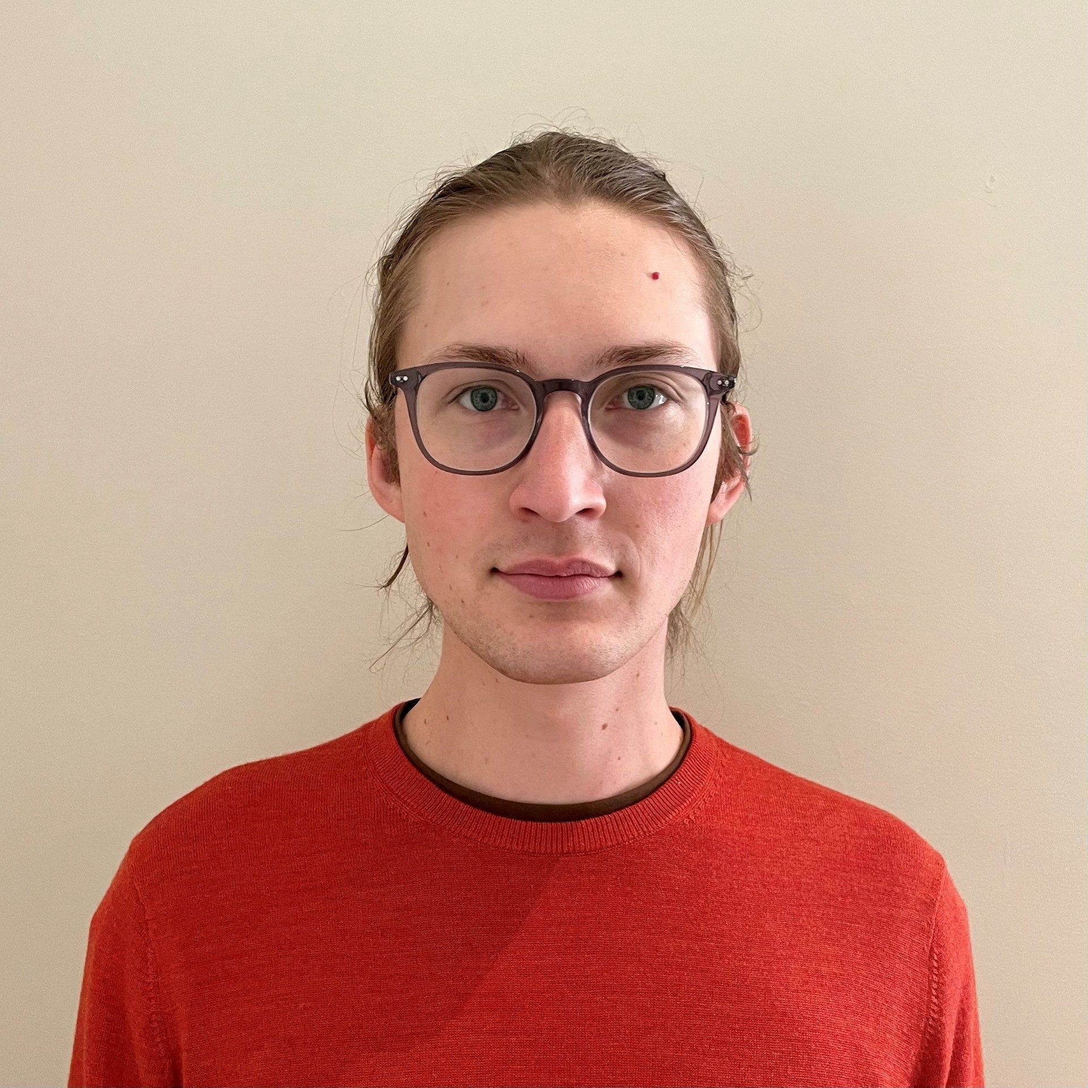


Our Team
Mr Joseph Elias
Prof. Claire E. Wakefield
PhD Candidate/Research Officer, UNSW Implementation to impact
Director of Research, Pediatric Palliative Care and Quality of Life, Stanford University
Ms Skye McKay
Prof. Richard Cohn
Senior Project Officer, UNSW Implementation to Impact
Founding Medical Director, Behavioural Sciences Unit, Kids Cancer Centre
Dr Carolyn Mazariego
Dr Shuang Liang
Deputy Director and Senior Research Fellow, UNSW Implementation to Impact
Post-Doctoral Fellow, UNSW Implementation to Impact
Dr Jordana McLoone
Mr Elijah Tyedmers
Deputy Director, Behavioural Sciences Unit, Kids Cancer Centre; Senior Lecturer, UNSW School of Clinical Medicine
PhD Candidate/Research Assistant, UNSW Implementation to Impact
Dr Christina Signorelli
Ms Nada Vidić
Senior Research Fellow, UNSW Medicine & Health; Health Systems and Survivorship Team Leader, Behavioural Sciences Unit, Kids Cancer Centre
PhD Candidate, UNSW School of Population Health

Slide 19


It’s estimated that…
80%
+6 decades
96%
of children diagnosed with cancer will go on to survive
of life await survivors past their initial diagnosis
of survivor's report experiencing severe, life threatening or even fatal side effects from treatment
Long-term cancer survivorship

Slide 20

Are survivors engaged?
54%
65%
60%
75%
84%
International phenomena
44%
54%

Slide 21







Step 3
Step 1
Step 2
First nurse consult
Initial treatment summary
Health assessment survey
Step 4
Step 6
Step 5
Multi-disciplinary case review
Second nurse consult
Personalised treatment recommendations
The Engage
Intervention
Step 7
Nurse booster session

Slide 22
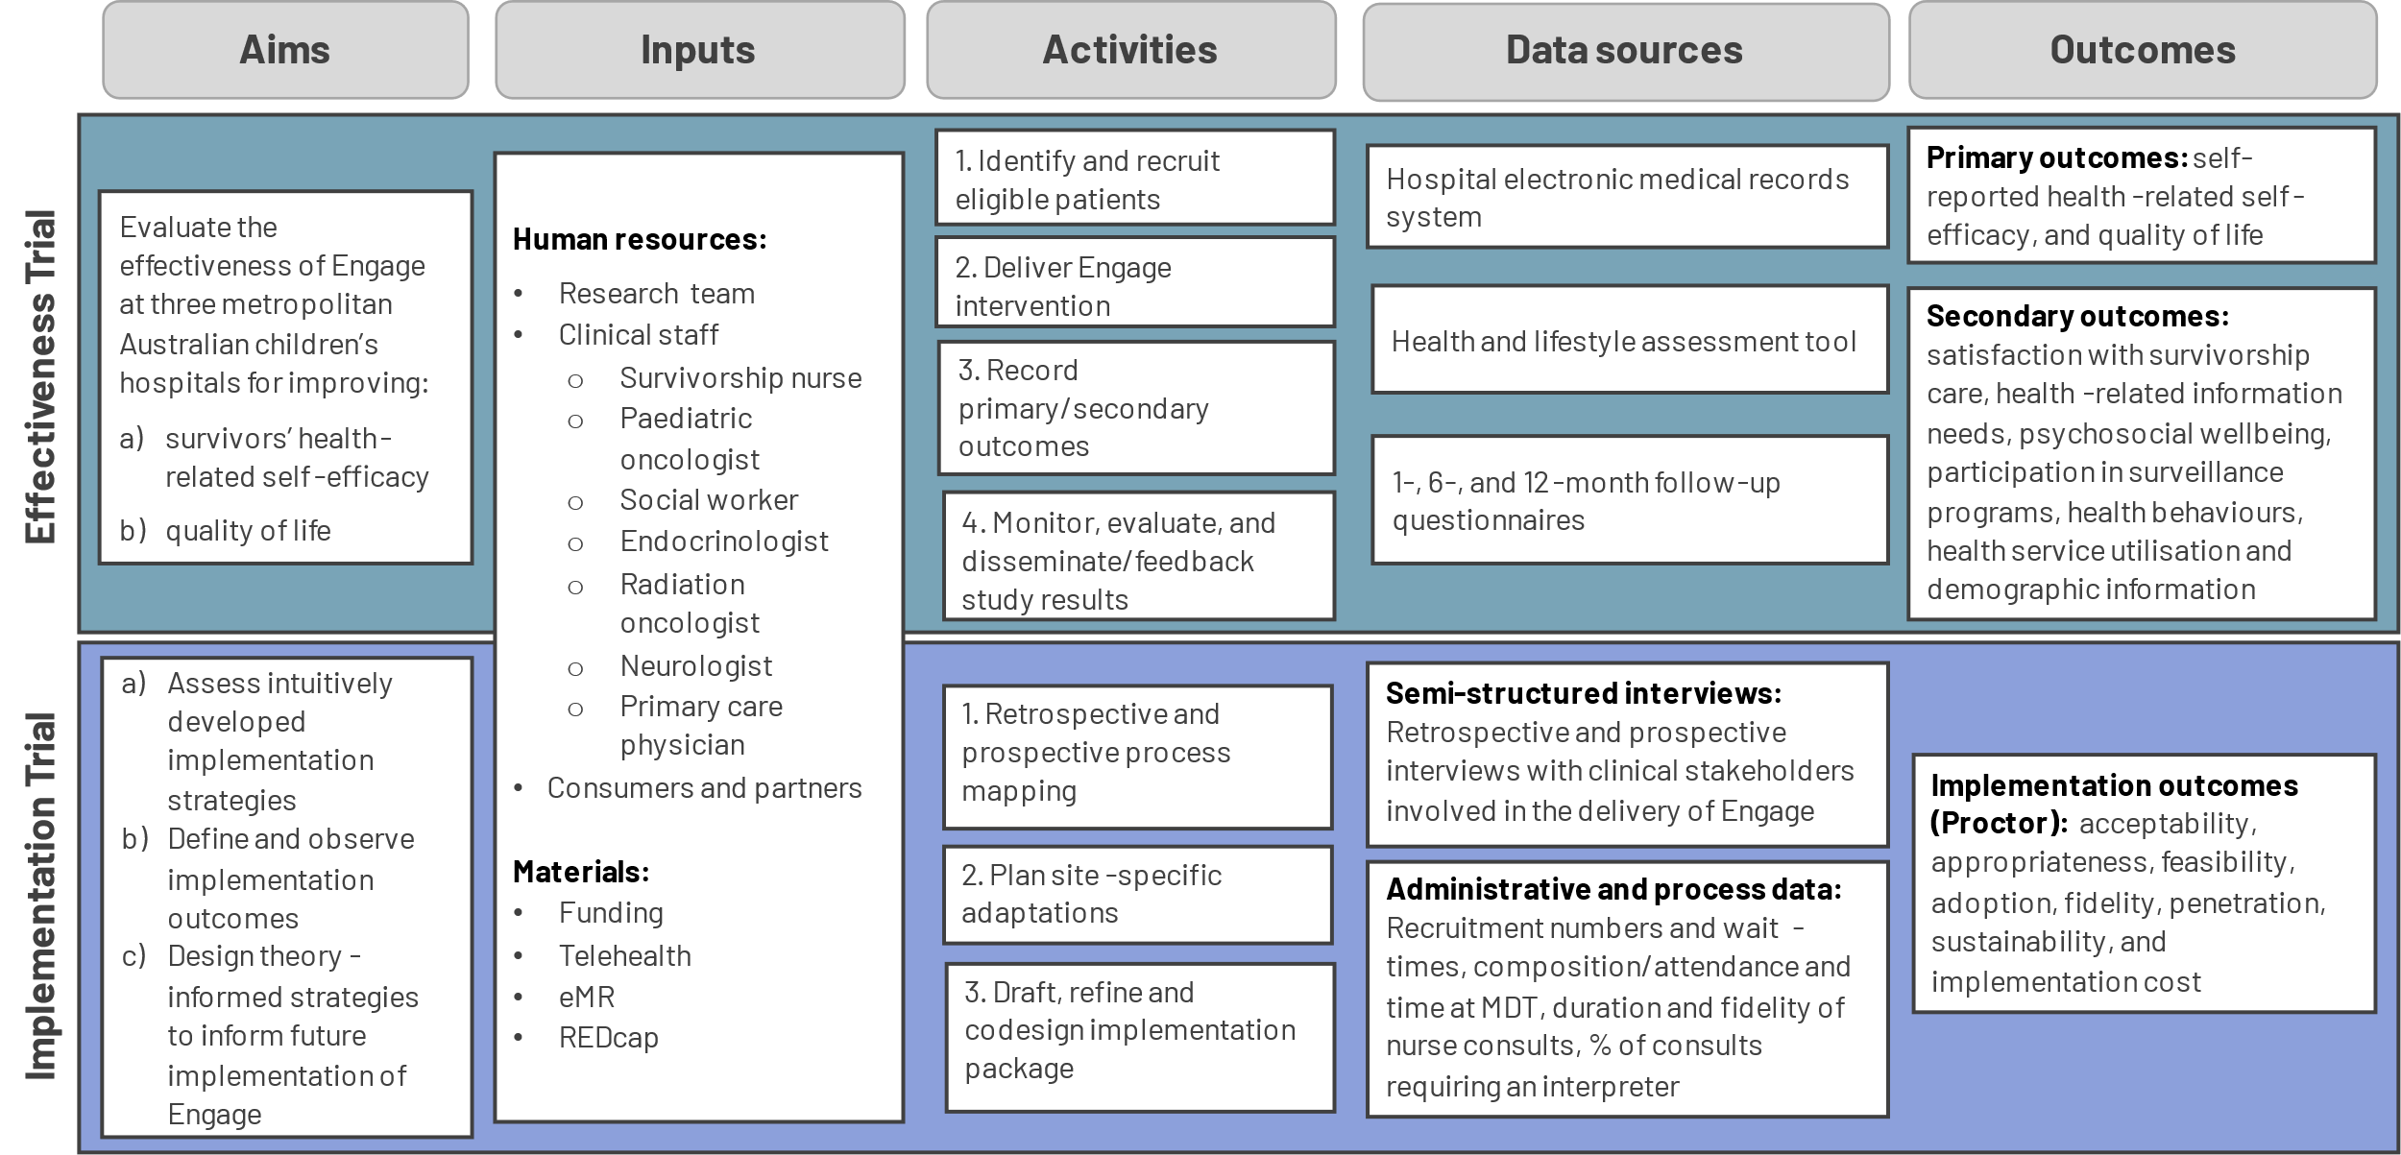
The Engage Type-1 Hybrid Trial
Mixed methods, multi-site process evaluation

Slide 23
IMPLEMENTATION
2
Identify factors influencing implementation
Determine whether Engage was delivered as intended
A PROCESS EVALUATION FRAMEWORK TO SCALE ‘ENGAGE’
PRE-IMPLEMENTATION
1
Define programme theory
Evaluate Proctor outcomes
PLANNING
IMPLEMENTATION
Determine minimal intervention component to retain clinical benefits
3
Analyse contextual differences between trial sites
PRACTICE SETTING
ECOLOGICAL SETTING
Determine feasibility
and operationalise scale-up
POST-MPLEMENTATION SCALE-UP
Identify contextual factors in primary care
Identify where strategies work and why
Identify the individual and system related factors across a range of settings
4

Slide 24
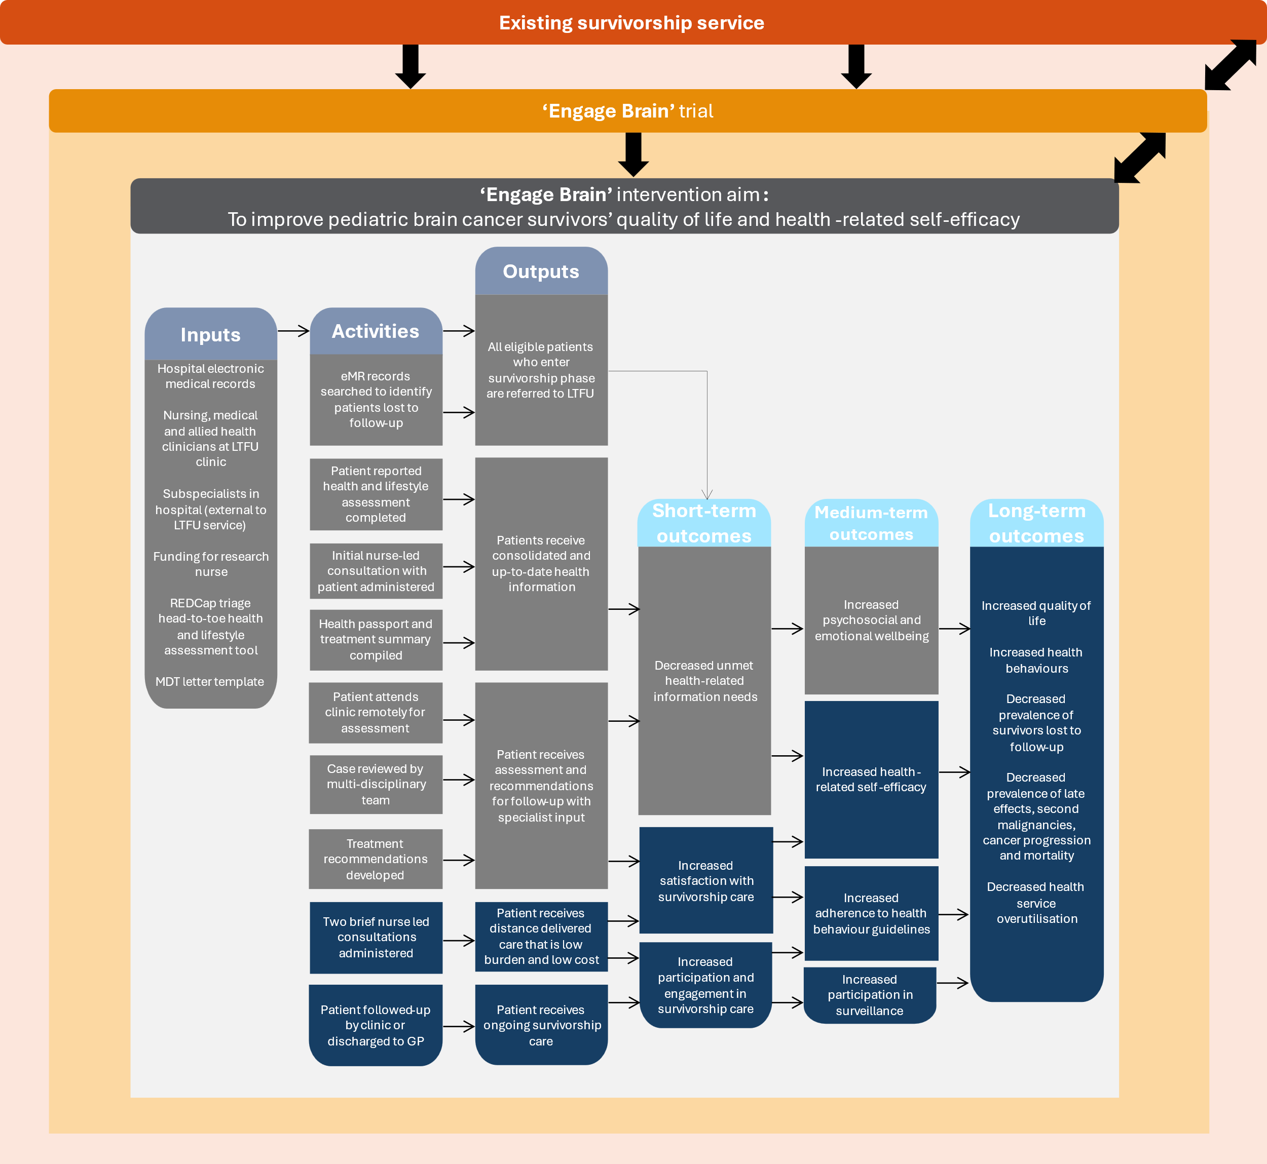
Planning – Defining the context
The existing survivorship context
Levels of implementation
The Engage trial context
The Engage program

Slide 25




Domain 1a - Planning
AIM
1
Define programme theory
Specify the key theoretical constructs that are expected to mediate or influence change in clinical and service outcomes following the delivery of Engage
METHOD
Review and code trial protocol & intervention manual
Code as resources, activities, outputs and outcomes
Develop initial draft program logic model
Co-refine logic model
With trial investigators, including researchers and clinicians

Slide 26
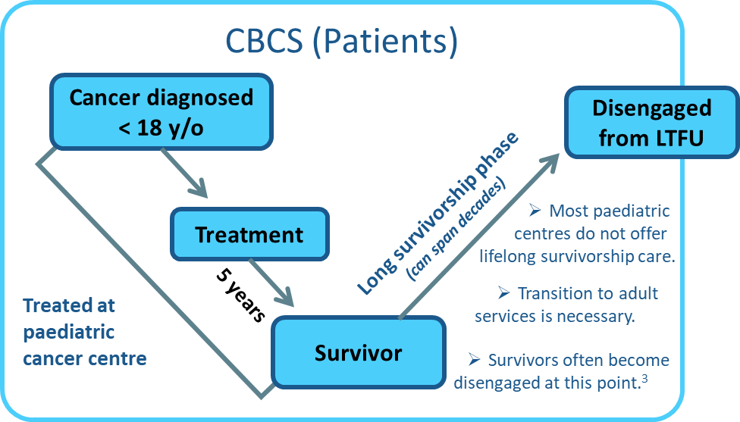
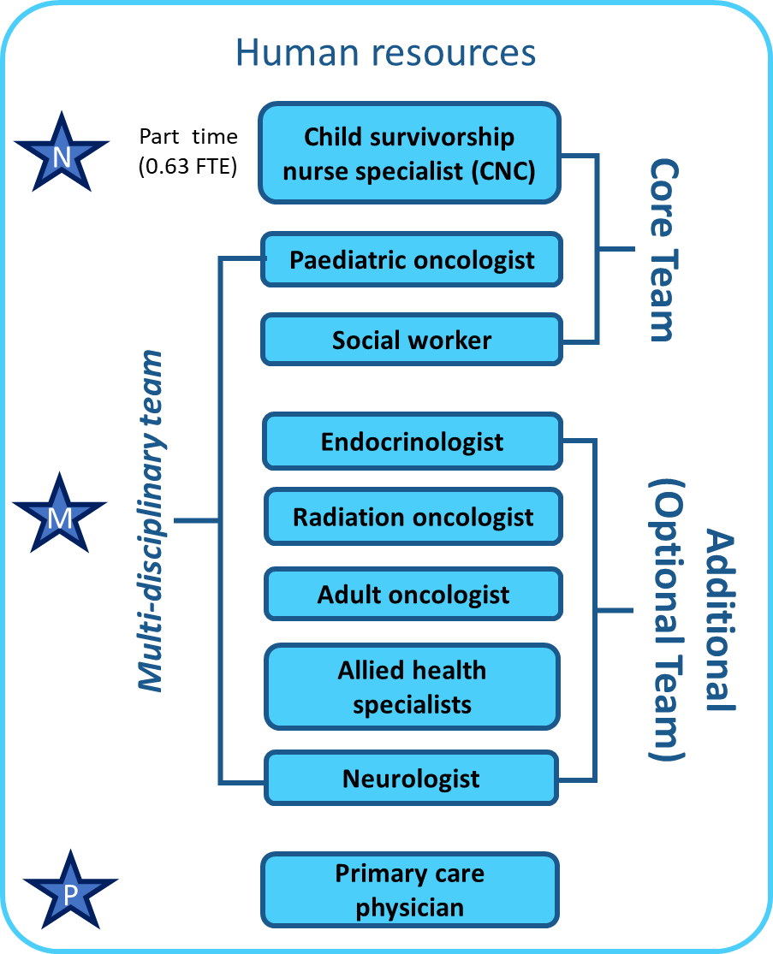
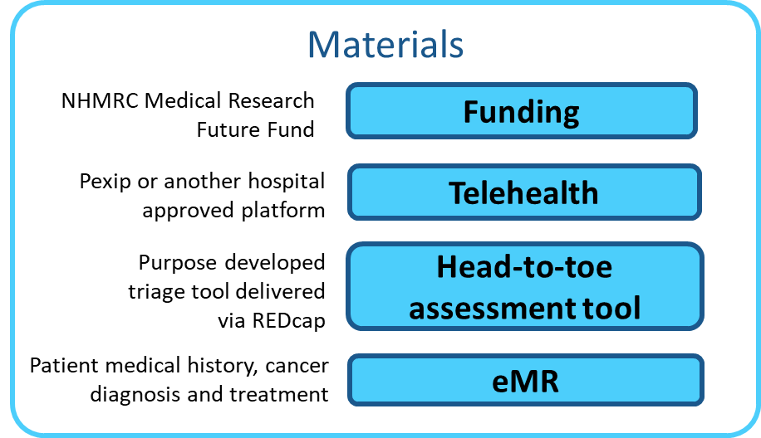


What resources are needed to implement Engage?
1. Resources/ Inputs

Slide 27
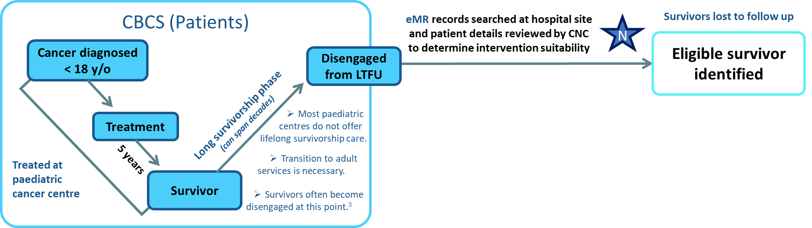
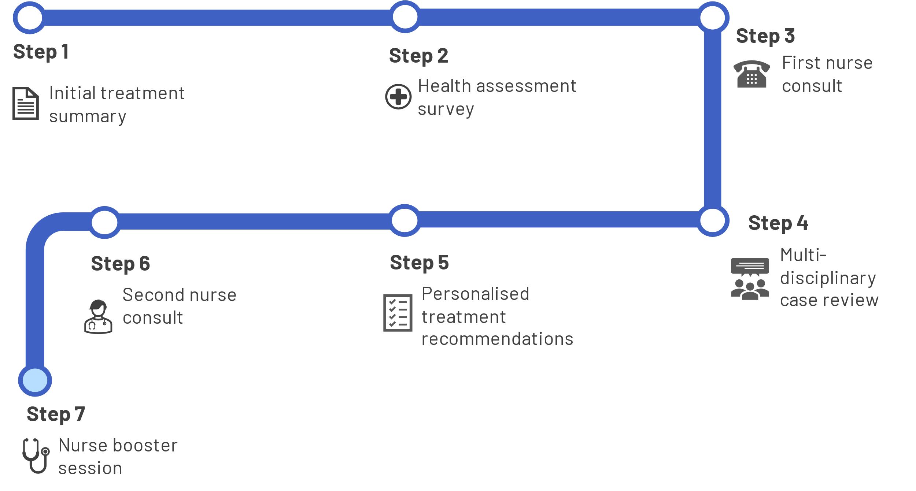

What planned activities will you accomplish by having access to these resources?
What resources are needed to implement Engage?
1. Resources/ Inputs
2. Activities
Notes:
The next component are the intervention steps.

Slide 28
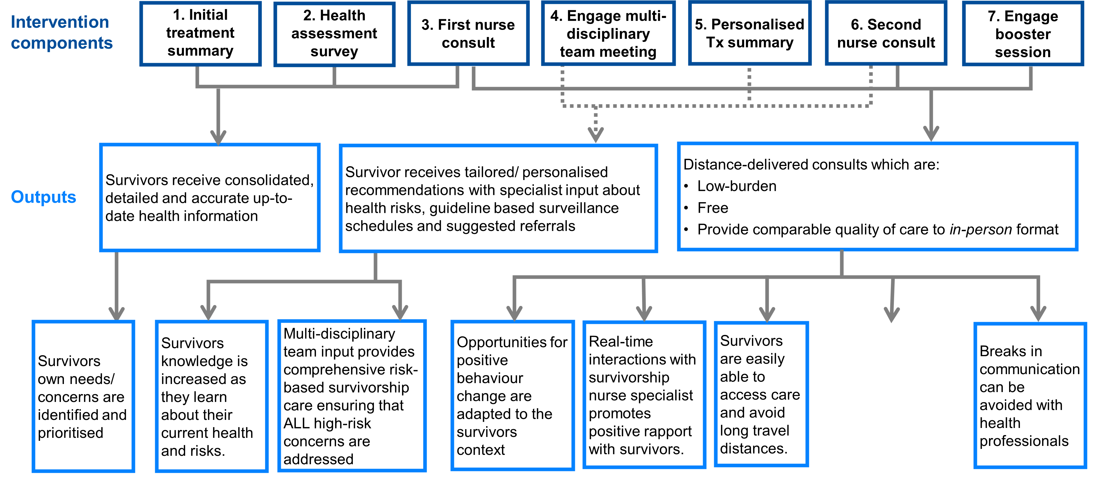

2. Activities
What are the direct results of the program activities? (i.e., size or scope of the service)
Survivors are encouraged to self-manage and be active in their care
3. Outputs
Notes:
The next are the outputs, and

Slide 29
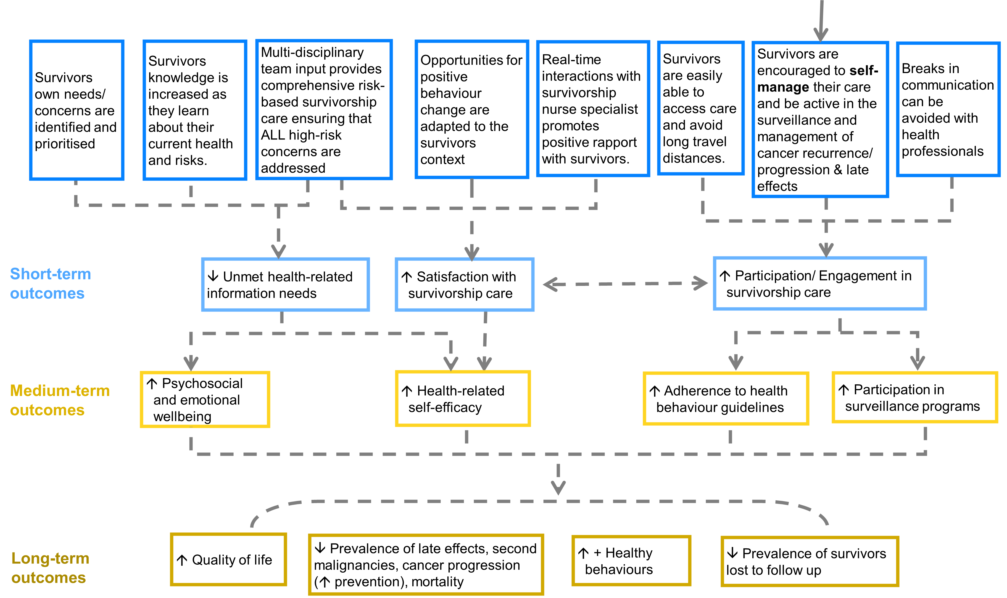

Survivors are encouraged to self-manage and be active in their care
3. Outputs
What benefits are conferred to participants after activities are accomplished to the extent you intended?
4. Outcomes
Notes:
There are a few variations of a program logic model, but they typically contain

Slide 30

Survivors are encouraged to self-manage and be active in their care
3. Outputs
What benefits are conferred to participants after activities are accomplished to the extent you intended?
Fewer unmet needs (p=.028)
98% satisfaction
93% participation rate
Improved psychosocial outcomes at 12m
(p = .011)
90% increase in self-efficacy at 12 m
4. Outcomes
Published trial results for Engage all cancers
Notes:
There are a few variations of a program logic model, but they typically contain

Slide 31




Domain 1b - Planning
Identify factors influencing implementation
AIM
1
Define programme theory
Identify factors influencing the implementation of existing survivorship models of care at the three trial sites
METHOD
N=16 clinical stakeholder semi-structured interviews
CFIR guided + process mapping
IRLM
ANALYSIS
Hybrid inductive-deductive thematic analysis
CFIR2.0/TDF frameworks
Clinician intuitive strategies recorded
Aligned to ERIC/BCTs
Theory-driven strategies generated
ERIC-CFIR matching tool, and Theory and Techniques Tool (BCTs-TDF)

Slide 32
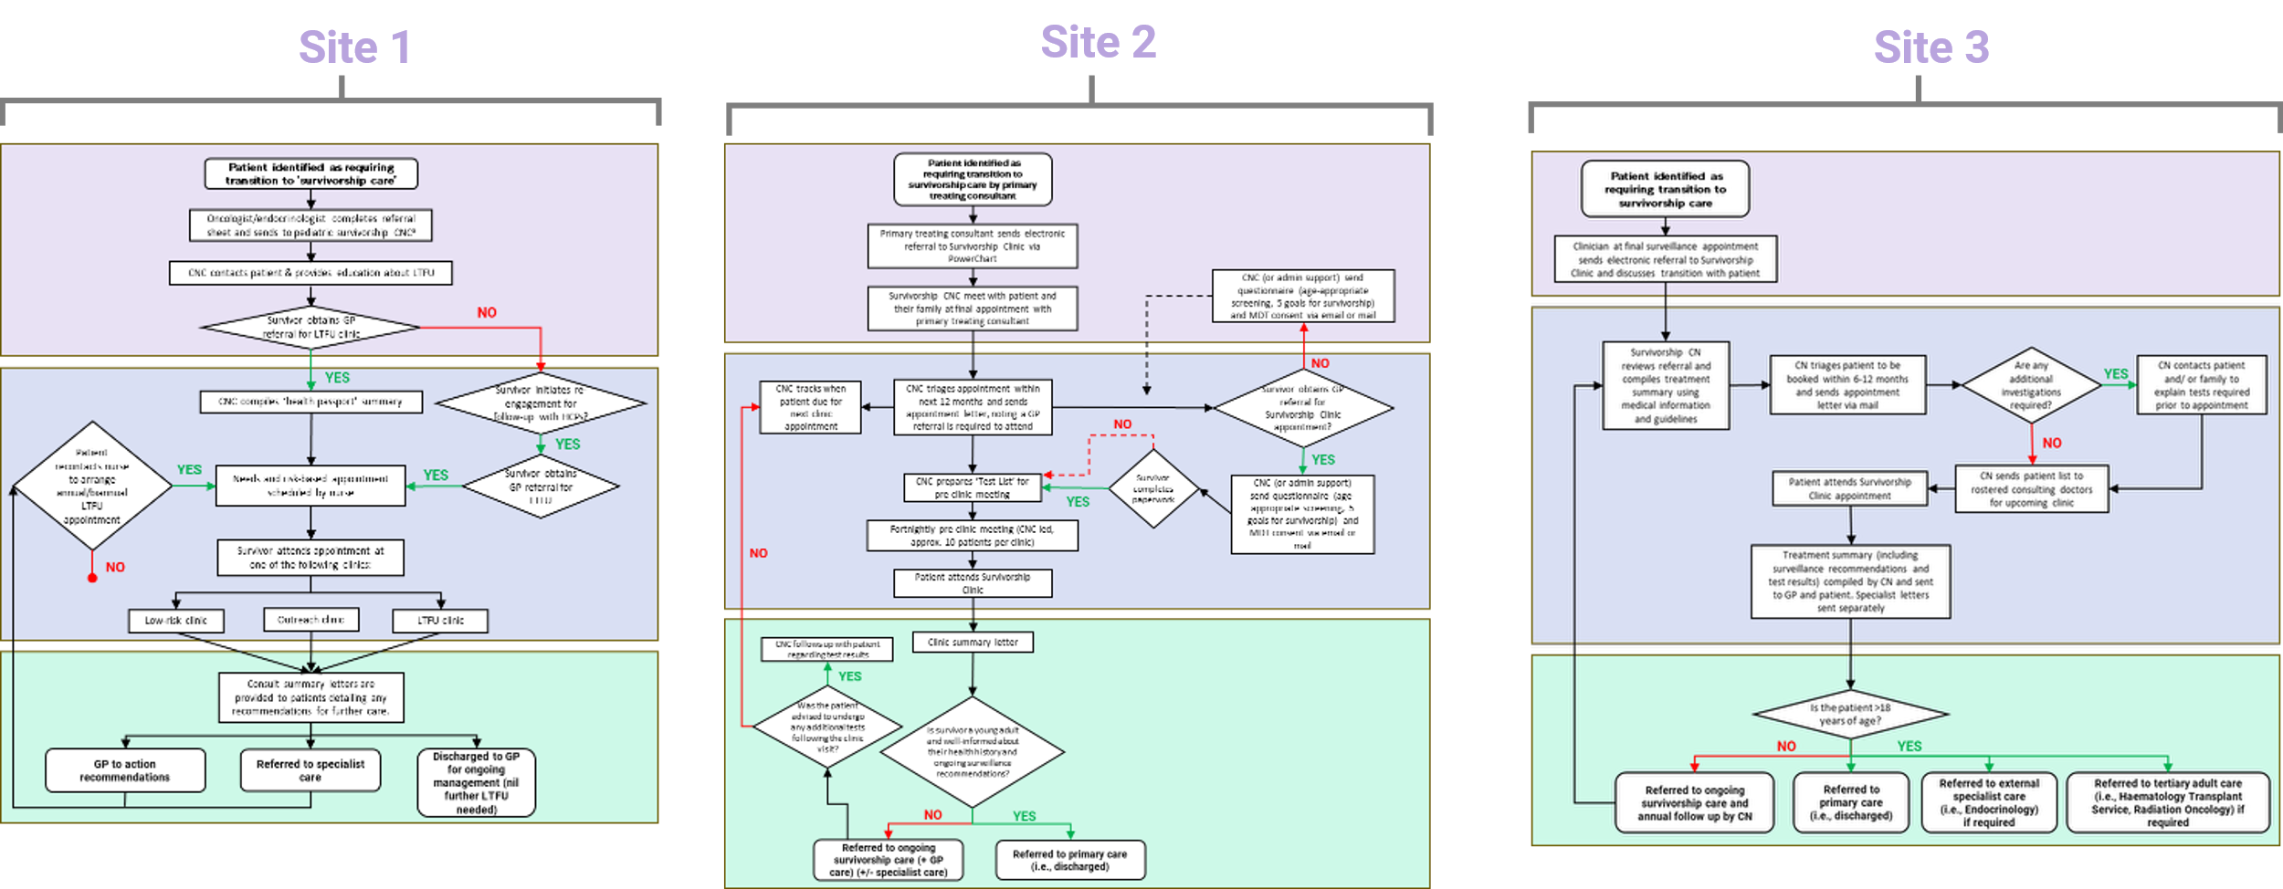
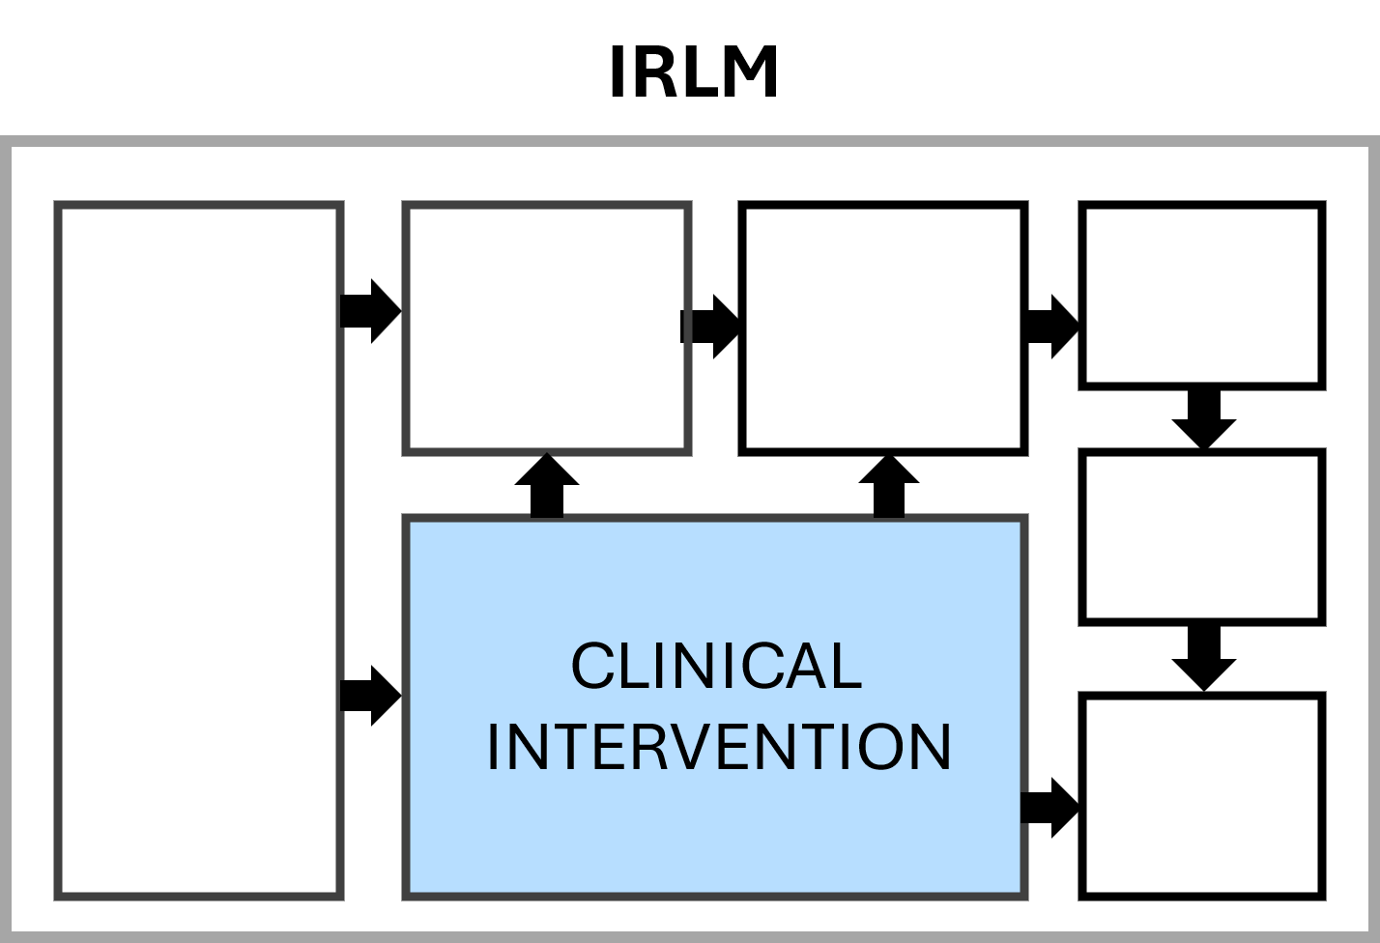
Domain 1b - Planning
Identify factors influencing implementation
Process mapping existing survivorship model of care at each site
1
Define programme theory

Slide 33
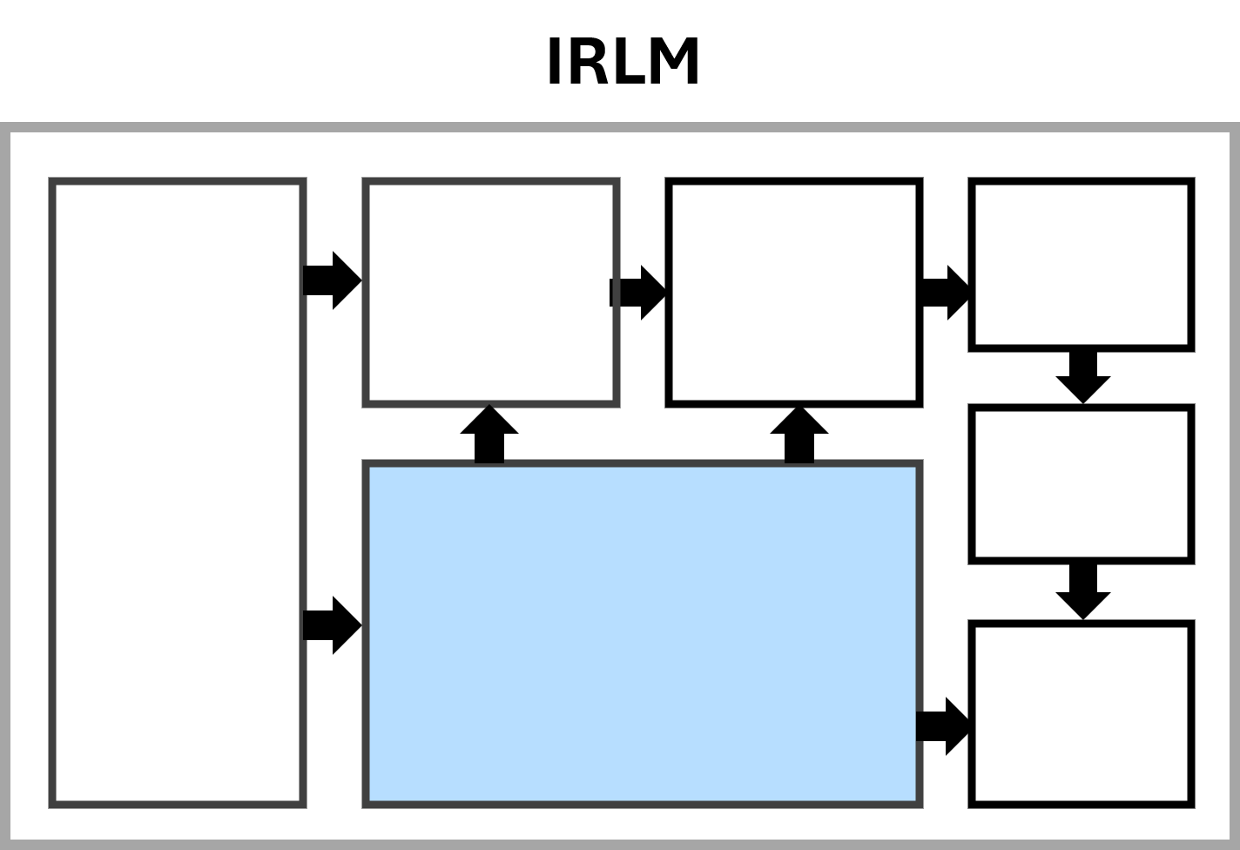
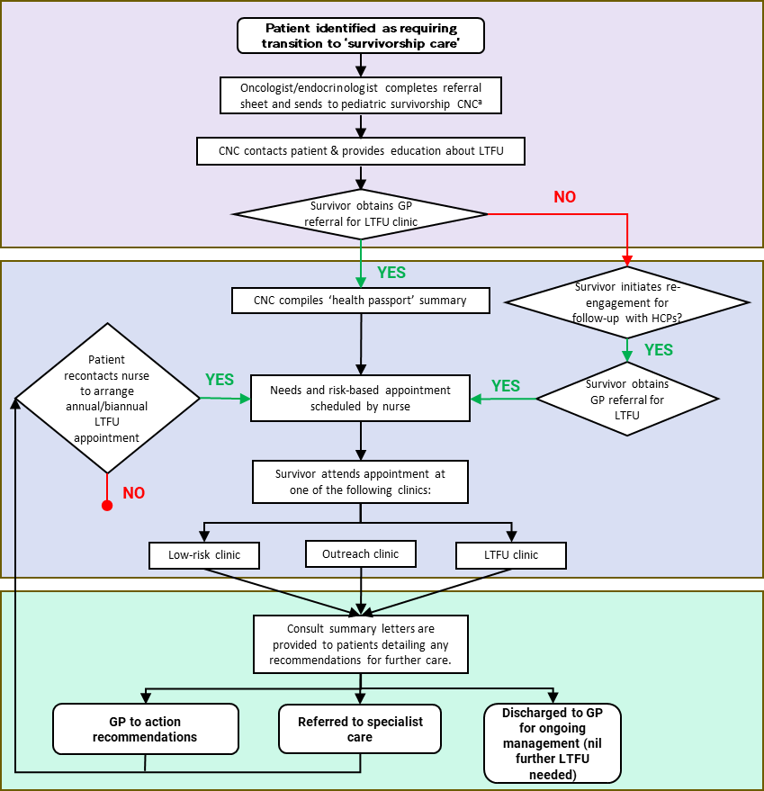
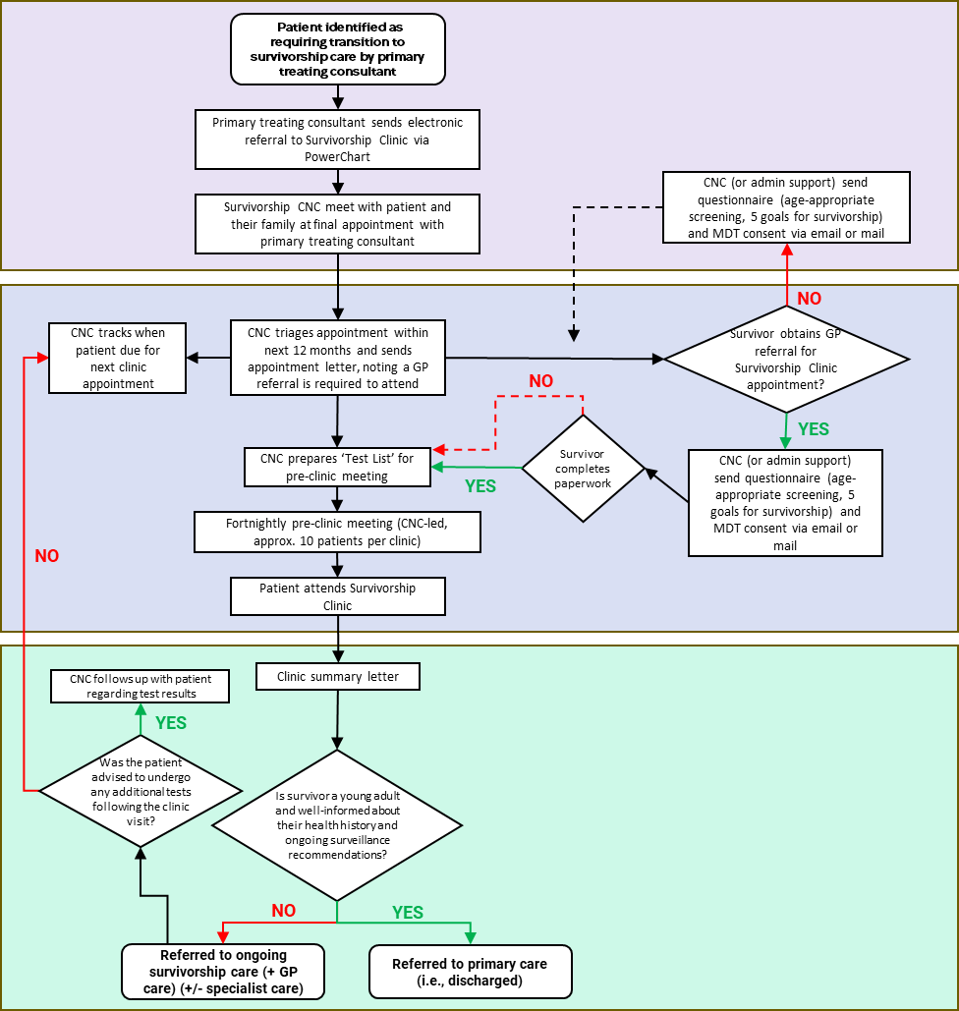
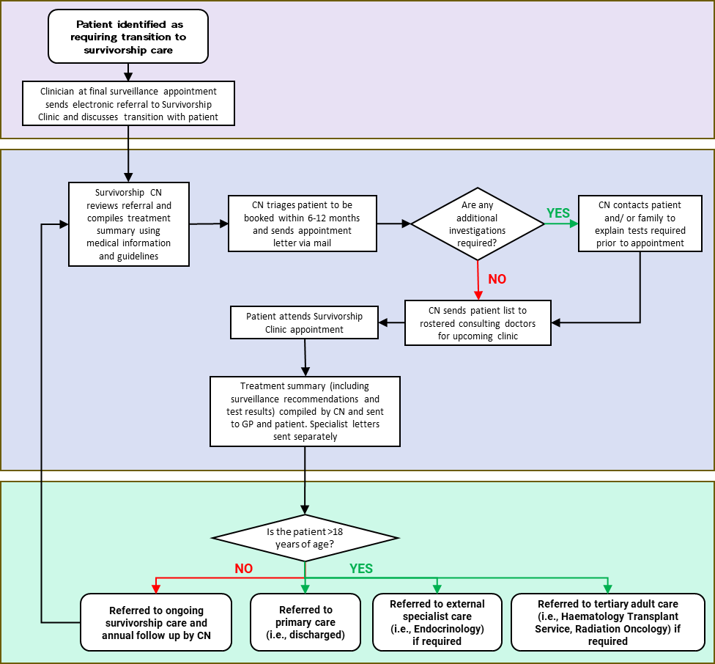
Domain 1b - Planning
Deductive-inductive thematic analysis of barriers/facilitators to the CFIR2.0/TDF, intuitive and theory driven strategies aligned/generated to ERIC/BCTs taxonomies
STRATEGIES
MECHANISMS
DETERMINANTS
OUTCOMES
CLINICAL INTERVENTION

Slide 34
Domain 1b - Planning
Shared determinants
Implementation strategies
Mechanisms
Outcomes
Improved understanding of primary context will facilitate ↑ tertiary-primary care coordination
Implementation
↑ Acceptability – clinician satisfaction
↑ Fidelity – adherence, completion
Outer setting, partnerships and connections: Clinic staff communication and engagement with primary care physicians (-)
Explore barriers and facilitators to implementing survivorship care from the primary care perspective (ERIC: visit other sites)
Theory
Service
↑ Timeliness – returning summaries
↑ Effectiveness of care coordination
Problem solving with physicians to make returning consult summaries more efficient (ERIC: facilitation)
Strategizing with subspecialists and promoting flexible approaches to generating consult summaries ↑ communications with CNC
Intuitive
Inner setting, work infrastructure: Difficulties coordinating specialists with limited time and availability (-)
Incentivise clinic participation/engagement (ERIC: alter incentive/allowance structures)
Clinical
↓ Patient lost to follow-up
↑ Patient satisfaction
Theory
Clinical intervention
Existing survivorship model of care

Slide 35
Domain 1b - Planning
Shared determinants
Implementation strategies
Mechanisms
Outcomes
Improved understanding of primary context will facilitate ↑ tertiary-primary care coordination
Implementation
↑ Acceptability – clinician satisfaction
↑ Fidelity – adherence, completion
Outer setting, partnerships and connections: Clinic staff communication and engagement with primary care physicians (-)
Explore barriers and facilitators to implementing survivorship care from the primary care perspective (ERIC: visit other sites)
Theory
Service
↑ Timeliness – returning summaries
↑ Effectiveness of care coordination
Problem solving with physicians to make returning consult summaries more efficient (ERIC: facilitation)
Strategizing with subspecialists and promoting flexible approaches to generating consult summaries ↑ communications with CNC
Intuitive
Inner setting, work infrastructure: Difficulties coordinating specialists with limited time and availability (-)
Incentivise clinic participation/engagement (ERIC: alter incentive/allowance structures)
Clinical
↓ Patient lost to follow-up
↑ Patient satisfaction
Theory
Clinical intervention
Existing survivorship model of care

Slide 36


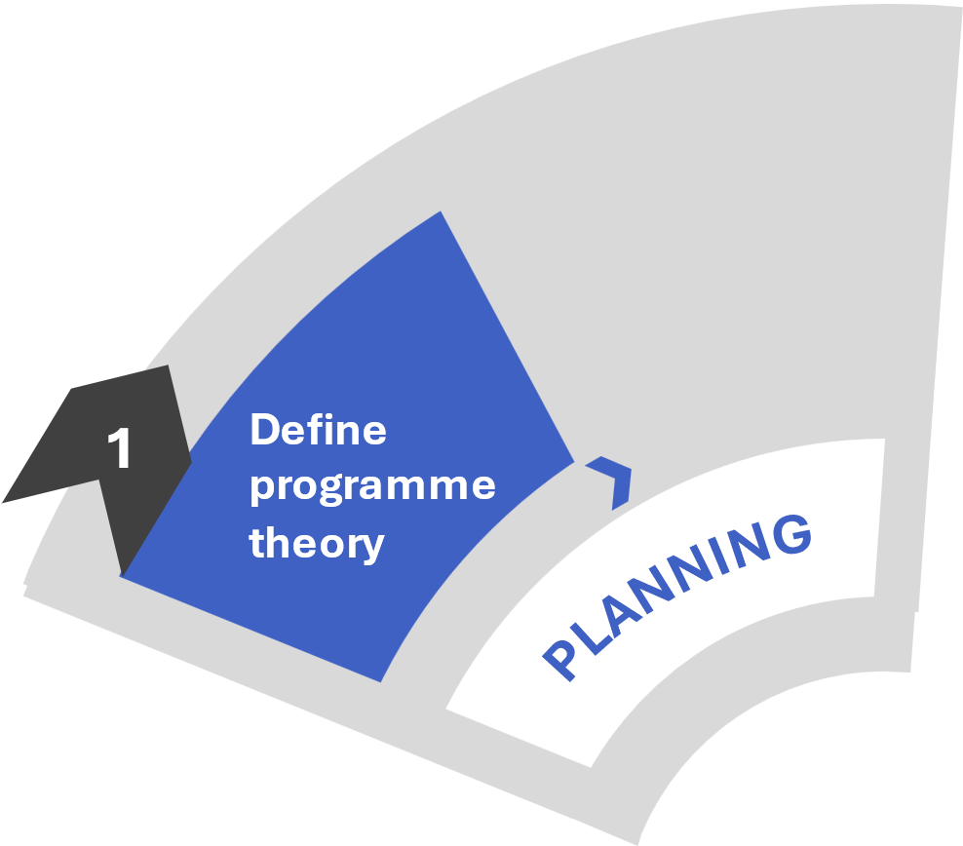
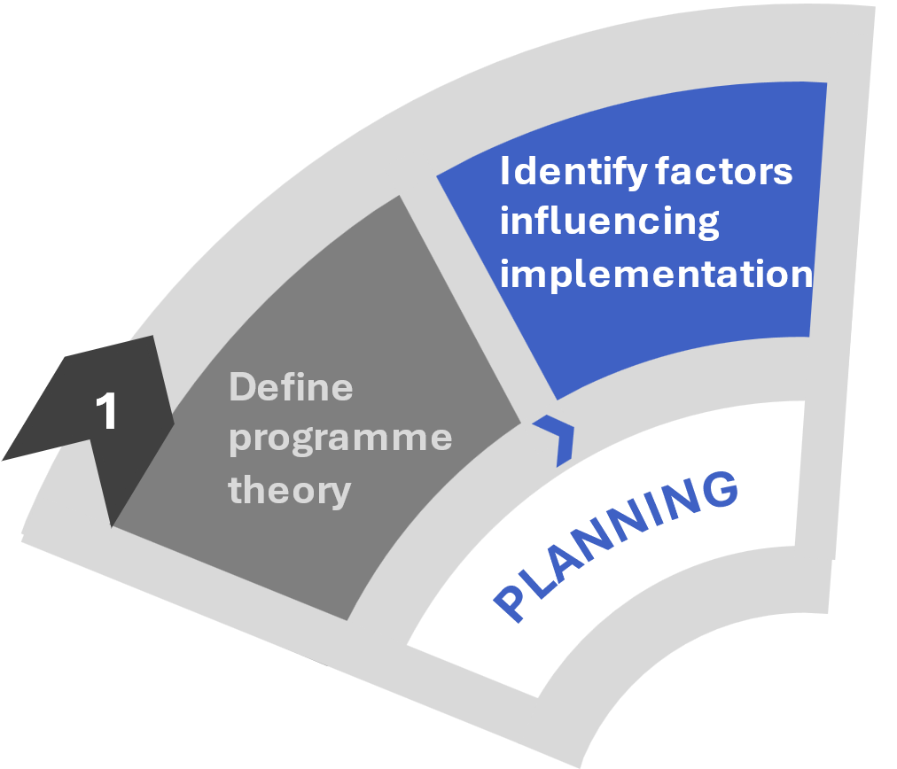
Domain 1a & b - Planning
Theory of change
Uncertainties to probe further
Program logic model
IRLM
Impact of nurse consult 2 and 3 on patient adherence
Barriers/facilitators in primary care

Slide 37
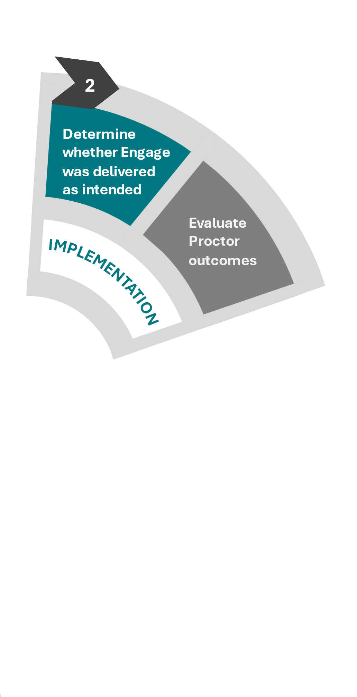
Domain 2 - Implementation
Program logic model
Impact of nurse consult 2 and 3 on patient adherence

Slide 38


Domain 2 - Implementation
AIM
Determine extent to which level of nurse discussion of health recommendations predict patient adherence
METHOD
Transcribed nurse consultation 2 and 3 (n=65 patient )
Nurse post-consult survey indicating extent of discussion
No, yes briefly, yes extensively
Patient survey reported adherence
1m, 6m, and 12m post-intervention
Steps 6 and 7
Nurse consult 2 and 3
ANALYSIS
Transcripts validated for concordance/reliability
Generalised linear mixed model
with ordinal outcome and random effects performed

Slide 39
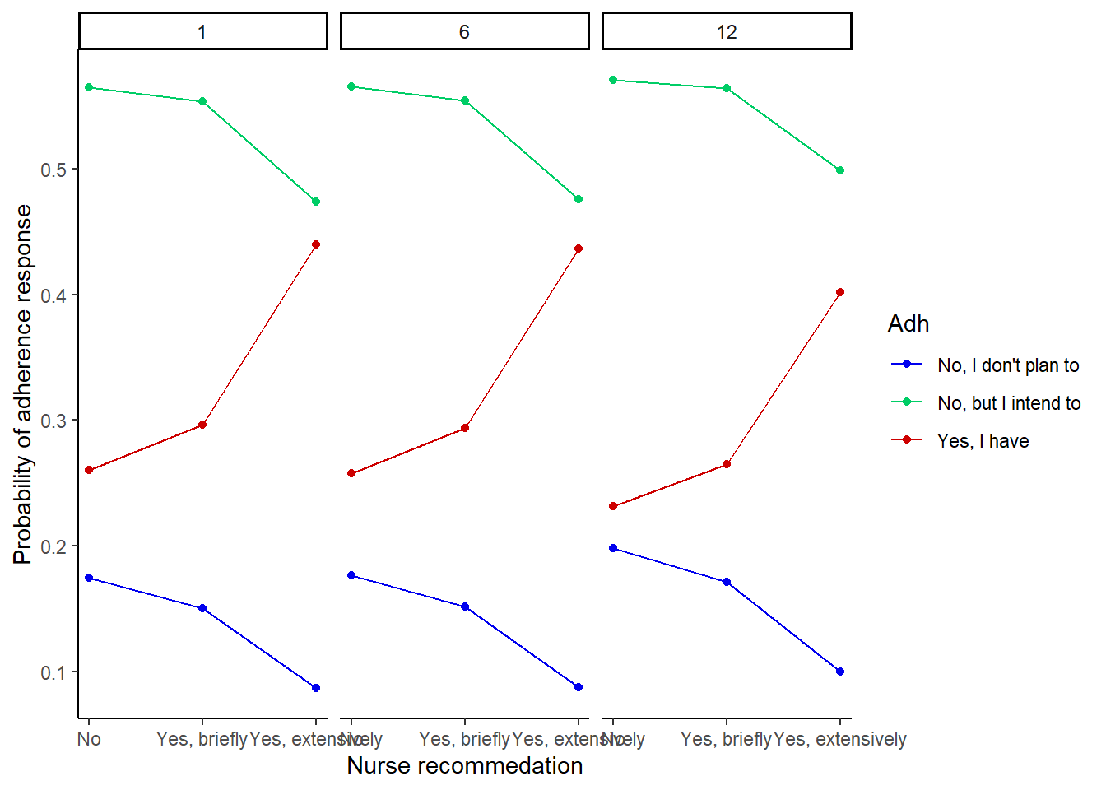
Domain 2 - Implementation
No evidence of statistically significant effect of nurse discussion on adherence response (p>.05).
ODDs RATIOS
Month 1
Positive response with extensive discussion are 1.02 times vs no discussion and 1.51 times for brief discussion
Month 6
Positive response with extensive discussion are 0.93 times vs no discussion and 1.39 times for brief discussion
Month 12
Positive response with extensive discussion are 3.92 times vs no discussion and 2.45 times for brief discussion
No
(100%)
Yes, briefly
(63%)
Yes, extensively
(40%)
No
(100%)
Yes, briefly
(63%)
Yes, extensively
(67%)
No
Yes, briefly
Yes, extensively
Avg. 62% concordance for NC2
Avg. 68% concordance for NC3
NC3 time variable predictor for 12m
Moderate agreement

Slide 40


Domain 2 - Implementation
Engage Step 5
Engage Step 7
Patient survey
Personalised treatment recommendations
Nurse booster session
6-months
MDT Recommendation: Echocardiogram (due now and then every 5 years)
Extensive intervention
Completed recommendation 6m post-intervention
“have you sort of had any further thoughts into an echocardiogram. I know that, you we're needing an MRI under sedation. So this might be a difficult task, but due to the spinal radiation, currently, the recommendations and the survivorship guidelines are for people like [SUBJECT] given the radiotherapy to the spine and the scatter to the heart, to undergo an echocardiogram every five years. Is that something that you think, or I'm not sure, if you've had discussions with your GP?...it'll be through like a cardiologist. I think you can get it done, I think what we typically do, because we do the long term follow up clinic down in Canberra four times a year and you can have it done through the hospital. So I believe, I'm not sure sort of what your GP would suggest given the local services, but, I think maybe that's the best way to go about it for [SUBJECT]”
Survivorship nurse

Slide 41
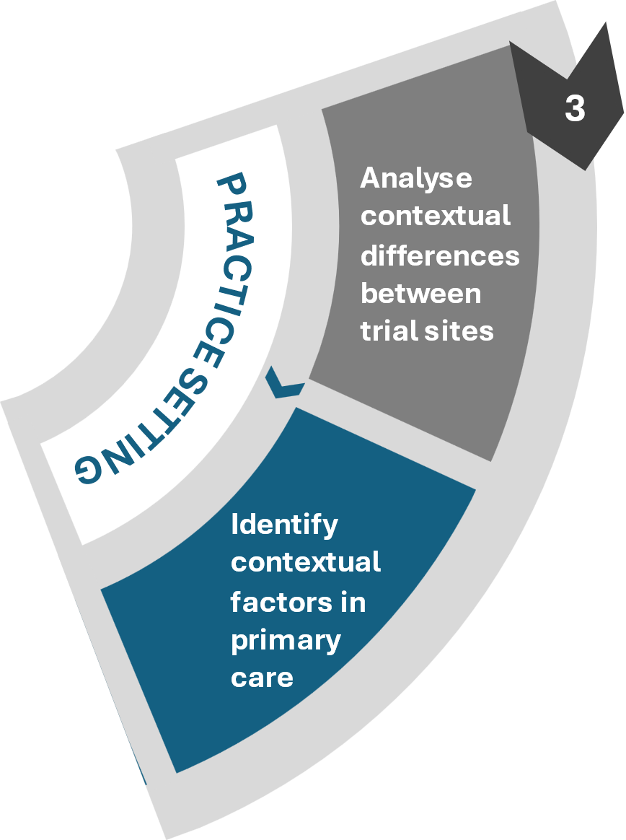
Domain 3a – Practice setting
IRLM
Barriers/facilitators in primary care
4

Slide 42
Domain 3a – Practice setting
AIM
Investigate PCPs preferences for Engage care plans, and identify barriers and facilitators to implementing survivorship care
METHOD
N=20 semi-structured PCP interviews
CFIR guided + cognitive interviewing
ANALYSIS
Hybrid inductive-deductive thematic analysis
CFIR2.0/TDF frameworks

Slide 43


Domain 3a – Practice setting
Systems level factors
“I've got patients who will die of bowel cancer before they get the scope because there's a two to three year waiting list, even if they have bowel cancer symptoms”
Access to community and specialist resources Local conditions
Communications with public hospitals Partnerships & connections
Eligibility for PCP management plans Policies & laws
Provider level factors
Time constraints Opportunity – environmental context and resources
Support from survivorship nurse Access to knowledge and information
Practice software constraints Information-technology infrastructure
Patient level factors
Patients’ financial capacity Opportunity – environmental context and resources
Supporting patient engagement and adherence Motivation - emotion

Slide 44
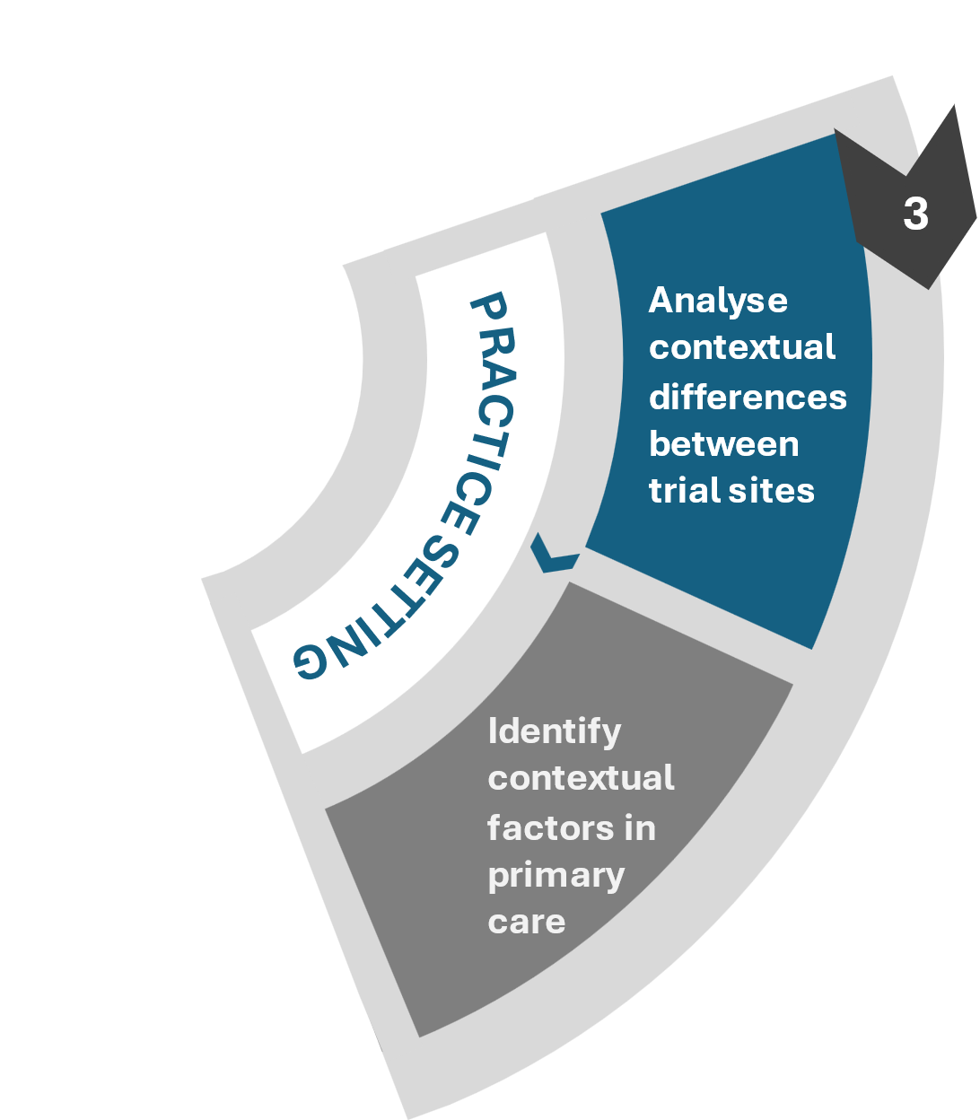

Domain 3b – Practice setting
AIM
Examine contextual factors influencing delivery and implementation of Engage between trial sites
METHOD
N=31 semi-structured interviews/consults
With clinical stakeholders
Observational data
10 x transcribed implementation meetings, 7 x project log entries
Administrative/process variables
Recruitment and intervention lead times, MDT composition/attendance
ANALYSIS
Hybrid inductive-deductive thematic analysis
CFIR2.0/TDF frameworks

Slide 45
Domain 3b – Practice setting
Barrier | Site 1 | Site 2 | Site 3
Establishing Engage MDT | Difficult to schedule a new meeting amenable to all specialties | Reduced study timeline and difficult to re-engage key stakeholders | No MDT meeting in current survivorship service
Inner Setting
- Available resources
- Relative priority
Develop resource sharing agreements
Change physical structure
Conduct local consensus discussions
Intervention not implemented at site
Step 4
ERIC Strategies
Multi-disciplinary case review
4

Slide 46
Domain 3b – Practice setting
Barrier | Site 1 | Site 2
Establishing Engage MDT | Difficult to schedule a new meeting amenable to all specialties | Reduced study timeline and difficult to re-engage key stakeholders
Categorise MDT attendees as ‘core’ vs ‘sub-specialty’, with sub-specialty group providing input remotely
Incorporate ‘high-risk’ survivors into existing survivorship clinic MDT and obtain remote input for those deemed ‘low-risk’
Step 4
Multi-disciplinary case review
4

Slide 47
Adaptations to Engage
1. ENGAGE MDT PREPARATION
Engage nurse incorporates patient information from hospital treatment records, Health Assessment Survey & Nurse Consult 1 (NC1) for each case summary
Engage nurse circulates patient case list to core MDT specialists (including copy of NC1 survey, health passport and Passport for Care) for review 1 week prior via password protected Cloudstor platform
Engage nurse drafts MDT summary letter for each patient case using available information and MDT letter template
Core MDT specialists review patient case list prior to meeting
Step 4
Multi-disciplinary case review
2. ENGAGE MDT MEETING
Core specialists (x2 nurse, paediatric oncologist, social worker, GP) meet monthly for patient case review (hybrid F2F and Zoom). 3–4 cases discussed per 90–120-minute meeting
Engage nurse runs through each patient case and each specialist provides input. Recommendations are determined as a group.
Engage nurse revises MDT summary letter for each patient case in meeting
MDT case review based on information consolidated in Steps 1 – 3. MDT includes core team and additional specialists, depending on survivorship needs and hospital resources.
3. MDT LETTER PREPARATION
Engage nurse further refines drafted MDT letter, and sources any additional information as specified in the MDT
Draft letter reviewed by paediatric oncologist (program director), and further consultation with the Engage nurse as required
Paediatric oncologist (program director) sends the letter (including copy of NC1 survey, health passport and Passport for Care) to additional specialists (radiation oncologist, endocrinologist, neurologist) for review
Additional specialists provide contributions via email (~1–2 weeks)
Paediatric oncologist (program director) incorporates additional comments and finalises summary letter
Summary letter sent to Engage nurse to proofread and accept tracked changes. Sends to Kids Cancer Centre secretary.
4

Slide 48

Domain 4 - Scale-up…
2
Identify factors influencing implementation
Determine whether Engage was delivered as intended
1
Define programme theory
Evaluate Proctor outcomes
PLANNING
IMPLEMENTATION
Determine minimal intervention component to retain clinical benefits
3
Analyse contextual differences between trial sites
PRACTICE SETTING
ECOLOGICAL SETTING
Determine feasibility
and operationalise scale-up
Next
steps
Cost effectiveness
Identify contextual factors in primary care
Identify where strategies work and why
Improved long-term health outcomes
Identify the individual and system related factors across a range of settings
4
Efficiency
Multi-context strategy toolkit
4

Slide 49



Access the
process evaluation protocol
here
A/Professor Natalie Taylor
Director | i2i | Implementation to Impact
Director of Research
School of Population Health
Faculty of Medicine and Health, UNSW
Director | Implementation Science Platform
Chair | Implementation Science Collaborative
Maridulu Budyari Gumal (SPHERE)

Slide 50



Optimizing the Implementation of Digital Health Applications:
Insights from Healthcare Professional Engagement and Strategy Evaluation in Germany
Dipl.-Psych. Anne Etzelmüller, PP
June 2025

Slide 51



Agenda
Aim
1
Context: DiGA in Germany
2
Study 1: HCP perspective
3
Study 2: Assessing strategies
4
Conclusion & Outlook
5

Slide 52

Aim & Context

Slide 53





Context
Digital mental health implementation in Germany
What is DiGA?
"Digitale Gesundheitsanwendungen" (Digital Health Applications)
Medical devices and digital tools officially prescribed by doctors
Reimbursement
Covered by Statutory Health Insurance (SHI)
Doctors and psychotherapists can prescribe DiGAs to patients
Fast Track Process
Applications are reviewed and approved by BfArM (Federal Institute for Drugs and Medical Devices)
Ensures safety, functionality, data security, and positive healthcare effects
Benefits
Promotes digital innovation in healthcare
Improves patient access to care
Increases efficiency and supports self-management

Slide 54

Aim
Problem:
DiGA adoption remains low despite effectiveness
Only 12% of German physicians prescribed DiGA by 2023
Barriers remain under-investigated and implementation strategies lack systematic evaluation
Objective:
1. Systematically evaluate existing barriers to DiGA implementation
2. Test feasibility of Multiphase Optimization Strategy (MOST) framework
for evaluating implementation strategies to increase DiGA activations

Slide 55
Study 1: The HCP perspective

Slide 56

Method Study 1
Mixed-Method Design
Qualitative Analysis
HCP feedback analysis
Sales team interaction reports
Open coding approach¹
Multi-level analysis framework
Quantitative Data
HCP surveys 2022-2024¹
Implementation metrics
Frequency analysis
Cross-validation of findings
¹ Supported by Dust (Claude-3.5)

Slide 57
Results Study 1 Part 1
Qualitative feedback from healthcare professionals (HCPs)
Collected through sales team interactions
Barriers:
PVS system difficulties (8x)
Skepticism about digital interventions (7x)
Complex prescription process (6x)
Difficulty remembering DiGAs (6x)
Time constraints (5x)
Facilitators:
TVB (Therapy Progress Report) system (12x)
Positive patient feedback (10x)
Bridging waiting times (9x)
HelloBetter support (8x)
Clear materials (7x)

Slide 58
Results Study 1 Part 1
Qualitative feedback from healthcare professionals (HCPs)
Collected through sales team interactions
Provider level findings
Barriers:
PVS (Practice Management System) difficulties (8x)
Scepticism about digital interventions (7x)
Complex prescription process (6x)
Difficulty remembering DiGAs (6x)
Time constraints (5x)
Facilitators:
TVB (Therapy Progress Report) system (12x)
Positive patient feedback (10x)
Bridging waiting times (9x)
HelloBetter support (8x)
Clear materials (7x)

Slide 59
Results Study 1 Part 1
Qualitative feedback from healthcare professionals (HCPs)
Collected through sales team interactions
Patient level findings
Barriers:
Low digital literacy (9x)
Language barriers (8x)
Insurance delays (7x)
Low adherence (6x)
Lack of devices (5x)
Facilitators:
Personal coaching (11x)
Hotline availability (8x)
Evidence-based content (7x)
Flexible usage (5x)
Personalization (5x)

Slide 60


Results Study 1 Part 1
Contradictions?
Age factor:
Perceived as barrier by many HCPs
vs. Success stories with 70+ patients
Professional Role:
Threat to practice vs. Valuable support tool
Implementation Effort:
Additional work vs. Time-saving in long-term practice
Prescription Timing:
Immediate prescription vs.
Wait for follow-up

Slide 61

Results Study 1 Aggregated results
Sales feedback integrated with HCP interview and questionnaire data
Provider level findings
Barriers:
Technical knowledge / digital literacy
DiGA knowledge
Complicated prescription process
Time constraints
Insufficient compensation
Forgetting DiGA
Patient scepticism
Concerns about patient‘s motivation, compliance and technical literacy
Doubting effectiveness / preference for traditional methods
Data security concerns
Challenges integrating DiGA in existing therapies
Notes:
KEY FINDINGS:
ATTITUDES:
Overall positive reception: 73% of surveyed HCPs reported a (very/rather) good impression of DiGA ¹
Varying adoption levels by provider type:
Physicians (especially GPs) more likely to prescribe than psychotherapists
Clinic-based HCPs less likely to prescribe than those in private practice ¹
KEY FACILITATORS:
Professional Motivators:
Desire to offer innovative treatment methods (75% of prescribers) ¹
Ability to bridge waiting times
Scientific evidence of effectiveness
Positive patient feedback ¹
Implementation Support:
Personal experience with DiGA (51% tried themselves)
Training and seminars (41% participated)
Clear use cases for implementation ¹
Practice Integration:
Most successful as supplement/augmentation to existing treatment (85%)
Effective for bridging waiting times (61%)
Valuable as standalone solution (44%) ¹

Slide 62
Results user research HB data
SOURCES:
2022-08 HCP Interviews ³
2023-06 HCP Dropout & Progress Report Survey ¹
2024-07 HCP TVB & Portfolio Survey ²
Data Analytics team for usage metrics
1
2023-06 HCP Dropout & therapy progress report Survey
2
2024-07 HCP TVB & Portfolio Survey
3
2022-08 Interviews: HCP Personas

Slide 63
Study 2: Assessing strategies
Aydin, A., Van Ballegooijen, W., Cornelisz, I., & Etzelmueller, A. (2025). Evaluating the Feasibility of Using the Multiphase Optimization Strategy Framework to Assess Implementation Strategies for Digital Mental Health Applications Activations A Proof of Concept Study. Frontiers in Digital Health, 7, 1509415.

Slide 64


Method Study 2
Notes:
Study Design:
Proof-of-concept study
Including naturalistic data of N = 24,817 HCPs
January 2022 - June 2024
Implementation Strategies:
Phone calls
Online meetings
Arranged on-site visits
Walk-in visits
→ 2⁴ retrospective factorial design

Slide 65
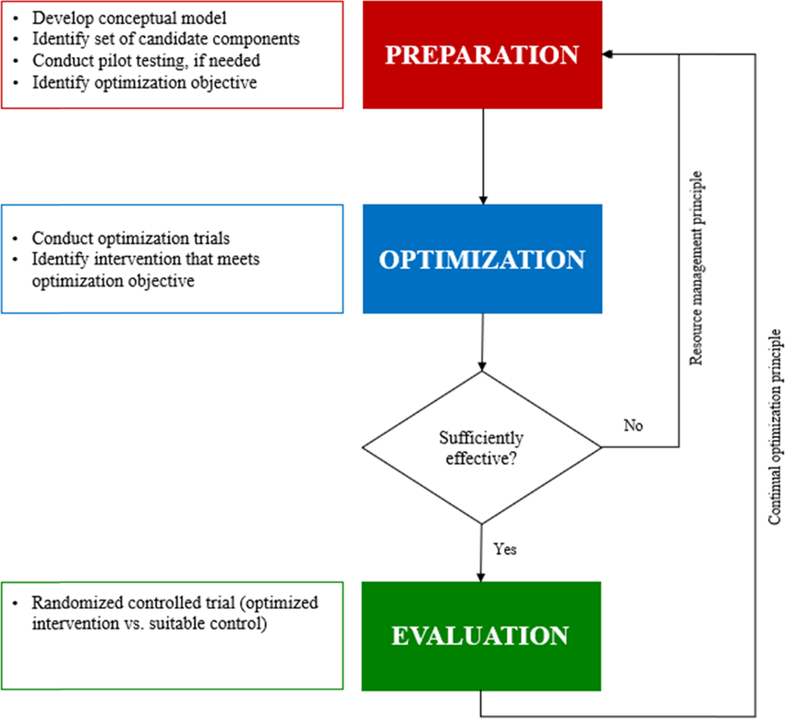
Method Study 2
Collins LM. Optimization of Behavioral, Biobehavioral, and Biomedical Interventions: The Multiphase Optimization Strategy (MOST). Cham: Springer International Publishing (Statistics for Social and Behavioral Sciences) (2018). doi: 10.1007/978-3-319-72206-1
Notes:
MOST Framework Application:
Preparation → Logic Model
Optimization → Factorial Design
Evaluation → (Not included in this study)

Slide 66
Method Study 2
Study Design:
Proof-of-concept study
Including naturalistic data of N = 24,817 HCPs
January 2022 - June 2024
Implementation Strategies:
Phone calls
Online meetings
Arranged on-site visits
Walk-in visits
→ 2⁴ retrospective factorial design
Notes:
MOST Framework Application:
Preparation → Logic Model
Optimization → Factorial Design
Evaluation → (Not included in this study)

Slide 67

Results Study 2
Sample Characteristics:
• 57.9% Female HCPs
• 84.4% Medical Doctors, 15.6% Psychotherapists
Feasibility Demonstrated:
• MOST framework successfully applied to implementation strategies
• Systematic comparison of 16 strategy combinations
• Significant differences between groups (χ² = 1,665.2, p < .001)
Strategy Effectiveness (limitations apply!):
• Any strategy > no strategy
• Combined arranged + walk-in visits most effective
• Moderate correlation: more strategies = more activations (r = 0.30)

Slide 68

Limitations & Insights Study 2
Key Limitations:
Non-randomized retrospective design
Underpowered analysis (unequal group sizes) Potential feedback loops between variables
Limited to activation numbers (not prescriptions)
Future Recommendations:
Conduct full MOST trial with original data
Random assignment to strategy groups
Include evaluation phase (RCT)
Examine both prescriptions and activations
Consider cost-effectiveness analysis

Slide 69
Conclusion & Outlook

Slide 70
Conclusion
Primary Findings:
1. There are multiple barriers that currently impede the widespread adoption of DiGA in Germany
2. MOST framework is feasible for evaluating implementation strategies in digital health, providing structured approach for optimization
Practical Implications:
DiGA implementation must be planned systematically to overcome identified barriers
MOST enables systematic, quantitative evaluation of implementation strategies
Impact:
Systematically planning and evaluating implementation may improve DiGA adoption efficiency, reduce implementation costs, and enhance access to digital mental health care

Slide 71



Before I say Thank You …

Slide 72



Thank you for your attention
Dipl.-Psych. Anne Etzelmüller, PP
anne.etzelmueller@tum.de
www.linkedin.com/in/anne-etzelmueller-78bb5a73/

Slide 73
THANK YOU!
Questions & Discussion
Presentation 1: Rosa Lorente Català
Presentation 2: Jay Ford
Presentation 3: Natalie Taylor
Presentation 4: Anne Etzelmüller
Session host: Brian Mittman
Thought-provoking presentations and interesting insights?
Spread the word and let us follow along by using #EIE2025!

