Slide 1


Ride the Knowledge Wave 8
NORMALISATION AS IMPLEMENTATION
Presentation 1: Ingrid Hickman
Presentation 2: Saskia Oesch
Presentation 3: Myrta Kohler
Presentation 4: Tracy Finch
Session host: Keitly Mensah

Slide 2


Translating an evidence-based dietary practice into routine care in a public health service: evaluation of impacts on practice sustainment
Brisbane, AUSTRALIA
A/Prof Ingrid J Hickman AdvAPD, PhD
Principal Research Fellow Implementation Science
The University of Queensland
Faculty of Health, Medicine and Behavioural Sciences
Dr Hannah Mayr AdvAPD, PhD
Principal Research Fellow (Nutr&Diet) Princess Alexandra Hospital
Brisbane, Australia
Notes:
Thank you for the introduction. I am privileged to be here in the UK from Brisbane Australia, presenting on behalf of our talented principal research fellow Dr Hannah Mayr who has led this work translating an evidence based dietary practice into routine care in a public health service with a focus today on the evaluation of impacts on practice sustainment.

Slide 3


Cardiovascular Disease (CVD) and Type 2 diabetes (T2D)
Nutrition evidence has evolved
Class 1 Level A (CVD) or Level B (T2DM) evidence for Mediterranean diet pattern (MedDiet)
Mozaffarian D. Circulation 2016;133:187-225
Notes:
Over the past 10 years, the evidence for dietary management of Cardiovascular disease and Type 2 diabetes has evolved. No longer should education be focused on single nutrient restrictions. Practice guidelines show Class 1, Level A and Level B evidence for the use of dietary pattern diet quality based approaches such as the Mediterranean Diet.

Slide 4



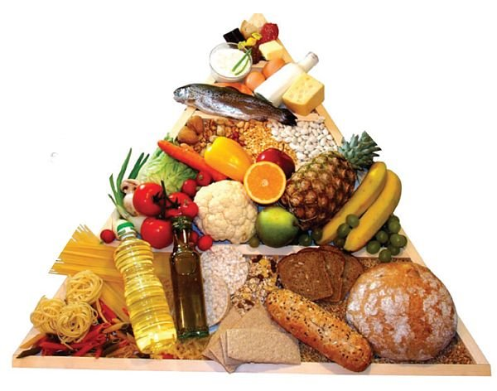

Australian Dietitians using MedDiet for CVD and/or T2DM
Aim: take a robust implementation approach to support clinicians to translate Mediterranean-style diet evidence into routine care for CVD and T2D
CHD
T2D
Four units across a metro health district
x2 Diabetes
x2 Cardiology
CVD 48%
T2D 26%
Mayr et al Nutrients. 2020;12(11):3395.
Notes:
When we surveyed the dietetic profession in Australia there was a clear evidence practice gap with well under half our Dietitians using MedDIet principles for these conditions. We set out to take a robust implementation approach to support clinicians working in Metropolitan hospital and health services to translate MedDiet evidence into routine care across four sites in Brisbane.

Slide 5
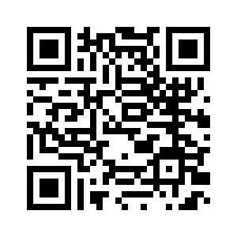
Mayr et al Healthcare 2025
Knowledge
Translation
Monitor evidence use
Evaluate outcomes
Sustain evidence use
Evidence-practice gap
Implement strategies
Local context
Barriers and enablers
Diet is part of everyone's role
Varied acceptance of evidence
Lack of training and use
Practical point-of-care tools needed
Knowledge Synthesis
Theoretical Domains Framework (TDF)
Adapted from Graham et al. J Contin Educ Health Prof. 2006, 26: 13-24
Cane et al. Implement Sci. 2012;7(1):37.
Notes:
The initial planning and implementation of this project has been published this year and details can be accessed via the QR code. In brief, we were guided by the knowledge to action cycle. Following on from the evidence practice gap that had been established, the next steps were to determine the local health service context. This work utilised the theoretical domains framework and Interviews with 57 clinicians identified that
Diet is part of everyone's role
Varied acceptance of evidence
Lack of training and use
Practical point-of-care tools needed

Slide 6
Mayr et al Healthcare 2025
15 months implementation
83% adopted practice
Knowledge
Translation
Monitor evidence use
Evaluate outcomes
Sustain evidence use
Evidence-practice gap
Implement strategies
Local context
Barriers and enablers
Facilitation
Local clinical champions
Education meetings
Local consensus discussions
Distribute education material
Update workforce orientation procedures
CFIR-ERIC strategy matching tool
Knowledge Synthesis
2 years
Waltz, et al. Implementation science 14 (2019): 1-15. https://cfirguide.org/tools/
Notes:
We then chose implementation strategies, and evaluated the outcomes over time
With the assistance of the CFIR-ERIC matching tool some of the implementation strategies used included
Facilitation
Local clinical champions
Conduct educational meetings
Conduct local consensus discussions
Develop/distribute education materials
Update workforce orientation procedures
After 15 months, 83% of clinicians had self reported adopting MedDiet as usual practice. And at this point active facilitation was ceased.
Two years later we investigated the Clinicians sustained use of MedDiet practice – and that is the focus of the data presented today

Slide 7

Clinicians “any profession with a diet related role in target services”
Adoption
Modified 14-item NoMAD
  4 core constructs
Sustainment: ≥7 [0 to 10] that “recommending MedDiet is a normal part of their work”.
Predictors of sustainment variable assessed with logistic regression
Evaluation
November 2022
n=55
Sustainment
October 2024
n=67
5pt- Likert Scale
“Advice to relevant patients would align to MedDiet”
Finch, et al (2015). NoMAD: Implementation measure based on Normalization Process Theory http://www.normalizationprocess.org
Notes:
Clinician adoption after the intervention was initially assessed by a 5-pt likert scale question asking staff if their dietary advice aligns with the MedDiet. The same question was repeated with clinicians from the same units two years later.
Public hospital services have an expected rotation of trainees and temporary staff along with a more permanent workforce. The clinician cohort included Dietitians, doctors, nurses and allied health professionals, and at time of sustainment survey some had been exposed to the initial intervention from two years earlier whilst others may haveonly recently commenced in their role within the last two years and would not have experienced any facilitated implementation.
A modified 14-item NoMAD tool was used to assess what may be influencing the normalisation of the approach with between 2 to 5 questions aligned to the core constructs of Coherence, cognitive participation, collective action and reflexive monitoring.
We defined Sustainment as clinicians self-rating >/=7 on a scale of 1-10 that “recommending MedDiet is a normal part of their work”
Predictors of this sustainment variable was assessed with logistic regression including modelling with demographics, role, target service characteristics, individual NoMAD constructs as well as the four core construct mean data.

Slide 8
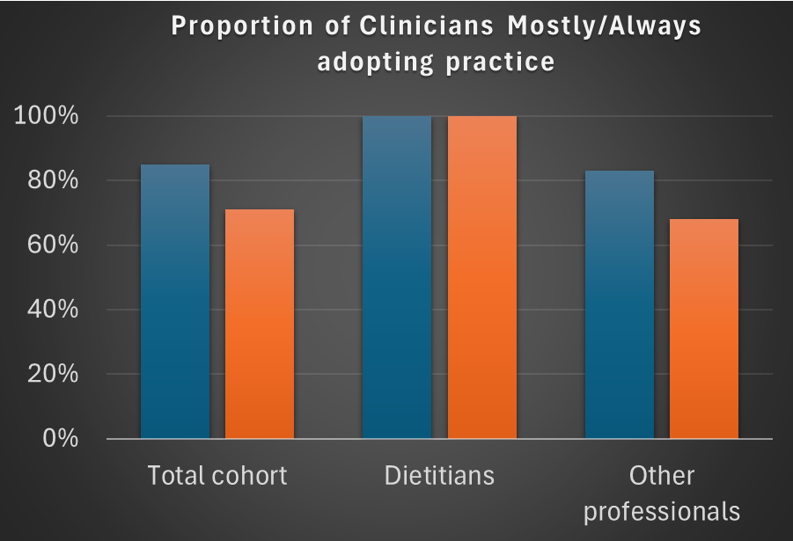
Adoption over time
“Advice to relevant patients would align to MedDiet”
Notes:
This data shows evaluation of adoption over time from end of implementation (in blue bars) to sustainment period (orange bars). When asked if their advice would align to meddiet principles most or all of the time, there was some fading of effect in the total cohort with a drift from 85% to 71% after 2 years.
When we separate the Dietitians from the cohort, we can see this drift is related to non-dietetic workforce with non-dietitians drifting from 83% to 68% whilst 100% of Dietitians sustained adoption of the practice.

Slide 9
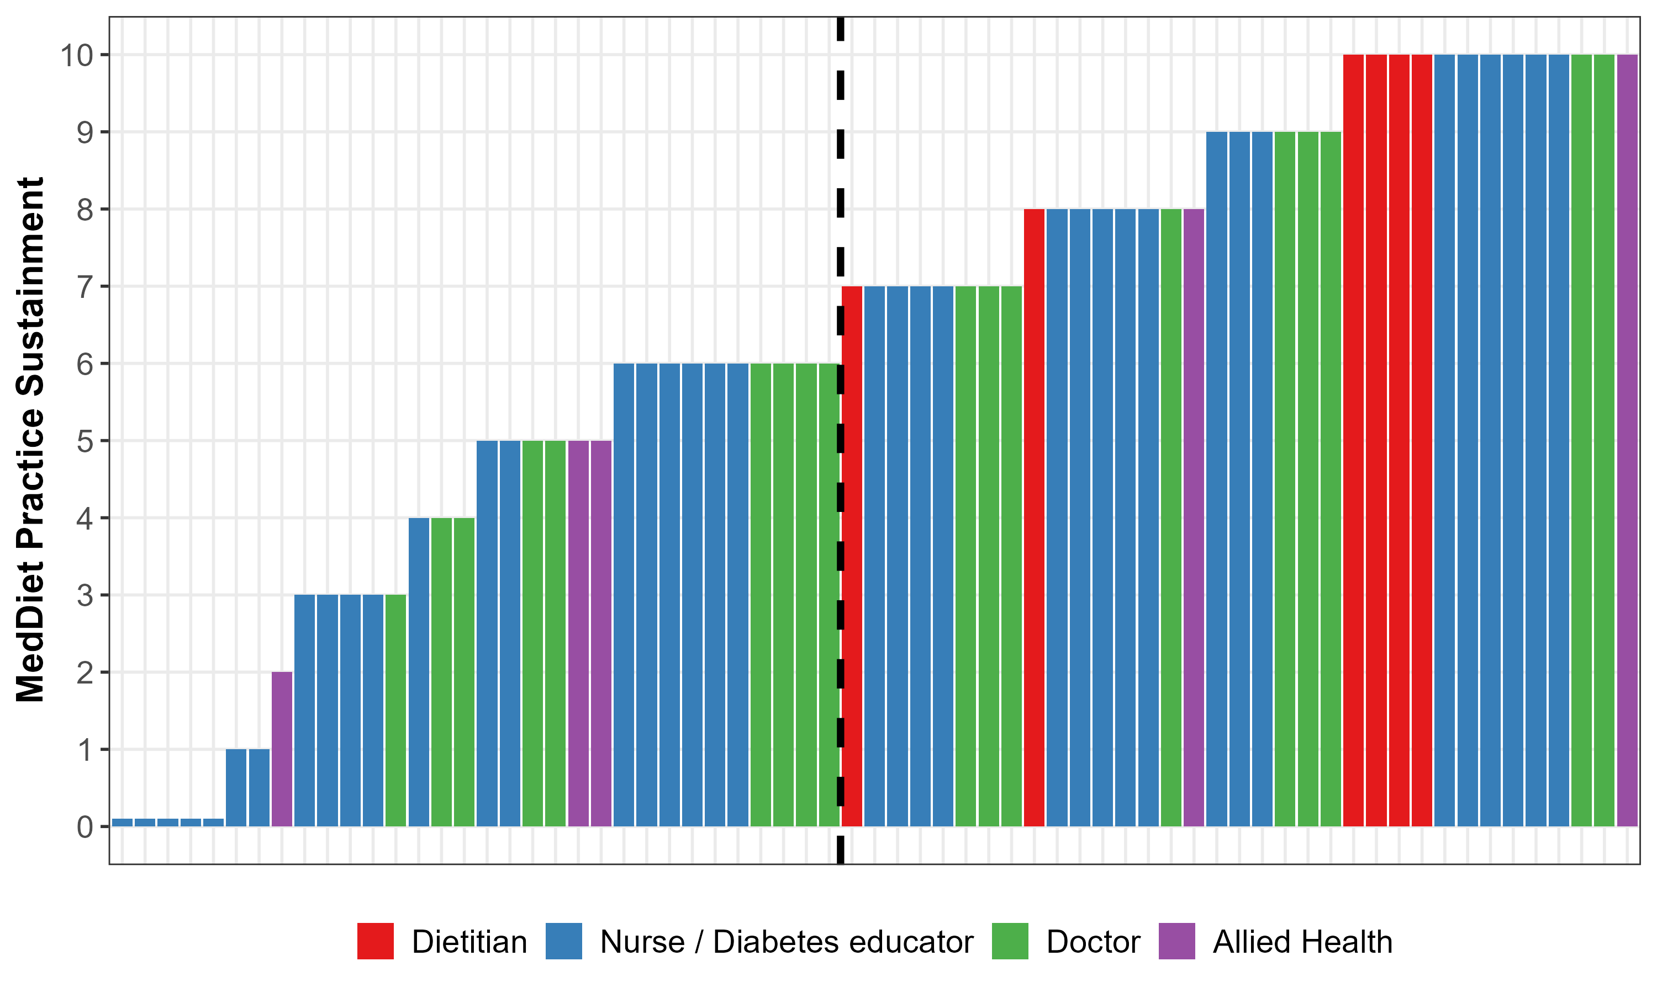
CLINICIAN SUSTAINMENT n=67: “Do you feel recommending MedDiet is a normal part of your work?”
Completely
Not at all
Notes:
67 clinicians completed the sustainment survey with each bar on this graph representing an individual clinician from their respective roles of Dietitian in red, nurses in blue, doctors in green and other health professionals in purple. Clinicians rated whether they recommended MedDiet as a normal part of their work on a scale of zero not at all to 10 completely.
At 2 years, 52% of participants met our sustainment criteria of 7 or more.
Mean score differed depending on role with Dietitians rating highest with mean 9.2, followed by doctors mean 6.7, nurses mean 6.0 and other allied health mean score of 4.7
Mean score was 9.2 ± 1.2 for dietitians, 6.7 ± 2.1 for doctors, 6.0 ± 3.2 for nurses/diabetes educators and 4.7 ± 3.2 for other allied health.
The five participants who selected ‘0’ were nurses.

Slide 10
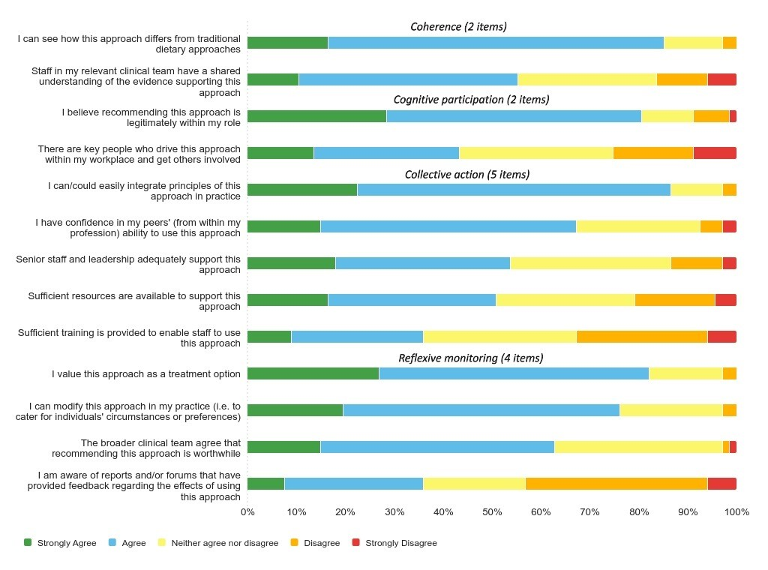
Clinician responses to NoMAD items
Notes:
This graph represents categorical agreement data for the 13 other NoMAD items , ordered according to the core constructs and within those ordered by most to least agreement. The green and blue represent agreement whereas the red and orange represent disagreement.
There were a couple of key items identified by the NoMAD whereby ≤50% of the cohort agreed with the statements and these included items within collective action construct related to having sufficient resources and/or training available for the practice; as well as in the Cognitive participation construct, relating to identifying who the key peoplewere that were driving the approach

Slide 11
Characteristics as Predictors of Sustainment
NoMAD Items
  The approach being legitimately within their role
  (OR 15.7, 95%CI 2.10-117, p=0.007)
  Shared understanding of evidence
  (OR 3.79, 95%CI 1.14-12.6, p=0.03)
NoMAD Items (non-dietetic workforce only)
  The approach being legitimately within their role
  (OR 13.2, 95%CI 1.91-91.9, p=0.009)
  Sufficient training provided
  (OR 6.81, 95%CI 1.36-34.2, p=0.02)
Notes:
For multivariable analysis the Dietitian group was used as a reference group
Predictors of sustainment included staff believing the practice is legitimately within their role, those that did were 15 times more likely to sustain than those that did not and that they believed the clinical team have a shared understanding of the supporting evidence which made them almost 4 times more likely to sustain practice
When this analysis was repeated in non-dietetic staff only, the belief that the approach is legitimately within their role and having sufficient training provided were statistically significant predictors of sustainment.
Higher scores in NoMAD domains of Cognitive Participation and Collective Action increased the odds of sustainment by approximately 6 times.
Core Constructs
Cognitive participation (OR 6.12, 95%CI 1.59-23.6, p=0.009)
Collective action (OR 5.70, 95%CI, 1.30-25.1, p=0.02)

Slide 12
Sustainment in an environment of high staff turnover
40% clinicians had commenced their role ≤2 years prior
No difference in the sustainment between new and established clinicians
  6.4 ± 3.1 vs 6.3 ± 2.9, p=0.85.
Half new clinicians reported receiving orientation related to MedDiet
Sustainment was significantly higher in those who received orientation
  Mean sustainment score: 8.0 ± 2.2 vs 4.4 ± 2.4 p<0.001
  Sustainment Score ≥7: 71% vs 29% p=0.012
Notes:
As I mentioned earlier, this project was conducted in a health service setting whereby there is an expected high rotation of staff due to the nature of training hospitals.
At time of sustainment evaluation, 27 (40%) of clinicians had commenced their role within the last 2 years and so had not been exposed to any active facilitation. Despite this, there was no difference in mean sustainment scores between those with more or less than 2 years service in their role.
We were not able to quantify exposure to all the implementation strategies but we were able to determine that only half of the new clinicians recalled receiving orientation related to MedDiet when they commenced their role. This appeared to be a highly influential strategy on sustainment. Mean sustainment score was double that of those who did not receive orientation to the practice and 71% of those who were orientated scored 7 or greater in sustainment compared to only 29% of those who were not orientated to the practice on commencement.

Slide 13
Discussion
>70% reported sustainment of practice after 2 years (fade from 85%)
NoMAD flagged key areas that may contribute to or prevent further fade
Components important for success
  establish that practice supported by evidence and is a legitimate team activity
  systemise staff training and orientation, particularly for non-dietetic clinicians
How can the NoMAD inform where to focus our efforts for sustaining knowledge translation?
Considering implementation strategies that address key items in NoMAD constructs could improve sustainment of knowledge translation.
  Collective action – workforce practically operationalise, organise and structure the practice in their setting
  Cognitive participation – who and what motivates staff to continue practice aligned with evidence
Notes:
Two years after facilitated implementation strategies ceased, >70% reported sustainment of practice (fade from 85%)
NoMAD tool allowed us to flag key areas that may contribute to or prevent further fade
Components which appear to be critical to successful sustainment in the local health service context include
establishing expectations early that the practice is supported by evidence and is a legitimate activity across the team and
systemising staff training and orientation on utilising the practice, particularly for non-dietetics clinicians who provide dietary care.
How can the NoMAD inform where to focus our efforts for sustaining knowledge translation – particularly in the absence of resourced facilitation?
It has allowed us to prospectively consider implementation strategies that address key NoMAD constructs that could improve sustainment of knowledge translation.
In particular for this setting, aligning strategies that target collective action related to how the workforce practically operationalise, organise and structure the practice in their setting, and cognitive participation – knowing who and what motivates staff to continue practice aligned with evidence.

Slide 14

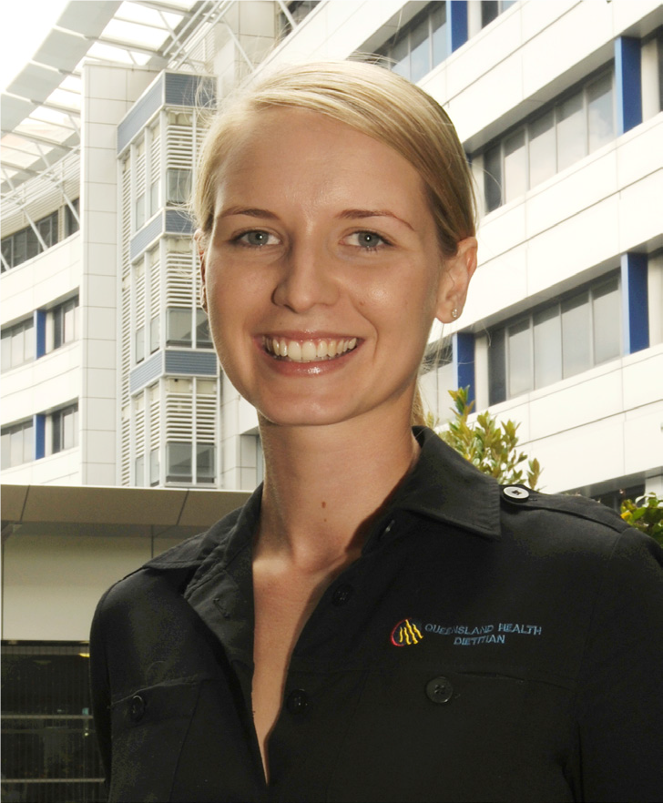










Acknowledgements
Other Contributors
Dr Michelle Palmer
Dr Jaimon Kelly
Dr Katrina Campbell
Ms Jan Hill
Prof Graeme Macdonald
Student dietitians
Clinical dietitians
Consumers
Eryn Murray
Lindsey Webb
Dr William Wang
Dr Lisa Hayes
Patrick Maher
Prof Andrew Martin
Dr Hannah Mayr AdvAPD, PhD
Hannah.Mayr@health.qld.gov.au
We acknowledge the lands of Jagera and Turrbal People
Notes:
I’d like to acknowledge the leaders, team members and partners who have contributed to this work and would like to open the floor for questions. Thank you.

Slide 15

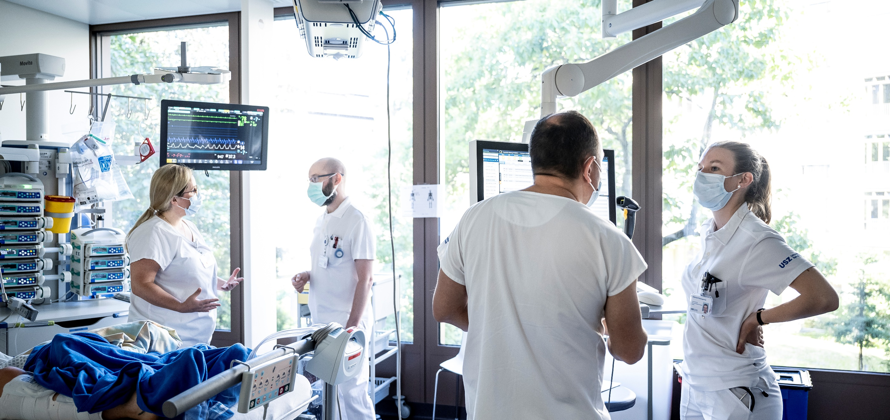
Institute für Implementation Science in Health Care
Zentrum Klinische Pflegewissenschaft
Normalization of a Complex Family Support Intervention in
Intensive Care Units (FICUS): Findings of a Quantitative Evaluation
with ICU Health Professionals
  Saskia Oesch, Marco Riguzzi, Lotte Verweij, Tracy Finch, Rahel Naef
    European Implementation Event, RTKW 8
    June 6, 2025, Newcastle upon Tyne UK

Slide 16
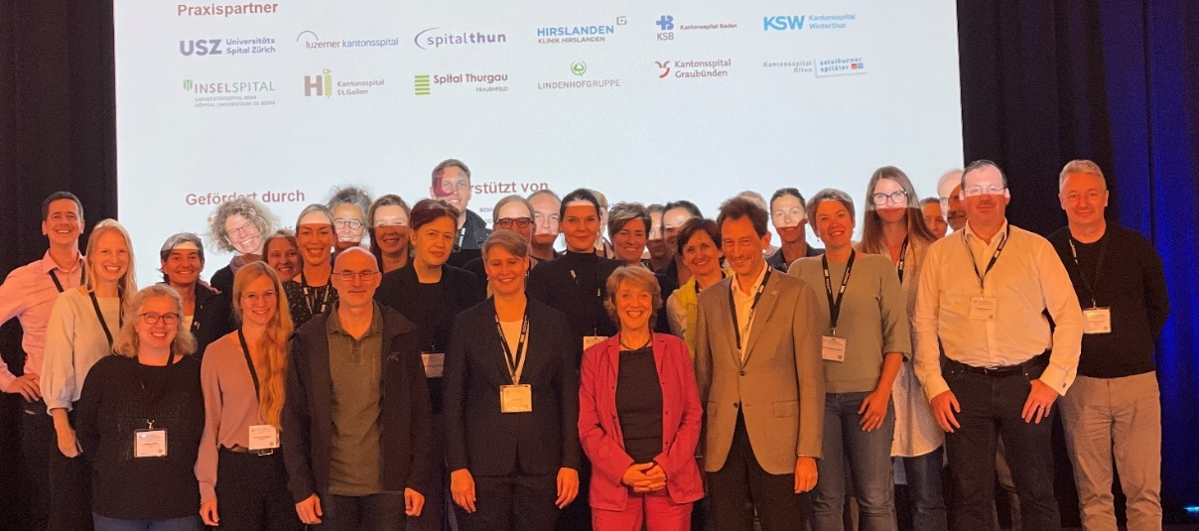

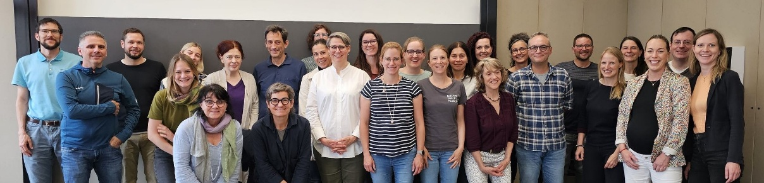













Acknowledgement – FICUS study group
Principal investigator: Rahel Naef
Co-Investigators: Marie-Madlen Jeitziner, Miodrag Filipovic
Core research team: Saskia Oesch, Lotte Verweij, Marco Riguzzi, Simone Sutter, Michael Rufer, Judith Safford, Stefanie von Felten
And many, many more….
Supported by

Slide 17

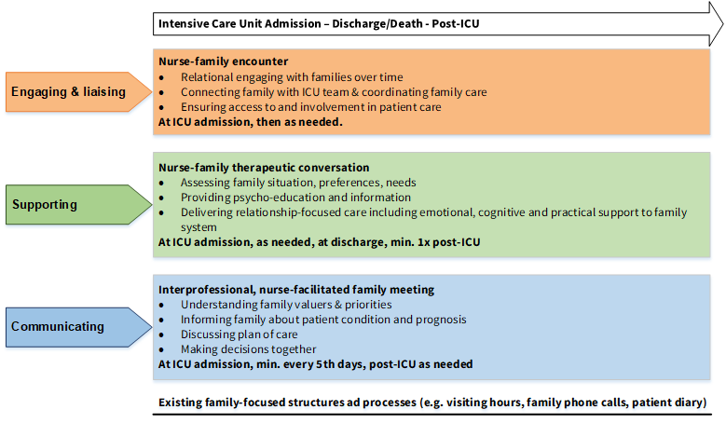
Background FICUS hybrid study type 1 (2021-2025)
FICUS= Family support intervention in Intensive Care UnitS
Family care pathway - 3 intervention components delivered by an ICU family nurse in close collaboration with team
FICUS Implementation Study: Implementation barriers & facilitators, process and outcomes
Oesch et al., 2023, BMJ open, https://doi.org/10.5167/uzh-235237
Naef et al., 2025 accepted for publication
FICUS cluster RCT: Evaluating service and health outcomes
Naef et al., 2022 Trials, https://doi.org/10.1186/s13063-022-06454-y
Notes:
Figure 1: To meet family members’ needs for communication and support in ICUs, we developed a nurse-led family support intervention with three components: engagement, support, and communication. Trained ICU family nurses delivered the intervention along the patient pathway up to 4 months post-discharge.
Figure 2: Effectiveness was tested in the FICUS cRCT (2021–2024) with 16 ICUs (8 intervention, 8 control). Implementation followed a tailored strategy.
Figure 3: Implementing the complex FSI was expected to be challenging. As sustainable integration depends on normalization, embedding new practices into routine work, we conducted a mixed-methods study to explore barriers, facilitators, and implementation processes and outcomes, addressing the current gap in empirical evidence.
Today we present quantitative findings, assessed as part of a mixed-methods summative evaluation which was conducted in eight ICUs randomized to the intervention arm of the FICUS trial towards the end of an 18 months implementation period. This study was guided by the Normalization Process Theory and Proctors Framework for Implementation Outcomes

Slide 18
Study aims of summative evaluation
To assess the level of integration (normalization & sustainability), acceptability, appropriateness, feasibility and perceived need of the family support intervention (FSI).
To investigate how acceptability, appropriateness, feasibility and the perceived need of the FSI are associated with FSI integration and its benefits.
Oesch et al., 2023, BMJ open, https://doi.org/10.5167/uzh-235237
Notes:
The aims of this cross-sectional, quantitative study part of a summative evaluation were first to.. and second…

Slide 19
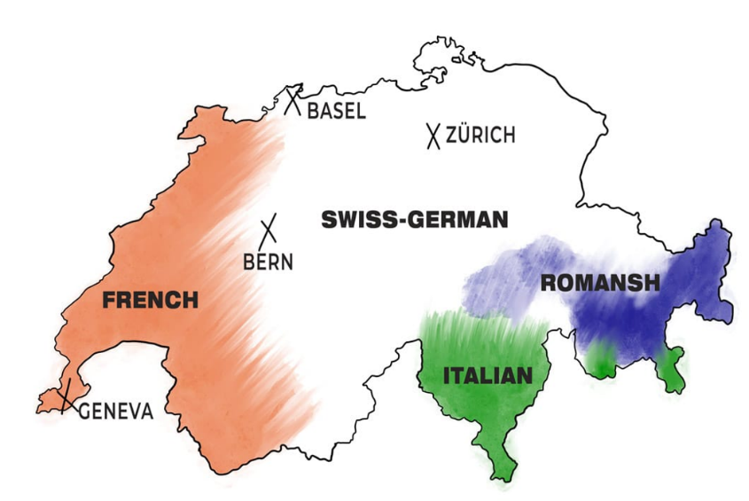
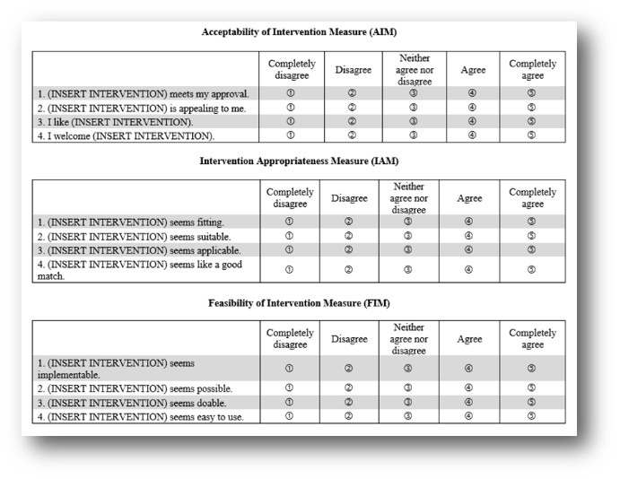
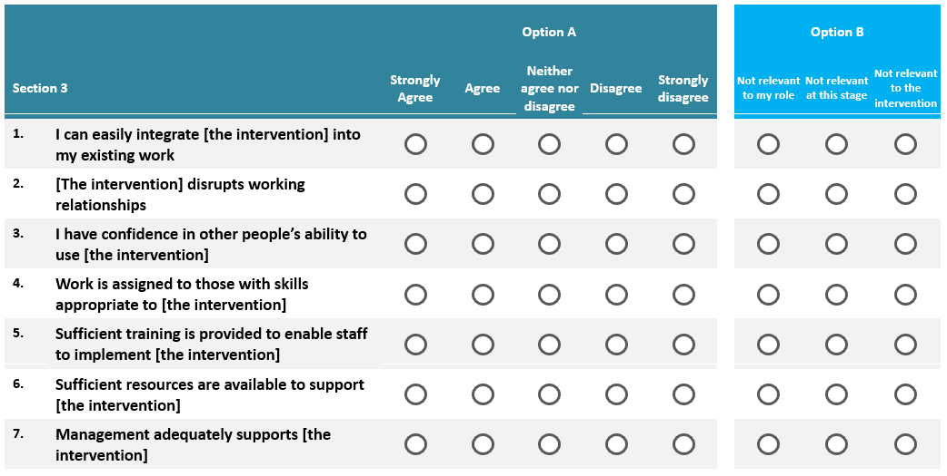
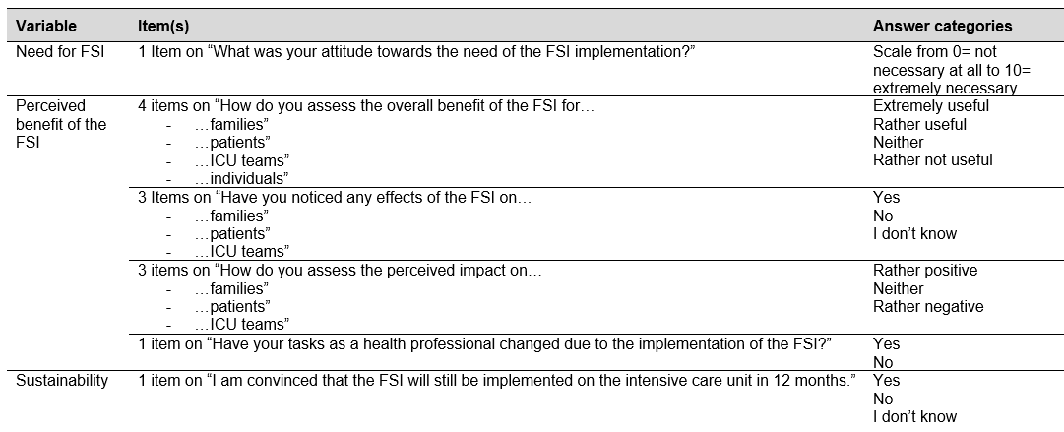
Methods
Setting & participants
ICUs assigned to the FICUS cRCT intervention arm (n=8) in the German-speaking part of Switzerland
ICU staff (n=228) (nurses, physicians, leadership persons)
Data collection & analysis
Online survey
Mixed linear effects models and logistic regression
AIM, IAM & FIM (Kien et al. 2021)
G-NoMAD (Freund et al. 2021)
Self-developed questions on FSI need, benefit & sustainability
Notes:
Figure 1: The study was conducted in eight ICUs assigned to the FICUS intervention arm, where the FSI was implemented. A total of 228 ICU staff participated, primarily nurses and physicians.
Figure 2: FSI integration was assessed using the German NPT-based G-NoMAD questionnaire. Acceptability, appropriateness, and feasibility were measured with the validated AIM, IAM, and FIM tools. Perceived benefit and sustainability (e.g., likelihood of continued delivery after 12 months) were evaluated with self-developed items. All items were included in an online survey. Data were analyzed using mixed linear models, and logistic regression with random effects (clustered by ICU), examining predictors like intervention acceptance, perceived need, professional role, and work experience.

Slide 20
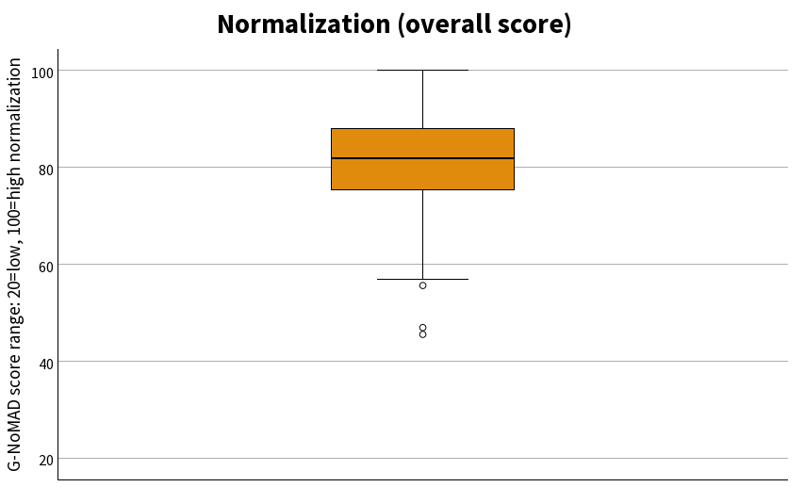
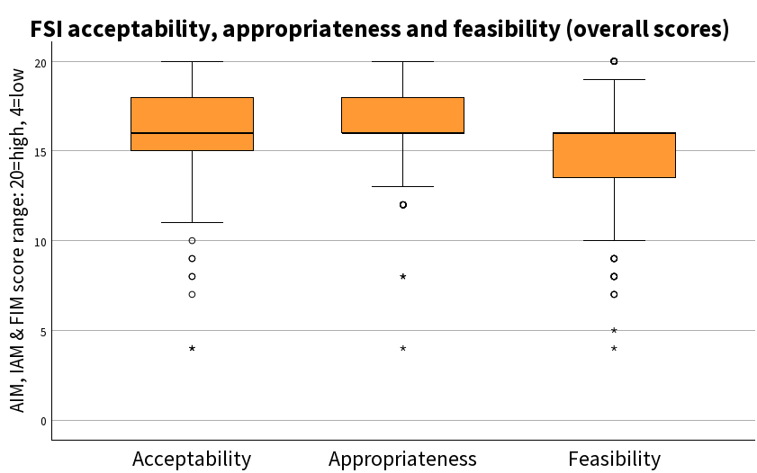
Findings – FSI integration and perception
Oesch et al., 2025, manuscript under review, please do not take pictures of this slide.
Notes:
Regarding study aim 1, we found high overall normalization levels (G-NoMAD median = 82/100), including across all subconstructs.
Data also showed high levels of acceptance, appropriateness, feasibility and with medians of 16 (scale range 4=low, 20=high) and a high perceived need at the end of the active FSI implementation.
Sustainability: only about 30% were convinced that the FSI will still be implemented 12 moths after completion of active implementation, around 50% were unsure nevertheless rating on the perceived need of the FSI was high with a median of 8 on a 0 to 10 scale.

Slide 21
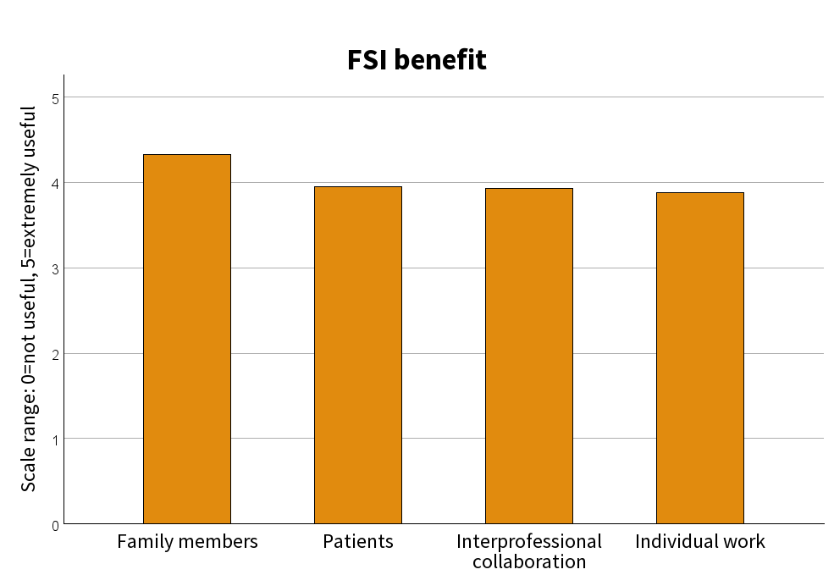
Findings – Benefits of the FSI
mean=4.33
mean=3.95
mean=3.93
mean=3.88
Oesch et al., 2025, manuscript under review, please do not take pictures of this slide.
Notes:
High ratings on overall benefit
Highest rating for benefit was given to family members. (assessed by ICU staff).
Lower physician ratings (vs. nurses) on the benefit for families (-12.0 pts), patients (–12.5 pts) and individual work (-18.8%).

Slide 22
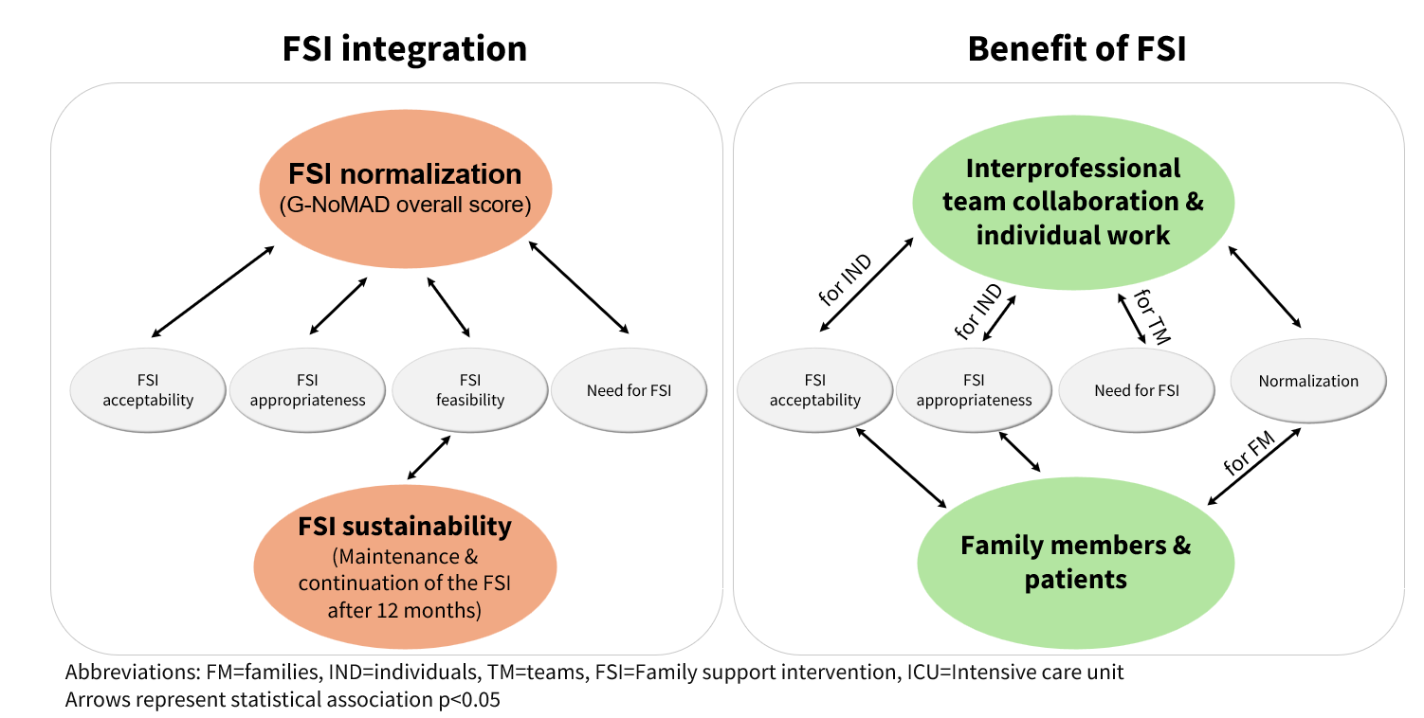
Findings – Predictors of FSI integration and benefit
Oesch et al., 2025, manuscript under review, please do not take pictures of this slide.
Notes:
To adress the second aim of this study, namely to determine predictors of normalization, sustainability and perceived benefit we calculated regression models using predefined predictors such as the FSI’s acceptability, appropriateness, feasibility, need for the FSI, professional role, or ICU work experience.
Here in this figure you see the statistical associations we found in our analysis.
Regarding integration, we found:
…that higher normalization of the FSI in ICU teams was associated with acceptance, appropriateness, feasibility & the intervention’s perceived need.
….that FSI sustainability, i.e., its continued delivery, was predicted solely by feasibility.
Regarding predictors of the FSI’s benefit we found:
…. that acceptability and appropriateness of the intervention was predicitive for seeing a benefit of the FSI for health care professionals individual work.
…. That normalization of the FSI was predictive for seeing a benefit for family members.

Slide 23
Conclusion
FSI as an acceptable, appropriate, feasible and beneficial nursing health intervention.
Normalization is associated with FSI acceptability, appropriateness and feasibility.
Feasibility – critical to sustainability in complex health interventions.
Notes:
I would like to end this presentation with a short conclusion.
FSI showed to be an acceptable, appropriate, feasible and beneficial intervention. Further research is now needed to explore FSI implementation beyond a clinical trial context and to assess its longterm sustainability in ICUs
Although we cannot infer causality, our findings suggest that proximal implementation outcomes such as acceptability, appropriateness, and feasibility are associated with the normalization of the FSI and appear to be crucial for the successful implementation of complex family health interventions like the FSI. Normalization predicted the perceived benefit of the FSI for family members and ICU teams → This suggests that when an intervention is experienced as a “normal” or integrated part of work, its value becomes more apparent. Thus, think normalization early in implementation processes and think about how acceptance, appropriateness and perceived need could be effectively identified and strengthened during the planning and implementation phases of similar interventions. In this study, NPT provided a valuable frame in understanding the integration the family support intervention.
The FSI’s feasibility was seen as important for its sustainability → Ensuring feasibility may be key to sustaining family support interventions in ICUs.

Slide 24





THANK YOU!
CONTACT
Saskia Oesch
saskia.oesch2@uzh.ch
www.ifis.uzh.ch
Find IfIS on LinkedIn and Bluesky

Slide 25

References
Freund J, Piotrowski A, Bührmann L, Oehler C, Titzler I, Netter A-L, et al. Validation of the German Normalisation Process Theory Measure G-NoMAD: translation, adaptation, and pilot testing. Implementation Science Communications. 2023;4(1):126.
Kien C, Griebler U, Schultes M-T, Thaler K, Stamm T. Psychometric Testing of the German Versions of Three Implementation Outcome Measures. Global Implementation Research and Applications. 2021;1.
Naef R, Filipovic M, Jeitziner M-M, von Felten S, Safford J, Riguzzi M, et al. A multicomponent family support intervention in intensive care units: study protocol for a multicenter cluster-randomized trial (FICUS Trial). Trials. 2022;23(1):533.
Oesch S, Verweij L, Clack L, Finch T, Riguzzi M, Naef R. Implementation of a multicomponent family support intervention in adult intensive care units: study protocol for an embedded mixed-methods multiple case study (FICUS implementation study). BMJ Open. 2023;13(8):e074142.
Verweij L, Oesch S, Naef R. Tailored implementation of the FICUS multicomponent family support intervention in adult intensive care units: findings from a mixed methods contextual analysis. BMC Health Services Research. 2023;23(1):1339.

Slide 26

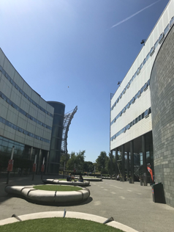

Systematic review of applications and properties of the NoMAD instrument for assessing implementation outcomes
Can implementation outcome measurement be both robust and pragmatic?
Tracy L Finch , Leah Bührmann, Sebastian Potthoff, Carl R May, Beckie Gibson, Jiri Gumancik,
Oliver Wilson-Dickson, Melissa Girling, Jessica Gates, Tim Rapley
EIE Conference 2025

Slide 27

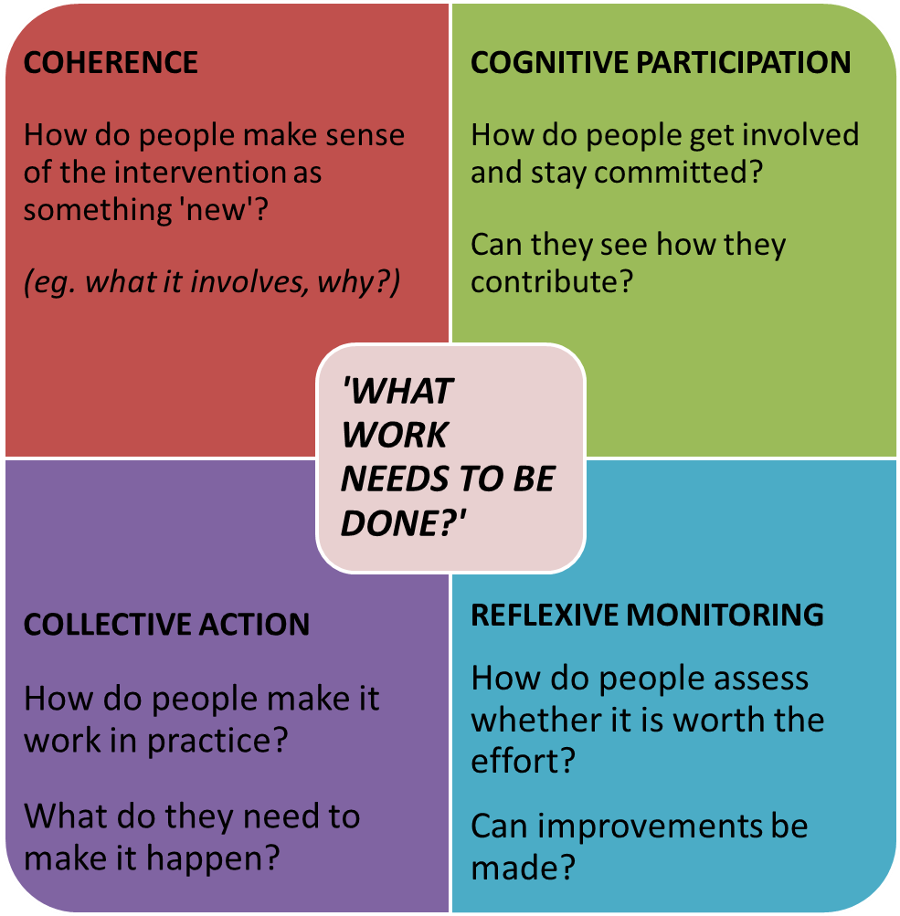
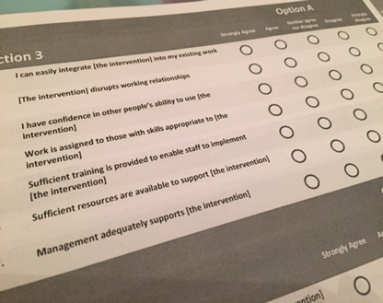

Moving from theory to ‘measurement’
2012 – 2015
Theoretical integrity – item generation, workshops, expert ratings
User/ responder focused work – cognitive interviews

Slide 28
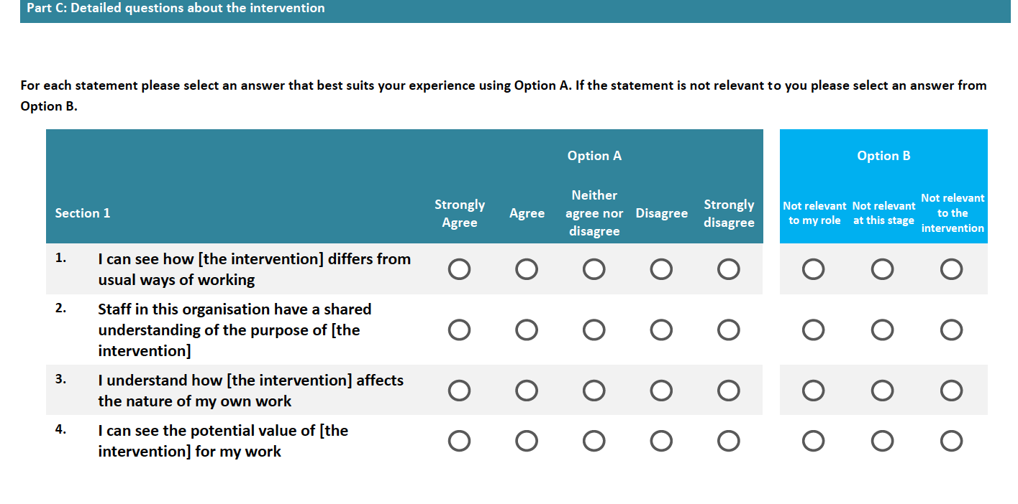
20 construct-specific items; 3 ‘general assessment’ items

Slide 29
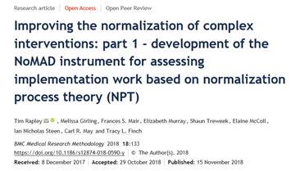
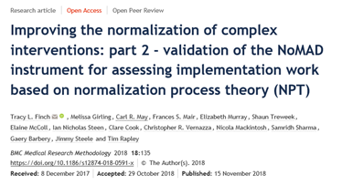
NoMAD
Development study told us:
Items make sense (face validity) but….
Consider (different) roles
Consider temporality (tense) of implementation
Contextualise use for specific study
Validation study told us:
theoretical structure (four NPT constructs) supported statistically
‘Not applicable’ responding can be legitimate and informative

Slide 30
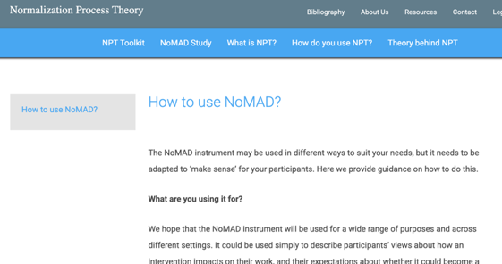
We concluded that……
NoMAD is a theoretically derived instrument for assessing implementation processes from the perspective of individuals involved in (collective) implementation activity
And advised:
Apply flexibly, adapt to own implementation research and practice needs
Select items (or item sets) as appropriate
Exercise judgement on validity claims where adaptations made

Slide 31
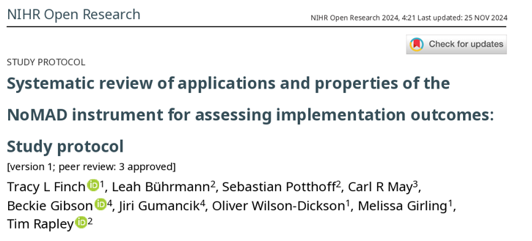
10 years on: Systematic review
*Manuscript of results is currently under review for publication
Methods:
PubMed AND NoMAD key publications citation search
Search period: 2015 to Aug 2023
Papers used NoMAD and reported data
Independent double screening (titles, abstracts, full papers)
Structured data extraction
A focus on:
How NoMAD was used
Psychometric properties

Slide 32
What we found: Overview
64 papers, totalling 10,949 NoMAD surveys
Sample size: range 6-1342, mean = 174; median =101
Study type:
  Implementation and evaluation of specific intervention: n=32 (50%)
  Evaluation of planned intervention, or a general practice: n=21
  Translation and /or validation: n=8
  Intervention development or optimisation: n=3
Methods: Majority (69%) used NoMAD alongside qualitative methods
Timepoints: Mostly single administration (n = 46) or twice (n = 11),
but up to 10 (n=1)

Slide 33
Implementation as collaborative, multi-professional work
How many groups included in a study?
One group only: n=15 (23%)
Two: n=14 (22%)
Three n=11 (17%)
Four: n=12 (20%)
Five: n=5, (8%)
Six: n=3 (5%)
Seven: n=3 (11%)
Eight: n=1
PARTICIPANTS | NUMBER OF STUDIES
Clinical professional | 42
Dental professional | 4
Nurse professional | 38
Allied Health professional | 28
Support professional (health) | 19
Social and Community professional | 20
Service users and patients | 3
Managers | 13
Support staff (eg clerical/ admin/ other) | 16
Research staff | 3
Policy professional | 3
Other (unclassified) | 7

Slide 34
NPT construct measures hold across settings, countries, interventions…
Scale structure: 8 studies, all confirm 4 NPT constructs (Confirmatory Factor Analyses)
  Translations to: Dutch, Swedish, Brazilian Portuguese, Chinese & German
Internal consistency (Cronbach alpha): 20 studies, generally in the target region of >.07
Concurrent validity: No studies
Test-retest analyses: No studies
Use of NoMAD alongside other implementation outcome measures: Few studies (no reporting of associations)

Slide 35
How is NoMAD being used and adapted?
NoMAD use and construct items | Yes | No (or not fully, or unknown)
Made notable adaptations to survey for study use | 28* | 36
Full set of construct items (n=20) used | 40 | 24
Original 5pt Likert scale used for construct items | 53 | 11
General assessment items (n=3) used | 24 | 40
Use of original (n=3) not applicable category options | 14 | 50 (28 ‘unknown’)
*44% of studies in review

Slide 36
Contextualising items and item sets to the study
Type of adaptions | Reason | n
Excluded items | Implementation stage Item/s didn’t suit intervention Item/s didn’t suit target population Items performed poorly statistically | 8 4 1 2
Re-wording of items | Prospective tense (anticipatory) Improve clarity for study context Result of piloting for study | 6 2 3
Additional items | Supplementary items of interest to study | 5
Addition of free-text option | For elaboration on item ratings | 2

Slide 37
Global items | When you use [the intervention], how familiar does it feel? Do you feel [the intervention] is currently a normal part of your work? Do you feel [the intervention] will become a normal part of your work?
Construct | Sub-Construct | Items | Excl (n)
Coherence | Differentiation | I can see how the [intervention] differs from usual ways of working | 4
 | Communal specification | Staff in this organisation have a shared understanding of the purpose of this [intervention] | 7
 | Individual specification | I understand how the [intervention] affects the nature of my own work | 5
 | Internalization | I can see the potential value of the [intervention] for my work | 3
Cognitive Participation | Initiation | There are key people who drive the [intervention] forward and get others involved | 6
 | Legitimation | I believe that participating in the [intervention] is a legitimate part of my role | 2
 | Enrolment | I’m open to working with colleagues in new ways to use the [intervention] | 4
 | Activation | I will continue to support the [intervention] | 4
Collective Action | Interactional workability | I can easily integrate the [intervention] into my existing work | 2
 | Relational integration | The [intervention] disrupts working relationships | 9
 | Relational integration | I have confidence in other people’s ability to use the [intervention] | 7
 | Skill set workability | Work is assigned to those with skills appropriate to the [intervention] | 10
 | Skill set workability | Sufficient training is provided to enable staff to use the [intervention] | 5
 | Contextual Integration | Sufficient resources are available to support the [intervention] | 5
 | Contextual integration | Management adequately supports the [intervention] | 3
Reflexive Monitoring | Systemisation | I am aware of reports about the effects of the [intervention] | 12
 | Communal appraisal | The staff agree that the [intervention] is worthwhile | 6
 | Individual appraisal | I value the effects the [intervention] has had on my work | 6
 | Reconfiguration | Feedback about the [intervention] can be used to improve it in the future | 9
 | Reconfiguration | I can modify how I work with the [intervention] | 10

Slide 38
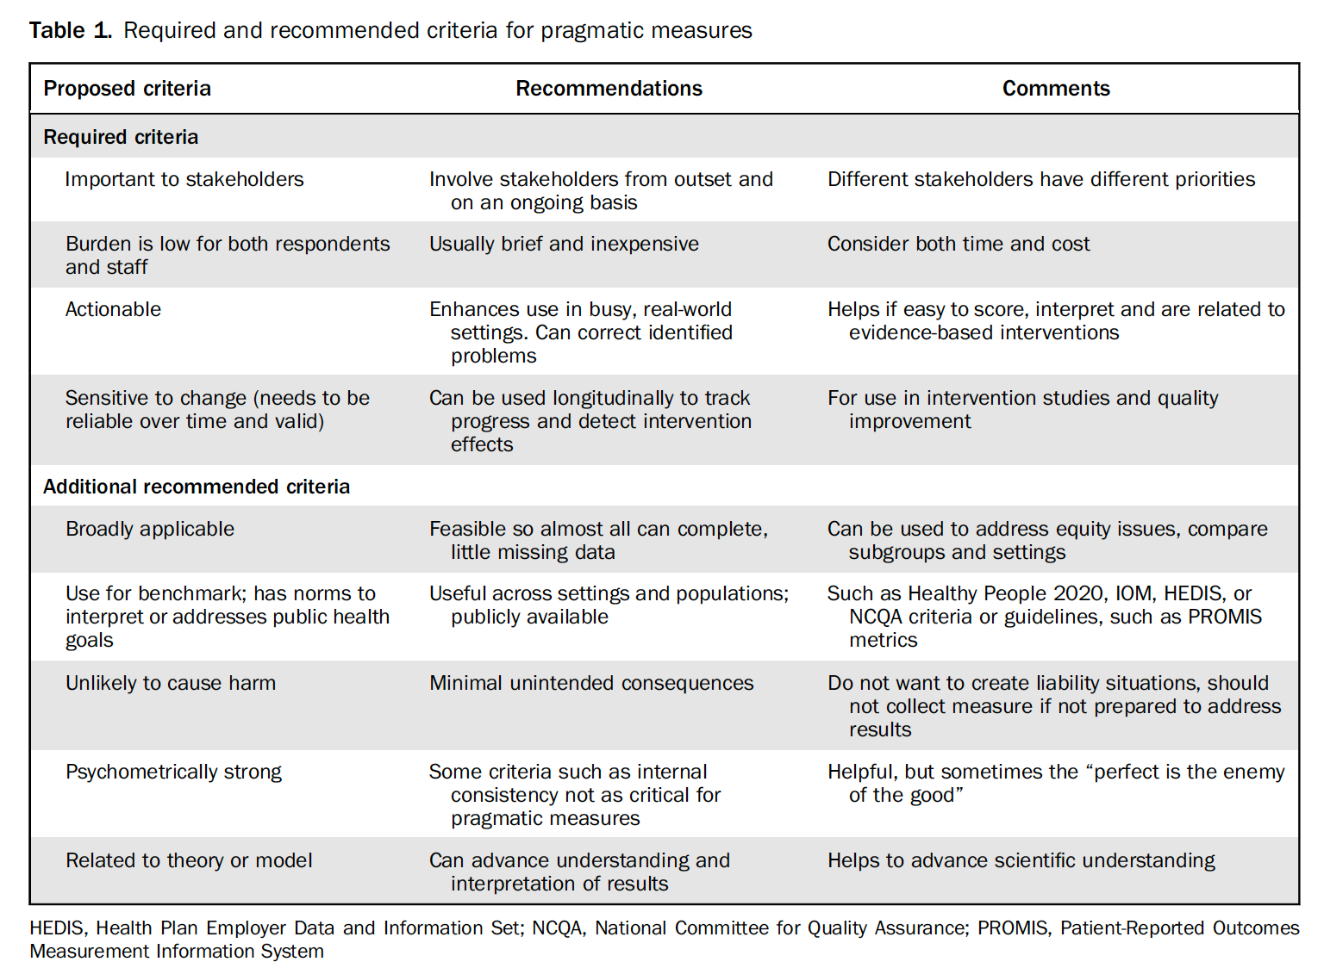
Pragmatic measures
Glasgow & Riley (2013). Pragmatic measures: what they are and why we need them. American Journal of Preventive Medicine. Vol 45 (2) pp 237–243.

Slide 39
Conclusion
Implementation outcome measures can be psychometrically sound AND pragmatic
NoMAD can be used in different ways – for measuring, describing, reflecting or guiding (actions)
Notes:
Discussion questions (from abstract):
How can we ensure that pragmatic tools remain valid and reliable despite being used flexibly across various projects or research settings?
How can we ensure that pragmatic measurement instruments remain sensitive to the outcomes that matter most to end users (e.g., patients, communities, practitioners)?

Slide 41
THANK YOU!
Questions & Discussion
Presentation 1: Ingrid Hickman
Presentation 2: Saskia Oesch
Presentation 3: Myrta Kohler
Presentation 4: Tracy Finch
Session host: Keitly Mensah
Thought-provoking presentations and interesting insights?
Spread the word and let us follow along by using #EIE2025!

