Slide 1


Ride the Knowledge Wave 9
IMPLEMENTATION IN EDUCATIONAL SETTINGS
Presentation 1: Maria Fagerström
Presentation 2: Jane Lewis
Presentation 3: Andreas Rödlund
Presentation 4: Kristi Sidney Annerstedt
Session host: Sylwia Kazmierczak-Murray

Slide 2
What role do end-users play in implementation? Interview study to explore determinants for adopting a mental health app among high school students in Sweden
Maria Fagerström, PhD-student Marie Löf, Professor Ulrika Müssener, Associate Professor
Margit Neher, Senior Lecturer
Sissela Bergman Nutley, PhD Kristin Thomas, Associate Professor

Slide 3




Background
Rising mental health challenges among adolescents
Schools key arenas for mental health promotion
Regular “health visits” conducted by school nurses are part of the Swedish school system
Promoting mental health via mobile phones
Low real-world usage - how can we increase usage?
Technology-related factors (e.g., usability, design)
Individual factors (e.g., motivation, self-efficacy)
But what about the broader context; students as part of the implementation?

Slide 4
Aim
To explore high school students’ perceptions of determinants for adopting a mental health app following routinised health visits in Swedish school healthcare
So…end-users’ perspective on implementation!

Slide 5
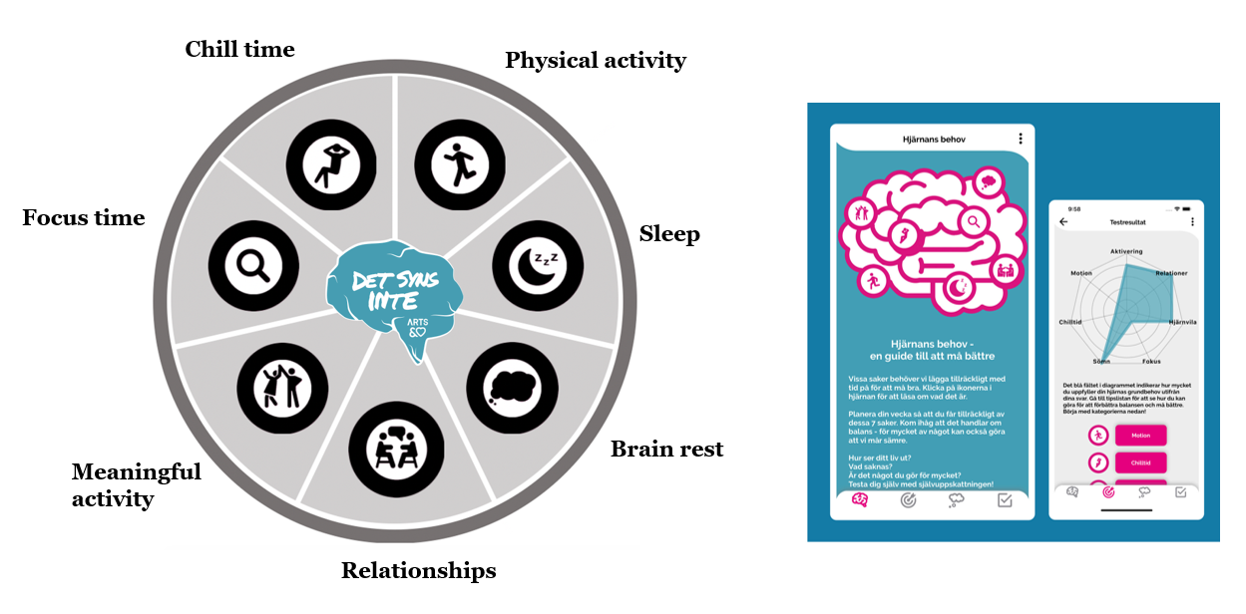
The Mobile Implementation Project
The intervention:
“On the inside”; a mobile app consisting of information on protective factors for mental health
The implementation:
Seven Swedish high schools implemented the “On the Inside” during routine health visits for first-year high school students (aged 15-16)
Arts & Hearts. App: Det syns inte.
https://apps.apple.com/se/app/det-syns-inte/id1517379505

Slide 6
Method
6
Characteristics of the mental health app
Individual interviews with high-school students that had been recommended the app during the health visits (n=18; all women between 15-18 years)
Convenience sampling method
Semi-structured guide inspired by general determinants for implementation.
Inductive content analysis according to Elo & Kyngäs.
Characterstics of the individual student
Contextual factors within and outside the school
Strategies employed by the school to enhance usage
Influences from the school healthcare nurse
(Adapted from Nilsen, 2020)

Slide 7

The impact of the formative period of life
Recommendations during health visits are not enough
Developed their own stance on the app by striking a balance between own beliefs and influence from peers and adults
The impact of the formative period of life
Alignment between the app and the student | Awareness of the app | Having responsive adults in the surroundings

Slide 8

Students’ determinants for adopting the app
Alignment between the app and the student
What’s my beliefs in using mobile apps to promote mental health?
Does the intervention align with the kind of mobile design that I like?
Can I trust this mobile app?
Understanding a personal reason for using the app – why should I use it?
The impact of the formative period of life
Alignment between the app and the student | Awareness of the app | Having responsive adults in the surroundings

Slide 9

Students’ determinants for adopting the app
Alignment between the app and the student
What’s my beliefs in using mobile apps to promote mental health?
Does the intervention align with the kind of mobile design that I like?
Can I trust this mobile app?
Understanding a personal reason for using the app – why should I use it?
Awareness of the app
Does the school enable discussions among students about the app and mental health?
Is there any publicity around the app, as posters or word-of-mouth?
The impact of the formative period of life
Alignment between the app and the student | Awareness of the app | Having responsive adults in the surroundings

Slide 10

Students’ determinants for adopting the app
Alignment between the app and the student
What’s my beliefs in using mobile apps to promote mental health?
Does the intervention align with the kind of mobile design that I like?
Can I trust this mobile app?
Understanding a personal reason for using the app – why should I use it?
Awareness of the app
Does the school enable discussions among students about the intervention and mental health?
Is there any publicity around the intervention, as posters or word-of-mouth?
Having responsive adults in the surroundings
Do I have adults around me, that creates a climate inwhere it’s open to talk about mental health?
Do the adults care and react to my mental health needs?
The impact of the formative period of life
Alignment between the app and the student | Awareness of the app | Having responsive adults in the surroundings

Slide 11

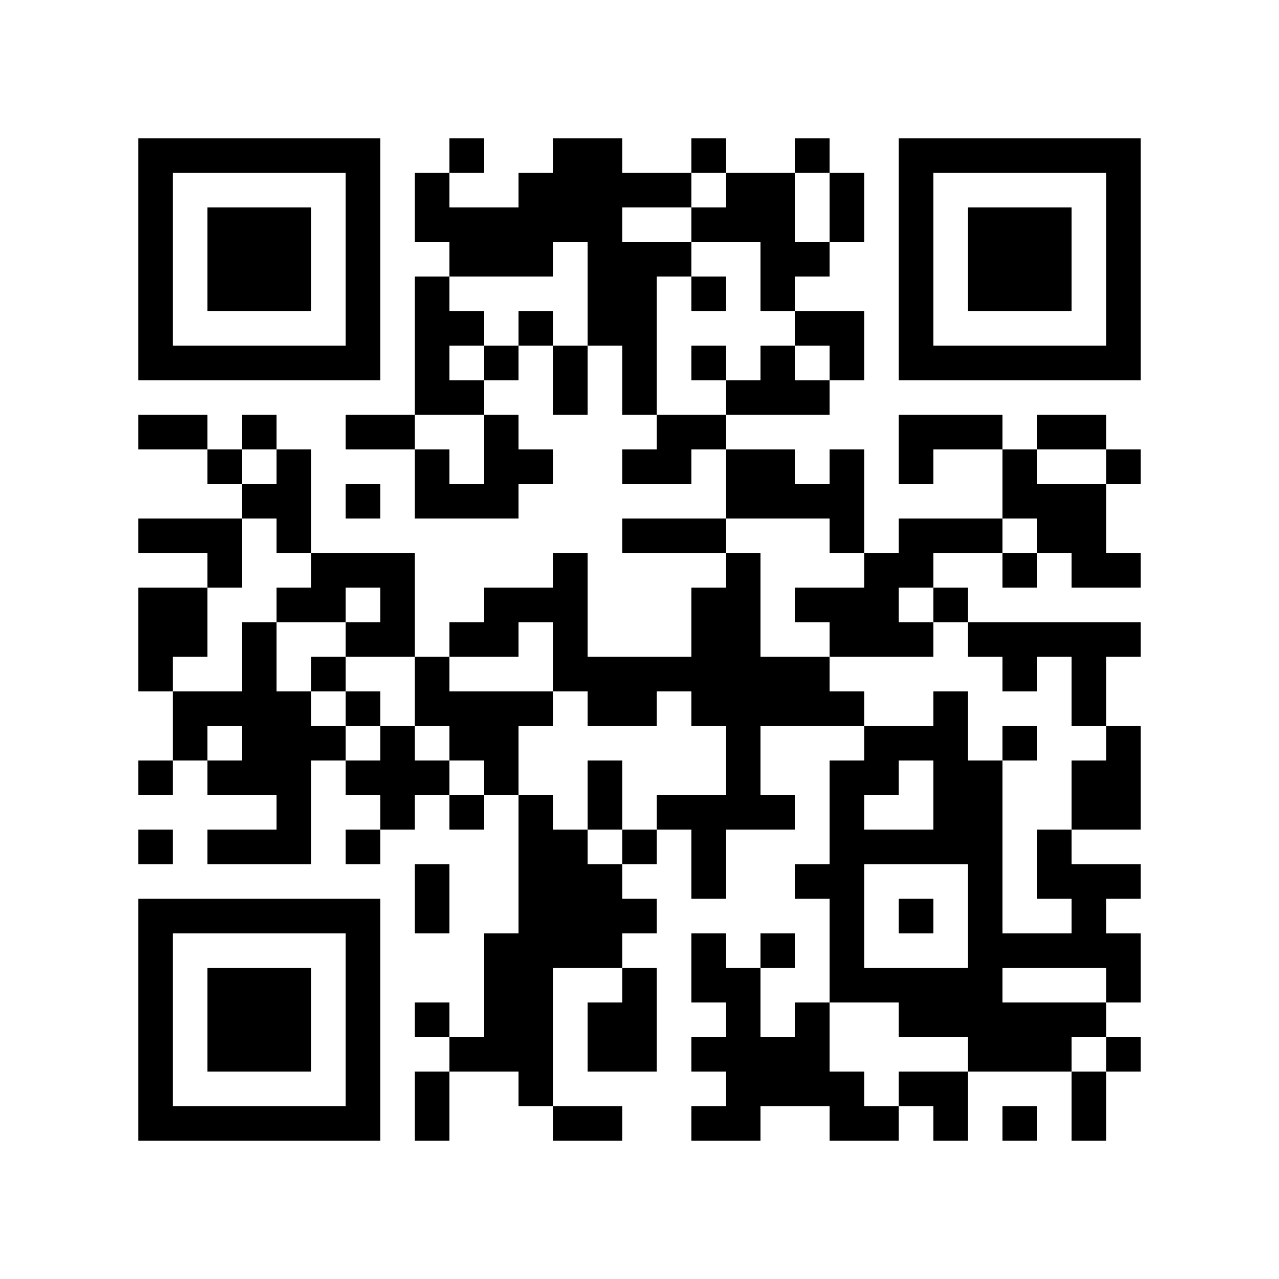
Take-home messages
Related to apps and school settings
It’s not just about the app and the student. Students’ adoption of a mental health app is also influenced by contextual factors in schools.
To support adoption, efforts should be focus on:
Providing personal recommendations during health visits, including school nurses communicating their own trust in the app
Enabling class-room based discussions about mental health and the app
Creating a positive school climate, where students feel pschycologically safe – it serves as a foundation for implementation.
Related to Implementation Science in general
Implementation of an intervention with a high end-user focus– like a health promoting app - involves a collaborative process between end-users and professionals.
This makes it relevant to consider the end-users’ determinants when designing implementation strategies.
maria.fagerstrom@liu.se

Slide 12



Slide 13

A tool to support scaling activity and investment decisions in education: Translating scaling science into real world scaling success
Amy Hall, Anne-Marie Baan, Patrick Taylor, Jane Lewis
Ride The Knowledge Wave: European Implementation Event, June 2025

Slide 14





Objectives:
Scale-up
To develop a scaling framework to be applied:
Across EEF’s programme pipeline
By EEF, grantees and evaluators
For the full range of programme types
In early years, primary, secondary and 16-19 education
Effectiveness
Efficacy
Pilot
Innovation
Notes:
Explain EEF
Scaling central to mission
Some successes but needed help to achieve more
Experiencing voltage drop – prog form changing – Bronwen maxwell and colleagues - 2021
Shared understanding of what needed, trigger more work by progs, evals and EEF
Evaluation pipeline stages

Slide 15
Four phases of work
Workshopped dimensions
Selected and synthesised frameworks and evaluations
Output: Agreed dimensions
Developed Framework with indicators
Iterative feedback from EEF
Output: Version for piloting
1.
Planning
2. Developing the Framework
3.
Piloting the
Framework
4. Finalising
Further consultation with EEF
Output: Final framework, self- assessment version, advice on evaluation
Piloted by EEF staff, delivery teams and evaluators
Output: Revised Framework
Notes:
Why we needed a new framework: diversity in user (funder, practitioner, developer), purpose (select, develop), stage (end, start), coverage, geog, sector
Worked with EEF throughout
Piloting: 6 EEF teams, 5 delivery teams, 4 evaluation teams – cognitive application

Slide 16

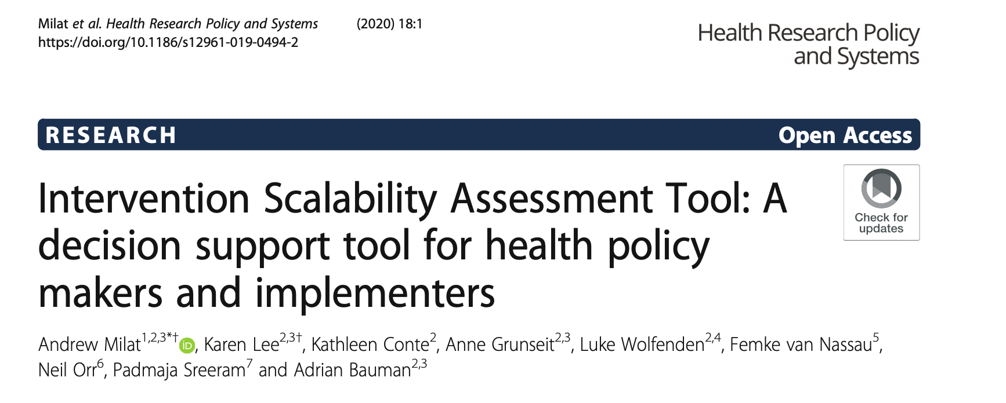


Selection and synthesis of frameworks and evaluations
Based on previous reviews including Ben Charif 2022
Empirically supported, relevant and comprehensive
9 steps for developing a scaling strategy (WHO and ExpandNet)
12 steps for designing pilot programs with scaling up in mind (WHO and ExpandNet)
Education Scalability checklist (VVOB, 2021)
From research to market (Institute of Education and Sciences / SRI International: Wu et al., 2021)
Intervention Scalability Assessment Tool (Milat et al., 2020)
Scalability assessment and planning toolkit (Bremaud et al., 2018)
Scaling strategy worksheet (Brookings, 2021)
Scaling up—from vision to large-scale change (MSI – framework (2020) and toolkit (2021))
Notes:
Previous reviews – ben Charif – identified 21 relevant to health PLUS previous and new rapid reviews
Longlist of 31
Selected 8 – res-based; comprehensive, relevant
Also EEF scaling evaluations and other reports

Slide 17







Final scaling dimensions
Programme development
Feasibility and acceptability
Scaling vision and strategy
Capacity of lead organisation/s
Policy context and support
Market considerations
Notes:
Prog development: ToC, manual or other documentation, training, fidelity and QA
Feasibility and acceptability – alignment with school context, priorities, ways of working, capacity
Scaling vision and strategy – including pathways to scale
Capacity – prog developmt and delivery but also leadership, finance, tech, legal – and scale of org means won’t be overwhelmed
Policy – fit or deliberately counter but with plans for policy influencing and wider constituency of support
Market – competitor, demand and target market analysis, cost and fundability
But not:
Evidence of promise – cos focus of other assessments
Socio-economic disadvantage and sustainability – absolutely vital so embedded throughout

Slide 18
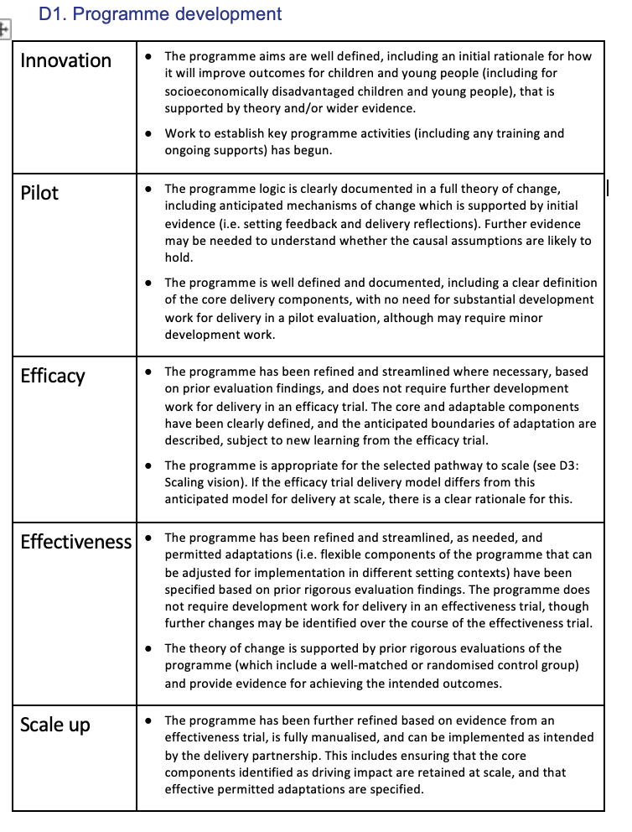
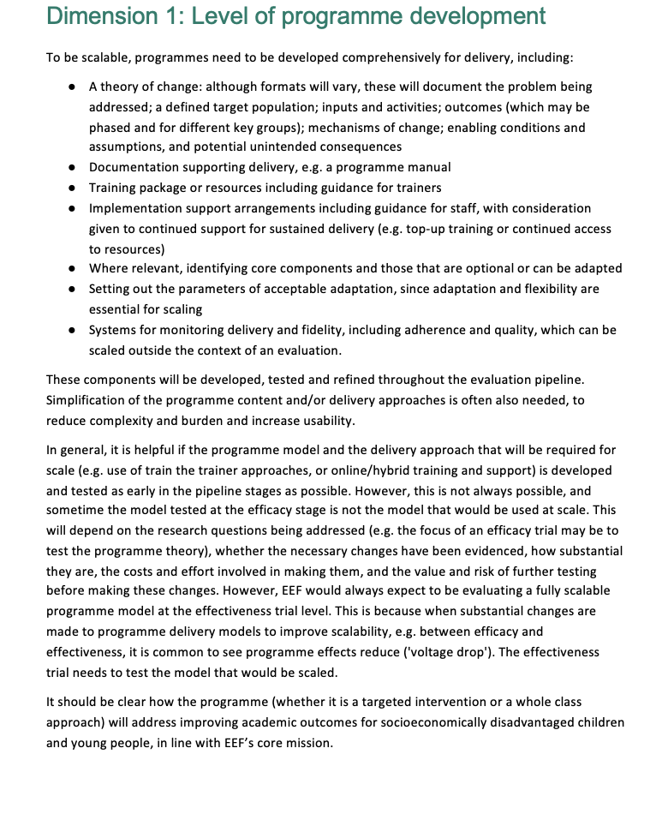
What does it look like?
Notes:
Initial explanation of dimension, why it matters, what’s needed
Then specific indicators at each pipeline stage
Build cumulatively
Based on entry into

Slide 19


Reflections and next steps
Stimulate planning for scale from the start
Excellent programme developers can’t always deliver at scale
Funding for iterative programme development is essential
We need to stretch ourselves as evaluators
Develop useability value-added features
Live piloting and continued development
Test our hunches about developer capacities
Try it and tell us what you think!
Notes:
Which dimensions are S and W in diffnt policy areas. Data.
Hunches: acad:
Strengths: Programme development (optimising based on evidence), Feasibility and acceptability for education settings (based on sequential evals: pilot, efficacy, effectiveness)
Weaknesses: Scaling vision and strategy (caricature is the uni department that has given this zero thought),
Wider - possibly the opposite:
Strengths: Relentless focus on the business plan because resources are scarce, Scaling vision and strategy (realistic sense of achievable scale based on available resources)
Weaknesses: Programme development (often based more on practical experience and no or weak theories), Capacity (sometimes limited because of limited workforce and often low salaries)

Slide 20


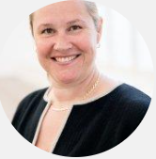




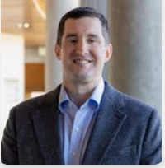
A cluster-randomized controlled trial in schools exploring the mechanisms of change in five implementation strategies through mixed-methods
Lydia Kwak Karolinska Institutet
Irene Jensen Karolinska Institutet
Christina Björklund Karolinska Institutet
Project Team
Andreas Rödlund Karolinska Institutet
Anna Toropova Karolinska Institutet
Liselotte
Schäfer-
Elinder Karolinska Institutet
Byron Powell
Washington University
Rebecca Lengnick-Hall
Washington University
Andreas Rödlund, Doctoral Candidate The unit of intervention and implementation research for worker health Karolinska Institutet, Sweden
Notes:
Intro,
I will present some of the work from my thesis that is based on….

Slide 21

The Thing – The Guideline for the Prevention of Mental Ill-health at the workplace
Lydia Kwak Karolinska Institutet
Irene Jensen Karolinska Institutet
Christina Björklund Karolinska Institutet
Project Team
Andreas Rödlund Karolinska Institutet
Anna Toropova Karolinska Institutet
Liselotte
Schäfer-
Elinder Karolinska Institutet
Byron Powell
Washington University
Rebecca Lengnick-Hall
Washington University
Notes:
This project is led by Associate professor Lydia Kwak at the unit of intervention and implementation research at KI, but we also have some collaboration with Washington University in St.louis.

Slide 22

The Thing – The Guideline for the Prevention of Mental Ill-health at the workplace
Why school settings?
Teachers have high prevalence of mental ill-health related sick leave (Försäkringskassan, 2020)
Psychosocial risks is highly prevalent in schools (Andersen et al., 2022).
Schools have shortcomings in the systematic management of the work environment (Arbetsmiljöverket, 2017)
Recommendations
Workplaces should have well-established policies related to the psychosocial risk management
Employers have knowledge on the relationship between psychosocial risks and mental health problems
Workplaces regularly assess their psychosocial work environment and intervene on identified risk factors
Lydia Kwak Karolinska Institutet
Irene Jensen Karolinska Institutet
Christina Björklund Karolinska Institutet
Project Team
Andreas Rödlund Karolinska Institutet
Anna Toropova Karolinska Institutet
Liselotte
Schäfer-
Elinder Karolinska Institutet
Byron Powell
Washington University
Rebecca Lengnick-Hall
Washington University
Notes:
A little bit of background… The guideline provides three overarching recommendations…

Slide 23

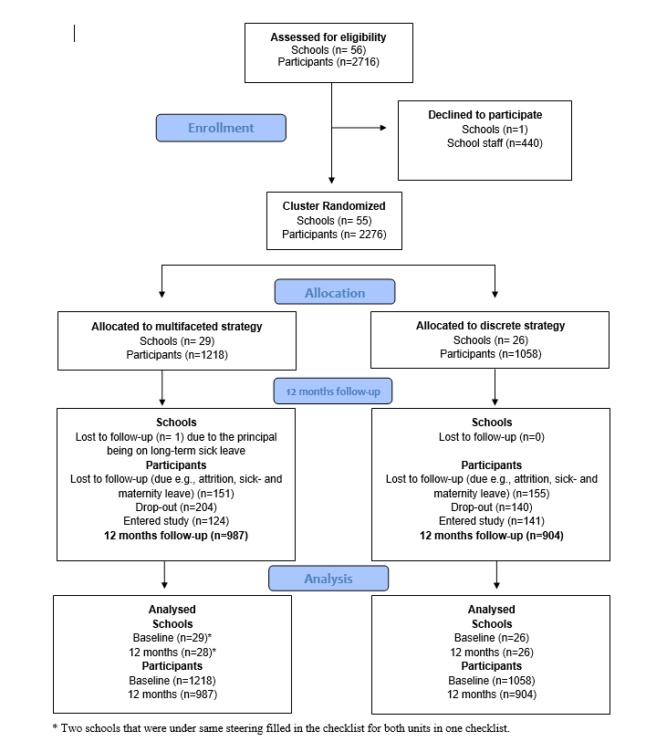

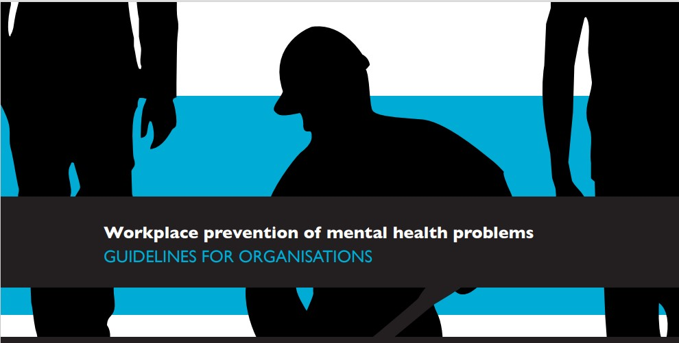
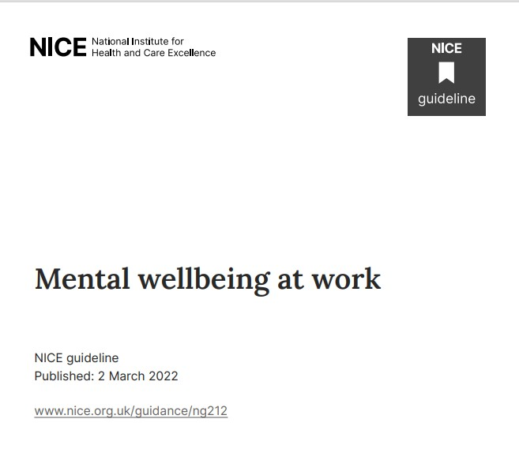
Why school settings?
The Thing – The Guideline for the Prevention of Mental Ill-health at the workplace
Teachers have high prevalence of mental ill-health and related sick leave (Försäkringskassan, 2020)
Psychosocial risks are highly prevalent in schools (Andersen et al., 2022).
Schools have shortcomings in the systematic management of the work environment (Arbetsmiljöverket, 2017)
Notes:
Why conduct these studies in schools…
First and foremost, school personnel is the occupational group with the second highest prevalence of MHP and related sick leave in Sweden (4),
This is mainly due to their exposure to multiple psychosocial risk factors in their work-environment (4, 5). These risks include lack of support from managers and colleagues, high levels of workload and emotional demands, negative pupil behaviors, and increased class sizes (6-9).
but despite this, 9/10 school have shortcomnings in their systematic management of the work environment.

Slide 24
Study Setting
Why school settings?
Implementation Strategies
Health Outcome
Hypothesized Mediators
COM-B Dimension
Implementation Outcome
Teachers have high prevalence of mental ill-health related sick leave (Försäkringskassan, 2020)
Psychosocial risks is highly prevalent in schools (Andersen et al., 2022).
Schools have shortcomings in the systematic management of the work environment (Arbetsmiljöverket, 2017)
Cluster-Randomized Controlled Trial » 4 Municipalities » 55 Schools » 2276 School staff
Implementation Object The Guideline for the Prevention of Mental ill-health
Implementation Strategies » Multifaceted Implementation Strategy » Educational meeting + Implementation teams
Implementation outcomes » Guideline Fidelity
Knowledge, Awareness
Fidelity to the guideline, operationalized through guideline adherence
ERIC Cluster - Train, Educate stakeholders - Conduct an educational meeting (15) - Conduct ongoing training in the form of workshops (19)
- Distribute educational materials (21)
General Health, Stress
Skills
Capability
Behavioral regulation
Social influences
ERIC Cluster - Develop Stakeholder interrelationships - Organize implementation teams (48)
Opportunity
Environmental context and resources
Social role and identify
ERIC Cluster - Evaluate and iterative strategies - Conduct cyclical small tests of change (14)
Goals
Beliefs about consequences
Motivation
Beliefs about capability
ERIC-Cluster - Provide interactive assistance - Implementation facilitation (10)
Intention
Notes:
So to support the implementation of the guideline in school we conducted a cluster-randomized trial in 4 municipalities and 55 schools…
We used a hybrid type 3 approach, meaning that all schools received the same intervention, the guideline, but had different implementation support.
The primary outcome of the trial was guideline fidelity

Slide 25
Implementation strategies
Implementation Strategies
Hypothesized Mediators
COM-B Dimension
Implementation Outcome
Health Outcome
Education Meeting
Workshop
1
Workshop 2
Workshop 3
Workshop 4
Workshop 5
ERIC Cluster - Train, Educate stakeholders - Conduct an educational meeting (15) - Conduct ongoing training in the form of workshops (19)
- Distribute educational materials (21)
Knowledge, Awareness
Fidelity to the guideline, operationalized through guideline adherence
General Health, Stress
Skills
Capability
Behavioral regulation
Implementation Teams
ERIC Cluster - Develop Stakeholder interrelationships - Organize implementation teams (48)
Social influences
Opportunity
Environmental context and resources
Social role and identify
Cycles
Cycles
Cycles
Cycles
ERIC Cluster - Evaluate and iterative strategies - Conduct cyclical small tests of change (14)
Goals
P
D
S
A
P
D
S
A
P
D
S
A
P
D
S
A
Beliefs about consequences
Motivation
Internal Facilitator
ERIC-Cluster - Provide interactive assistance - Implementation facilitation (10)
Beliefs about capability
Intention
Baseline
Notes:
So, here is an overview of the multifaceted implementation strategy…. It was developed to improve capability, opportunity, and motivation of those that will implement the guideline, and we hypothesized that the effect of the strategy would go through different determinants related to these dimensions.

Slide 26
Implementation strategies
Implementation Strategies
Health Outcome
Implementation Strategies
Hypothesized Mediators
COM-B Dimension
Implementation Outcome
ERIC Cluster - Train, Educate stakeholders - Conduct an educational meeting (15) - Conduct ongoing training in the form of workshops (19)
- Distribute educational materials (21)
Knowledge, Awareness
Fidelity to the guideline, operationalized through guideline adherence
ERIC Cluster - Train, Educate stakeholders - Conduct an educational meeting (15) - Conduct ongoing training in the form of workshops (19)
- Distribute educational materials (21)
Education Meeting
Workshop
1
Workshop 2
Workshop 3
Workshop 4
Workshop 5
General Health, Stress
Skills
Capability
Behavioral regulation
ERIC Cluster - Develop Stakeholder interrelationships - Organize implementation teams (48)
Implementation Teams
Social influences
ERIC Cluster - Develop Stakeholder interrelationships - Organize implementation teams (48)
Opportunity
Environmental context and resources
Social role and identify
ERIC Cluster - Evaluate and iterative strategies - Conduct cyclical small tests of change (14)
ERIC Cluster - Evaluate and iterative strategies - Conduct cyclical small tests of change (14)
Cycles
Cycles
Cycles
Cycles
Goals
P
D
S
A
P
D
S
A
P
D
S
A
P
D
S
A
Beliefs about consequences
Motivation
ERIC-Cluster - Provide interactive assistance - Implementation facilitation (10)
Internal Facilitator
Beliefs about capability
ERIC-Cluster - Provide interactive assistance - Implementation facilitation (10)
Intention
Baseline
9 months
Notes:
Specifically, each school started by organizing an implementation team of 3-5 individuals… this team then participated in an educational meeting… the team then recieved a workshop series of five workshops… in between the workshops the team conducted plan do study act cycles… and during the implementation process they also recieved support from the municipality by an internal facilitator.

Slide 27
AIM
The doctoral thesis explores mechanisms in a multifaceted implementation strategy used to implement an evidence-based guideline for preventing work-related mental health problems within a school setting. Using quantitative and qualitative methods, we examine how and why this strategy produces change. Study 1 – Favorable effects in guideline fidelity were observed between baseline and 12 months for the multifaceted strategy compared to the control (B= 2.81, 95 CI: 2.49 to 3.12, p=<.001). Study 2 – A partial mediation effect was present in nine out of ten mediators (indirect effects= 0.35 to 2.01, p<.05). The largest proportion of the strategy’s effect on fidelity was mediated through skills (41%) and behavioral regulation (35%). Study 3 - Investigate how, why, and under what conditions the five discrete implementation strategies contributed to the implementation of the guideline.
Notes:
So, in the thesis, we explores the mechanisms of this multifaceted strategy. In this presentation, I will focus on one study but I will mention that in the first study we have found that the multifaceted strategy was more effective over time than the discrete strategy and we also found that nine of ten of these determinants showed partial mediation and could explain some of the effect of the relationship between the strategy and fidelity.

Slide 28
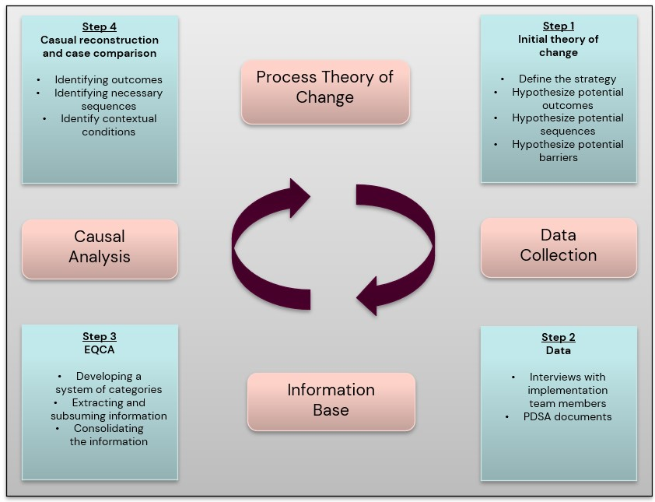
AIM
The doctoral thesis explores mechanisms in a multifaceted implementation strategy used to implement an evidence-based guideline for preventing work-related mental health problems within a school setting. Using quantitative and qualitative methods, we examine how and why this strategy produces change. Study 1 – Favorable effects in guideline fidelity were observed between baseline and 12 months for the multifaceted strategy compared to the control (B= 2.81, 95 CI: 2.49 to 3.12, p=<.001). Study 2 – A partial mediation effect was present in nine out of ten mediators (indirect effects= 0.35 to 2.01, p<.05). The largest proportion of the strategy’s effect on fidelity was mediated through skills (41%) and behavioral regulation (35%). Study 3 - Investigate how, why, and under what conditions the five discrete implementation strategies contributed to the implementation of the guideline.
Notes:
However, for this presentation, I will focus on the third study where we have used qualitative data to investigate how, why, and under what conditions the discrete strategy contributed to the implementation of the guideline.

Slide 29
Method
Process Tracing with Comparative Case Studies
Investigate how, why, and under what conditions the five discrete implementation strategies contributed to the implementation of the guideline
24 Implementers (Cases) » Interviews » PDSA documents » Participation lists
Method » Extractive Qualitative Content Analysis » Causal Reconstruction » Case-pattern Analysis
Mediators Implementers (n=220)
Measures Determinant of Implementation Behaviour Questionnaire (DIBQ)
Time-points » T1= Educational meeting » T2= 3 months » T3= 9 months
Notes:
Process tracing with comparative cases studies Process tracing is a theory-driven method to discover mechanism. It conceptualizes a mechansism as two or more interrelated sequences that link cause and outcome (22, 29). Each sequence involves a specific action (what), performed by an actor (who), which engages the next step in the causal process. So, the aim is to unpack these sequences Our approach started with the development of an initial theory of change, where we used our programme theory as a guide. Next, we constructed case. We had 24 cases and we constructed the cases based on interviews, plan do study, act, documents, and participation lists. After that, we used extractive qualitative content analysis to extract information from the data sources. This was done to generate an information bases for further analysis rather than answering the research questions. Lastly, we made a causal reconstruction of each cases followed by a case-pattern analysis to determine which of these sequences that was necessary for attaining the outcome.

Slide 30
Results – Educational Meeting
X - Strategy
Causal Mechanism
Y - Outcome
Knowledge The educational meeting “…was good and broke down this work, which in itself is quite difficult, scattered, when it comes to the organizational and social factors that is connected to mental ill-health and so on. So, it became graspable in some way to… to get forms around how to work with it.”
Educators provide education and facilitate goal setting
Educators promote knowledge acquisition among implementers by them participating in the educational meeting and receiving educational content.
Implementers form beliefs by reflecting on the current situation and the outcome expectancies of implementing the guideline because of the knowledge they have acquired.
A conscious decision was taken to implement the guideline during the year
Contextual factors influencing the operation of the mechanism
Barrier: No staff involvement during the educational meeting
Enabler: Social influence
Notes:
As this study is ongoing, I will show some results from the educational meeting. The outcome of the educational meeting was conceptualized as decision to implement the guideline during the year such as they made an action plan or a goal.

Slide 31
Results – Educational Meeting
Knowledge The educational meeting “…was good and broke down this work, which in itself is quite difficult, scattered, when it comes to the organizational and social factors that is connected to mental ill-health and so on. So, it became graspable in some way to… to get forms around how to work with it.”
Beliefs About Consequences The educational meeting “…provided us with a general, basic understanding of what work environment efforts are all about […] it has not been handled very clearly. So, we immediately felt, oh, wow, this is important and valuable, we really need to think things through, something needs to happen at the school.
X - Strategy
Causal Mechanism
Y - Outcome
Beliefs About Consequences The educational meeting “…provided us with a general, basic understanding of what work environment efforts are all about […] it has not been handled very clearly. So, we immediately felt, oh, wow, this is important and valuable, we really need to think things through, something needs to happen at the school.
Educators provide education and facilitate goal setting
Educators promote knowledge acquisition among implementers by them participating in the educational meeting and receiving educational content.
Implementers form beliefs by reflecting on the current situation and the outcome expectancies of implementing the guideline because of the knowledge they have acquired.
A conscious decision was taken to implement the guideline during the year
Contextual factors influencing the operation of the mechanism
Barrier: No staff involvement during the educational meeting
Enabler: Social influence
Notes:
Through the causal reconstruction, we identified that the mechanism was engaged by the educators provide education and facilitate goal setting, the first sequence was that Educators promote knowledge acquisition among implementers by them participating in the educational meeting and receiving educational content. I selected an example quote from one implementer to illustrate this process. He talks about that the educational meeting made it graspable and they received froms around how to work with this.

Slide 32
Results – Educational Meeting
Knowledge The educational meeting “…was good and broke down this work, which in itself is quite difficult, scattered, when it comes to the organizational and social factors that is connected to mental ill-health and so on. So, it became graspable in some way to… to get forms around how to work with it.”
Beliefs About Consequences The educational meeting “…provided us with a general, basic understanding of what work environment efforts are all about […] it has not been handled very clearly. So, we immediately felt, oh, wow, this is important and valuable, we really need to think things through, something needs to happen at the school.
Knowledge I think that it [educational meeting] was good and broke down this work, which in itself is quite difficult, scattered, when it comes to the organizational and social factors that is connected to mental ill-health and so on. So, it became graspable in some way to… to get forms around how to work with it.
X - Strategy
Causal Mechanism
Y - Outcome
Staff involvement When we attended the educational meeting, it was only us in the school management from our school… So, we did not really have any counterpart or collaborative partner, it was just us. I would say that we did not really get anywhere during that day.
Educators provide education and facilitate goal setting
Educators promote knowledge acquisition among implementers by them participating in the educational meeting and receiving educational content.
Implementers form beliefs by reflecting on the current situation and the outcome expectancies of implementing the guideline because of the knowledge they have acquired.
A conscious decision was taken to implement the guideline during the year
Contextual factors influencing the operation of the mechanism
Barrier: No staff involvement during the educational meeting
Enabler: Social influence
Notes:
This knowledge acquisition engaged the next sequence in the mechanism, where implementers form beliefs by reflecting at the situation at the school and outcome expectancies of implementing the guideline because of the knowledge they received. Here is another quote, where the implementer mentioned they received knowledge, and

Slide 33
Results – Educational meeting
Beliefs About Consequences The educational meeting “…provided us with a general, basic understanding of what work environment efforts are all about […] it has not been handled very clearly. So, we immediately felt, oh, wow, this is important and valuable, we really need to think things through, something needs to happen at the school.
Beliefs About Consequences The first day was probably quite good, because it provided us with a general, basic understanding of what work environment efforts are all about. I have worked here for 20 years, and I have never really understood it… I mean, I do understand the physical aspects, but I have never grasped a coherent overall picture… it has not been handled very clearly. So, we immediately felt, oh, wow, this is important and valuable, we really need to think things through, something needs to happen at the school.
X - Strategy
Causal Mechanism
Y - Outcome
Staff involvement When we attended the educational meeting, it was only us in the school management from our school… So, we did not really have any counterpart or collaborative partner, it was just us. I would say that we did not really get anywhere during that day.
Social Influence I think that collaboration with, like, the union representatives helps a lot […] this is something that we set up together, and we are all going to work out together... so that this becomes a... well, like a plan for us.
Educators provide education and facilitate goal setting
Educators promote knowledge acquisition among implementers by them participating in the educational meeting and receiving educational content.
Implementers form beliefs by reflecting on the current situation and the outcome expectancies of implementing the guideline because of the knowledge they have acquired.
A conscious decision was taken to implement the guideline during the year
Contextual factors influencing the operation of the mechanism
Barrier: No staff involvement during the educational meeting
Enabler: Social influence
Notes:
By looking at deviant cases, we also found potential barriers influencing the mechanism… here an example of one school where only school management attended the educational meeting and they did not have any collaborative part.

Slide 34
Results – Educational Meeting
Causal Mechanism
Y - Outcome
Social Influence I think that collaboration with, like, the union representatives helps a lot […] this is something that we set up together, and we are all going to work out together... so that this becomes a... well, like a plan for us.
Staff involvement When we attended the educational meeting, it was only us in the school management from our school… So, we did not really have any counterpart or collaborative partner, it was just us. I would say that we did not really get anywhere during that day.
X - Strategy
The combination of
Knowledge + Beliefs + Social influence + Staff involvement explains 100% of the successful cases and is the only pattern that does so.
No successful cases occurred without the combination of all four conditions.
Educators provide education and facilitate goal setting
Educators promote knowledge acquisition among implementers by them participating in the educational meeting and receiving educational content.
Implementers form beliefs by reflecting on the current situation and the outcome expectancies of implementing the guideline because of the knowledge they have acquired.
A conscious decision was taken to implement the guideline during the year
Contextual factors influencing the operation of the mechanism
Barrier: No staff involvement during the educational meeting
Enabler: Social influence
Notes:
We also found that social influence could enable the mechanism.

Slide 35
Results – Educational Meeting
Social Influence I think that collaboration with, like, the union representatives helps a lot. Because before, there really has not been that much collaboration, you could say, but it's been some kind of... well... questions and answers, like, in a way, like that. And this was much more... it became much more... this is something that we set up together, and we are all going to work out together... so that this becomes a... well, like a plan for us.
X - Strategy
Causal Mechanism
Y - Outcome
The combination of
Knowledge + Beliefs + Social influence + Staff involvement explains 100% of the successful cases and is the only pattern that does so.
No successful cases occurred without the combination of all four conditions.
Social Influence I think that collaboration with, like, the union representatives helps a lot […] this is something that we set up together, and we are all going to work out together... so that this becomes a... well, like a plan for us.
Educators provide education and facilitate goal setting
Educators promote knowledge acquisition among implementers by them participating in the educational meeting and receiving educational content.
Implementers form beliefs by reflecting on the current situation and the outcome expectancies of implementing the guideline because of the knowledge they have acquired.
A conscious decision was taken to implement the guideline during the year
Contextual factors influencing the operation of the mechanism
Barrier: No staff involvement during the educational meeting
Enabler: Social influence
Notes:
In the cross-case pattern analysis, we found that the present of all these for conditions explained 100 % of those cases that received the outcome, and this was the only pattern that did so… in all deviant cases one of these conditions were absent.

Slide 36
Avslutningsbild med Karolinska Institutets logotyp

Slide 37
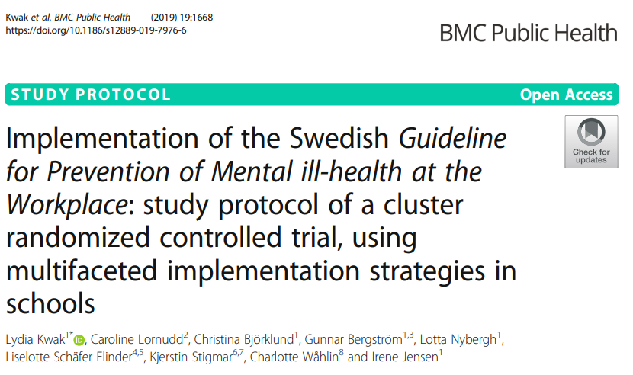
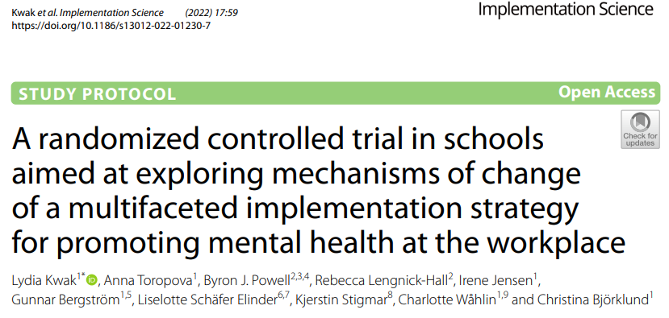
2017-2019
Lydia Kwak Karolinska Institutet
Step 1 - Guideline
Step 3 – iSkol Plus
Irene Jensen Karolinska Institutet
Christina Björklund Karolinska Institutet
Project Team
Andreas Rödlund Karolinska Institutet
Anna Toropova Karolinska Institutet
2011-2014
2020-2025
Step 2 - iSkol
Liselotte
Schäfer-
Elinder Karolinska Institutet
Byron Powell
Washington University
Rebecca Lengnick-Hall
Washington University
Recommendation 3

Slide 38
Fidelity
Step 3 – iSkol Plus
Recommendation 1
2020-2025
*
Implementation Strategies
Guideline Fidelity Self-constructed - School Staff Survey - Baseline and 12 months
Multifaceted Group Schools (k = 29) School staff (n = 1307) »Timepoints 1 & 2 (n = 829) »Timepoint 1 only (n = 347) »Timepoint 2 only (n = 131)
Discrete Group Schools (k = 26) School staff (n = 1173) »Timepoints 1 & 2 (n = 720) »Timepoint 1 only (n = 296) »Timepoint 2 only (n = 157)
Mediators Implementers (n=220)
Measures Determinant of Implementation Behaviour Questionnaire (DIBQ)
Time-points » T1= Educational meeting » T2= 3 months » T3= 9 months
Recommendation 2
ERIC Cluster - Train, Educate stakeholders - Conduct an educational meeting (15) - Conduct ongoing training in the form of workshops (19)
- Distribute educational materials (21)
Education Meeting
Workshop
1
Workshop 2
Workshop 3
Workshop 4
Workshop 5
*
ERIC Cluster - Develop Stakeholder interrelationships - Organize implementation teams (48)
Implementation Teams
Recommendation 3
ERIC Cluster - Evaluate and iterative strategies - Conduct cyclical small tests of change (14)
Cycles
Cycles
Cycles
Cycles
**
P
D
S
A
P
D
S
A
P
D
S
A
P
D
S
A
ERIC-Cluster - Provide interactive assistance - Implementation facilitation (10)
Internal Facilitator
Baseline
Note * p<.05, ** p<.001
9 months

Slide 39
Mediators
Recommendation 1
Process Tracing with Comparative Case studies
Investigate how, why, and under what conditions the five discrete implementation strategies contributed to the implementation of the guideline
24 Implementers (Cases) » Interviews, » PDSA documents » Participation lists
Method » Extractive Qualitative Content Analysis » Causal Reconstruction » Case-pattern Analysis
Guideline Fidelity Self-constructed - School Staff Survey - Baseline and 12 months
Multifaceted Group Schools (k = 29) School staff (n = 1307) »Timepoints 1 & 2 (n = 829) »Timepoint 1 only (n = 347) »Timepoint 2 only (n = 131)
Discrete Group Schools (k = 26) School staff (n = 1173) »Timepoints 1 & 2 (n = 720) »Timepoint 1 only (n = 296) »Timepoint 2 only (n = 157)
Mediators Implementers (n=220)
Measures Determinant of Implementation Behaviour Questionnaire (DIBQ)
Time-points » T1= Educational meeting » T2= 3 months » T3= 9 months
Recommendation 2
Recommendation 3
Note * p<.05, ** p<.001

Slide 40

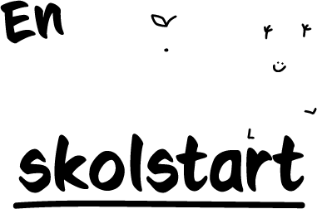
Tailored Strategies to Enhance Fidelity in School-Based Obesity Prevention: IMPROVE Hybrid Type III Trial
Assoc. prof. Kristi Sidney Annerstedt
Departement of Global Public Health, Karolinska Institutet, Sweden

Slide 41

Universal family support program for healthy lifestyles & obesity prevention
An evidence-based family support program
Integrated into routine school activities and in line with the Education Act, the Curriculum and Guidance for Student Health
Developed in areas with high health needs since 2010
Based on Social Cognitive Theory
Implemented in kindergarten or first grade

Slide 42





A Healthy School Start Program
1. Parent health brochure
2. Motiviational interview health talk
3. Classroom activities with homework
4. Diabetes risk test for parents

Slide 43
Implementation strategies
Basic + Enhanced (group 2)
Basic strategies (group 1)
Conduct local consensus discussions
Distribute educational materials
Organize school personnel implementation team meetings
Peer-assisted learning
Change/alter environment
Prepare families and students to be active participants
Coaching
Obtain and use student and family feedback
Networking with primary healthcare
Educational outreach activities
Conduct local consensus discussions
Distribute educational materials
Organize school personnel implementation team meetings
Peer-assisted learning
Change/alter environment
Prepare families and students to be active participants
Does the extra strategies make a difference in fidelity?
vs

Slide 44

Methods
Study Design
Hybrid type 3 – cluster randomized trial. No control – both groups received the HSS intervention.
Who
946 parents of 6–7-year-old children from 45 schools in 3 Stockholm municipalities (Sweden).
August 2021 – June 2024. Over two academic school years.
When
Methods
Primary outcome – fidelity to intervention components (0-4). Secondary was fidelity to implementation strategies (0-18 or 0-25).
Outcomes
Analysis
Mixed-effects linear regression.

Slide 45

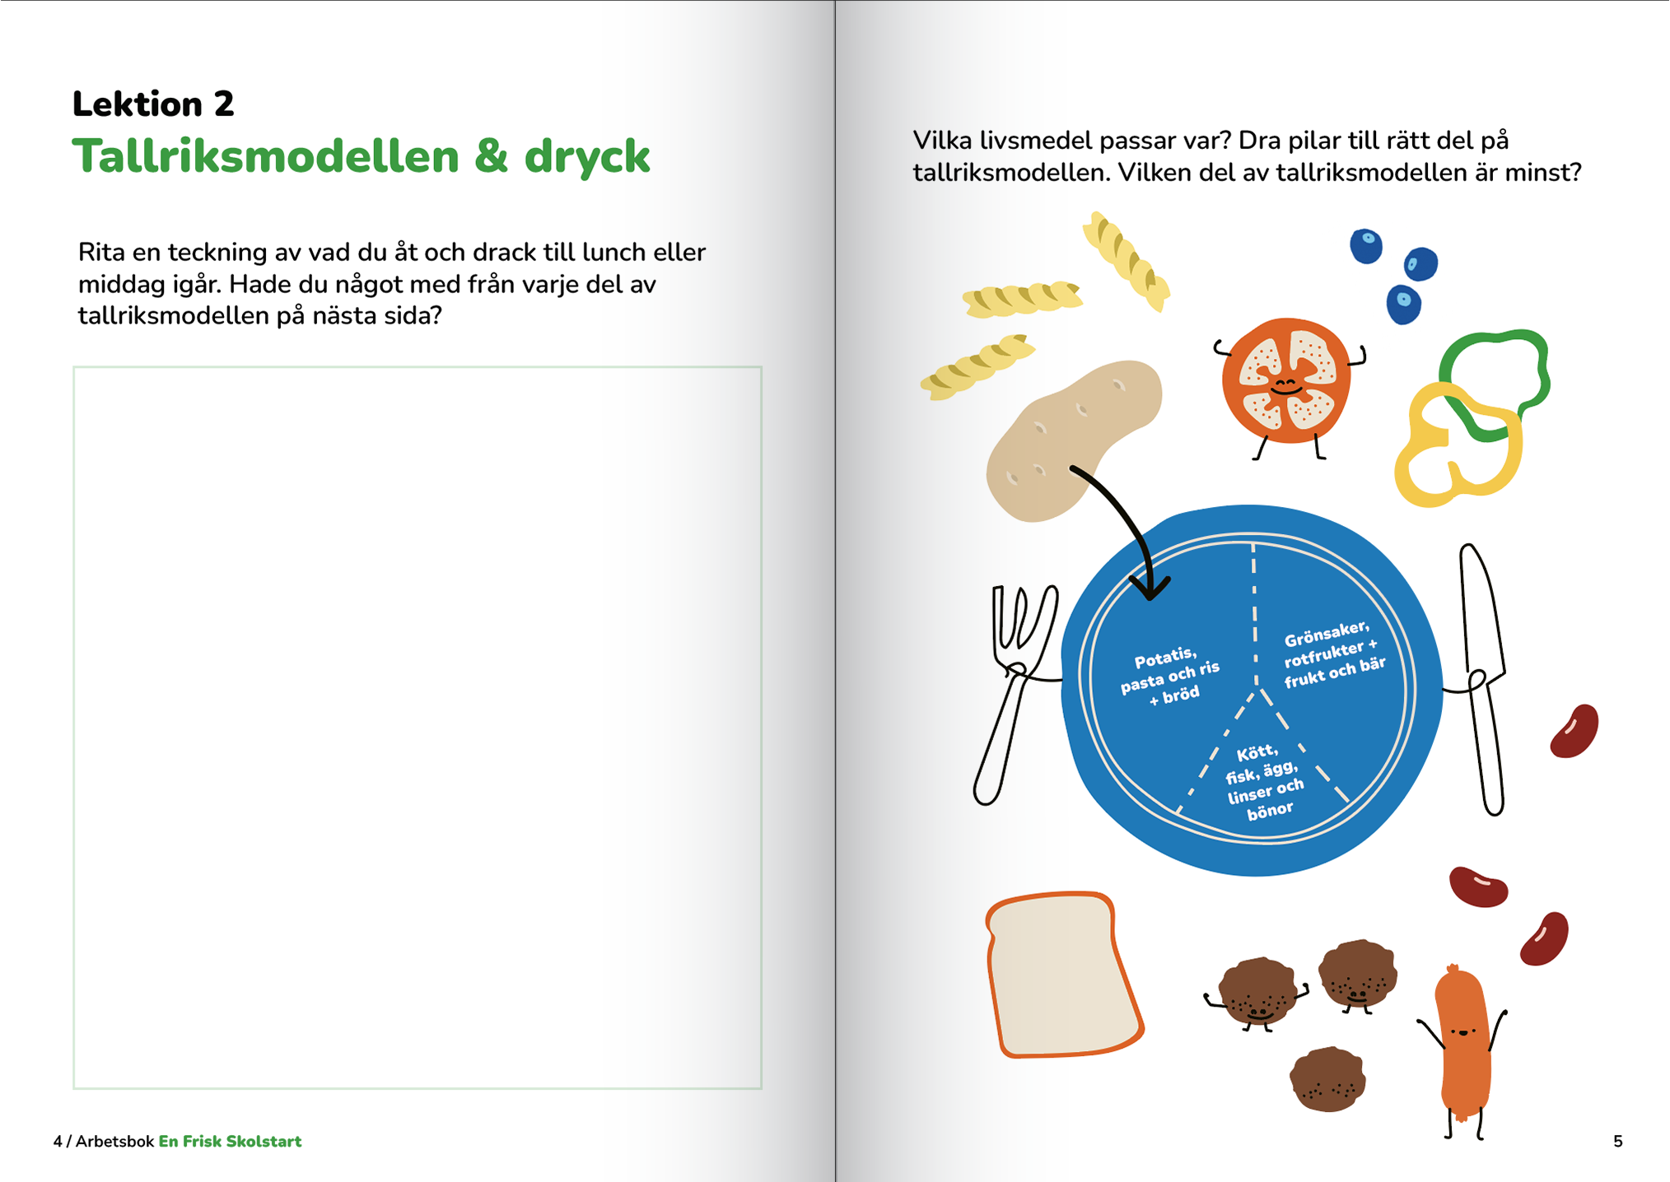



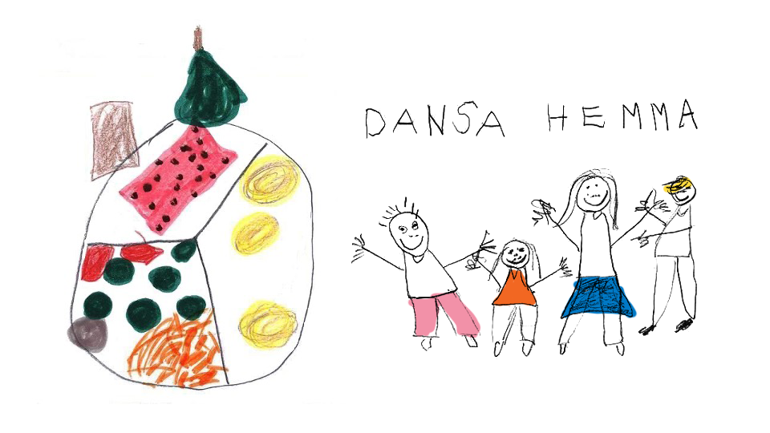
Fidelity to the HSS components
 | Year 1 |  | Year 2
 | Basic | Enhanced | Basic | Enhanced
Read brochure | 52% | 61% | 55% | 55%
Health Talk | 63% | 67% | 76% | 79%
Classroom | 100% | 100% | 100% | 100%
T2D Risktest | 56% | 63% | 63% | 64%
Parents born in the Nordic region had 2x higher adherence to MI.
En introduktion till En frisk skolstart / Namn på den som föreläser
Notes:
Brochure: Slightly higher adherence for the “Enhanced” group at the end of year 1 – but this difference disappeared during the second year
Adherence to MI improved in both groups from year 1 to year 2Parents born in the Nordic region had 2x higher adherence to MI
All classes had 100% compliance with classroom activities! – now one could have argued that this was not the most interesting way to measure this component. But we felt it would have been challenging to assess each homework assignment for each lesson

Slide 46
Fidelity score for 4 components
~ 75% of components implemented
Small difference in year 1 – but disappeared after 2 years of implementation
No significant difference after 2 years
Notes:
You see a difference in the first year between the groups – but when you dig a little deeper you see that the difference is caused by the difference in adherence scores between parents born outside the Nordic region compared to the groups. – not the different implementation bundles
One of our most important conclusions is that the program improves after one year. The extra support may make it a little easier for group 2 – but by the end of the second year both groups are at the same level.

Slide 47
Fidelity to Basic implementation strategies yr 1 & 2
Year 1
Year 2
Good implementation for all schools
 | Group 1 | Group 2
Year 1 | 15.3 | 16
Year 2 | 13.1 | 13.8
* out of 18

Slide 48
Fidelity to Enhanced Implementation Strategies – Group 2 Schools
"Coaching" and “Feedback" worked well after we shifted from the forums to 1:1 meetings
"Conduct educational outreach visits" and "Promote network weaving" did not work
2 out of 4 strategies worked well
 | Year 1 | Year 2
Group 2 | 1.3 | 2.7
* out of 5
Notes:
- Nämn kortfattat

Slide 49





Key takeaways
Adherence
High and stable adherence across the groups over two years
Support
External coaching mostly useful the first year
Equity
Appreciation
High program value reported by parents across all area
MI uptake improved but lower among non-Nordic born parents
Motivation
More tailored efforts needed to engage parents from non-Nordic backgrounds

Slide 50
Acknowledgments
Professor Liselotte Schäfer Elinder, Principal Investigator
Mr. Jhon Álvarez Ahlgren
Associate Professor Emma Patterson
Associate Professor Susanne Andermo
Associate Professor Åsa Norman
Dr. Sara Raposo
Associate Professor Lydia Kwak
All study participants – Parents, School personnel and children

Slide 51

A Healthy School Start program site
The program is described on the website, www.ki.se/gph/forskning/en-frisk-skolstart, where all material is available and can be downloaded.

Slide 53
THANK YOU!
Questions & Discussion
Presentation 1: Maria Fagerström
Presentation 2: Jane Lewis
Presentation 3: Andreas Rödlund
Presentation 4: Kristi Sidney Annerstedt
Session host: Sylwia Kazmierczak-Murray
Thought-provoking presentations and interesting insights?
Spread the word and let us follow along by using #EIE2025!

