Slide 1
Professionalising Implementation Science and Implementation (Support) Practice: Do we need practice standards? A European Debate.
European Implementation Event 2025

Slide 2


Slide 3

Full name of the network: UK Implementation Society
Acronym: UK-IS
Year of establishment: 2017
Estimated number of members: 50
Aimed at: Scientists and practitioners

Slide 4

Full name of the network: Implementierungs-Netzwerk für Forschung und Praxis
Acronym: INFo↔P
Year of establishment: 2017
Estimated number of members: 170
Aimed at: Scientists and practitioners

Slide 5
Full name of the network: Belgian Implementation Collaborative
Acronym: BIC
Year of establishment: 2025
Estimated number of members: 7
Aimed at: Scientists, practitioners and patients

Slide 6

Full name of the network: Swiss Implementation Science Network
Acronym: IMPACT
Year of establishment: 2019
Estimated number of members: 20 core group members, 13 supporting institutions
Aimed at: Scientists and practitioners

Slide 7

Full name of the network: Netherlands Implementation Collaborative
Acronym: NIC
Year of establishment: 2014
Estimated number of members: 170
Aimed at: Scientists and practitioners

Slide 8
Discussants & Main question
Sven Geelen, The Netherlands Implementation Collaborative (NIC)
Tom Jefford, UK Implementation Society
Rahel Naef, Swiss Implementation Science Network (IMPACT)
Marie-Therese Schultes, Implementierungsnetzwerk für Forschung & Praxis (INFo↔P)
Ashley Boers and Nathalie Pauwen, Belgium Implementation Network
Should the (inter)national implementation science and practice community work to establish professional associations and (if yes) what should these associations encompass?

Slide 9
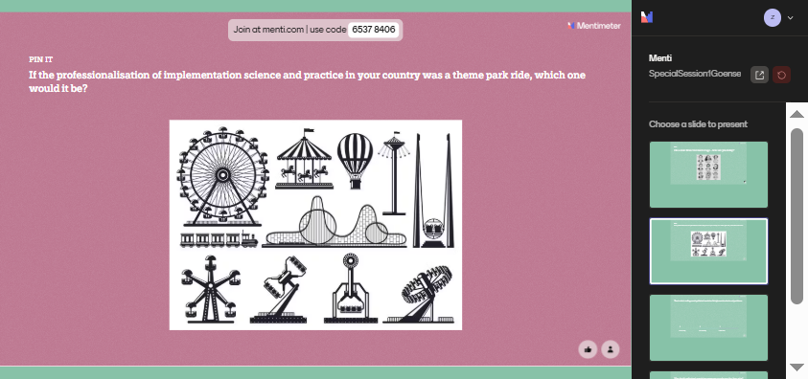

Slide 10


Slide 11
Discussants & Main question
Sven Geelen, The Netherlands Implementation Collaborative (NIC)
Tom Jefford, UK Implementation Society
Rahel Naef, Swiss Implementation Science Network (IMPACT)
Marie-Therese Schultes, Implementierungsnetzwerk für Forschung & Praxis (INFo↔P)
Ashley Boers and Nathalie Pauwen, Belgium Implementation Network
Should the (inter)national implementation science and practice community work to establish professional associations and (if yes) what should these associations encompass?

Slide 13
Discussants & Main question
Sven Geelen, The Netherlands Implementation Collaborative (NIC)
Tom Jefford, UK Implementation Society
Rahel Naef, Swiss Implementation Science Network (IMPACT)
Marie-Therese Schultes, Implementierungsnetzwerk für Forschung & Praxis (INFo↔P)
Ashley Boers and Nathalie Pauwen, Belgium Implementation Network
Should the (inter)national implementation science and practice community work to establish professional associations and (if yes) what should these associations encompass?

Slide 14

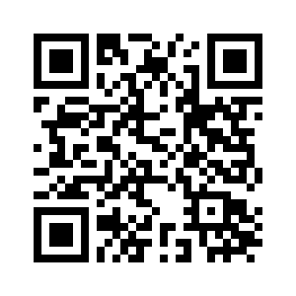
4th Swiss Implementation Science Conference
True IMPACT – providing innovation for patients and the public
12–13 February 2026
Abstract submission is open (until 1st. Sept)
Early Bird registration is available
Keynote speakers:
Prof. Roman Kislov, Professor of Health Policy and Management, Manchester Metropolitan University Prof. Catherine Decouttere, Director at Access-To-Medicines Research Centre, Director at KU Leuven One Health Institute Dr. David Chambers, Deputy Director for Implementation Science, NCI US

