Slide 1
‘Hard to reach? How hard are you trying?
An interactive workshop that will explore co-production in PPI that is inclusive, and results in real changes’
Sandra Atkinson NIHR ARC NENC Public Advisory Network, RDN Research Champion, Involved and Equal CIC
Ian Atkinson NIHR ARC NENC Public Advisory Network, RDN Research Champion, Involved and Equal CIC
Chris Lloyd NIHR ARC NENC Public Advisory Network, RDN Research Champion

Slide 2
Acronyms
ARC = Applied Research Collaboration
NENC = North East and North Cumbria
PICE = Public Involvement Community Engagement
PPI = Patient Public Involvement
CVS = Community and Voluntary Sector
VCSE = Voluntary, Community and Social Enterprise
VONNE =Voluntary Organisation Network North East
Introduction

Slide 3
Introduction
Definitions
Public involvement in research is defined as research being carried out ‘with’ or ‘by’ members of the public rather than ‘to’, ‘about’ or ‘for’ them, and uses the following terms to distinguish between the different activities:
Involvement – where members of the public are actively involved in research projects and in research organisations.
Participation – where people take part in a research study.
Engagement – where information and knowledge about research is provided and disseminated. (www.invo.org.uk)

Slide 4
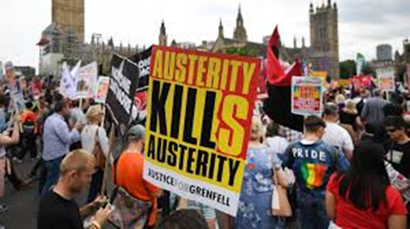
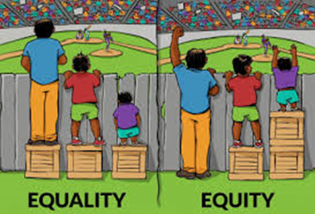




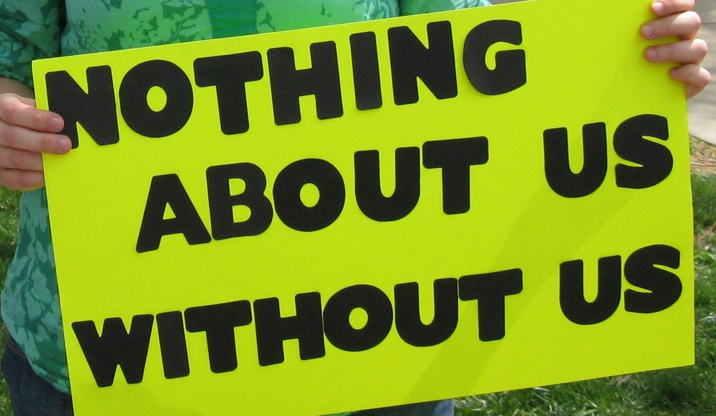


Introduction
PICE is a social justice issue

Slide 5
“Where access and support needs are met, service users are more than capable of being involved ‘from the start’ to meaningfully contribute to planning.
Surely, it is also disrespectful to ask service users to contribute when a plan of action has already been crafted and decided upon without their involvement.”
Duffy et al (2022)
Introduction
Duffy, J., Cameron, C., Casey, H., Beresford, P., McLaughlin, H. (2022), Service User Involvement and COVID-19 – An Afterthought?, British Journal of Social Work 52 2384-2402

Slide 6
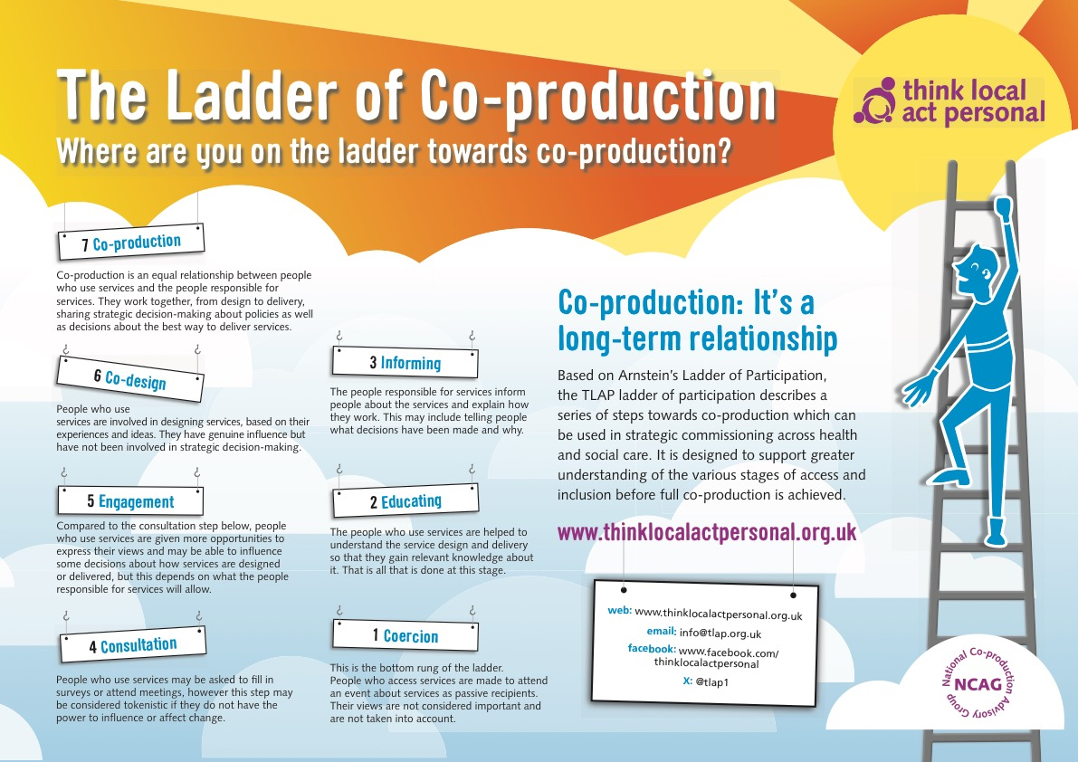
Introduction

Slide 7
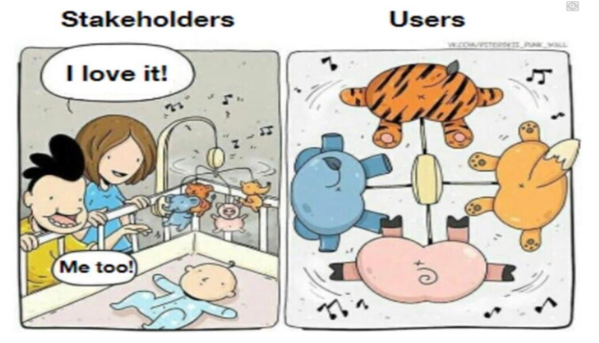
Co-production Insight
Introduction

Slide 8
Hard to reach Communities and Groups
Discuss and feedback
What are the issues you have with reaching Communities and Groups?
Why are some groups hard to reach? How hard do you try to reach them?

Slide 9
Hard to reach Communities and Groups
It’s common for certain communities to be labelled as being ‘hard to reach’.
But communities are only ‘hard to reach’ if we fail to reach out and engage with them.
In fact, rather than being ‘hard to reach’, many communities are ‘hardly reached’. It is surely part of our role as academics to tackle inequalities by helping to raise the voices of these groups.
How can we do this? Much of it is about building trust and expectations, so it’s important we allow ourselves the time to develop meaningful, sustainable relationships.
By facilitating opportunities for engagement, communities can become part of the research process rather than simply being targets of research. Having meaningful relationships also helps ensure that academics have evidence for the claims they make, and that they are up to date with relevant issues when asked to speak about the communities they research.
The most fruitful relationships develop when both parties have properly considered why they wish to engage.
Dr Jasit Singh
https://spotlight.leeds.ac.uk/world-changers/empowering-communities/

Slide 10
Hard to reach Communities and Groups
Voluntary Organisation Network North East (VONNE)
Voluntary, Community and Social Enterprise (VCSE) Research Partnerships support at VONNE aims to provide a single point of contact for researchers and VCSE organisations who are interested in collaborating on health and care-focussed research.
Drawing on insights from partners and people in the VCSE and research sectors, our Research Partnerships work focuses on:
Supporting partners to connect and develop ways of working together based on reciprocity and sustainability.
Building capacity for partnerships by developing shared expectations and enhancing skills and knowledge.
Oversight and strategic direction for this work is provided by a steering group with representation from funding NIHR organisations funding the role, VONNE and Cumbria Community and Voluntary Sector (CVS). A working group including representatives from the Creating Connections Network meet bi-monthly to provide guidance on the delivery of programme activities.

Slide 11
Plan to Succeed
Discuss and feedback
Could you share with us information about a research programme did not go to plan?
Based on co-production and design, what could you do differently?

Slide 12
Plan to Succeed
Coproduction- Bristol YPAG
The voluntary sector Trauma and Stigma issues – Baby deaths? (page 7 of report)
The Peer Researchers Backpack
1
https://arc-w.nihr.ac.uk/news/new-diagram-explains-how-young-people-can-get-involved-in-research/
https://healthwatchcumberland.co.uk/wp-content/uploads/2025/01/Lived-Experience-Network-Event-Report.pdf
2
https://arc-nenc.nihr.ac.uk/resources/the-peer-researchers-backpack/
3

Slide 13
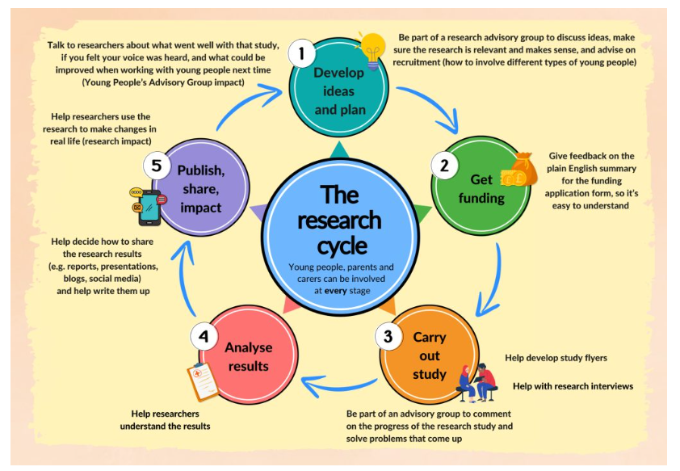
Plan to Succeed – Bristol YPAG

Slide 14
Plan to Succeed
Planning –
At bid writing stage and throughout:
Costs for involvement
Plan time for the unplanned
Plan for time to get to know your community or group and build relationships
Remember, the research or implementation may not go how you thought it might but by involving the end users, you are more likely to be most effective to the end users of a service

Slide 15
Good Public Involvement in Research
Discuss and feedback
What is good Public Involvement in research?

Slide 16
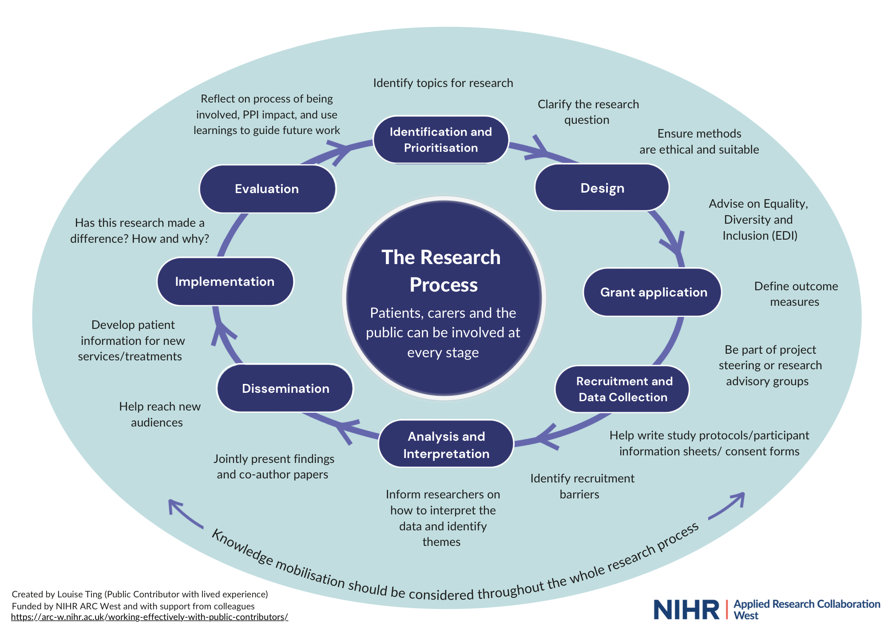
The Research cycle: More examples…
The potential reach of public collaboration throughout the Cycle

Slide 17
Good Public Involvement in Research
PPI is crucial to effective research. Sarah Biggs, highlights where public contributors can add value to the research process. As she explains
“One of the main advantages of engaging with public contributors is that they are not entirely focussed on the academic research process, so they have a complementary perspective that helps improve the quality of health and social care research. They want to understand how such research might benefit patients and society at large, as well as represent value for money. They are particularly keen to see good research outcomes implemented and this should form part of your early discussions with them.”

Slide 18
Remember!
Co-production or Bums and Feet

Slide 19
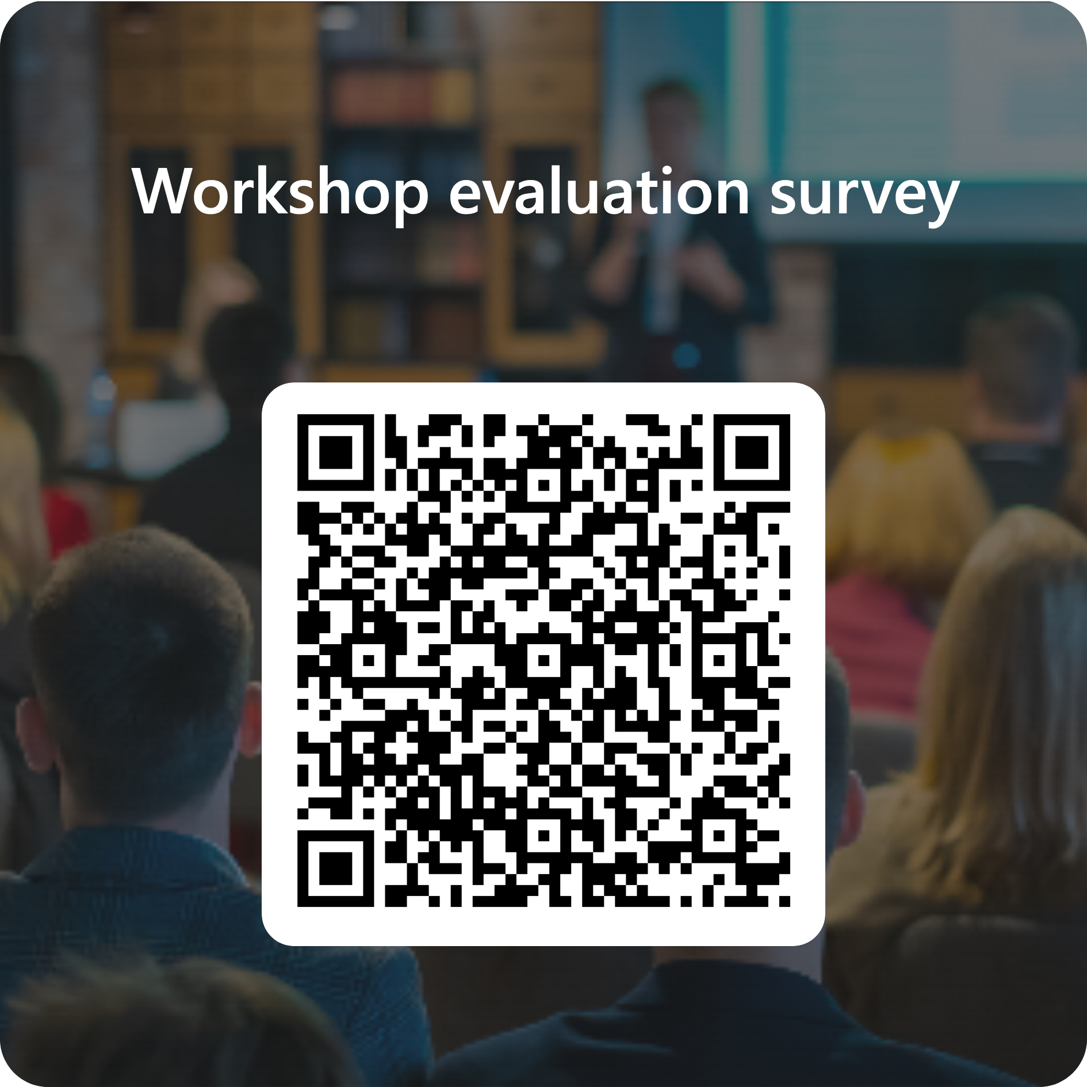

Thank You and enjoy the rest of your conference
Sandra Atkinson Pebbles0906@gmail.com
Ian Atkinson Ian.Involvedandequal@gmail.com
Chris Lloyd chris.lloydadvisory@gmail.com

Slide 20
Co-Production
‘It's about power sharing for me. One of the main things about co- production is realising who has the power and how you share it, and what that actually means’.
‘The thing about co-production is about being with people, where they're at, and asking them what the issues are, and seeing it through their eyes’
The Co-Production Collective website is an excellent entry point for exploring co-production, including:
toolkits, guidance and advice about evaluation and evidence gathering
https://www.coproductioncollective.co.uk/

Slide 21
Hard to reach Communities and Groups
Mend the Gap
The gap mending approach originated at Lund University in Sweden in 2005; it was then taken up by Lillehammer University Norway 2009, and in 2012 a partnership with Shaping Our Lives (UK) was established as a new international network called PowerUs. (McLaughlin et al, 2020)
The Mend the Gap Project for Gateshead was put together by Empowerment Consultancy and Training in partnership with Power Us, the Open University and funded by the North East Social Work Alliance (NESWA).
The purpose of the Gateshead Project was to identify gaps and barriers facing disabled people when it comes to accessing Social Support Services.
The group was made up of disabled service users, Personal Assistants and family carers, Practising Social Workers and Social Work Students.
The group met for a total of 8 meetings each Friday with agendas that were agreed by the disabled service users.

Slide 22
Good Public Involvement in Research
What do you think?
Big Question – Is Research for Science or for the public good?
The counter view – what does the public, Voluntary Sector want?
The Fidelity Adaptation Dilemma – If Involved throughout research process, perhaps this dilemma would appear less often
  Make a difference
    Quick Wins
    Kept informed during the project
    Co-Production in dissemination
    Co-Production in Implementation

