Slide 1

Living labs implementing medication adherence interventions
Results and future challenges
Medication Adherence Knowledge, Expertise and Implementation Taskforce
Caroline van de Steeg, Marcia Vervloet, Liset van Dijk

Slide 2
Today’s agenda
Make-It, the context
Lost in translation: science versus practice of implementation strategies
RE-AIM outcomes of four living labs
Scalability of medication adherence interventions

Slide 3
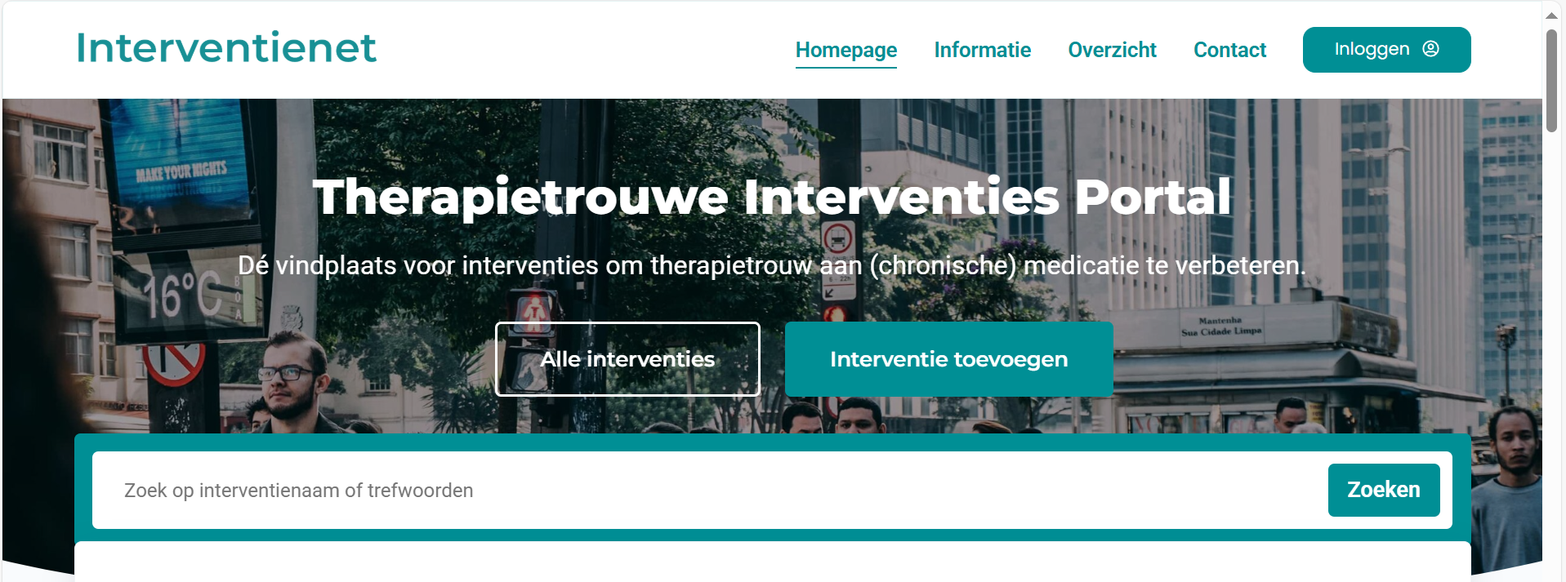
Medication adherence
Long lasting problem with impact on health and health care
Numerous interventions developed and tested : from simple one-element to complex multicomponent

Slide 4

Why a living lab study?
Few interventions are brought to the usual care setting:
Interventions tested in controlled settings are sometimes too complex and expensive
Too little attention is paid to implementation and sustainability in usual care

Slide 5
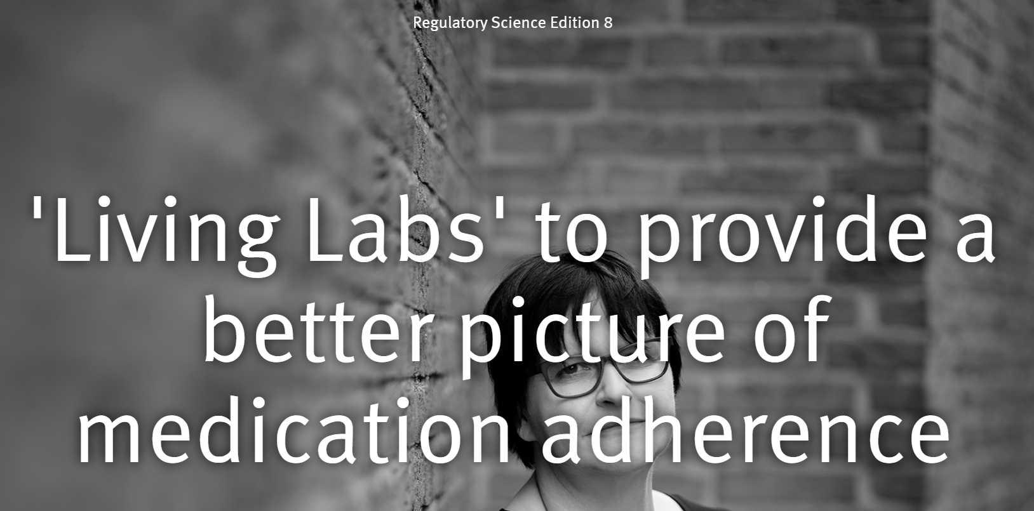
Living Labs adherence
(National) implementation program for medication adherence
8 living labs
1 knowledge consortium
Living labs: an open innovation ecosystem based on a systematic user co-creation approach, integrating research and innovation processes in real-life communities and settings
The real-life environment is needed for innovative solutions that can survive in the complexities of real life

Slide 6










Current Make-it consortium members
Liset van Dijk, Marcia Vervloet
Marle Gemmeke
Rob Heerdink, Ruby Janssen
Jacqueline Hugtenburg
Charlotte Bekker, Bart van den Bemt, Mirthe Oude Lansink
Menno van Woerkom
Caroline van de Steeg
Funded by

Slide 7

Idea behind the living lab program
Phased introduction (2x4 local settings – living labs – “try-out garden” )
  First four: frontrunners to learn from
  Second four: not necessarily frontrunners, to learn to
Living labs implemented existing, tested interventions
Multidisciplinary local settings
After 2x4 -> broader roll out (new program starts in 2025)
Guidance by a knowledge consortium

Slide 8
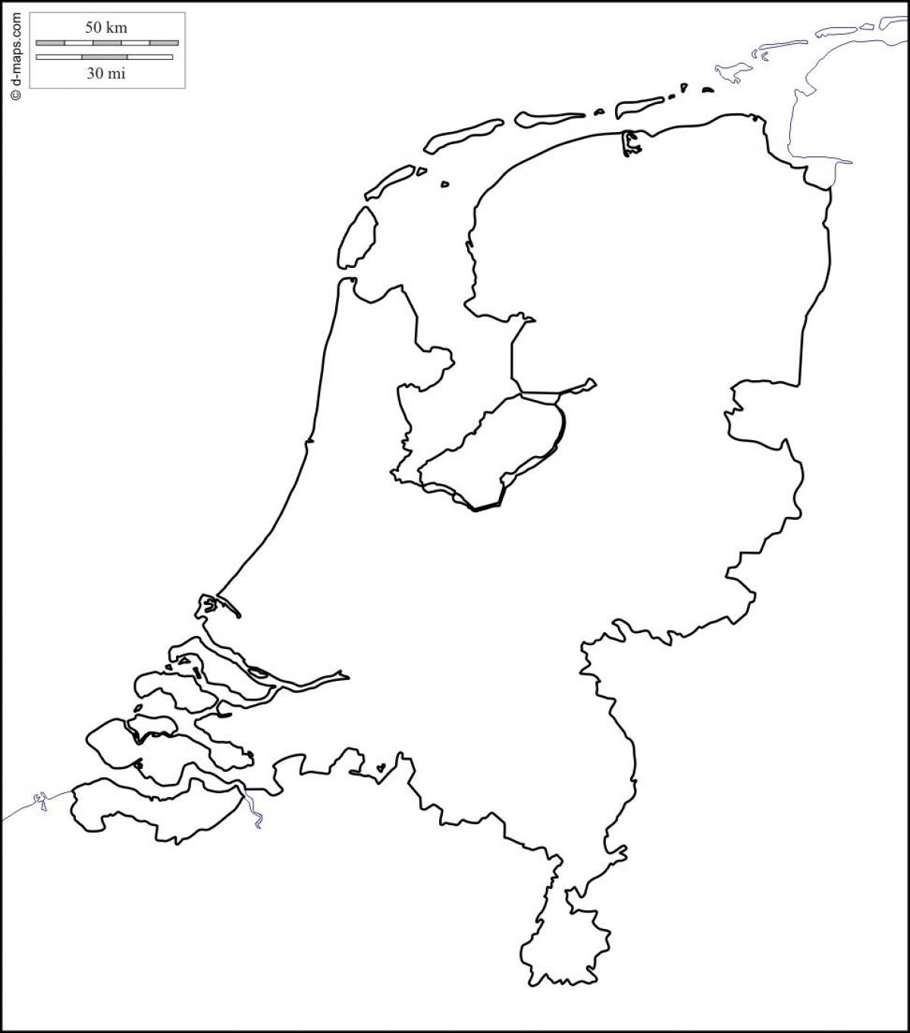
Aim for living labs
To implement and sustain medication adherence previously tested interventions (interventienet.nl) in the ambulant care sector for patients who live at home
To evaluate their own living lab results
To contribute to dissemination of the results to other settings
Friesland
Almere
Amsterdam
Amersfoort
Utrecht
Leiden/Vleuten
Noord-Limburg
Curaçao/Aruba

Slide 9
Follow the leader!
Outcomes of living labs implementing adherence interventions in the Netherlands: a mixed method study using RE-AIM
Medication Adherence Knowledge, Expertise and Implementation Taskforce
Marcia Vervloet

Slide 10

Evaluation of the implementation
To gain insight into the implementation outcomes of the four pharmacy-driven living labs implementing medication adherence interventions
To identify barriers & facilitators that occurred during implementation
Overarching evaluation

Slide 11
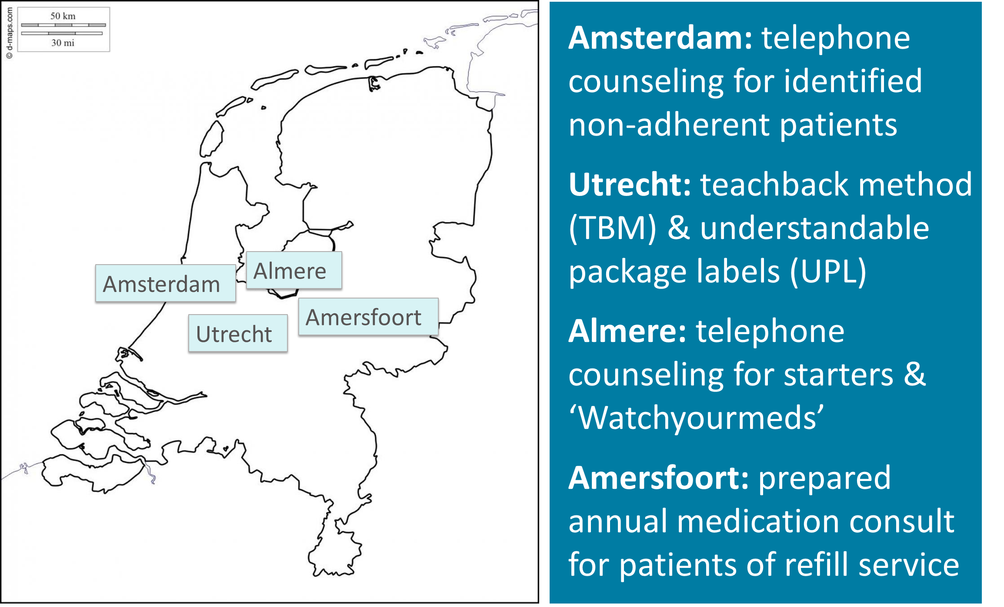

Living labs implementing consultation-based interventions

Slide 12



mixed method Data collection
In-depth interviews with project leaders
Minutes of monthly meetings Make-it and individual lab Minutes of 6-weekly reflection meetings all living labs together
Documentation generated in living labs (e.g. master theses)
Final reports handed in to grant provider

Slide 13


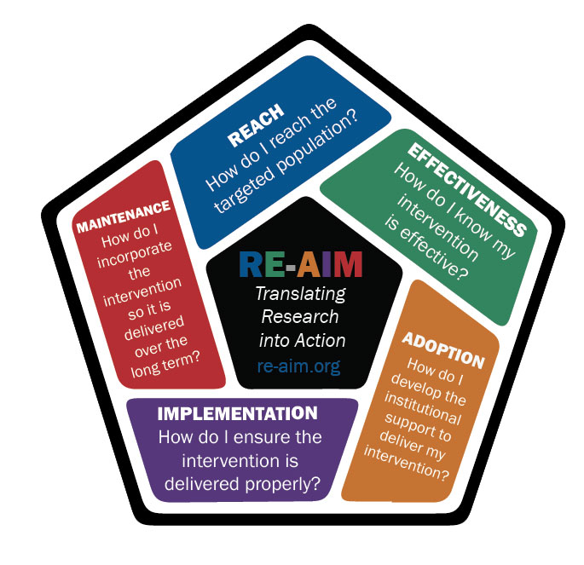
Data analyses
Interviews transcribed and coded individually by two researchers. Deductive thematic analyses.
All documentation scanned and relevant data extracted per living lab
Data extraction and analyses guided by RE-AIM framework (Glasgow 1999)

Slide 14
Implementation outcomes
REACH
All but one living lab reached (more than) target number of patients
Living lab | Patients # reached (# target)
Amsterdam | 522 (500)
Utrecht | 67% (40%) TBM 88% (90%) UPL
Almere | 743 (400)
Amersfoort | 3000 (5400)

Slide 15
Implementation outcomes
ADOPTION
Very high adoption of interventions by all pharmacies
Living lab | Pharmacies # reached (# target)
Amsterdam | 6 (6)
Utrecht | 2 (2)
Almere | 14 (14)
Amersfoort | 3 (3)
But amongst general practitioners adoption was low

Slide 16
Implementation outcomes
EFFECTIVENESS
Medication adherence improved in 1 living lab
Patient-level:
  Higher patient satisfaction (interventions appreciated)
  Early detection of problems or misunderstandings in medication use
Pharmacy team level:
  Higher job satisfaction
  Enriched their work
Overall:
  Better contact between patient and pharmacy team
  Stronger patient – pharmacy relation

Slide 17
Implementation outcomes
IMPLEMENTATION
High fidelity in all living labs
Adequate communication training
Use of protocols
Start with pioneers (enthusiastic pharmacist / pharmacy technicians)
Regular meetings organised by projectleader
Adaptations made (allowed) to align with local context

Slide 18
Implementation outcomes
MAINTENANCE
All labs intention to maintain intervention, but…
… only 1 eventually did integrate intervention in daily practice
How?
Reorganisation of workflow in the pharmacy

Slide 19


Barriers & facilitators
Passionate projectleader (champion)
Adequate training for pharmacy team
Strong leaderschip
No reimbursement for care provided
Create support, motivation of team
Insufficient integration in daily workflow
Start small, short-cycle evaluations, scale up
Lack of resources (time, capacity)
Resistance to changing way of working
Inadequate integration ICT

Slide 20
discussion
Implementation of adherence interventions in primary care can be successful but requires large investment to create support amongst all involved.
We would like to discuss leadership as a crucial factor for successful implementation: how to ensure good implementation leadership?

Slide 21
Lost in translation
Implementation strategies: challenges at the intersection of science and practice
Medication Adherence Knowledge, Expertise and Implementation Taskforce
Caroline van de Steeg

Slide 22
ERIC¹-Implementation strategies in round 1 living labs
Living lab | # different strategies used
Almere | 22
Amersfoort | 21
Amsterdam | 31
Utrecht | 20
All living labs | 41
Build a coalition
Inform local opinion leaders
Assess for readiness and identify B&F
Work with educational institutions
Develop educational materials
Use an implementation advisor
Centralize technical assistance
Audit and provide feedback
Used by # living labs | # different strategies (of 59)
0 | 18
1 | 14
2 | 9
3 | 10
4 | 8
¹ Powell et al. Implementation Science (2015) 10:21
DOI 10.1186/s13012-015-0209-1

Slide 23
Goal & Method to operationalize 8 strategies in round 2
Instructions to project leaders of living labs:
  At start: incorporate 8 strategies into your project
  Workshop during implementation phase based on Proctor et al.*:
    Name and definition of strategies were given in a workbook
    Instruction: operationalize the 8 strategies as used in living lab:
      Actor
      Action
      Target for action
      Temporality
      Dose
      Implementation outcome affected
      Justification
* Proctor EK, Powell BJ, McMillen JC. Implementation strategies: recommendations for specifying and reporting. Implement Sci. 2013 Dec 1;8:139. doi: 10.1186/1748-5908-8-139. PMID: 24289295; PMCID: PMC3882890.

Slide 24
Results round 2
Different interpretation of names and definitions according to ERIC, e.g. Work with educational institutions
In actions, strategies were often combined, e.g.
  Build a coalition + Involve executive boards + Use advisory boards and workgroups + Assess for readiness and identify barriers and facilitators
  Inform local opinion leaders + Conduct educational meetings + Conduct local consensus discussions
  Conduct educational meetings + Develop educational materials + Distribute educational materials + Organize clinician implementation team meetings + Capture and share local knowledge + Create a learning collaborative → Make training dynamic
  Audit and provide feedback + Organize clinician implementation team meetings + Create a learning collaborative

Slide 25
Results round 2
Partial agreement with clusters of strategies in [1]:
  Build a coalition + Involve executive boards + Use advisory boards and workgroups + Assess for readiness and identify barriers and facilitators
  Inform local opinion leaders + Conduct educational meetings + Conduct local consensus discussions
  Conduct educational meetings + Develop educational materials + Distribute educational materials + Organize clinician implementation team meetings + Capture and share local knowledge + Create a learning collaborative → Make training dynamic
  Audit and provide feedback + Organize clinician implementation team meetings + Create a learning collaborative
Develop stakeholder interrelationships
Train and educate stakeholders
Use evaluative and iterative strategies
[1] Waltz, T.J., Powell, B.J., Matthieu, M.M. et al. Use of concept mapping to characterize relationships among implementation strategies and assess their feasibility and importance: results from the Expert Recommendations for Implementing Change (ERIC) study. Implementation Sci 10, 109 (2015). https://doi.org/10.1186/s13012-015-0295-0

Slide 26
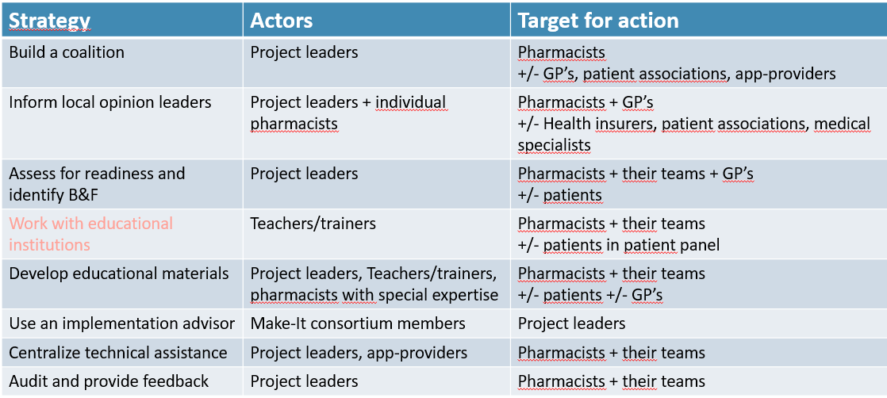
Results round 2

Slide 27
Results round 2
Strategy | Action(s)
Build a coalition | Establishing and maintaining contacts, making cooperation agreements
Inform local opinion leaders | Informing stakeholders during regular and special meetings, +/- by telephone or news letters
Assess for readiness and identify B&F | Inventory during team meetings, prospective risk inventory, questionnaires
Work with educational institutions | Educational meetings
Develop educational materials | Presentations, conversation guide, work instructions, knowledge quiz, case descriptions, e-learning, news letters
Use an implementation advisor | Workshop on implementation strategies, monthly monitoring & evaluation meetings Make-It consortium
Centralize technical assistance | Helpdesk, automating the logistics process, setting the technical settings, environment for intervention registration
Audit and provide feedback | Benchmark of intervention registration and discussing them during reflection meetings

Slide 28
Results round 2
Strategy | Temporality (# living labs) | Dose
Build a coalition | From beginning to end (4) | Difficult to specify
Inform local opinion leaders | Exploratory + preparatory phase (4), +/- implementation (2) + sustainment (1) | Exploration + preparation ± 8h Implementation ± 15-60 minutes/living lab
Assess for readiness and identify B&F | Exploratory + preparatory phase (3) + implementation phase (4) +/- sustainment (3) | Exploration + preparation between 30 minutes once and 28x 1h
Work with educational institutions | Preparatory phase (3/3), +/- implementation phase (2/3) | 1-4 meetings of 1-3 hrs per target group
Develop educational materials | preparatory + implementation phase (4) | Difficult to specify
Use an implementation advisor | Exploratory phase (3) + preparatory + implementation phase (4) +/- sustainment (3) | Half-day workshop, monthly 1h monitoring & evaluation meetings LL + Make-It, monthly 1,5hrs monitoring & evaluation meetings between LL’s + Make-It
Centralize technical assistance | Exploratory phase (1) + preparatory phase (4) +/- implementation phase (3) +/- sustainment (2) | Difficult to specify
Audit and provide feedback | Preparatory (1) + implementation phase (4) | Benchmark feedback: each week/month/3 months Audit meetings: 1h/month, several one-time evaluations
Notes:
Audit: ook video-opnamen + zelfevaluatie, feedback aan patiënten gevraagd, cliëntenpanel

Slide 29
Results round 2
Strategy | Outcome to be affected |  |  |  |  | Justification
 | Adopt | Impl | Reach | Effect | Sust
Build a coalition | 3 | 2 | 1 | 2 | 2 | Mainly: example previous living labs and advice Make-It Also: own experiences, B&F’s other projects, brainstorming, pragmatic considerations Less: theory, literature search by themselves
Inform local opinion leaders | 4 | 1 | 2 | 1 | 2
Assess for readiness and identify B&F | 4 | 3 | 2 | 1 | 1
Work with educational institutions | 2/4 | 2/4 | 2/4 | 4 | -
Develop educational materials | 2 | 4 | 3 | 2 | 1
Use an implementation advisor | 1 | 4 | 3 | 3 | 2
Centralize technical assistance | 1 | 4 | 1 | 1 | 1
Audit and provide feedback | 2 | 4 | 3 | 2 | 3
Notes:
Audit: ook video-opnamen + zelfevaluatie, feedback aan patiënten gevraagd, cliëntenpanel

Slide 30
conclusion & Discussion
Eight recommended strategies were successfully implemented
Large variation in operationalization
Translational difficulties from ERIC strategies to practice and reverse
QUESTIONS
What to consider when translating scientific knowledge to practice?
What tot consider when translating practice experience to science?

Slide 31
Scale up!
Evaluating the scalability of adherence interventions implemented in primary care real world settings in the Netherlands
Medication Adherence Knowledge, Expertise and Implementation Taskforce
Liset van Dijk

Slide 32
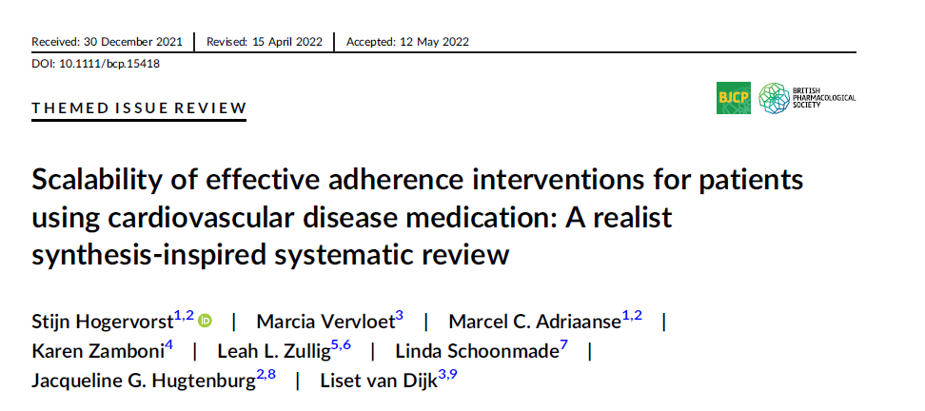
Scaling UP: an undocumented challenge
Review to assess which intervention aspects may be important for the scalability of effective CVD medication adherence interventions and how they are reported in effectiveness studies

Slide 33
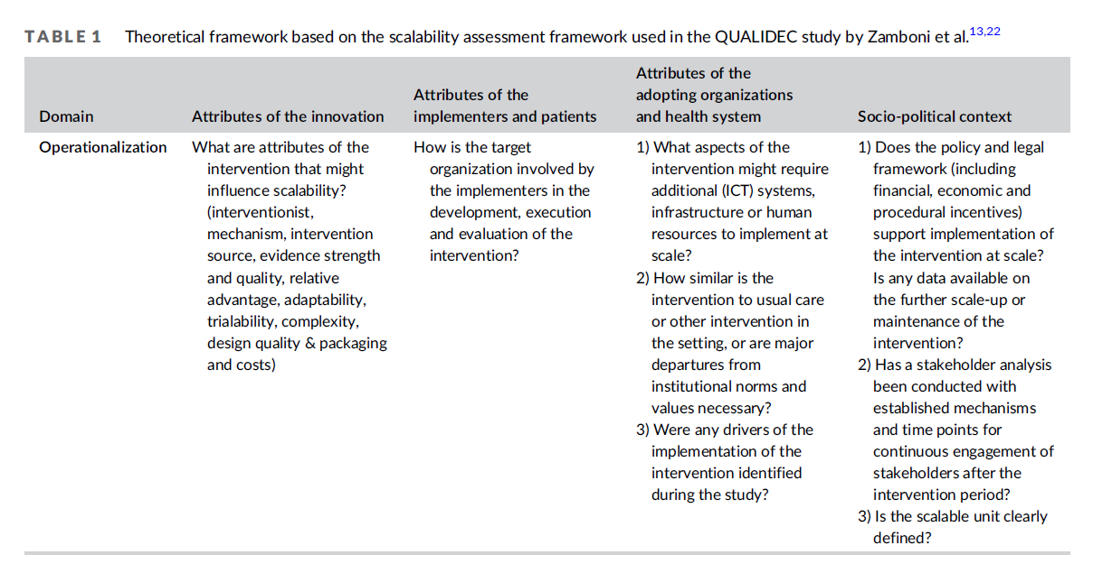
Scalability assessment framework - QUALIDEC study (Zamboni et al)
Initial theoretical framework with as domains: (1) attributes of the innovation, (2) attributes of the implementers, (3) attributes of the adopting organization and health system, and (4) socio-political context.
31 studies assessed

Slide 34
Six domains relevant for scaling up adherence interventions
complexity
training needed
customization
drivers of the intervention
technical level interventions
stakeholder involvement

Slide 35

Complexity: TRADE-OFF WITH SCALABILITY
Less complex interventions are often more scalable:
  easier to apply to different settings
  require fewer human resources.
Overall, less relative advantage over usual care.
Living labs:
selected interventions: not too complex, feasible to implement
effects found on adherence relatively small

Slide 36

Training
Training may be necessary for initial implementation of the intervention, but may have a negative impact on scalability.
A more extensive training might be necessary for implementation when the intervention consists of components not similar to usual care
Living labs:
Fairly intensive training, mainly to improve communication skills for mor intensive consultations - variation between living labs
Appreciation by participating healthcare providers
May be potential barrier when scaling up to less intrinsically driven settings

Slide 37

cUstomization of the intervention
Adapting the intervention to the needs and wishes of the healthcare providers involved increase satisfaction with the intervention
Offering to specific population may be beneficial
Living labs:
Round 1: adapted existing interventions to their situation
Round 2: adapted interventions from round 1 to their situation
Interventions proved to be adaptable
Choice for a specific population worked well

Slide 38

Drivers of the intervention
Drivers, such as policy-making organisations or professional bodies, play an important role in the process of scale-up.
They are important partners to build support with and
Can play a role in funding interventions and ensuring that interventions can continue after initial research funding ends.
Living labs:
Support among many organizations present
Financial driver is currently still lacking.
However, there see to come opportunities for reimbursement

Slide 39

TECHnical interventions
Technical interventions are often relatively simple (electronic reminders, online information)
Deployment requires relatively little manpower
However, they often require legal, policy or ICT adjustments, which might be a barrier at the start but once implemented can help with scaling up
Living labs
Caribbean living lab: translation of animation video library into Papiamento major adaptation that required investment, but can now be used by all local pharmacies

Slide 40

Stakeholder involvement
Different stakeholders play an important role in upscaling. Stakeholder analysis important
Creating support from the start is important
Information on strengths and limitations of intervention in specific setting, data on (cost) effectiveness and data on intervention use relevant for stakeholders to make decisions on upscaling.
Living labs
Did stakeholder analyses
Health insurers are not easy to involve

Slide 41
How did the livings labs do on scalability?
Domain | Scalability
Complexity: Relatively easy interventions | +
Training: intensive, well appreciated trainings | +/-
Customization: interventions that are well adaptable to the local context | +
Drivers of intervention: financial drivers are still lacking | -
Technical interventions: little technical interventions | NA
Stakeholder involvement: stakeholder analyses, support but health insurers hard to involve | +/-

Slide 42
First successes in upscaling
Annual medication consultation (AMC): annual consultation of about 15-20 minutes with (all) chronic medication users, proactive, to discover medication-related problems
Implemented in three living labs:
  Amersfoort: initiator
  Leiden/Vleuten
  Friesland
Over 6000 patients have received an AMC
Het Jaargesprek

Slide 43
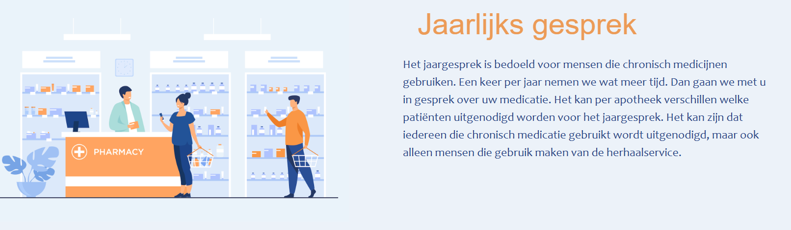
First successes in upscaling
Numerous other pharmacies are interested to implement/have started
Toolbox for upscaling (by the 3 living labs & Make-It representative)
The Ministry of health has asked KNMP to develop a manual
Reimbursement discussions are going on

Slide 44
Conclusion
Scalability of medication adherence interventions is a challenge
Still, step-by-step implementation programs like the (Make-It) living lab approach lay a ground for widescale implementation of relatively simple interventions

Slide 45
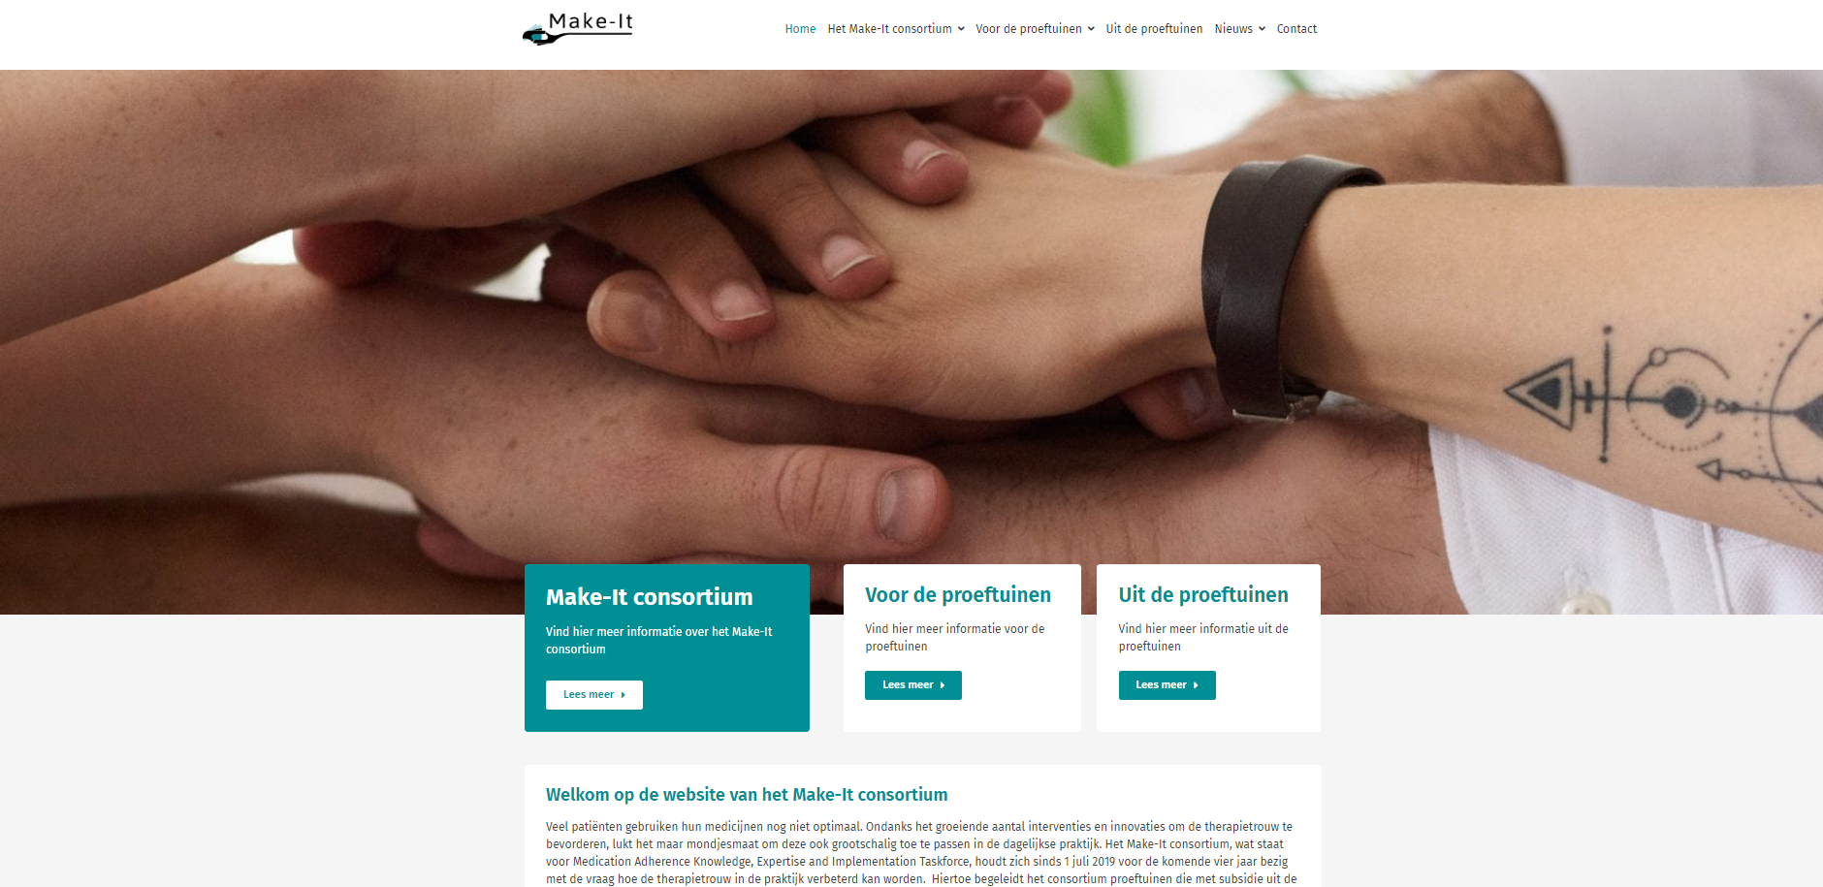
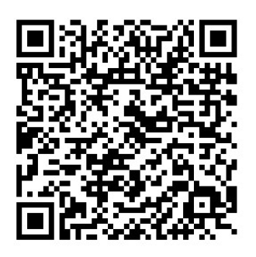
Contact: https://makeitconsortium.nl
Kennissynthese (Dutch)
m.vervloet@nivel.nl
c.vandesteeg@sirstevenshof.nl
l.vandijk@nivel.nl

