Slide 1



Anti-racist quality improvement in maternal care:
Adapting MUSIQ to embed anti-racist principles to evaluate maternal and neonatal care quality improvement projects in England
European Implementation Event 2025
Minara Chowdhury, Rob Lee, Helen Sheldon, Nandi Simpson, Andrew Walker

Slide 2

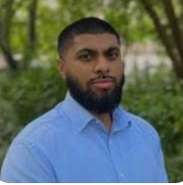





Who are we?
A collaborative partnership united by a shared commitment to equity, innovation, and improvement in health and care.
Presenting today
Nandi Simpson - NHS Race & Health Observatory
Minara Chowdhury - Institute Healthcare Improvement
Andrew Walker - Health Innovation Network South London
Helen Sheldon - Health Innovation Network South London
Robert Lee - Health Innovation Network South London
Lucy Goulding UCLP
Rohit Syed-Hasan UCLP
Kate Cheema UCLP
Tracy Bignall REF
Alima Ashfaq
Expert by Experience
Abigail Mensah
Expert by Experience

Slide 3

Purpose and format of the session
We aim to:
  Introduce the NHS Race and Health Observatory’s anti-racism principles and explore how these are being embedded in anti-racist initiatives within maternal care across England.
  Introduce MUSIQ and describe how it has been adapted to take an anti-racist lens.
  Seek your expertise to ensure anti-racism principles are embedded in MUSIQ to be an effective tool.
  Engage in a debate about anti-racist approaches in implementation and improvement science and practice.
We encourage you to interact with us and each other as much as possible.
There will be specific points in the session where we call on you to share your thoughts.

Slide 4
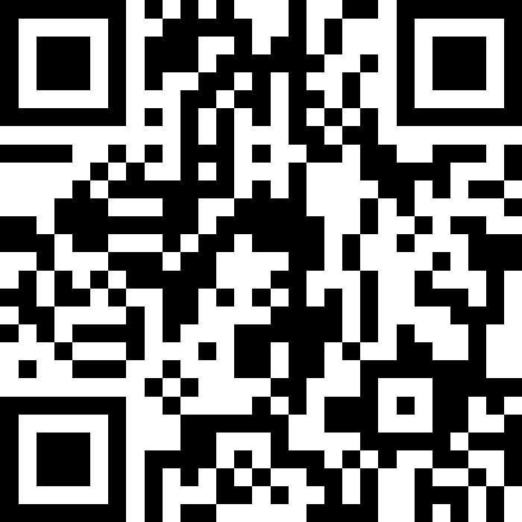
During the session you can comment and/or ask us a question via the chat function in Slido:
www.slido.com code: 3600895

Slide 5
The Race and Health Observatory Learning Action Network
and Anti-Racism Principles

Slide 6
RHO Learning and Action Network: purpose
WHY?
No large scale maternal and neonatal improvement programme has focused specifically on racial/ ethnic inequalities and there are evidence gaps around translatable interventions to reduce maternal and neonatal ethnic health inequalities
Racism is one of the factors that underlies the persistence of the maternal & neonatal ethnic health inequalities
We aim, through this programme, to:
develop an anti-racism focused QI approach, that supports practitioners to identify and address racism within maternity services;
Identify, scale and spread improvement approaches that embed anti-racism into services and improve maternal and neonatal health outcomes
WHAT?
HOW?
Notes:
Commissioned by NHS RHO in 2022
Aim: to map existing policy interventions designed to tackle ethnic health inequalities in England

Slide 7
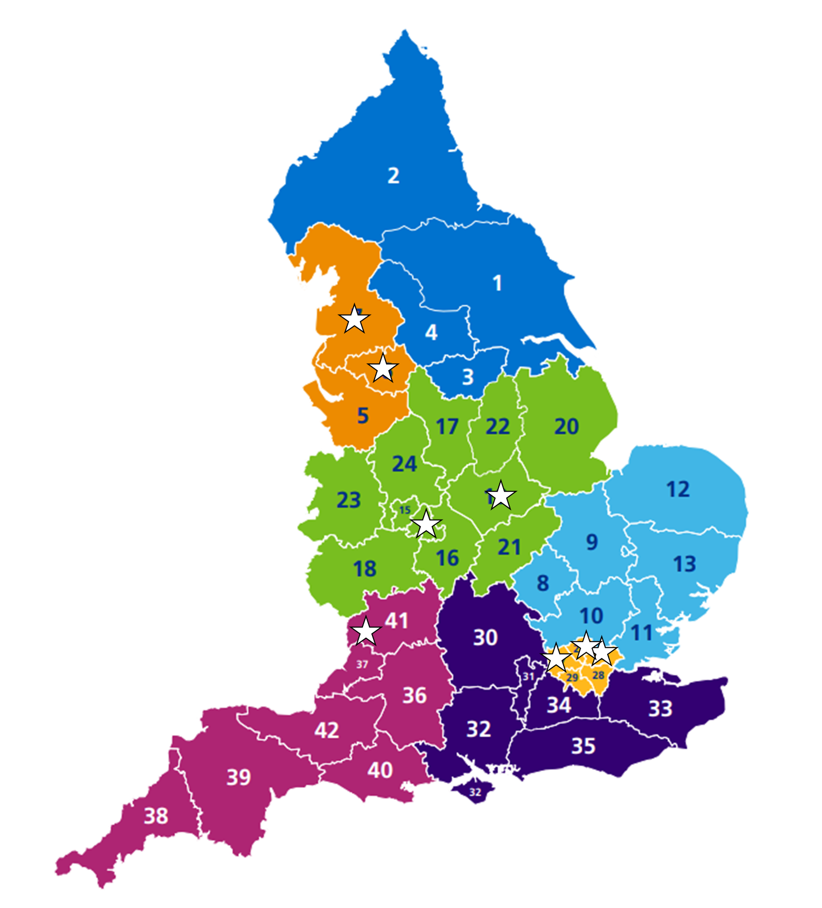
RHO Learning and Action Network: overview
10 Teams
8 Integrated Care Systems
4 Regions in England
4 Conditions:
  Post-partum Haemorrhage
  Gestational Diabetes
  Perinatal Mental Health
  Preterm Birth
14 months Jan 2024 – Mar 2025
1 Aim: To reduce clinically avoidable severe maternal morbidity, perinatal mortality and neonatal morbidity while improving the experience of care for pregnant women and people from Black, Asian and minority ethnic groups.

Slide 8
RHO Learning and Action Network anti-racism components
Focus on conditions where ethnic health inequalities are significant (proportionate universalism)
Embedding RHO anti-racism principles (racism as a determinant of health)
Testing anti-racism interventions as well as clinical interventions
Anti-racism webinars & clinical workshops – learning together
Contributing to evidence base through evaluation

Slide 9
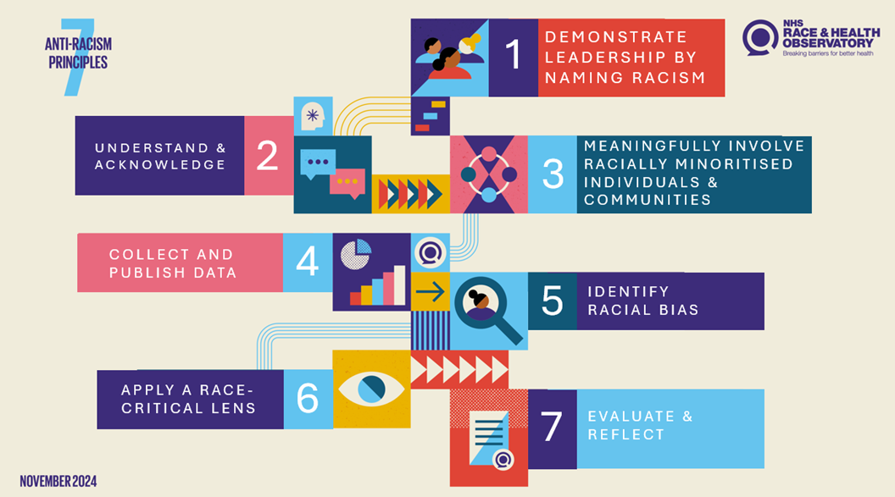

Slide 10
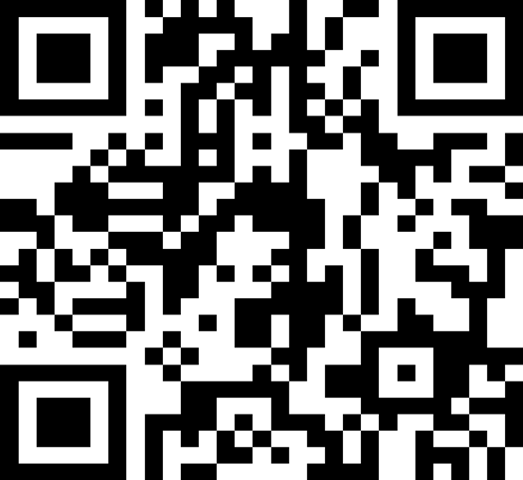
www.slido.com code: 3600895
Which of these 7 anti-racism principles do you have experience of applying?

Slide 11
Talk to person next to you about…
What reflections do you have on implementing the 7 anti-racism principles?​

Slide 12
Examples from the Learning Action Network

Slide 13
Driver Diagram focused on key clinical areas
Clinical Focus Areas / Primary Drivers:
Guiding Principles that cut across all drivers:
Equity and anti-racism principles
Strong and committed leadership
Equity in Access
Patient & Staff Experience (incl psychological safety)
Closing the gap in Outcomes
Communication & Bi-Directional Trust
Learning & Data segmented by ethnicity
LAN Aim:
Reduce clinically avoidable severe maternal morbidity, perinatal mortality and neonatal morbidity while improving the experience of care of pregnant women and pregnant people from Black, Asian and minority ethnic groups.
Gestational Diabetes
Haemorrhage
Mental Health
Preterm Births
Notes:
Minara

Slide 14
Understanding the System
Data Deep Dive
Colleague Feedback
Service User Feedback

Slide 15
Imperial College Healthcare NHS Trust

Slide 16
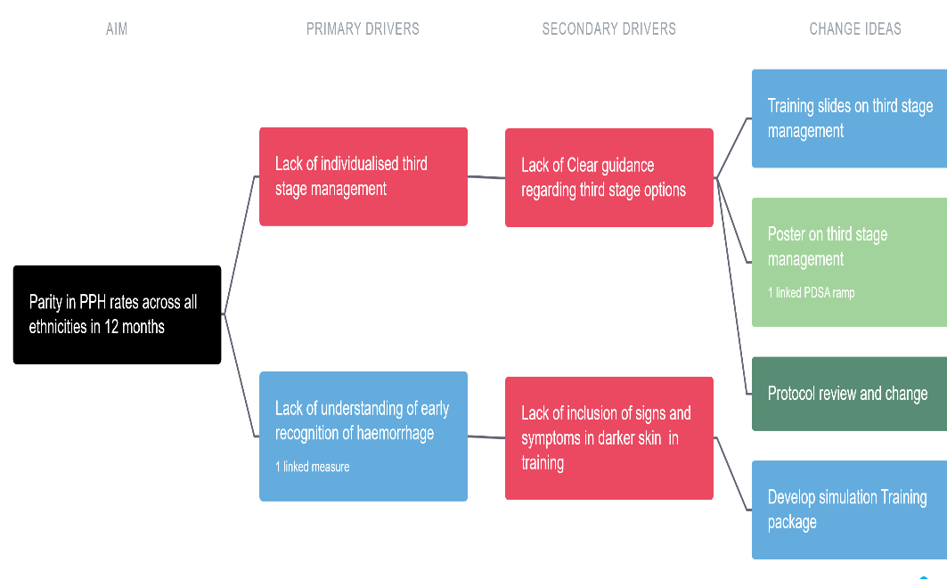
Context
Mission Statement - Our Health equity project drives advances through awareness, action and understanding, ensuring the right health needs are met and knowledge gaps are addressed.
Problem Statement – PPH rates are higher in Black and Asian communities in comparison to the white population
Aim Statement & Driver Diagram - To achieve parity in PPH rates in all ethnicities in 12 months
Population of Focus : Black population was focused on this as they had higher PPH rates despite lower operative delivery rates

Slide 17




Don’t Miss the Signs
Poster on Signs
Pale nail beds
Pale lips
Pale conjunctivae
Pale palms

Slide 18

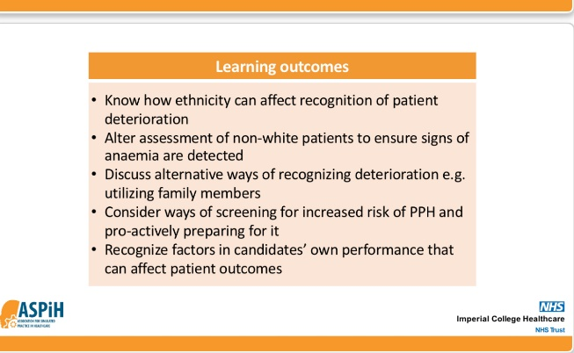
Impact
Service Recipients
Equity in PPH rates
Reduction in Trauma
Reduction in LOS (to be evaluated)
Guideline Equity
Staff
Recognition of needed action with darker skins
Raising Discussion and Awareness
Incorporation into local training
National ASPiH awareness
Community
PPIE project
Heard Voices
Improved communication and trust

Slide 19
Bristol, North Somerset & South Gloucestershire (BNSSG)

Slide 20

Implementation
Increase in the number of BNSSG staff undertaking Black Maternity Matters Training
Implementation of cohort 4 of BMM for BNSSG
Increase in anti racist practice and theory and acceptance of the role of unconscious bias in treatment of women racialised as Black
Alignment and acknowledgement of the negative impact of unconscious biases in achieving preterm optimisation for Black women and babies
Creation / adoption of Anti Racist Framework and Strategy for BNSSG perinatal system
Enhancement and alignment of NHSE Perinatal Culture work with Anti Racist practice and theory
Training for perinatal staff on “asking about race and ethnicity”
Increase the proportion of women racialised as Black in BNSSG at less than 34 + 0 weeks’ gestation with threatened preterm labour receiving a full course of antenatal corticosteroids and magnesium sulphate within one week prior to delivery to 80% or greater by March 2025
Improved data quality and accuracy regarding race and ethnicity and preterm birth
Accurate data completeness for women, families and babies racialised as Black
Development of “About me and my baby” conversation process to improve data on race and ethnicity for mother baby dyads
Facilitation and embedding of a safe, trusted perinatal service for Black women and babies
Expert led, race trauma informed qualitative exploration of the experiences of Black women and families
Enhanced and optimised preterm care pathway for women and babies racialised as Black in BNSSG
Consistent approach and reduction in variation of preterm birth interventions through system wide guidelines and decision-making
Retrospective audit of all Black women and preterm babies
Interrogation and identification of the system wide risk factors for bias interacting with optimised preterm care including deep dive into number of contact points by gestation (i.e. at preterm birth clinic)
Development of a BNSSG optimised preterm birth pathway for women and babies racialised as Black including unconscious bias and racism as a risk factor for morbidity and mortality
Black women and families are involved and contributing lived experience and insight
Design and implement a continuous improvement process for the review of all preterm births for Black women and babies in BNSSG
Increase in acceptability, trust and psychological safety reported by Black women and families
Identification of the touch points of the preterm pathway that are impacted by racism and unconscious bias and are barriers to optimised preterm care
Enhanced understanding and deeper knowledge regarding why Black women and babies are receiving suboptimal preterm care in BNSSG
Diversification of BNSSG MNVP membership including improving engagement with women and families racialised as Black

Slide 21
Qualitative Data - themes
4 women racialised as black with lived experience of pre-term birth interviewed by race and trauma informed practitioners
Understanding that racism does exist in healthcare- insidious in nature and embedded in systems and behaviours
The importance of patient advocacy-both mother and baby
The need for improved understanding and communication between healthcare providers and patients
Staff assumptions based on race being a potential safety risk
The importance of continuing with anti racism training for staff
Lack of diversity and support for black mothers
Lack of information on pre-term birth

Slide 22
Impact so far
In 2023, no disparities evident compared to 2022 on mgs04 & steroids (Vermont Oxford Network preliminary data)
Early data suggests a reduction in preterm birth rates for Black women within BNSSG.
SW has the lowest neonatal mortality rate in England for the last 2 years (NNAP 2024)
Review of every pre-term birth within BNSSG since April 24 identifying where improvement is needed if preterm optimisation not achieved – this is embedded in practice
Robustness of data segmented by ethnicity - Badgernet (both maternity and neonatal) not matching with primary care data sources & using 2001 census breakdowns which are outdated. From a neonatal viewpoint - not part of National Neonatal Audit Programme
Trauma informed qualitative interviews with women and families by race informed research experts commenced – early findings highlight key themes experienced by Black women, this willl be used to guide where further anti racism education is needed within system for example the triage process
QI project on improving women and families’ knowledge on the signs and symptoms of pre-term birth. Currently being evaluated by Maternity and Neonatal Voices Partnership and link in via senior community matrons to ensure engagement and adoption.
Personal growth and development as Anti Racist Champions within each of our own immediate systems and as a wider Local Maternity and Neonatal System team.

Slide 23
Learnings from the Learning and Action Network
Data systems for improvement – ethnicity data is not always available
Scoping to understand what other specialities and systems are doing
Embed cultural change by cycles of learning
Give all parts of the system a voice
Centring and embedding coproduction
Focused on finding hard evidence with mechanisms not set up to collect it
Culture change takes time- Anti Racism culture takes a long time
This is not time limited- it’s the first step of many to impact change
To embed meaningful change, the wider systems need to be activated to enable this eg nursing, midwifery and medical education

Slide 24

Fireside chat

Slide 25
Creating a theoretical framework for assessing quality improvement through an anti-racist lens
(and applying this in the LAN evaluation)

Slide 26
Evaluation aims
To understand the feasibility and acceptability of an anti-racism focused improvement approach to address ethnic inequalities in maternal and neonatal health.
To work with RHO and IHI teams to develop an evaluation protocol that enables them to understand contextual and implementation factors that affect the effectiveness and scalability of interventions developed through the anti-racism focused LAN approach, to inform subsequent phases of the programme.

Slide 27
Evaluation methodology
Comparative case study design
Mixed methods:
Document analysis
Observation
Secondary analysis of quantitative and qualitative data collected by the QI projects
Interviews and focus groups
Survey
MUSIQ as the evaluation theoretical framework – adapted to incorporate the RHO 7 anti-racism principles

Slide 28
Through a literature review we identified MUSIQ2 as the most appropriate theoretical framework for data collection and analysis
Model for Understanding Success in Quality (MUSIQ) framework
Created to understand and optimise the contextual factors that affect the success of quality improvement projects in healthcare
There is an associated data collection tool (or questionnaire)
MUSIQ2 is a refinement of MUSIQ v1
Developed and tested in a US maternity hospital setting and across in UK hospitals
Identifies 34 contextual factors under 5 domains:
External environment
Organisation
Infrastructure
Microsystem
QI and Implementation team
References: Kaplan et al (2011) https://pubmed.ncbi.nlm.nih.gov/21835762/; Reed et al (2018) https://doi.org/10.1186/s12913-018-3348-7

Slide 29



Creating MUSIQ-AR
MUSIQ did not include a focus on anti-racism
We opted to adapt MUSIQ2 incorporating the RHOs 7 anti-racism principles
A series of workshops and consultations, involving people from racially minoritised communities, people with relevant lived experience, and experts in improvement science

Slide 30
How MUSIQ-AR can be used
Teams attending a LAN Learning Event used MUSIQ-AR to score their projects allowing us to gather information about contextual factors and test the tool
Inform data collection materials for the ongoing evaluation
An analytical framework for the case study data
A core component of the protocol for evaluating scale and spread
A tool for any team working on an anti-racism focussed QI project, helping to maximise enablers and mitigate barriers

Slide 31
What we heard at the advisory group meeting gave us some ground rules
Limit what we add to maintain integrity of MUSIQ and minimise burden on teams
This is challenging work!
Keep the tool as simple as possible to reduce the burden on people using it as much as possible
Notes:
Who should be involved in review?

Slide 32
It’s not straightforward to integrate this…

Slide 33
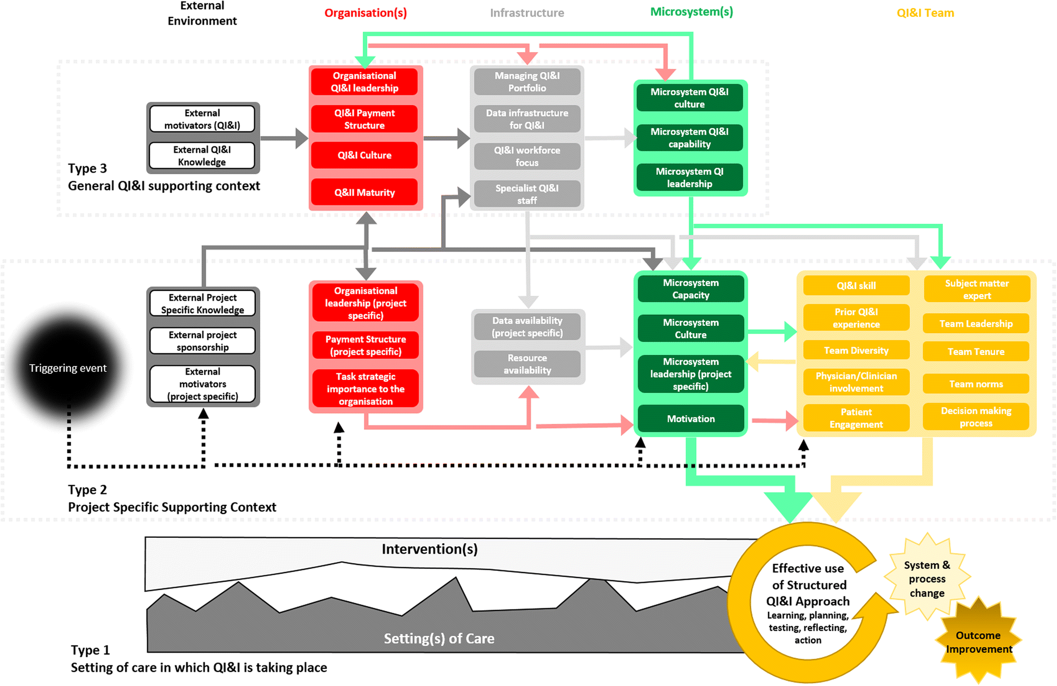

Slide 34
With these…

Slide 35
Race and Health Observatory’s 7 Anti-Racism Principles
Demonstrate leadership by naming racism, engaging seriously and continuously with the ways in which racism impacts the lives of the patients and the public, and actively working to dismantle it.
Understand and acknowledge that structural, institutional and interpersonal racism all impact on health and be clear about where accountability lies for improvement and progress. Create transparent pathways for raising concerns and tangible steps for addressing them.
Meaningfully involve racially minoritised individuals and communities in in every stage of developing a service or intervention, including ensuring that teams and decision-making structures themselves are racially diverse and fundamentally inclusive. ​
Collect and publish data on race inequity in its entirety, ensuring it directly informs policy, strategy, and improvement. Where data is not available, change policies to ensure that data is collected.​
Identify racist bias in policies, decision making processes, and other areas within your organisation. ​
Apply a race-critical lens to the adoption of any interventions or improvements to be tested, and to the design and delivery of services.
Evaluate and reflect on interventions using metrics that recognise the role of racism as determinant of health. These evaluations should seek to understand the extent to which interventions mitigate the impacts of racism.

Slide 36
So, we explored how we could make the adaptation feasible and useful for all?

Slide 37
MUSIQ 2 identifies 34 contextual factors under 5 domains…
Mapping the anti-racist principles to each factor quickly made the framework feel unwieldy
Domain: External Environment | Domain: Infrastructure
External motivators (project specific) | Data available to guide project
External motivators (QI&I) | Data Infrastructure for QI&I | Domain: QI&I Team
External knowledge (project specific) | Resource availability (project specific) | Prior QI&I Experience
External knowledge (QI&I) | Specialist QI&I staff | Team Diversity
External project sponsorship | QI&I Workforce Focus | Physician and Clinician Involvement
 | Managing QI&I Portfolio | Patient Engagement and Involvement
Domain: Organisation |  | Team Leadership
Organisational Leadership (project specific) | Domain: Microsystem | Decision Making Processes
Organisational Leadership (QI&I) | Microsystem Leadership (project specific) | Team Norms
Task Strategic Importance to Organisation | Microsystem QI&I Leadership | QI&I Skill
Organisational QI&I Maturity | Microsystem Capacity (project specific) | Team Tenure
Payment Structure (project specific) | Microsystem QI&I Capability | Subject Matter Expert
Payment Structure (QI&I) | Microsystem Culture
Organisational QI&I Culture | Microsystem QI&I Culture
Notes:
We started out by taking a very comprehensive approach, looking at how the 7 anti-racist principles might be incorporated within, or added to, all 34 contextual factors. Multiple principles seemed relevant to many of the factors. Our framework could very quickly become unwieldy and impractical.

Slide 38
Our initial recommendation was to add an anti-racism domain and integrate the anti-racist principles into this
Domain: External Environment | Domain: Infrastructure | Domain: QI&I Team | Domain: Anti-racism
External motivators (project specific) | Data available to guide project | Prior QI&I Experience | External environment
External motivators (QI&I) | Data infrastructure for QI&I | Team Diversity | Organisation
External knowledge (project specific) | Resource availability (project specific) | Physician & Clinician Involvement | Infrastructure
External knowledge (QI&I) | Specialist QI&I staff | Patient Engagement & Involvement | Microsystem
External project sponsorship | QI&I Workforce Focus | Team Leadership | Team
 | Managing QI&I Portfolio | Decision Making Processes
Domain: Organisation |  | Team Norms
Organisational Leadership (project specific) | Domain: Microsystem | QI&I Skill
Organisational Leadership (QI&I) | Microsystem Leadership (project specific) | Team Tenure
Task Strategic Importance to Organisation | Microsystem QI&I Leadership | Subject Matter Expert
Organisational QI&I Maturity | Microsystem Capacity (project specific)
Payment Structure (project specific) | Microsystem QI&I Capability
Payment Structure (QI&I) | Microsystem Culture
Organisational QI&I Culture | Microsystem QI&I Culture
Notes:
In research, a domain refers to a specific field of study or knowledge

Slide 39
Combining the best parts of the ideas from engagement with stakeholders we integrated anti-racism factors within each domain = 10 additional factors
Domain: External Environment | Domain: Infrastructure | Domain: QI&I Team
External motivators (project specific) | Data available to guide project | Prior QI&I Experience
External motivators (QI&I) | Data Infrastructure for QI&I | Team Diversity
External knowledge (project specific) | Resource availability (project specific) | Physician and Clinician Involvement
External knowledge (QI&I) | Specialist QI&I staff | Patient Engagement and Involvement
External project sponsorship | QI&I Workforce Focus | Team Leadership
Anti-racism (2 additional factors) | Managing QI&I Portfolio | Decision Making Processes
Domain: Organisation | Anti-racism (1 additional factor) | Team Norms
Organisational Leadership (project specific) | Domain: Microsystem | QI&I Skill
Organisational Leadership (QI&I) | Microsystem Leadership (project specific) | Team Tenure
Task Strategic Importance to Organisation | Microsystem QI&I Leadership | Subject Matter Expert
Organisational QI&I Maturity | Microsystem Capacity (project specific) | Anti-racism (2 additional factors)
Payment Structure (project specific) | Microsystem QI&I Capability
Payment Structure (QI&I) | Microsystem Culture
Organisational QI&I Culture | Microsystem QI&I Culture
Anti-racism (2 additional factors) | Anti-racism (3 additional factors)

Slide 40
Having finalised the MUSIQ-AR framework, we adapted the existing MUSIQ data collection tool and used this to gather feedback from all project team members
Notes:
Add info guide the audience’s thinking and engagement:
- detail on what the tool does and what it looks like e.g., excel based, intended to be completed by project lead, numerical scales to rank each factor, aggregated score against a set of self-assessment criteria that indicate a project’s chance of success/risk areas.
A screenshot of the tool might help bring this to life also.

Slide 41
MUSIQ-AR statement | Average for all teams
The leadership of the microsystem engages seriously and continuously with the ways in which racism impacts the lives of patients and the public, and actively works to dismantle it | 4.89
Good quality data (accurate, complete, consistent and up-to-date) on ethnic group and inequalities is collected and available to inform and evaluate this QI project | 4.89
Lived experience partners (service users) from racially minoritised communities are meaningfully involved in every stage of this QI project, including in designing the project and decision making for the project | 4.78
Microsystem staff actively seek to identify racial bias, for example within policies and decision making | 3.89
Microsystem staff effectively apply a race-critical lens within other quality improvement projects | 4.44
Our understanding of structural racism provided motivation to undertake this QI project | 6.33
Structural racism has negatively impacted the progress and success of this QI project | 3.56
The leadership of the organisation engages seriously and continuously with the ways in which racism impacts the lives of the patients and the public, and actively works to dismantle it | 5.44
The organisation actively seeks to identify racial bias for example within policies and decision making | 5.00
The QI project team includes racially minoritised staff who are involved in every stage of this QI project | 5.89

Slide 42
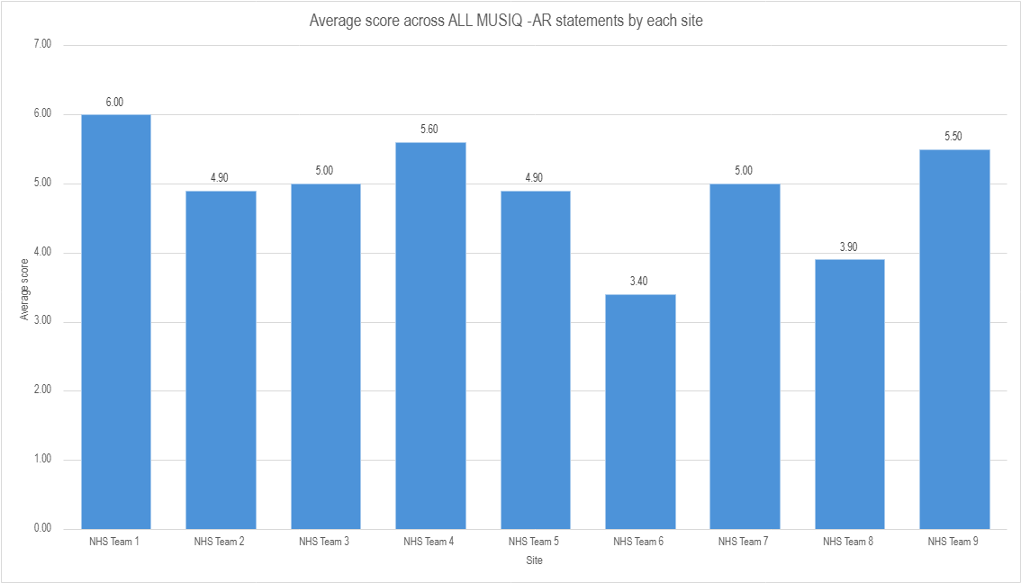

Slide 43
Questions and suggestions from the audience

Slide 44
What questions or suggestions do you have for us?

Slide 45
What else could be done to embed anti-racism principles in MUSIQ to support implementation of anti-racism initiatives?

Slide 46
What are your top three ideas for application?

Slide 47
www.slido.com code: 3600895
Add your details on the Slido to contact us and find out more about using MUSIQ-AR

Slide 48
Call to action
Tomorrow
Next week
Next month

Slide 49
www.slido.com code: 3600895
How will (or might) MUSIQ-AR be applied? (multiple options in a Slido poll)

Slide 50
Floor 10, Becket House,
1 Lambeth Palace Road, London, SE1 7EU
Closest station: Waterloo
healthinnovationnetwork.com
Health Innovation Network South London

