Slide 1
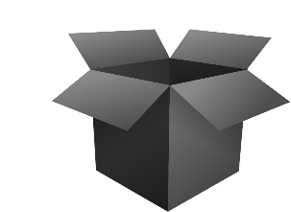
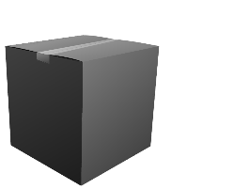

Bridging Knowledge and Practice: Pragmatic Pre-Implementation Approaches Using the Knowledge-to-Action Framework
Jenni Moore Physiotherapist, DHS, NCS
Charlotte Schanke Physiotherapist MSc
Elisabeth Sætre Physiotherapist, MSc
Ingvild Lilleheie Physiotherapist, PhD
Siri Tveitan Social Worker, MSc
Regional Rehabilitation Knowledge Center, Sunnaas Rehabilitation Hospital, NORWAY

Slide 2
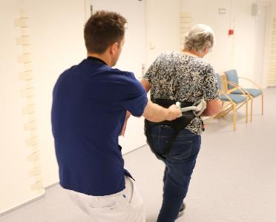
The Impact of the Pre-Implementation Phases on a Two-phase Multi-Site Implementation Project
Jenni Moore

Slide 3
Most implementation efforts fail before the practice is offered to a patient.
Rigorous pre-implementation improves the odds of success.
100%
35%
15%
Initial Projects
Reach Implementation
Delivered with Fidelity
Chamberlain, Brown and Saldana, 2011; Saldana et al, 2012; Alley et al, 2023)
Notes:
Let’s start with a sobering reality: most implementation efforts never reach the patient.
According to large-scale studies of over 1,200 projects,
[CLICK] only 35% of initiatives even make it to the point of delivering services
[CLICK] And of those, just 15% are delivered with fidelity.
That means that most implementation efforts fail before they have a chance to make an impact.
[CLICK] But there’s a bright spot: we’ve learned from the research that projects that invest in strong, structured pre-implementation are more likely to succeed.

Slide 4
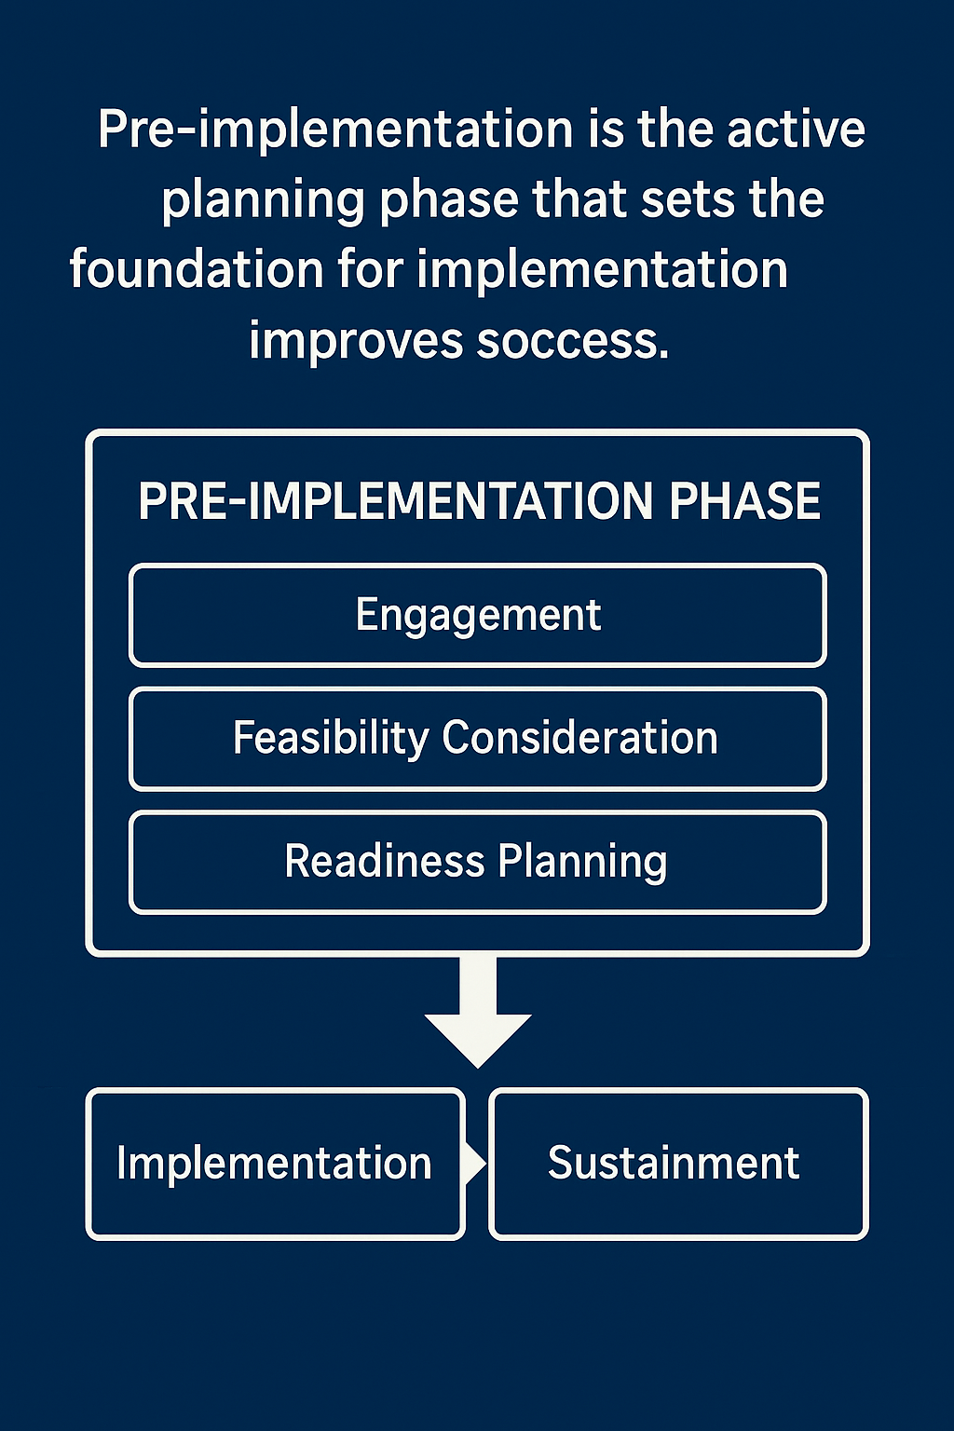
Pre-implementation lays the foundation for successful implementation by preparing people, processes, and systems for change.
Adapted from the Stages of Implementation Completion (Saldana et al., 2012)
Notes:
Pre-implementation refers to the structured, intentional phase that happens before an intervention is launched.
It’s where we lay the foundation for successful implementation by preparing people, processes, and systems for change.
In the Stages of Implementation Completion, pre-implementation includes three core components: Engagement, Feasibility Consideration, and Readiness Planning.

Slide 5
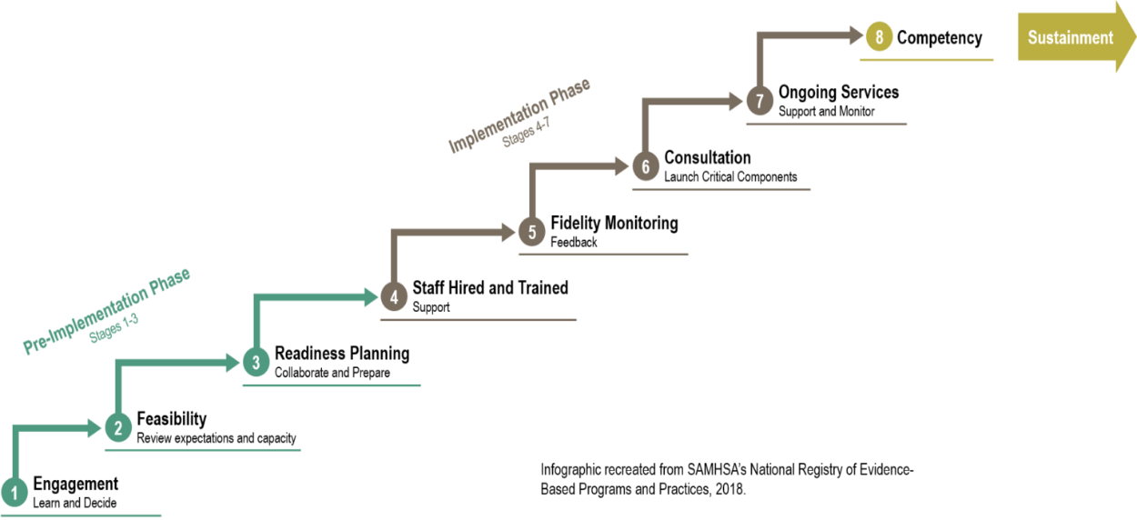
Of 1200 sites, 35% delivered program to patient and 15% achieved fidelity
If pre-implementation was completed, 93% delivered program to patient and 53% achieved fidelity
Stages of Implementation Completion
Chamberlain, Brown and Saldana, 2011; Saldana et al, 2012; Alley et al, 2023)
Fidelity
Pre-implementation
Implementation
Competency
Notes:
This is an illustration of all stages of implementation completion
It which is an observation-based measure that tracks key implementation milestones. It includes [CLICK] pre-implementation phases, [CLICK] implementation, and [CLICK] competency – which I will refer to as fidelity – delivering the practice as recommended or studied.
[CLICK] As I previously mentioned, studies using this scale from over 1200 sites that were implementing an evidence-based program indicated that only 35% delivered the program to a patient and only 15% delivered achieved competency.
[CLICK] However, the groups that completed the pre-implementation phase, 93% delivered the program to patients and 53% delivered the program with fidelity.
When pre-implementation was not completed well, the probability of achieving fidelity was low – even when every implementation phase stage was completed.
Interestingly, in our experience, people often want to skip this phase!! They are VERY eager to start implementing and often start before the organization and the team are ready for the change.

Slide 6
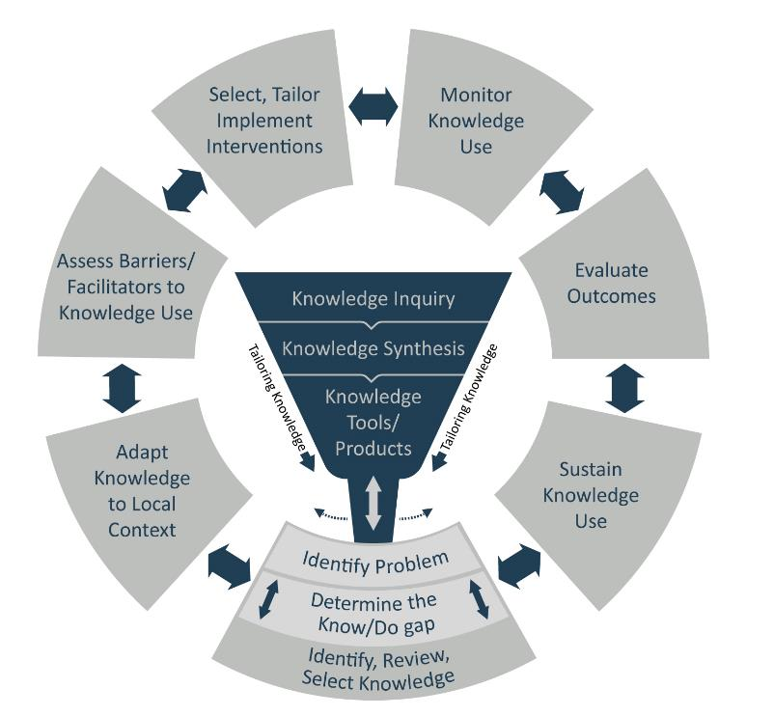
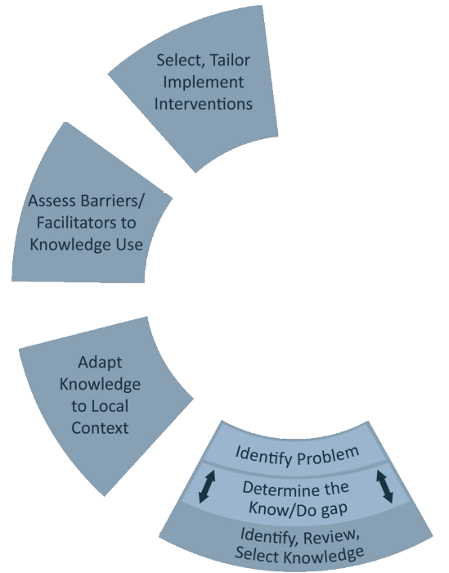
Pre-implementation aligns with the first four phases of the KTA Framework, transforming evidence into actionable, context-specific plans for change.
Notes:
In our work we use the Knowledge-to-Action Framework as a process model for implementing research into clinical practices in rehabilitation.
(CLICK)
Pre-implementation activities correspond directly to the first four phases of this framework. These include identifying the know-do gap, adapting knowledge to the local context, assessing barriers and facilitators, and selecting and tailoring implementation strategies.

Slide 7
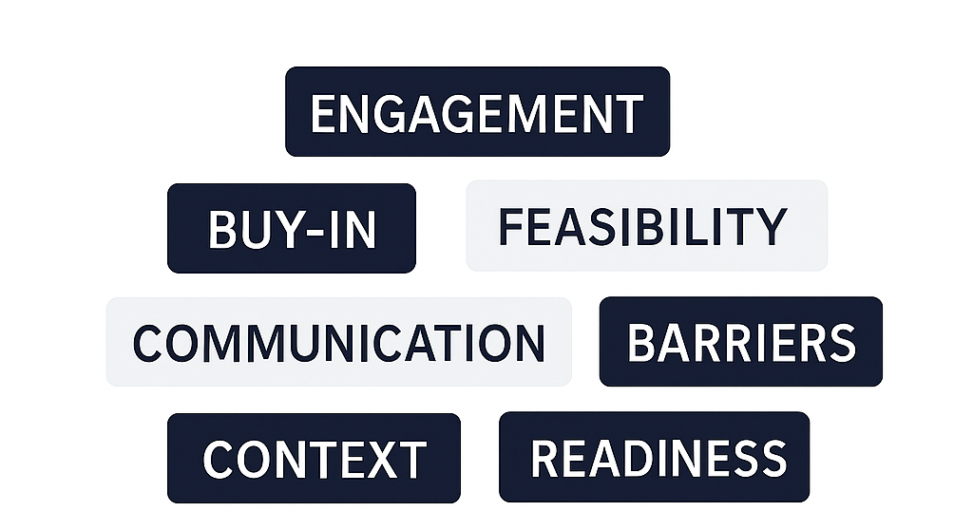

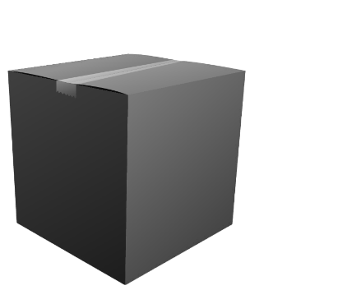
We will unpack the ‘black box’ of pre-implementation to explore the strategies that may prepare teams for change.
Notes:
In this presentation, we will talk about the ‘black box’ of pre-implementation - the often underreported phase before implementation starts. We often hear words like “engagement” “readiness” and “communication” – but how are these strategies employed?
In this presentation, we’ll open that black box and examine what actually happens during pre-implementation.

Slide 8
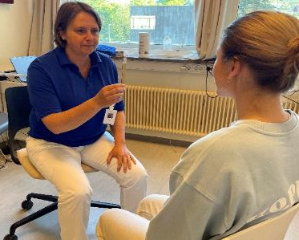
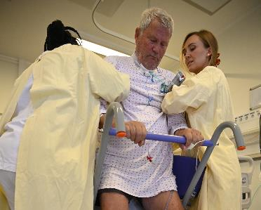
Exploring the Pre-Implementation Black Box Across Three Rehabilitation Projects
High Intensity Gait Training in
Stroke Rehabilitation
Measurement in
the ICU
Measurement in
Concussion Rehabilitation
Notes:
[UPDATE TEXT AS NECESSARY TO REFLECT CONTENT OF PRESENTATIONS
We’ll explore three rehabilitation-focused projects that each used the Knowledge-to-Action Framework but varied in setting, intervention, and context.
First, we examine two stroke rehabilitation sites implementing high-intensity gait training with different levels of pre-implementation engagement.
Second, we look at the rollout of a physical assessment tool in intensive care units, highlighting the role of trust and tailoring.
Finally, we present a multi-department concussion project that faced different barriers across one hospital system. Together, these examples reveal how early-phase planning, leadership involvement, and local adaptation critically influence readiness and results.

Slide 9
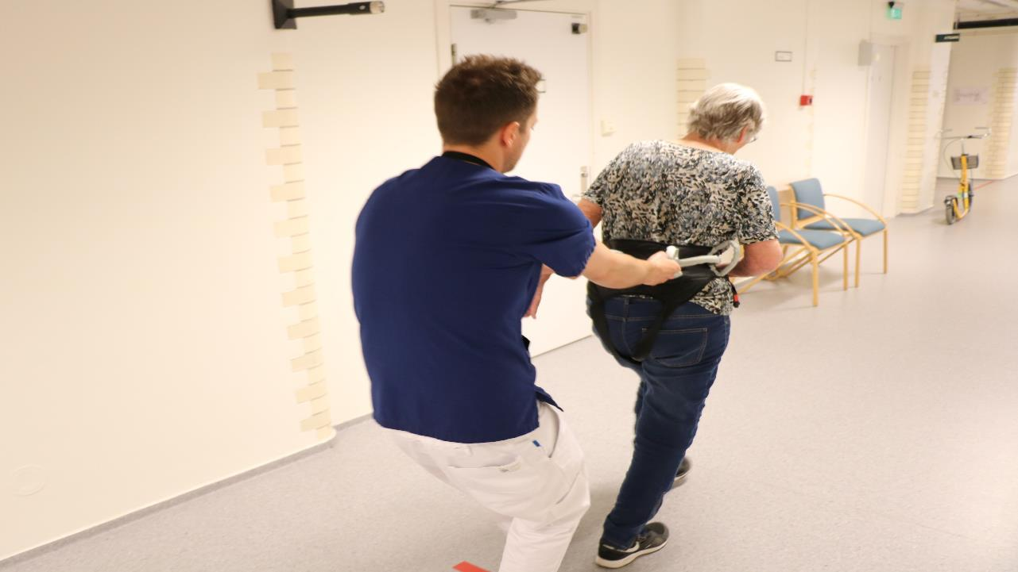
Pre-implementation activities impacted implementation success across two rehabilitation sites.
Notes:
In this section, we’ll explore how pre-implementation activities shaped outcomes across two stroke rehabilitation sites that implemented high-intensity gait training or HIT.
HIT is an evidence-based approach that includes task-specific walking practice at heart rates of >70% of the predicted maximum to improve walking speed, endurance, and function after stroke. Research shows HIT leads to greater and faster gains in mobility compared to traditional therapy, making it a recommended intervention in clinical guidelines.
At both sites, the goal was to embed HIT as a routine part of inpatient stroke rehabilitation, standardizing how walking intensity was measured and delivered.
While the clinical objective was the same, the approach to preparing for implementation looked very different.
We’ll examine how each team engaged with the pre-implementation phase, and how those early decisions influenced their ability to implement HIT with fidelity.

Slide 10
Differences in Pre-Implementation and Readiness for Change Shaped Implementation Success
Feature | Site 1 | Site 2
Setting | Private specialty rehab facility
Structure | Lean leadership structure with direct lines of communication
Leadership Engagement | Strong and visible
Clinician Involvement | High, collaborative
Pre-Implementation Planning | Systematic
Notes:
These two sites shared a common goal, but they entered the implementation phase from very different starting points.
Site 1, a private specialty rehabilitation facility, had a lean leadership structure with clear communication and streamlined decision-making.
The project was initiated organically when the stroke unit leader heard about high-intensity gait training at a conference.
She brought the idea to her department leader, and together they engaged clinicians over a year-long period to assess whether the practice would benefit their patients.
After gaining team consensus, they presented the plan to the CEO and CFO—not only as a clinical improvement, but also as a strategic business opportunity.
They framed it as a way to attract more patients and secure contracts, and in doing so, secured leadership buy-in and financial support.

Slide 11
Differences in Pre-Implementation and Readiness for Change Shaped Implementation Success
Feature | Site 1 | Site 2
Setting | Private specialty rehab facility | Public hospital with rehab unit
Structure | Lean leadership structure with direct lines of communication | Hierarchical structure with less direct engagement
Leadership Engagement | Strong and visible | Passive or absent
Clinician Involvement | High, collaborative | Limited, top-down rollout
Pre-Implementation Planning | Systematic | Minimal
Notes:
Site 2, a public hospital with a more hierarchical structure, followed a different path. The coordinating center approached hospital leadership directly to invite participation. Leaders agreed to join the project but did not consult with clinicians beforehand. Soon after the project began, the leader who approved participation left the organization, leaving the team without direction or internal sponsorship. Pre-implementation planning was limited, and clinicians experienced the project as something handed down from above.

Slide 12
Site 1 used structured leadership, clinician engagement, and team-based planning to build readiness for HIT.
Site 1 used structured leadership, clinician engagement, and team-based planning to build readiness for HIT.
Leadership Engagement
Readiness for Change
Clinician Empowerment
Collaborative Planning
Mbalilki et al, 2024
Notes:
To better understand the clinicians’ experiences during the implementation process, we conducted focus groups with clinicians at both sites.
At Site 1, readiness for high-intensity gait training was built through intentional leadership engagement [CLICK], collaborative team planning [CLICK], and empowered clinical involvement.
Leaders were highly engaged, not only approving the project but actively participating in planning meetings and aligning the initiative with organizational goals.
They listened to staff and ensured the necessary time and resources were in place.
[click]
The team engaged in structured planning sessions where clinicians and leaders reviewed articles together, discussed the evidence base, and co-developed the implementation plan.
[click]
Clinicians felt safe raising concerns and asking questions—not just about the intervention, but about how to make it work for their patients in this setting.
They requested equipment and resources and received them.
They supported one another by discussing patient cases, brainstorming how to meet HIT targets, and iteratively refining their approach.
This level of involvement fostered ownership, built confidence, and fostered readiness for change.

Slide 13
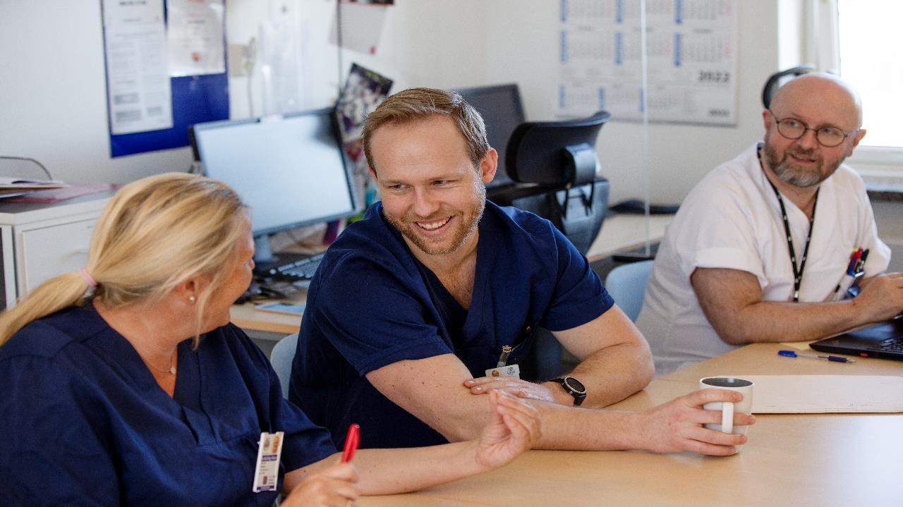
Clinicians described strong leadership, shared expectations, and a collaborative culture. (Mbalilaki et al, 2024)
Notes:
Our focus group results revealed that, at Site 1, clinicians described a culture defined by strong, visible leadership and clear expectations. Leaders actively set the direction and followed through, which contributed to a shared sense of purpose and commitment to high-intensity gait training.
Team members also described a collaborative environment where colleagues supported and challenged one another, fostering continuous improvement. Leadership was not only engaged but responsive and quick to prioritize and address problems as they arose. Importantly, this visible support helped clinicians overcome other barriers, such as time constraints.
These conditions appeared to lay the foundation for successful implementation.

Slide 14
Over ~5 years, Site 1 progressed through structured pre-implementation and implementation phases to achieve high-fidelity HIT delivery.
Over ~5 years, Site 1 progressed through structured pre-implementation and implementation phases to achieve high-fidelity HIT delivery.
2018 Awareness of HIT, team and leader buy-in
Jan 2023
Competency phase initiated
Team collabotion: readiness planning, education, data collection
Implementation Strategies
Sustainability Strategies
Pre-Implementation
Implementation
Competency
Notes:
Site 1 started discussing the possibility of implementation in 2018 and progressed through a systematic pre-implementation phase that included readiness planning and education.
We implemented standardized measures and began collecting usual care data in January of 2020.
[CLICK] Then, we started implementing HIT in 2022 and achieved competency in January of 2023.
[CLICK] Since then we have been focusing on the sustainability plan.
What’s notable here is the time investment, nearly five years from initial exploration to achieving competency – and that includes implementing standardized assessments first.
Rather than rushing into implementation, Site 1 took time to create a culture and a workforce ready for change.
When they began the active implementation phase, they were able to efficiently and effectively implement HIT.

Slide 15

Site 2 lacked structured planning and leadership engagement, leading to resistance and inconsistent HIT implementation.
Notes:
At Site 2, the leader decided to implement HIT with minimal clinician involvement, however, they did not engage in planning or ensure that the clinical team had input into whether the intervention was a good fit.
Clinicians were trained in the project operations, including how to administer standardized assessments, track fidelity metrics, and deliver the evidence-based practice. But they weren’t given time or space to process the change, ask questions, or decide whether they supported it.
The expectation was clear: implement the practice. But there was no structured follow-up from leadership to monitor progress, provide feedback, or support implementation.

Slide 16

Clinicians described limited support, poor communication, and uncertainty about their role in HIT.
(Mbalilaki et al, 2024)
Notes:
Our focus group results from site 2 revealed that the clinicians felt the implementation process lacked transparency and inclusion.
Decisions were made without their input, and communication from leadership was inconsistent. One clinician explained, “It is just as if it has been thrown at us” They also stated their leader was not supportive or involved, they stated they were ran over be the leader.
They also described the effects of poor communication, saying, a lot of information never reached them, and as a result, they were less engaged. Clinicians noted they lacked basic information such as documentation, structured updates, and had limited practical experience with the intervention.

Slide 17
Site 2 paused implementation midstream to re-engage in pre-implementation activities, leading to improved fidelity one year later.
Site 2 paused implementation midstream to re-engage in pre-implementation activities, leading to improved fidelity one year later.
2017 Leader agreeed to participate
March 2024
Acheived competency
Clinician training, usual care data collection
HIT implementation strategies
Discussions, engagement
HIT
Pre-Implementation
Implementation
Competency
Notes:
Although Site 2 began the project in 2017, which is earlier than Site 1, their implementation journey took longer and followed a less linear path.
[CLICK] Initial efforts to implement HIT were rushed, with minimal planning or engagement.
[CLICK] By 2023, several years into the project, they paused active implementation altogether. They pivoted back to foundational work typically done during the pre-implementation phase. They began focusing on building clinician buy-in, increasing leadership visibility, and creating space for staff to ask questions and shape the process. Ownership began to shift from external coordinators to the clinical team.
[CLICK] Rather than pushing forward, they stepped back rebuilding consensus and readiness to support more sustainable, effective implementation moving forward.
[CLICK] Importantly, about a year after this shift, they were able to improve the fidelity of HIT delivery, demonstrating that meaningful pre-implementation work can still be impactful, even midstream.
In the end, they implemented with improved fidelity, but not quite at the fidelity levels of site #1. It took them about 7 years to get there.

Slide 18
One Site Progressed, the Other Pivoted: Pre-Implementation Activities Made the Difference
Site 1
Pre-Implementation
Implementation
Pre-implementation: readiness planning, education, data collection
HIT Implementation
Site 2
Clinician training, usual care data collection
HIT implementation strategies
Discussions, engagement
HIT
Notes:
This visual summarizes the key difference in each site’s implementation journey. Site 1 followed a relatively straight trajectory, investing early in structured pre-implementation activities, which laid the groundwork for smooth implementation and eventually achieving competency. They started their pre-implementation activities in 2018, and implemented with fidelity by 2023.
In contrast, Site 2 initially moved into implementation in 2017 without conducting thorough pre-implementation activiteis. As challenges emerged, they had to pause and revisit pre-implementation activities, such as securing leadership support, engaging clinicians, and building consensus. Finally, the implemented with fidelity in 2024.
Only after re-engaging in these efforts were they able to move forward and ultimately deliver HIT with competency.
In both cases, the path to success required pre-implementation work—but for Site 2, skipping it early meant a slower, more turbulent route.

Slide 19
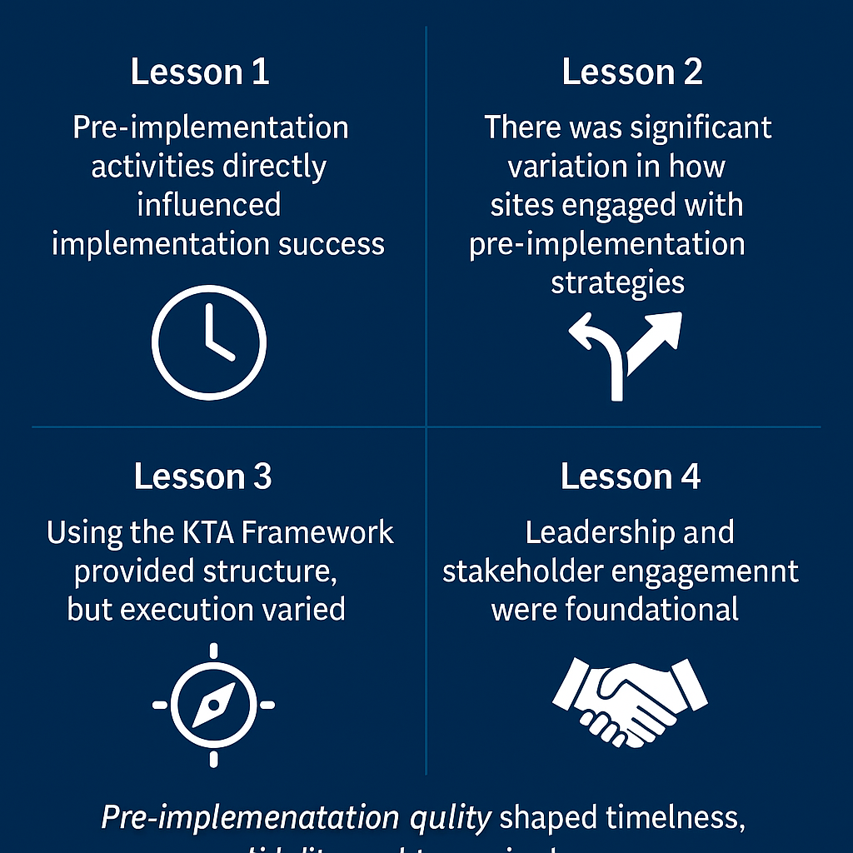
Pre-implementation quality shaped timelines, fidelity, and the need to pivot.
Notes:
As we close, I want to return to the central theme of this presentation: the pre-implementation phase is not just a preliminary step, it’s a critical determinant of implementation success.
Across both sites, we saw that the quality, structure, and intentionality of pre-implementation activities directly influenced how quickly teams achieved fidelity. One site laid the groundwork early and progressed steadily. The other had to pause and revisit this phase midstream, costing time, effort, and momentum.
Through these and similar experiences, we learned that investing in structured pre-implementation, including activities such as leadership engagement, consensus-building, and readiness planning, is foundational, not optional.

Slide 20
The Impact of tailored pre-implementation strategies and activities at for CPAx in Oslo University Hospital
Charlotte Schanke
Notes:
Hello everyone and thank you for the opportunity to speak today.
Let me start with a statement:
Implementation isn't just about what we do—it's about how we prepare to do it!
In this presentation I will tell you about how we tailored pre-implementation strategies and activities in a project in Norways biggest hospital.

Slide 21
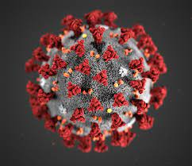


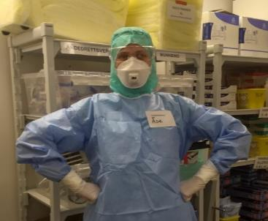

Many people still associate the ICU with images from the pandemic—patients in comas, completely immobile. But that’s not the case.
Notes:
Why do we need a rehabilitation focus in the ICU?
Many people still associate the ICU with images from the pandemic—patients in comas, completely immobile. But that’s not the case.

Slide 22
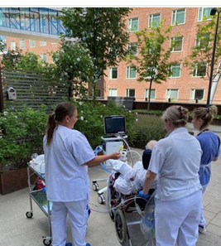
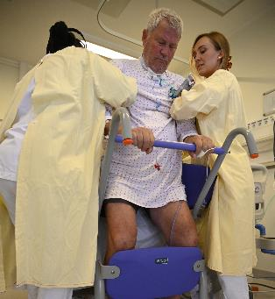
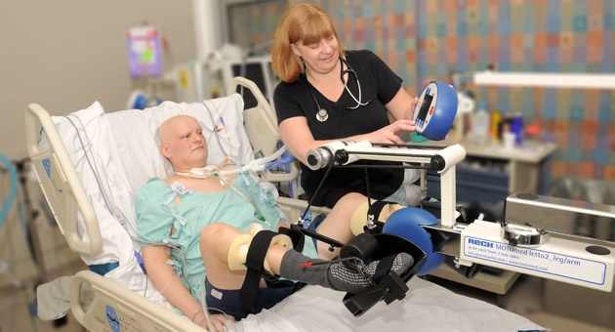
Early rehabilitation starts in the ICU – from bed rest to active rehabilitation
Notes:
Over the past 20 years, intensive care medicine has made enormous advances—we are saving more and much sicker people, and they are not always sedated and immobilized for long periods. The vast majority are awake and can participate more actively in the rehabilitation process, which has also placed significant demands on all healthcare professionals working with ICU patients to change their approach in line with research confirming that this is the path to saving patients for a better life that is meant to be lived.
But to do early rehabilitation that effectively, we need a shared language across professions. That’s where CPAx fits in—a functional assessment tool for critically ill patients.
☺

Slide 23
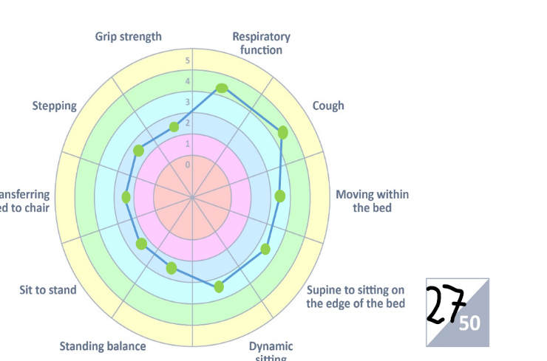
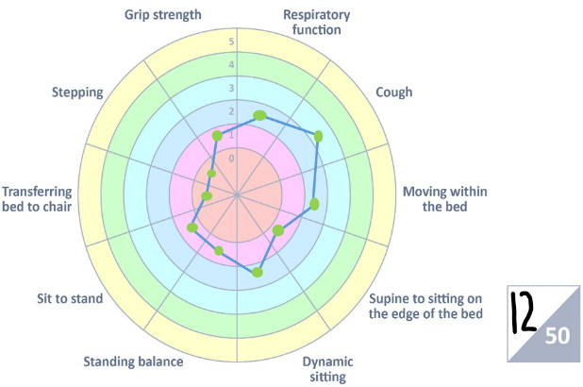
Chelsea Critical Care Assessment Tool (CPAx) helps us systematically evaluate physical function in ICU patients and guide personalized rehabilitation
Notes:
So what is CPAx?
The Chelsea Critical Care Assessment Tool (CPAx) helps us systematically evaluate physical function in ICU patients and guide personalized rehabilitation. It’s already translated and implemented in several countries and supports teamwork by giving all professionals a shared framework.
Here you can see this measurement tool used to track a patients recovery process in the ICU. Early in the ICU stay and then again at discharge from ICU.
But even the best tool won’t work if people aren’t ready to use it.
Implementation requires more than training—it requires preparation, trust, and context-awareness.

Slide 24

Understanding the context of the organization where you’re implementing something is crucial for success.
All the units have different sizes, dynamics, culture and traditions.
Notes:
Our goal was to lay the groundwork—what we call pragmatic pre-implementation.
And if there’s one thing I’ve learned as one of the most important success factors in an implementation project, it’s how crucial it is to understand the context of the environment where you’re implementing something.
I dare say that in the pre-implentation phase, context is everything!
Understanding the leadership structures (both formal and informal), workflows, and the people working there- the clinicians and their professions.
At Oslo University Hospital, we faced complexity: 24,000 employees in total with four campuses 3 kilometers apart and 10 ICUs.
The nurses and doctors are dedicated to work mainly in the intensive care unit, the language is based on diagnosis and numbers—while physiotherapists are usually not dedicated to work only in the ICU, the physios work across multiple departments, they do not have the same leaders as the nurses and doctors, and focus on function by describing it with nuances, rather than numbers.
Like this puzzle, all the pieces (in this project; physio and ICU-units) have different sizes, dynamics, culture and traditions.
Already here, I imagine you implementation-minded people are spotting the barriers. 😊
So with this context-knowledge, we knew that jumping straight into implementation, wouldn’t work.
We asked ourself: how do we introduce CPAx in a way that clinicians and leaders feel ownership from the very beginning?
We committed to a pre-implementation phase, focusing on tayloring the strategies and activites.

Slide 25




Tailoring strategies to fit the context.
Three key strategies
Engage both leaders and clinicians
Informal trust-building through relational approaches
Tayloring and customization for each ICU and physiounit
Notes:
We had three key strategies (1):
First: We engaged both leaders and clinicians through ongoing conversations (2). We made phone calls (KLIKK 3), sent emails to personalize follow-ups. We scheduled face-to-face formal meetings (KLIKK 4), and sometimes also just dropped by when the timing felt right (KLIKK 5). A lot of my time was spent on a bicycle between locations. This gave us important information about the formal and informal structures in the organization and in the respective units. This was a part of the multi-level engagement strategy. We gathered information that we could use to later “seize the moment”.
Second: We leaned into informal trust-building. (KLIKK 6) Sometimes, a tray of cinnamon buns went further than a PowerPoint.(7) These small gestures opened doors and made space for real dialogue.
Third: We paid attention to geography (8). Our ICUs are physically spread out, so we actively created opportunities for connection across locations —helping clinicians feel like they were a part of a larger shared project. We paid attention to make cross-unit connections in every conversation so that we could reduce the silos.

Slide 26


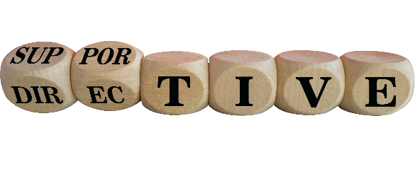
Securing buy-in requires tailoring strategies to leadership style, organizational context, and local norms.
«We don`t do that here»
Understand leadership styles
Customize engagement accordingly
Respect local norms = stronger buy-in
Notes:
We paid attention to:
Understand leadership styles and to customize engagement accordingly
We Respected local norms because we believed it would create stronger buy-in
(KLIKK 1 og 2)
Let’s reflect on this phrase: “We don’t do that here….”
Rather than pushing back, we treated it as a diagnostic insight. It told us something important about local norms and leadership styles.
By understanding how each physio and ICU leadership operated—Some units were top-down. Others were more flat and team-based,
we could tailor our engagement strategy. And by respecting these differences, we secured stronger and more lasting leadership buy-in.
(KLIKK 3)
So- here are 2 questions for you to answer yes or no:
1.Have you ever encountered the phrase 'We don’t do that here' during an implementation process?
2.Is it enough to meet only with formal leaders to understand a unit’s leadership style?

Slide 27

Securing clinician buy-in starts with recognizing
that they are the experts.
“How will this impact my clinical practice?”
“Seeing it through their lens”
Understand daily routines and challenges
Frame CPAx around clinical relevance
When people feel seen, they engage
“Will this help my patient today?”
“Will this work with our routines?”
Notes:
What about the clinicians?
Clinician engagement isn’t just about information—it’s about perspective.
“Seeing it through their lens”
We took time to learn how each team worked, what challenges they faced, and how CPAx could fit—or not fit—into their workflow.
This approach allowed us to shape our implementation language around what mattered to them: (KLIKK1, 2,3)
“Will this help my patient today?” “Will this work with our routines?”
“How will this impact my clinical practice?”
We held focused knowledge-sharing sessions during lunch meetings that emphasized practical use of CPAx, not just theory. We invited discussion on real-world barriers and co-developed strategies for integrating CPAx into existing routines.
The clinicians feedback shaped the pre-implementation steps.
I believe this helped clinicians feel seen, heard, and part of the process—not just recipients of a top-down decision.
Securing clinician buy-in starts with recognizing that they are the experts—understanding their world and aligning changes to what matters to them.
So here are another 2 questions for you:
1. Have you ever co-developed implementation strategies directly with clinicians/end-users?
2. Is practical relevance more important than theoretical explanation when introducing new tools to clinicians?

Slide 28


Opening the black box of activities in pre-implementation.
What did we actually do in this period?
Notes:
So let us open up the black box...
What did we actually do in this period?

Slide 29
Pre-implementation activities
📌 Aug – Sep 2023
Initial engagement & groundwork
Meetings with physio and ICU leaders and key clinicians
Follow-up emails, phone calls, informal chats
Application for funding
📌 Oct – Nov 2023
Education & knowledge sharing with clinicians
Meetings to discuss CPAx: what, why, how
📌 Dec 2023
Funding application declined
Leaders reaffirmed their commitment to implement CPAx
📌 Jan – Feb 2024
Practical workshops with clinicians
Ongoing communication with stakeholders
Notes:
📌 Aug – Sep 2023
The initial engagement & groundwork began
Meetings with physio and ICU leaders and key clinicians
Follow-up emails, phone calls, informal chats and we prepared an application for funding
📌 Oct – Nov 2023
Education & knowledge sharing with the clinicians were in focus
We had meetings to discuss the CPAx: What, Why, How
📌 Dec 2023
The Funding application was declined, but the leaders reaffirmed their commitment to implement CPAx
📌 Jan – Feb 2024
Practical Workshops with clinicians were conducted, scheduled by the leaders
Ongoing communication with stakeholders via phone, SMS, and email were continued

Slide 30
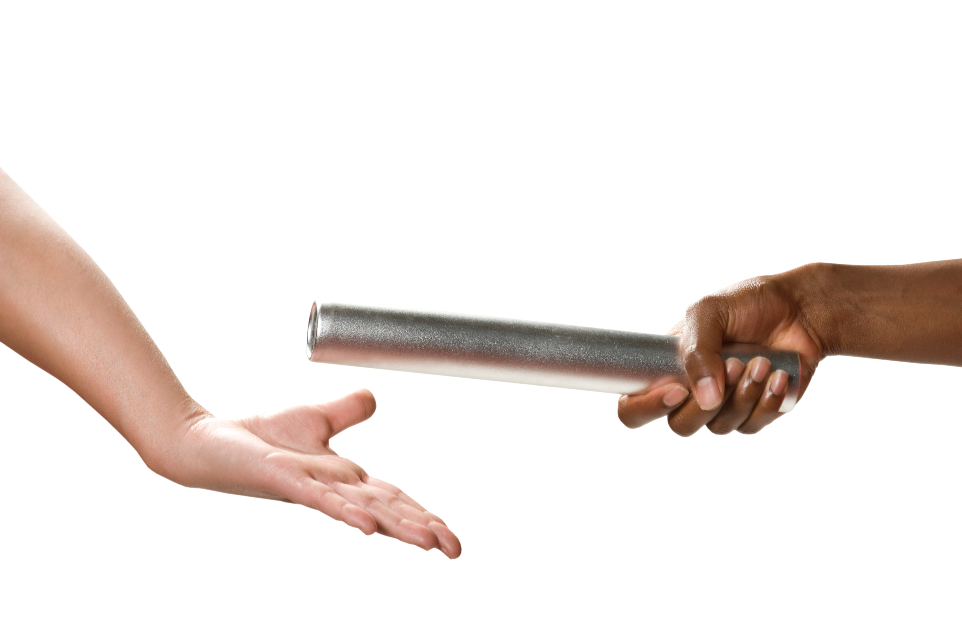
After approximately 8 months, clinicians and leaders started to take ownership of their own implementation plans.
Notes:
After approximately 8 months, a shift began to take place.
Clinicians and local leaders started to take ownership of their own implementation plans.
Instead of waiting for instructions, they initiated the discussions, made local adaptations, and built enthusiasm within their teams.
Each physiounit began developing its own pathway—grounded in a common purpose but shaped by its own needs.
So in March 2024, CPAx was introduced into clinical practice and each unit had competitions & activities led by physio team to boost staff involvement.
5 CPAxes conducted pr clinicians = pizza!
So now our role changed to become facilitators and supporters upon their request.

Slide 31

Before we change practice, we must change the conditions for change.
Context matters—one size never fits all.
Relationships and trust precede change.
Ownership grows from involvement and when people feel heard and supported.
Notes:
Finally, take home message!
One: Context matters. Implementation isn’t one-size-fits-all. Two: Trust comes before frameworks and "tools". Building relationships takes time—but pays off.
Three: Ownership grows when people are involved from the beginning—not when they’re told what to do.
I’ll close with this:
Before we change practice, we must change the conditions for change.
Thank you for listening.

Slide 32

«THE CRAWL»
Have You heard about Sian Welch and Wendy Ingraham?
Notes:
(Click) «Have You heard about Sian Welch & Wendy Ingraham?»
These two women compeded at the Ironman i 97, and became iconic because of their dramatic finish.
(Click): This is also named as «the Crawl»; I believe this picture captures how I have felt at times during this implementation project, particularly in terms of getting relevant stakeholders on board and engaging leaders to be actively involved and committed to supporting the integration of evidence-based practices.

Slide 33
The Impact of Pre-implementation Activities in Concussion Rehabilitation
Elisabeth Sætre

Slide 34
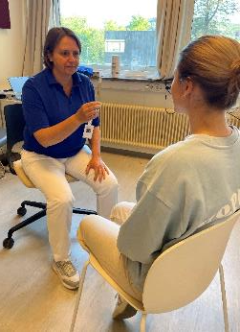
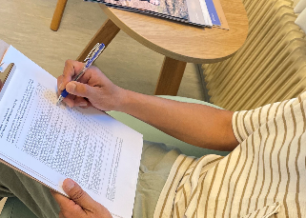
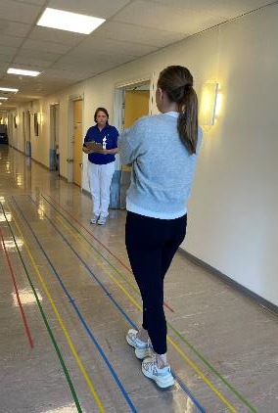
This project aims to implement measurement tools for concussion patients across three departments in a rehabilitation hospital
(Jacobsen & Newman, 1990, Tamber et.al., 2009, Wrisley et. al., 2004, Mucha et.al., 2014)
Notes:
These measurements are used by physiotherapists to assess vestibular dysfunction to patients with concussion. (Click): A patient reported questionnaire for dizziness (DHI), (Click) a performance-based test for balance (FGA) and (Click) a screening tool (VOMS) for vision. (Click) references Method: Is the KTA- framework You heard about earlier, defined as the pre-implementation phase by focusing on four phases: (1 identifying the know do-gap 2 adapting knowledge to local context, 3 assess barriers and facilitators, 4 tailored implementation strategies). Results: This project is ongoing. I will share insights and what I have learned from recent implementation efforts, but for this session have a specific focus on leadership engagement.

Slide 35

Chief Executive Officer
(CEO)
Administration and
Organisation
Finance and
Analytics
Accounting
Communications
Research and Education
Clinic
Medicine and Health Science
Technology and Digitalisation
Research Activity
Physicians
Competence and
Collaboration
Rehabilitation
Technology
Professional
Education
Patient Safety and
Quality Assurance
TRS National
Resource Centre
for Rare Disorders
Clinical
Management Support
and Night Team
Regional Rehabilitation Knowledge Center
Sunnaas
Rehabilitation
Cluster (SRC)
Regional
Coordination Unit
C
B
A
Spinal Cord Injury with Children and
Adolescents Unit
Follow-up services
after Spinal Cord Injury
Multitrauma,
Neurology and
Burn Injury
Traumatic
Brain Injury
Stroke
Follow-up Services after Brain Injury
Cognitive Rehabilitation
Functional Assessment
Services
Outpatient Clinic,
Admission and Outreach Services
Notes:
But first, implementation takes place at a specialized rehabilitation hospital in Norway. I know this is a lot of information to take in of the organizational chart but show the nine clinical departments at the bottom.
Three of these departments are included in this project, which I will refer to as departments A (click), B (click), and C (click). I work at Department A, which is an outpatient clinic. Departments B and C are located geographically another site with inpatient care. So, the same hospital but two different locations.
My role in this project is both a physiotherapist and a project manager. For this project, we did not conduct surveys or interviews with leaders. Instead, our findings are based on experiences and observations from formal and informal meetings. This hospital comprises multiple departments, layers of leadership, and diverse clinical practices, creating an environment where implementation involves not only introducing new practices but also navigating a (click) complex web of roles and cultural dynamics.
As Charlotte said about complexity, but here in a smaller hospital

Slide 36





To achieve real buy-in, leaders need to move beyond verbal support and demonstrate the project's value through consistent actions.
June 2023
Sept 2025
Jan 2024
Sept 2024
June 2025
Planning
Funding
Facilitation
Notes:
This picture illustrates a timeline from the start of the project.
(Click) In June 23, the idea was developed, followed by writing an application and conducting literature research to support these measurements. (Click) At the same time, meetings were held with leaders and physiotherapists at each unit to gain “buy-in” and ensure the project's relevance. (To inform and involve them about the project. Also, give them opportunity to ask questions about the project and give them ownership to this).
(Click) I was fortunate to receive funding from Fysiofondet, this is a minimal amount equivalent to 20% of (click) a year's work.
Do You Think I got buy in from leaders? (Click) assertion

Slide 37


Clinicians embraced tool improvements if paired with sufficient training and support.
«DIZZINESS IS A HOT TOPIC»
«TIME AND TIMING»
(Swinkels et.al., 2011, Shea et.al. 2014)
Notes:
Surveys and focus groups were conducted to assess clinicians’ readiness for the project.
The results revealed a generally positive attitude toward implementing new measurement tools, with clinicians expressing willingness to use the tools, as long as adequate training were provided.
In the adapted Swinkels survey, 100% of physiotherapists reported that their leader supported the use of standardized measures, an encouraging sign of leadership alignment. Interviews echoed these findings.
(Clikc): Clinicians emphasized time management concerns and unfamiliar tools can feel more burdensome. However, when they understand the tool’s purpose, they can prioritize more efficiently and confidently.
(Click): A recurring theme was that “dizziness is a hot topic,” reinforcing the clinical relevance of the project. Many clinicians expressed motivation to improve their competence in this area. (Click): references

Slide 38
Leadership buy-in isn’t one-size-fits-all: Progress required adapting messages to context and relationships
June 2023
Sept 2025
June 2025
Jan 2024
Sept 2024
DEPARTMENT A
DEPARTMENT B
DEPARTMENT C
Notes:
This timeline illustrates how implementation unfolded across these sites. While we began with consistent foundational strategies, including leadership engagement – such as sharing project details via email and conducting joint meetings with leaders and physiotherapists - and clinician training delivered both virtually and in person, we quickly learned that context matters.
Although many leaders initially expressed enthusiasm, saying things like “Great project!” and “How can I support you?” verbal support alone was not enough.
Each site differed in leadership structure, communication preferences, and departmental culture. As a result, I had to adapt the messaging, strategies, and timing to align with each leader’s priorities and the unique dynamics of each department.
Site A progressed quickly.
Site B advanced more slowly but steadily, as we invested time in building relationships and tailoring communication to meet local needs.
Site C struggled. With limited leadership involvement, no data were collected, and implementation stalled.

Slide 39

A key part of the strategy is to “navigate” by assessing and identifying the dynamics among leaders, clinicians, and the culture
Notes:
So, what where my further strategies?

Slide 40



Implementation is relational, and progress depends on how we adapt to local norms and communication styles
Notes:
(Click): Assertion (Click): Identifying individuals who can help drive evidence-based practice (EBP) is essential, but success depends on more than formal leadership roles. It’s just as important to understand how leaders relate to frontline clinicians and how their support shows up in practice. (click)
In Department A, there was a strong relationship between the physiotherapists and the department leader. This leader demonstrated early support verbally and in writing, which helped secure resources and build trust. Interestingly, the leader didn’t require regular updates or hands-on involvement, but because of the trust and shared priorities, the physiotherapists confidently took the lead. In this case, active implementation was driven by clinicians with the leader’s quiet endorsement.
At the other sites, I encountered less clarity around who was responsible for implementation. I was unfamiliar with local leadership styles and departmental priorities.
Over time, I recognized the need to work more closely with individuals on the ground. Their involvement helped encourage broader participation and signaled relevance to the team.
I also prioritized being physically present at Departments B and C. Informal conversations in hallways often led to more meaningful insights than formal meetings.
One day, after struggling with communication at one of these sites, I asked a physiotherapist, “What can I do better?” The physio replied, “It’s not you—it’s how we talk about things here.”
That exchange reminded me (click): implementation is relational, and progress depends on how we adapt to local norms and communication styles, not just what’s on the plan.

Slide 41


Tailoring communication to each leader builds relationships and secures their buy-in for the project.
Notes:
(Click): Assertion At times, the lack of feedback and engagement from leadership, whether through email or chat, left me feeling frustrated and slowed the project’s momentum.
One of the lessons I’ve learned is that communication during implementation is a continuous process, not a single conversation. When challenges arose, I shifted my approach to focus on building honest dialogue, especially about communication breakdowns.
(Click) At certain points, I couldn’t help but feel like Puss in Boots, using my best wide-eyed expression, not to manipulate, but to plea for attention and action. This reflects how emotionally taxing it can be to push forward without clear responses.
Rather than pointing out communication gaps, I tried to understand each leader’s perspective. In a meeting with one of the leader, I asked: “Do you know the process so far?” The leader responded: “No—and what’s left?” That moment underscored the disconnect.
I reframed the conversation by emphasizing that our implementation project was designed to align with clinical routines and protect standard patient care. I used the term “our patients” to foster a sense of collective responsibility. By the end of that conversation, we agreed to support the next steps, and I was invited to the clinical decision-making forum, which includes physicians. That felt like a breakthrough moment.
(Click) Barriers are inevitable in implementation, but they also create opportunities. It’s important to share those barriers with leadership, not just to inform them, but to invite proactive problem-solving, not just passive support.

Slide 42
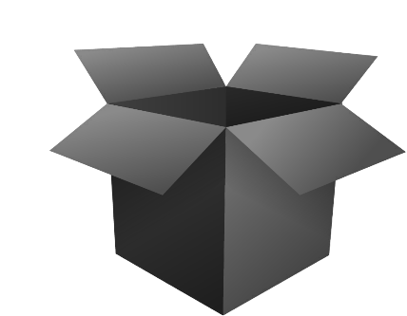


Today- we are celebrating the small and big successes!!
Notes:
So, when we talk about implementation as something successful, I think it's important to highlight both the big and small successes. Yes, we have done well with the implementation at site A and as a standard routine for our patients. In the beginning, I thought this would be straightforward, and I learned to promote positive aspects even though they are small ones. Like getting a meeting with the leaders and receiving positive feedback from them to continue regarding the project's intention!
(Click): “Hopefully, we have opened a bit of the black box?"

Slide 43
Take home message
Notes:
from panel debate
SIRI WILL WORK ON THIS DURING THE DEBATE!

Slide 44


Bridging Knowledge and Practice: Pragmatic Pre-Implementation Approaches Using the Knowledge-to-Action Framework
Jenni Moore Physiotherapist, DHS, NCS
Charlotte Schanke Physiotherapist, MSc
Elisabeth Sætre Physiotherapist, MSc
Ingvild Lilleheie Physiotherapist, PhD
Siri Tveitan Social Worker, MSc
Regional Rehabilitation Knowledge Center, Sunnaas Rehabilitation hospital, NORWAY
Email: rkr@sunnaas.no
Notes:
END SLIDE!!!

