Slide 1

Reflecting on the development and use of pragmatic tools for collaborative implementation
Walk the Talk 1
Presenters: Tim Rapley, Sebastian Potthoff, and Leah Bührmann
Discussant: Tracy Finch
Innovation and Implementation Research Group (IIR)
Northumbria University, Newcastle

Slide 2
Intro: What do we need (pragmatic) implementation tools for?
Tracy Finch

Slide 3
What do we mean by ‘implementation toolkit’?
Starting position:
a compilation of adaptable tools and materials (to inform/facilitate implementation)
various documents and resources (Eg. educational materials, timelines, assessment tools, activities, etc)
‘tools’ may be used individually or collectively
(often) tailored to specific context

Slide 4
What could implementation tools help with?
Bring together implementation focused theory, knowledge, and experience
Develop strategic approach – focused and ‘manageable chunks’
Develop thoughtful, reflexive, collaborative approach – enact ‘conversations’
Embed ‘implementation thinking’ as a practice

Slide 5
(our) Approach to developing implementation toolkits
Theory-based
Translation work
(end) User in mind
Co-design process (stakeholders)
Not re-invent wheel(s)
What is the (core) problem to address?

Slide 6
What do our tools focus on?
1 – IT-FITS - tailoring (problem, people and context)
2 – I-STEM - stakeholders (people, ultra light tools)
3 – IMPLEMENTATION CONTEXT TOOL - context (priority setting and focus)

Slide 7
Some things to think about during this symposium….
In doing (or supporting) implementation work…..
1. What kind(s) of work might implementation toolkits do? (And who for?)
2. How should we approach self-guidance vs facilitation?

Slide 8
Talk 1: ItFits-Toolkit
Tim Rapley

Slide 9

Generous constraints… ?
tim.rapley@northumbria.ac.uk

Slide 10


Challenge
Support implementers in developing evidence-informed implementation strategies that are adapted to local contexts to increase the uptake of internet-based cognitive behavioural therapy (iCBT) services.

Slide 11
Challenge
Support implementers in developing evidence-informed implementation strategies that are adapted to local contexts to increase the uptake of internet-based cognitive behavioural therapy (iCBT) services.
Accessible, self-guided, process for non-implementation science literate people.
Lack of ready to hand frameworks or toolkits

Slide 12
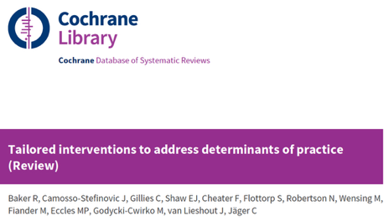
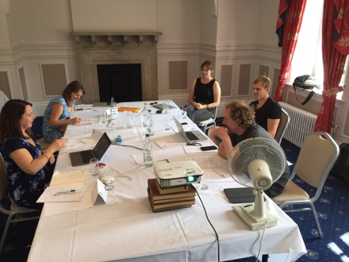
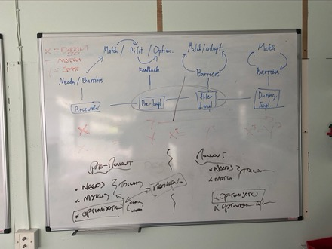
Development Process
Conceptual Development
Internal Meetings, Workshops, Reviews
Tailoring (Baker 2015); Principals and Core Processes
Resource Development
Internal Meetings, Workshops, Reviews
Systematic review; Rapid scoping; Needs Analysis
Pilot-Testing
User workshops, think-aloud, alpha and beta testing
Manual and Digital tools

Slide 13
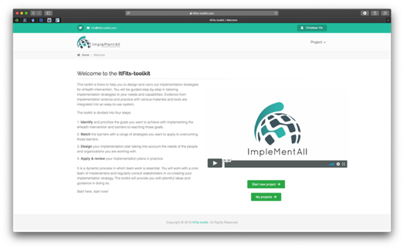
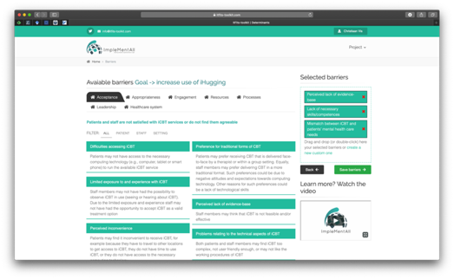
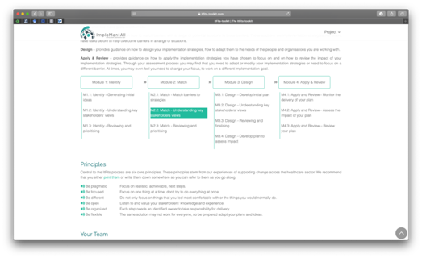
Toolkit Process
Integrated step-by-step self guided process
Identify and prioritise goals and determinants
Match determinants to strategies
Design an implementation plan (and evaluation plan)
Apply and review

Slide 14
Toolkit Process
Integrated step-by-step self guided process
Evidence (and theory)-informed materials
Six working principles (e.g. be pragmatic, be different)
Systematic way to work with team and stakeholders
Various tools for collecting and storing information
User-friendly design

Slide 15
Core Learning: build systems to support users’ expertise
These are systems that will support and complement, and not attempt to thoroughly replicate or replace, the communally organized work practices and problem solving strategies — the professional and practical expertise.[Whalen 1995, 181]

Slide 16
Core learning: find ways to slow people down
These are systems that will support and complement, and not attempt to thoroughly replicate or replace, the communally organized work practices and problem solving strategies — the professional and practical expertise.[Whalen 1995, 181]
Give them permission … to take time out
reflect with (relevant) others
think (and act) differently

Slide 17
Core learning: thinking differently takes work
These are systems that will support and complement, and not attempt to thoroughly replicate or replace, the communally organized work practices and problem solving strategies — the professional and practical expertise.[Whalen 1995, 181]
Give them permission … to take time out
reflect with (relevant) others … but who is in the room and when?
think (and act) differently … but can be constrained by capacity to act on contexts

Slide 18
1 – ITFITS - tailoring (problem, people and context)
2 – I-STEM - stakeholders (people)
3 – IMPLEMENTATION CONTEXT TOOL - context (priority setting and focus)

Slide 19
Talk 2: I-STEM-Toolkit
Sebastian Potthoff

Slide 20



No implementation without stakeholders
Dr Sebastian Potthoff, Assistant Professor of Implementation Science
Department of Social Work, Education and Community Wellbeing, Northumbria University
Co-Lead Innovation & Implementation Research
European Implementation Event, Newcastle 2025

Slide 21

Challenges
Minimal engagement of ‘usual suspects’
Top-down approach
Not theoretically informed

Slide 22
Lessons learned from IMplementall
Verify and discuss
Refine and finalize
Initialize
Lead & core team
Stakeholders
Lead & core team
Notes:
ImpleMentAll taught us that comprehensive stakeholder engagement is key…
Embedded in ItFits approach
Qualitative process evaluation showed us…
Implementers saw value in engaging stakeholders at each step
Supported collaborative implementation and ‘thinking outside the box’
Different to what they were already doing (minimal engagement)
This made us think we are onto something

Slide 23
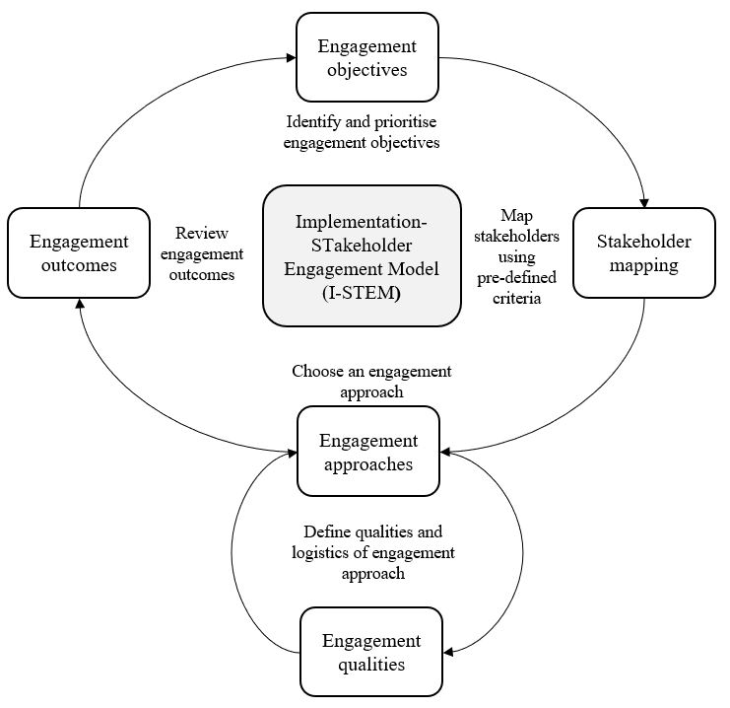
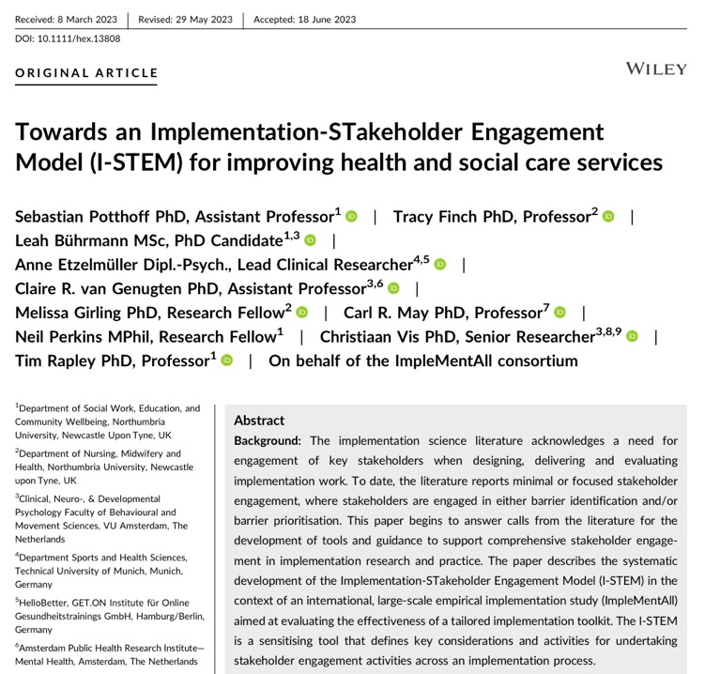
The implementation stakeholder engagement model (i-stem)
Potthoff et al, 2023. Health Expectations
Notes:
Ultimately led to the development of I-STEM
Conceptual model / sensitising tool that defines key considerations
Top 10 most cited articles in Health Expectations
Practitioners told us they wanted practical how-to guidance

Slide 24
Co-designing tools for stakeholder engagement
Project aim: To co-develop the I-STEM into a user-friendly toolkit for non-academic users
Toolkit programming
Scoping review
Review of QI tools
Co-design workshops
Usability testing

Slide 25
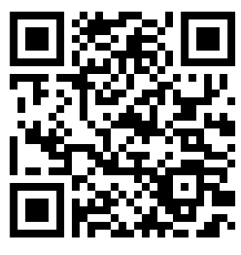
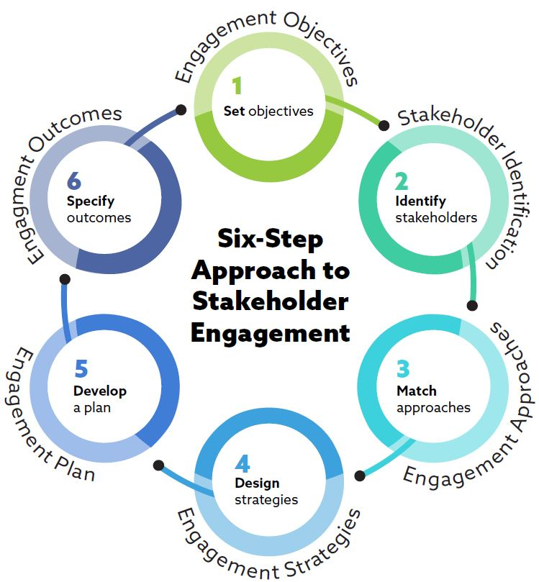
i-stem toolkit six-step approach
Scan QR to download
the I-STEM toolkit

Slide 26
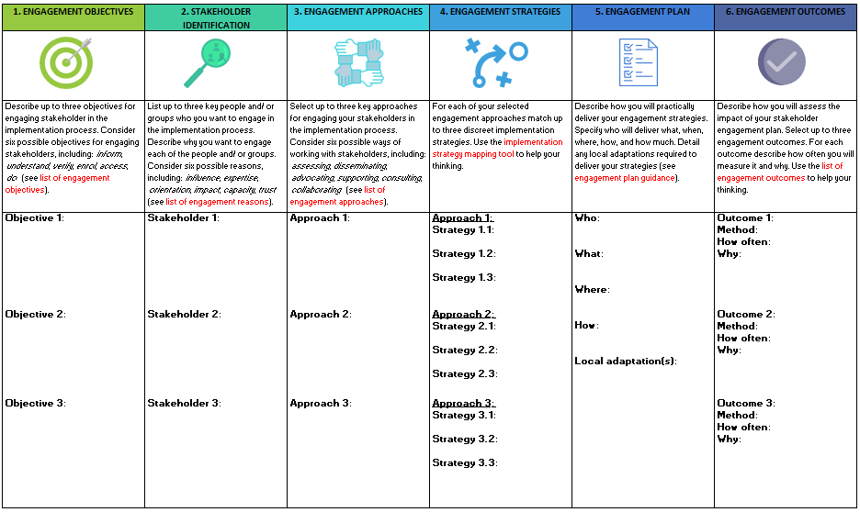
Core learnings
Scan QR to download
the I-STEM toolkit
Thinking tool
Takes time / slowing down
Flexible / generous constraints
Need for ‘ultra light’ version

Slide 27
summary
Importance of stakeholder engagement seems intuitive
01
However, often see minimal engagement of ‘usual suspects’
02
A theory-informed approach has potential to increase ownership / implementation success
03

Slide 28
1 – ITFITS - tailoring (problem, people and context)
2 – I-STEM - stakeholders (people)
3 – IMPLEMENTATION CONTEXT TOOL - context (priority setting and focus)

Slide 29
Talk 3: Implementation Context Toolkit
Leah Bührmann

Slide 30



Context is… contextual?
Challenge
Zoom out –
“Context is everything”
Zoom in –
what’s important for you/
your implementation process

Slide 31
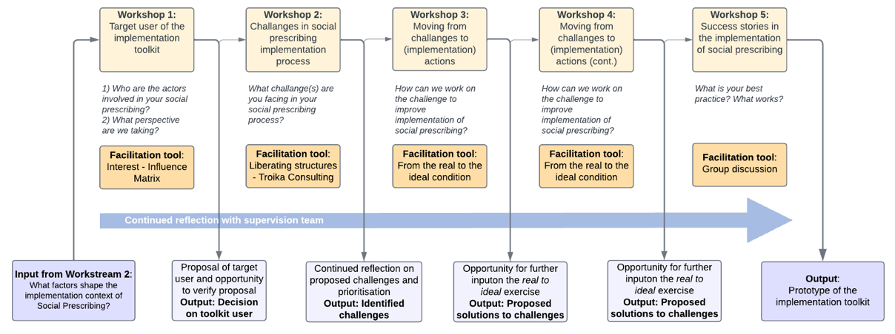
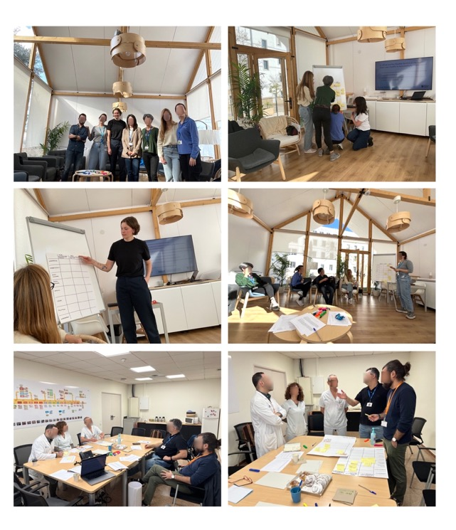

Very briefly…. toolkit development
4 care teams within the Catalan integrated care system, Barcelona region
3 hospitals, 1 department of health
Workshop-style testing, 2 hours, guided

Slide 32






Toolkit processes to zoom out, to then zoom in to help implementers create their own, manageable, and enabling implementation context
comprehensive understanding of the [intervention]
individuals to take time and space to meaningfully engage with the [intervention]
understand users’ own locus of control within the implementation process
making implicit implementation mechanisms explicit
integration of [intervention] into existing structures
facilitating reflexivity in teams

Slide 33
Core learning from the development / pilot testing
Team composition is key
Iterative thinking is essential
Prompting tools are best used flexibly
Who needs to be in the room? (I-STEM)
Make it a continuous conversation – building the capacity for it
How to best facilitate context assessment

Slide 34
Summary & Discussions

Slide 35
What is key across all three toolkits?
Enact conversations
Levels of guidance
The users of tool/ team composition
Flexibility/ ability to ‘fit’ (the problem, the situation)

Slide 36
So what? Our main take aways
More conversations
Reflective? Changing ways of thinking? Determine key focus?
Levels of guidance
What is the right balance?
The users of tool/ team composition
Who needs to be in the room (or not) and when?
Flexibility/ ability to ‘fit’ (the problem, the situation)

Slide 37
Discussion 1: What kind(s) of work might implementation toolkits do? (And who for?)
Speak to you neighbour:
Exchange your stories and experiences on: Do you (or have you) used toolkits or tools to support implementation work? What did using them do (or not do)?

Slide 38
Discussion 2: How should we approach self-guidance vs facilitation?
Speak to you neighbour:
Exchange your stories and experiences on: How much guidance can be ‘designed in’ to toolkits like these? What extra support is needed?

Slide 39

Collective Acknowledgments
ImpleMentAll - European Union’s Horizon 2020 research and innovation programme under grant agreement No 733025
NIHR ARC North East & North Cumbria
Health and social care professionals involved in social prescribing, as well as service users engaged with these services, in the North East and North Cumbria Integrated Care System, who collaborated on the implementation context toolkit development.

