Slide 1

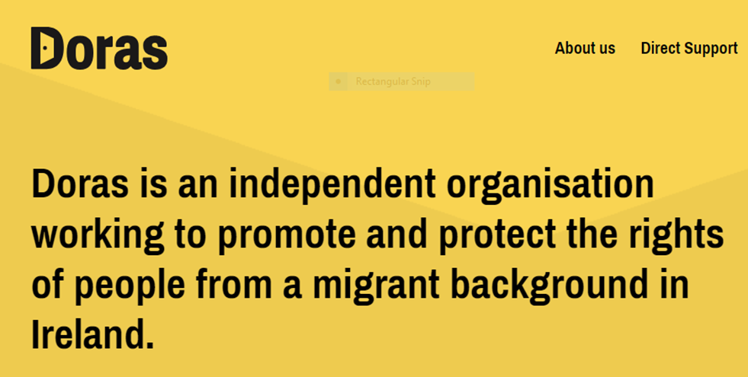



Time to sing? The use of music and singing as participatory methods to facilitate co-production in implementation science
Anne MacFarlane, Anna Papyan, Sarbik Guha, Helen Phelan
On behalf of the Refugee and Migrant Health Partnership, Ireland
Participatory Health Research Unit, School of Medicine

Slide 2
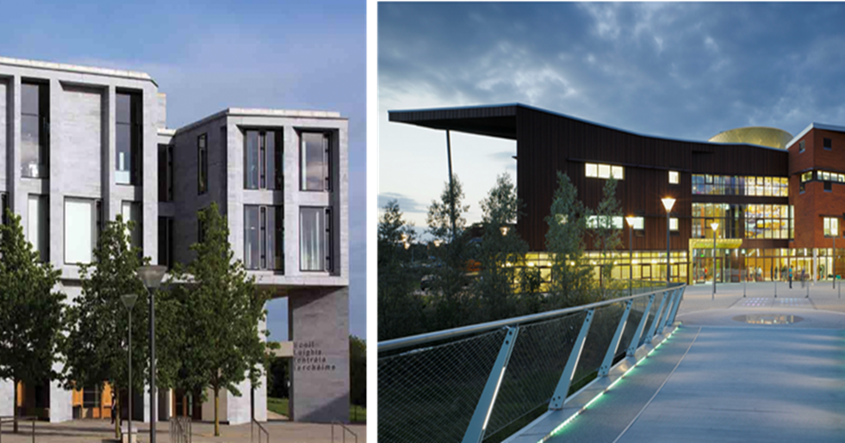
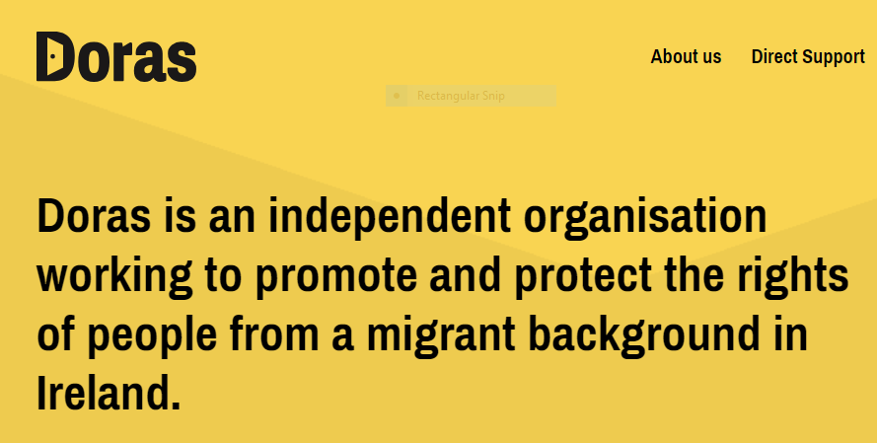

UL ‘s WHO Collaborating Centre for Participatory Health Research with Refugees and Migrants
Participatory Health Research Unit, School of Medicine
Notes:
Anne

Slide 3
Background
Implementation science and issues of equity (Metz, Woo and Loper, 2018; Baumann and Cabassa, 2020)
More inclusive and meaningful co-production processes to address epistemic injustice in the field (ICPHR, 2021; Beresford, 2020)
Refugees and migrants experience health disparities in resettlement countries (WHO, 2022)
Urgent need to involve communities in co-production processes to optimise research and policy making for their health (WHO, 2022; ICPHR, 2021; MacFarlane et al., 2024)
Notes:
Anne

Slide 4
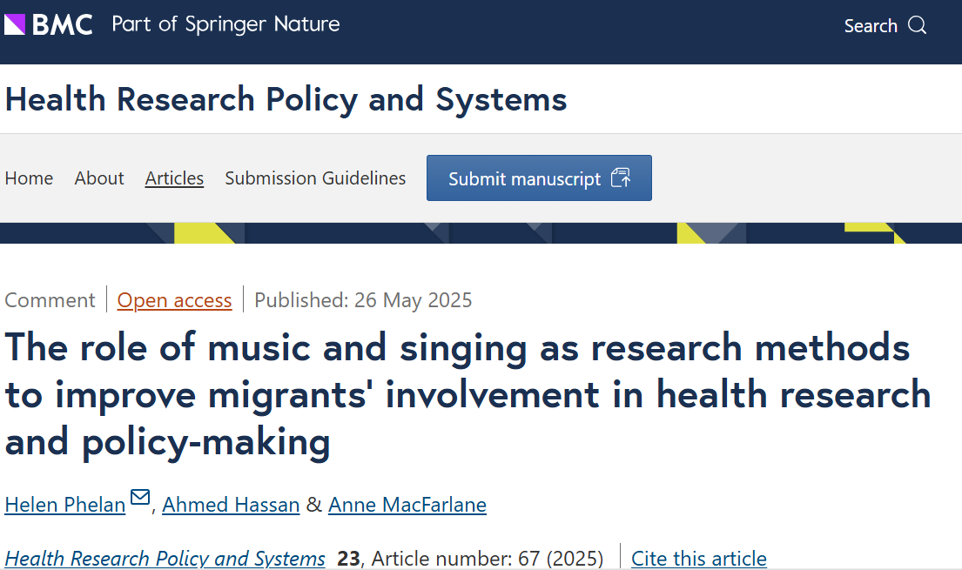
Testing new directions for co-production

Slide 5

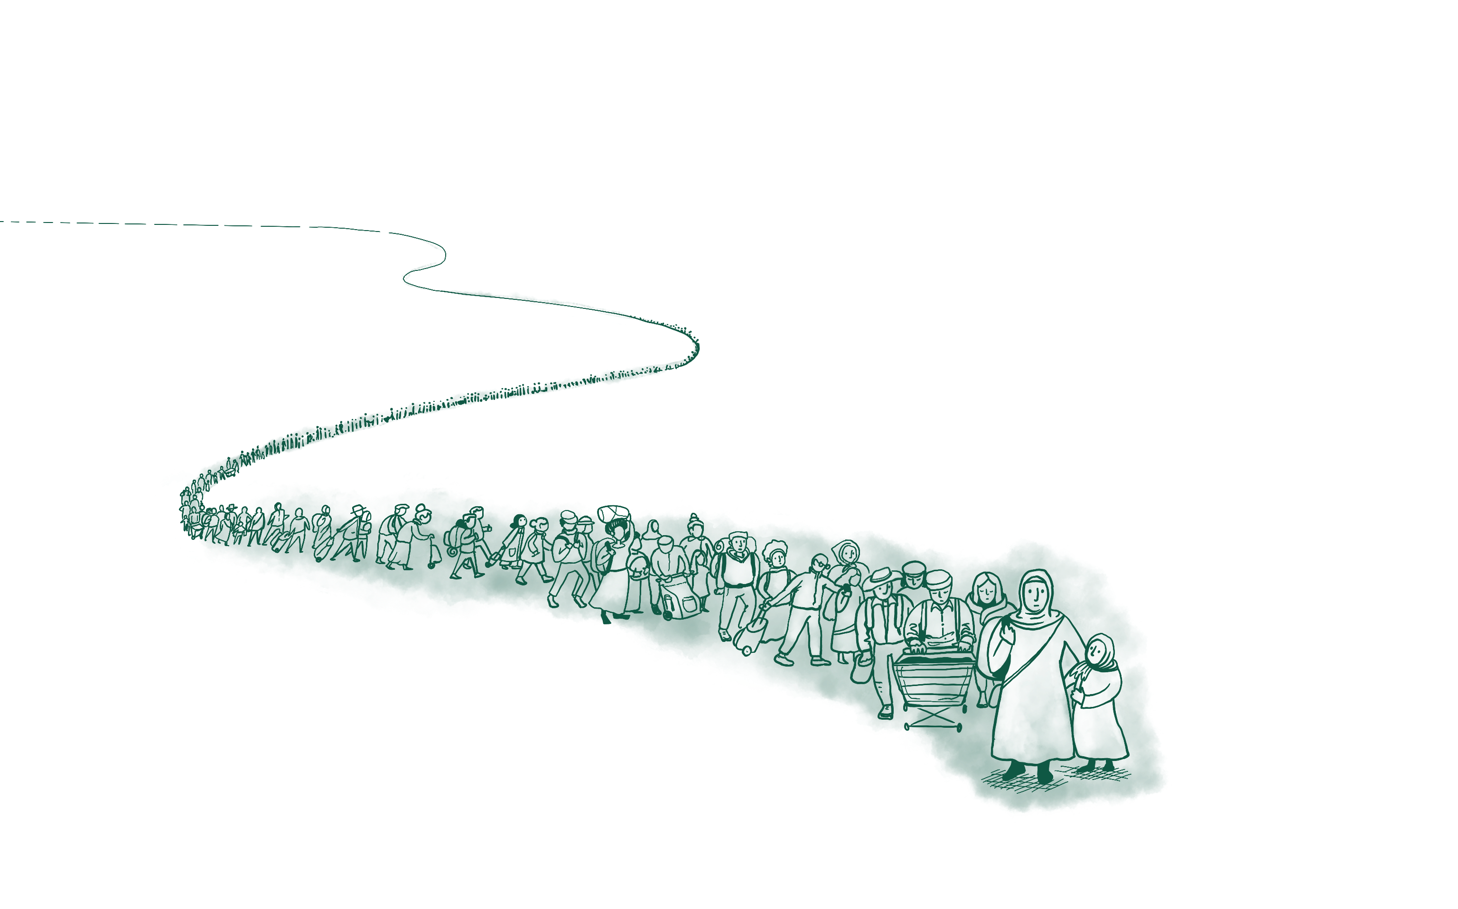
This symposium will debate the motion: the potential of music and singing to facilitate co-production processes with refugees and migrants is under-appreciated.
06.11.19
Notes:
Anne

Slide 6

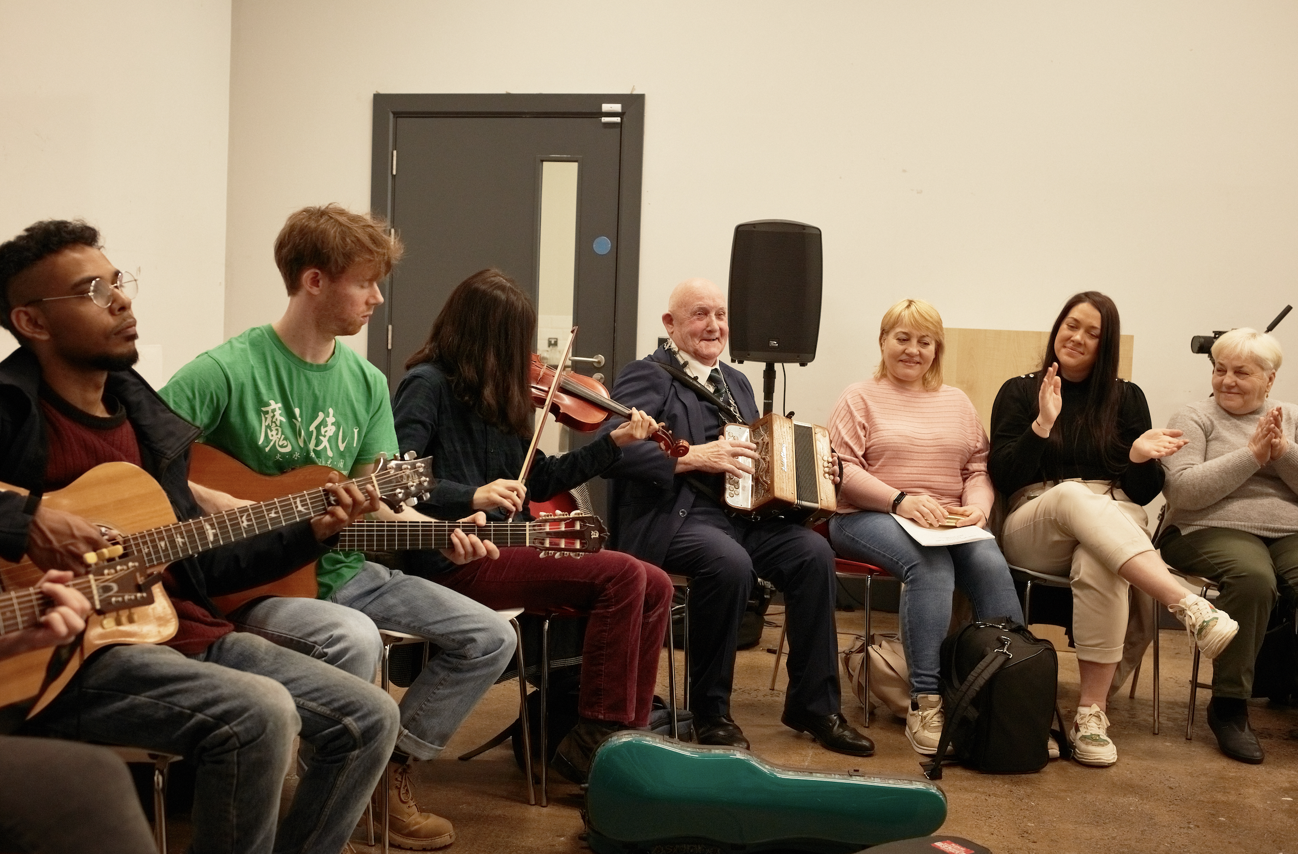
Problem & testing solutions
Involving refugees and migrants directly in co-production processes. Challenge: Refugees and migrants are both over-researched and under-researched (Omata, 2019; MacFarlane et al., 2023) leading to lack of meaningful engagement in research. Response: Disrupt “business as usual” (MacFarlane et al., 2024) and develop innovative, culturally attuned methods for conducting health research with, not on migrants and refugees.
Notes:
Anna However, their involvement in co-production processes is rare, adhoc and unevenly spread. Further, there is research fatigue in these communities because they are tired of being subjects in extractive research processes that do not lead to concrete changes in their lives or improved health outcomes.
Examples of other methods for co-production include experience based co-design, participatory learning and action research BUT all of these rely on /are dominated by cognitive processes. What if this is not enough?

Slide 7
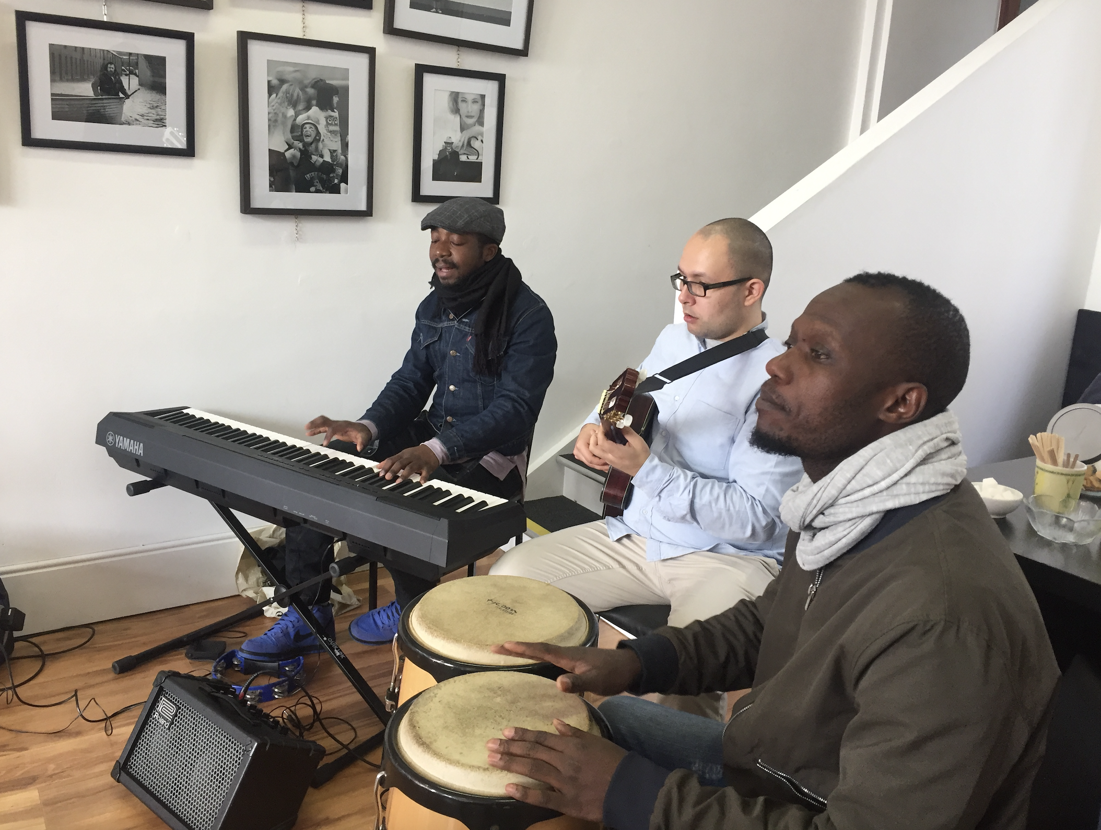
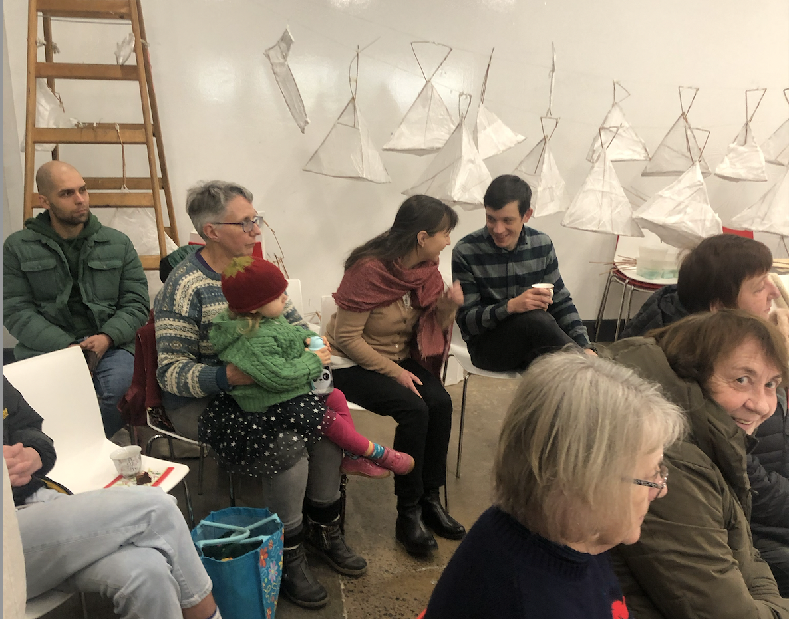
Testing the role of the arts as culturally attuned methods in health research
‘There is an emerging body of literature about improving meaningful, participatory spaces for migrants’ involvement in health research using creative tools and techniques that are attuned to cultural diversity. These include the use of arts-based research methods.’ (Garry et al., 2020)
Notes:
Anna
The arts invite whole body participation – cognitive and affective

Slide 8


Testing the use of music and singing as research methods
Music in community and social settings
Enhances sense of social connection
Accelerates process of bonding
Works well with diverse groups
Invites whole person engagement
Supports trust building
Fancourt, Daisy & Finn, Saoirse. (‎2019)‎. What is the evidence on the role of the arts in improving health and well-being? A scoping review.
World Health Organisation
Notes:
Anna
What we know about music in community and social settings e.g., choirs
What we know about the role of the arts, including music on health and wellbeing

Slide 9
Can we harness these effects of music and singing in co-production processes for migration health?
06.11.19
Notes:
Helen leading into the experiential piece....for 15 mins
This is the key question – can we harness these effects in co-production processes for migration health?

Slide 10
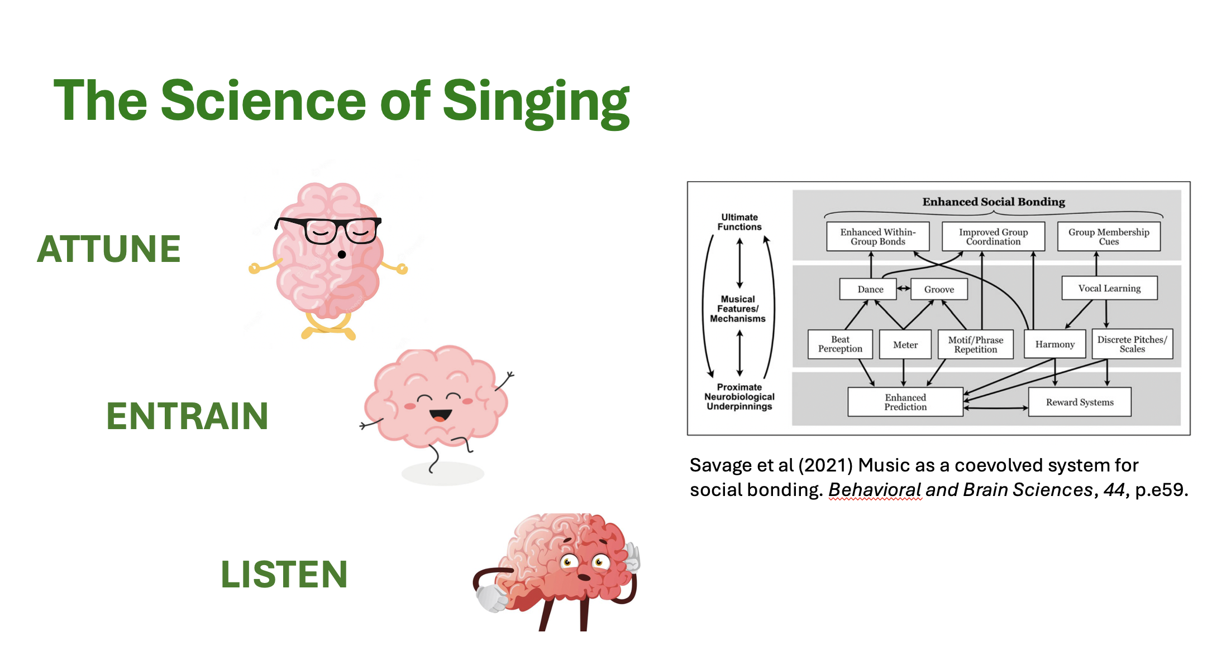
Notes:
15 MINS Musical activities –
breathing - singing; melody, rhythm, harmony Helen
song exchange – learn a song in another language Sarbik

Slide 11
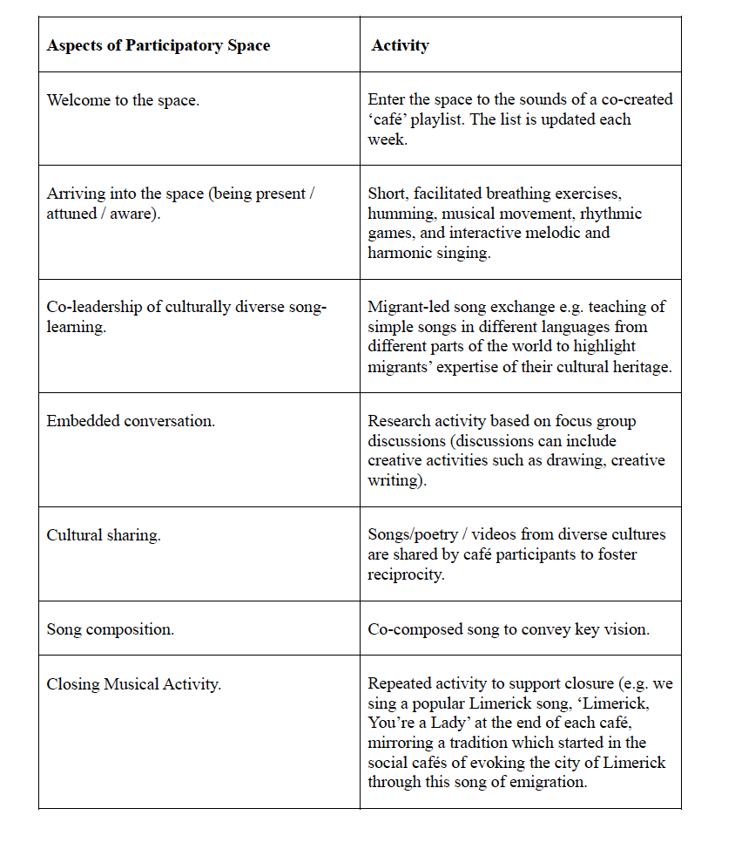
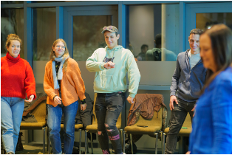
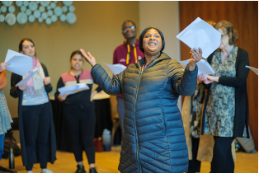
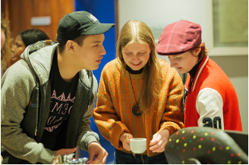
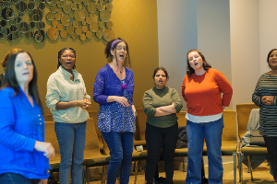
Irish World Music Café (Phelan et al., 2017): a music infused participatory space
Notes:
Anne 5 mins slides re. Irish World Music Café and evidence about co-production (it didn’t work to bring in Palmer here - way too much info for the time available so I have leaned into the PPI INCLUDES report instead

Slide 12
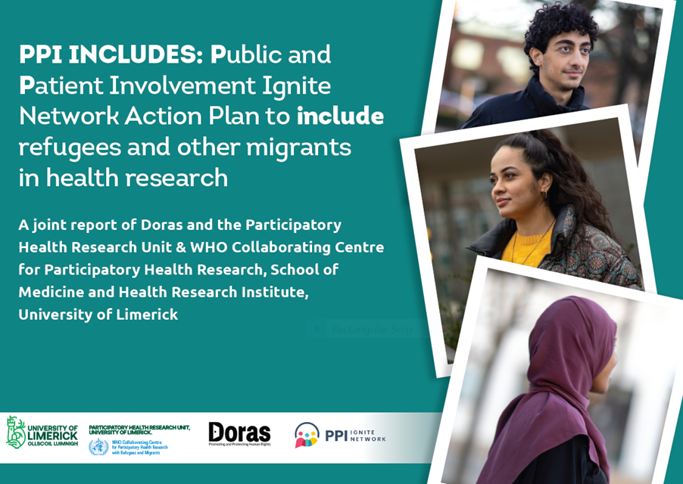
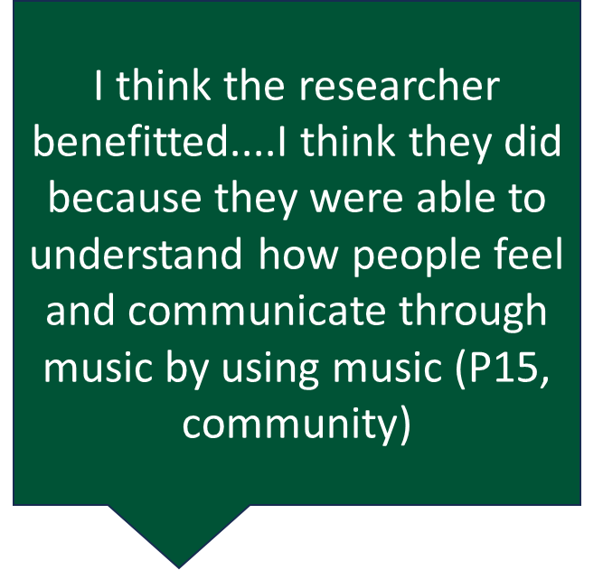
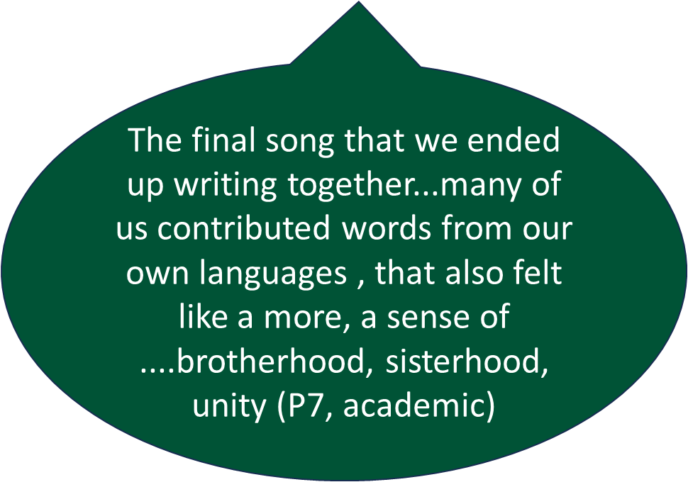
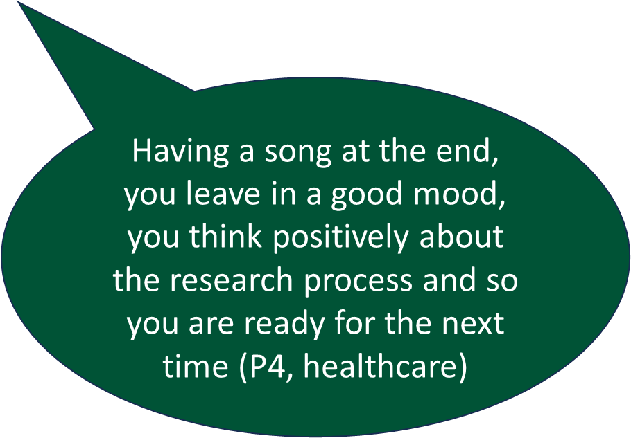

Slide 13
Useful as a method in implementation science?
Why? Why not?
Potential for you to use these methods?
Why? Why not?
06.11.19
Notes:
Helen introduce the group work 15 minutes, flip chart with stickies for each group followed by 5 mins open discussion

Slide 14
Closing song
Notes:
10 MINS Sarbik with Helen 4 line simple melody – call and response with harmony? Composition based on Sarbik listening to discussions, the essence of the idea
Prep in advance (data capture, data generation, dissemination)

Slide 15
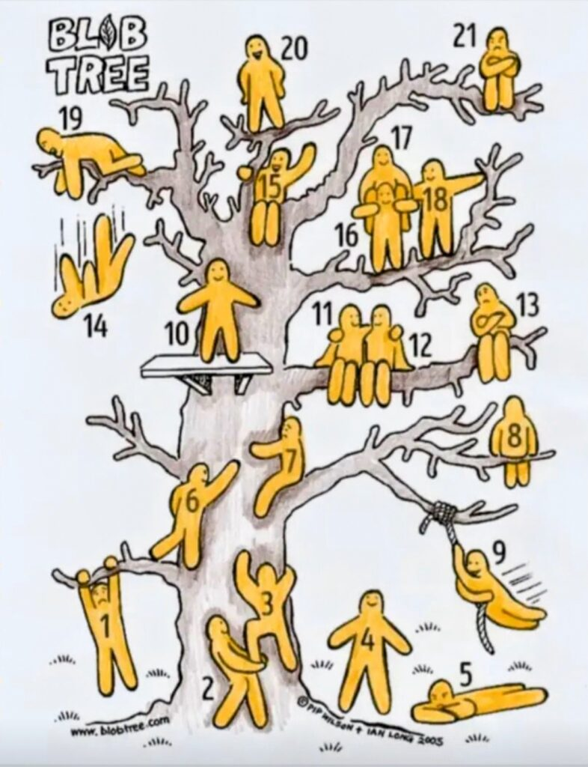
EVALUATION
This is a blob tree!
Put a stickie note on the blob that shows what you feel like after this symposium and say why?
Notes:
Anna

Slide 16
Thank you!
Participatory Health Research Unit | University of Limerick
WHO Collaborating Centre for Participatory Health Research with Refugees and Migrants | University of Limerick
Anne.macfarlane@ul.ie
Helen.Phelan@ul.ie
Anna.papyan@ul.ie
guha.sarbik@ul.ie

Slide 17
Thank you

